Slide 1
Collimator BPMs
and their electronics in Run 3
Tom Levens, Marek Gasior
BE-BI-IQ

Slide 2
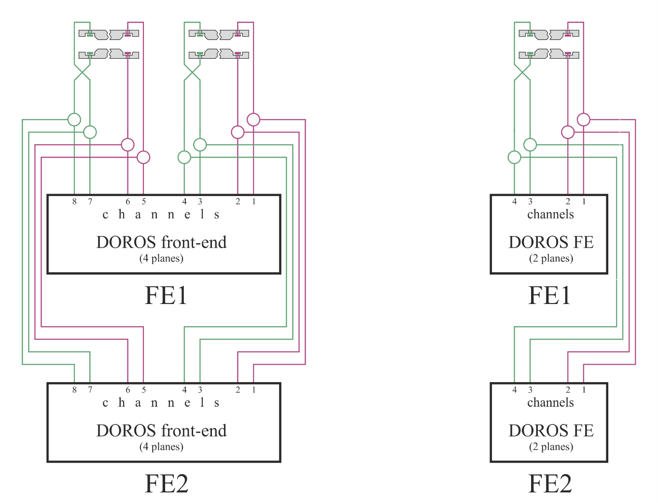
Introduction
During run 2, some DOROS channels have been equipped with an interlock acting via the SIS:
  LSS1: TCTPH/V.4L1.B1, TCTPH/V.4R1.B2
  LSS5: TCTPH/V.4L5.B1, TCTPH/V.4R5.B2
  LSS6: TCSP.A4L6.B2, TCSP.A4R6.B1
In order to avoid spurious beam dumps and downtime, the system has been made redundant:
  BPM signals are split to two DOROS front-ends installed in parallel
  Interlock logic implemented such that if one front-end fails, the second can provide the interlock functionality alone
  Avoids blocking operation and allows intervention to repair/replace the front-end to be scheduled at a convenient time
Note, no failures observed during run 2.

Slide 3
LS2 collimator installations
New LS2 collimators:
  14 in P7 with cables coming to TZ76
  2 in P2 with cables coming to UA23 and UA27
P7 collimators with interlocks
  all collimation planes with redundant front-ends
  all orthogonal planes without redundancy
P2 collimators with or without interlocks ?

Slide 4
Work progress and plans
All collimators installed, except two in P7
All cables ready
All cables in P7 connected to the installed collimators, P2 cables will be connected soon
About half of the BPM electronics already in TZ76, connections to be finalised
  The rest is in production, planned to be installed in spring 2021
  Already available electronics will be used for early system tests by the end of this year
P2 small installation will be done within next few weeks
Ongoing work to put all the existing software infrastructure back into operation
Software polishing and reliability tests from the beginning of 2021

Slide 5
New potential options for LS3 P7 installation
LS3 plan: ≈ 30 new collimators:
  ≈ 10 in P1
  ≈ 10 in P5
  ≈ 10 in P7
So far all LS3 P7 electronics have been planned to be installed in TZ76, in addition to the current installation
  Two DOROS front-ends operating in Run 2 in RR77 and UJ76 moved to TZ76
NEW: available radiation estimations for UJ76 for Run 3 (EDMS 2302154)
  1 Gy as annual total integrated dose during HL operation
  When used in redundant configuration DOROS front-ends are expected
  to work fine in such environment
We should consider the option of putting LS3 P7 electronics to UJ76 instead of TZ76, with the following benefits:
  shorter cables = less money + more signal
  A lot of rack space in UJ76 and quite limited in TZ76
  For the installation of the LS3 collimators with their cables coming to TZ76
  the LS2 electronics already installed there would have to be temporarily removed
Investigations to be done in UJ76 during Run 3 to take the decision at the beginning of LS3:
  Detailed radiation monitoring
  Test operation of a couple of extra DOROS front-ends

Slide 6
Spare slides

Slide 7
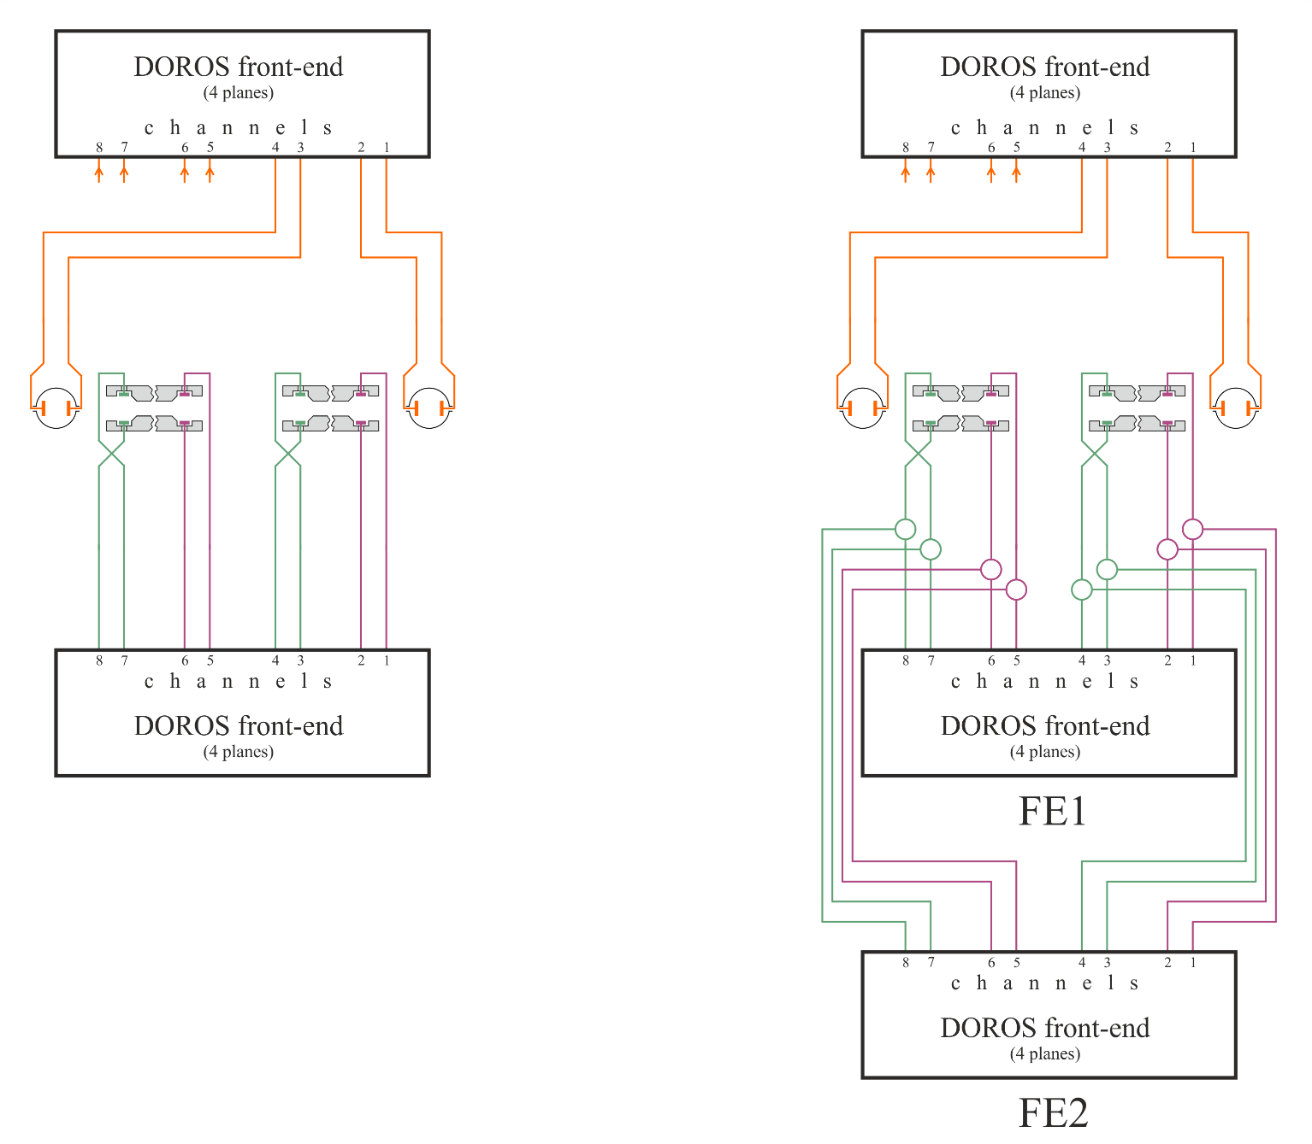
Run 3: Potential optimisation of the installations
2019 assumption: one 3-plane collimator = one front-end
Optimised installation for 3-plane collimators in dense TZ76:
  standard: one collimator = 3/4 × front-end
  redundant: one collimator = 5/4 × front-end

Slide 8
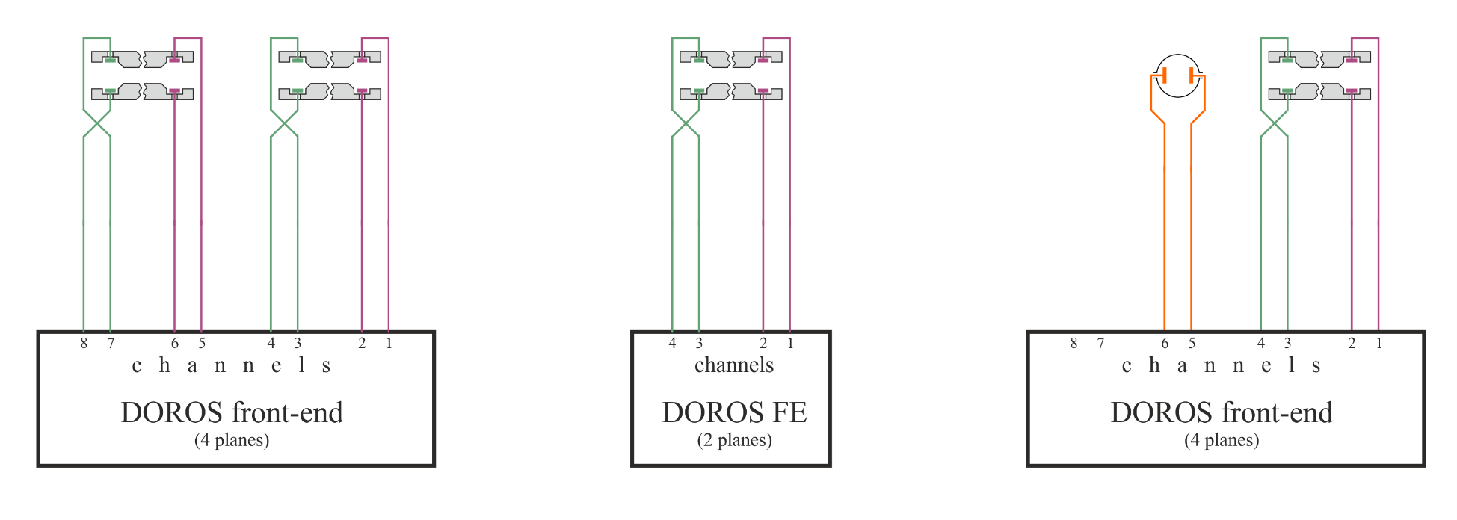
Collimator BPM installations in Run 3
Most dense and difficult installation is in TZ76, only three rack installed due to very limited space
In total there are planned 30 collimators with cables going to TZ76:
  14 during LS2
  16 during LS3
At the beginning of 2019, when we had to start the production of electronic boards for the DOROS front-ends,
we assumed that each collimator will be served by one front-end, so the TZ76 infrastructure has been prepared for 30 front-ends, 10 per rack

Slide 9
Collimator FEs in Run 2 – standard installations
Majority
Some cases
One case
(TCSPM, P7R)

Slide 10
Collimator FEs in Run 2 – SIS redundant installations
P1 + P5
P6 L + R

Slide 11
Collimator DOROS front-ends in Run 2
 |  |  |  |  |  | active ch.
point | collimator | front-end | ID | rack |  | CH config |  | remarks | comments
P1 L | TCTP H + V B1 | CFB-US152-BIDRC1A | 0x11FF | BY01.US152 |  | 8 | 00 |  | SIS A | prime SIS
P1 L | as above, split signals | CFB-US152-BIDRC1B | 0x118F | BY01.US152 |  | 8 | 00 |  | SIS B | redundant SIS, new 2018
P1 L | TCLVW.5L1.B2 | CFB-US152-BIDRC3 | 0x11FE | BY01.US152 |  | 4 | 10 |  | 4 ch. | new 2018
P1 R | TCTP H + V B2 | CFB-US152-BIDRC2A | 0x1101 | BY01.US152 |  | 8 | 00 |  | SIS A | prime SIS
P1 R | as above, split signals | CFB-US152-BIDRC2B | 0x1181 | BY01.US152 |  | 8 | 00 |  | SIS B | redundant SIS, new 2018
P2 L | TCTP H + V B1 | CFB-UA23-BIDRC1 | 0x12FF | BY02.UA23 |  | 8 | 00
P2 R | TCTP H + V B2 | CFB-UA27-BIDRC1 | 0x1201 | BY04.UA27 |  | 8 | 00
P5 L | TCTP H + V B1 | CFB-USC55-BIDRC1A | 0x15FF | BY04.USC55 |  | 8 | 00 |  | SIS A | prime SIS
P5 L | as above, split signals | CFB-USC55-BIDRC1B | 0x158F | BY04.USC55 |  | 8 | 00 |  | SIS B | redundant SIS, new 2018
P5 L | TCL H B2 | CFB-USC55-BIDRC3 | 0x15FE | BY04.USC55 |  | 4 | 10 |  | 4 ch.
P5 R | TCTP H + V B2 A | CFB-USC55-BIDRC2A | 0x1501 | BY04.USC55 |  | 8 | 00 |  | SIS A | prime SIS
P5 R | TCTP H + V B2 B | CFB-USC55-BIDRC2B | 0x1581 | BY04.USC55 |  | 8 | 00 |  | SIS B | redundant SIS, new 2018
P6 L | TCSP H B2 | CFB-UA63-BIDRC1A | 0x16FF | BY02.UA63 |  | 4 | 10 |  | SIS A, 4 ch. | prime SIS
P6 L | as above, split signals | CFB-UA63-BIDRC1B | 0x168F | BY02.UA63 |  | 4 | 10 |  | SIS B, 4 ch. | redundant SIS, new 2018
P6 R | TCSP H B1 | CFB-UA67-BIDRC1A | 0x1601 | BY02.UA67 |  | 4 | 10 |  | SIS A, 4 ch. | prime SIS
P6 R | as above, split signals | CFB-UA67-BIDRC1B | 0x1681 | BY02.UA67 |  | 4 | 10 |  | SIS B 4 ch. | redundant SIS, new 2018
P7 L | TCP H B1 | CFB-UJ76-BIDRC1 | 0x17FF | BY03.UJ76 |  | 4 | 10 |  | 4 ch.
P7 R | TCSPM V B2 | CFB-RR77-BIDRC1 | 0x1701 | BY01.RR77 |  | 6 | 01 |  | 6 ch.
P8 L | TCTP H + V B1 | CFB-UA83-BIDRC1 | 0x18FF | BY02.UA83 |  | 8 | 00
P8 R | TCTP H + V B2 | CFB-UA87-BIDRC1 | 0x1801 | BY03.UA87 |  | 8 | 00
 |  | front-ends | 20 |  | 8-channel FE | 12
 |  |  |  |  | other | 8

Slide 12
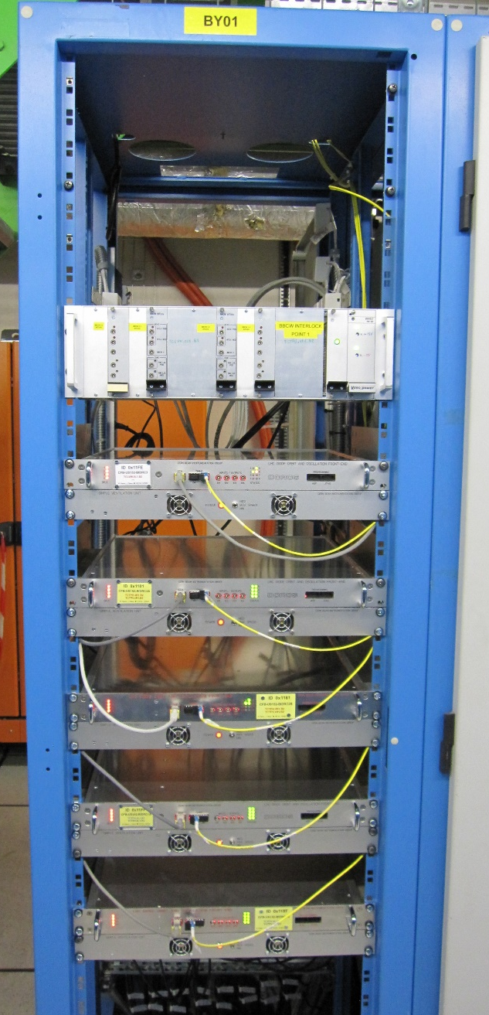
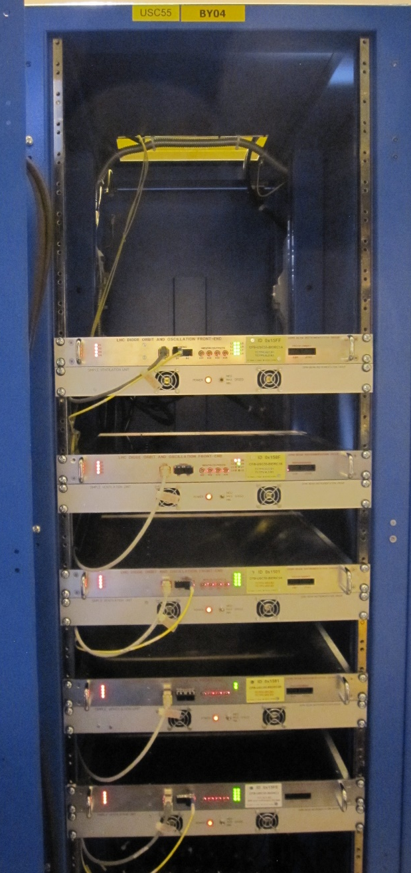
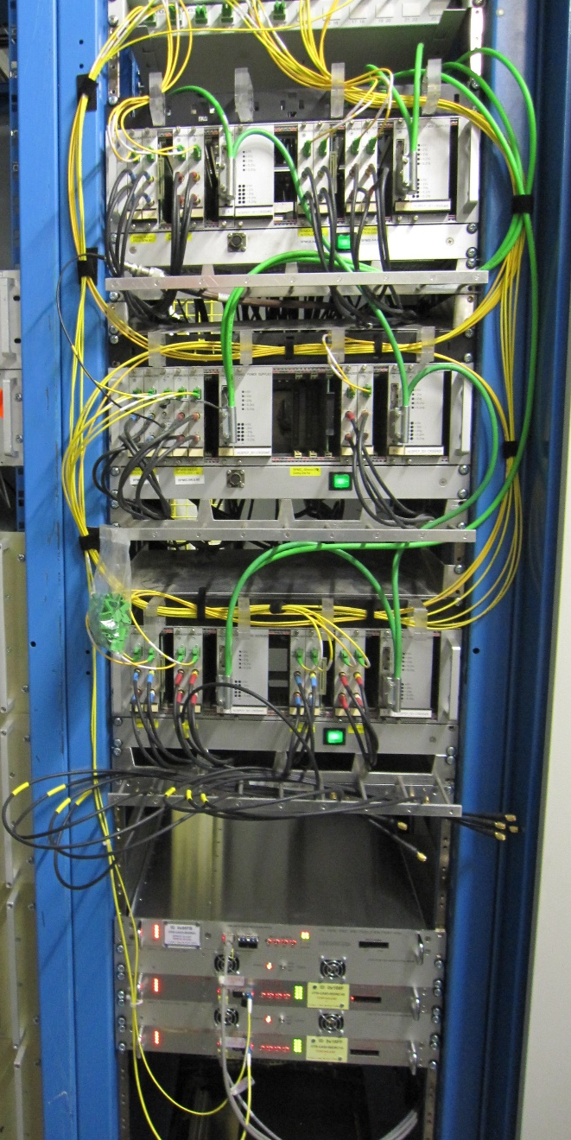
Collimator FEs in Run 2 – SIS redundant installations
BY01.US152
BY04.USC55
UA63.BY02

