Slide 2
Leaving CERN / Quitter le CERN
DEPARTURE FORMALITIES
Notes:
The purpose of the departure formalities is to ensure :
that you contact all relevant services to return necessary items
that you are aware of the benefits you are entitled to

Slide 3
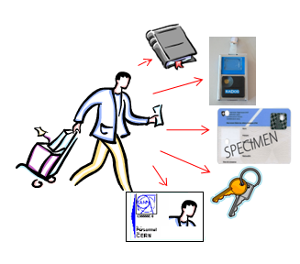
Overview
Departure formalities
Admin e-guide
Brochure from Social Services
“When you leave CERN”
Access to your computing account
Alumni
Further advice and assistance
Notes:
The Departure formalities are well described in the admin e-guide. We will explain the process of these formalities
There is also the Brochure from the Social Services ; this not only includes information on what to do at CERN, but also on formalities that you are required to do outside CERN
We will

Slide 4
DEPARTURE FORMALITIES (1)
PERSONALIZED DEPARTURE FORMALITIES
Departure Email
3 months before the end of the contract
earlier if lot of leave (last day of work > 3 months before end of contract)
Departure Formalities Letter
      PDF generated when you click on the link in the mail (saved in AISMedia)
      tailored according to your personal situation (benefits).
Termination Sheet
personalized EDH document indicating the procedures you need to follow

Slide 5
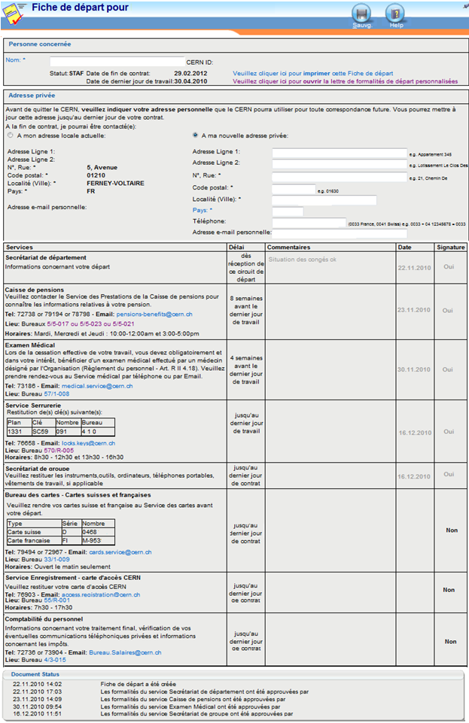
DEPARTURE FORMALITIES (2)
PERSONALIZED DEPARTURE FORMALITIES
Important: CLICK on the link provided in your departure letter to
generate the EDH Termination Sheet
Follow the indicated steps within the foreseen delay
    - before your last day of work
    - before you last day of contract
possibility to do certain procedures remotely
(eg. return plates by mail)
….also important:
announce your (new) private address in the EDH Termination Sheet (forward paper mail)
must complete all formalities, even if you stay at CERN as User
last stop = Salary Office

Slide 6
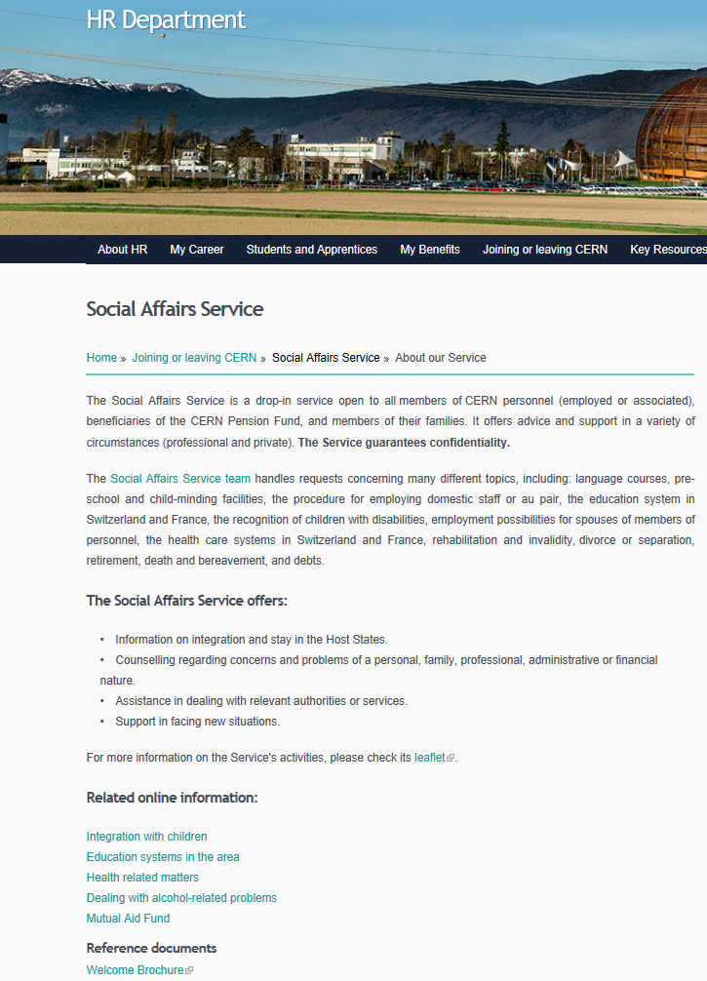


WHEN YOU LEAVE CERN BROCHURE
CONTENT
Administrative matters – Termination Sheet, Final Payments, Pension Fund, Health Insurance etc.
Personal matters – Links with CERN , Vehicles, Termination of Leases, Public Utilities, Insurance Policies, Bank Accounts, Taxes, Social Security.
Notes:
http://cds.cern.ch/record/1995621/files/WYLC.pdf

Slide 7
Access to your Computing Account
Your computing account is accessible during 60 days after the end of the contract.
After 60 days, the account is automatically deactivated
After 180 days, the account is automatically deleted.
After the end of your contract:
enter your private email address in the account management portal via Manage my Accounts page (https://account.cern.ch/account/Management/MyAccounts.aspx )
2 months after the end of the contract an external account is automatically created (follow the instructions received in your external email address to create the external account).
Note: When the annual internal taxation attestation is generated (March) an email will be sent to your private email address to allow you to access it.
Notes:
https://account.cern.ch/account/Management/MyAccounts.aspx

Slide 8

CERN Alumni
Can join at any time
Keep in contact with CERN (news, visit, …)
Remain involved
  talks about CERN (ambassadors)
  regional networks
  …

Slide 9
Services to contact for advice and assistance
Departmental Secretariat (DAO) Admin e-guide | General Questions http://admin-eguide.web.cern.ch/procedure/formalites-de-depart
Social Services Email: social.affairs@cern.ch | Brochure ‘When you leave CERN’ http://cds.cern.ch/record/1995621/files/WYLC.pdf
IT support Email: service-desk@cern.ch | Computing accounts https://account.cern.ch/account/Help/?kbid=012010
CERN Alumni | https://alumni.cern/
Staff Association / GACEPA | https://home.cern/cern-people/staff-association https://www.gac-epa.org/

Slide 10


