Slide 1


Slide 2

Preparing Your Retirement
Sandrine BAUDAT (HR-CB-CMO)
08 October, 2020
2

Slide 3

Topics
Keeping the CHIS: What you must do & when
What does and does not change
Obtaining information
Good to know tips
Questions & answers
08 October, 2020
3

Slide 4
To keep the CHIS ①
Inform Pension Fund if you want to keep the CHIS, within 30 calendar days of retiring
  by default, your CHIS cover ends on the last day of your employment contract
  if you quit, you will never be allowed back
08 October, 2020
4

Slide 5
To keep the CHIS ②
However, if your spouse is an MPE then you have to keep the CHIS as a Main Member.
Later, when your spouse also retires, both of you may then leave the CHIS (forever); if not, you both remain Main Members
08 October, 2020
5

Slide 6
Topics
Keeping the CHIS: What you must do & when
What does and does not change
Obtaining information
Good to know tips
Questions & answers
08 October, 2020
6

Slide 7
What does & does not change 
Your CHIS contributions will be adjusted when your pension is adjusted (no more when salaries are adjusted), LPP mechanism taken into account (8% loss of purchasing power)
You become a “Post-compulsory Member”
08 October, 2020
7

Slide 8
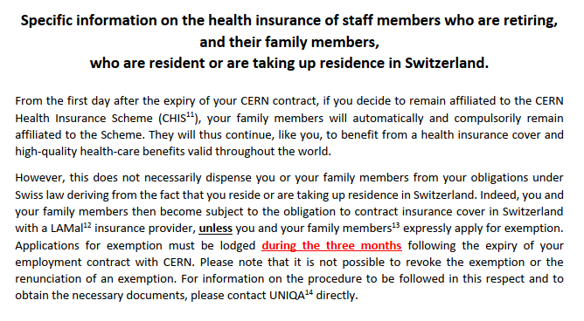
Specific information ②
chis.cern
08 October, 2020
8

Slide 9
What does & does not change 
Spouse and dependent children fully covered
***Keep PF informed of any change in family situation***
Supplementary contribution required for spouse or partner with income from professional activity (or retirement pension) and no other adequate insurance; use paper SHIPID to keep CHIS informed of your spouse’s situation
08 October, 2020
9

Slide 10
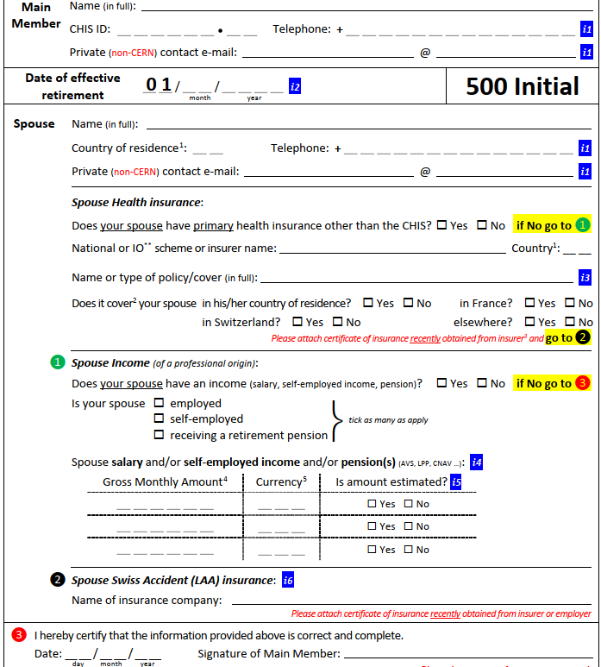
SHIPID 
Spouse Health Insurance & Professional Income Declaration
Sorry !
Exists only on paper for retirees
08 October, 2020
10

Slide 11
What does & does not change 
You have to remember to ask, fill-in and send back a SHIPID every time there’s a change
  your spouse retirees : her/his income drops, your supplementary contribution may drop too
  your spouse reaches retirement age after a period without work & income : his/her income increases, your supplementary contribution may increase too
08 October, 2020
11

Slide 12
Topics
Keeping the CHIS: What you must do & when
What does and does not change
Obtaining information
Good to know tips
Questions & answers
08 October, 2020
12

Slide 13
Obtaining Information 
General questions : uniqa@cern.ch
Claims: www.MyUNIQA.ch
Medical assistance & Medgate
+41.22.819.44.77 (esp. when travelling)
CHIS Rules, general advice
https://chis.cern
08 October, 2020
13

Slide 14
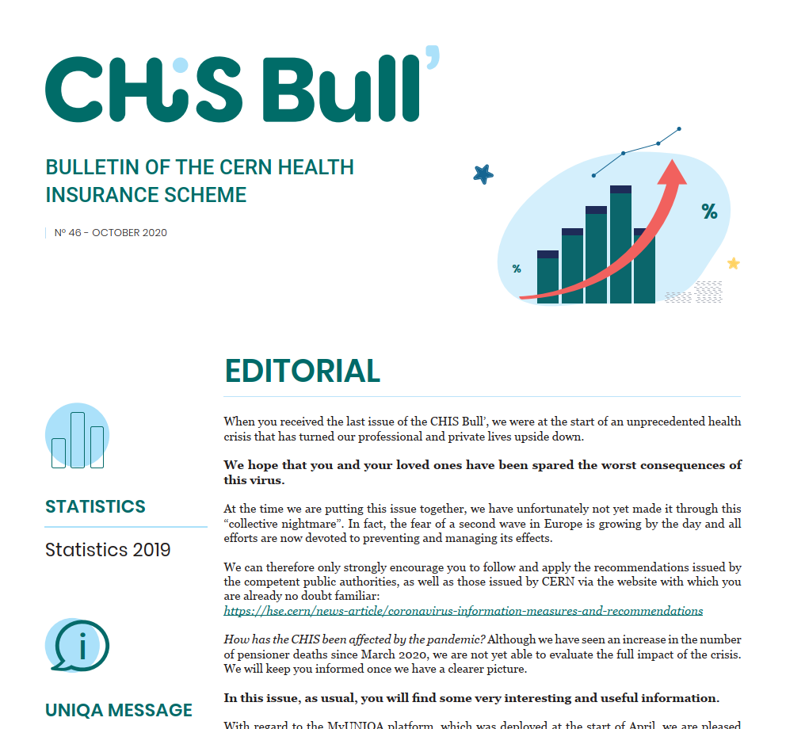
Obtaining Information 
CHIS Bull’
newsletter: general info, news, tips
sent by email or postal mail
available on the CHIS website
CERN’s Official news
formal notices, major changes
home.cern/cern-people
08 October, 2020
14

Slide 15
Topics
Keeping the CHIS: What you must do & when
What does and does not change
Obtaining information
Good to know tips
Questions & answers
08 October, 2020
15

Slide 16
Good to know tips 
Long Term Care (LTC) benefits are there to help when dependency impacts daily life
  contact CERN Social Service and ask for guidance
  ask relative to help with procedure when needed
  three dependency levels (low, medium, severe)
  do not wait for severe dependency to act
08 October, 2020
16

Slide 17
Good to know tips 
Reimbursement Bonus
If you go to France or in one the CERN Member States (all, except Denmark, Norway and Switzerland) to see a doctor, buy medication, have tests or scans, you will be reimbursed 85% of the costs instead of 80%, or 95% instead of 90%
08 October, 2020
17

Slide 18
Good to know tips 
Using CHIS as supplementary insurance
  if you or your spouse/partner or your child(ren) have another insurance (Sécurité sociale, NHS, …)
  use other insurance first, submit other insurance’s reimbursement statement to UNIQA
  ☺ get much better overall reimbursement rate
08 October, 2020
18

Slide 19
Good to know tips 
Your claims can be sent in 4 ways:
Electronic submission on MyUNIQA website.
Electronic submission on MyUNIQA application for smartphone.
Safe deposit of your "blue envelopes" in the "UNIQA" mailbox (building 33/Visitors' Reception or Main building/UNIQA’s office)
Send your stamped "blue envelopes" by regular mail to the following address :UNIQA, 94 rue des Eaux Vives - CP 6402 - 1211 Geneva 6.
Get attestations and other personal documents through your account on MyUNIQA website.
08 October, 2020
19

Slide 20
Topics
Keeping the CHIS: What you must do & when
What does and does not change
Obtaining information
Good to know tips
Questions & answers
08 October, 2020
20

