Slide 1

Mini-CAS on Mechanical and Materials Engineering for Accelerators
Numerical Tools I
Federico Carra
CERN Engineering Department
Mechanical and Materials Engineering Group
November 6th, 2020

Slide 2
Outline
What is CAE and why do we use it?
FEM theory in a Nutshell
FE Implicit vs Explicit Solvers
Examples of FE Implicit studies for particle accelerator components
Conclusions

Slide 3
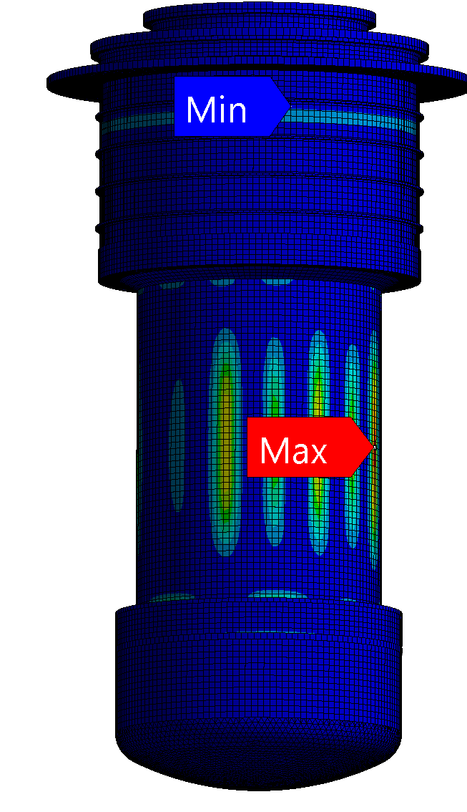
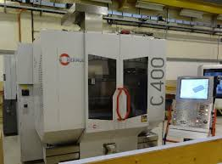
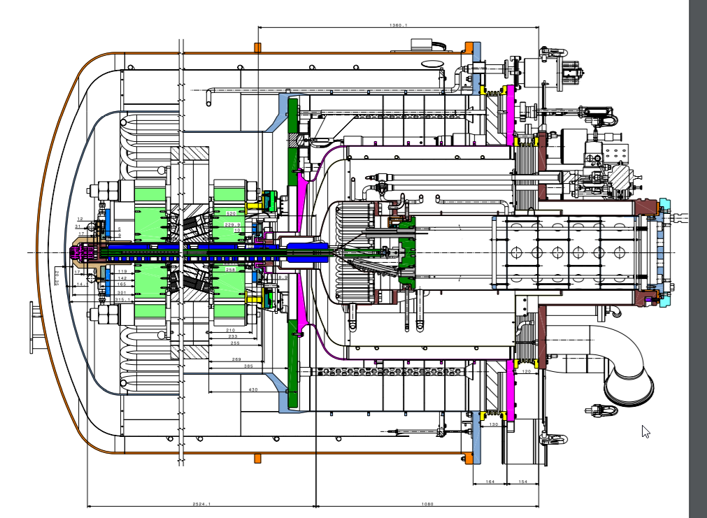
Computer-Aided Technologies (CAx)
CAx
Computer-Aided Design
(CAD)
Computer-Aided Engineering
(CAE – e.g. FEA, CFD)
Computer-Aided
Manufacturing
(CAM)

Slide 4
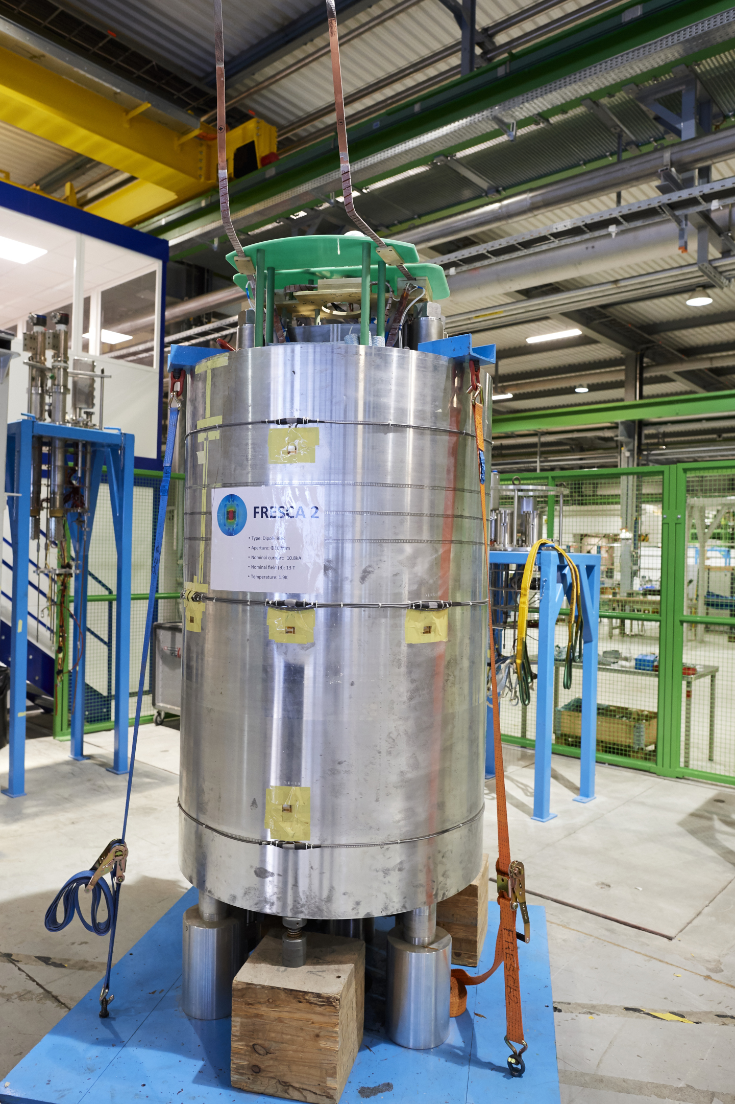
Computer-Aided Design and Engineering (CAD/CAE)
CAD/CAE
Design and Analysis*
Virtual Prototyping
Physical Prototyping
Final Product Testing
$ Relatively cheap
$$ Not so cheap
$$$ Really expensive
*The more time spent here, the less money and time spent later

Slide 5
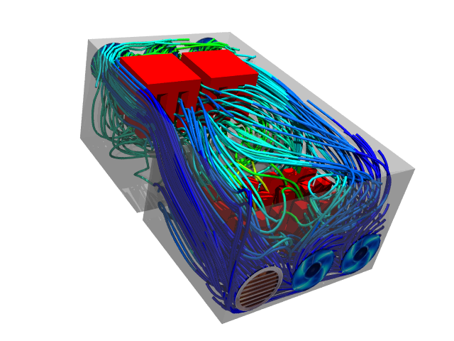
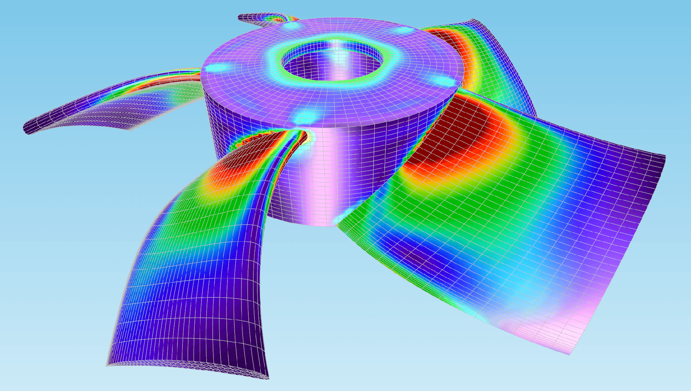
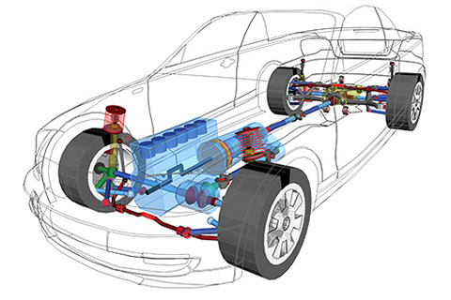
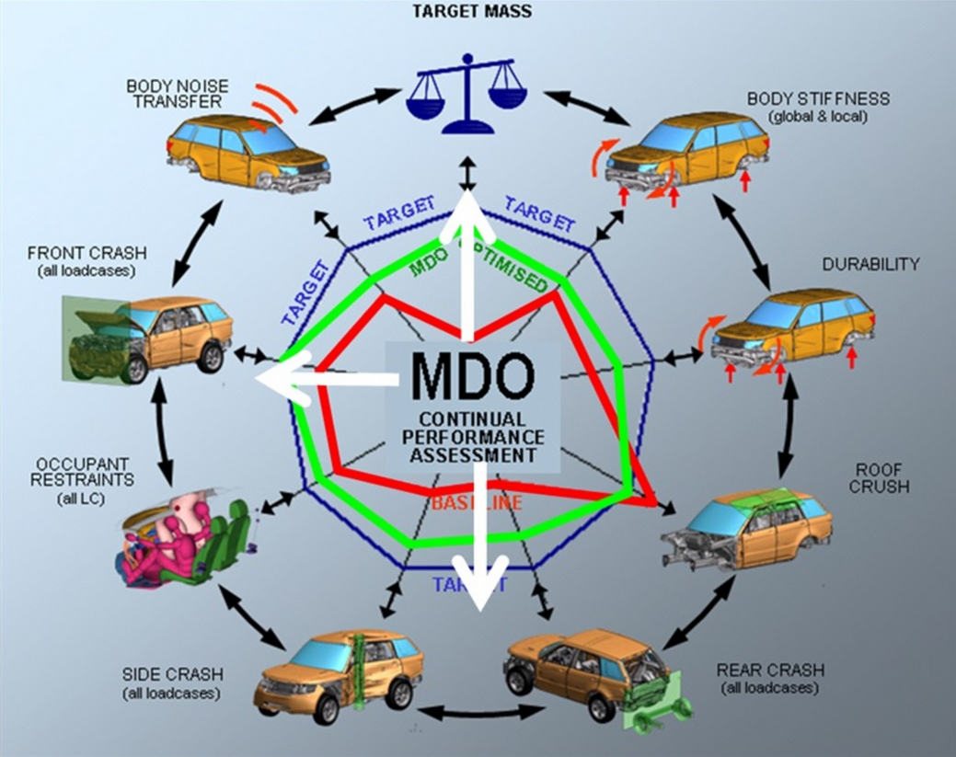
CAE Fields
Computational Fluid Dynamics
(CFD)
Finite‐Element Analysis
(FEA)
Multibody
Dynamics
(MBD)
Multidisciplinary design optimization
(MDO)

Slide 6
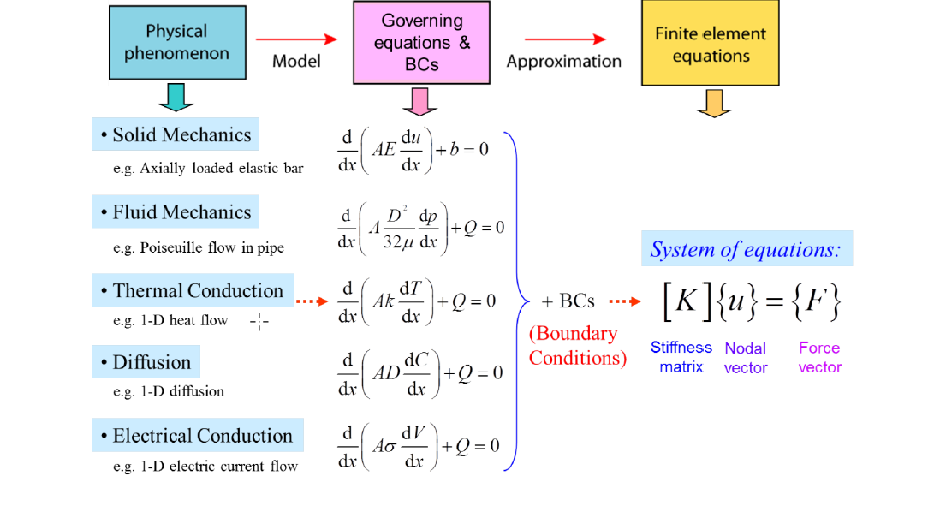
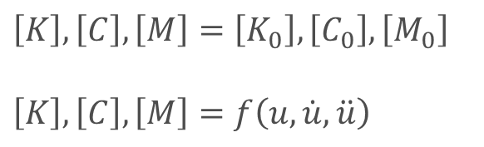

FEM Theory in a Nutshell
$$\left[K\right]\left\{u\right\}=\left\{F\right\}$$
$$\left[M\right]\left\{\ddot{u}\right\}+\left[C\right]\left\{\dot{u}\right\}+\left[K\right]\left\{u\right\}=\left\{F\right\}$$
Static problems
Dynamic problems
Linear problems:
$$\left[K\right],\left[C\right],\left[M\right]=\left[K_{0}\right],\left[C_{0}\right],\left[M_{0}\right]$$
$$\left[K\right],\left[C\right],\left[M\right]=f\left(u,\dot{u},\ddot{u}\right)$$
Nonlinear problems:
Notes:
Engineering problems are expressed through mathematical partial differential equations (PDEs).
Today’s computers can’t single-handedly solve PDEs, they are equipped to solve matrix equations (linear or nonlinear).
The PDEs are reduced to a matrix equation
C damping matrix

Slide 7
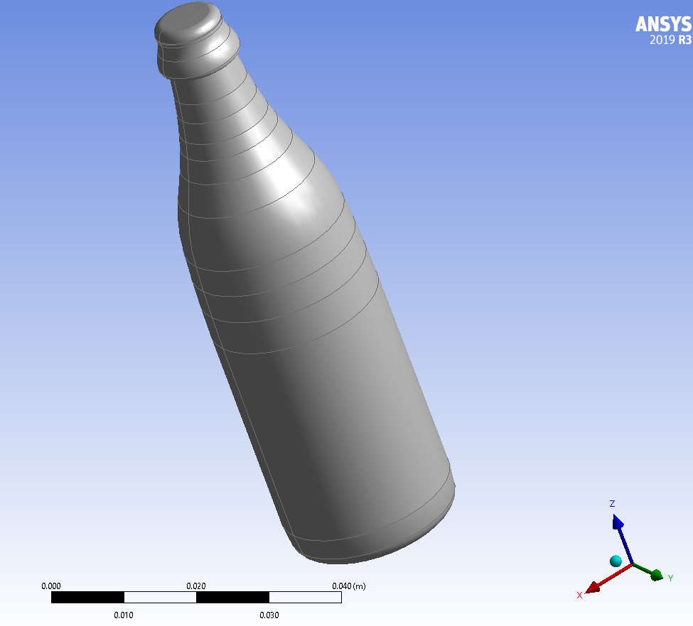
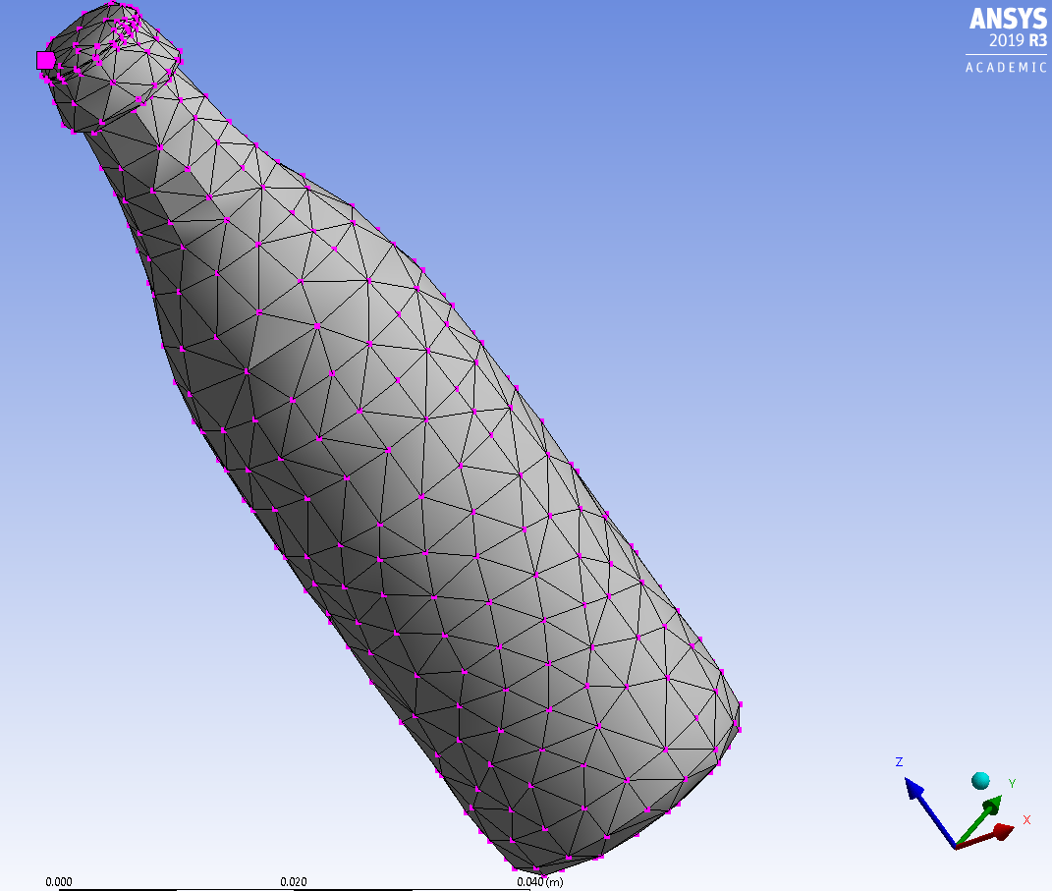
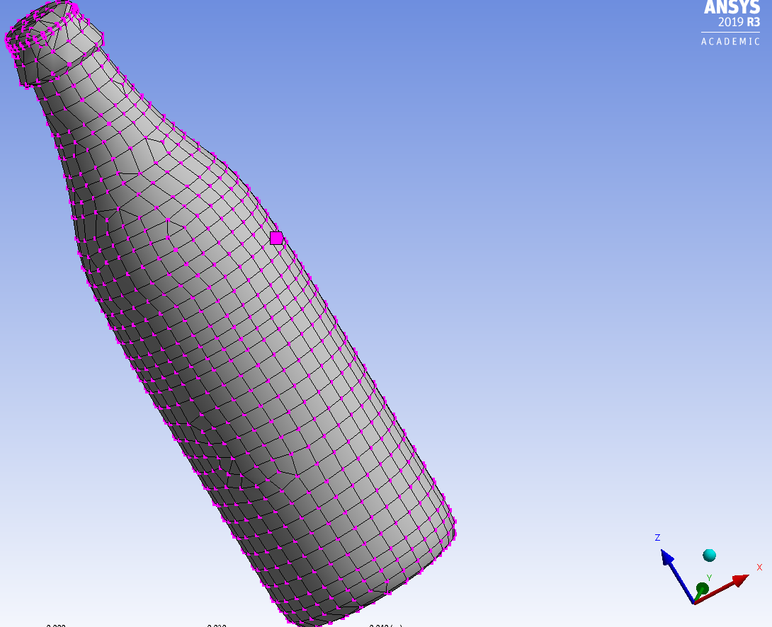
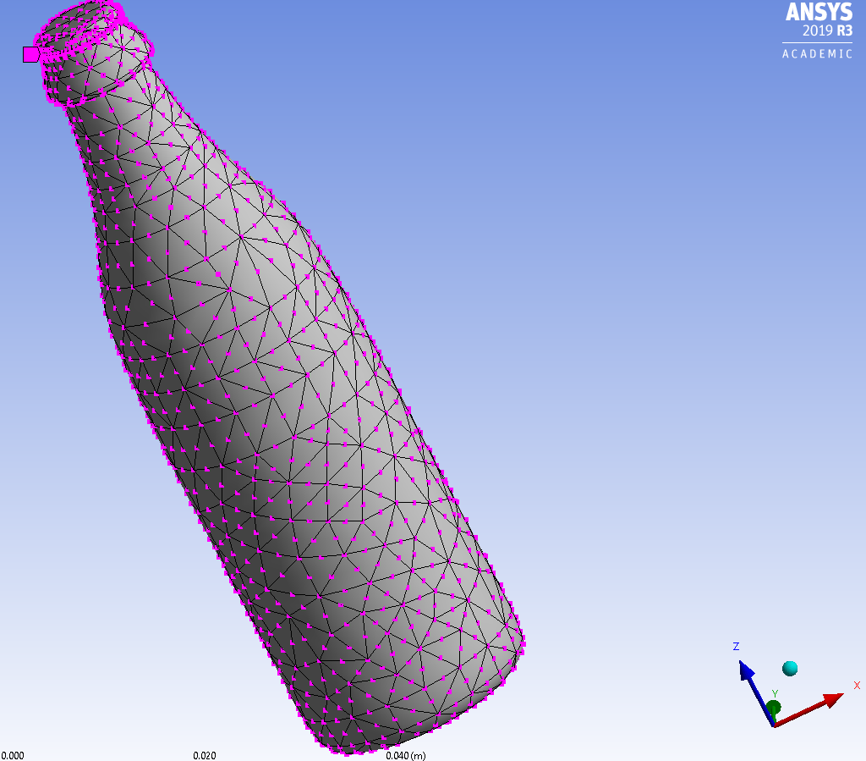
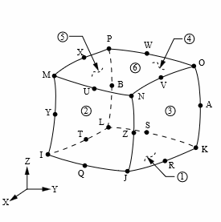
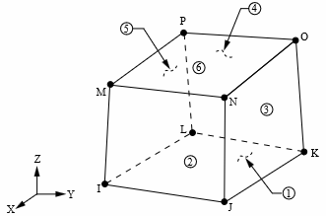


FEM Theory in a Nutshell
The displacements of all the points in a continuum under the action of external forces depends on the displacements of discrete points known as nodes.
This dependence is regulated by interpolating functions known as shape functions.
To study a body with FEM, we must thus discretize the continuum in a finite number of elements, each one featuring a number of nodes which depends on the type of element chosen.

Slide 8





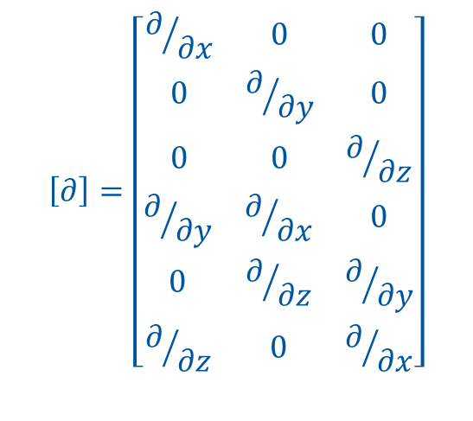
FEM Theory in a Nutshell
$$\left[∂\right]=\left[\begin{aligned}\begin{matrix}∂/{∂x} & 0 & 0 \\ 0 & ∂/{∂y} & 0 \\ 0 & 0 & ∂/{∂z}\end{matrix} \\ \begin{matrix}∂/{∂y} & ∂/{∂x} & 0 \\ 0 & ∂/{∂z} & ∂/{∂y} \\ ∂/{∂z} & 0 & ∂/{∂x}\end{matrix}\end{aligned}\right]$$
FEM: solving for the nodal displacements $\left\{s\right\}$
$$\left\{s\right\}={\left[K\right]}^{−1}\left\{F\right\}$$
After calculation of $\left\{s\right\}$:
$$\left\{u\right\}=\left[N\right]\left\{s\right\}$$
N
Shape functions
$$\left\{ε\right\}=\left[∂\right]\left\{u\right\}=\left[∂\right]\left[N\right]\left\{s\right\}$$
C
Compatibility Equations
$$\left\{σ\right\}=\left[D\right]\left\{ε\right\}=\left[D\right]\left[∂\right]\left[N\right]\left\{s\right\}$$
M
Material Constitutive Law (e.g. Hooke’s law)
+
+
M
Solution known in all points of the structure (not only at the nodes!)
N
C
Notes:
D= material constant matrix o constitutive matrix
S= vector of nodal displacements

Slide 9
Properties of shape functions
It must be a continuous function, and must possess a derivative at least until to the n-1 order required by the problem under study (e.g. n = 1 for a truss element, n = 2 for a beam or plane element, etc.)
It must reproduce rigid motion of the element with a null deformation energy (i.e. in an eigenvalue problem, the rigid motion d.o.f. gave a null eigenvalue → in a 3D space, for an unconstrained body there will be 6 null eigenvalues)
It must guarantee a constant deformation along the element (minimal condition when element size tends to zero)
It must guarantee continuity among elements (i.e. identical displacement field on a segment belonging to two adjacent elements)
It should be geometrically isotropic (i.e. displacement field is invariant wrt the reference system, not presenting preferential directions)
Complete
Conform
Compatible
Polynomials

Slide 10
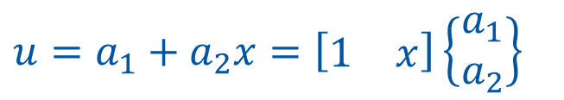
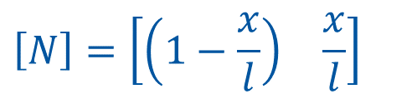

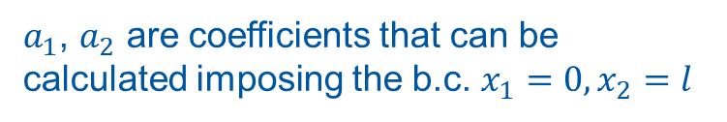
Shape function of a truss element
y
1
2
x
u₂
Displacements will be varying linearly over the length of the element, while strains and stresses will be constant
This shape function respects the properties discussed earlier, in particular the n order of the problem under study
Choose the right element for the right problem! In case of bending and shear, use a beam element instead
u₁
$$l$$
$$u=a_{1}+a_{2}x=\left[\begin{matrix}1 & x\end{matrix}\right]\left\{\begin{matrix}a_{1} \\ a_{2}\end{matrix}\right\}$$
$a_{1}$, $a_{2}$ are coefficients that can be calculated imposing the b.c. $x_{1}=0,x_{2}=l$
$$\left[N\right]=\left[\begin{matrix}\left(1−\frac{x}{l}\right) & \frac{x}{l}\end{matrix}\right]$$

Slide 11
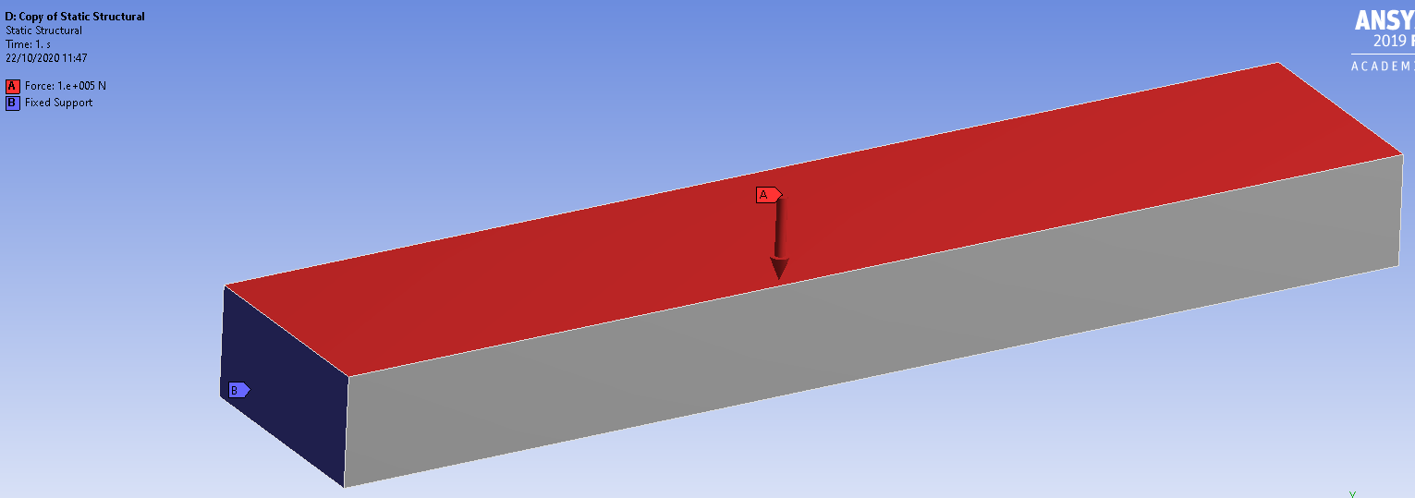
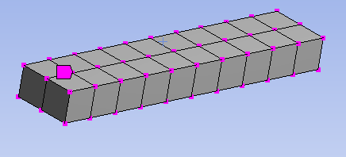
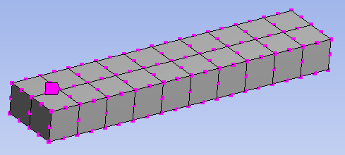
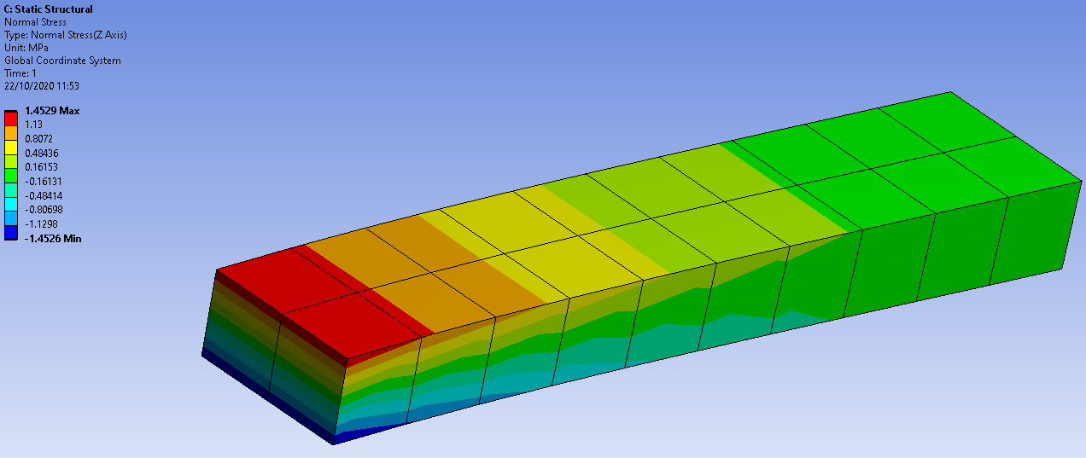
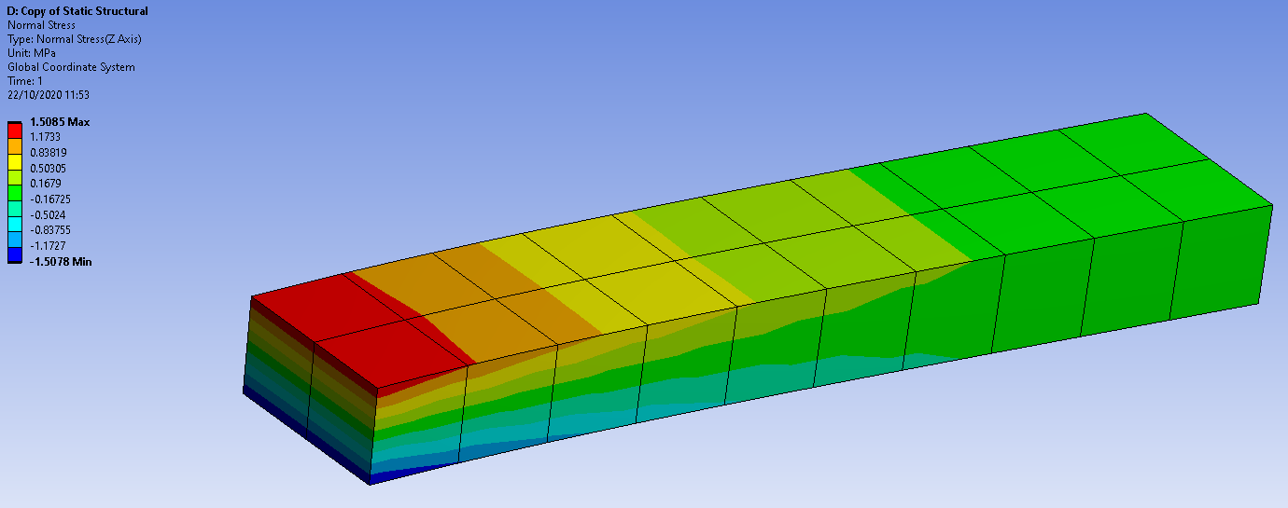
Linear vs quadratic elements
Distributed load
Fixed support
Linear elements
Quadratic elements
Bending stress (MPa)
Bending stress (MPa)
1.48
1.50
-1.48
-1.50
Linear elements: computationally more efficient, but when a nonlinear stress state is expected, use quadratic elements or more linear elements over the thickness

Slide 12







FEM Solvers
Explicit solvers: derive the unknowns (displacements, velocities, accelerations) at a time instant t+Δt by developing the equilibrium equations at the time t.
Implicit solvers: derive the unknowns at a time instant t+Δt by developing simultaneous equilibrium equations at the time t and t+Δt.
Explicit solvers: suggested for fast transient and highly nonlinear problems
Implicit solvers: suggested for slow transient and static problems
O. C. Zienkiewicz, “The Finite Element Method: Its Basis and Fundamentals”, ISBN 978-1-85617-633-0.
O. C. Zienkiewicz, “The Finite Element Method for Solid and Structural Mechanics”, ISBN 978-1-85617-634-7.
D. Braess, “Finite Elements: Theory, Fast Solvers, and Applications in Solid Mechanics”, ISBN 978-0-52170-518-9.
Implicit codes
  Unconditionally stable
  Large time steps
  Matrix inversion
  Coupled equations
  Convergence problem
Explicit codes
  Conditionally stable
  Small time steps
  «Lumped» matrix multiplication
  Uncoupled equations
  «Keep going»
Notes:
Explicit
impact, penetration, high rate dynamics,
time step size small
courant condition limits largest stable time step
Implicit
static, eigenvalue, low rate dynamic analyses
few large time steps
model size (degrees of freedom) affects wall time

Slide 13
FEM tips: from reality to model
Simplification of the model: removal of details not contributing to the solution of the problem under study
  Screws, welds typically defeatured in the FEA, and calculated “by hand” extracting internal loads from FEA
  Chamfers, radii can be verified via submodels
Loads and boundaries:
  As accurate as possible representation of the real working conditions
  Compromise sometimes to be made to simplify the problem (e.g. nonlinear contacts, etc.)
  Most critical step of the process
Safety factors! (i.e. factor of ignorance)
When approximating, always be on the conservative side
Start simple, complexify later

Slide 14
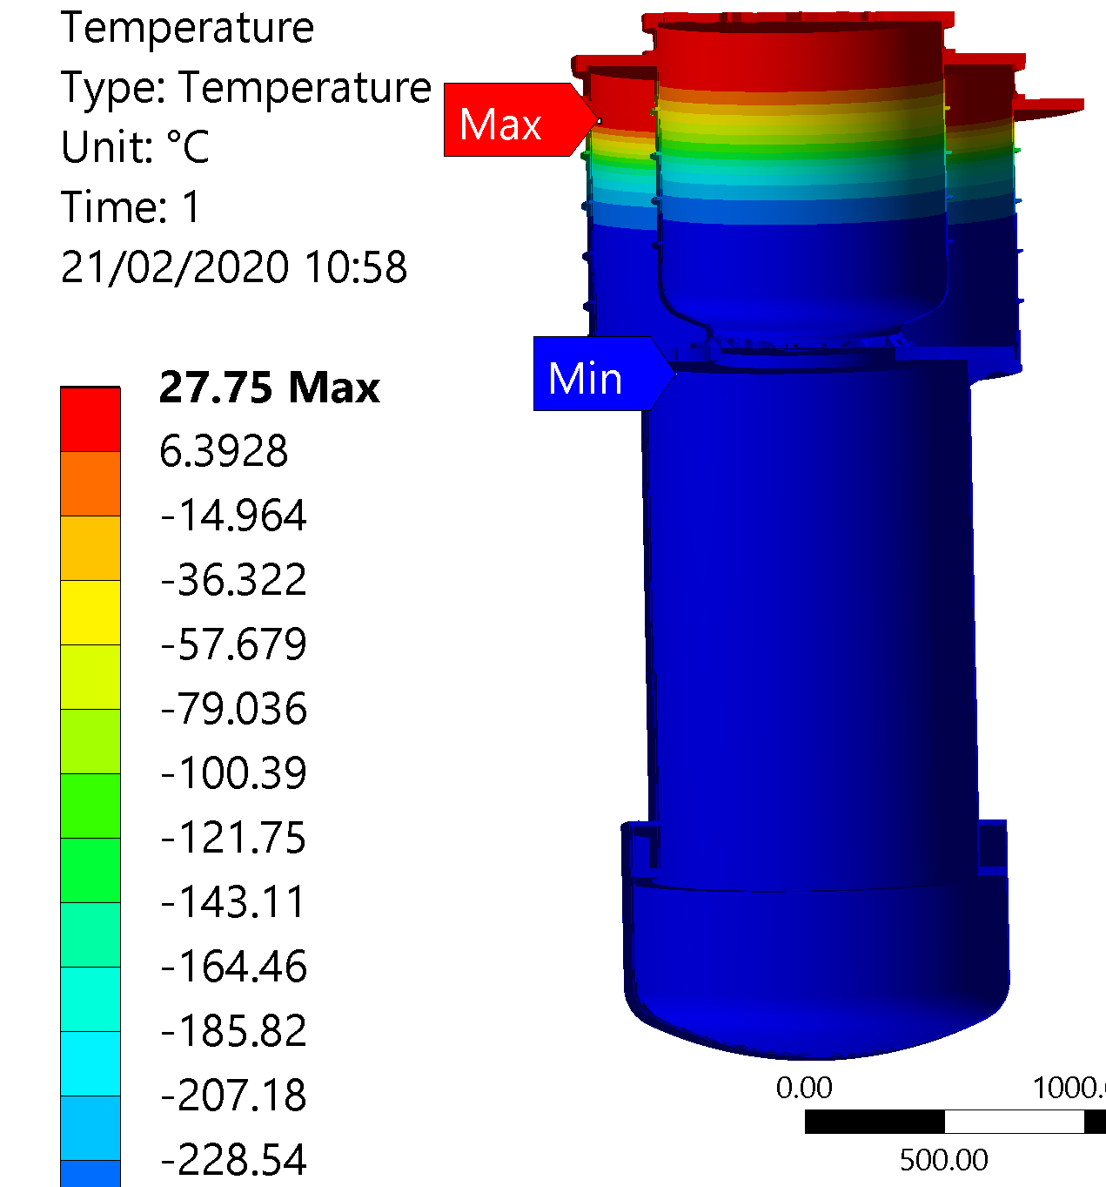
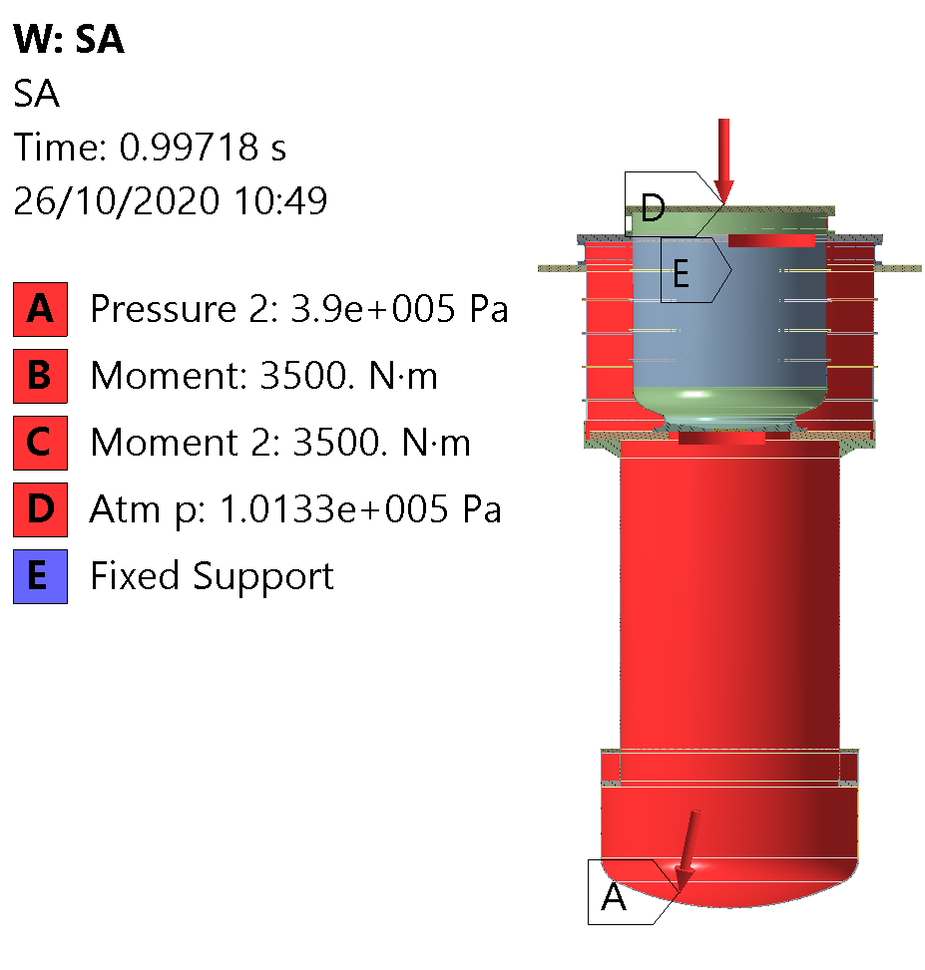
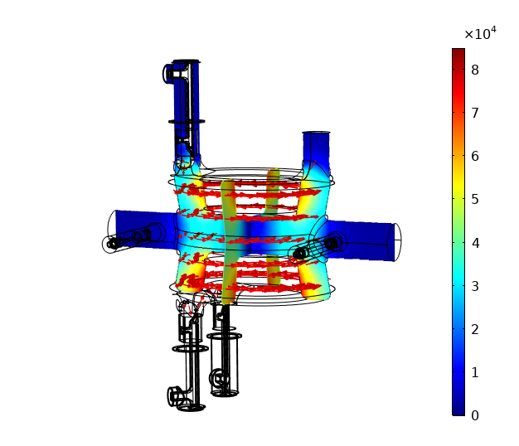
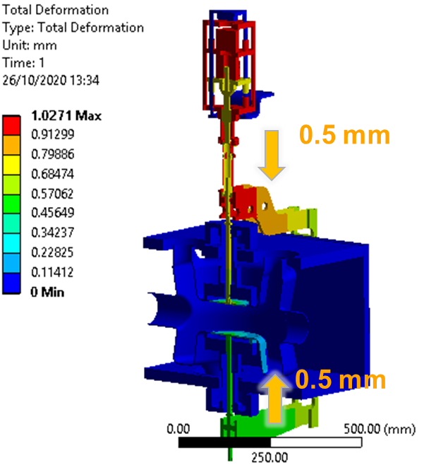
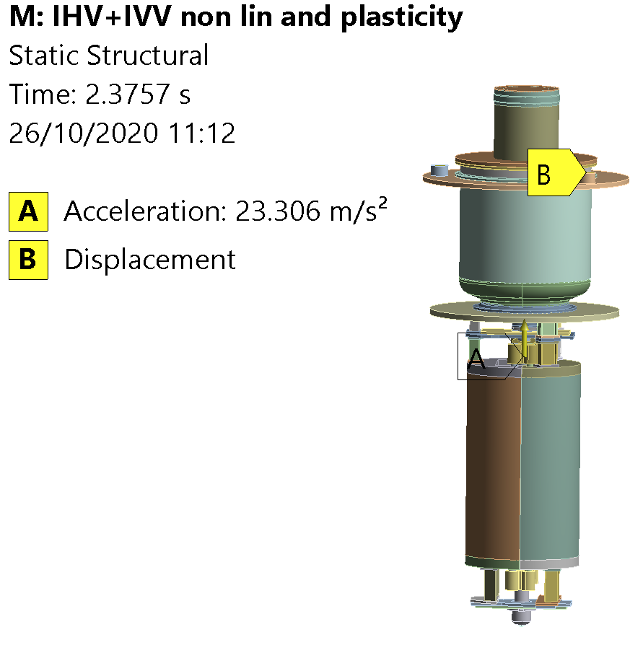
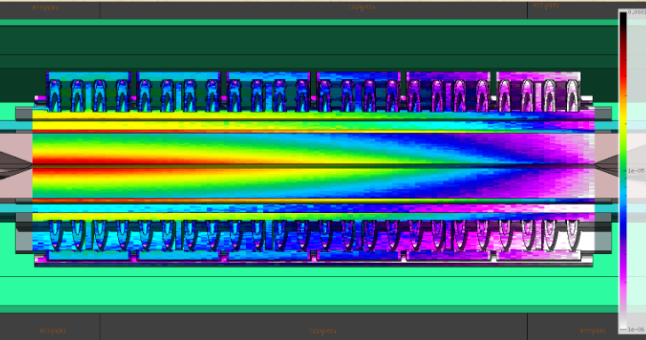
Particle accelerator components: typical loads
Temperature gradient
Mechanical forces
Electromagnetic forces
Can be typically studied with implicit FE codes
Displacements
Accelerations
Beam loads (RF & particle losses)

Slide 15
Examples

Slide 16
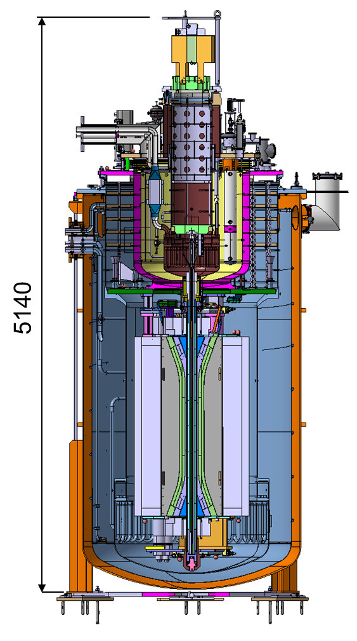
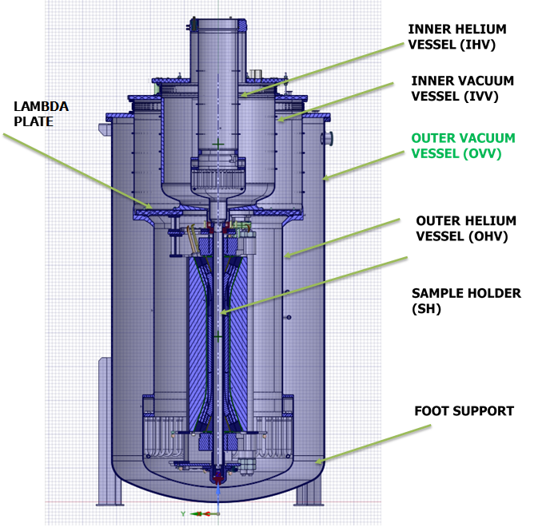
FRESCA2: a facility for testing SC samples
Simplified model for computations

Slide 17
FRESCA2: design of the OHV
Two main design cases:
Operation:
  Internal pressure in the OHV 3.9 bara
  Thermal gradient 2-300 K
  EM torque 3500 Nm
  Most likely failure scenario is by plastic deformation
Vacuum loss during OHV purging:
  External pressure on the OHV 1.5 bara
  Most likely failure scenario is by buckling

Slide 18
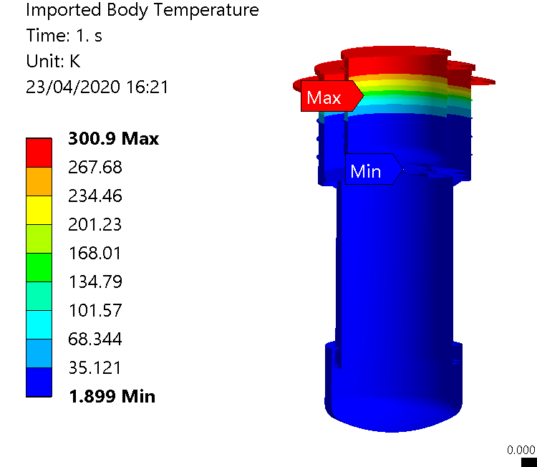
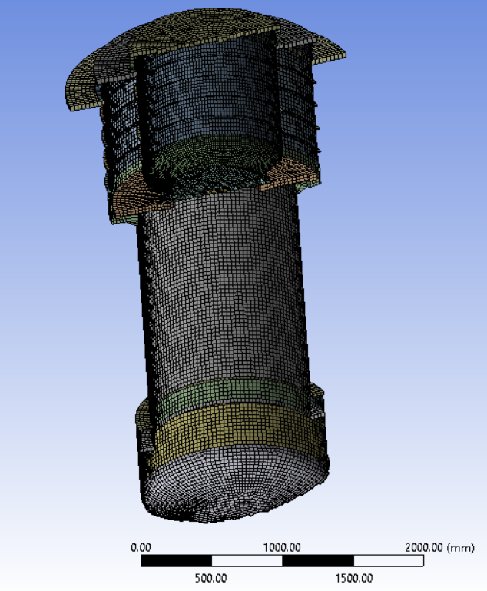
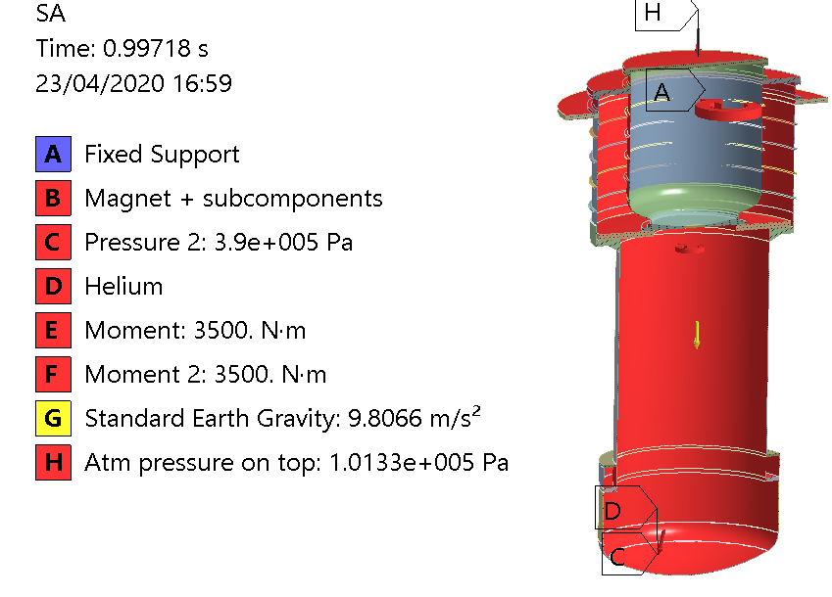
FRESCA2 OHV: operational scenario
Use shell elements wherever possible wrt solids
Nonlinearity of materials (temperature, strain, …)
Structure verified against EN-13445 Direct Route: plastic strain must be less than 5%
T field can be calculated in a separated thermal analysis, then imported into structural (thermomechanical coupling)

Slide 19
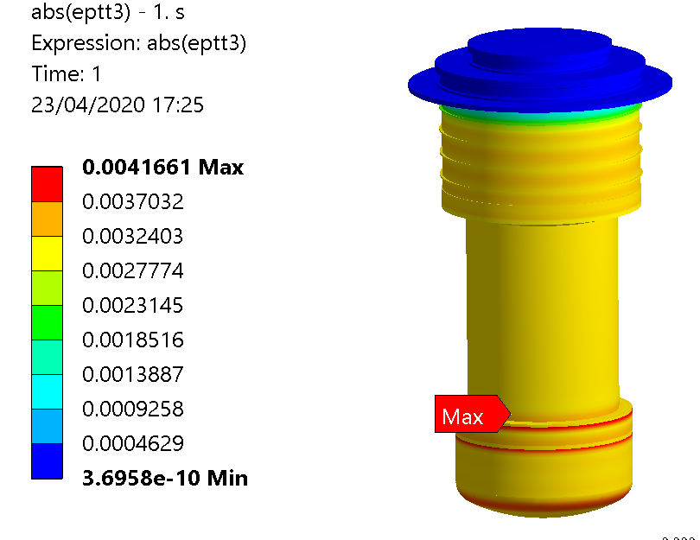
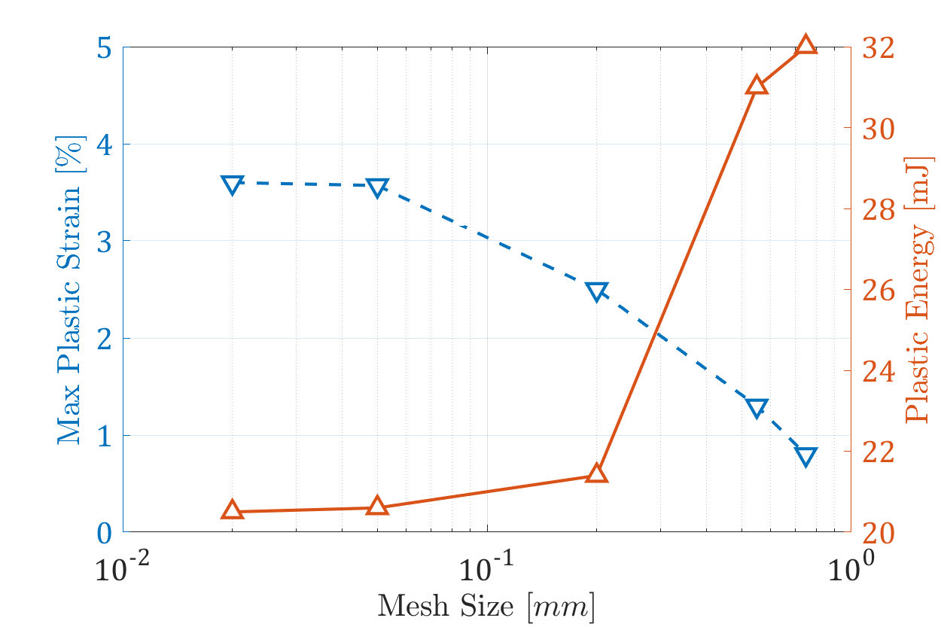
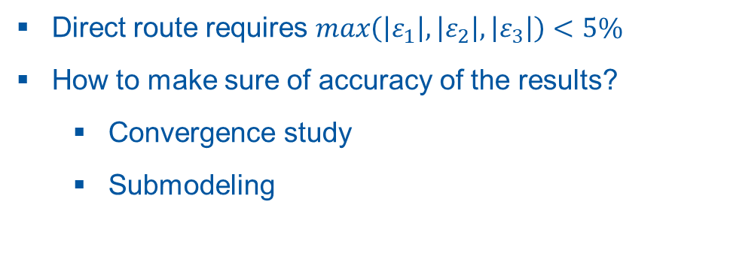
FRESCA2 OHV: operational scenario
Direct route requires $max\left(\left|ε_{1}\right|,\left|ε_{2}\right|,\left|ε_{3}\right|\right)<5\%$
How to make sure of accuracy of the results?
  Convergence study
  Submodeling
0.4%

Slide 20
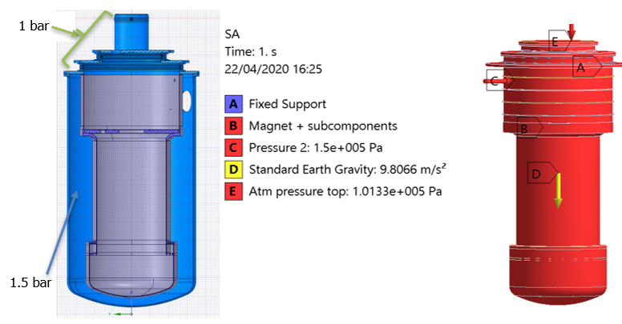
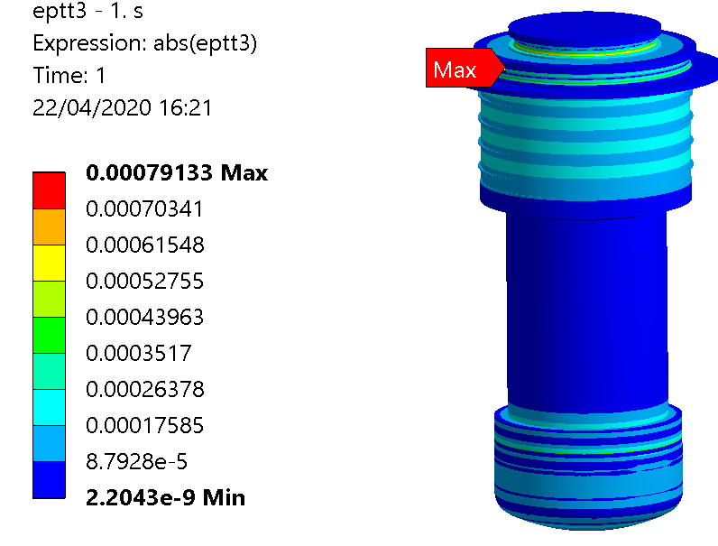
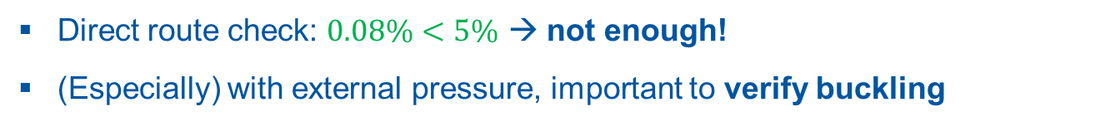
FRESCA2 OHV: vacuum loss during purging
0.08%
Direct route check: $0.08\%<5\%$ → not enough!
(Especially) with external pressure, important to verify buckling
20

Slide 21
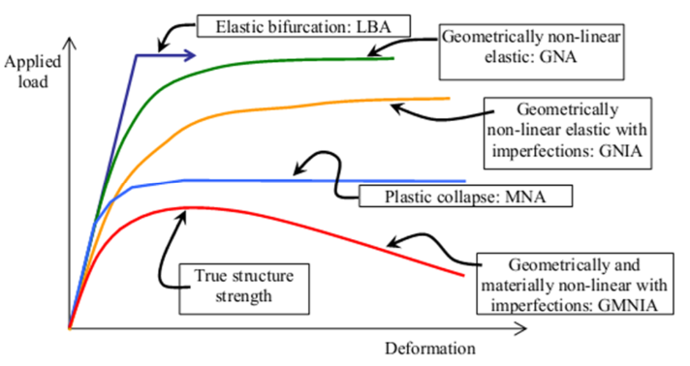
FRESCA2 OHV: vacuum loss during purging – Buckling
Which kind of buckling study?
When going with FEM, better to directly take the most accurate one (GMNIA)
Also required by direct route. It accounts for large deformation theory, material nonlinearities, and initial geometry imperfections (e.g. shape errors, etc.)
21

Slide 22
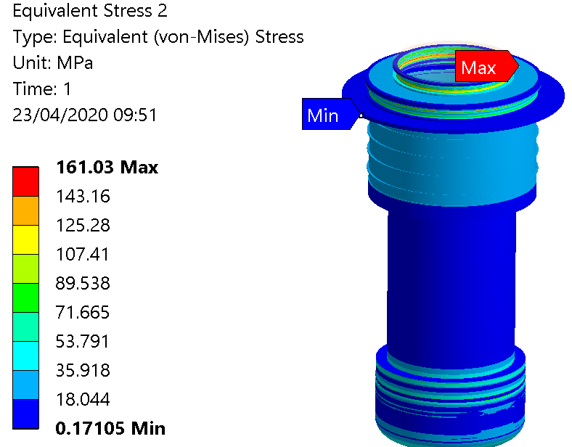
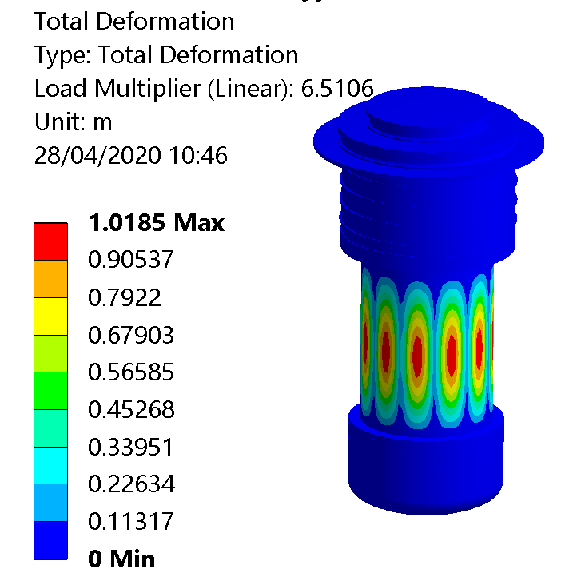
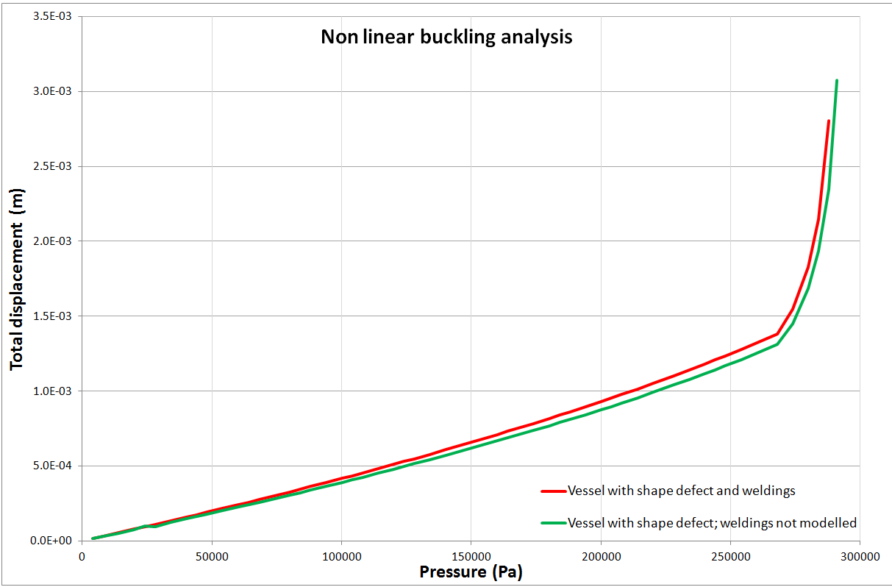
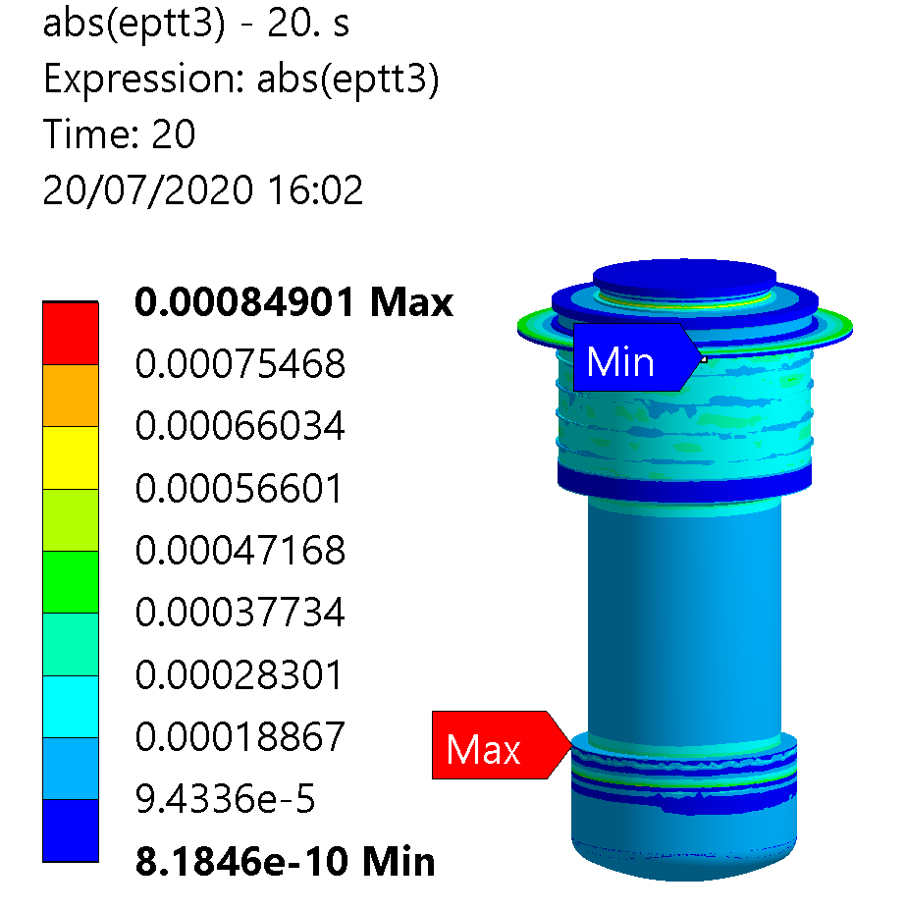
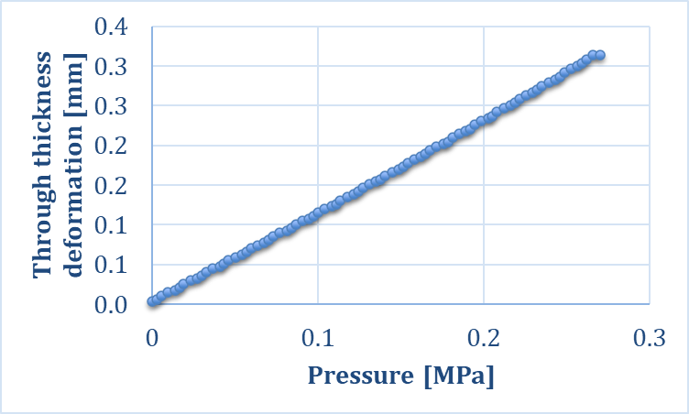
FRESCA2 OHV: vacuum loss during purging – Buckling
LSA
LBA
How to perform a GMNIA?
Steps:
LSA: Run a linear elastic static analysis (no imperfections), with nominal loads
LBA: Perform a bifurcation analysis (eigenvalue buckling) and determine the linear buckling modes, and the load multipliers wrt (1)
GMNIA: Run a nonlinear material, large deformation analysis, importing the deformed geometry of (2) as initial geometry of the analysis. Increase the loads progressively until:
  Buckling occurs, or
  The safety factor required by the Standard is reached
GMNIA
22

Slide 23
Conclusions
Nowadays, Computer-Aided Engineering (CAE) is of paramount importance in the design phase of components, to decrease cost, time, risk for the project
CAE require a number of iterations with CAD, with the goal of optimizing the component
What cannot be calculated, must be validated through tests / prototypes (calculation cannot replace everything!)
Thanks to the increase in the computational power, the Finite-Element Method (FEM) has been, in the last years, the most adopted tool for CAE
When engineering particle accelerator components, implicit codes are typically adopted over explicit ones
Explicit codes become necessary when dealing with short transient simulations (e.g. beam impact on dumps, windows, etc.) and with strongly nonlinear problems (e.g. fabrication technologies: cutting, welding, brazing, forming, etc.)
Graphical interfaces of FEM tools are becoming simpler: easier for the work, riskier if we do not well master the method!

Slide 24
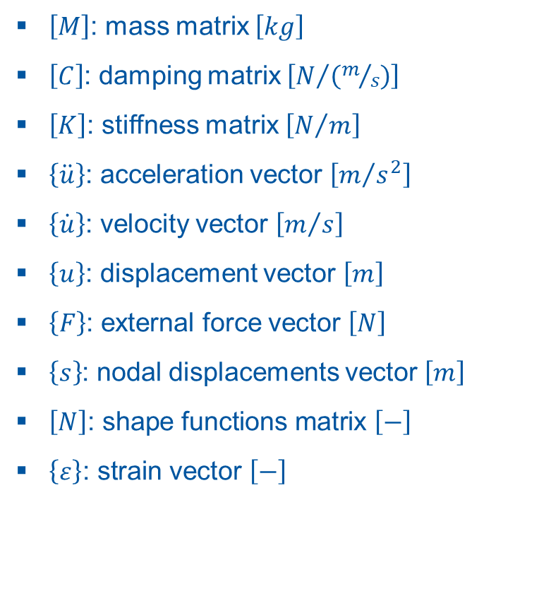

Symbols
$\left[M\right]$: mass matrix $\left[kg\right]$
$\left[C\right]$: damping matrix $\left[N/{\left(m/s\right)}\right]$
$\left[K\right]$: stiffness matrix $\left[N/m\right]$
$\left\{\ddot{u}\right\}$: acceleration vector $\left[m/{s^{2}}\right]$
$\left\{\dot{u}\right\}$: velocity vector $\left[m/s\right]$
$\left\{u\right\}$: displacement vector $\left[m\right]$
$\left\{F\right\}$: external force vector $\left[N\right]$
$\left\{s\right\}$: nodal displacements vector $\left[m\right]$
$\left[N\right]\text{: }\text{shape} \text{functions} \text{matrix} \left[−\right]$
$\left\{ε\right\}\text{: }\text{strain} \text{vector} \left[−\right]$
$\left[∂\right]$: strain-displacement matrix $\left[m^{−1}\right]$
$\left\{σ\right\}$ : stress vector $\left[Pa\right]$
$\left[D\right]$: material constitutive matrix $\left[Pa\right]$
$\left\{a\right\}\text{: }\text{polynomial} \text{coefficients} \text{vector} \left[−\right]$
$\left[P\right]\text{: }\text{position} \text{matrix} \left[m\right]$
$\left\{a\right\}\text{: }\text{nodal} \text{position} \text{matrix} \left[m\right]$
$ε_{1}\text{: }\text{maximum} \text{principal} \text{strain} \left[−\right]$
$ε_{2}\text{: }\text{middle} \text{principal} \text{strain} \left[−\right]$
$ε_{3}\text{: }\text{minimum} \text{principal} \text{strain} \left[−\right]$

Slide 25
Thank you!
Questions?

Slide 26
Backup slides

Slide 27

FEM Theory (backup)
E
C
M
EQUILIBRIUM
COMPATIBILITY
MATERIAL LAWS
Displacements & strains
Stress & strain
IF are satisfied everywhere inside and on the surface of an elastic body
strand strain fields are exactly correct
FE usually guarantees two of the laws are satisfied exactly:
E
C
M
BUT, impossible for complex structures !
C
M
Principle of Virtual Work
E
is approximated, by:
Principle of Minimum Potential
Solution will converge to exact answer as number of elements tends to infinity.

Slide 28

Manual FE in 10 steps
I .Displacement u=[N]{s}.
u ↔ ε↔ σ↔ P
[k]{u}={P}
II. Strain {ε}=[B]{s}.
III. Define material property matrix [D].
IV. Stress {σ}=[D][B]{s}.
V. Determine element stiffness matrix and force vectors.
VI. Transform nodal variables to global.
VII. Assemble the global stiffness matrix and load vector.
VIII. Boundary conditions.
IX. Get unknown displacements and reactions.
X. {σ}=[D][B]{u}.
Notes:
Can be divided in 2 slides if decided to keep
Step I → Define the displacement relationship on the element u=[N]{u}.
Step II → Evaluate the strain-displacement relationship {ε}=[B]{u}.
Step III → Define the material property matrix [D].
Step IV → Evaluate the stress-displacement relationship {σ}=[D][B]{u}.
Step V → Determine element stiffness matrix and force vectors.
Step VI → Transform nodal variables to global ones using [T] if necessary.
Step VII → Assemble the global stiffness matrix and load vector.
Step VIII → Apply kinematic boundary conditions.
Step IX → Solve for unknown displacements and reactions.
Step X → Back substitute for element stresses {σ}=[D][B]{u}.

Slide 29


Derivation of shape function for a truss element
y
1
2
x
u₁
$$l$$
u₂
$u=a_{1}+a_{2}x=\left[\begin{matrix}1 & x\end{matrix}\right]\left\{\begin{matrix}a_{1} \\ a_{2}\end{matrix}\right\}=\left[P\right]\left\{a\right\} →$ $u_{1}=\left[\begin{matrix}1 & x_{1}\end{matrix}\right]\left\{\begin{matrix}a_{1} \\ a_{2}\end{matrix}\right\};{ u}_{2}=\left[\begin{matrix}1 & x_{2}\end{matrix}\right]\left\{\begin{matrix}a_{1} \\ a_{2}\end{matrix}\right\}$
(1)
$b.c.:{ x}_{1}=0$; ${ x}_{2}=x_{1}+l=l$
$\left\{s\right\}=\left\{\begin{matrix}u_{1} \\ u_{2}\end{matrix}\right\}=\left[\begin{matrix}1 & 0 \\ 1 & l\end{matrix}\right]\left\{\begin{matrix}a_{1} \\ a_{2}\end{matrix}\right\}=\left[A\right]\left\{a\right\} → {\left[A\right]}^{−1}=\frac{1}{l}\left[\begin{matrix}l & 0 \\ −1 & 1\end{matrix}\right]$ $→ \left\{a\right\}={\left[A\right]}^{−1}$ $\left\{s\right\}=\frac{1}{l}\left[\begin{matrix}l & 0 \\ −1 & 1\end{matrix}\right]\left\{\begin{matrix}u_{1} \\ u_{2}\end{matrix}\right\}$
(2)
(1) + (2) $→u=\left[P\right]{\left[A\right]}^{−1} \left\{s\right\}=\left[\begin{matrix}1 & x\end{matrix}\right]$ $\frac{1}{l}\left[\begin{matrix}l & 0 \\ −1 & 1\end{matrix}\right]\left\{\begin{matrix}u_{1} \\ u_{2}\end{matrix}\right\}=\left[\begin{matrix}\left(1−\frac{x}{l}\right) & \frac{x}{l}\end{matrix}\right]$ $\left\{\begin{matrix}u_{1} \\ u_{2}\end{matrix}\right\}$
$$\left[N\right]=\left[P\right]{\left[A\right]}^{−1}=\left[\begin{matrix}\left(1−\frac{x}{l}\right) & \frac{x}{l}\end{matrix}\right]$$

Slide 30

Deformation matrix $\left[B\right]=\left[∂\right]\left[N\right]$
Applying principle of virtual works: $\left[K\right]=\int_{V}{{\left[B\right]}^{T}\left[D\right]}\left[B\right]dV$
Calculation of the element stiffness matrix

Slide 31
Implicit and Explicit Problems
Implicit analysis
- aim to solve the unknowns {x} through matrix inversion.
- in nonlinear problems - the solution is obtained in a number of steps and the solution for the current step is based on the solution from the previous step.
- for large models - inverting the matrix is highly expensive and will require advanced iterative solvers
- these solutions are unconditionally stable and facilitate larger time steps.
Despite this advantage, the implicit methods can be extremely time-consuming when solving dynamic and nonlinear problems.
Explicit analysis
- aim to solve for acceleration {x’’}
- in most cases, the mass matrix is considered as lumped → a diagonal matrix → inversion is straightforward
- once the accelerations are calculated in n^{th} step, the velocity at n+1/2 step and displacement at n+1 step are calculated
- in these calculations, the scheme is not unconditionally stable and thus smaller time steps are required.
To be more precise, the time step in an explicit finite element analysis must be less than the Courant time step (the time taken by a sound wave to travel across an element).

Slide 32
Explicit vs Implicit
Explicit
Implicit
robust, even for strongly non linear models
low memory requirements
expensive to conduct long term simulations
conditionally stable
equations are uncoupled
only matrix multiplication
can be unconditionally stable
eventually problematic for strongly non-linear models
high memory requirements(inverting stiffnes matrix)
relatively inexpensive for long duration analysis
equations are coupled
matrix inversion
convergence problem
Notes:
Explicit
impact, penetration, high rate dynamics,
time step size small
courant condition limits largest stable time step
Implicit
static, eigenvalue, low rate dynamic analyses
few large time steps
model size (degrees of freedom) affects wall time

Slide 33







Examples of studies performed (2)
Crab cavities (BE-RF)
Studies for the design of dressed cavities and cryomodule, optimization of the thermal loss balance
Stress on He vessel and DQW cavity
DQW bowl and diabolo
Explicit analyses for the sheet metal forming of cavity components (bowl, diabolo, etc.), to explore different tool shapes and forming steps as well as predict the stress-strain field and thickness distribution

Slide 34






More on the TIDVG5 study
Job example: TIDVG5 hipping
User: EN-STI
Problem: TIDVG5 cooling circuit bursting during hipping
Method: FEA (implicit + explicit)
Proposed solution: reduce pipe/housing gap, adapted shape of housing
Future developments: standardize bending process
Fracture!
Hipping, 0.5 mm gap
Hipping, infinite gap
Pipe bending, LS-Dyna
Pipe bending, Autodyn

