Slide 1


Steels & Stainless Steels
“Mini-CAS” course on Mechanical and Materials Engineering for Accelerators, 6/11/20-22/01/21
Stefano Sgobba, EN-MME-MM, CERN - 20/11/2020
Stefano.Sgobba@cern.ch

Slide 2
Outline
Introduction to steels and stainless steels:
        Iron and steel, major players in the history of mankind
        Stainless steels, a 100 years of know-how
Rules for the selection and specification of stainless steels
        Metallurgy of general purpose and advanced stainless steels grades/processes for specific applications
Steelmaking routes to secure the final quality of the product
Stability of the properties: precipitations and transformations
        Considerations for welding
        Case study: steel for the new CMS HG-CAL detector
Thermal treatments, sensitization, corrosion failures
Conclusions

Slide 3
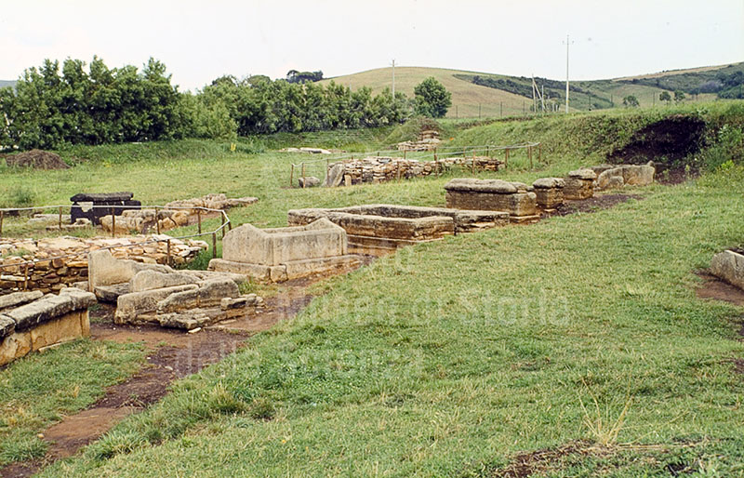
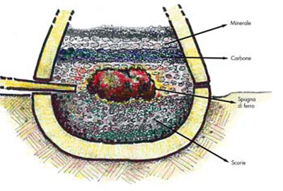
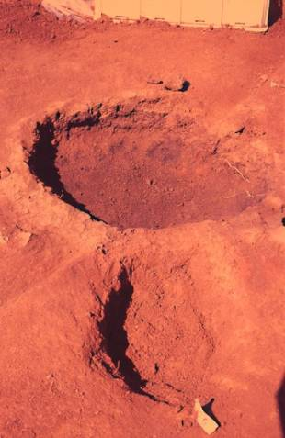
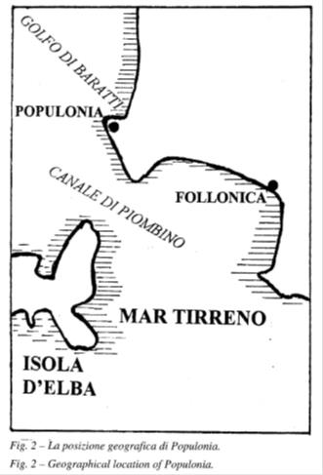
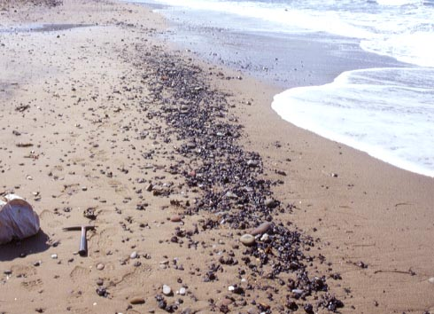
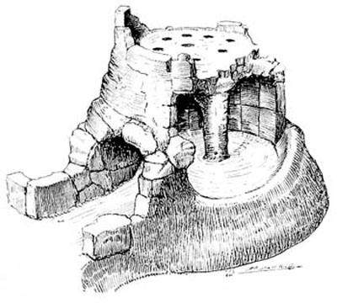
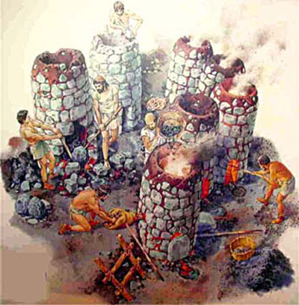
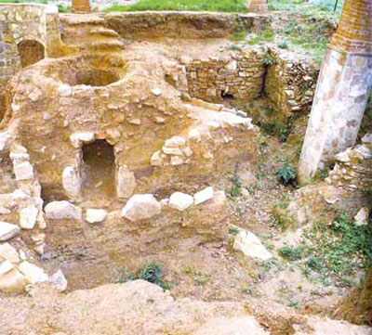
1. Steels and stainless steel
A. Berveglieri, R. Valentini, La Metallurgia Italiana, June 2001, p. 49ff
Remains of Etruscan furnaces, exploited from the end of the Iron Age (9th – 8th century BC) to the 1st century BC
Residues, exploited until 1969…
Fe₃O₄ + CO → 3FeO + CO₂
FeO + CO → Fe + CO₂
FeO + C → Fe + CO

Slide 4
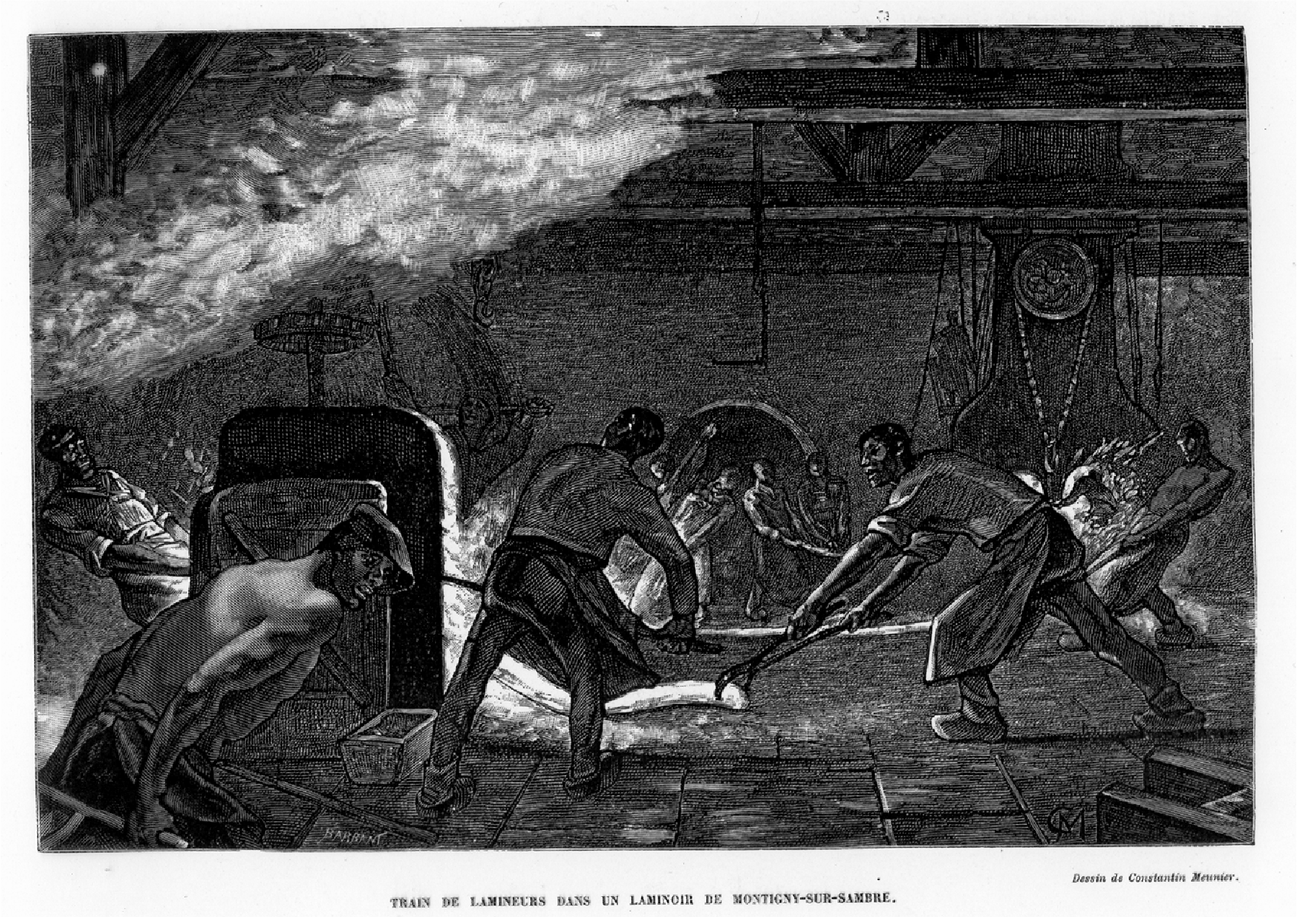
1. Steels and stainless steel
C. Lemonnier, La Belgique, Paris, Hachette (1888)
R. F. Tylecote. A history of metallurgy. The Metals Society, London, 2nd impr. 1979

Slide 5
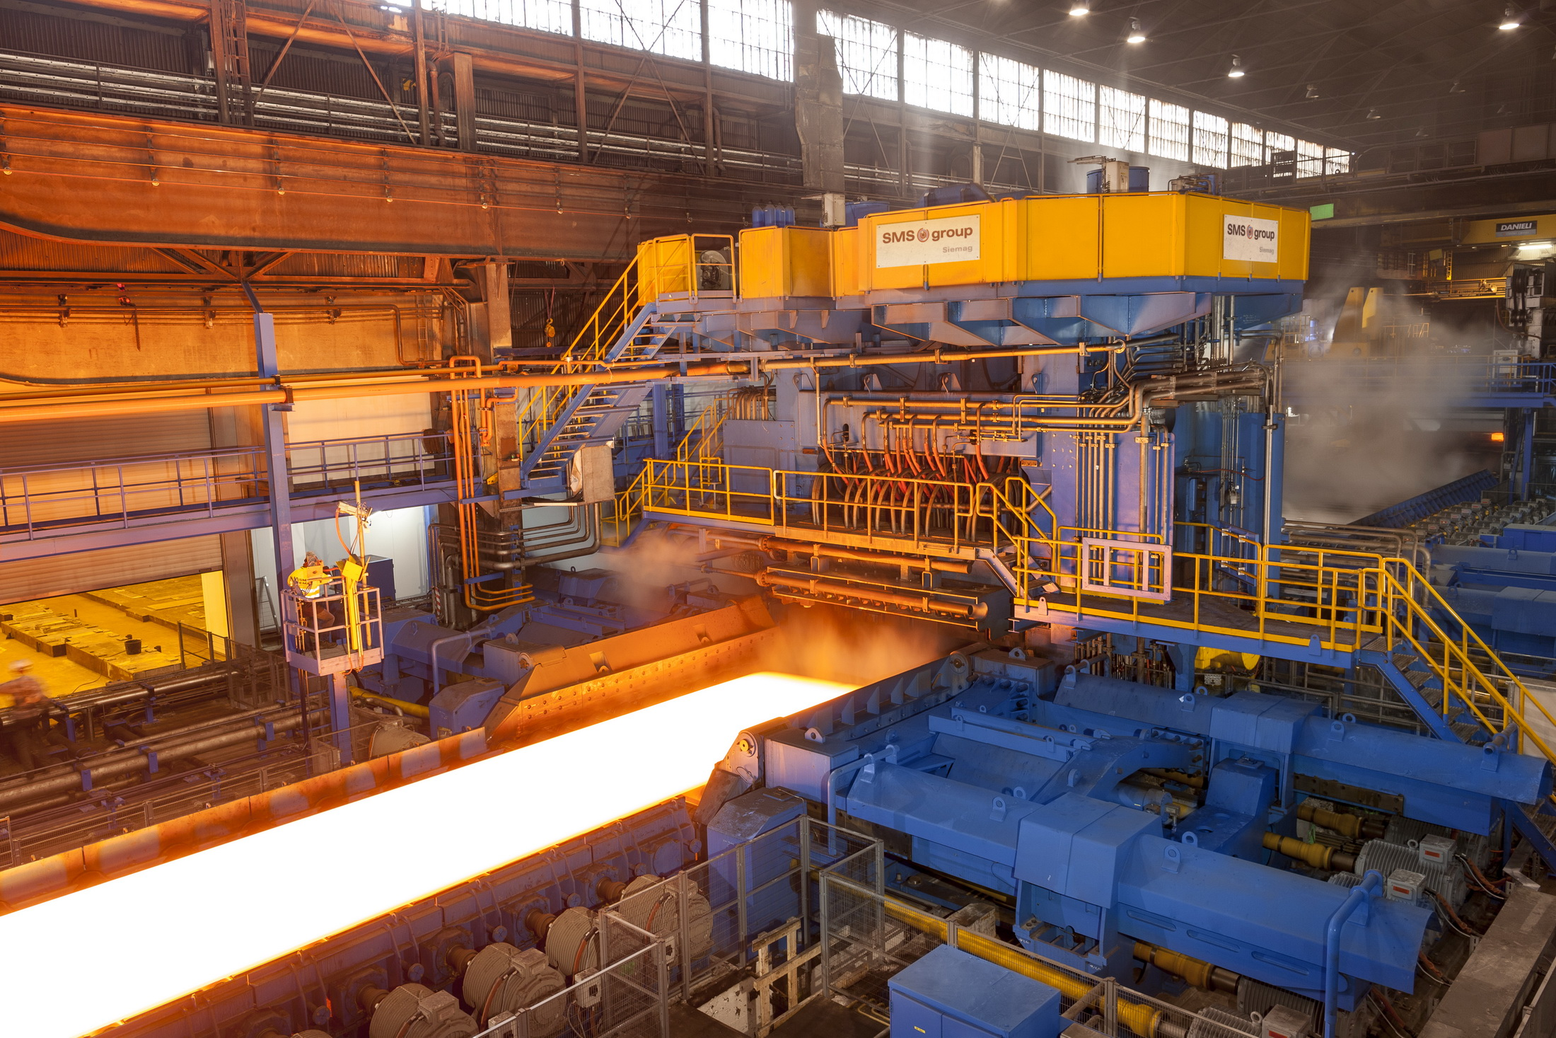
1. Steels and stainless steel
Courtesy of TISCO /CN, hot rolling stainless steel plate mills, 2018

Slide 6
1. Steels and stainless steel
Courtesy of Sandvik Stainless Services

Slide 7
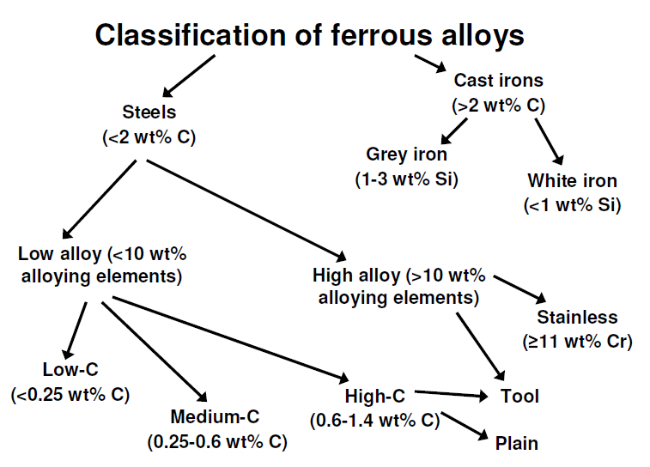
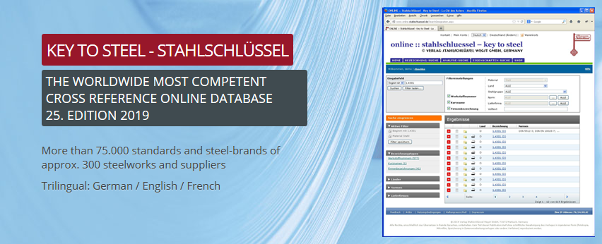

1. Steels and stainless steel
Steel is an iron based alloy containing Carbon, Silicon, Manganese etc., http://steel.nic.in/Glossary-I.pdf
Steel is an alloy of iron and carbon. The amount of carbon dictates whether a steel is hard or it is tough. C content in steel usually falls a range between 0.3 ~ 1.5 % by volume, http://www.ksky.ne.jp/~sumie99/ironandsteel.html

Slide 8
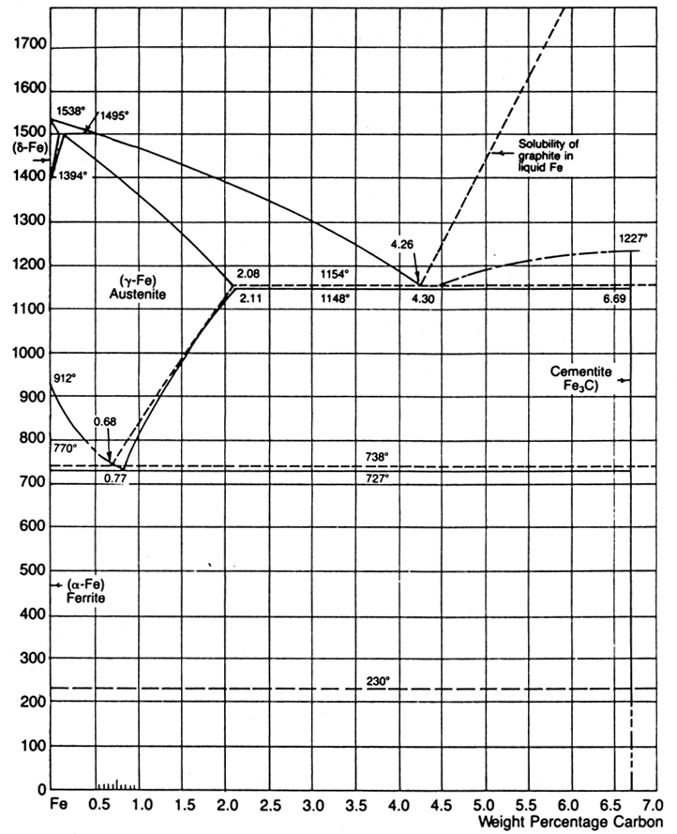
1. Steels and stainless steel
Steels
Cast
irons
The Fe-C (Fe-Fe₃C) diagram
Fe₃C (metastable cementite) → 3 Fe + C (graphite)
Fe - Fe3C
Fe - graphite

Slide 9
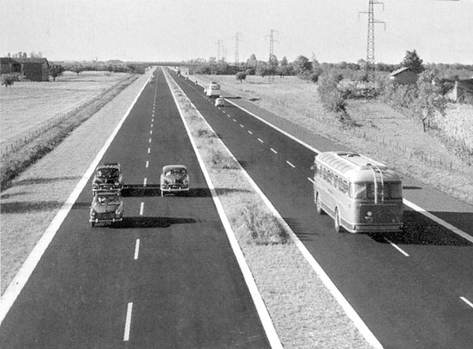
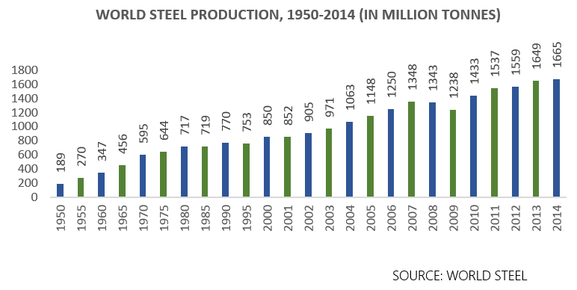
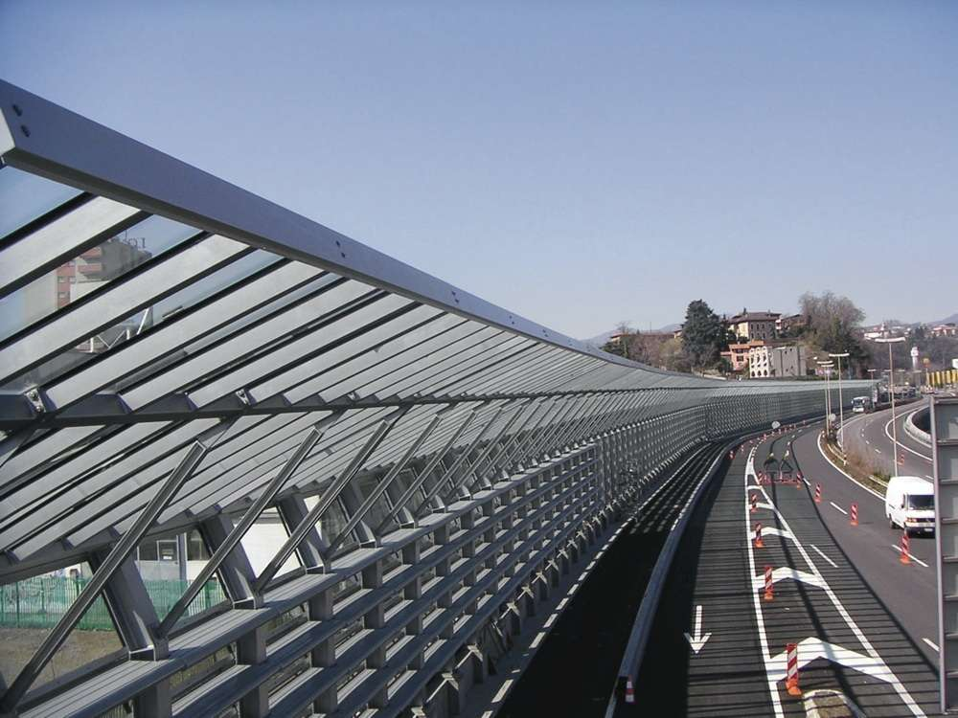
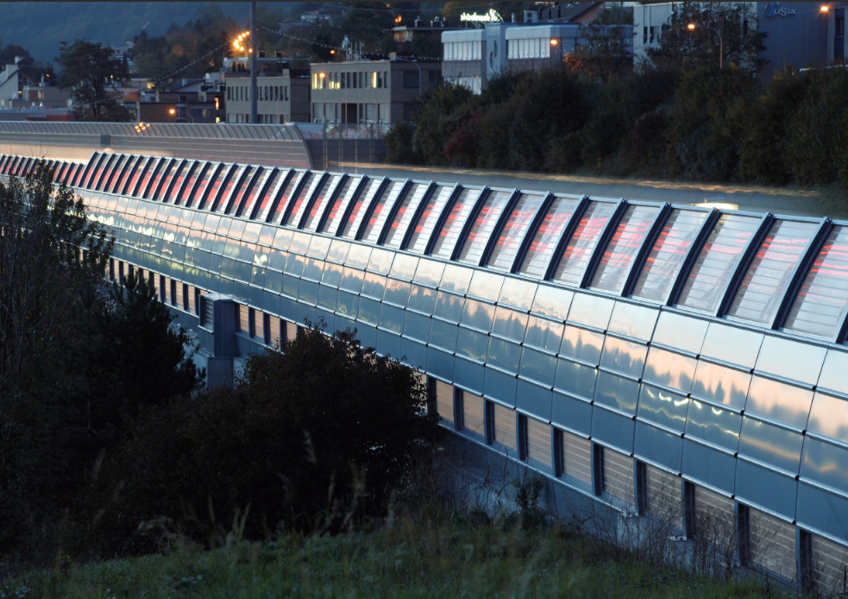
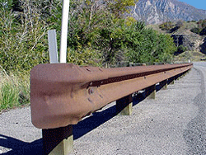
1. Steels and stainless steel
Autostrada del Sole, first open section 1958
A2 (CH), Chiasso boundary, 2014
A22, Autobrennero, 1974
Weathering steel COR-TEN trademark of United States Steel Corporation (USS): by amount of Cu, P Si and Cr, can develop under favourable climatic conditions a patina of hydrated Fe oxide retarding further attack. Long dry summer periods required.
Hot galvanizing + powder coating

Slide 10
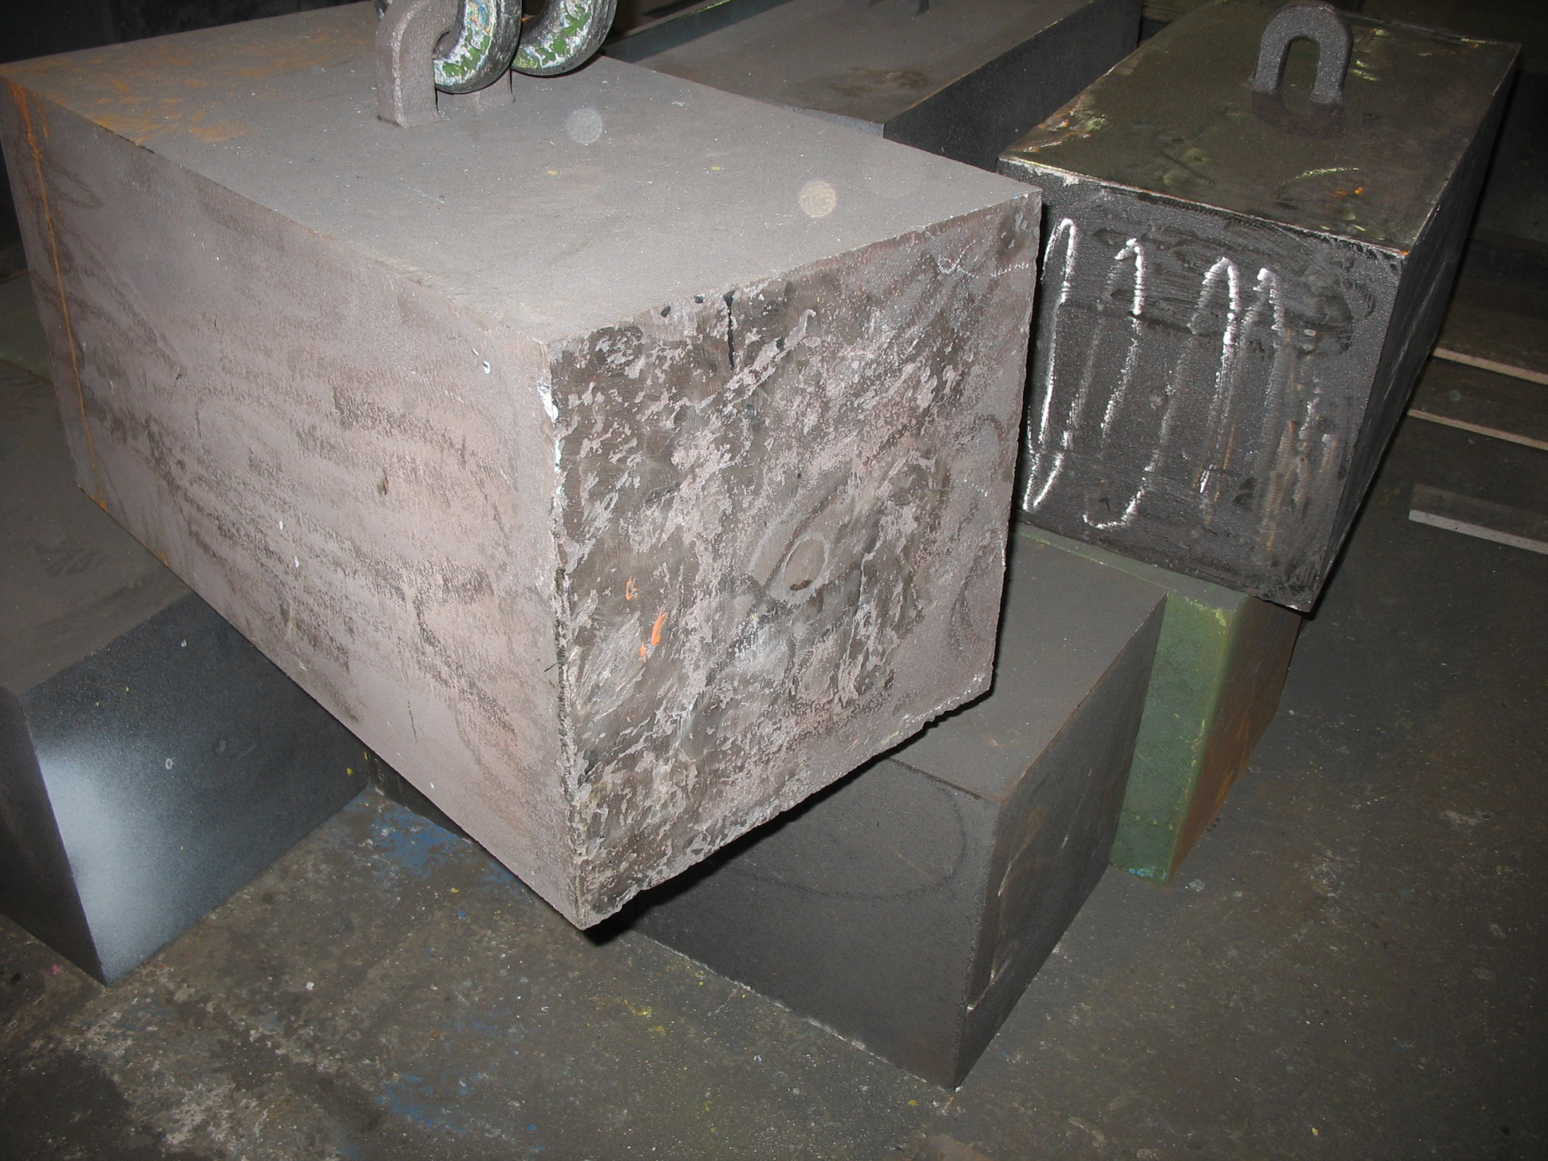
1. Steels and stainless steel
Cast irons:
Class of ferrous alloys with C ≥ 2.14 %
Most contain 3.0 % ≤ C ≤ 4.5 %
Lower T_{m} (1150 °C - 1300 °C) than steel
Easily melted and amenable to casting
Based on the reaction Fe₃C → 3 Fe + C
Tendency to form graphite regulated by composition and rate of cooling
Spheroid-graphite cast iron shielding blocks, LHC-R2E project. 436 t procured from NV Ferromatrix /BE.
More on steels, see ⇒
CAS course on "Mechanical & Materials Engineering", S. Sgobba, Steels & stainless steels I & II

Slide 11
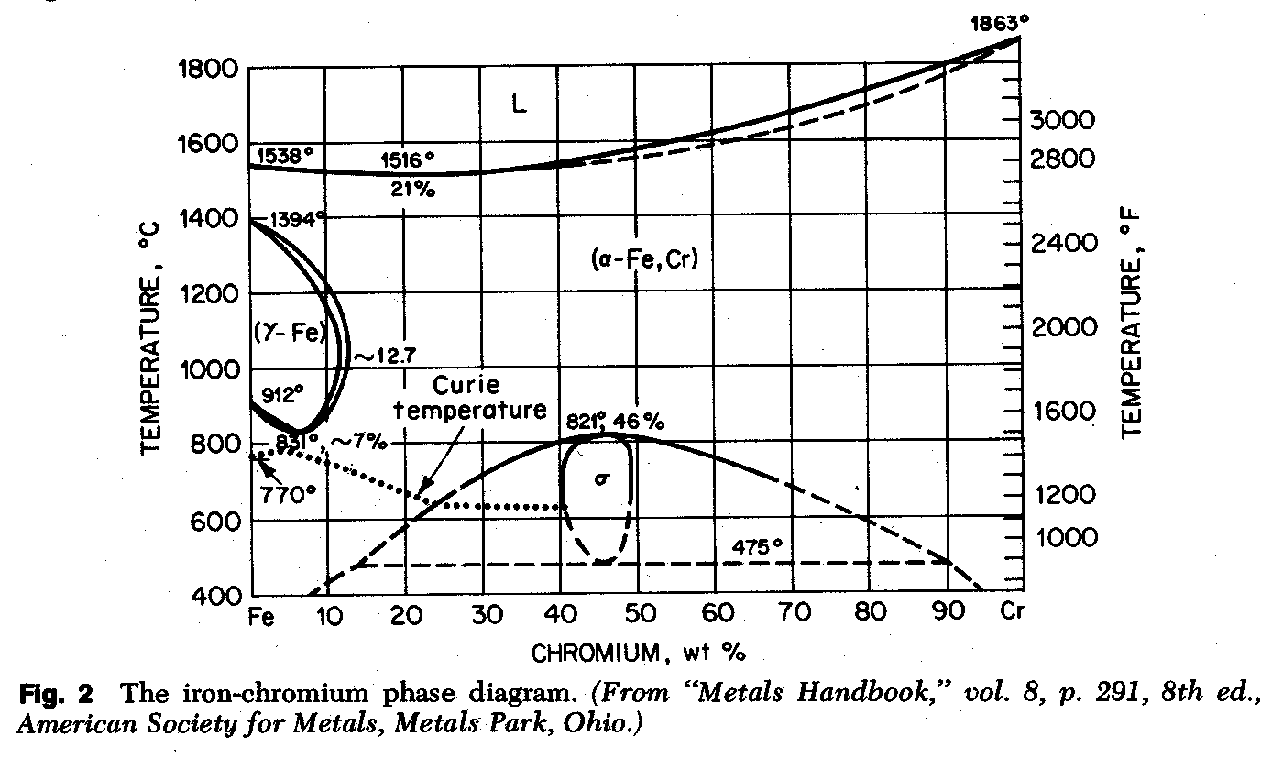
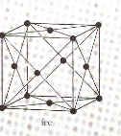
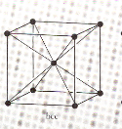
2. Stainless steels, metallurgy and families
δ-Fe
fcc
γ-Fe
bcc
α-Fe
Stainless steel: iron alloys containing a minimum of approx. 11 % Cr

Slide 12
2 Stainless steels, ferritic
ferritic grades, 14.5 % to 27 % Cr
resistant to corrosion
subject to grain growth during firing
ferromagnetic at RT and below
brittle at low T

Slide 13
2 Stainless steels, martensitic
C added to increase the "austenitic loop"
martensitic grades, Cr between 11.5 % and 18 %, C up to 1.2 %
hardenable by HT
high strength
ferromagnetic at RT and below
brittle at low T

Slide 14
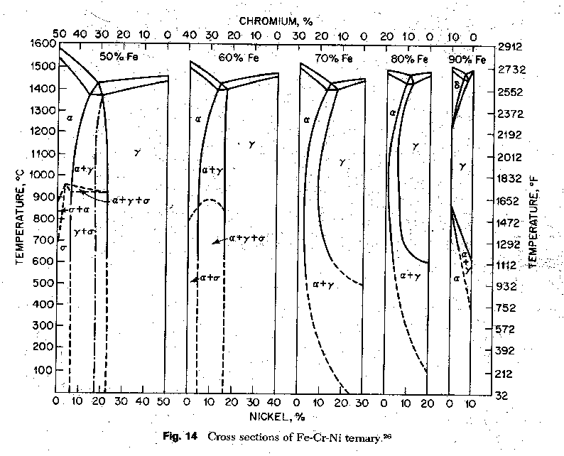
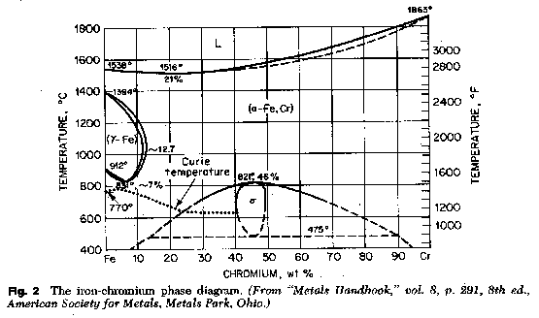
2 Stainless steels, austenitic
AISI 304, the "18-8" or "18-10" stainless (18%Cr, 8-10%Ni)
formed by an addition of a fcc element (Ni, Mn) to the FeCr system
γ-loop expanded
γ-phase enhanced and enlarged
formation of ferrite can be suppressed (austenite former elements)
transformation to martensite can be reduced or suppressed (increasing alloying elements)
Ni, Mn (C, N...)

Slide 15
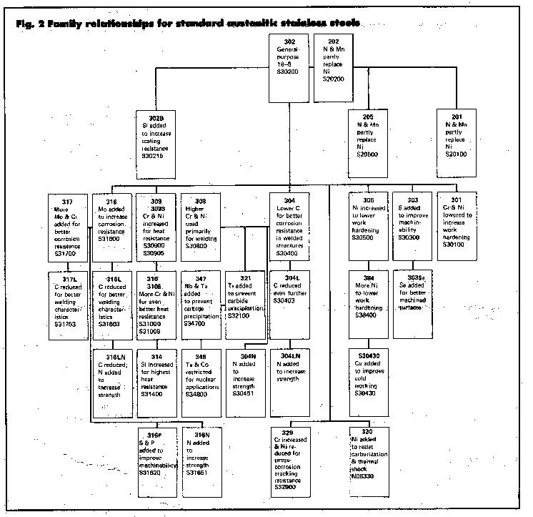
2 Stainless steels, austenitic
Vacuum & cryogenic applications: 304L, 316L, 316LN
×
×
×
Source: ASM Metals Handbook, vol. 3, 9th ed. (1980)

Slide 16
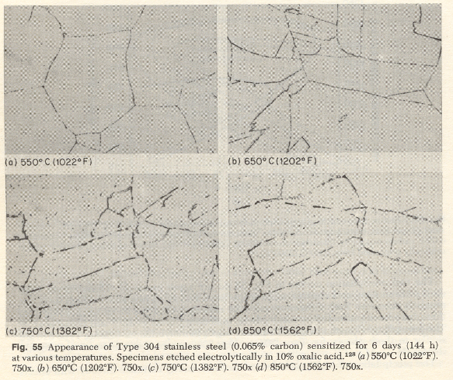
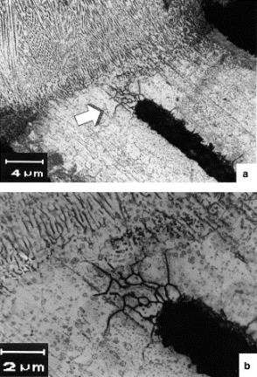
2. Stainless steels, austenitic
Why low C (304L, 316L, 316LN)?
"Sensitization" of base metal, HAZs and welds
M₂₃C₆ (Cr₂₃C₆)
Cr depleted zones
A.K. Jha et al., Engineering Failure Analysis
D. Peckner, I.M. Bernstein, 1977

Slide 17
2. Stainless steels

Slide 18
2. Stainless steels, inclusions
Oversized (1,2,3) and thick (4) B type inclusions up to class 2.

Slide 19
2. Stainless steels, inclusions
RD ⇔

Slide 20
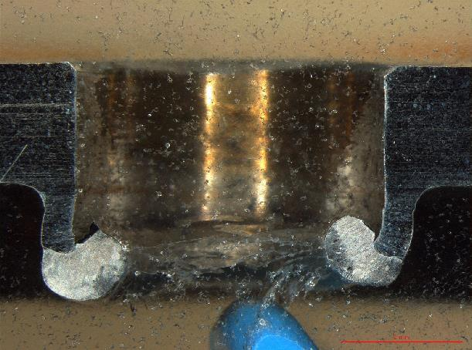
2. Stainless steels, inclusions
For any wrought product (plate, tube, bar), an unfavourable inclusions alignment will be anyway present in the rolling or drawing direction

Slide 21
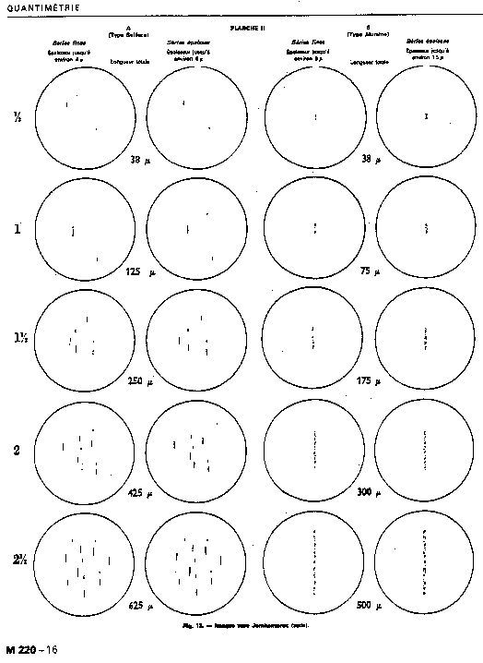
2. Stainless steels, inclusions
Spec. N°1001_1.4429_316LN_blanks

Slide 22
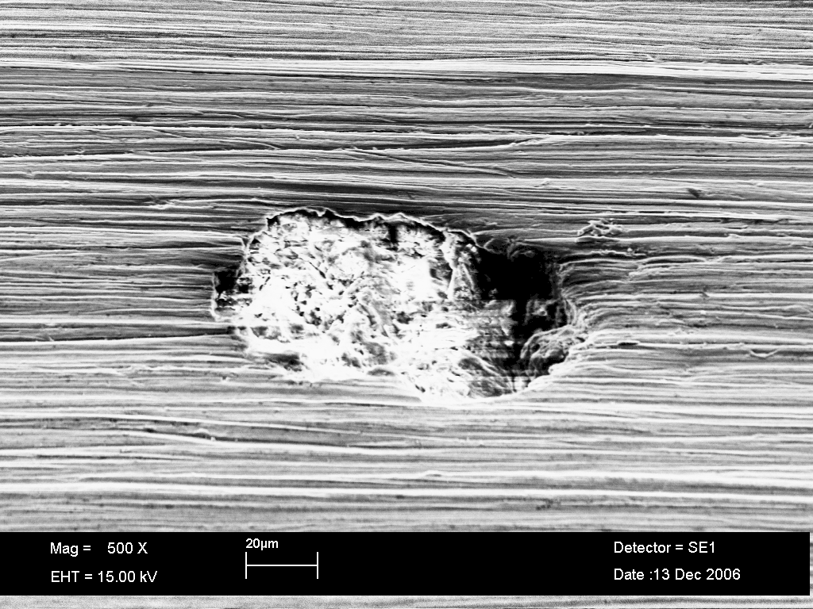
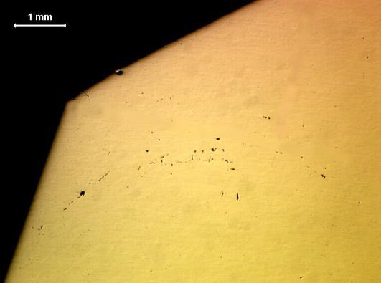
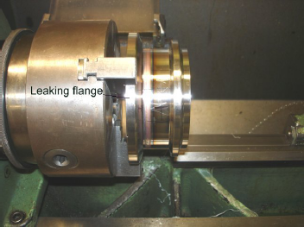
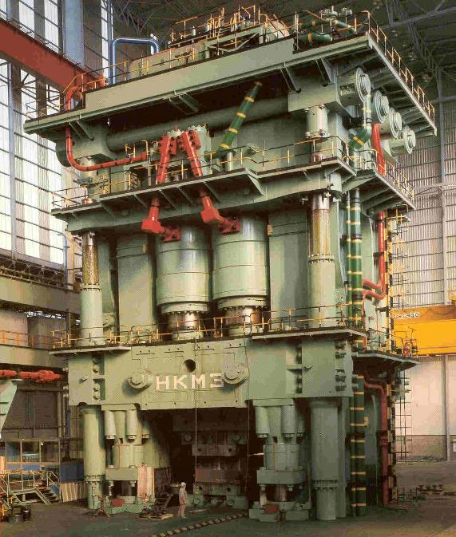
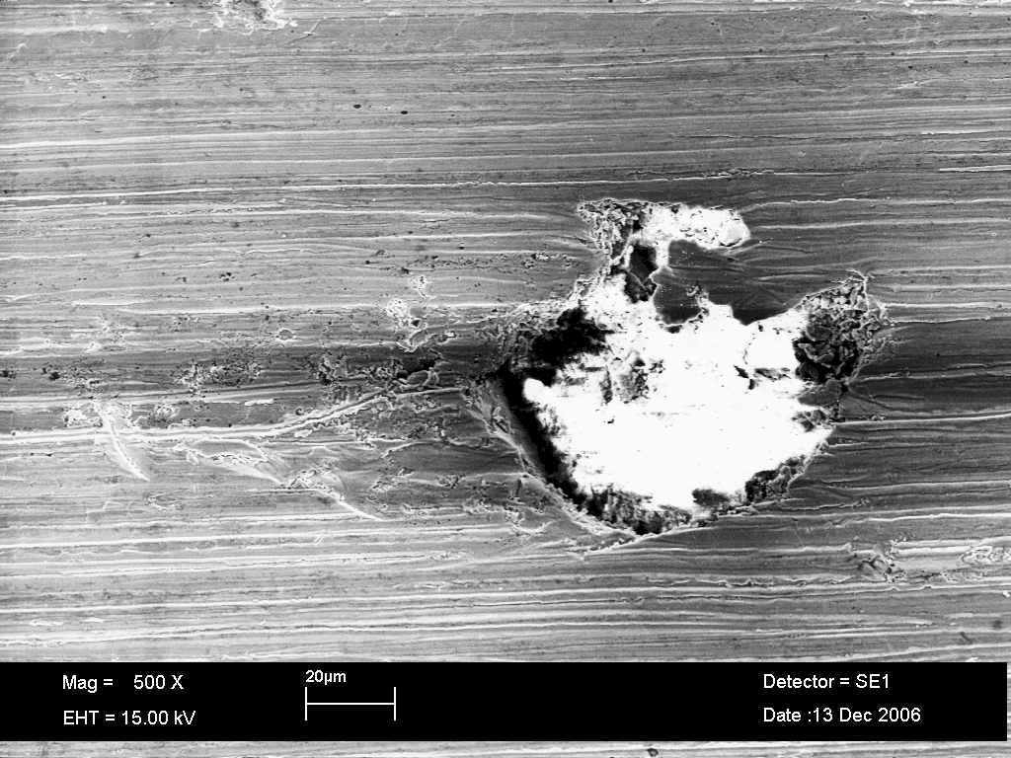
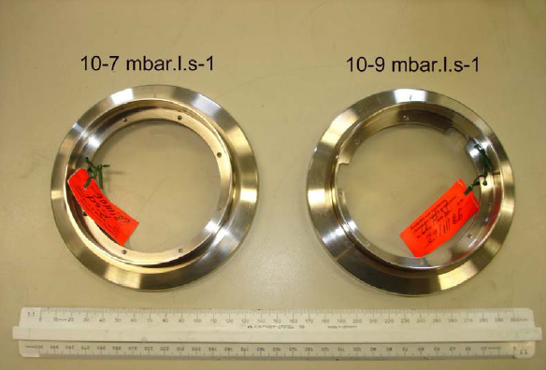
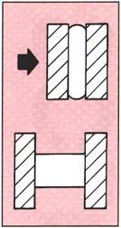
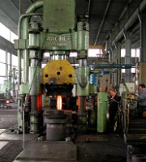
2.a Stainless steels, macroinclusions
Courtesy of Interforge /FR
Outer surface
Ca, Si, Al, O
Inner surface
Large inclusion
Multidirectional forging alone, even if including
upsetting is not enough to avoid the risk of leaks due to macroinclusions
Courtesy of Imbach /CH

Slide 23
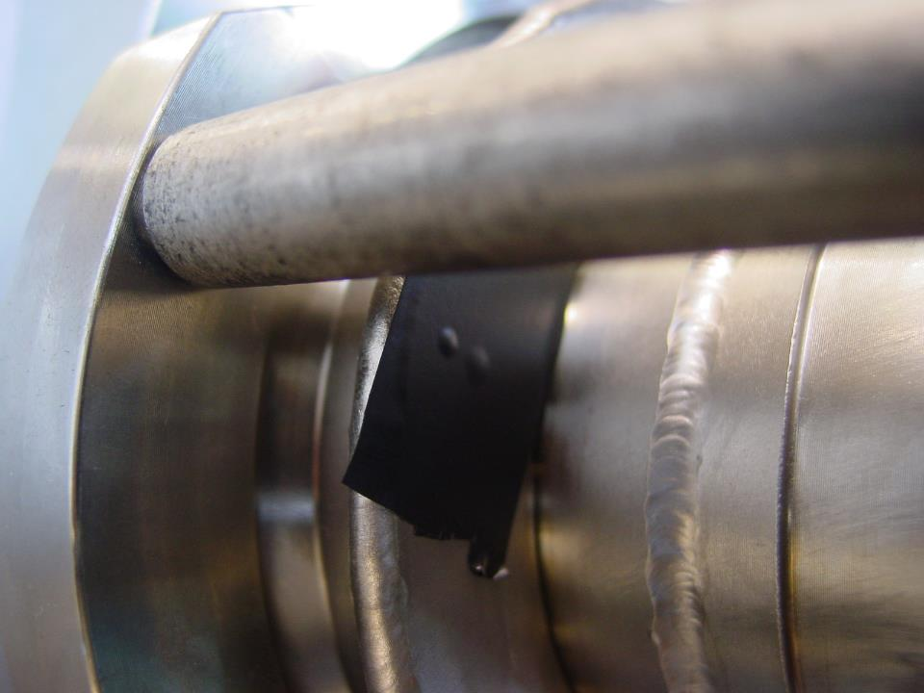
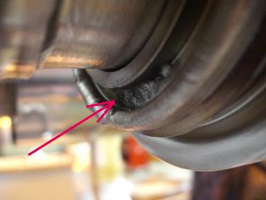
2.a Stainless steels, macroinclusions
10⁻⁵ torr l/s
courtesy of A. Poncet

Slide 24
2. Stainless steels, macroinclusions
Spec. N°1001_1.4429_316LN_blanks

Slide 25

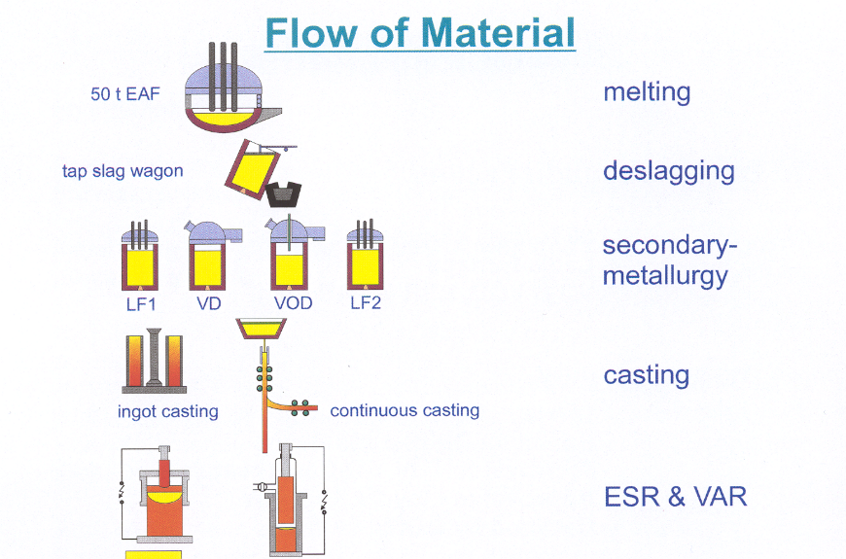
3. Steelmaking
C ↓
P ↓
(to a limited extent)
Electrical Arc Furnace: functions solely as a melt-down unit
Tapped as free as possible of slag into the ladle
Pure gaseous oxigen blown onto the metal; C down to 0.015 % before Cr losses begin; removal of Non-Metallic Inclusions (NMI)

Slide 26
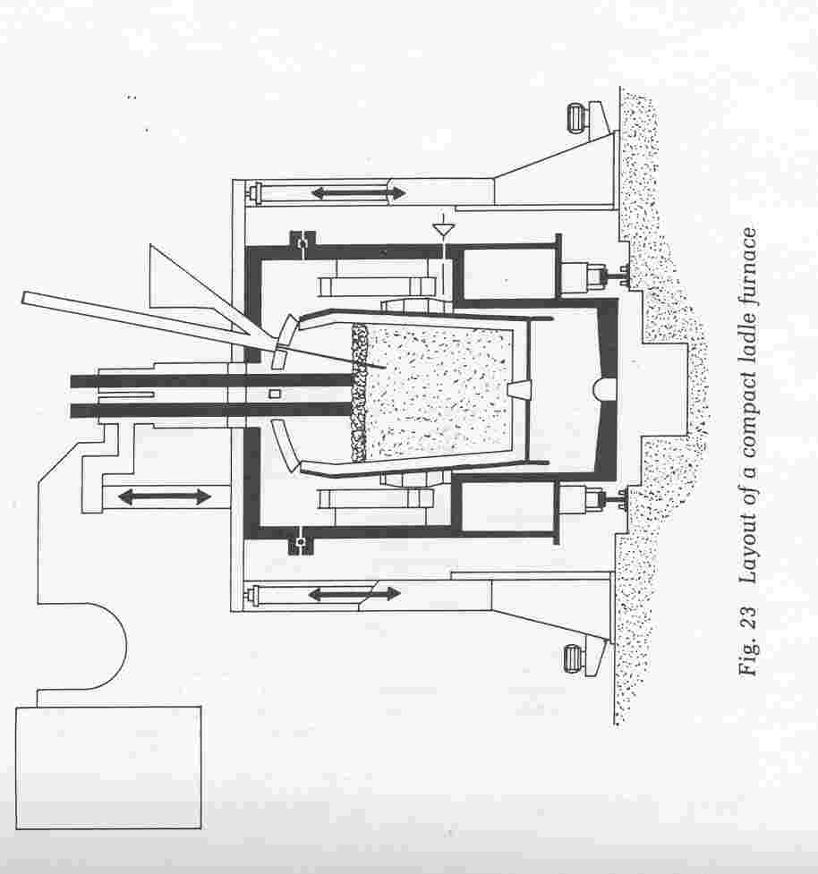
3. Steelmaking
A. Choudhury: Vacuum Metallurgy, ASM Int., USA, (1990)

Slide 27
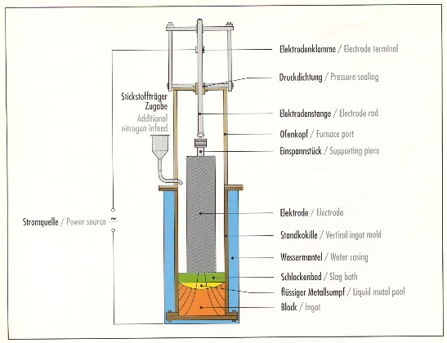
3. Steelmaking, stainless steel
Courtesy of Böhler Edelstahl

Slide 28
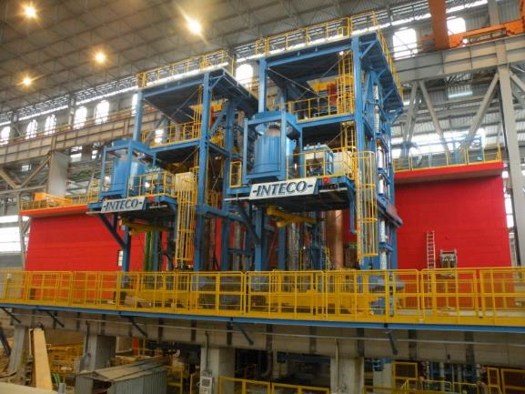
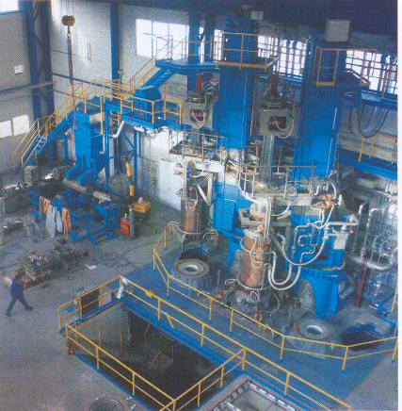
3. Steelmaking, stainless steel
Courtesy of Forgiatura Vienna /IT
Max. ingot weight/capacity: 250 t
Two furnace heads, electrode exchange, protective gas hood, fully coaxial design; biggest ESR plant worldwide in operation
The additional cost of ESR ingots is in the order of 1 EUR/kg (Minutes of the visit to Company A on 27 January 2015, ITER CS Lower Keyblock Material Progress Meeting)
Courtesy of Breitenfeld Edelstahl /AT.
Electrodes of diam. 500 mm, 750 mm, 1000 mm, 1200 mm, respectively, up to a length of 4 m and a weight of 35 t. Annual capacity is 250 000 t.

Slide 29
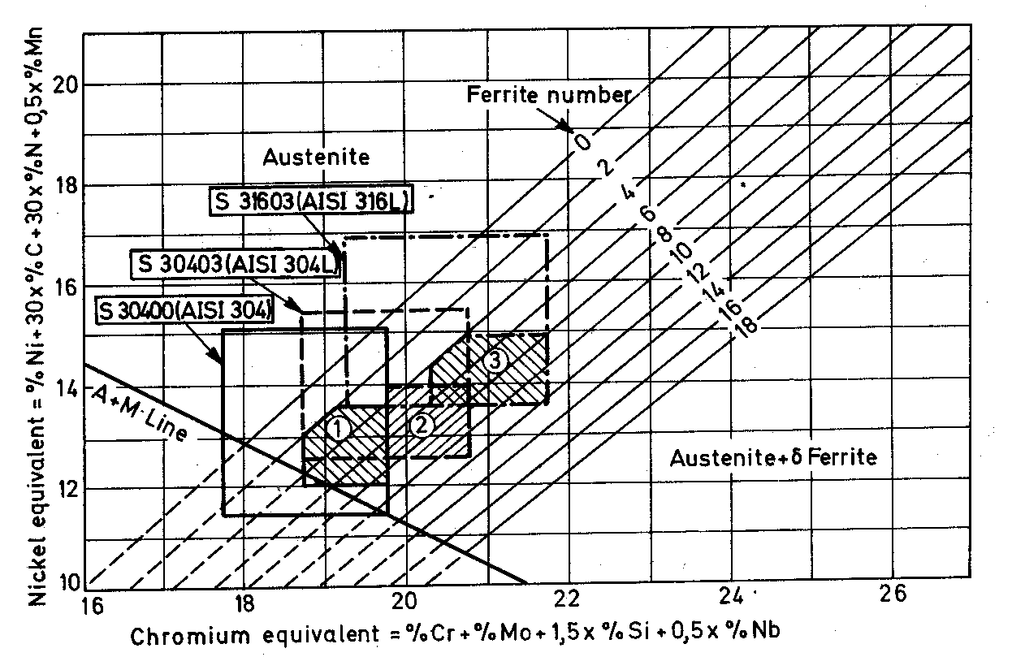
4. Stainless steels, precipitation and transformations, effect on properties
CERN 316LN
γ-stabilizers
CERN 316LN
δ-stabilizers

Slide 30
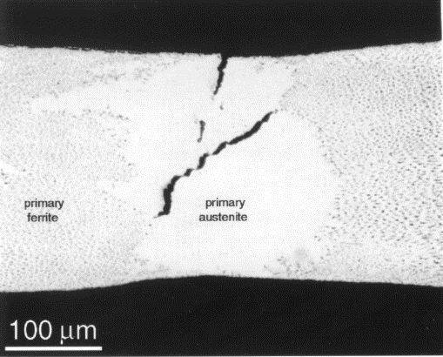
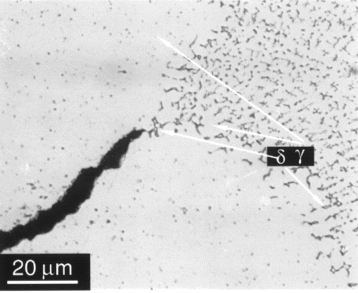
4. Stainless steels, precipitation
Korinko, P.S. & Malene, S.H. Practical Failure Analysis (2001) 1: 61. doi:10.1007/BF02715336
γ−primary solidification
316LN end-covers
δ−primary solidification
Schaeffler equivalent formulae for Cr_{eq} and Ni_{eq}
Cr_{eq} = Cr + 1.5Si + 1.37Mo
Ni_{eq} = Ni + 0.31Mn + 22C + 14.2N

Slide 31
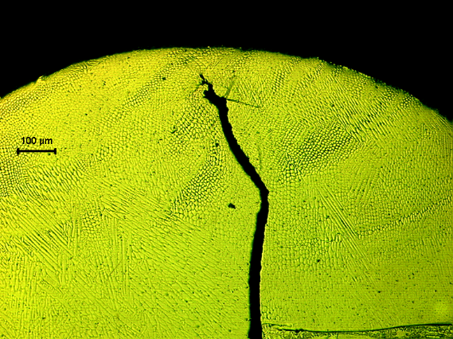
4. Stainless steels, , δ-ferrite and solidification cracking
304L vacuum appl.
(free machining)
"mumetal", Ni80Mo0.5Mn0.5;
S<0.0005; P=0.003 (!)

Slide 32
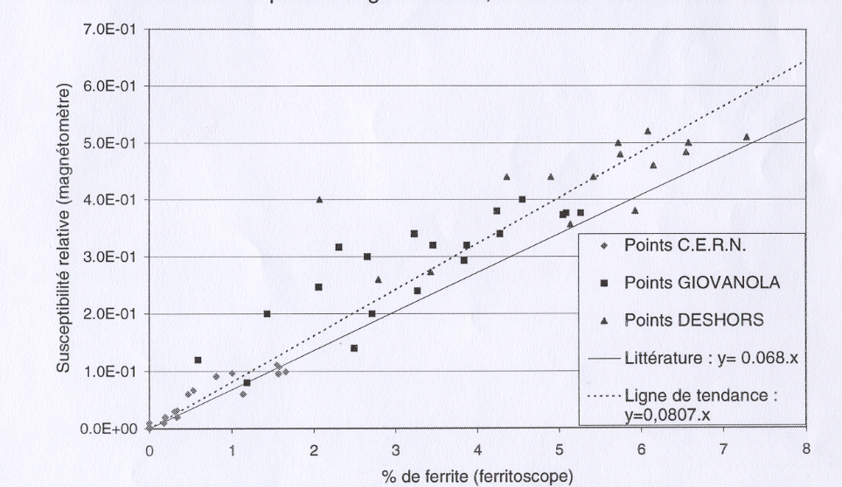
4. Stainless steels, δ-ferrite
S. Sgobba, C. Boudot, Matériaux et Techniques 95, n°11-12, p. 23 (1997)
µ_{r} ≤ 1.005; structure after solution annealing shall be completely austenitic

Slide 33
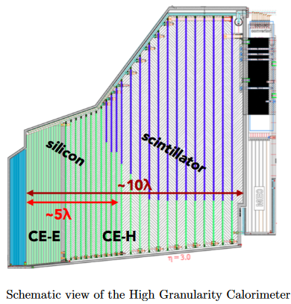

4. Case study, CMS HG-CAL detector
564 t of stainless steel required for the CE-H cassettes, thickness 45 ∼110 mm
The relative magnetic permeability in the bulk plate material shall not exceed 1.05 →
  Stringent control of ferrite content
  Stability against martensitic transformations

Slide 34
4. Case study, CMS HG-CAL detector
S. Sgobba and C. Boudot, Matériaux et Techniques 95, vol. 11-12, p. 23 (1997)
304L HGCAL: µ_{r} ≤ 1.05 strongly limits ferrite allowance
CERN 316LN: µ_{r} ≤ 1.005; structure after solution annealing shall be completely austenitic

Slide 35







Ingot or slab casting
From Arcelor Mittal – Industeel /FR-BE, ref. [1] & [2]
Courtesy of S. Moccia & M. Pentella
Rolled slab
Rolling of quarto plates
Solution annealing and finishing (descaling, grinding, skin pass rolling where applicable)
HGCAL 1:1 scale half disks

Slide 36
1.4307:
"Low alloy" 304L
1.4306:
"High alloy" 304L
Very clean heat, 143 ppm S+P
"High alloy" 1.4306
Low magnetic permeability, ceteris paribus:
  Stringent control of ferrite content (composition / steelmaking route)
  Stability against martensitic transformations (grade selection)
HGCAL 1:1 scale half disks

Slide 37


4. Martensitic transformations
Martensitic transformation (γ ⇒ α’),
a cause of loss of non-magnetism
in austenitic stainless steels
Low C SS ⇒ α’≅α
20 November 2020
EMAG training 2019
37

Slide 38
4. Martensitic transformations
Martensitic transformation have two forms:
  γ ⇒ α’, b.c.c., relevant for magnetic purposes
  γ ⇒ ε, h.c.p., not treated here
occur spontaneously on cooling and/or are strain induced under a given temperature

Slide 39

4. Martensitic transformations
R.P. Reed, A.F. Clark (1983)
Phase transformationd and their
influence on magnetic behaviour
T_{ms}, temperature of spontaneous γ ⇒ α’ martensitic transformation
T_{md}, temperature of strain induced γ ⇒ α’ martensitic transformation
20 November 2020
EMAG training 2019
39

Slide 40
4. Martensitic transformations
All coefficient are negative:
  good rule: "the more alloying elements one uses (and can afford!), the more stable the austenite will be"
  304L is the least stable among the alloys used at CERN.
  1.4306 generally specified by CERN and preferred to 1.4307 (general purpose)
  total stability requires a specific alloy selection or design, see the (HL-) LHC beam screen example
Transformation (T_{ms}, T_{md}, calculated):
  General purpose 304L (1.4307, X2CrNi18-9) ⇒ T_{ms} = 280 K, T_{md} = 346 K
  High alloy 304L (1.4306, X2CrNi19-11) ⇒ T_{ms} = 140 K, T_{md} = 320 K
  Prototype HG-CAL 304L (as above) ⇒ T_{ms} = 76 K, T_{md} = 305 K
  CERN store 316LN (1.4429, X2CrNiMoN17-13-3) ⇒ T_{ms} = n.a., T_{md} = 240 K
  Beam screen P506 grade ⇒ T_{ms} = n.a., T_{md} = 36 K

Slide 41


4. Martensitic transformations
a
b
Partially transformed austenite of an AISI 316L austenitic stainless steel sample strained 6.5% at 4.2 K. Martensite is concentrated in bands (under the white boundary in Fig. a), developing during tensile deformation. A detail of the austenite-martensite microstructure is shown in Fig. b (see also C. GARION, S. SGOBBA, B. SKOCZEN, Constitutive modelling and identification of parameters of the plastic strain-induced martensitic transformation in 316L stainless steel at cryogenic temperatures, International Journal of Plasticity, 22 (2006) 1234-1264)

Slide 42


4. Martensitic transformations
Quantitative assessment through EBSD techniques associated to SEM
Courtesy of E. García-Tabarés Valdivieso, P. Fernandez Pison, A. T. Pérez Fontenla, to be published

Slide 43
4. Martensitic transformations
Courtesy P. Fernandez Pison, to be published

Slide 44
5. Thermal treatments, sensitization, corrosion failures
Austenitic stainless steels to be furnished and preferentially used in their solution annealed condition
All standards (except for specific applications) impose furnishing in the solution annealed condition
Max. hardness also limited by relevant standards and specifications
Post-weld heat treatments generally not required
CERN specification, 316LN

Slide 45
5. Thermal treatments, sensitization, corrosion failures
316LN
316L
304L
Vacuum firing of components and subassemblies to effectively remove the dissolved gas load in cleaned and degreased parts
See also ⇒
CAS course on "Mechanical & Materials Engineering", P. Chiggiato, Vacuum

Slide 46

5. Thermal treatments, sensitization, corrosion failures
Alternative treatment at 650 °C
Handbook of stainless steels, D. Peckner, I.M. Bernstein. McGraw-Hill, 1977
Stress relieving:
Select temperature-time combinations outside the sensitization range
It can be made coincident with 950 °C vacuum firing treatment whenever possible
Avoid ranges of σ-phase precipitation specially for welded structures

Slide 47



5. Thermal treatments, sensitization, corrosion failures
EDMS 1095336
316LN ITER grade, TF jackets, extra low C (<0.015%) grade, aged 200 h at 650 °C, tensile tested at 7 K
See also ⇒
CAS course on "Mechanical & Materials Engineering", Klaus Peter Weiss, Mechanical testing
20/11/2020

Slide 48




5. Thermal treatments, sensitization, corrosion failures
Sensitization:
Loss of corrosion resistance (Cr depletion at GB)
Loss of ductility (specially at cryogenic temperatures), ductile-to-brittle transition onset
Check the effects of your treatment against ASTM A262
Sensitization: oxalic acid etching, ASTM A262, practice A (⇒E)

Slide 49
7. Conclusions
A stainless steel for an accelerator part is not a mere "chemical composition" or a designation
    specification
    steelmaking
    definition and extent of the controls
    certification
    price
Application of extensive “state of the art” NDT techniques
    stainless steels for vacuum applications 100 % examined during production and at reception
    advanced techniques such as X-ray computed tomography or Phased Array Ultrasonic Testing often applied to welds or PM parts
Low T and/or non-magnetism of components require special care
Corrosion environment during the whole life cycle of the parts
Advanced grades imply extensive prior R&D
Stainless steels
304L, general purpose ⇒ 3-3.5 EUR/kg
304L, vacuum/cryogenic application ⇒ 6 EUR/kg
316LN, as above ⇒ 11 EUR/kg (bars) to 32 EUR/kg (plates)
316LN, blanks ⇒ 50 (and up to above 100) EUR/kg
P506, 316L convolutions for bellows ⇒ 50-80 EUR/kg
Additive manufactured 316L ⇒ 65 EUR/kg (powder)

