Slide 1
Closing remarks

Slide 2
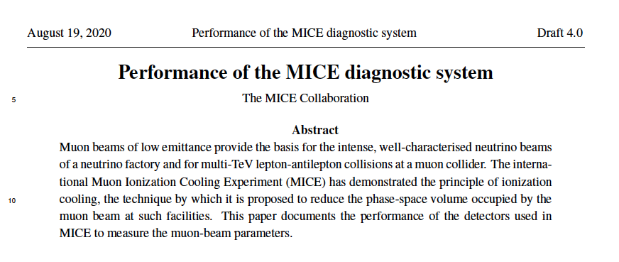
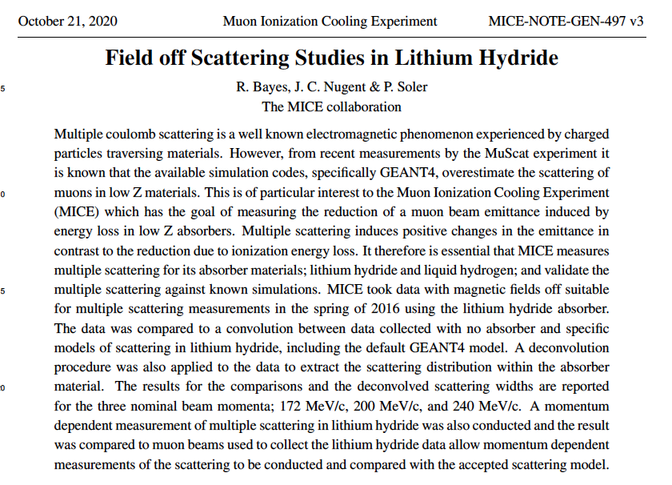
Papers

Slide 3
Flip-mode emittance evolution; PJ
Good progress:
  Convincing data/MC
  comparison
Issues:
  Systematic studies to
  accommodate data/MC
  differences

Slide 4
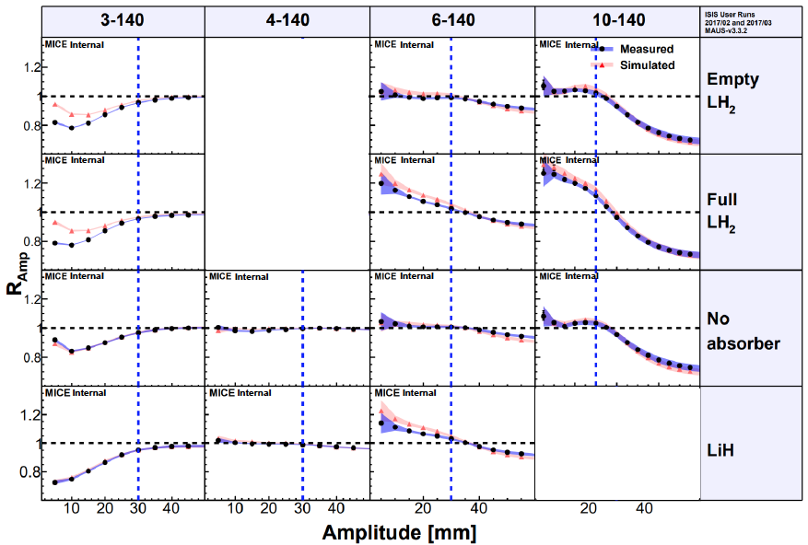
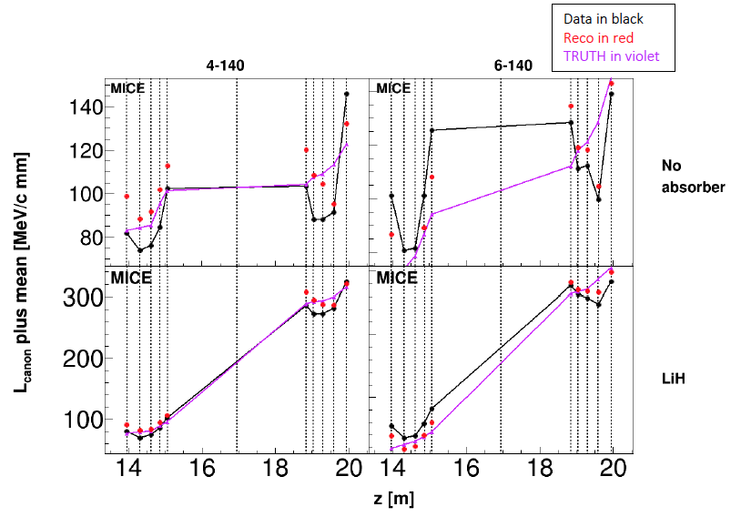
Emittance evolution, solenoid mode; TL
Good progress:
  Convincing data/MC
  comparison
  Canonical angular mmtm:
    Difficult analysis:
      Detail of field, reconstruction …
    But demonstration of gain of L_{canon}
Issues:
  Systematics:
    Probably both for full amplitude
    analysis and L_{canon}

Slide 5
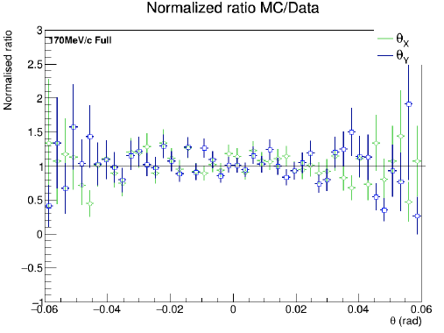
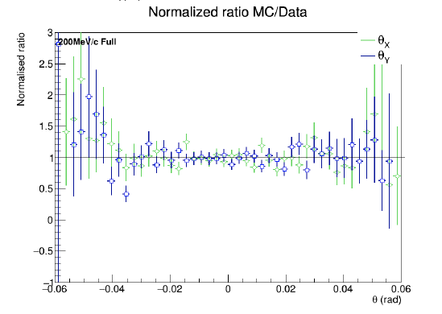
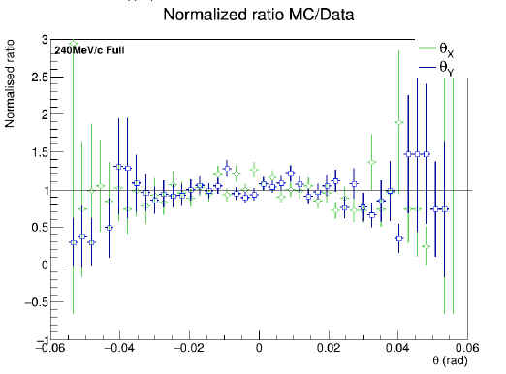
LH₂ scattering: GC
Good progress:
  Full analysis chain; data is generally well described by MC
Issues:
  Some issues in selection and data/MC comparison
  Unfolding and systematics

Slide 6
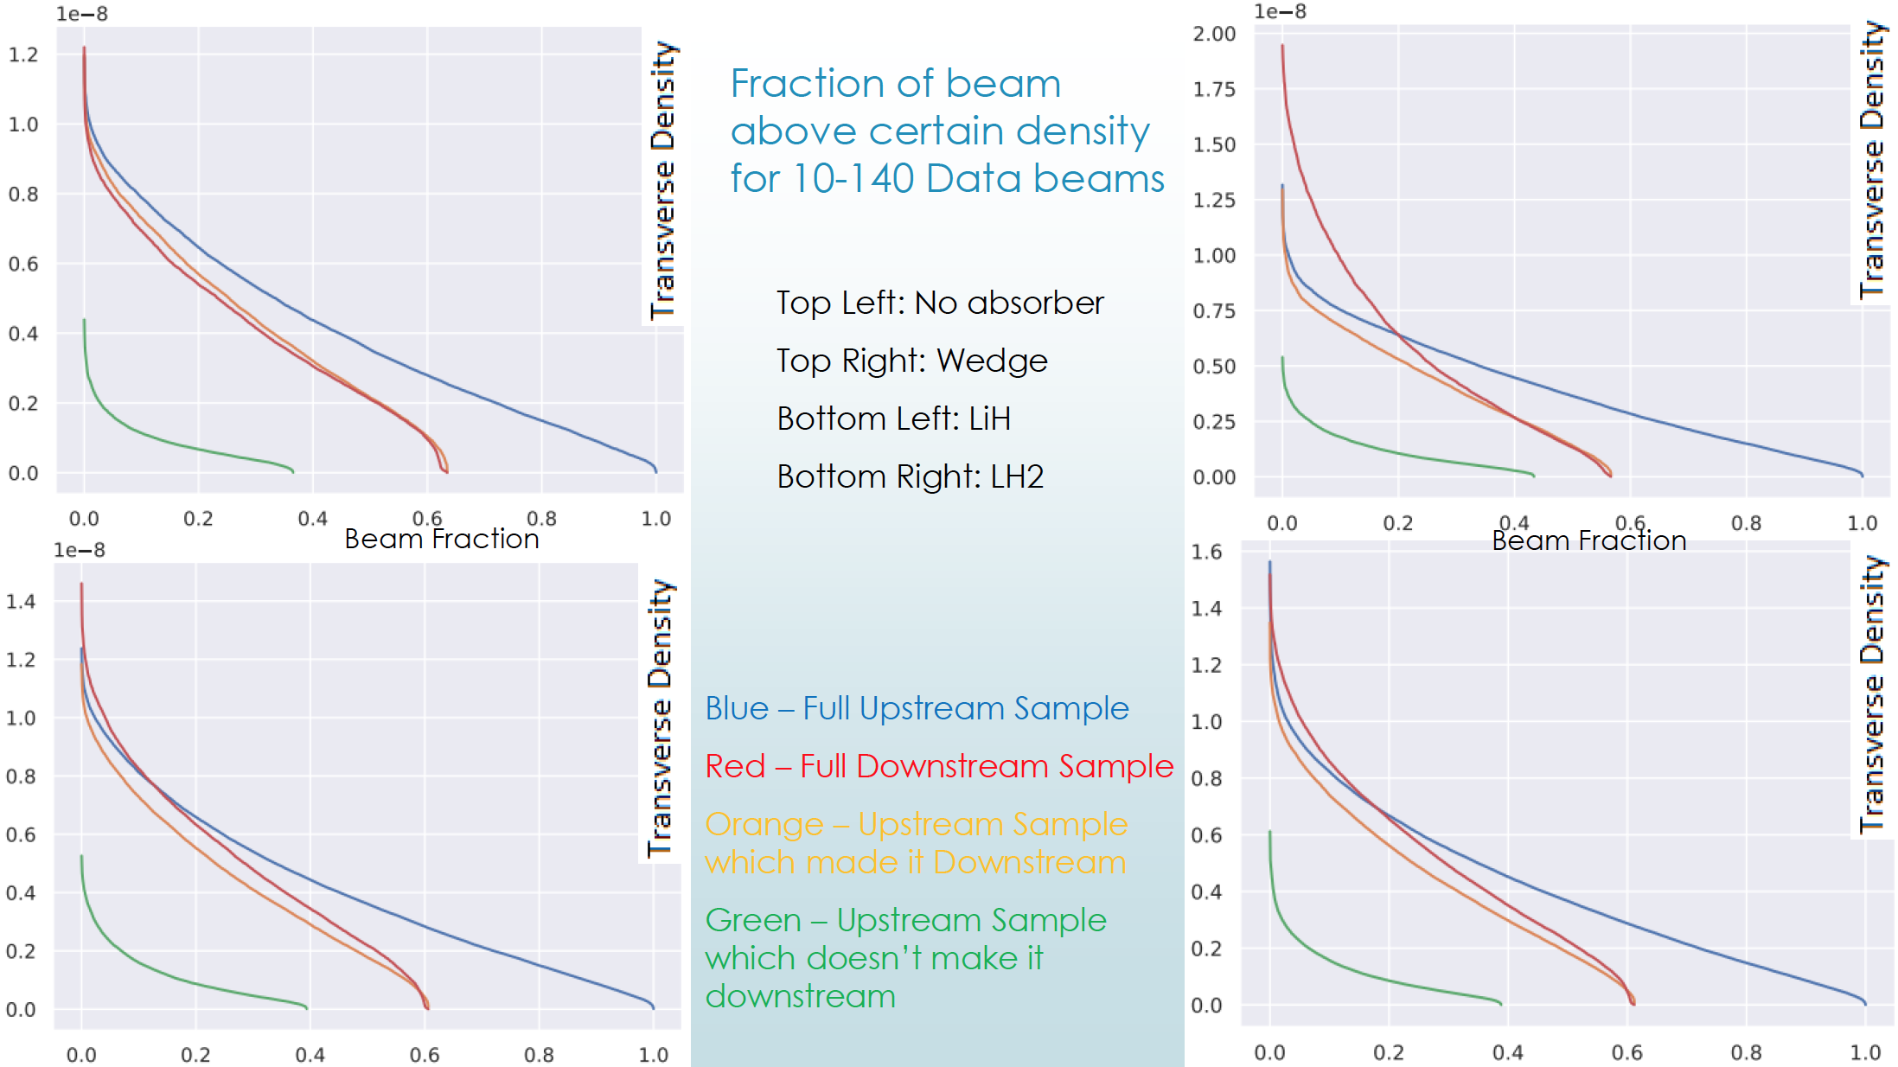
Emittance exchange: CB
Full density analysis chain
  Effects small, analysis subtle
Personal feeling:
  Need an accessible measure to demonstrate an effect exists

Slide 7
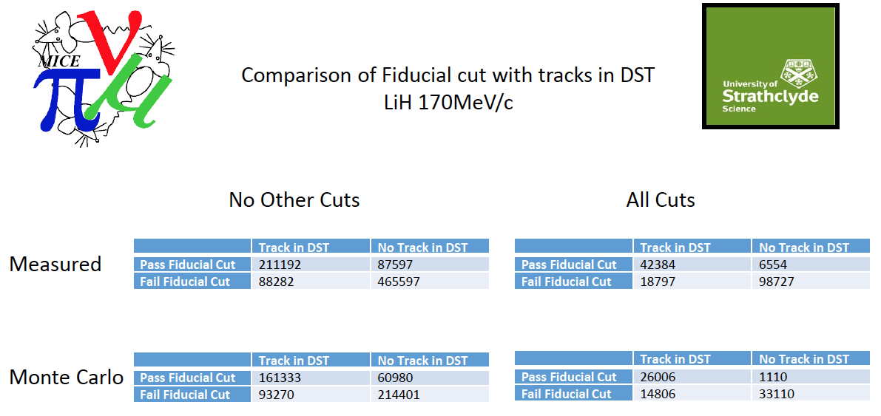
Field-on scattering: AY
Good progress on event selection and cut studies

Slide 8
Future meetings
2020:
  CM58 – offer to co-organise with iMC/nuSTORM
    March 2021
  CM59:
    October 2021
Analysis meetings:
  05Nov20
  19Nov29
Analysis workshop:
  17Dec20
Video conferences:
  03Dec20
  04Feb21
Muon collider cooling:
  12Nov20
  26Nov29
  10Dec20

Slide 9
Thanks to:
You all for joining, presenting and arguing!
See you at CM58 on ZOOM in Mar21

