Slide 1
Emittance Exchange in MICE
Craig Brown
Brunel University
22 October 2020

Slide 2
Today’s Menu
Emittance Exchange – What is it?
How to measure it – Emittance, Amplitude and Phase Space Density
  Covariance Matrix
  Missing Data - Transmission losses
  Transverse Phase Space Density, Amplitude and Emittance
  Liouville, Introducing Time and Longitudinal Density, Amplitude and Emittance
Recon Bias – TKU and TKD are different
  PT bias, PZ bias, Energy addition and a non-homogenous magnetic field
Magnetic field
  Potential sources of error
Conclusion

Slide 3
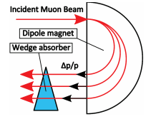
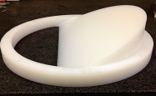
Aims
Demonstrate Emittance Exchange and Reverse Emittance Exchange in the Wedge using MICE data
Emittance Exchange can be demonstrated by looking at the change in phase space density of the particle selection before and after having passed through a Wedge absorber
Emittance Exchange is shown by a decreased transverse phase space density (x, px, y, py) and increased longitudinal phase space density (z, pz), (and vice versa for Reverse Emittance Exchange)
Can use a number of techniques to calculate phase space density: KDE, KNN, Voronoi Tessellations, etc.
MICE beam only has a small natural dispersion → Use beam reweighing techniques to select beams with desired dispersion

Slide 4
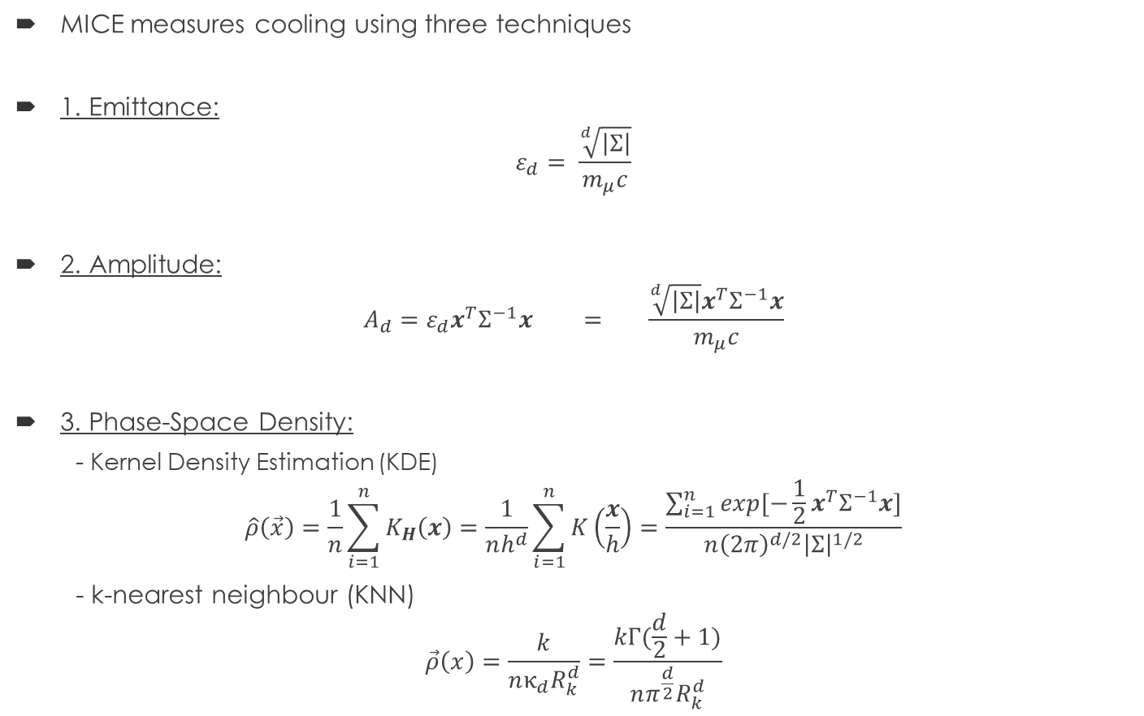
MICE – 3 Cooling measurements
MICE measures cooling using three techniques
1. Emittance:
$$ε_{d}= \frac{\sqrt[d]{\left|Σ\right|}}{m_{μ}c}$$
2. Amplitude:
$$A_{d}=ε_{d}x^{T}Σ^{−1}x = \frac{\sqrt[d]{\left|Σ\right|}x^{T}Σ^{−1}x}{m_{μ}c}$$
3. Phase-Space Density:
  - Kernel Density Estimation (KDE)
$$\hat{ρ}\left(\vec{x}\right)=\frac{1}{n}\sum_{i=1}^{n}{K_{H}\left(x\right)}=\frac{1}{nh^{d}}\sum_{i=1}^{n}{K\left(\frac{x}{h}\right)}=\frac{\sum_{i=1}^{n}{exp[−\frac{1}{2}x^{T}Σ^{−1}x]}}{n{\left(2π\right)}^{d/2}{\left|Σ\right|}^{1/2}}$$
- k-nearest neighbour (KNN)
$$\vec{ρ}\left(x\right)=\frac{k}{nκ_{d}R_{k}^{d}}=\frac{kΓ(\frac{d}{2}+1)}{nπ^{\frac{d}{2}}R_{k}^{d}}$$

Slide 5
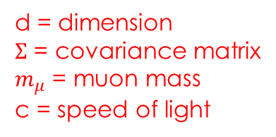

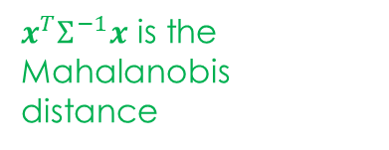
MICE – 3 Cooling measurements
MICE measures cooling using three techniques
1. Emittance:
$$ε_{d}= \frac{\sqrt[d]{\left|Σ\right|}}{m_{μ}c}$$
2. Amplitude:
$$A_{d}=ε_{d}x^{T}Σ^{−1}x = \frac{\sqrt[d]{\left|Σ\right|}x^{T}Σ^{−1}x}{m_{μ}c}$$
3. Phase-Space Density:
  - Kernel Density Estimation (KDE)
$$\hat{ρ}\left(\vec{x}\right)=\frac{1}{n}\sum_{i=1}^{n}{K_{H}\left(x\right)}=\frac{1}{nh^{d}}\sum_{i=1}^{n}{K\left(\frac{x}{h}\right)}=\frac{\sum_{i=1}^{n}{exp[−\frac{1}{2}x^{T}Σ^{−1}x]}}{n{\left(2π\right)}^{d/2}{\left|Σ\right|}^{1/2}}$$
- k-nearest neighbour (KNN)
$$\vec{ρ}\left(x\right)=\frac{k}{nκ_{d}R_{k}^{d}}=\frac{kΓ(\frac{d}{2}+1)}{nπ^{\frac{d}{2}}R_{k}^{d}}$$
d = dimension
$Σ$ = covariance matrix
$m_{μ}$ = muon mass
c = speed of light
$x^{T}Σ^{−1}x$ is the Mahalanobis distance
K = Kernel Choice
h = Kernel bandwidth
n = no. pf particles
Last part shows a Gaussian kernel
k = no. of neighbours
$R_{k}^{d}$ = Euclidean distance
$κ_{d}$ = Volume of a unit d-ball
$Γ(\frac{d}{2}+1)$ = Euler-Gamma function

Slide 6
MICE – 3 Cooling measurements
MICE measures cooling using three techniques
1. Emittance:
$$ε_{d}= \frac{\sqrt[d]{\left|Σ\right|}}{m_{μ}c}$$
2. Amplitude:
$$A_{d}=ε_{d}x^{T}Σ^{−1}x = \frac{\sqrt[d]{\left|Σ\right|}x^{T}Σ^{−1}x}{m_{μ}c}$$
3. Phase-Space Density:
  - Kernel Density Estimation (KDE)
$$\hat{ρ}\left(\vec{x}\right)=\frac{1}{n}\sum_{i=1}^{n}{K_{H}\left(x\right)}=\frac{1}{nh^{d}}\sum_{i=1}^{n}{K\left(\frac{x}{h}\right)}=\frac{\sum_{i=1}^{n}{exp[−\frac{1}{2}x^{T}Σ^{−1}x]}}{n{\left(2π\right)}^{d/2}{\left|Σ\right|}^{1/2}}$$
- k-nearest neighbour (KNN)
$$\vec{ρ}\left(x\right)=\frac{k}{nκ_{d}R_{k}^{d}}=\frac{kΓ(\frac{d}{2}+1)}{nπ^{\frac{d}{2}}R_{k}^{d}}$$
What do all 3 share?
Dependence on the Covariance Matrix

Slide 7
Covariance Matrix
Covariance Matrix representation of the distribution of your particles in your beam
In linear optics (e.g. rotations, translations) the determinant of the covariance matrix remains constant, hence emittance, amplitude and density remain constant.
In linear optics the transverse and longitudinal planes can be decoupled in a solenoid (where we measure)
Hence we can look at the transverse planes separately and thus look at the transverse and longitudinal emittance, amplitude and density
Problems for some of these techniques arise when there are non-linear effects (e.g. emittance growth already extensively seen) or misalignments
Or when there are transmission losses – This results in a downstream selection bias as we are now comparing different particle distribution functions.
If we are looking at different particle distribution functions, then we will have changing covariance matrices (determinant is no longer constant)

Slide 8
Missing Data - Missing particles
Missing Data can be classified in three different ways
  - Missing Completely At Random (MCAR)
    Particle Distribution Functions remain the same
    E.g. 1000 vs 2000 coin tosses
  - Missing At Random (MAR)
    Particle Distribution Functions change, but can be corrected for
    E.g. Sensor defect. 10 sensors measure the number of cars passing along a road, but one sensor only makes readings 95% of the time
  - Missing Not At Random (MNAR)
    Data is missing due to the experiment
    Common problem in medicine e.g. COVID-19 death rate with low testing
    In MICE data is MNAR due to aperture of the MICE beamline, and the reasons for particles to escape the beamline, e.g. magnetic field, scattering

Slide 9
MICE – transmission losses
Transmission losses leads to survivorship bias
  We only measure particles downstream which remain within experiment aperture
  To a certain extent upstream distribution is arbitrary (non-unique) as long as it contains the distribution which makes it downstream
In MICE so far, the full Upstream sample is compared to the full downstream sample with some corrections made (e.g. normalize for the number of events)
Does this work? Simple check:
Split the full upstream sample into the sample which made it downstream and into the sample which didn’t make it downstream
Calculate the density, amplitude and emittance and see how it compares to full upstream sample
Will show soon, but first what should the distribution look like

Slide 10
Phase-Space Density
(Uniform Distribution)
What should a Phase-Space Density plot look like (sample size = 100,000)?
For a uniform distribution (e.g. a solid piece of ice):
  In 1D all particles should have approximately the same peak density, except the edge of the distribution.
  At the edge of the distribution, the bounding volume the density is calculated over has free space within that volume.
  In 2D (e.g. a square), for the same sample size, more particles are now at the edge of the distribution, and so fewer particles are found at the peak density.
  In higher dimensions, more of the particles become edge or bounding particles of the distribution, and thus more particles shift away from the peak density
  The shape of the phase-space density plot is now determined by both the number of particles (Curse of dimensionality) and shape of your uniform volume (e.g. line -> square -> cube, etc., or line -> circle -> sphere, etc.)

Slide 11
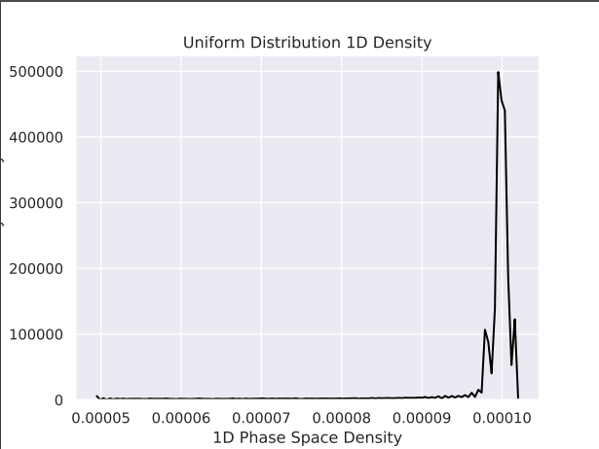
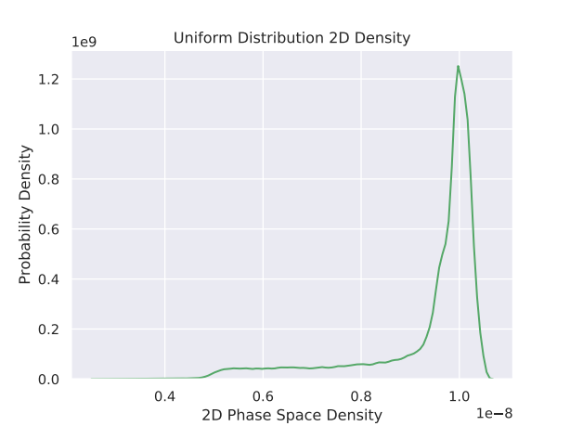
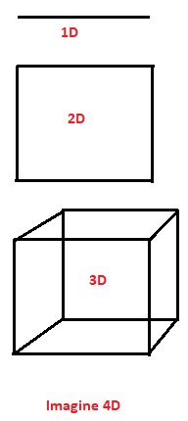
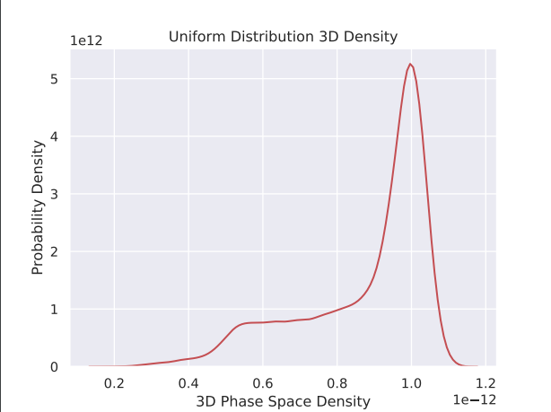
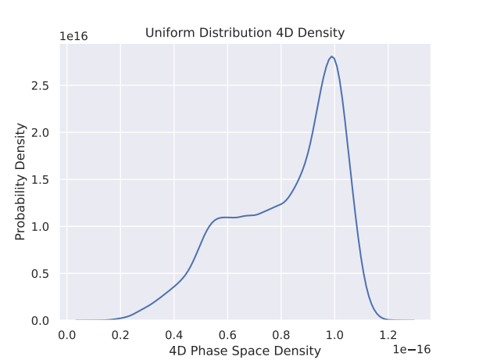

Slide 12
Phase-Space Density
(Gaussian Distribution)
What should a Phase-Space Density plot look like (sample size = 100,000)?
For a Gaussian distribution (e.g. gas leak, density changes further from leak):
  In 1D, most particles are found at centre of the distribution
  Away from the centre the particles have to go a further distance to find the same number of neighbours, and so are at a lower density
  In 2D, each co-ordinate contributes individually (i.e each point in a 1D Gaussian is represented by another 1D Gaussian perpendicular to that point).
  The combination of the two results in each probability becoming equally likely
  In the n-th dimensions each point from the (n-1) dimension can again be represented by another Gaussian perpendicular to that point.
  For n = 3 or higher, it becomes more likely that at least 1 dimension is at a low density, and thus it becomes more and more likely for the particle overall to be found at a low density

Slide 13
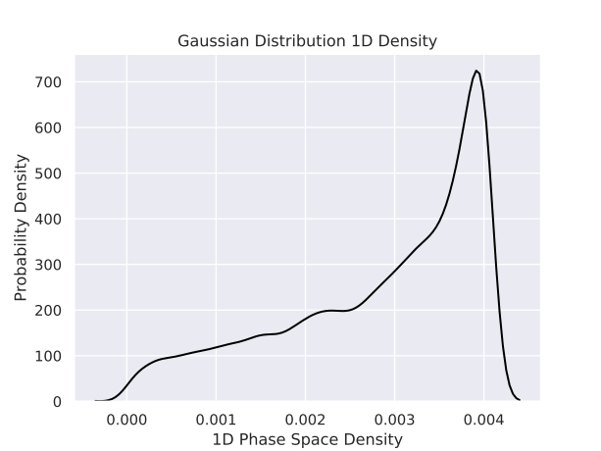
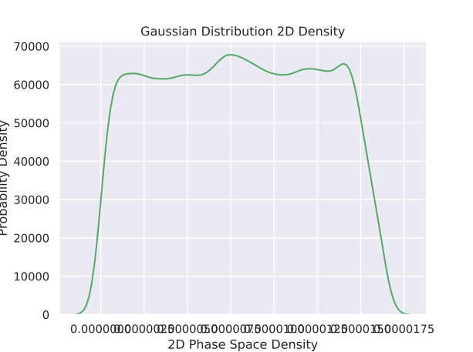
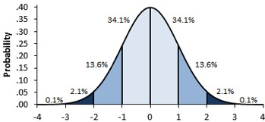
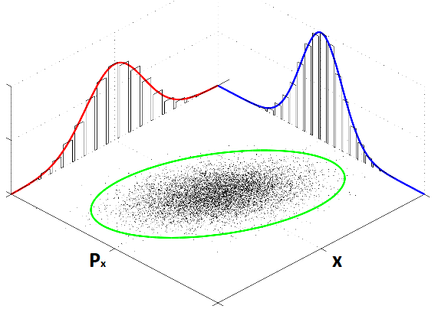
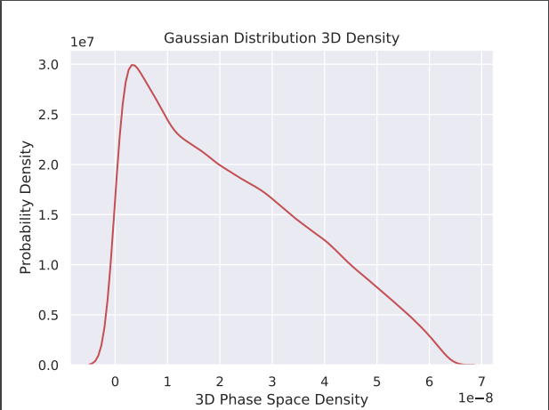
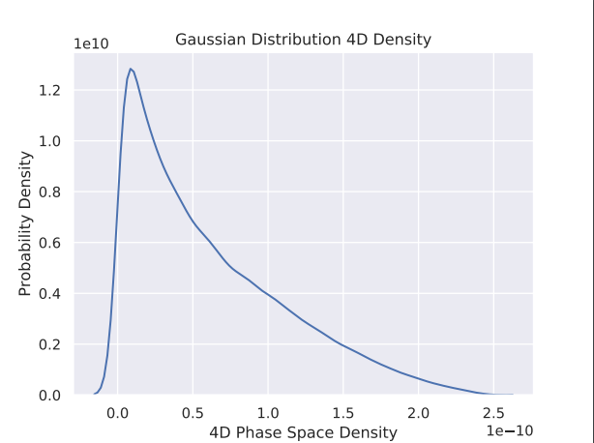
1D Gaussian
2D Gaussian
Imagine
3D and 4D

Slide 14
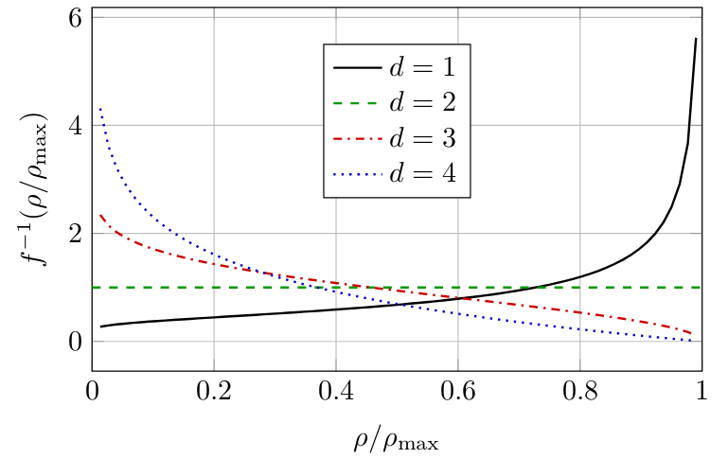
Phase-Space Density
(Gaussian Distribution)
Below, nice plot from Francois in limit n -> infinity
It shows the expected Density for a Gaussian sample in each dimension normalized to the maximum density. As the dimension increases, particles more likely be found at a low phase space density

Slide 15
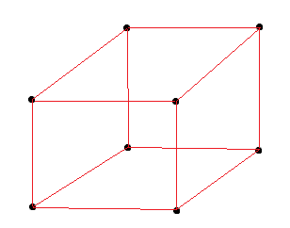
Transmission effects – extreme example
Imagine phase space distribution given by 8 points arranged in a cube separated by a 1 unit distance, giving a 1 unit volume.
The system is sent through a magnetic system with no dissipative forces. The points may have changed location, but the 1 unit volume is preserved.

Slide 16
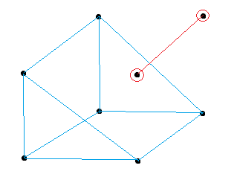
Transmission effects – extreme example
The eight particles are again put through a magnetic system which has an aperture (acts as a dissipative force), resulting in a loss of two particles.
The volume of the remaining 6 particles is 0.5 unit volume.
If one were to normalize the downstream sample by the sample size, one would artificially increase the density (which is wrong). For transmission losses, the change in particle distribution is important.

Slide 17
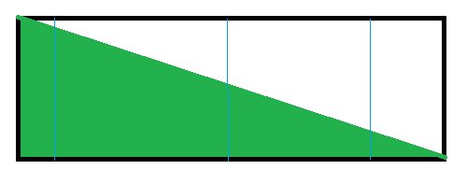
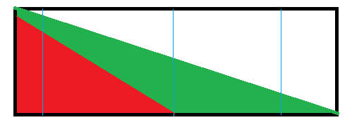
“Just use number of particles at core of beam” -
What does Transmission loss mean
Imagine we now have a non-uniform distribution (e.g. gas leak). It fills the black box and is represented by the green distribution
The density we measure depends on which volume we look at.
The density we measure between 0 and 2 will be different from that between 0 and 4
Our gas leak detection system is not efficient and can only measure the red distribution.
In our phase-phase calculation our bounding box would only be given by the volume between 0 and 2 (as we don’t see particles beyond 2)
We also can’t scale our red distribution by the number of particles as it doesn’t represent the parent distribution anymore
MICE loses some particles at the core of the beam. The remaining beam core may not share the beam core of the parent distribution – not comparing like with like
0
1
2
3
4
0
1
2
3
4

Slide 18
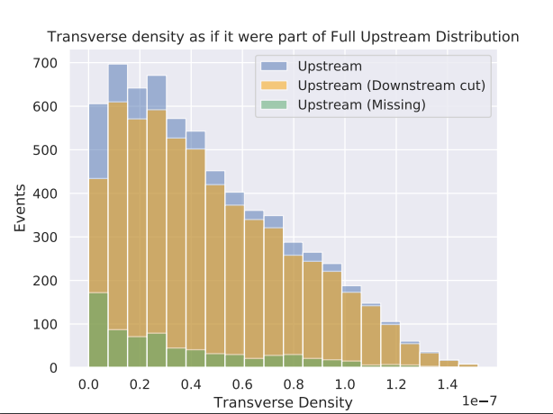
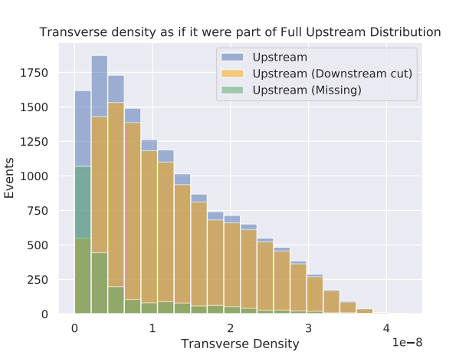
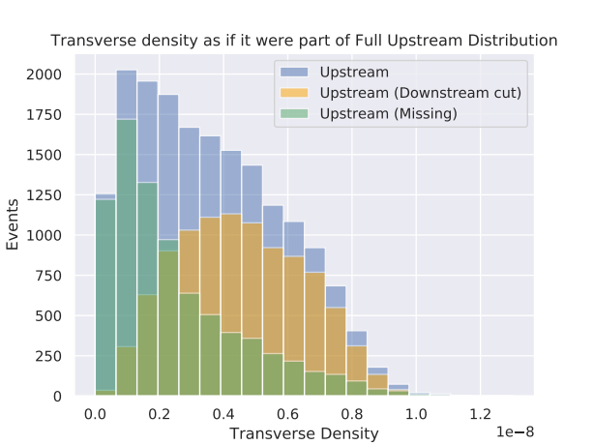
Transverse densities as if they were part of Upstream Distribution making it to TKD or not (i.e. missing) – MC Recon
3-140 No Absorber
Top right: 3-140 No Absorber
Bottom left: 6-140 No Absorber
Bottom right: 10-140 No Absorber
Small numbers go missing at beam core
Note: beam core is at high density
6-140 No Absorber
10-140 No Absorber

Slide 19
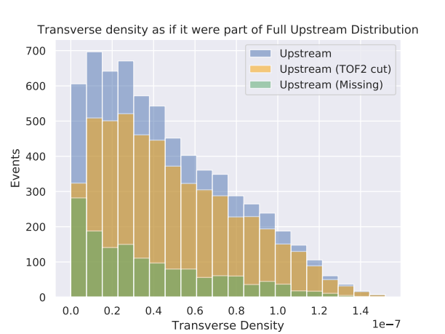
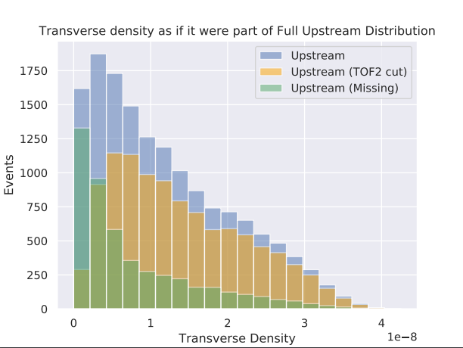
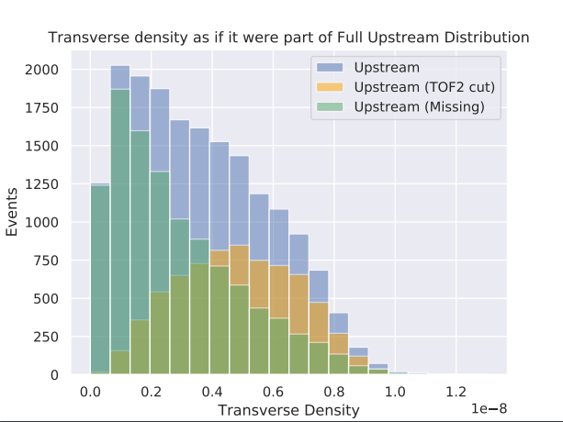
Transverse densities as if they were part of Upstream Distribution making it to TOF2 or not (i.e. missing) – MC Recon
3-140 No Absorber
Wedge Analysis requires TOF2
TOF2 is even stricter cut than TKD
More missing particles, even at core
6-140 No Absorber
10-140 No Absorber

Slide 20
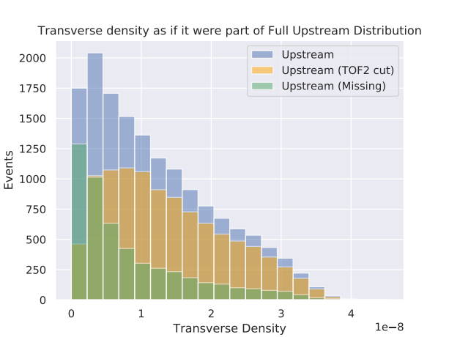
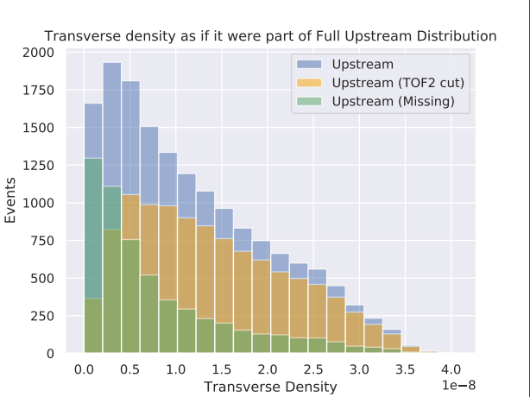
6-140 Lithium Hydride
Transverse densities as if they were part of Upstream Distribution making it to TOF2 or not (i.e. missing) – MC Recon
Further particles will not be detected downstream (i.e. missing from particle distribution function) when the beam encounters an absorber
Downstream we only have the remaining distribution
We don’t know what volume the beam would occupy if it had full transmission
We can only calculate the density for the remaining distribution
6-140 Wedge

Slide 21
Transverse densities as if they were part of Upstream Distribution making it to TOF2 or not (i.e. missing) – MC Recon
3-140 No Absorber
Wedge Analysis requires TOF2
TOF2 is even stricter cut than TKD
More missing particles, even at core
6-140 No Absorber
10-140 No Absorber

Slide 22
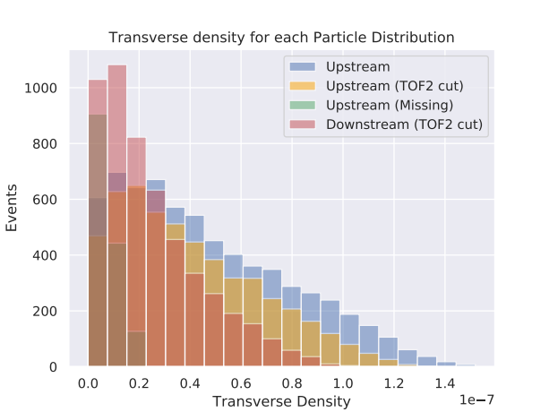
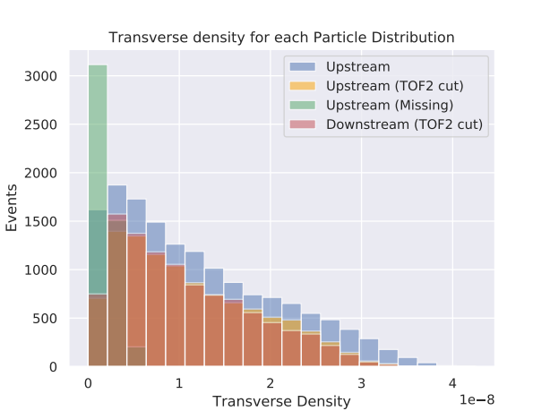
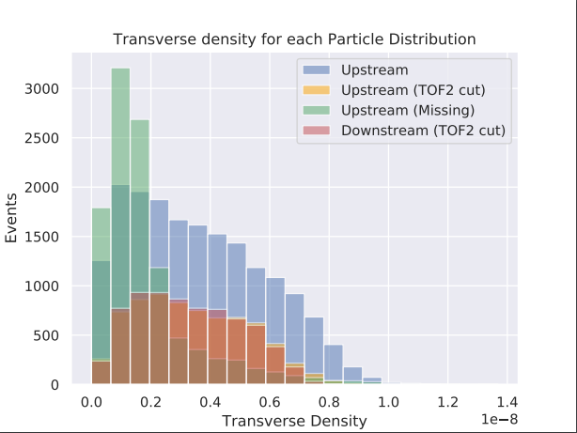
Transvers densities calculated over each measured distribution
3-140 No Absorber
When the Upstream sample (blue) is separated into the sample which makes it downstream (yellow) and the sample which doesn’t (green) and the density is calculated for each, their sum doesn’t result in the original distribution
This means there is no simple scaling to compare the full Upstream sample (blue) with the Downstream sample (red)
We can only compare the yellow and red samples noting it is biased by survivorship, unless we can apply an appropriate correction
6-140 No Absorber
10-140 No Absorber

Slide 23
Biased Cooling
Cooling can be shown in a number of different ways
One is to through cumulative plots showing what fraction of the beam is above a certain density
If the downstream line is above the upstream line it shows cooling as the phase space density has increased.
The opposite is the case for heating
It is highly affected by transmission losses

Slide 24
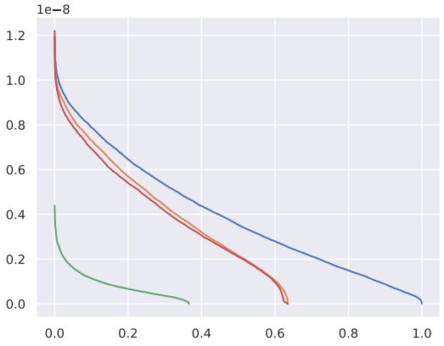
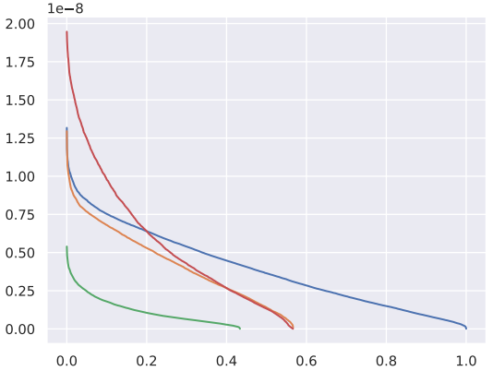
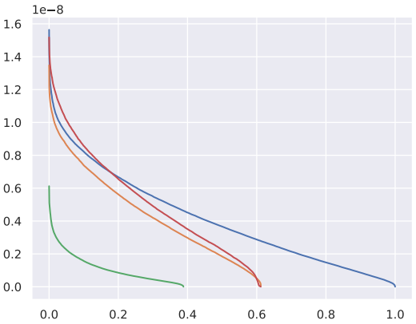
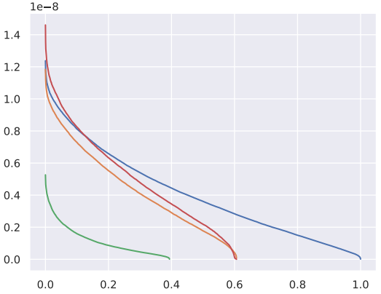
Fraction of beam above certain density for 10-140 Data beams
Top Left: No absorber
Top Right: Wedge
Bottom Left: LiH
Bottom Right: LH2
Blue – Full Upstream Sample
Red – Full Downstream Sample
Orange – Upstream Sample which made it Downstream
Green – Upstream Sample which doesn’t make it downstream
Beam Fraction
Beam Fraction

Slide 25
Biased Cooling
Another way to show cooling is to take the ratio of the fraction of the upstream sample which makes it downstream to the downstream sample. This should remain constant across the whole fraction of the beam for the symmetric absorber cases. For the wedge the ratio will be proportional to the thickness traversed
It is biased however as it does not contain the full beam
Particles are eliminated by the absorber, and some particles make it downstream because of the absorber

Slide 26
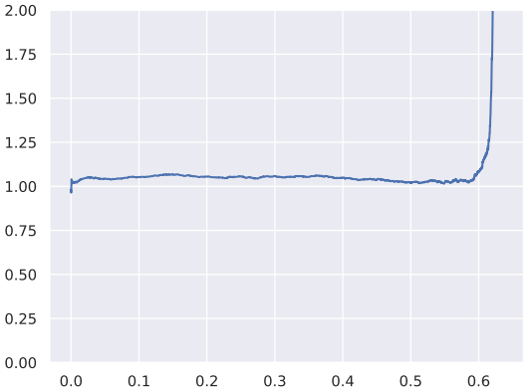
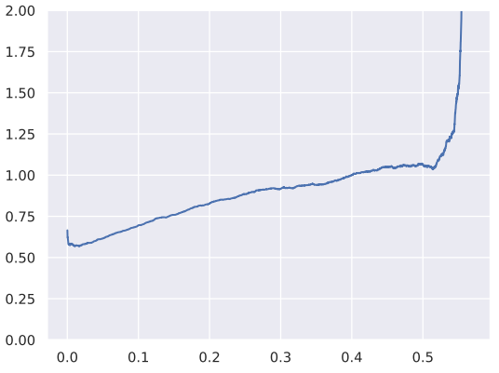
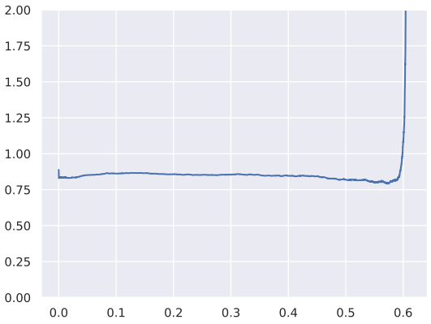
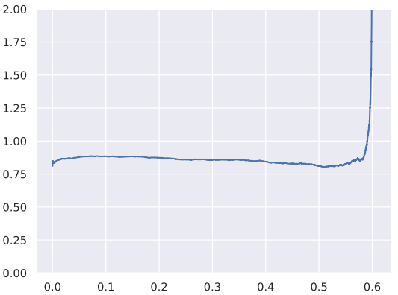
Ratio of the Downstream density to the Upstream density which makes it downstream
10-140 Data
Top Left: No absorber
Top Right: Wedge
Bottom Left: LiH
Bottom Right: LH2
Beam Fraction
Beam Fraction
Ratio above one indicates heating while a ratio below one indicates cooling.
Transmission limits the beam to approximately 60% of the full upstream sample.
The min and max are limited by low sample size and scraping respectively

Slide 27
Amplitude
Seen particles lost at core of beam for Phase-Space Density
Will show particles at core of beam are also lost for Amplitude
What to expect:
MICE beam is approximately Gaussian
Amplitude distribution should follow Chi-squared distribution with number of degrees of freedom equal to the number of dimensions

Slide 28
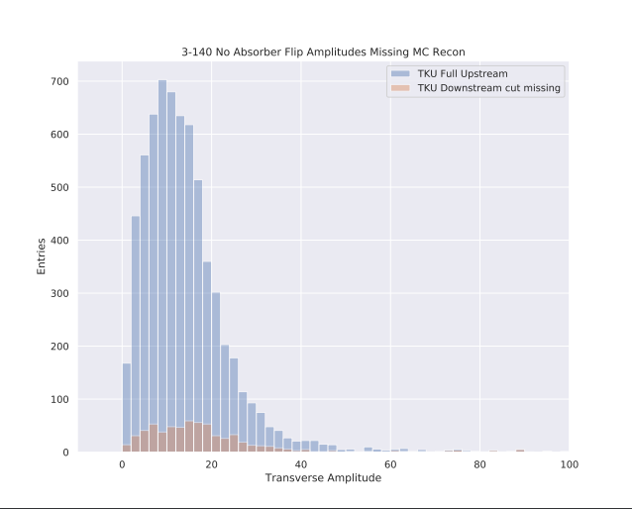
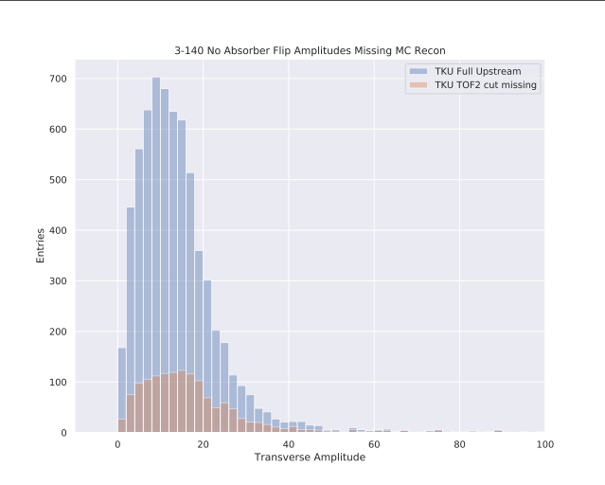
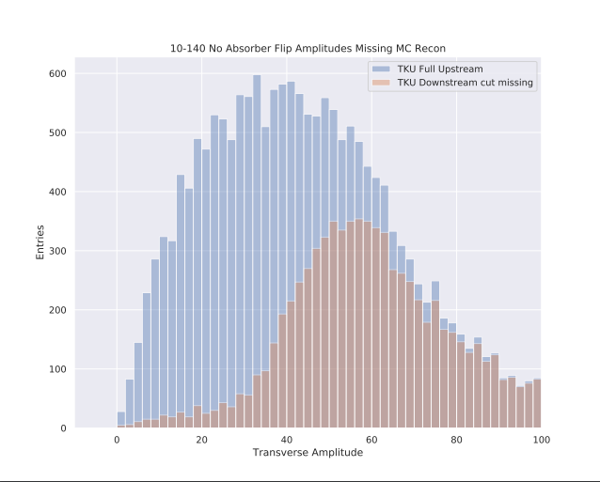
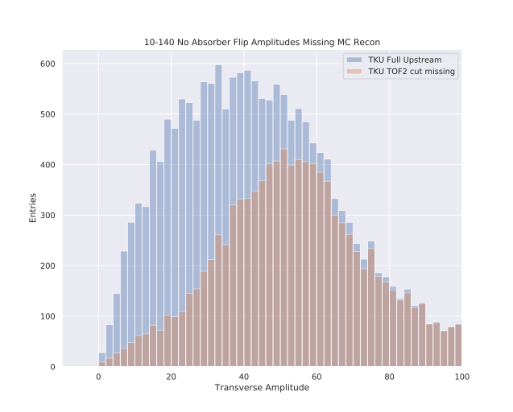
Transverse Amplitude
TOF2 requirement results in more particles being lost
Particles at beam core are also lost

Slide 29
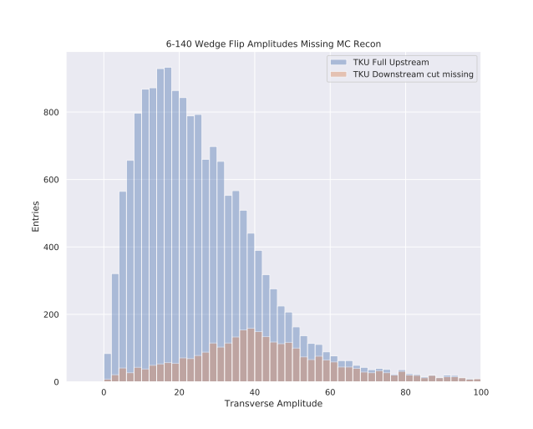
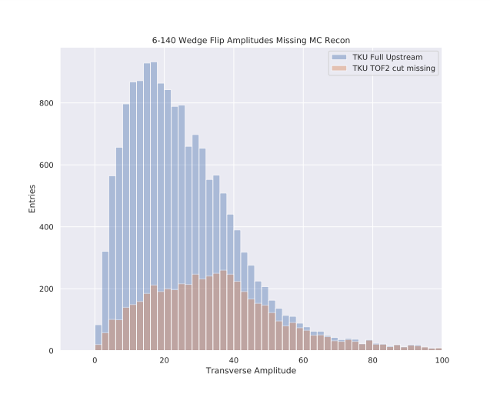
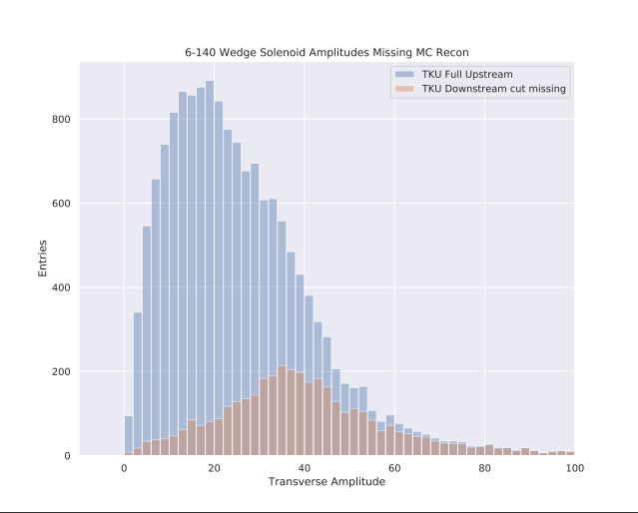
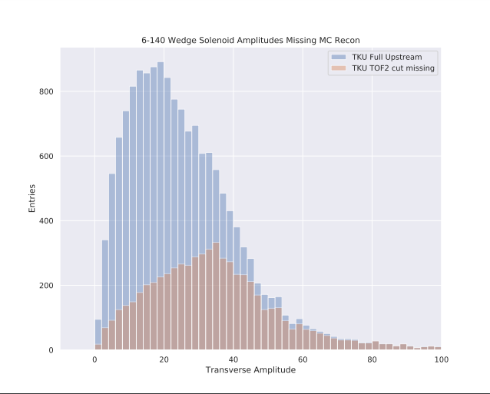
Transverse Amplitude
Missingness depends both on absorber used and field setting

Slide 30
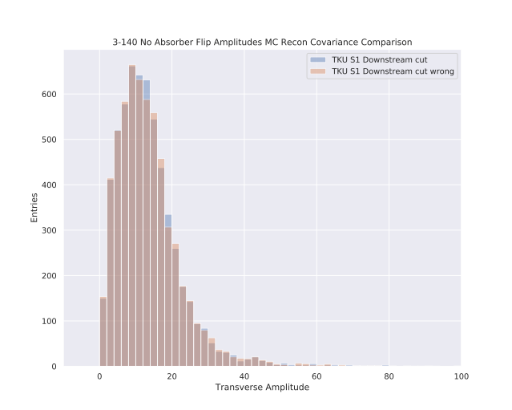



Amplitudes
Selection bias also affects Amplitude calculation
Amplitudes at TKU have been calculated using the covariance matrix of the sample which makes it downstream (blue) and using the full Upstream sample (red)
There is some small variation and thus the amplitude is affected by the input particle distribution

Slide 31



Cumulative Amplitude Plots
If there are only small variations, does it even matter? Maybe it is just noise
The cumulative plots also show only some small variation, and mainly at the higher input emittance beams.
The sampled beam calculation is slightly cooler than that calculated by the full upstream sample
The cooling performance may be slightly biased (in this case underestimated), although it mainly tells that the input distribution does have some influence

Slide 32


Cumulative Amplitude Plots
The variation seen for the Upstream sample using the sampled covariance matrix and the full upstream matrix may look small, but then again the expected cooling performance of Lithium Hydride seen in the Cumulative Amplitude plots is also small

Slide 33

Amplitude Correction in MICE
MICE currently uses an algorithm to correct the amplitudes
From Chris’ note, the algorithm follows:
    While events in sample {
      Calculate amplitudes
      Remove highest amplitude event
      Update covariance matrix
    }
From Francois’ thesis this is written as:
$${\left\langle x_{α}\right\rangle }_{n−1}=\frac{1}{n−1}\left(n{\left\langle x_{α}\right\rangle }_{n}−x_{α}^{n}\right)$$
$$Σ_{αβ}^{n−1}=\frac{n−1}{n−2}Σ_{αβ}^{n}−\frac{n}{n−1}\left(x_{α}^{n}−{\left\langle x_{α}\right\rangle }_{n}\right)\left(x_{β}^{n}−{\left\langle x_{β}\right\rangle }_{n}\right)$$
$$with α,β=x,y,p_{x},p_{y}$$
The idea of the algorithm is to constantly update the amplitudes so that the cores of the Full Upstream and Downstream sample can be compared

Slide 34


Amplitude Correction in MICE
The idea of the algorithm is to constantly update the amplitudes so that the cores of the Full Upstream and Downstream sample can be compared
It is an algorithm, which was tested by Francois on the left on two different input distributions.
However there is no mathematical proof that this is valid (I mention this because of the incorrect MICE normalisation for the phase-space density)
Concern 1: Each amplitude is calculated using a new covariance matrix. It is effectively a new ruler for each measurement, but each ruler has a slightly different scale
Concern 2: The idea behind it is that at the core the covariance matrix should remain relatively stable. Therefore there is a limit to the amplitudes which can be compared.
Concern 3: There is transmission loss. We have already seen that the beam loses particles at the core of the beam, so does the algorithm still remain valid for that scenario

Slide 35
Emittance
Emittance like Amplitude is conserved in linear optics
In MICE emittance growth has been extensively seen
Emittance “is” the determinant of the covariance matrix
If Emittance growth is seen it is clear indicator of non-linear effects as the beam becomes more distorted
Makes it difficult to get a cooling signal using emittance

Slide 36



Emittance
Upstream Emittance bears no resemblance to Downstream distribution
Emittance only comparable for a selection
Emittance growth seen also dependent on particle distribution function. Growth is smaller for a “tighter” selection, i.e. going through less non-linear optics

Slide 37


Emittance
Upstream distributions similar, with similar gradients through Upstream tracker
In TKD: No Absorber Emittance emittance relatively flat
For LiH, growth seen within TKD (possibly due to Energy Straggling)
In Wedge, significant growth in TKD due to dispersion

Slide 38

Emittance
The emittance seen is also dependent on the magnetic field mode i.e. flip or solenoid
This is because each mode will have different transmission losses and thus affect the downstream survival bias
For Emittance, Amplitude and Phase-Space Density we can only compare the same particles upstream and downstream, however this is biased by transmission losses
The full Upstream sample is unbiased
The challenge is to have an unbiased downstream “cooling” signal
Emittance, Amplitude and Density all have the Covariance Matrix in common.

Slide 39
MICE – 3 Cooling measurements
MICE measures cooling using three techniques
1. Emittance:
$$ε_{d}= \frac{\sqrt[d]{\left|Σ\right|}}{m_{μ}c}$$
2. Amplitude:
$$A_{d}=ε_{d}x^{T}Σ^{−1}x = \frac{\sqrt[d]{\left|Σ\right|}x^{T}Σ^{−1}x}{m_{μ}c}$$
3. Phase-Space Density:
  - Kernel Density Estimation (KDE)
$$\hat{ρ}\left(\vec{x}\right)=\frac{1}{n}\sum_{i=1}^{n}{K_{H}\left(x\right)}=\frac{1}{nh^{d}}\sum_{i=1}^{n}{K\left(\frac{x}{h}\right)}=\frac{\sum_{i=1}^{n}{exp[−\frac{1}{2}x^{T}Σ^{−1}x]}}{n{\left(2π\right)}^{d/2}{\left|Σ\right|}^{1/2}}$$
- k-nearest neighbour (KNN)
$$\vec{ρ}\left(x\right)=\frac{k}{nκ_{d}R_{k}^{d}}=\frac{kΓ(\frac{d}{2}+1)}{nπ^{\frac{d}{2}}R_{k}^{d}}$$
What do all 3 share?
Dependence on the Covariance Matrix

Slide 40

How should the Covariance Matrix be altered if there are transmission losses?
Let the full upstream sample be denoted by:
$$Σ_{1}=\sum_{1}^{N_{1}}{\left(P_{i}−{\overline{P}}_{1}\right)\left(P_{i}−{\overline{P}}_{1}\right)/N_{1}}$$
where $P_{i}$ is the Phase Space vector $(x,y,z,px,py,pz)$ and $N_{1 }$is the sample size. The Upstream sample which makes it downstream and the sample which doesn’t make it downstream are respectively denoted by:
$$Σ_{2}=\sum_{1}^{N_{2}}{\left(P_{i}−{\overline{P}}_{2}\right)\left(P_{i}−{\overline{P}}_{2}\right)/N_{2}}, Σ_{3}=\sum_{1}^{N_{3}}{\left(P_{i}−{\overline{P}}_{3}\right)\left(P_{i}−{\overline{P}}_{3}\right)/N_{3}}$$
$$with N_{1}=N_{2}+N_{3} and {\overline{P}}_{1}=\frac{N_{2}{\overline{P}}_{2}+N_{3}{\overline{P}}_{3}}{N_{2}+N_{3}}$$
Then
$$Σ_{1}=\sum_{1}^{N_{1}}{\left(P_{i}−\frac{N_{2}{\overline{P}}_{2}+N_{3}{\overline{P}}_{3}}{N_{2}+N_{3}}\right)\left(P_{i}−\frac{N_{2}{\overline{P}}_{2}+N_{3}{\overline{P}}_{3}}{N_{2}+N_{3}}\right)/(N_{2}+N_{3})}$$
Plan is to write $Σ_{1}$as a combination of $Σ_{2}$ and $Σ_{3}$.

Slide 41



Separating the Upstream Covariance matrix
$$Σ_{1}=\sum_{1}^{N_{1}}{\left(P_{i}−\frac{N_{2}{\overline{P}}_{2}+N_{3}{\overline{P}}_{3}}{N_{2}+N_{3}}\right)\left(P_{i}−\frac{N_{2}{\overline{P}}_{2}+N_{3}{\overline{P}}_{3}}{N_{2}+N_{3}}\right)/(N_{2}+N_{3})}$$
$$=\sum_{1}^{N_{1}}{\left((N_{2}+N_{3})P_{i}−N_{2}{\overline{P}}_{2}+N_{3}{\overline{P}}_{3}\right)\left({{(N}_{2}+N_{3})P}_{i}−N_{2}{\overline{P}}_{2}+N_{3}{\overline{P}}_{3}\right)/(N_{2}+N_{3})^{3}}$$
$$=\sum_{1}^{N_{1}}{\left(N_{2}^{2}\left(P_{i}−{\overline{P}}_{2}\right)\left(P_{i}−{\overline{P}}_{2}\right)+N_{2}N_{3}\left(P_{i}−{\overline{P}}_{2}\right)\left(P_{i}−{\overline{P}}_{3}\right)+N_{2}N_{3}\left(P_{i}−{\overline{P}}_{3}\right)\left(P_{i}−{\overline{P}}_{2}\right)+N_{3}^{2}\left(P_{i}−{\overline{P}}_{3}\right)\left(P_{i}−{\overline{P}}_{3}\right)\right)/(N_{2}+N_{3})^{3}}$$
$$=\sum_{1}^{N_{2}}{\left(N_{2}^{2}\left(P_{i}−{\overline{P}}_{2}\right)\left(P_{i}−{\overline{P}}_{2}\right)+N_{2}N_{3}\left(P_{i}−{\overline{P}}_{2}\right)\left(P_{i}−{\overline{P}}_{3}\right)+N_{2}N_{3}\left(P_{i}−{\overline{P}}_{3}\right)\left(P_{i}−{\overline{P}}_{2}\right)+N_{3}^{2}\left(P_{i}−{\overline{P}}_{3}\right)\left(P_{i}−{\overline{P}}_{3}\right)\right)/(N_{2}+N_{3})^{3}}$$
$$+\sum_{1}^{N_{3}}{\left(N_{2}^{2}\left(P_{i}−{\overline{P}}_{2}\right)\left(P_{i}−{\overline{P}}_{2}\right)+N_{2}N_{3}\left(P_{i}−{\overline{P}}_{2}\right)\left(P_{i}−{\overline{P}}_{3}\right)+N_{2}N_{3}\left(P_{i}−{\overline{P}}_{3}\right)\left(P_{i}−{\overline{P}}_{2}\right)+N_{3}^{2}\left(P_{i}−{\overline{P}}_{3}\right)\left(P_{i}−{\overline{P}}_{3}\right)\right)/(N_{2}+N_{3})^{3}}$$
Multiply above and below by $(N_{2}+N_{3})^{2}$
Multiply out and reorder
Separate the sum into sums over $N_{2}$ and $N_{3}$

Slide 42


Separating the Upstream Covariance matrix
$$Σ_{1}=\frac{N_{2}^{3}}{{(N_{2}+N_{3}) }^{3}}Σ_{2}+\frac{N_{3}^{3}}{{(N_{2}+N_{3}) }^{3}}Σ_{3}+\sum_{1}^{N_{2}}{\left(N_{2}N_{3}\left(P_{i}−{\overline{P}}_{2}\right)\left(P_{i}−{\overline{P}}_{3}\right)+N_{2}N_{3}\left(P_{i}−{\overline{P}}_{3}\right)\left(P_{i}−{\overline{P}}_{2}\right)+N_{3}^{2}\left(P_{i}−{\overline{P}}_{3}\right)\left(P_{i}−{\overline{P}}_{3}\right)\right)/(N_{2}+N_{3})^{3}}+\sum_{1}^{N_{3}}{\left(N_{2}N_{3}\left(P_{i}−{\overline{P}}_{2}\right)\left(P_{i}−{\overline{P}}_{3}\right)+N_{2}N_{3}\left(P_{i}−{\overline{P}}_{3}\right)\left(P_{i}−{\overline{P}}_{2}\right)+N_{2}^{2}\left(P_{i}−{\overline{P}}_{2}\right)\left(P_{i}−{\overline{P}}_{2}\right)\right)/(N_{2}+N_{3})^{3}}$$
For a symmetric absorber and cooling channel (LiH, lH2, No absorber): ${\overline{P}}_{2}≈{\overline{P}}_{3}$, then
$$Σ_{1}=\frac{N_{2}^{3}}{{(N_{2}+N_{3}) }^{3}}Σ_{2}+\frac{N_{3}^{3}}{{(N_{2}+N_{3}) }^{3}}Σ_{3}+\sum_{1}^{N_{2}}{\left({2N}_{2}N_{3}\left(P_{i}−{\overline{P}}_{2}\right)\left(P_{i}−{\overline{P}}_{2}\right)+N_{3}^{2}\left(P_{i}−{\overline{P}}_{2}\right)\left(P_{i}−{\overline{P}}_{2}\right)\right)/(N_{2}+N_{3})^{3}}+\sum_{1}^{N_{3}}{\left({2N}_{2}N_{3}\left(P_{i}−{\overline{P}}_{3}\right)\left(P_{i}−{\overline{P}}_{3}\right)+N_{2}^{2}\left(P_{i}−{\overline{P}}_{3}\right)\left(P_{i}−{\overline{P}}_{3}\right)\right)/(N_{2}+N_{3})^{3}}$$
$$=Σ_{2}\left(\frac{N_{2}^{3}+2N_{2}^{2}N_{3}+{N_{2}N}_{3}^{2}}{{\left(N_{2}+N_{3}\right)}^{3}}\right)+Σ_{3}\left(\frac{N_{3}^{3}+N_{2}^{2}N_{3}+2{N_{2}N}_{3}^{2}}{{\left(N_{2}+N_{3}\right)}^{3}}\right)$$
This is the general form partially separating out the covariance matrices
Substituting for ${\overline{P}}_{2}$ and ${\overline{P}}_{3}$ in their sums

Slide 43

Separating the Upstream Covariance matrix
$$Σ_{1}=Σ_{2}\left(\frac{N_{2}^{3}+2N_{2}^{2}N_{3}+{N_{2}N}_{3}^{2}}{{\left(N_{2}+N_{3}\right)}^{3}}\right)+Σ_{3}\left(\frac{N_{3}^{3}+N_{2}^{2}N_{3}+2{N_{2}N}_{3}^{2}}{{\left(N_{2}+N_{3}\right)}^{3}}\right)$$
$$=Σ_{2}\left(\frac{N_{2}}{N_{2}+N_{3}}\right)+Σ_{3}\left(\frac{N_{3}}{N_{2}+N_{3}}\right)$$
Therefore
$${N_{1}Σ}_{1}={N_{2}Σ}_{2}+{N_{3}Σ}_{3}$$
For a radially symmetric absorber (ignoring dissipative forces) the upstream distribution can be separated into the covariance matrix of the sample which makes it downstream and missing sample weighted by their sample sizes.

Slide 44




No absorber Covariance matrices
2320.82 | 182.66 | 56.49 | -786.46
182.66 | 2427.89 | 675.30 | 163.87
56.49 | 675.30 | 829.47 | -60.89
-786.46 | 163.87 | -60.89 | 773.75
1518.43 | 85.98 | 90.92 | -604.66
85.98 | 1477.41 | 518.44 | 73.55
90.92 | 518.44 | 711.03 | -59.26
-604.66 | 73.55 | -59.26 | 639.62
Full Upstream Sample ($Σ_{1}$)
Upstream Sample that made it downstream($Σ_{2}$)
3712.64 | 349.76 | -3.34 | -1102.37
349.76 | 4077.46 | 947.56 | 320.47
-3.34 | 947.56 | 1035.08 | -63.73
-1102.37 | 320.47 | -63.73 | 1006.53
Recombined Upstream Sample ($Σ_{2}\left(\frac{N_{2}}{N_{1}}\right)+Σ_{3}\left(\frac{N_{3}}{N_{1}}\right)$)
Full Downstream Sample ($Σ_{3}$)
2320.42 | 182.39 | 56.46 | -786.58
182.39 | 2427.71 | 675.28 | 163.80
56.46 | 675.28 | 829.47 | -60.90
-786.58 | 163.80 | -60.90 | 773.72
Missing

Slide 45

The determinant of a matrix
The determinant of a matrix can be separated into parts using:
$$\left|Σ_{1}\right|=\sum_{i=0}^{n}{Γ_{n}^{i}\left|{Σ_{2}}/{{Σ_{3}}^{i}}\right|=\left|Σ_{2}\right|+\left|Σ_{3}\right|+\sum_{i=1}^{n−1}{Γ_{n}^{i}\left|{Σ_{2}}/{{Σ_{3}}^{i}}\right|}}$$
Where $Γ_{n}^{i}$ represents substituting all combinations of $i^{th}$ lines from $Σ_{2}$ by the same lines in $Σ_{3}$ and taking the subsequent determinant of the new matrix
For the symmetric case (LiH, LH2 and no absorber) the previous and above substitutions could be made to compare the upstream and downstream densities. Due to the asymmetry this cannot be done for the wedge and requires further derivation for the asymmetric case.

Slide 46

Potential next step
The missing data downstream is inaccessible, however the upstream sample which makes it downstream can be compared to the downstream sample
The transport, M, of a covariance matrix from upstream to downstream can be given by:
$$Σ_{down}=\left\langle X_{down}{\tilde{X}}_{down}\right\rangle =\left\langle {MX}_{up}\tilde{M}{\tilde{X}}_{up}\right\rangle =M\left\langle X_{up}{\tilde{X}}_{up}\right\rangle \tilde{M}=MΣ_{up}\tilde{M}$$
The determinant is given by:
$$\left|Σ_{down}\right|=\left|{MΣ}_{up}\tilde{M}\right|={\left|M\right|}^{2}\left|Σ_{up}\right|=\left|Σ_{up}\right|$$
The question is can a matrix M be found such that the Matrix is not dependent on its input parameters, i.e. no position or momentum dependence
We know there are non-linear effects, therefore a linear transfer map won’t work, i.e. will require a higher order transfer map
Recon values are based on a extended linear Kalman filter – Leads to inherent biases. These biases would be fed as inputs into the higher order transfer map
=> Need to understand Recon biases

Slide 47

Higher order transfer map
A normal linear transfer map looks like:
$$x_{d}=Mx_{u}$$
$$\left(\begin{matrix}x_{d} \\ x_{d}^{′} \\ y_{d} \\ y_{d}^{′} \\ z_{d}^{′}\end{matrix}\right)= \left(\begin{matrix}M_{00} & M_{01} & M_{02} & M_{03} & M_{04} \\ M_{10} & M_{11} & M_{12} & M_{13} & M_{14} \\ M_{20} & M_{21} & M_{22} & M_{23} & M_{24} \\ M_{30} & M_{31} & M_{32} & M_{33} & M_{34} \\ M_{40} & M_{41} & M_{42} & M_{43} & M_{44}\end{matrix}\right)\left(\begin{matrix}x_{u} \\ x_{u}^{′} \\ y_{u} \\ y_{u}^{′} \\ z_{u}^{′}\end{matrix}\right)+\left(\begin{matrix}a_{0} \\ a_{1} \\ a_{2} \\ a_{3} \\ a_{4}\end{matrix}\right)$$
The a terms are to account for misalignments
For higher orders, the matrix is expanded to include the likes of $x^{3}, x^{2}x^{′}, xx^{′}y$, etc.

Slide 48
Higher Order Transfer Map
Example scenario - Transfer map was calculated between TKU S2 and TKU S1
The Residuals for a run were then calculated between the measurement at TKU S1 and the track propagated to TKU S1 from TKU S2 by the transfer map
The Residuals decreased going to higher orders but didn’t improve beyond 3rd order.
A separate second run (independent sample) was then looked at
The same scenario was then repeated however using a 3rd order transfer map from the first run
The residuals are shown on next slide

Slide 49





3rd Order

Slide 50
Higher Order Transfer Map
Residuals for independent run look encouraging, variance seems to be at level of what the fibre width can measure
In future, need to apply transfer matrix approach between TKU and TKD
Need to also check that transfer matrix isn’t affected by different Particle Distribution functions
TKU S2 to TKU S1 will be highly correlated with Kalman filter (i.e. particle pulls). Expect the transfer map to then produce small residuals. It also bakes in the Recon bias into the transfer map. Need to check transfer map approach in MC Truth as well.
Need to check how Recon bias affects the transfer map.
Want to understand Recon bias

Slide 51

What would transfer map mean?
Full Upstream distribution is unbiased
Downstream distribution has survival bias. This effects the Covariance Matrix of the remaining sample and thus the calculated emittance, amplitude and density
Want to calculate the downstream emittance, density and amplitude as if there were no transmission losses (no bias then).
Use the transfer map to transport the full Upstream sample Covariance matrix. Calculate the downstream emittance, amplitude and density using the transported covariance matrix.
$$Σ_{down}=\left\langle X_{down}{\tilde{X}}_{down}\right\rangle =\left\langle {MX}_{up}\tilde{M}{\tilde{X}}_{up}\right\rangle =M\left\langle X_{up}{\tilde{X}}_{up}\right\rangle \tilde{M}=MΣ_{up}\tilde{M}$$
$$\left|Σ_{down}\right|=\left|{MΣ}_{up}\tilde{M}\right|={\left|M\right|}^{2}\left|Σ_{up}\right|=\left|Σ_{up}\right|$$
Can now compare the remaining downstream emittance, amplitude and density with the full upstream sample, having removed bias due to selection

Slide 52



What do the transverse density and Amplitude plots look like
Density depends on selection can only compare like with like Upstream and Downstream (i.e. same cut)
It also depends if one is looking at MC Truth or MC Recon as there are some Recon effects
3-140 case is difficult to explain in density, amplitude and emittance. Perhaps transverse momentum is too low with TKU measurement residual too large

Slide 53



What do the transverse density and Amplitude plots look like
In MC Truth the change in Phase Space density looks better between upstream and downstream, i.e. less growth
Can be instructive to look at growth between stations

Slide 54





What do the transverse density and Amplitude plots look like
Why does the Recon density move more?
One hint is the Transverse Momentum Reconstruction
It varies between stations and between Trackers
The magnetic field is not uniform in the trackers. The “U” shaped residuals in the trackers are similar to the shape of the Bz field (more on that later)

Slide 55


What do the transverse density and Amplitude plots look like
When an absorber is present, the downstream densities vary more between planes due to both Energy straggling and/or dispersion
The approximation of a “momentum bite” is no longer valid
Particles with different Pz will have different phase advances
The non-homogenous magnetic field also blurs the line where separation of transverse and longitudinal components remains valid

Slide 56



What do the transverse density and Amplitude plots look like
Amplitude plots look similar to density plots
Same difference between MC Recon and MC Truth is seen

Slide 57




What do the transverse density and Amplitude plots look like
Amplitude plots look similar to density plots
Same difference between MC Recon and MC Truth is seen
Evolution through tracker is also similar
Cumulative plots are more interesting

Slide 58




Truth shows little change between TKU and TKD
Recon shows some separation, as if some heating has taken place

Slide 59




LiH shows cooling for both Truth and Recon, however Recon slightly underestimates cooling
Compared to the parent distribution no noticeable effect is seen
Ratio plots will help, but caution due to the lower number of events
Wedge case is more interesting with a longitudinal component
-> Introduce a time Component

Slide 60

Liouville’s theorem
The complete state of a particle can be given by its coordinates and moments
A particle beam can be described by the distribution of the particles in the beam also known as the phase space density $ρ(x, y, z, p_{x}, p_{y},p_{z})$.
Liouville's theorem states that the density of particles in phase space is a constant i.e. ${dρ}/{dt}=0$ (providing there are no dissipative forces)
The number of particles in a phase-space volume is then given by:
$$N=\int{ρ\left(x, y, z, p_{x}, p_{y},p_{z}\right)dxdydzdp_{x}dp_{y}dp_{z}=\int{ρdV}}$$
The phase-space density is directly related to the phase space volume
We know $x, y, z, p_{x}, p_{y},p_{z}$ at the longitudinal z-planes. The particles in the beam will have different arrival times.
The plan will be to create a spread in z-space such that all particles are measured at the same time and thus we retain the constant volume of the beam

Slide 61

Introducing a Time Coordinate
Choose start time to be at TOF1 plane and end time to be at the TOF2 plane
Calculate time between 2 stations for each particle based on the distance between those 2 stations and the measured pz and Energy of each particle at each station, c is speed of light:
$$\text{∆} t_{stations}=\frac{{\text{∆}z}_{stations}E}{c{×p}_{z}}$$
Upstream time at each station based on adding the time between each station/TOF1 to the TOF1 start time (i.e. 0 sec)
Downstream time at each station based on subtracting the time between stations/TOF2 from the TOF2 time
It means Downstream tracks have the additional TOF2 cut
Each particle at each station now has a time coordinate, the time it takes from travelling from TOF1
Particle follows helical path, so some error likely

Slide 62

Calculating Longitudinal Coordinate
The mean arrival time is found at each station. The delta between the mean arrival time and the actual arrival time is used to calculate a z-coordinate for that particle.
The z-coordinate is based on a ∆z, the z distance the particle would travel in the time delta between mean arrival time and the actual arrival time
Calculating ∆z in terms of the time coordinate:
$v=βc= \frac{\text{∆}z}{\text{∆}t}=c\sqrt{1−\frac{1}{γ^{2}}}$
$\text{∆}z=\text{c}\text{∆}\text{t}\sqrt{1−\frac{1}{γ^{2}}}=c(t_{measured})\sqrt{1−\frac{1}{{γ_{measured}}^{2}}}−c(t_{mean})\sqrt{1−\frac{1}{{γ_{mean}}^{2}}}$
An assumption of a small Pz momentum bite is used, such that no corrections are made to the transverse components i.e. the time bite of the beam is so small that the difference in rotation of the particles in the beam through field gradients are negligible. This won’t be the case for larger Pz distributions and still needs to be looked into.

Slide 63
Introduce Time off-set
All Particles leaving TOF0 at the same time is not a realistic beam.
The starting beam has been smeared by a Gaussian Time Distribution. Each particle at the subsequent stations is offset by the same amount
The starting beam has a standard deviation of 2 nanoseconds, to be on a similar scale with a beam exciting a 200 MHz RF cavity
Note:
Energy Loss through the diffuser still needs to be added. Will create only a tiny spread in the beam, but provide a correction for the mean offset.
Still not sure on Energy Loss model – Want to use something similar as Model used for tracker stations.
Interestingly the TOF/Tracker combined uses Globals to account for the Energy loss in the diffuser.
Preference is for a full Reconstruction, rather than a Hybrid which uses some simulation

Slide 64


Time Coordinates at Reference Planes
Truth and Recon distributions are similar, slight offset in TKU as Energy loss for diffuser still needs to be incorporated

Slide 65


Time Coordinate Residuals at Reference Planes
RMS is slightly larger for downstream distribution due to measurement error as TOF1 is taken to have zero measurement error as the input distribution

Slide 66


Time Residuals – Mean and RMS
TKU shows little variance while TKD shows the time is on average of by 25 ps
The RMS in both trackers grows the further away from TOF the particle is

Slide 67



Longitudinal Emittance, Amplitude and Density
The longitudinal Reconstruction looks terrible
Its dependent on 2 components: z and pz
Will redo the Time coordinate Reconstruction but will use the virtual Pz coordinate instead of the Recon Pz

Slide 68



Longitudinal Emittance, Amplitude and Density
Recon and Truth look much better in that case
The problem in the longitudinal Reconstruction must be Pz then
This can be seen in the following slides

Slide 69


Pz Distribution at Reference Planes
TKU: Recon Probability Distribution is narrower and taller
TKD: Recon Probability Distribution is broader and smaller
Trackers are not identical in their reconstruction -> systematic bias

Slide 70


Pz Residuals at Reference Planes

Slide 71


Pz Mean and RMS
Recon adds more Pz in TKD

Slide 72


Energy distribution at Reference Planes
Similar to Pz

Slide 73


Energy Residual Mean and RMS
Recon adds Energy to System – we no longer have a conserved system
This has implications for Longitudinal/6D Emittance, Amplitude and Density

Slide 74


Longitudinal Emittance
Green is same as Truth except Time has been reconstructed using Truth Pz
Recon shows larger discrepancies (Resolution effect)
No Absorber Longitudinal Emittance shows small change, but Wedge Longitudinal Emittance doubles between TKU and TKD

Slide 75


6D emittance
Green is same as Truth except Time has been reconstructed using Truth Pz
Recon shows larger discrepancies (Resolution effect)
Could take larger momentum bite, but would then need to correct transverse components. Probably need to in Wedge case due to dispersion downstream

Slide 76




Longitudinal Amplitude
MC Truth shows conservation between TKU and TKD for No Absorber
Growth for Wedge
Recon is off due to the Pz being reconstructed differently in TKU and TKD

Slide 77




6D Amplitude
Truth shows 6D conservation for No Absorber case
Wedge shows change between TKU and TKD and within TKD due to dispersion
Likely need to correct Transverse components for extra rotation
Makes separation of 6D into Transverse and Longitudinal components tricky

Slide 78




Longitudinal
Density
See similar effects for longitudinal density as for Amplitude
Truth conserves No Absorber density and halves Wedge density of beam.
Wedge density shape change indicates some edge effect

Slide 79





6D Density
6D density is also similar to 6D Amplitude
It also has same effect through TKD -> Transverse Components need correction

Slide 80


Emittance, Amplitude and Density
Caution, these plots are affected by survivorship bias
Emittance and Amplitude conserved in linear optics, not necessarily when higher order effects apply
The choice of vector potential in the non-linear case becomes important
As well as where approximations are then made in the expansion
Currently MICE Recon uses linear optics i.e. only l=0 and l=1 terms in the expanded Hamiltonian (on right)
Solenoid is finite length, stations near edge may deviate further from approximation
Density remains a constant (only affected by dissipative forces), but it can be difficult to find a constant volume element

Slide 81
Recon bias
Is it a problem?
Depends, if it is a simple offset then can correct for it
If not, then need to figure out what each part of the Recon does to see how it introduces biases

Slide 82







Slide 83







Slide 84
X + Y Components
Average Pulls of up to 0.1 mm from the centre of the fibre may not seem that concerning
The fibres themselves however are very small, and as a percentage that is quite large
Pt and Pz may give better hints

Slide 85







Slide 86







Slide 87







Slide 88




Pz Residual vs Radial Position at Station
The Radial Position can affect the Residual, as well as the parent momentum
It can also be different between trackers
TKU Reference Plane: 3-140 above
TKU Reference Plane: 3-240 Below
TKD Reference Plane: 3-140 above
TKD Reference Plane: 3-240 Below

Slide 89




Pt Residual vs Radial Position at Station
The Radial Position can affect the Residual, as well as the parent momentum
It can also be different between trackers
TKU Reference Plane: 3-140 above
TKU Reference Plane: 3-240 Below
TKD Reference Plane: 3-140 above
TKD Reference Plane: 3-240 Below

Slide 90
Pt, Pz and E
They show Tracker dependence
They show Plane Dependence
They show cut selection dependence
Recon shows momentum dependence
Input Emittance Beam shows relatively small effect
Recon assumes magnetic field homogeneity of +/- 1%
Earlier showed Pt Residual followed similar shape to Bz field
What is the Bz Residual

Slide 91


Bz Fields

Slide 92


Bz fields
Recon assumes mean magnetic field through Tracker
However field varies significantly and is worst at reference planes (2-3%)
It is also different between upstream and downstream due to different field strengths
Next Slide: Field is not even uniform within station (Apologies: from different run)

Slide 93




< TKU S5
TKU S4 >
< TKU S2
TKU S1>
Reference Plane

Slide 94




< TKU S5
TKU S4 >
< TKU S2
TKU S1>
Reference Plane

Slide 95
Bz field
Field is not uniform
Recon will underestimate/overestimate at certain station
Not the only effect
Next: Energy loss

Slide 96

Path of particle in ideal solenoid
If there is no Energy Loss, then the particle will follow a constant radius path
If there is a constant Energy Loss with no scattering, then the particle will spiral towards a centre with radius $r=aφ$, where $φ$ is the turning angle and a is angle of the polar slope (between tangent and polar circle, dictates expansion of spiral).
dE/dx is fairly constant through the stations as the Energy Loss is small (or as implemented by MAUS)
In MICE we have 5 stations per tracker. Between stations the particles follow a helical path (with no Energy Loss, assume perfect vacuum) and are deviated at the station.
At the station, Energy Loss occurs, and the particle is deviated to a lower radius path but remains tangential to the circle centre unless scattered.
This in turn creates a new circle centre along the radial path. The radius change is proportional to the Energy Loss.

Slide 97


Exaggerated case – not to any scale
R1 true radius of initial particle
R2 true radius of particle after Energy Loss through 1st station, with new centre
Circle fit radius of five stations

Slide 98

Before Station 2 to after Station 2

Slide 99


Before Station 5 to after Station 5

Slide 100

What affect does it have on Pt and Pz
$p_{t}=cBQR$
c, B and Q are constant (should be), so transverse momentum changes by radius loss
A particle loses approximately 0.6 MeV per station, so ~ 3 MeV per tracker, which for a 140 MeV particle is ~2%
Therefore the radius from start to finish reduces by 2%
For a high radius particle, e.g. 100mm, this radius reduction would be more than a few widths of fibres, leading to a poor qui-squared value for the circle fit and thus being excluded

Slide 101

What effect does it have on Pt and Pz
z-s plane
Another qui-squared cut is made in the z-s plane, if the fit in the z-s plane fits a straight line.
$z=\frac{dz}{ds}s−s_{0 } with s=Rφ$, however if the radius is not constant, or not the appropriate radius (wrong circle centre), then the phase advance will be wrong.
Should have straight line between stations in s-z plane, however a small deviation at each station. That deviation should be similar at each station (i.e. angle change)
A too strict straight line qui-squared cut may exclude valid particles, but more importantly:
$${p_{z}}/{p_{t}}={∆z}/{R∆φ}$$
The $p_{t}$ to R ratio should be fairly constant and thus $p_{z}$ is heavily influenced by the phase advance.
If the movement of circle centre isn’t accounted for, then will have the wrong phase advance angle

Slide 102

Energy Loss and varying Magnetic field
- Effect on Particle Motion
This is a back of the envelope calculation to a certain extent – MC to come in future
100 column shows what radius at that station is with real field as percentage for comparable Mean field radius of 100% through the 10 stations
140 column shows what pz = 140 using mean field would equate to with field at station
No Energy loss added
There is variance on order of up to 4%, and also difference between TKU and TKD

Slide 103

Energy Loss and varying Magnetic field
- Effect on Particle Motion
Now, add in rough 0.6 MeV Energy Loss per station to see affect on radius
Comparing then solely affect of change in radius on PZ
Last column then shows combined effect
One can see between reference planes approximately 2.5 MeV has been added
TKU to
TKD adds ~ 2.5 MeV to Pz

Slide 104
Energy Loss and varying Magnetic field
- Effect on Particle Motion
Will be running MC to test effect of each scenario
Uniform vs non-uniform field
Affect of Energy Loss vs No Energy Loss at Trackers on Recon (for varying fields)
Combination will be different in TKU and TKD, due to when Energy loss takes place. Delta Z between trackers are opposite and thus Energy Loss contribution comes mainly in latter half of TKU and earlier half of TKD
Flip vs solenoid – Stations are near edges of field. Radial components will have different push/pull effects depending on flip or solenoid mode in TKD
Try to combine effects to make meaningful correction to Recon

Slide 105


Magnetic field concerns
Talk to long already, will talk more about this at next meeting
Fields in MAUS 3.3.2 has scaled TKU field by 2% and TKD field by 1.8%
Is this sensible?
MAUS tracker and field rotate by different amounts depending on run configuration. Why? No answer yet
Cobb/Blackmore – there are misalignments, worse in TKD, will affect separation of Longitudinal and Transverse components
MAUS field doesn’t include PRY, Langlands showed some variation
MAUS uses warm magnet dimensions, not cold dimensions. There are also forces between coils – Witte, Langlands and Blackmore showed it is not insignificant
Also to note Mandrel and coils have different cooling coefficients, factor of two difference
Further investigations to come

Slide 106
Conclusion
Covariance Matrix has significant effect on Emittance, Density and Amplitude calculations
Transmission losses leads to survivorship bias which can skew or calculated cooling performance
Method developed to separate the Covariance Matrix into a sample contribution and a missing contribution
Method developed for a higher order Transfer Matrix. Needs to be tested between TKU and TKD
Will lead to an unbiased determination of cooling
Introduced Time-Coordinate to allow Wedge analysis, showed negligible bias
Longitudinal emittance, amplitude and density measurements have problems due to Recon
Recon introduces biases
Biases appear to be due to assumptions used. Uniform field and Helix motion. Back of envelope calculation of Pz bias due to assumptions on par with Pz bias seen in Recon
Non-uniform field is not insignificant
Energy Loss distorts motion of particle from Helix to more of a spiral
Magnetic Field concerns
More MC to follow, which can hopefully aid in Pz Bias

Slide 107
THE END

