Slide 1
Welcome and introduction

Slide 2
Welcome
Thanks for coming!
Covid-19 continues to makes life not so straightforward

Slide 3
Papers
Introduction

Slide 4
Papers

Slide 5
nuSTORM & muon collider
Introduction

Slide 6
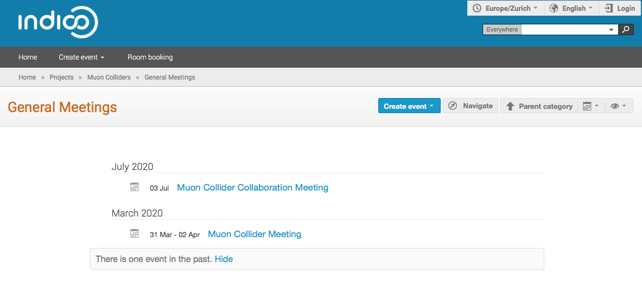
Muon collider
Developing initiative:
  Leads: Nadia Pastrone and Daniel Schulte
Cooling/front-end – Chris Rogers
Need to produce document for PPAP

Slide 7
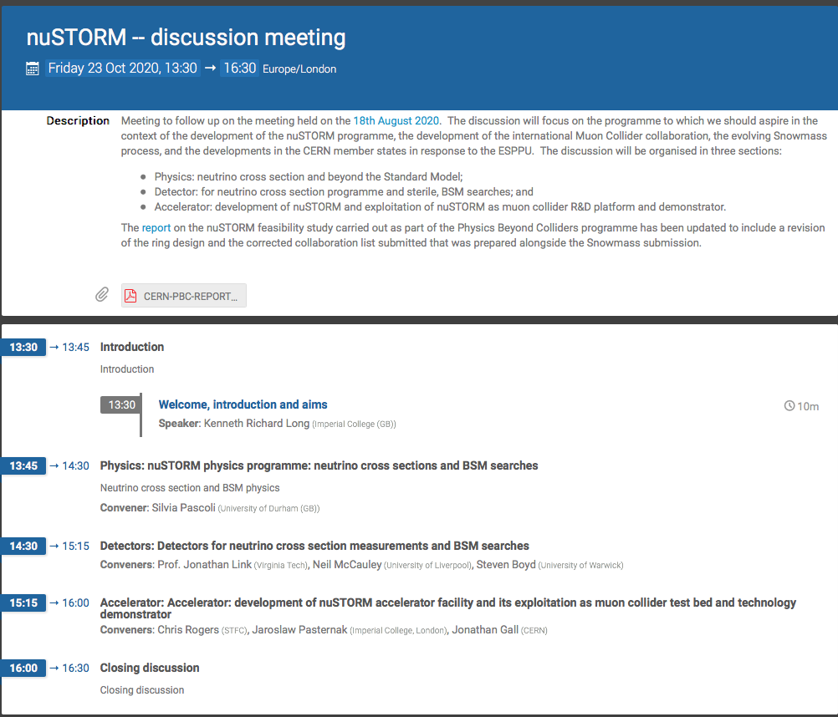
nuSTORM
Need build on
PBC activity

Slide 8
And now …
Welcome and introduction

Slide 9
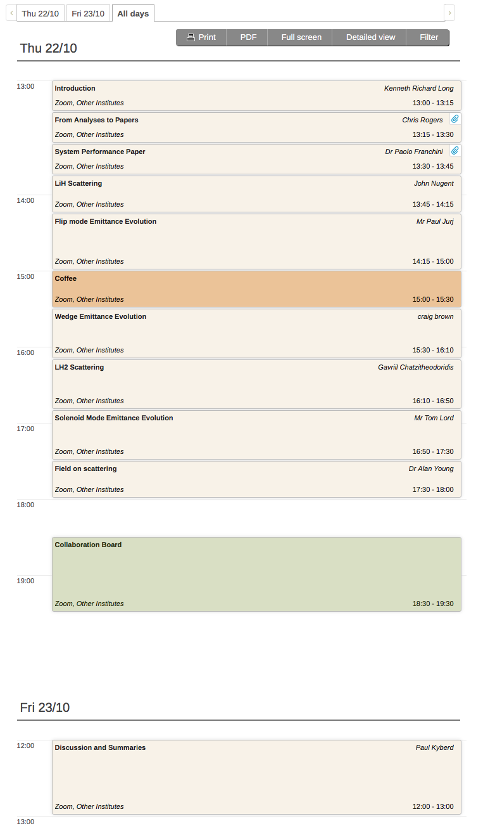
Over to you!

