Slide 1
C, X and K band accelerating modules
XLS injector layout, 02/10/2020
M. Diomede (INFN-LNF)
On behalf of CompactLight-XLS project

Slide 2
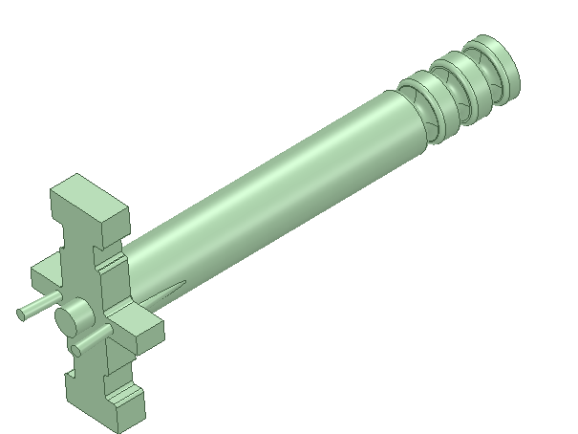
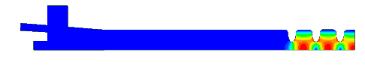
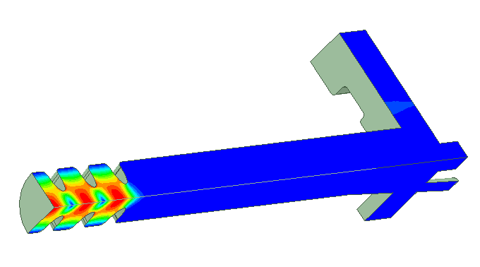
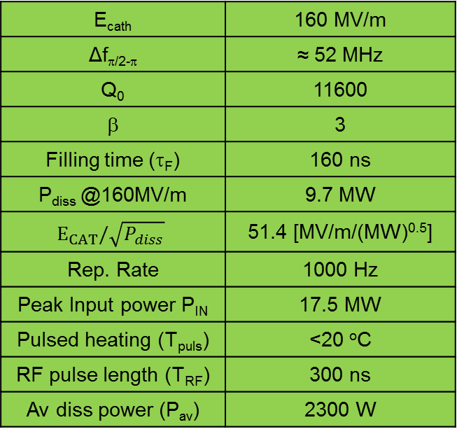
2.5 CELL GEOMETRY ELECTROMAGNETIC SIMULATIONS AND FINAL PARAMETERS
Accelerating cells
E_{cath} | 160 MV/m
Δf_{π/2-π} | ≈ 52 MHz
Q₀ | 11600
β | 3
Filling time (τ_{F}) | 160 ns
P_{diss} @160MV/m | 9.7 MW
$$E_{CAT}/\sqrt{P_{diss}}$$ | 51.4 [MV/m/(MW)^{0.5}]
Rep. Rate | 1000 Hz
Peak Input power P_{IN} | 17.5 MW
Pulsed heating (T_{puls}) | <20 ºC
RF pulse length (T_{RF}) | 300 ns
Av diss power (P_{av}) | 2300 W
RF ports
Pumping ports
Laser ports
Optimum value to maximize the peak field on cathode
solenoid
NB: in the present configuration 2 klystrons are needed to reach 160 MV/m on the cathode at 1 kHz.
With 1 klystron, simply scaling the performances of the present C-band sources (w/o R&D), we obtain 120 MV/m at 1 KHz
UPDATE: 1 high rep rate klystron is enough

Slide 3
NEW C-Band module WITH BOC
(@240 MV/m)
(@200 MV/m)
RF System
Operating frequency [GHz] | 5.996
Klystron pulse length [us] | 2
Klystron peak power [MW] | 15
Pulse rate [pps] | 1000
Q0 of BOC | 216000
Qe of BOC | 19100
Acc. Structure
Phase advance | 2pi/3
Cell length [mm] | 16.667
Number of cells | 120
Total length [m] | 2
Average iris radius [mm] | 6.6
Tapering angle [deg] | 0.02
Iris radius (first - last) [mm] | 6.943 – 6.257
Shunt imp. [MΩ/m] | 71 - 77
Q | 9986 - 9943
Group velocity/c [%] | 2.4 – 1.6
Filling time [ns] | 336
Repetition rate [Hz] | 1000
Avg. acc. gradient [MV/m] | 15
Kly. Power per module [MW] | 9
15 MW, 2 µs,
1 kHz
MODULATOR HALL
LINAC HALL
BOC

Slide 4
X-Band Module
Module (linear t No. 2)
Frequency [GHz] | 11.994
RF pulse (250 Hz) [µs] | 1.5 (0.15)
Average iris radius <a> [mm] | 3.5
Iris radius a [mm] | 4.3-2.7
Iris thickness t [mm] | 2.0-2.24
Structure length L_{s} [m] | 0.9
Unloaded SLED Q-factor Q₀ | 180000
External SLED Q-factor Q_{E} | 23300
Shunt impedance R [MΩ/m] | 85-111
Effective shunt Imp. R_{s} [MΩ/m] | 349
Group velocity v_g/c [%] | 4.7-0.9
Filling time [ns] | 146
Repetition rate [Hz] | 100 | 250 | 1000
SLED | ON | OFF | ON
Kly. Power per module [MW] | 44 | 44 | 9
Avg. acc. gradient [MV/m] | 65 | 30 | 30
10 MW, 1.5 µs,
1 kHz
50 MW, 1.5 µs,
100 Hz
RF switch
CPI VKX-8311A
MODE CONVERTER
MODULATOR HALL
CIRCULAR WAVEGUIDE
MODE CONVERTER
SLED
LINAC HALL
X-Band (11.994 GHz)

Slide 5
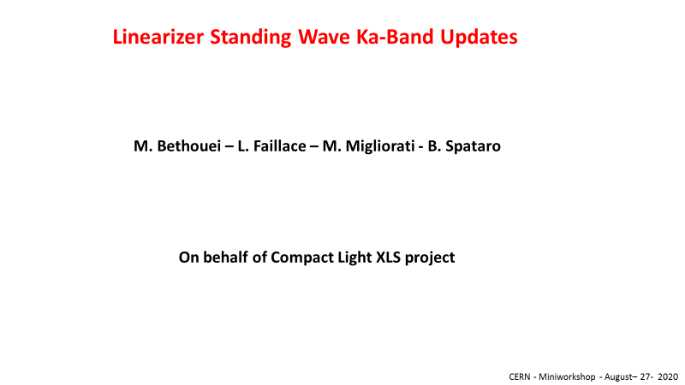

Slide 6
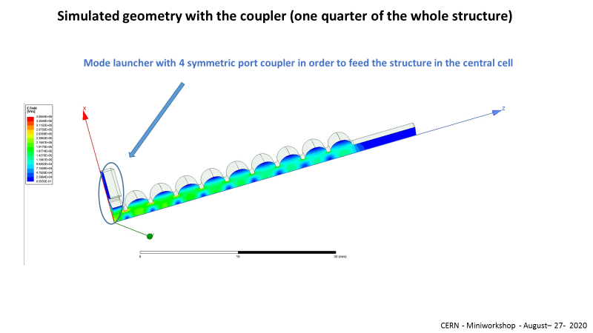

Slide 7
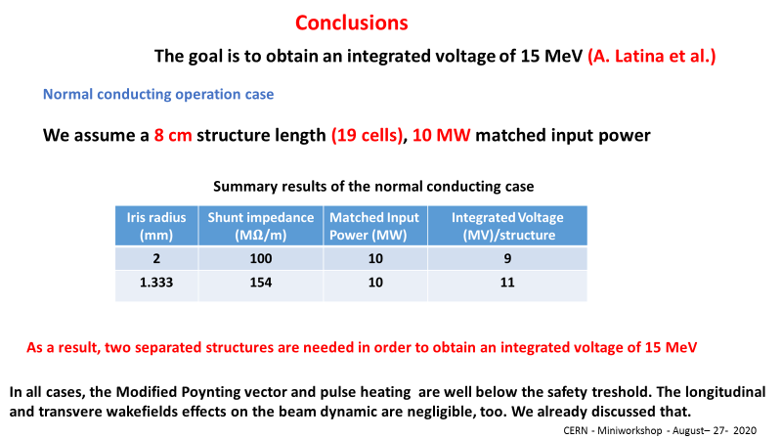

Slide 8
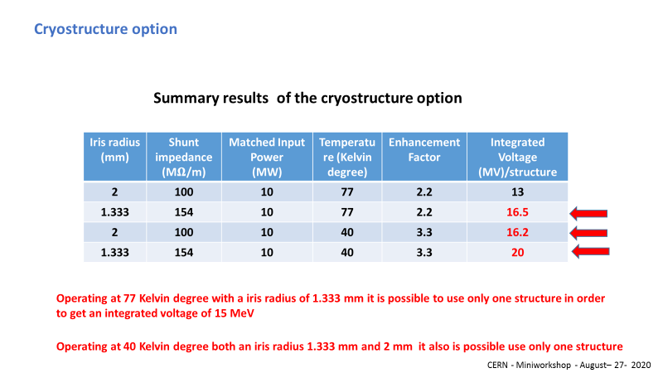

Slide 9
