Slide 1
Xboxes Update
23/09/2020

Slide 2
Summary
Problem with MKXTEST account was stopping all the computers. This was fixed yesterday.
XBOX1: Waiting for new PC
XBOX2: Off due to computer problem.
XBOX3AB: T42 Structures
  Restarted yesterday afternoon
  Currently OFF due to CRAZY behavior of PKI_B.
MKXTEST account migration issue resolved.
XBOX1:
XBOX2:
  Back online, now at 36.5/32.5 MW.
  Have a proposed plan for the upcoming weeks but I am open to suggestions.
XBOX3AB: T42 Back Structures
  Restarted after the MKXTEST Intervention.
  No CRAZY behavior seen.
  BD Cluster in Line 1 during the weekend, restarted on Monday at low power.

Slide 3
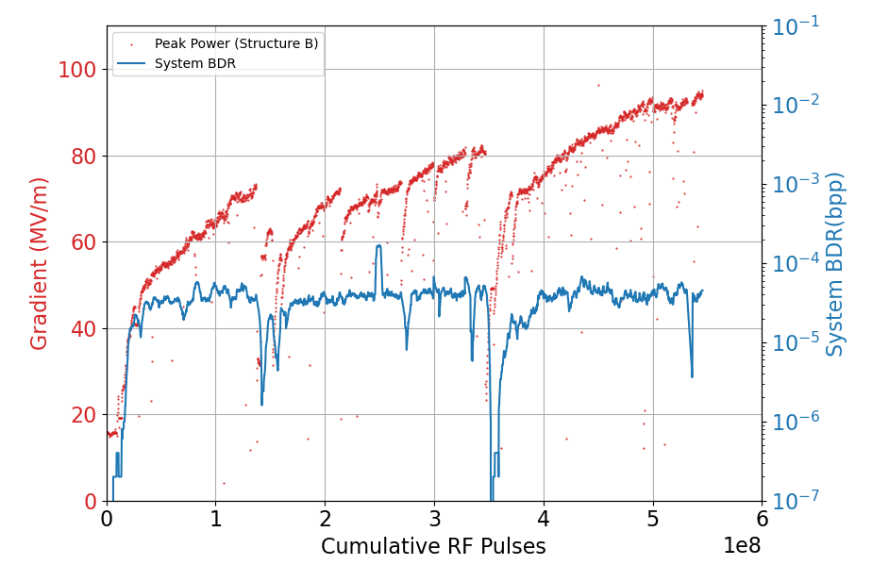
XBOX2
Spent some time “recovering” after a week switched off.
Now at 36.5/32.5 MW.
Parameters:
0.7us klystron pulse
50ns pulse
50Hz rep rate
Target Power: 40MW Peak in structure B
BDR Setpoint: 3E-5
Proposed plan on next slide, open to suggestions.

Slide 4
XBOX2 – Proposed plan for the next two weeks
Before BOC removal:
28th Sep: Set structure to run flat at slightly reduced power (35MW). Turn on radiation monitor and position close to structure, leave running to collect data.
29th Sep: Move phase shifter to ¾ insertion and run. Compare dark current, breakdown current and radiation data.
30th Sep (Before CLIC WS) : Move phase shifter to full insertion and run. (Before CLIC WS)
2nd Oct: Decrease power greatly and vary compressed pulse length to examine pulse shapes and compare with simulation. Move power splitter to ¾ insertion and retraction (if we can) and repeat.
5th Oct (or sooner): Remove BOC and pack?
After/during BOC removal (timeframe uncertain):
Tune SLED (could also be done prior to removal).
Unsure what the plan is for the solenoid installation?
Check directional coupler on structure output (I’m not sure what the coupling is exactly so would like to check it while the line is open).

Slide 5
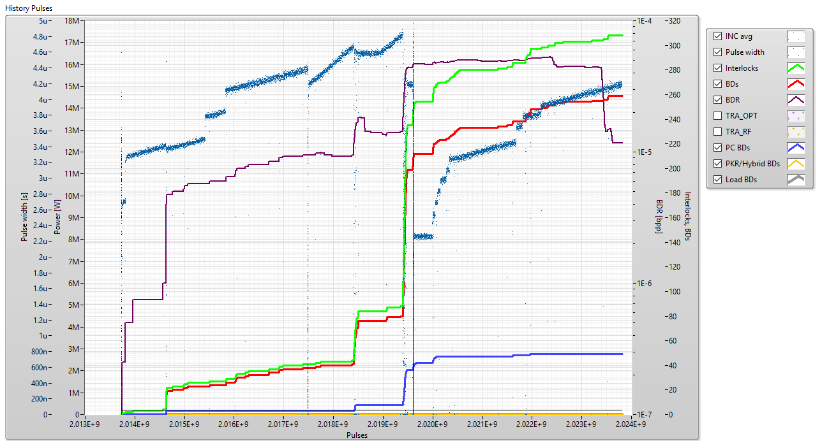
XBOX3 AB – Line 1
Parameters:
1.3us klystron pulse
50ns pulse
50Hz rep rate
Current Power: 15 MW

Slide 6
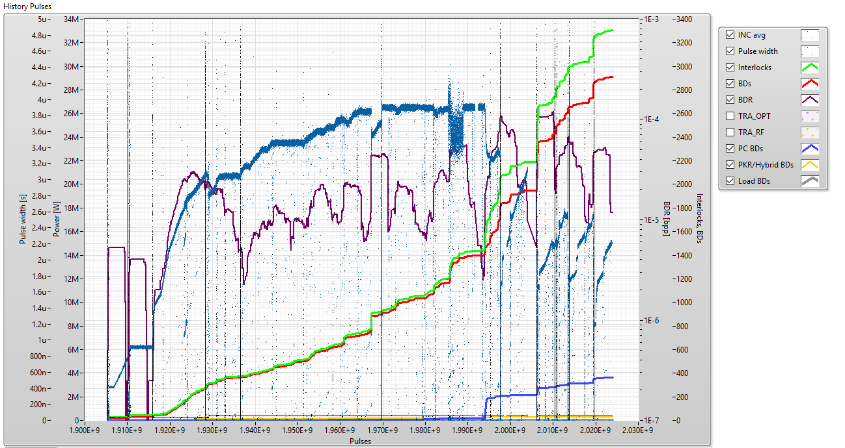
XBOX3 AB – Line 1
Parameters:
1.3us klystron pulse
50ns pulse
50Hz rep rate
Current Power: 15 MW

Slide 7
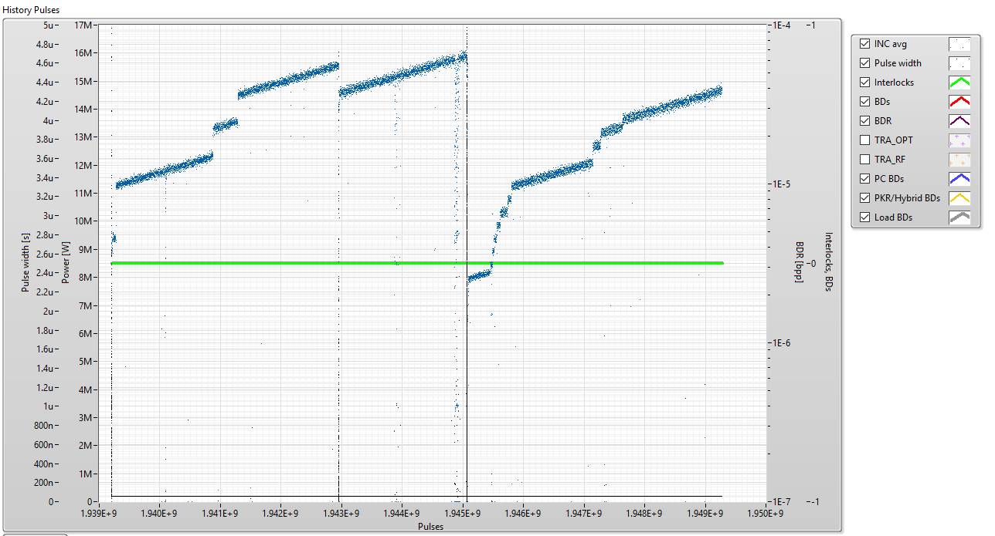
XBOX3 AB – Line 2
Parameters:
1.3us klystron pulse
50ns pulse
50Hz rep rate
Current Power: 15 MW

Slide 8
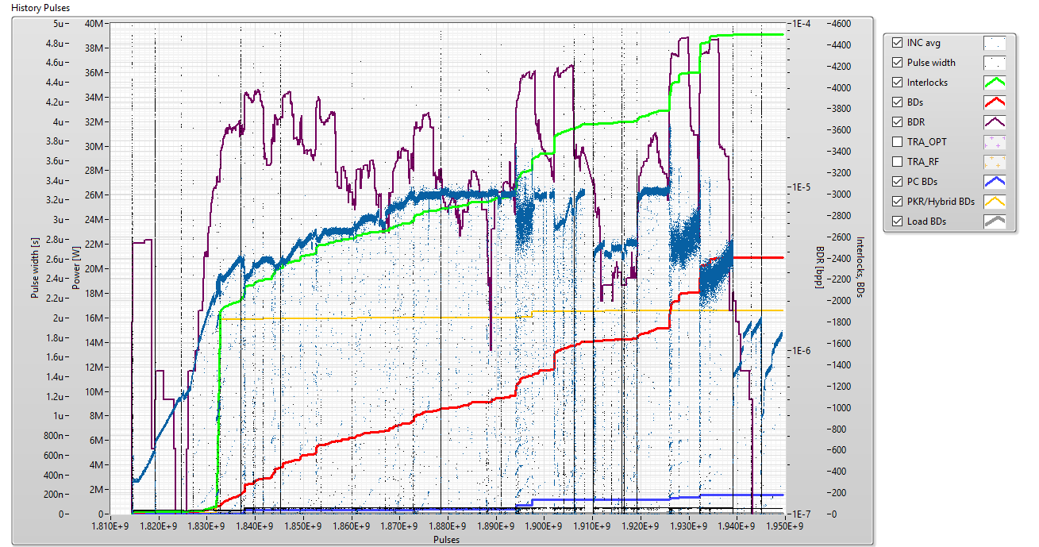
XBOX3 AB – Line 2
Parameters:
1.3us klystron pulse
50ns pulse
50Hz rep rate
Current Power: 15 MW

Slide 9
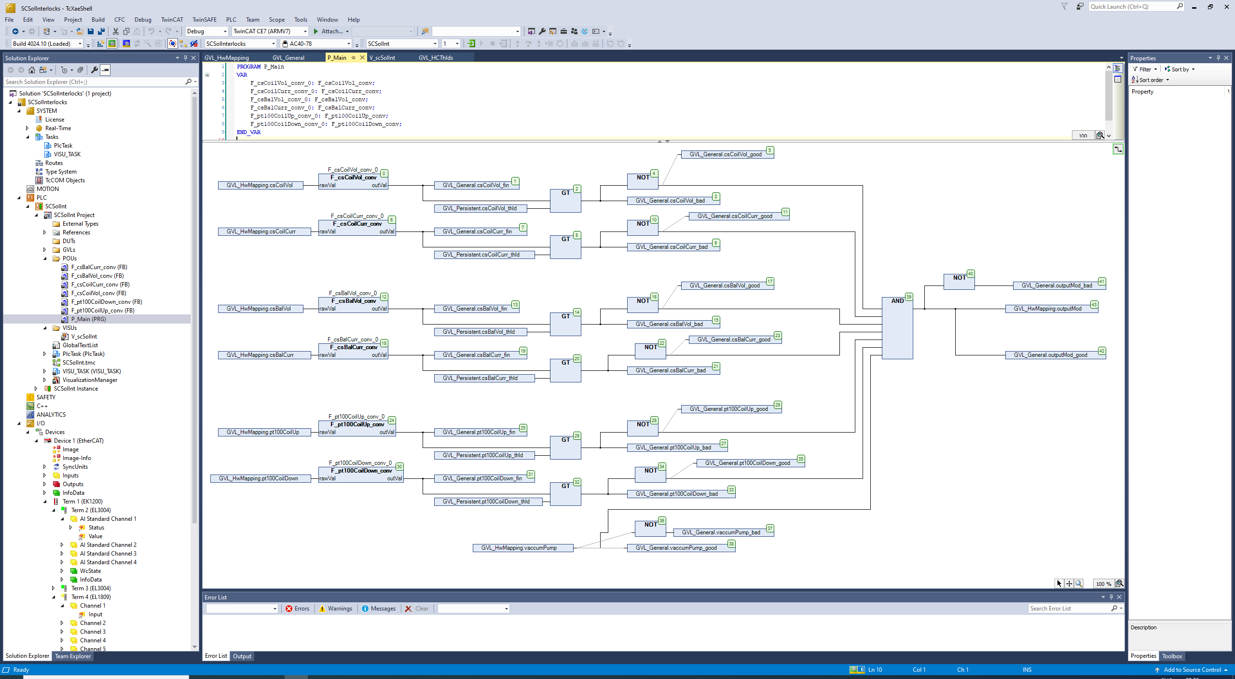
SC Solenoid Interlocks

Slide 10
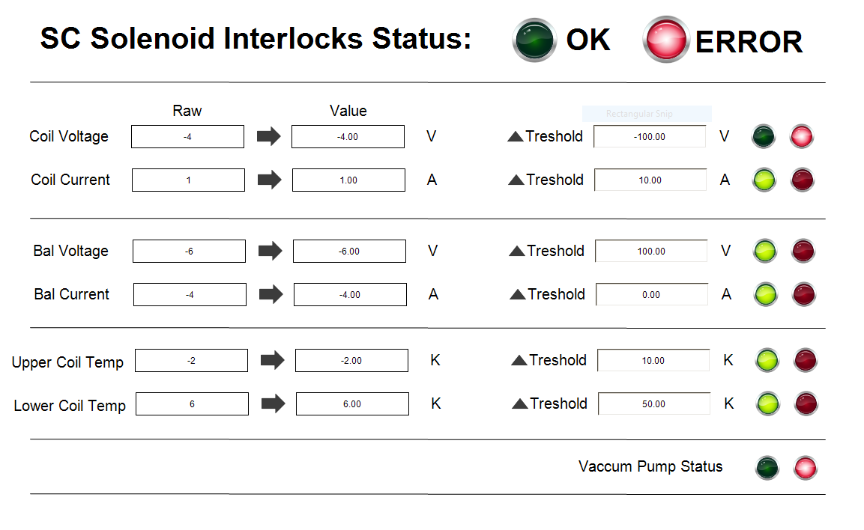
SC Solenoid Interlocks

Slide 11
SC Solenoid Interlocks
SC Solenoid TO DO:
Change the ADC cards from 12 bits to 24 bits
Check the communication between the PCL and the different components (current sources, temperature sensors …)
Calibrate the channels
Vacuum pump communication (NEXTorr)
Modulator and PXI communication.

