Slide 1
Review Orbit MCBX correction budget
R. De Maria

Slide 2

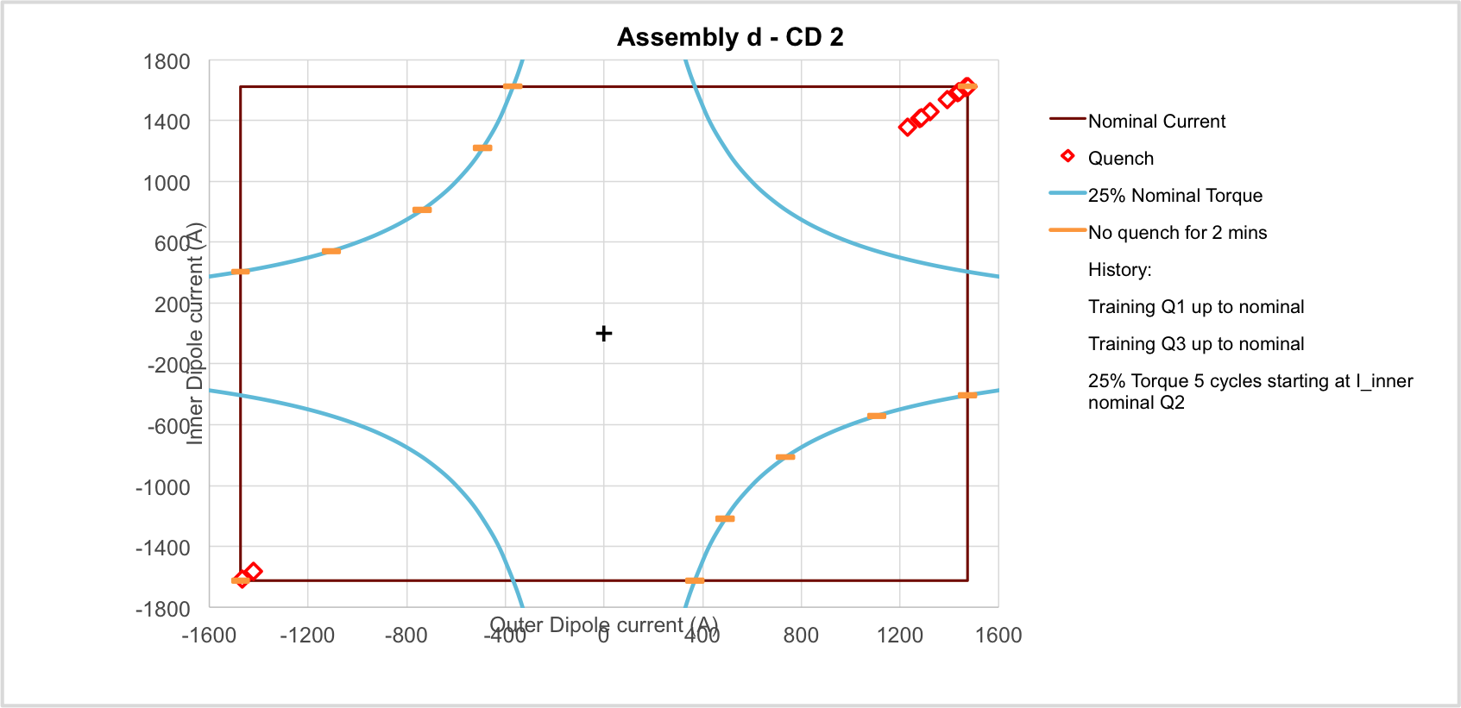

Status of MCBXF (nested corrector) E. Todesco
The first prototype reached nominal current in combined mode
  Retraining is needed to get more than 25% of the torque when changing the torque sign
  A second magnet is being tested, thermal cycle ongoing
  Two action lines being explored
    Options to improve the design, optimization of shimming plan
    Review the operational needs (requirements were established before the inclusion of remote alignment system)
Partially correct,
see next slides
MCBXFP1d operational space [courtesy of J. C. Perez]

Slide 3
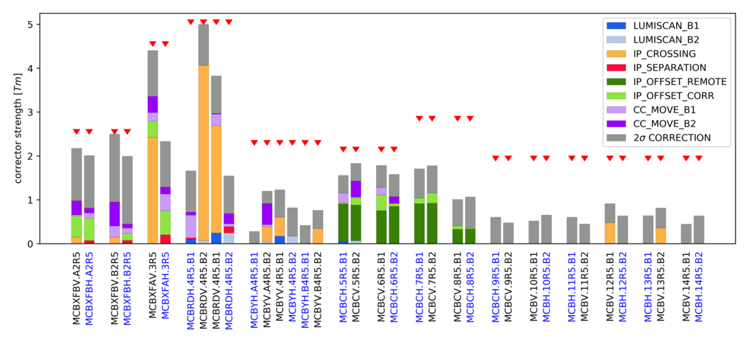
Orbit corrector budget
http://cds.cern.ch/record/2731920/files/CERN-ACC-NOTE-2020-0045.pdf
Family | Budget
MCBXFA | 2.5 Tm
MCBXFB | 4.5 Tm
MCBRD | 5 Tm
MCBY(s) | 2.25 Tm
MCBC | 2.1 Tm
Lumi scan: 100 um
IP Crossing: 295 µrad
IP Separation: 0.75 mm
IP Offset FRA: 2 mm
IP Offset Corr: 0.5 mm
CC Move: 0.5 mm
2σ CORR: 0.5 mm transverse - 0.1 mrad roll
FRAS is already considered in the budget to
Shift Q1-Q5 L/R (and therefore the IP) to follow the detector ground motion (2 mm)
Absorb yearly ground motions in the tunnel to keep the elements aligned (>0.5 mm)

Slide 4
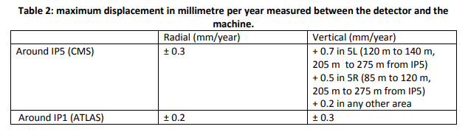
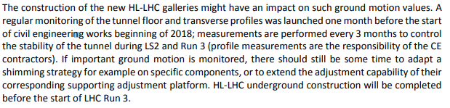
Ground motion
Based on the motion recorded so far

Slide 5
Worst case
MCBXA
MCBXB
Assuming 25% of the torque is a limit:
MCBXB limited in a circle of 1.15 Tm, missing ~1Tm
MCBXA limited in to 1.5 Tm in non-crossing, missing about ~1Tm
The working point of MCBXB and the non crossing angle part of MCBXA is not know a priori before beam commissioning.
Possible strategy: correct at injection, train MCBX on a line, correct at flat top.
NB: yellow part of MCBXA is larger at pre-squeeze β*>50 cm (0.4Tm at β*=1m )

Slide 6
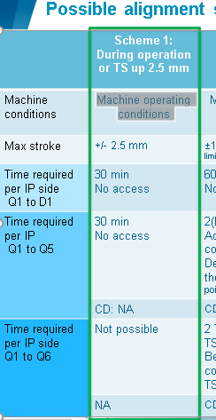
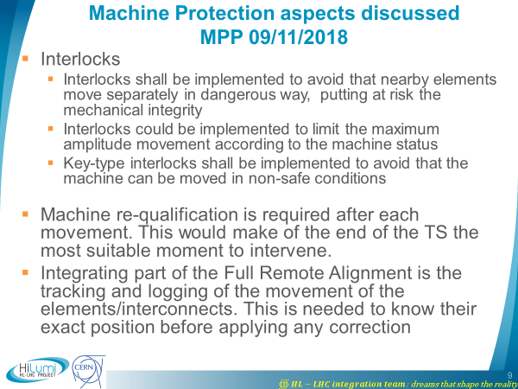
P. Fessia TCC
EDMS: 2166298 Small machine movements (within a few tenths of a millimetre) could be allowed without requalification during the operation of a pilot beam.
Is requalification needed when moving specifically quadrupoles with beam? Contrary to dipoles and absorbers, beam gives most accurate measure of applied offset.

Slide 7
Possible extension of FRAS scope
Knowing 1mm in the triplet is equivalent to 1Tm dipole kick,
if:
FRAS can be used during beam commissioning with beam during orbit adjustments, as of specs
the minimum step is in the order of ~45 µm (~1.5 µrad at 7TeV) as of specs
the reliability is sufficient for frequent usage, not in specs (but motors specified for 1.5 M revolution and 135kh operation)
the usage of FRAS is as safe as operating an orbit corrector, not in specs
then
the budget 2σ CORR, CC Move, IP Offset Corr. could be reduced by taking it from the FRAS budget of 2.5 mm.

Slide 8
MCBX and FRAS considerations
Assuming 25% of the torque is a limit:
MCBXB limited in a circle of 1.15 Tm
  FRAS needs to compensate 1Tm that is ~ 1mm for orbit correction in Q1-Q2.
MCBXA limited in to 1.5 Tm in non-crossing plane
  FRAS needs to compensate 1Tm that is ~1mm for orbit correction in Q3.
Other usage of FRAS needs to be reviewed for instance:
triplet misalignment for radiation
If FRAS is used for orbit correction, one needs to redistribute the FRAS budget (2.5 mm):
1.5 mm IP offset
1 mm (ground motion and orbit correction)
Remote alignment range can then be recovered with manual re-adjustment in the tunnel if the machine is not yet too activated.

