Slide 1



Vittorio Palladino, Univ & INFN Napoli, MICE CM27, 7 July 2010
UNIVERSITA' di NAPOLI
“FEDERICO II”

Slide 3
more and more accelerator υ physics at the Neutrino conference
….. dominated by υ transitions
ancillary
studies

Slide 6
Confirmations, too

Slide 7
MICE at Neutrino 2010
Poster Bross “Status”
Poster Coney “Step I”
Poster Snopok “Beyond Step I”

Slide 8
MINOS υμ→υx

Slide 9
MINOS υμ→υx
MINOS υμ→υe

Slide 10
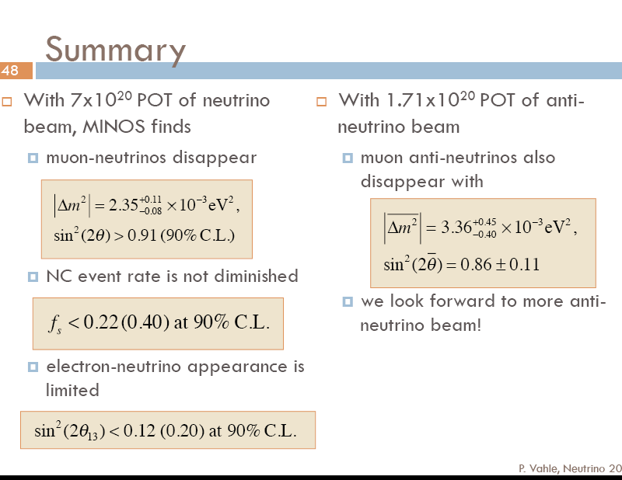
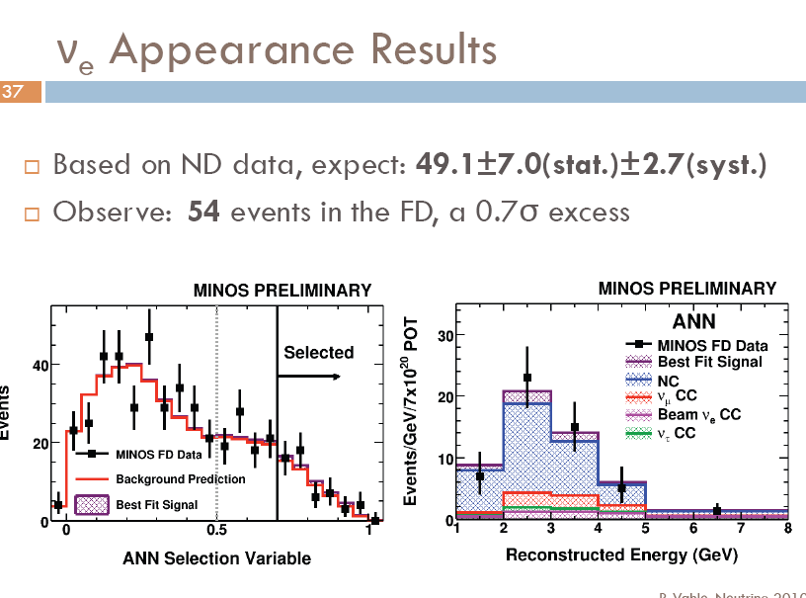

Slide 11
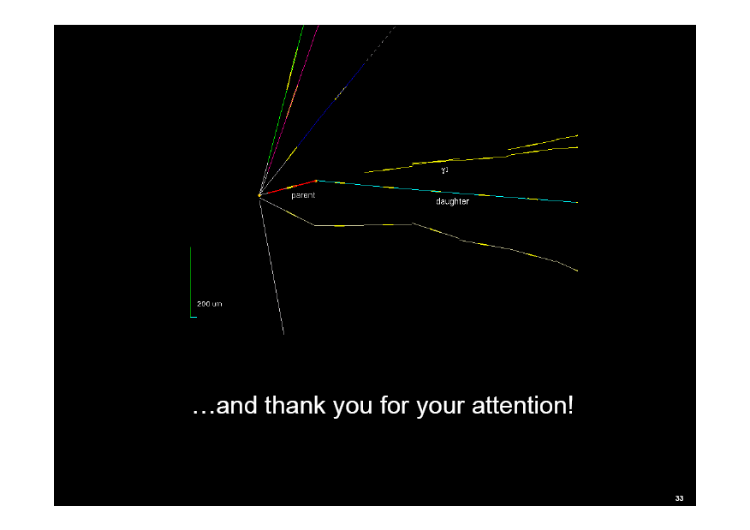
OPERA υμ→υτ

Slide 12
MINiBooNE υμ→υe

Slide 13
????

Slide 15


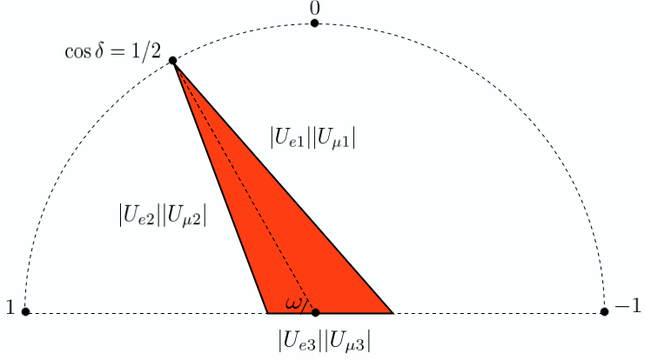



S. Parke, EUROnu Jun 3 2010

Slide 16
Eu possible Strategies
for
Future Accelerator υ Physics
NEu2012 Network
Neutrinos for Europe in2012
EUROnu Design Study (beams)
LAGUNA Design Study (sites)
CERN Council Strategy Document
dixit, July 2006
…… be in position to define the optimal neutrino program
…………………… ….. in around 2012
in the context of Japan plans on the JPARC beam line
US NuMI beam line(s) program
US muon accelerator program
NuFactJ, Indian Neutrino Observatory
……….
Joint
International
υ Factory DS
in progress
large Eu teams
in T2K
Mar 31, 2013 …..

Slide 17
An experimentalist view
Conclusions
Strategies for
Future Accelerator υ Physics
The Quark mixing matrix (CKM) is nearly 60 years old (strangeness 1953)
and we are still bulding strangeness, charm and beauty factories
The Neutrino mixing mixing (PMNS) has a long way to go, we have to
1) establish its 3*3 nature …. detect θ₁₃
2) measure its δ_{CPV} and the mixings precisely
3) check its unitarity & invariance properties … CP, T, CPT
NB Many answers will come only from accelerator neutrinos
We have a double task to coherently
progress with conventional beams ( π decay tunnel ) and detectors
1) T2K, NOυA, CNGS+
2)T2K+, LBNE, CERN
while we design, prototype and build novel beams and detectors
neutrino factory (μ decay ring)
betabeam (β decay ring)
do the experiments
we can do
prototype for the
ultimate experiments
Sustainable only if we build in steady solid progress in
in MWatts AND υ / Watt
as well as in detector Mtons
R&D !!!!!!!!

Slide 25
Decisive is what rate of progress we manage to implement
in the halls of
MICE and other R&D projects

Slide 26

Thank you
7/7/2010

