Slide 1
Accelerator Design
D. Schulte

Slide 2
Tentative Roadmap
Exploratory Phase
Definition Phase
4
1
2
3
4
1
2
3
4
1
2
3
4
1
2
3
4
1
2
3
4
Explore design
Identify critical issues
Explore and prioritise issues
Make design choices
Define realistic goals
Define design
Address feasibility issues
Develop design, refine choices
Develop R&D programme to demonstrate performances

Slide 3
Tentative Roadmap
Exploratory Phase
Definition Phase
4
1
2
3
4
1
2
3
4
1
2
3
4
1
2
3
4
1
2
3
4
Explore design
Identify critical issues
Explore and prioritise issues
Make design choices
Define realistic goals
Define design
Address feasibility issues
Develop design, refine choices
Develop R&D programme to demonstrate performances
Go through full collider to complete and update tentative list
Tentative list
Work
Study the most critical issues from initial list to find solutions, further refine understanding, iterate
Initial list ready
Work
Prioritised list ready

Slide 4
Proton-driven Muon Collider Concept (MAP)
From the MAP collaboration: Proton-driven source (M. Palmer et al.)
Acceleration to collision energy
Collision
Short, intense proton bunches to produce hadronic showers
Pions decay into muons that can be captured
Muon are captured, bunched and then cooled
No CDR exists, no fully integrated baseline
No cost estimate
Need to extend to higher energies (10+ TeV)
But did not find something that does not work

Slide 5
Tentative R&D List: RF
Superconducting high-energy accelerating cavities
  Maintain beam quality for short high-charge bunch
    longitudinal and transverse stability and emittance
  High efficiency for low current but high-charge, short bunch
Normal-conducting 6D cooling RF
  Gas-filled, high-gradient cavities
  High charge bunch, important losses
Front-end RF
  To capture muons
Other RF

Slide 6
Tentative Target Parameters
Parameter | Unit | 3 TeV | 10 TeV | 14 TeV
L | 10³⁴ cm⁻²s⁻¹ | 1.8 | 20 | 40
N | 10¹² | 2 | 2 | 2
f_{r} | Hz | 6 | 4 | 4
P_{beam} | MW | 5.8 | 12.8 | 17.9
C | km | 4.5 | 10 | 14
<B> | T | 7 | 10.5 | 10.5
ε_{L} | MeV m | 7.5 | 7.5 | 7.5
σ_{E} / E | % | 0.1 | 0.1 | 0.1
σ_{z} | mm | 5 | 1.5 | 1.07
β | mm | 5 | 1.5 | 1.07
ε | μm | 25 | 25 | 25
σ_{x,y} | μm | 3.0 | 0.9 | 0.63
Scaled from MAP parameters
Emittance is constant
Collider ring acceptance is constant
Bunch length decreases
Betafunction decreases

Slide 7
Tentative Target Parameters
Parameter | Unit | 3 TeV | 10 TeV | 14 TeV
L | 10³⁴ cm⁻²s⁻¹ | 1.8 | 20 | 40
N | 10¹² | 2 | 2 | 2
f_{r} | Hz | 6 | 4 | 4
P_{beam} | MW | 5.8 | 12.8 | 17.9
C | km | 4.5 | 10 | 14
<B> | T | 7 | 10.5 | 10.5
ε_{L} | MeV m | 7.5 | 7.5 | 7.5
σ_{E} / E | % | 0.1 | 0.1 | 0.1
σ_{z} | mm | 5 | 1.5 | 1.07
β | mm | 5 | 1.5 | 1.07
ε | μm | 25 | 25 | 25
σ_{x,y} | μm | 3.0 | 0.9 | 0.63
Scaled from MAP parameters
Beam power of CLIC is 28 MW @ 3 TeV
130 MW @ 14 TeV

Slide 8
Cooling Design
MAP design almost achieves target performance on paper
Final stage needs to be improved
Hardware performances were better than assumed in design
Additional options proposed (parametric cooling)
Highest-field solenoids for final cooling (> 30 T)
High-field superconducting magnets for 6D cooling
50+ MV/m, normal conducting RF in magnetic field
Targets
Optics design
Safety, instrumentation, vacuum, …
Highly integrated, compact cells
Considering MAP design and MICE experience, develop overall concept
Design of cooling for demonstrator

Slide 9
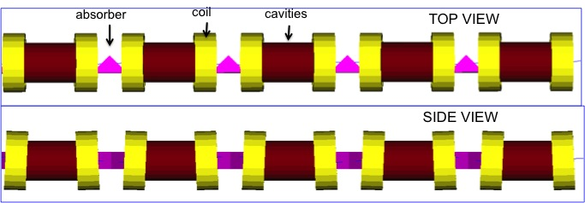
Cooling Concept
MAP collaboration
Superconducting solenoids
High-field normal conducting RF
Liquid hydrogen targets
Compact design

Slide 10
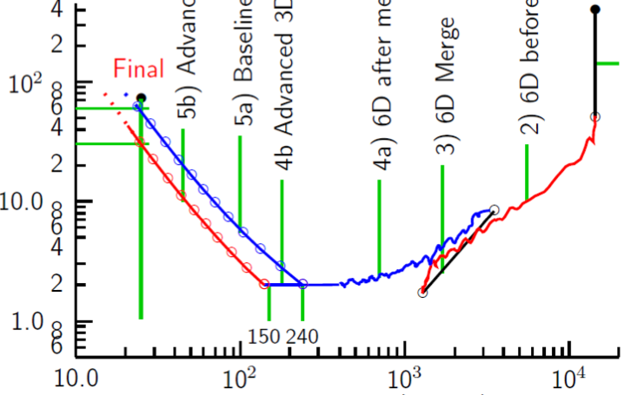
Cooling: The Emittance Path
Target
Y
Specification
•
•
•
For acceleration to
multi-TeV collider
Front End
For acceleration to NuMAX (325MHz injector acceptance 3mm,24mm)
Phase
Rotator
Exit Front End
(15mm,45mm)
Initial Cooling
Longitudinal Emittance (mm)
Final
Cooling
post-merge 6D Cooling
pre-merge
6D Cooling (original design)
For acceleration
to Higgs Factory
Bunch
Merge
Transverse Emittance (microns)
MAP collaboration

Slide 11
Cooling: The Emittance Path
Target
Y
Specification
Achieved (simulations)
•
•
•
For acceleration to
multi-TeV collider
Front End
For acceleration to NuMAX (325MHz injector acceptance 3mm,24mm)
Phase
Rotator
Final
Exit Front End
(15mm,45mm)
Initial Cooling
Longitudinal Emittance (mm)
Initial
(X)
Initial
(Y)
Final
Cooling
post-merge 6D Cooling
pre-merge
6D Cooling (original design)
For acceleration
to Higgs Factory
HCC
VCC &
Hybrid
Bunch
Merge
Transverse Emittance (microns)
MAP collaboration

Slide 12
Cooling: The Emittance Path
Target
Y
Specification
Achieved (simulations)
•
•
•
For acceleration to
multi-TeV collider
Front End
For acceleration to NuMAX (325MHz injector acceptance 3mm,24mm)
Phase
Rotator
Several ideas to improve final cooling
Need to work out the solution
Highest field HTS helps
Phase space manipulations of beam
Higher gradient helps
Final
Exit Front End
(15mm,45mm)
Initial Cooling
Longitudinal Emittance (mm)
Initial
(X)
Initial
(Y)
Final
Cooling
post-merge 6D Cooling
pre-merge
6D Cooling (original design)
For acceleration
to Higgs Factory
HCC
VCC &
Hybrid
Bunch
Merge
Maybe can improve this
Transverse Emittance (microns)
MAP collaboration

Slide 13
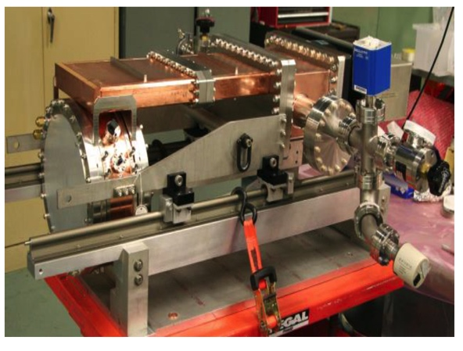
Design Challenges and Status
Very high gradients because muon lifetime is limited
Operation in a magnetic field (several T)
Strong beamloading
Different frequencies, from 200 MHz to 650 MHz
Final cooling reduces frequencies down to 20 Mhz or less
Induction linacs for lower frequencies
Solutions:
High pressure gas (H₂) to suppress breakdowns
Allows 50 MV/m in 3 T
Design to minimise breakdown by minimising pulsed heating
Use of different materials
Be walls allow 50 MV/m in 3 T
Al might be good and is much safer
MuCool: >50 MV/m in 5 T field
Goal:
10⁻⁵ breakdown probability
Highest possible gradient

Slide 14
Proton Source and Front-end Design
Proton complex
Optics
Efficient RF
Magnets
Front-end
High power target
Capture solenoid (20 T, 1.2 m aperture)
Radiation from target
Buncher
Phase rotator
Optics
Based on MAP design, optimise complex
Choice of target (solid/liquid, …)
Identify suitable existing proton installations for demonstrator
  Design required modifications
Design front end for demonstrator

Slide 15
Demonstrator
Demonstrator facility to produce useful muon beam
Demonstrator needs
to be based on muon collider source concept
a more detailed design than the collider source
to be based on technologies available in 5 years
to be affordable (0.5 GCHF?)
Hence we need to
Need to confirm choice of muon source concept
Have to have concept of full muon source
Identify use exiting infrastructure (e.g. proton beams)
Scale design to funding and available technology
Explore if it serve some physics
Develop source concept over the first two years
Then design demonstrator, preferably the same people

Slide 16
Accelerator Design
  Two bunches accelerated simultaneously: one μ⁺ one μ⁻
Charge about 1.5-2 x 2 x 10¹² muons
Five pulses per second
Need to compress m-long initial bunch maintaining it longitudinal emittance
In whole complex require average gradient > 1 MV/m to limit loss of muons
more at the beginning
Gradient in cavities O(20 MV/m), the higher the better
Initial linacs 0.2 to 1 GeV with 325 MHz and to 5 GeV with 650 MHz
Then recirculating linac
Finally accelerator ring

Slide 17
Accelerator Design, cont.
Final bunch parameters (14 TeV):
charge 2 x 10¹² muons, length 1 mm, energy spread 0.1%
Length maybe be different in the accelerator ring
Efficiency consideration
O(100) turns in ring, i.e. few ms beamloading
bunch spacing tens of microseconds
At 400 Mhz extract O(1%) of stored energy per passage
  higher frequencies proposed in MAP, is this reasonable?
Short bunch induces important higher order modes
  total loss factor effect up to 1 MV/m in four cell cavity
  approximately 6% energy difference between head and tail if not compensated
Need to mitigate single-bunch wakefield effect
Longitudinal beam profiles are important
In whole complex need to chose frequencies, mitigate beamloading, understand longitudinal dynamics
Assume pulsed superconducting system, but could one do differently?

Slide 18
Collider Ring
Need to control longitudinal motion in collider ring
average lifetime is O(3000) turns
want short bunches O(1mm) @ 14 TeV
significant energy spread O(10⁻³)
large ring (14 km @ 14 TeV)
Need very small momentum compaction
RF needs not yet known but could become important
Probably similar design to accelerator ring RF
Almost completely suppress motion for
i.e. 2.5 x 10⁻⁸ @ 14 TeV
5 x 10⁻⁶ @ 3 TeV
Or need enough RF voltage
e.g. 4 GV @ 14 TeV, α = 10⁻⁶, f_{RF} = 1 GHz
e.g. 86 MV @ 3 TeV, α = 10⁻⁵, f_{RF} = 1 GHz
Need to minimise momentum compaction

Slide 19
Accelerator and Collider Ring
Additional challenges
neutrino radiation
combined accelerator and collider ring
Neutrino radiation
option1: concentrate RF in straights in accelerator and buy land to which we point
Option 2: distribute many short (m-long) RF sections around the ring
  But how compact can this be, can we operate in magnetic field?
Combined rings
can we switch from acceleration to steady state rapidly enough?

Slide 20
Conclusion
Plenty of exciting RF work
Normal and superconducting

