Slide 1
SPS-crab cavity test stand recommissioning
G.Vandoni
SPS main dates
Planning test stand closure
Cooldown & RF conditioning
Summary

Slide 2
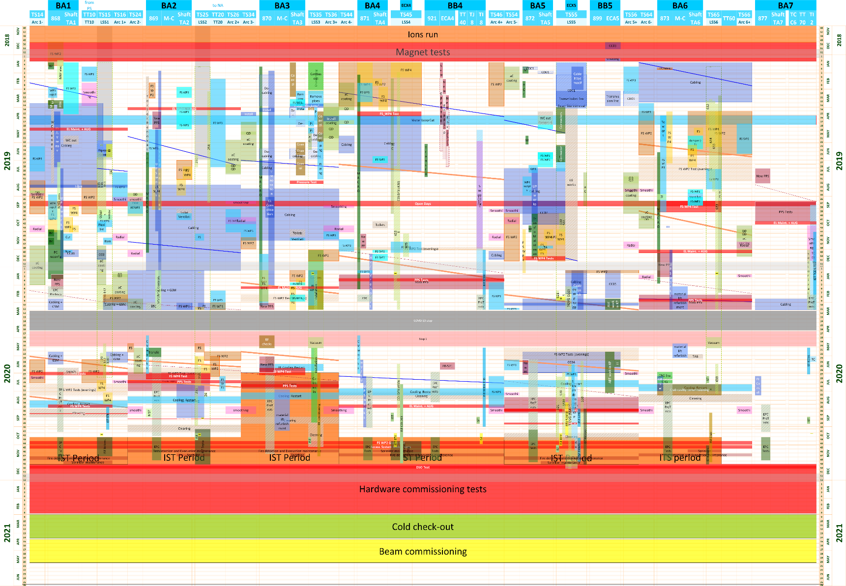
SPS main dates
SF1 cooling tower maintenance, primary water week 49
End normal access: 16th October
19 Oct (week 43)
26-30 Oct: SPS closed (Fire)
IST
2-6 Nov: SPS closed (PPS)
4 Dec (week 49)
Hardware commissioning : 7th Dec - 26th Feb 2021
Cold check-out: 1st March-9th April 2021

Slide 3
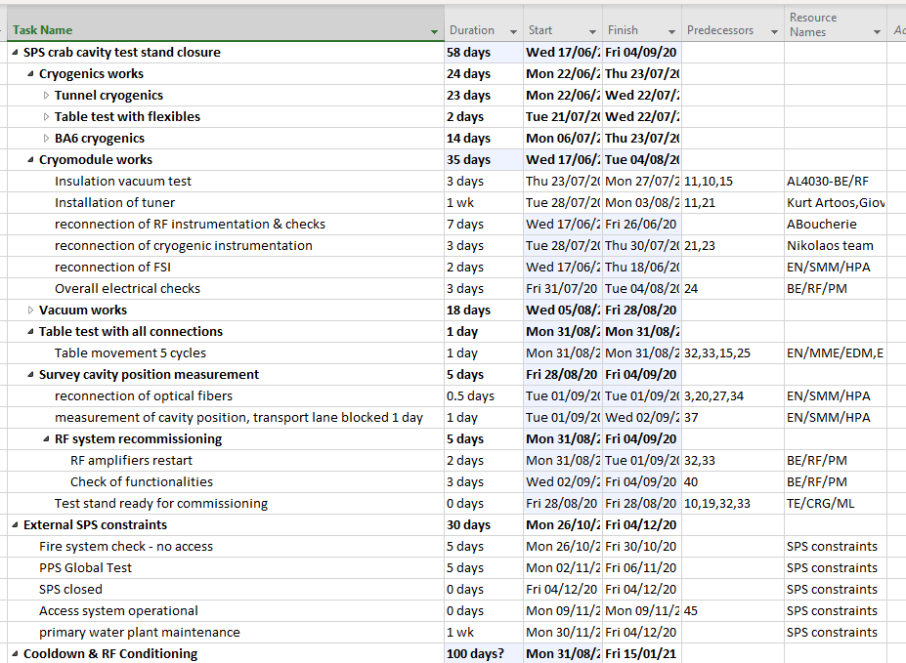
Planning SPS crab closure
Actors in the loop:
BE/RF/PM | G.Cipolla E.Montesinos (C.Julie)
BE/RF/CS | D.Glenat
LLRF | P.Baudrenghien
TE/VSC | C.Pasquino
TE/CRG | J.Metselaar J.Casas Benoit L.Alaux S.Claudet
Survey | V.Rude
AL4030 | F.Monnet
Table | K.Artoos
Tuners | K.Artoos

Slide 4
Planning SPS crab closure
Actors in the loop:
BE/RF/PM | G.Cipolla E.Montesinos (C.Julie)
BE/RF/CS | D.Glenat
LLRF | P.Baudrenghien
TE/VSC | C.Pasquino
TE/CRG | J.Metselaar J.Casas B.D’Hulster L.Alaux S.Claudet
Survey | V.Rude
AL4030 | F.Monnet
Table | K.Artoos
Tuners | K.Artoos
DONE 90%
DONE
DONE 90%
✓
✓
DONE, leak checked, under vacua

Slide 5
Cryo
L.Alaux
Missing instrumentation reconnection and test
Missing X-ray and pressure test for new line at the surface
Mutual interlock checks
RF
E.Montesinos
Functionality tests of all circuits & check of signals
Vacuum
Cryo
RF power
(Access)
(Table)
Tuners
K.Artoos
Cable repair
Final check of motor rotation, end switches, programming new load cells
Transport
Bleu
Remove chain hoist
→Cooldown
Survey
V.Rude
Reconnection of optical fibers
Final position measurement on cavities, in beam
Table
K.Artoos
Cycling
Vacuum
C.Pasquino
Reconnection of fixed pumping group and beam vacuum pumpdown

Slide 6
Cooldown & RF conditioning – our requests
Request | Requisites | Link | Duration
Cryogenic commissioning | Power Network Water (raw) Vacuum (beam & insul.) | L.Alaux S.Claudet (G.Vandoni) | 2 weeks (1 may be || to RF start)
DSO tests | The above PPS operational Table tested | D.Vaxelaire C.Gaignant (G.Vandoni) | 1 day
RF commissioning & cavity conditioning | The above Water (demi) SPS access closed status Cryomodule cold | E.Montesinos (G.Vandoni) | 5-7 weeks Continuous
Scheduled during Hardware commissioning

Slide 7
NOTES from meeting
V alkfdvf

