Slide 2
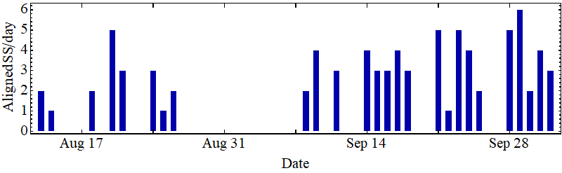
PS alignment campaign
PS switch yard (SWY) 13/08-27/08/2020 ~2 weeks
PS outside SWY 08/09-02/10/2020 ~4 weeks
SWY completed before closure, complete set of measurements
Few SS with low priority untouched
‘Online’ survey and alignment of PS ring outside SWY
Completed within allocated time, essentially all SS touched
Important experience for future campaigns

Slide 3
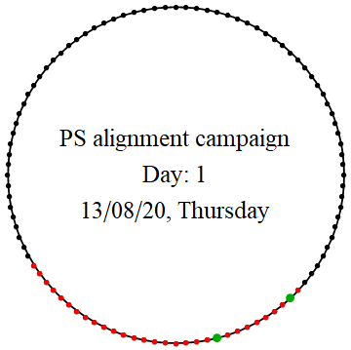
PS alignment campaign
PS switch yard (SWY) 13/08-27/08/2020 ~2 weeks
PS outside SWY 08/09-02/10/2020 ~4 weeks
Congratulations and thanks a lot to all teams involved!

