Slide 1
ALIGNMENT ASPECTS IN THE K-MODULE AND RESSOURCES NEEDED.
Hélène Mainaud Durand, 27/10/2020.

Slide 2
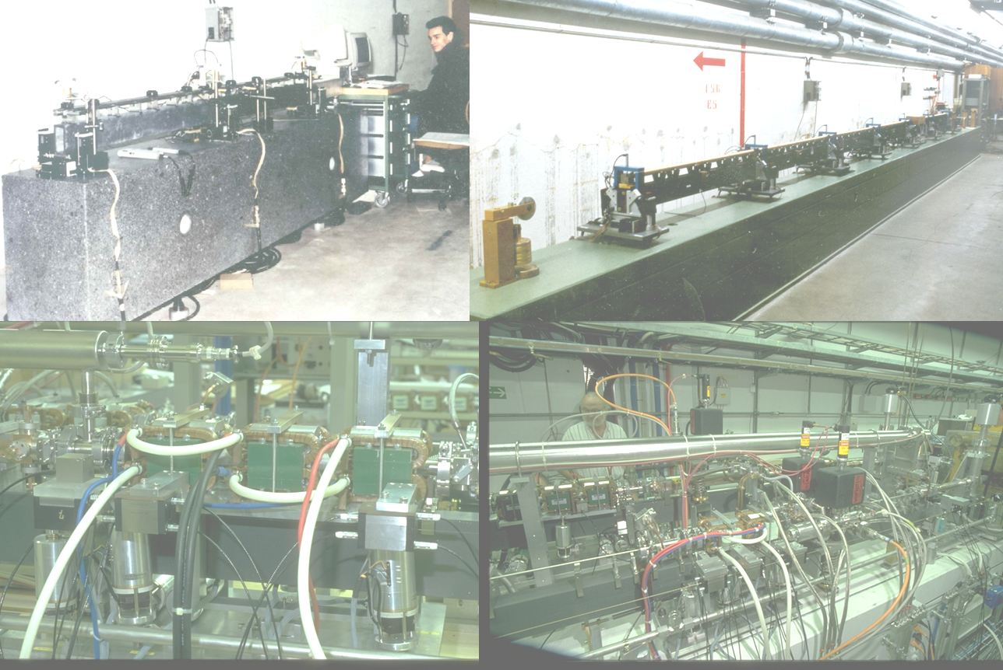
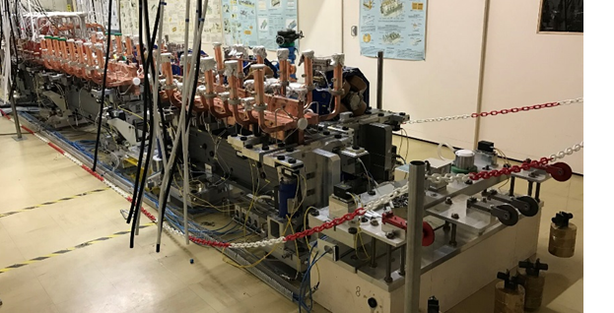

CLIC pre-alignment studies
1989
2019
Pre-alignment mock-ups
CTF1 and CTF2
Two Beam Test Modules
CLEX

Slide 3



CLIC pre-alignment achievements
«Snake configuration»
Development of WPS sensors & stretched wire as reference of alignment
Concept of overlapping wires
Concept for MDI area
Adjustable articulation point
Micrometric fiducialisation
Micrometric adjustment solutions
Alignment solutions in a real accelerator environment
Active pre-alignment validated
High accuracy fiducialisation
Simplification of the initial assembly step
In-situ measurements
Validated at 20°C only
Only partially tested and validated
To be cost-optimized
Only a relative alignment of the components, not absolute
No in-situ measurements
Time and cost consuming
Rigidity from other systems
HL-LHC: Full Remote Alignment System
WPS for LHC Low beta alignment
HL-LHC: Internal Monitoring with FSI

Slide 4
Challenges for lepton colliders…
Pre-alignment of lepton colliders is one of the main technical challenges.
We have to propose affordable and integrable solutions in the tunnel, compatible with a very aggressive installation schedule.
No R&D has started on the FCC-ee (no budget and no resources available) (except on geodesy), which is very worrying for the CDR+ targeted in 2026.
R&D studies on CLIC stopped in 2019.
Even if a few studies are specific for CLIC and FCC-ee, a common R&D Survey and alignment cell would be far more efficient from our point of view.

Slide 5
… pre-alignment aspects for the k-module
Bring expertise during the whole project on high precision position determination and adjustment (high precision 3D alignment).
Optimize the «in-situ» pre-alignment strategy developed in TBTM & PACMAN
New support configuration (sensors directly linked to the girder), no rigidity from other systems
Optimization of sequences of initial alignment / adjustment, measurements strategies and their duration
Study of impact of temperature and humidity on the micrometric alignment
Develop low cost solutions (sensors, actuators, adjustment platform)
Ressources ????

