Slide 1
CAST Proposal and Status Report
139th Meeting of the CERN SPSC
K. Zioutas,
University of Patras,
on behalf of CAST Collaboration
and external collaborators
M. Vogelsberger (MIT) & A. Kryemadhi (Messiah U.)
(CERN-SPSC-2020-022 / SPSC-SR-277 02/10/2020
http://cds.cern.ch/record/2738387 )
CERN, 13th October 2020

Slide 2
About CAST
Presently: 10 theses

Slide 3
ABSTRACT
With less than 2 months of data taking, the CAST-CAPP cavity experiment managed to cover a significant fraction of previously unexplored parameter DM axion space in the range 19.7 to 22.4 μeV (4.7 to 5.5 GHz), and exceeded the previous limits by ADMX-Sidecar by far. CAPP is a sub-detector of CAST with 4 resonance cavities. It is the full realization of the conceptual idea from 2011 and transforms CAST from an axion helioscope to an axion haloscope. Since 2019 data are taken with individual cavities as well as with all 4 cavities phase matched (=coherently). The experiment is not yet running under optimal conditions and further optimizations are already being prepared. These will improve the sensitivity even further and will lead to world-leading results. The full previously granted data taking time of 6 months, which due to the COVID19 pandemic would extend into 2021, is essential to achieve the planned sensitivity. To fully exploit its sensitivity, we have recently installed a second spectrum analyser which measures simultaneously the ambient electromagnetic noise. CAST-CAPP has pioneered the new technology of fast scanning and phase-matching of multiple cavities, which is capable to detect transient events from streaming dark matter or axion mini-clusters. An unambiguous detection of such events requires an independent detector at another location. We are currently in contact with the IBS Korea on the possibilities to facilitate establishment of a second detector there.
From the CAST report to SPSC: http://cds.cern.ch/record/2738387/files/SPSC-SR-277.pdf

Slide 4
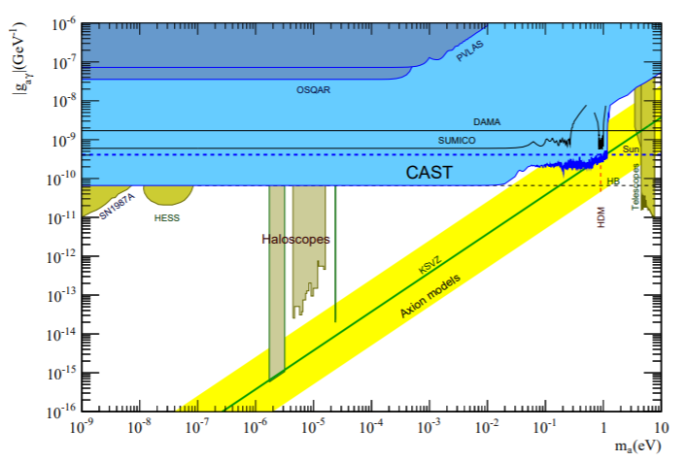
Solar axions: NATURE Phys.13(2017)584
CAST Motivation:
Dark Universe
…. Axions ➔ strong CP problem & DM & solar axions
…. Chameleons ➔ DE
Direct DM search
@ CERN
CAST’s approach: 1 out of 3 methods

Slide 5
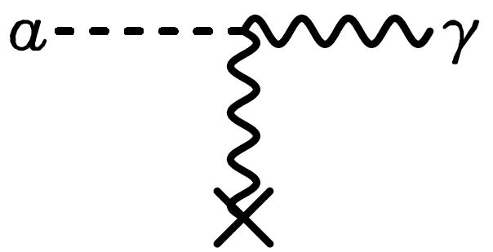
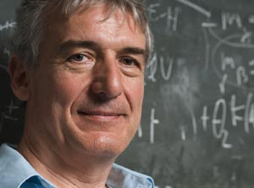
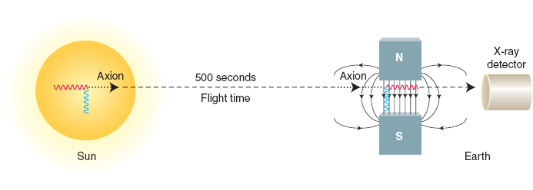
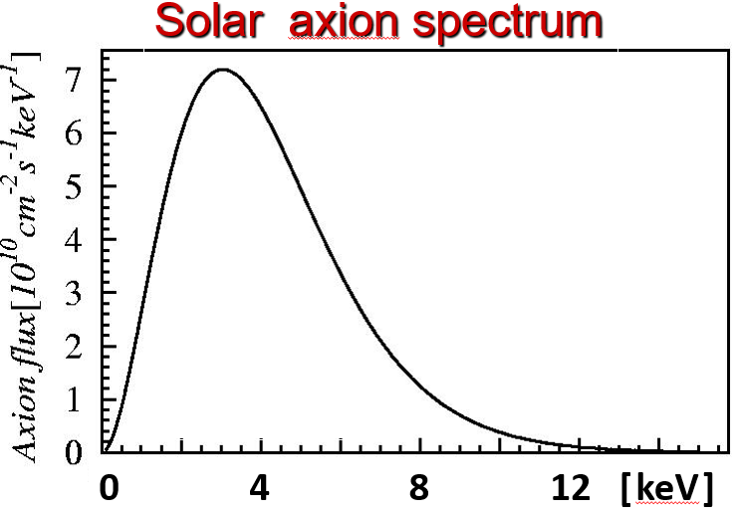
CAST
Axion - source
Axion - conversion
γ
P. Sikivie
Working principle:
a-helioscope
a-haloscope
×
E²
B²
~100 ktons of axions/s overlooked?
↓
↓
E_{axion}

Slide 6
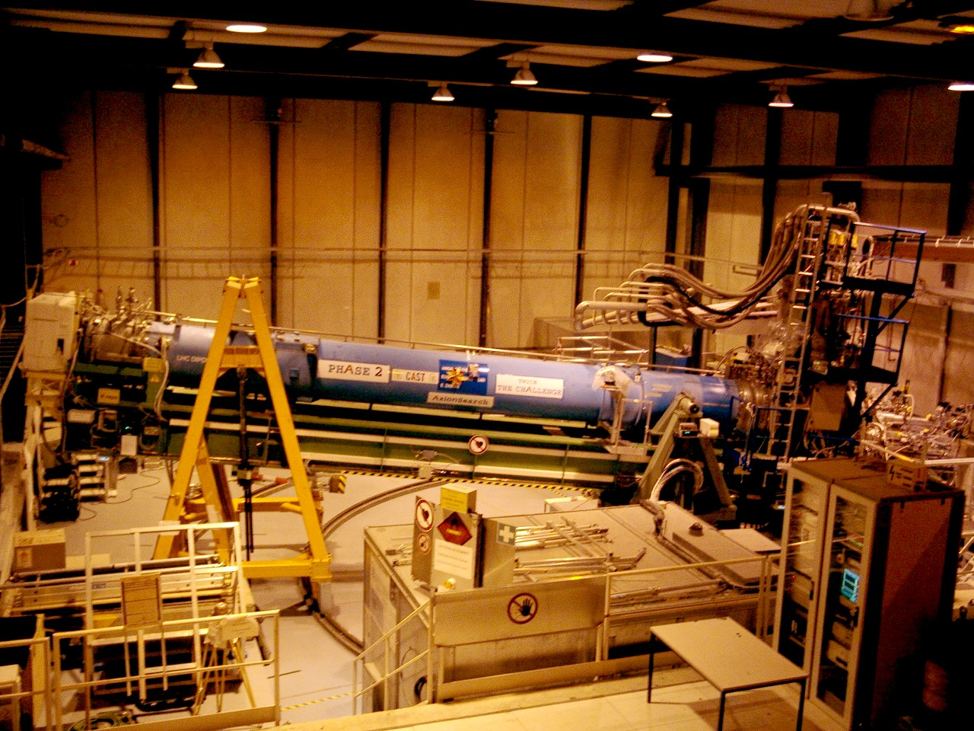
CAST
α
γ
γ_{virtual}
X
B

Slide 7
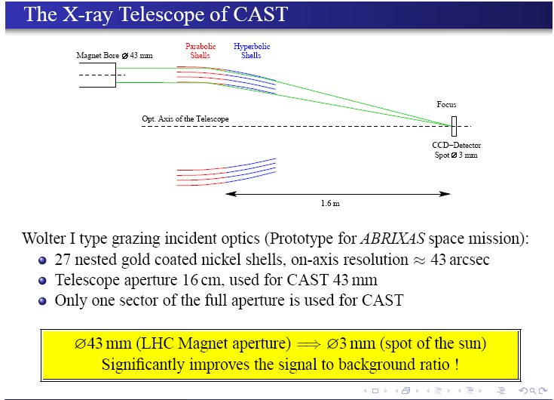
>>> + 2nd XRT
still
a CAST “first”
in astroparticle physics

Slide 8
Initially:
Solar axions (DM) ➔ solar chameleons (DE)
< 4 keV > < 1 keV >
2003- K.Z., P. Brax PR D85(2012)043014
2013-
➔
DM axions
(<m eV)
➔
CAST
3 “first” done:
with dipole magnet:
2019-
Fast tuning ⬄ a-transients
Phase matched cavities
➔ coherence
Unexplored axion mass
OK.Baker, …, K.Z.
PR D85(2012)035018
9authors / 7Institutes

Slide 9
<1999 CAST 2020
AxionPhobia AxionEuphoria

Slide 10
CAST – CAPP >> DM axions
+ transients
Cavity axion - haloscope
https://arxiv.org/abs/1703.01436
https://doi.org/10.1111/j.1365-2966.2011.18224.x
https://doi.org/10.1088/0004-637X/814/2/122
https://doi.org/10.1093/mnras/stx1474
Theses: Marios Maroudas
Kaan Özbozduman

Slide 11
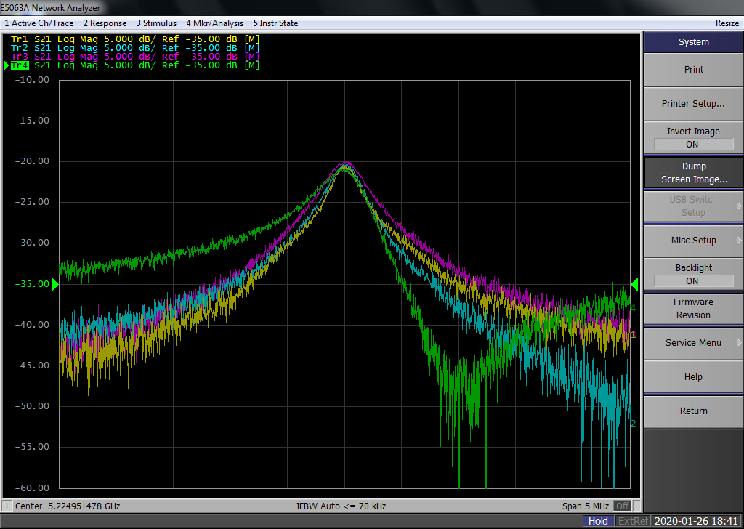

DATA-TAKING RESULTS
FAST TUNING & 4 PHASE-MATCHED CAVITIES!
Increase sensitivity by combining coherently the read-outs from several cavities:
$$SNR_{N}=N ∙ SNR_{single}$$
So far:: 0 h
TOTAL Phase Matched cav’s:
448.9 h (18.7days) & 125 MHz

Slide 12
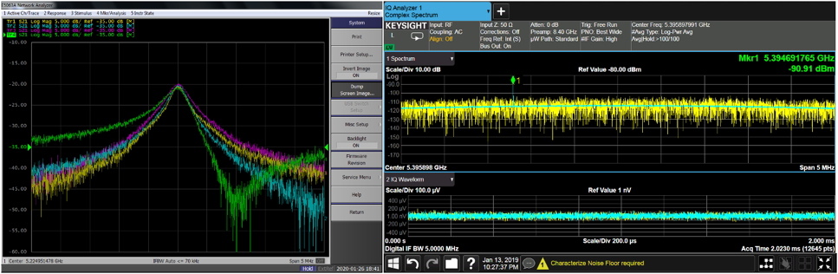
DATA-TAKING RESULTS
BACKGROUND DATA (B=OFF)
Goal: Comparison of frequencies with significant power excesses between B=ON & OFF
So far:378.3h (15.8d)
ies: 4.2h (0.2days)
TOTAL BKG: 442.9 h (17.6 days) & ~150MHz
POWER
Frequency =>
In time domain

Slide 13
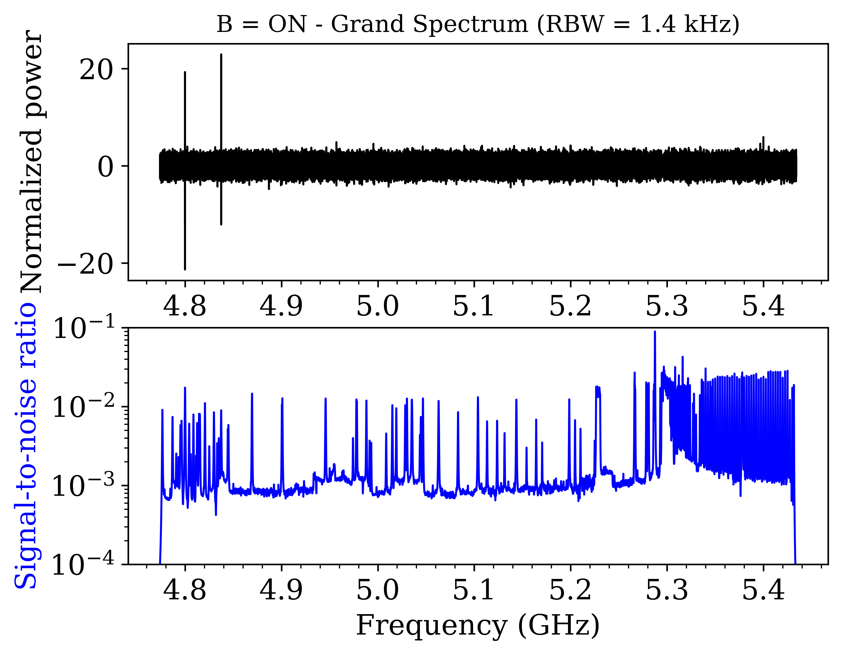
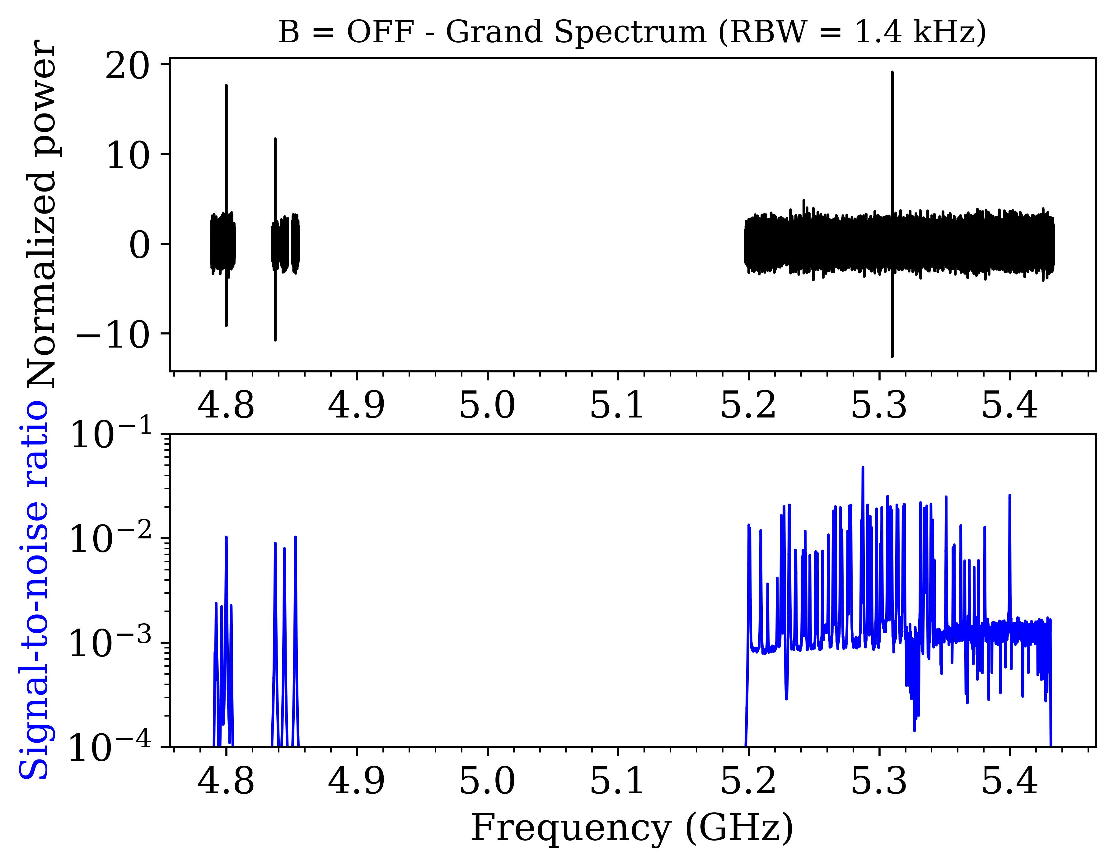
DATA ANALYSIS
Results from all data

Slide 14
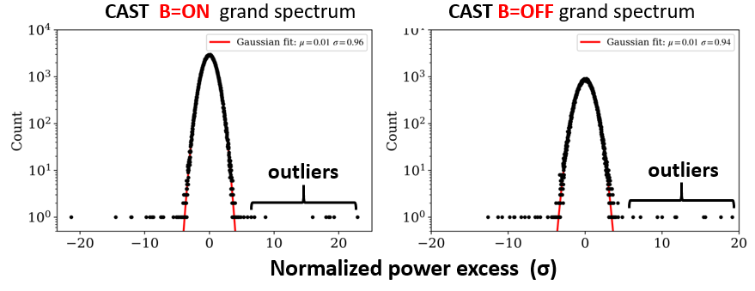
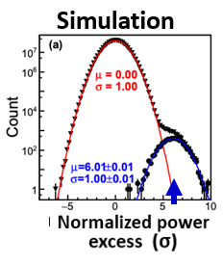
DATA ANALYSIS
Results
Histogram of the grand spectrum with a gaussian fit (in red). The outliers being scrutinized are the ones on the right side of the red curve.
outliers

Slide 15
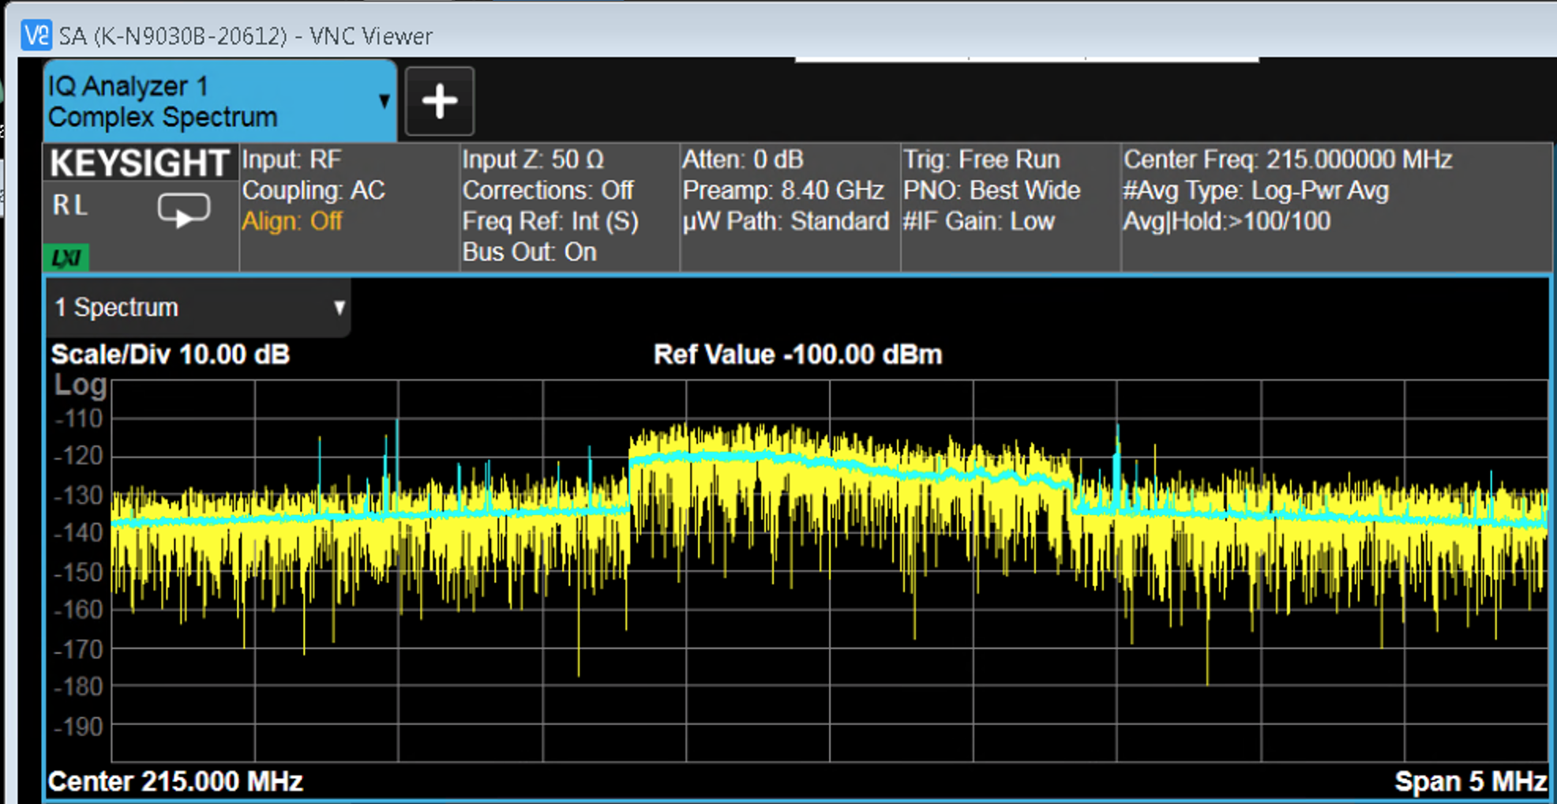
DATA-TAKING RESULTS
BACKGROUND (Environmental EMC NOISE)
07/2020
POWER
Frequency =>
Therefore: A simultaneous independent measurement with a second spectrum analyzer connected to an external antenna measuring the EM noise in the CAST area = A MUST: NOW INSTALLED!
frequency

Slide 16
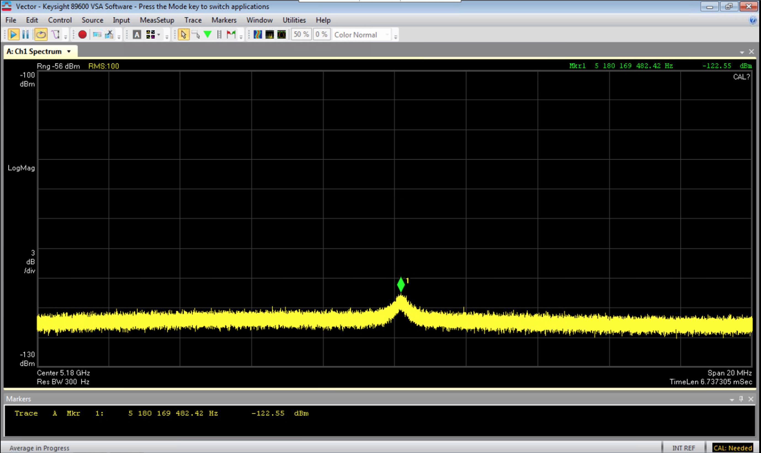
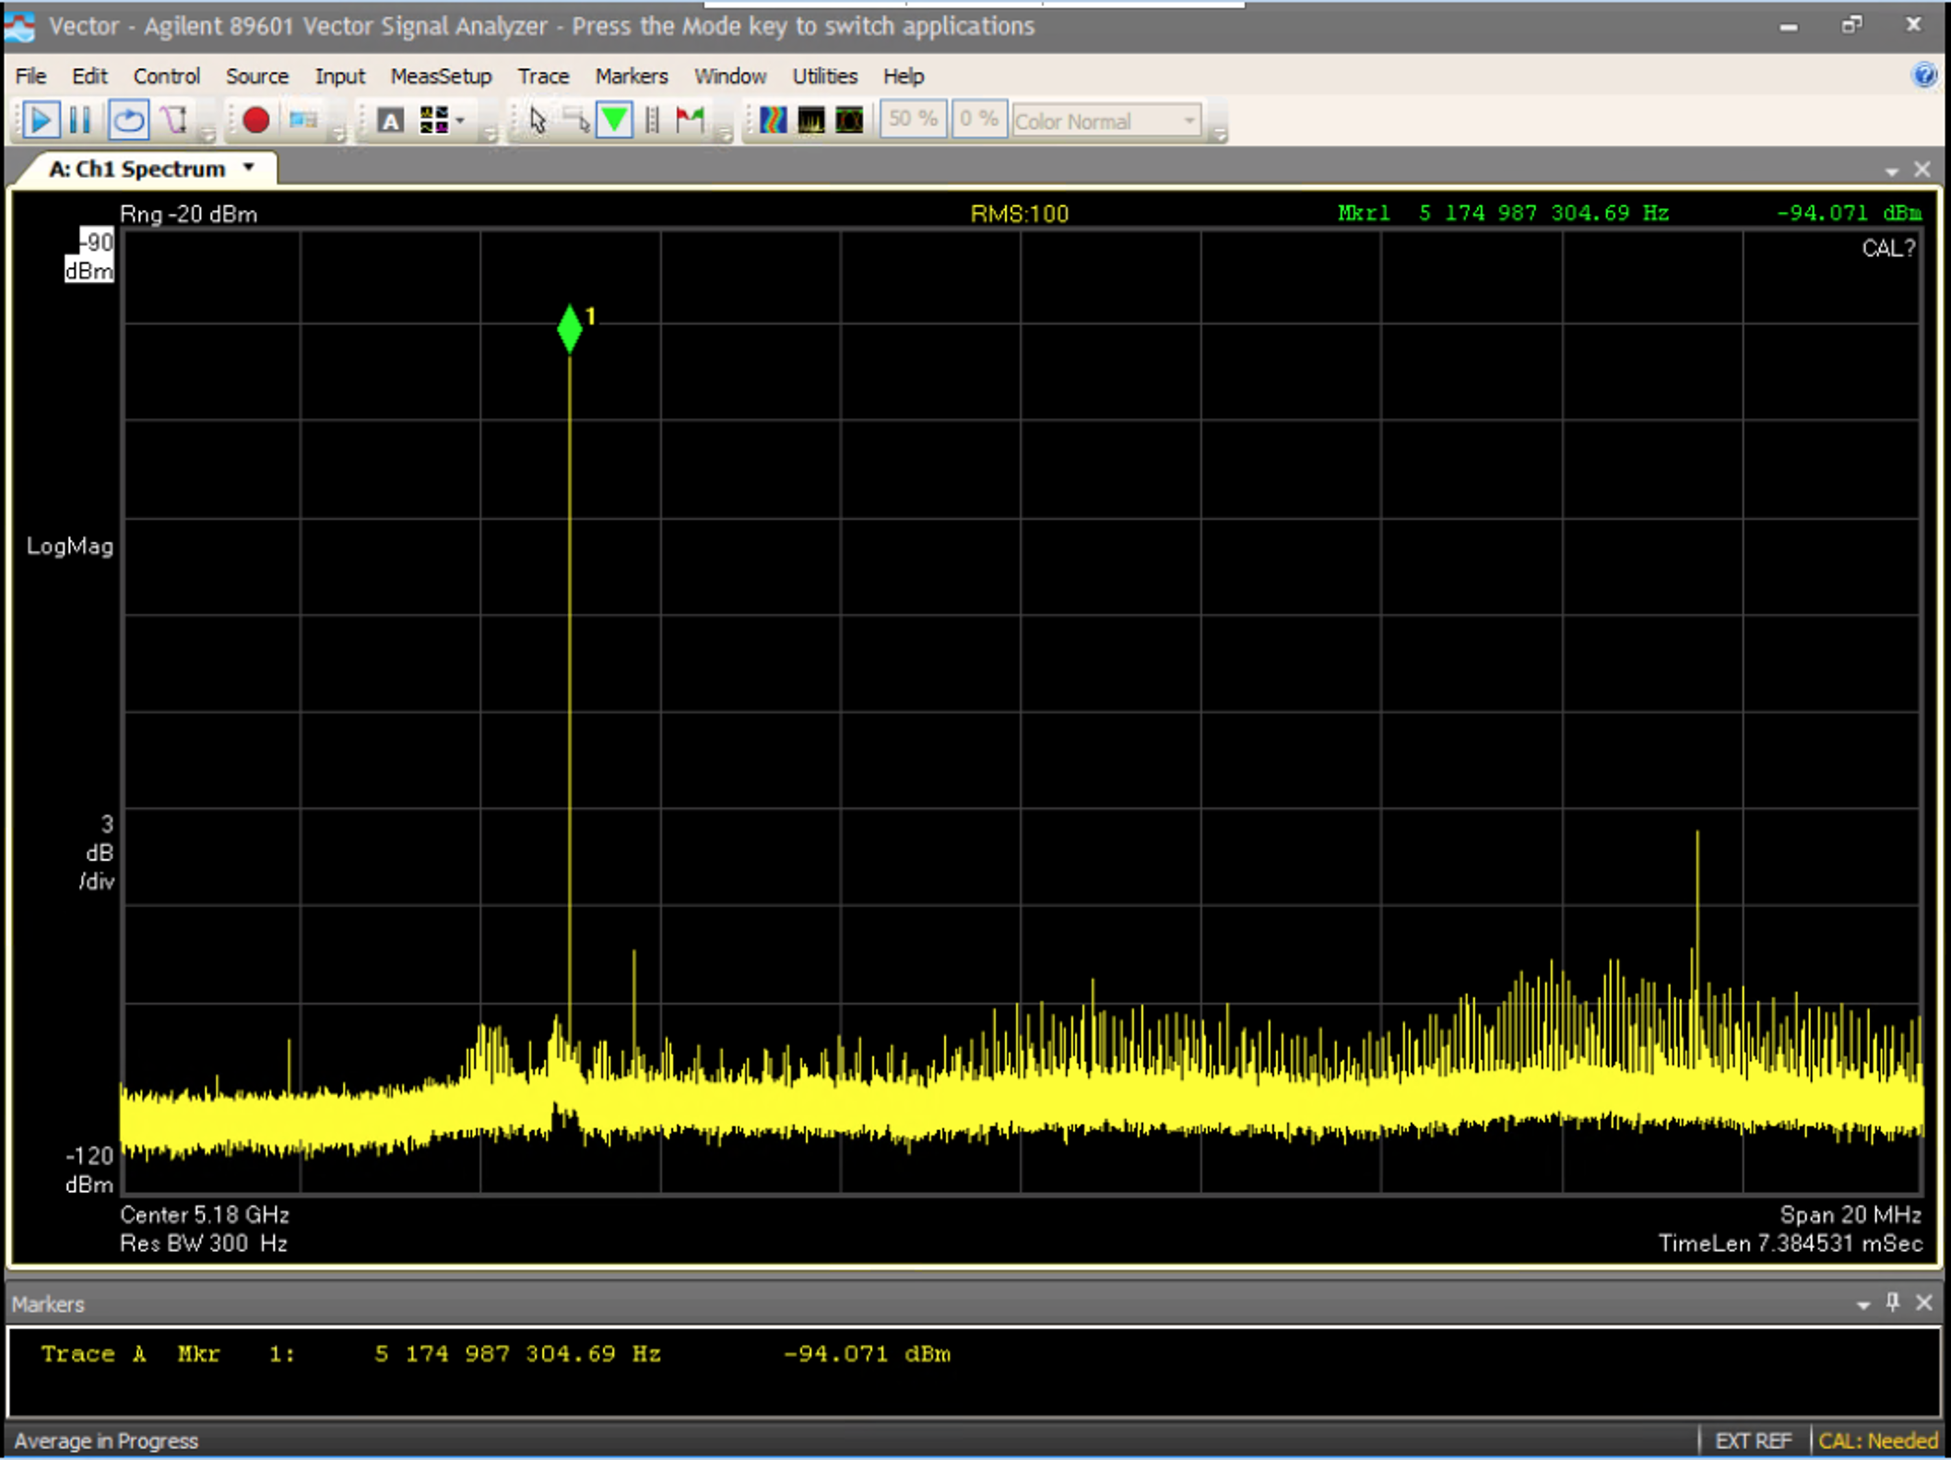
DATA-TAKING & Environmental EMC NOISE
Simultaneous comparison of data from cavities with EMC data
Both are in the frequency domain: FFT by the SA
Cavity 4 EMC noise in CAST area
Power excess
The noise bump ➔
Frequency =>
Frequency =>

Slide 17
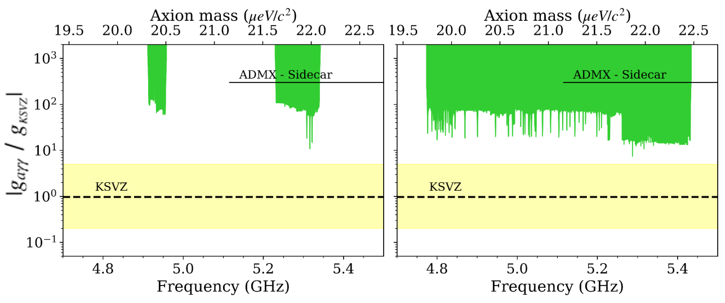
DATA ANALYSIS
Exclusion plot assuming Galactic DM axions
So far data-taking time with single & PM cavities and B=ON: 1461 hours
(60.9 days).
Spikes correspond to longer measurement times.
For comparison ADMX is also given
progress
09/2019 10/2020
PRELIMINARY

Slide 18
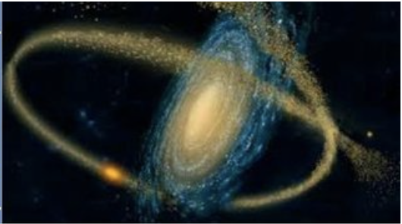
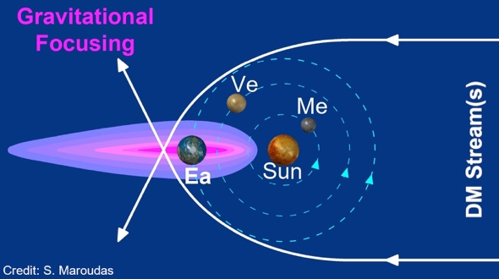
DATA-TAKING RESULTS
FAST TUNING (SINGLE CAVITIES)
Fast cavity tuning takes advantage of possible DM transients: streams / clusters
➔ gravitational (self-)focusing ➔ flux enhancement.
Special case free fall with low speed: ~46 km/s at 1 AU! [Adrien Leleu]
In total with single cavity and B=ON: 1013.2h (42.2 days) & ~660 MHz
Tidal streams

Slide 19
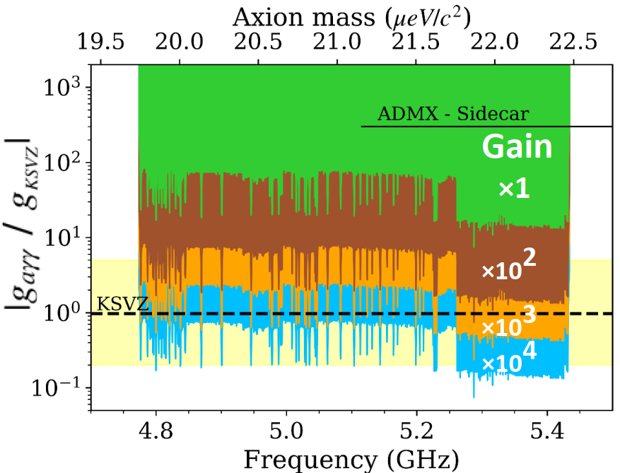
DATA ANALYSIS
SENSITIVITY plot for DM axions including flux enhancement
Due to gravitational lensing (by sun, …., Moon) or axion mini-clusters
Improvement due to streaming DM axions or axion-miniClusters lasting ~1 hour and for an increased flux by factor 10^{3±1} ➔ parasitically sensitive also to cosmological axion transients
10/2020
PRELIMINARY

Slide 20
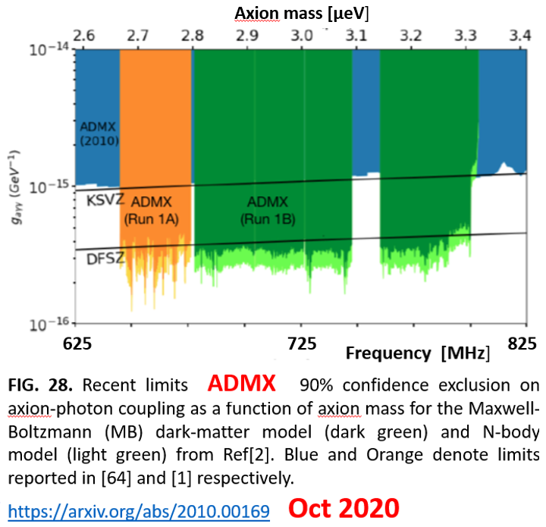
Comparison with ADMX around 0.5 - 0.8 GHz
CAST (660 MHz) vs. ADMX (200 MHz)
@~5 GHz @ <0.8 GHz
Higher axion mass ➔ a-Haloscopes less sensitive
=> volume effect

Slide 21
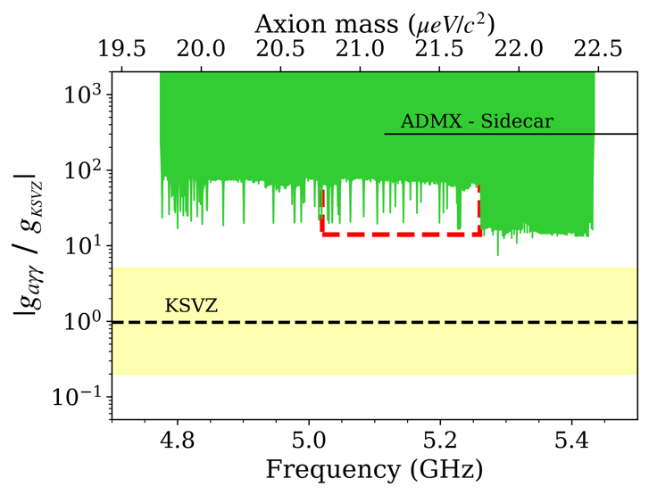
Future PROSPECTS
DATA taking
Projected relic axion detection sensitivity with the remaining 4 months (of the previously granted 6 months in total) of data taking.
Modest Flux enhancement due to streams / clusters reaches sensitivity to QCD axions.

Slide 22
CAST – CAPP conclusions
~2 months of data taken over the summer. We managed to cover a significant fraction of previously unexplored parameter axion space in the range of 19.7 to 22.4 μeV and exceeded the previous limits by ADMX-Sidecar by far.
Data taken with individual cavities as well as with all 4 cavities phase matched (=coherently).
More optimizations to extend the sensitivity even further are already being prepared and will result to world-leading results.
The full previously granted data taking time of 6 months, which due to COVID-19 would extend into 2021, is essential to achieve the planned sensitivity.
To fully exploit its sensitivity, we have recently installed a second spectrum analyser which measures simultaneously the ambient EM noise.
CAST-CAPP has pioneered the new technology of fast scanning and phase-matching of multiple cavities, which is capable to detect transient events from streaming dark matter or axion miniclusters.
an unambiguous detection of such events requires an independent detector at another location, therefore we are currently in contact with IBS Korea on the possibilities to facilitate the establishment of a 2nd detector there.

Slide 23
Other CAST activities
in parallel and parasitically to CAST-CAPP

Slide 24
CAST – Rades >> DM axions
>>> R&D for babyIAXO.
Cavity axion haloscope
Theses: Sergio Arguedas Cuendis
Jessica Golm
José María García Barceló

Slide 25
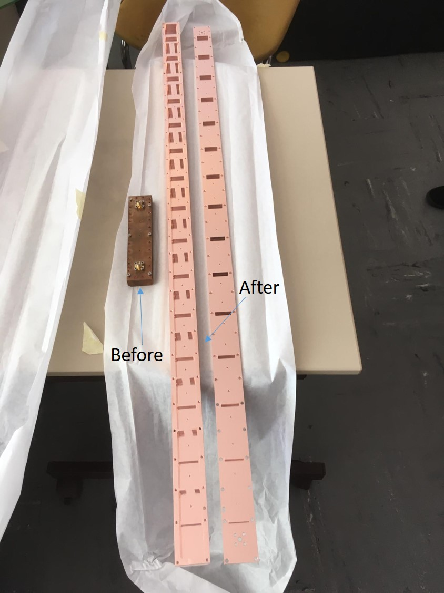
For 2020 data taking
RADES 1m long cavity
Increase of the detection volume by a factor 5 using a more complex cavity geometry relying on alternating irises theoretically shown to be more scalable than the previous cavity. The damaged cryogenic amplifier was replaced and has been functioning as expected.

Slide 26
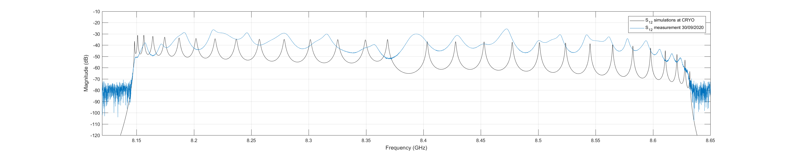
RADES 1m long cavity
measurement
Axion peak
simulation
The 2020 cavity Q-value is lower than expected.
Its EM response is also more complex and requires further characterization which are currently taking place.
Data taking with this cavity is ongoing.
Important R&D for babyIAXO.

Slide 27
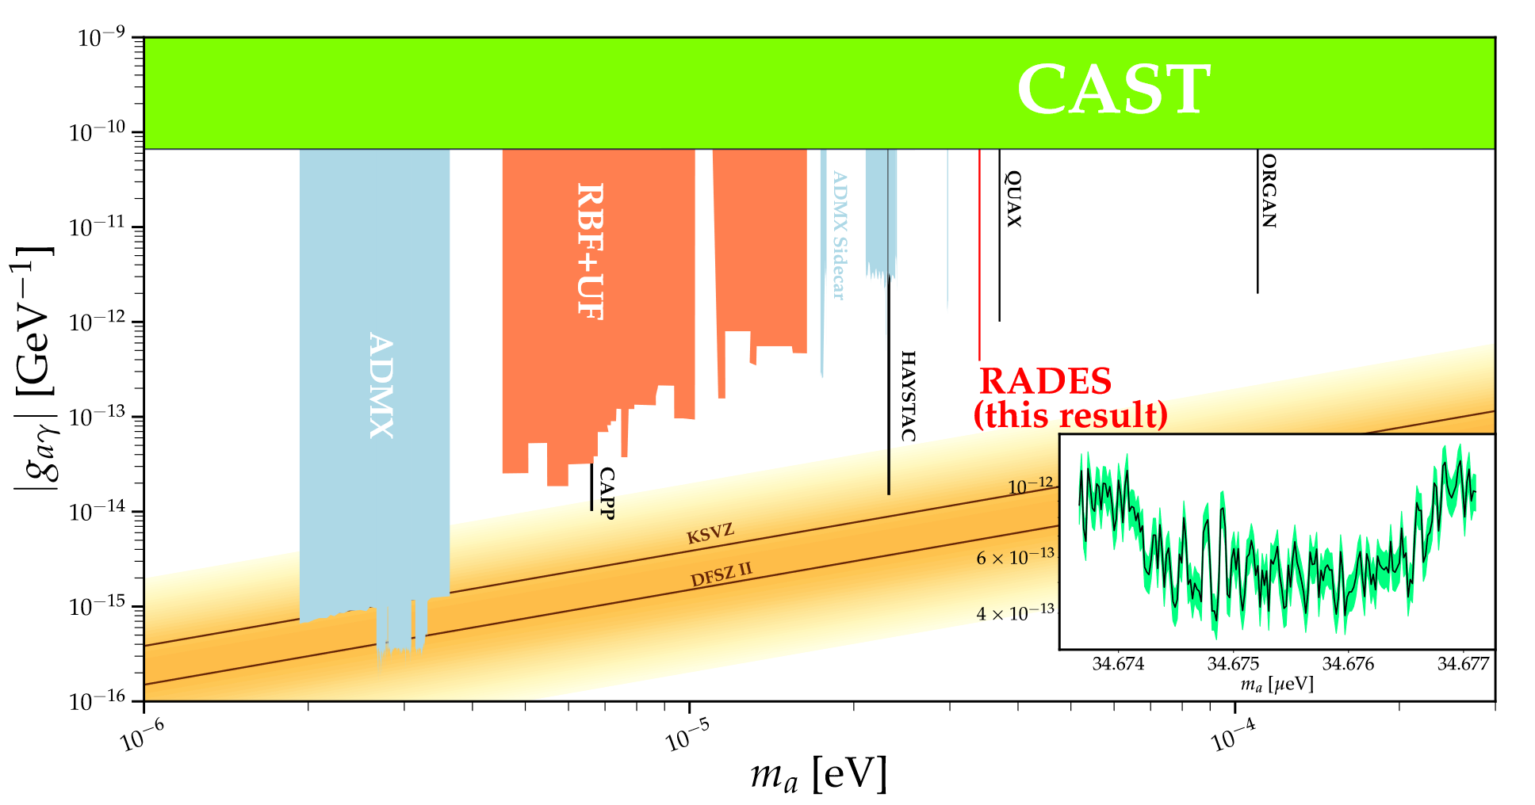
CAST-RADES preliminary exclusion limit
CAST-RADES exclusion limit using 2018 data-set in the context of other haloscope experimental results. Our result provides the strongest exclusion limit for an axion mass above 30 µeV.

Slide 28
CAST Micromegas detector
Solar axion search(DM)
with a new detector & the 2nd XRTelescope: first xenon data ➔
Important R&D for any future solar axion search , e.g. babyIAXO.
Theses: Cristina Margalejo Blasco,
Héctor Mirallas

Slide 29
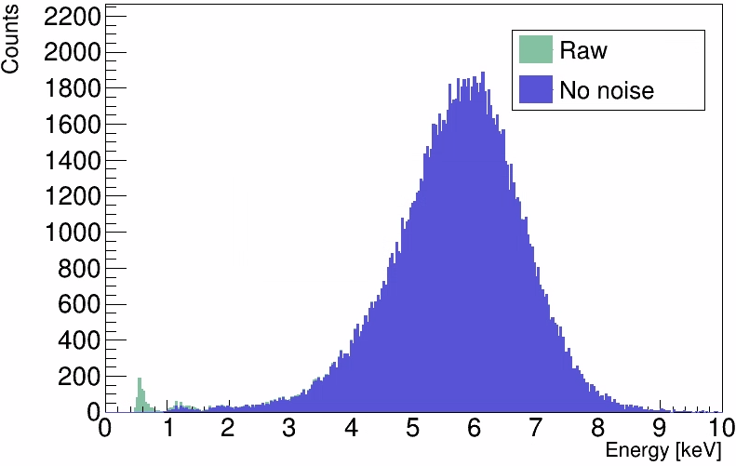
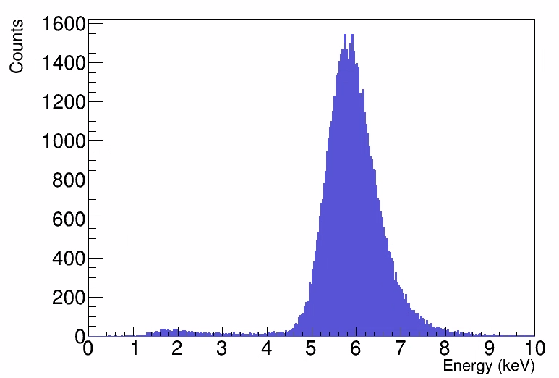
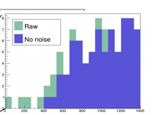
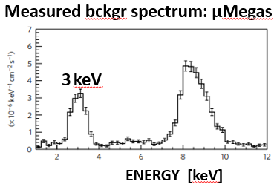
Xenon runs - calibration
Fe55 spectrum: Hit channels
Fe55 spectrum: All channels
3 keV
Xe + 50% Ne + 2.3% isobutane | Energy threshold | Resolution @ 5.9keV | Gain (5.9 keV peak in ADC)
Hit channels | 1100 eV | 37% | 5000
All channels | 700 eV | 19% | 8000
NATURE Phys.13(2017)584
Small peak at low energies (1 - 1.5keV). Possible fluorescence?
  Simulations will help define its energy.
  It will be useful for a better energy calibration at low energies.
  The argon fluorescence peak at ~3 keV no longer appears,
  reducing background level in that energy range. >> IMPORTANT!

Slide 30
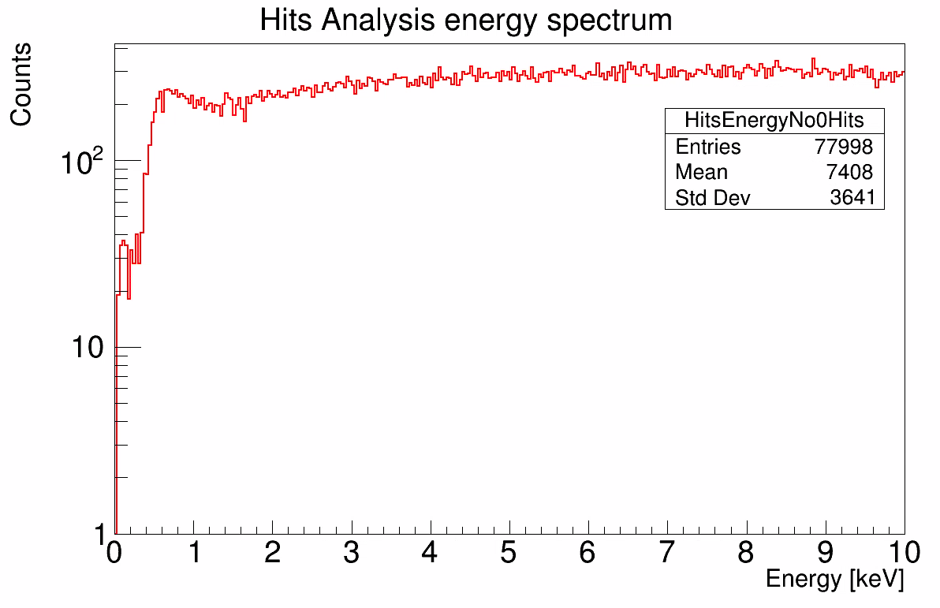
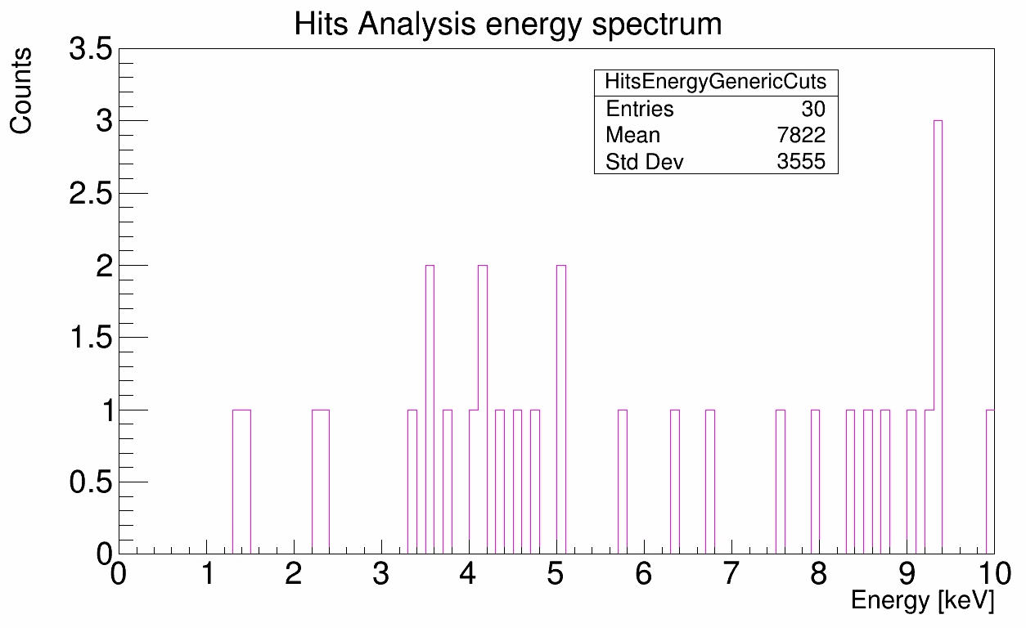
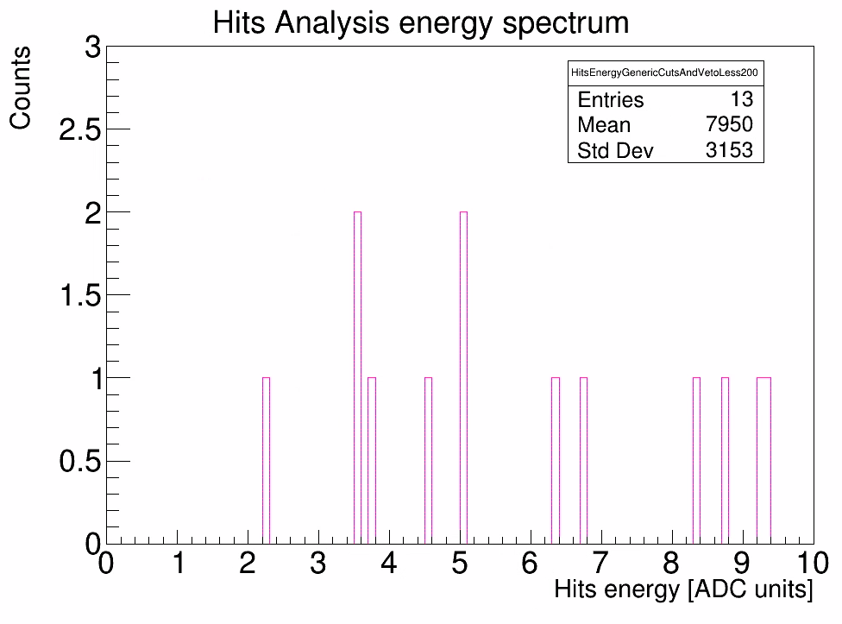
Xenon runs – background spectrum 224.5 h
Preliminary
Includes only 1-prong events
Raw spectrum (113.5h)
Generic cuts
Generic cuts and veto
3 keV
3 keV
6x10⁻³ c/keV/cm²/s
2.1x10⁻⁶ c/keV/cm²/s
1.2x10⁻⁶ c/keV/cm²/s
Background level for 1-prong events after
generic cuts based on ⁵⁵Fe calibrations with Xenon
NATURE Phys.13(2017)584
30

Slide 31
Summary
Ar+2.3% isobutane 2019 data taking campaign
  ~120 hours of tracking
  Background ~2x10⁻⁶ c/keV/cm²/s
  Analysis tools under development to achieve higher efficiency
Ar+2.3% isobutane 2020 data taking campaign
  ~35 hours of tracking
  Improved electronics configuration
Xe+50%Ne+2.3% isobutane 2020 data taking campaign
  35 hours & 23 trackings
  Saving all channels allows us to have higher gain, better energy resolution, lower energy threshold, and potentially better X-ray selection algorithms
Develop new analysis strategy that matches the new electronics configuration
Understand the differences we observe among different data taking campaigns and with the X-ray tube
Perform simulations for the different phenomena we observed
Possible re-calibration of the detector in the X-ray tube
Next steps

Slide 32
InGrid
Integrated Grid
solar chameleons (dark energy) & low energy solar axions (DM)
with a sensitive low energy x-ray detector

Slide 33
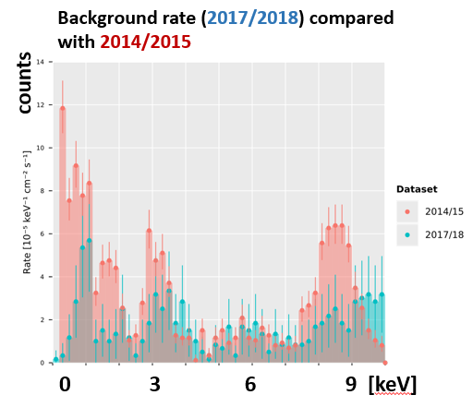
InGrid
Data analysis of the 2017/18 data nearing completion on the software
side.
Analysis framework including limit calculation is done.
Background rate still preliminary, due to:
usage of detector vetoes via scintillators to be finalized (cut values to be fixed)
GridPix(= Timepix + InGrid). Outer 6 GridPix validation for background rate over whole chip outstanding (=> understand clusters near chip edges
- data lossy, gap between chips)
Possible improvement from better FADC utilization
significant variation of photo peak position (in charge or pixels) of ⁵⁵Fe calibration data observed. Current energy calibration suffers possible bias because of this. Excess of 2017/18 in plot near 4 and 9.5 keV likely due to overestimate of energy in part of dataset.
Finally, a structured check of the whole analysis pipeline is ongoing
to verify no major bugs are hiding, by validating all intermediate steps.

Slide 34

Status of the KWISP detector
Working group: J. Baier, D. Božičević, G. Cantatore, S. Cetin,
H. Fischer, A. Gardikiotis, M. Karuza, Y. Semertzidis, K. Zioutas
Detection by radiation pressure
on a Si₃N₄ nano - membrane
Theses: Justin Baier
Martin Markanovic
Dorotea Bozicevic

Slide 35
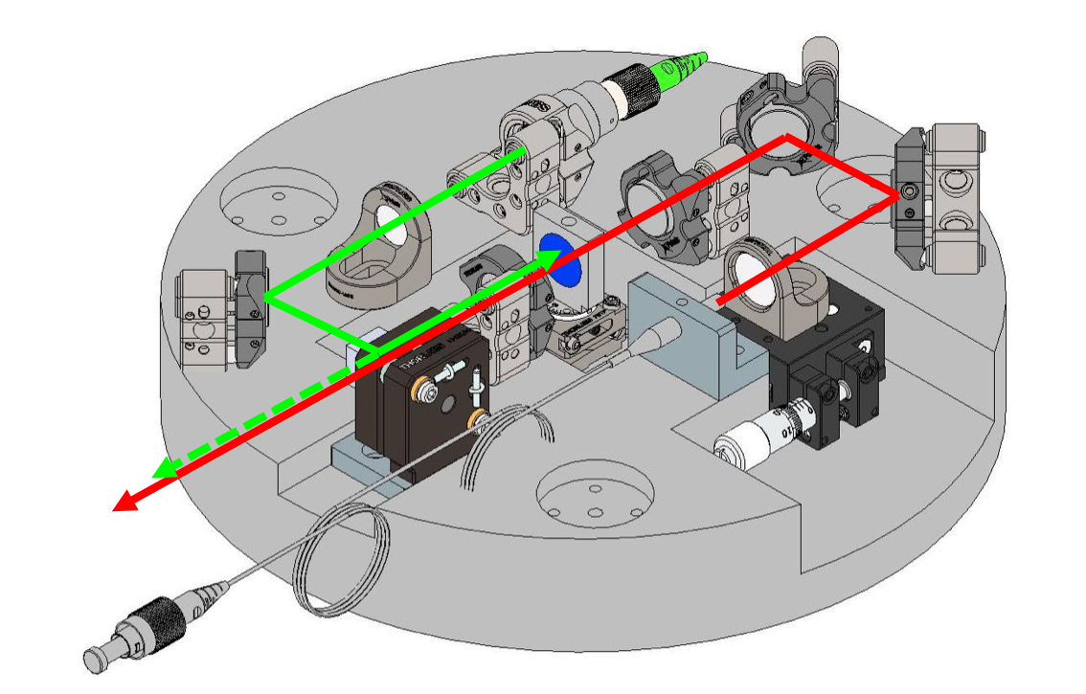
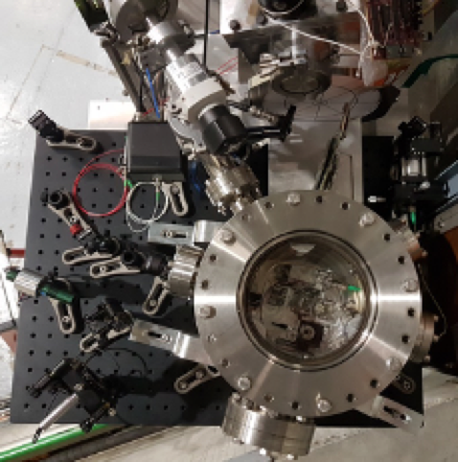
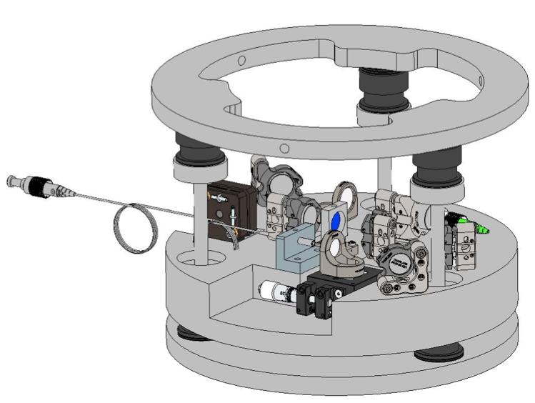

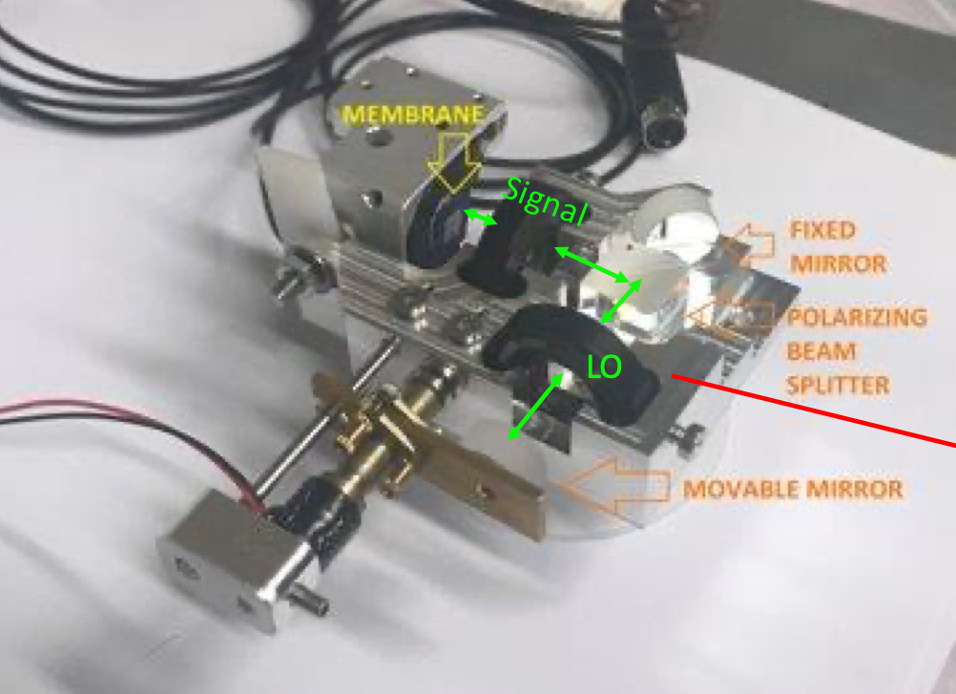
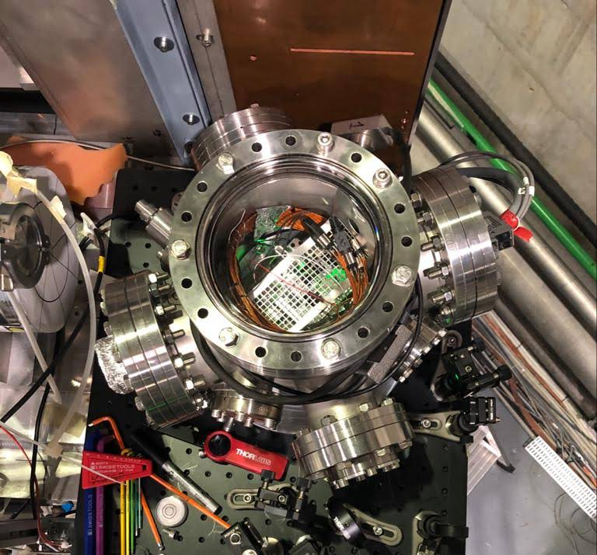
KWISP current version overview
KWISP 3.5
  Fabry-Pérot interferometer with full fiber-optic beam transport
  improved monolithic optics design
  uncoated membrane
  “sandwich-type” passive vibration isolation
  built-in force calibration with auxiliary beam
  DMD chopper
KWISP 1.5
  Michelson interferometer
  monolithic design
  high density Pt coated membrane
  “sandwich-type” passive vibration isolation
  “chopper-less” detection
Already acquired ~ 9h of sun-tracking data
Data taking continues
Short sun-tracking run in January 2020
Presently under test
and calibration in
the laboratory
35

Slide 36
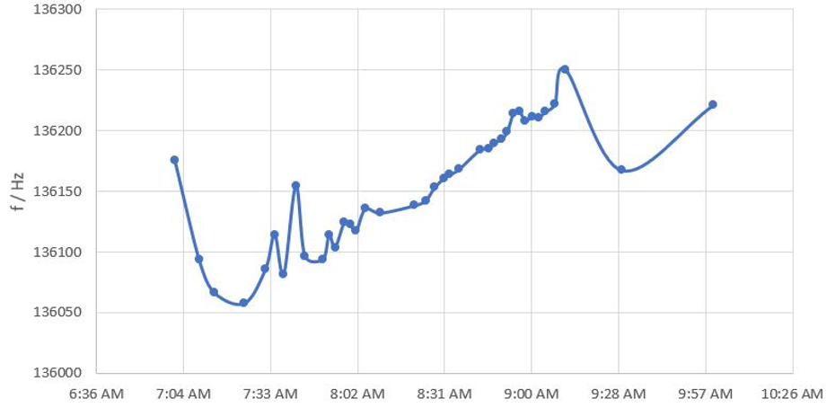
KWISP 1.5 status
Parasitic tracking performed in January 2020 with KWISP 1.5
  Sensitive to a static force ⇒ change in the frequency of the membrane mechanical resonant mode
  Now under calibration in the laboratory to check for long term pressure and temperature effects
  Preliminary force sensitivity in the pN range
FORCE =>
TIME =>
Sample KWISP 1.5 data from the 23/1/2020 sun tracking run
The linear trend can be interpreted as due to the variation of the component of the gravity force normal to the membrane surface when the CAST magnets tilts vertically
36

Slide 37
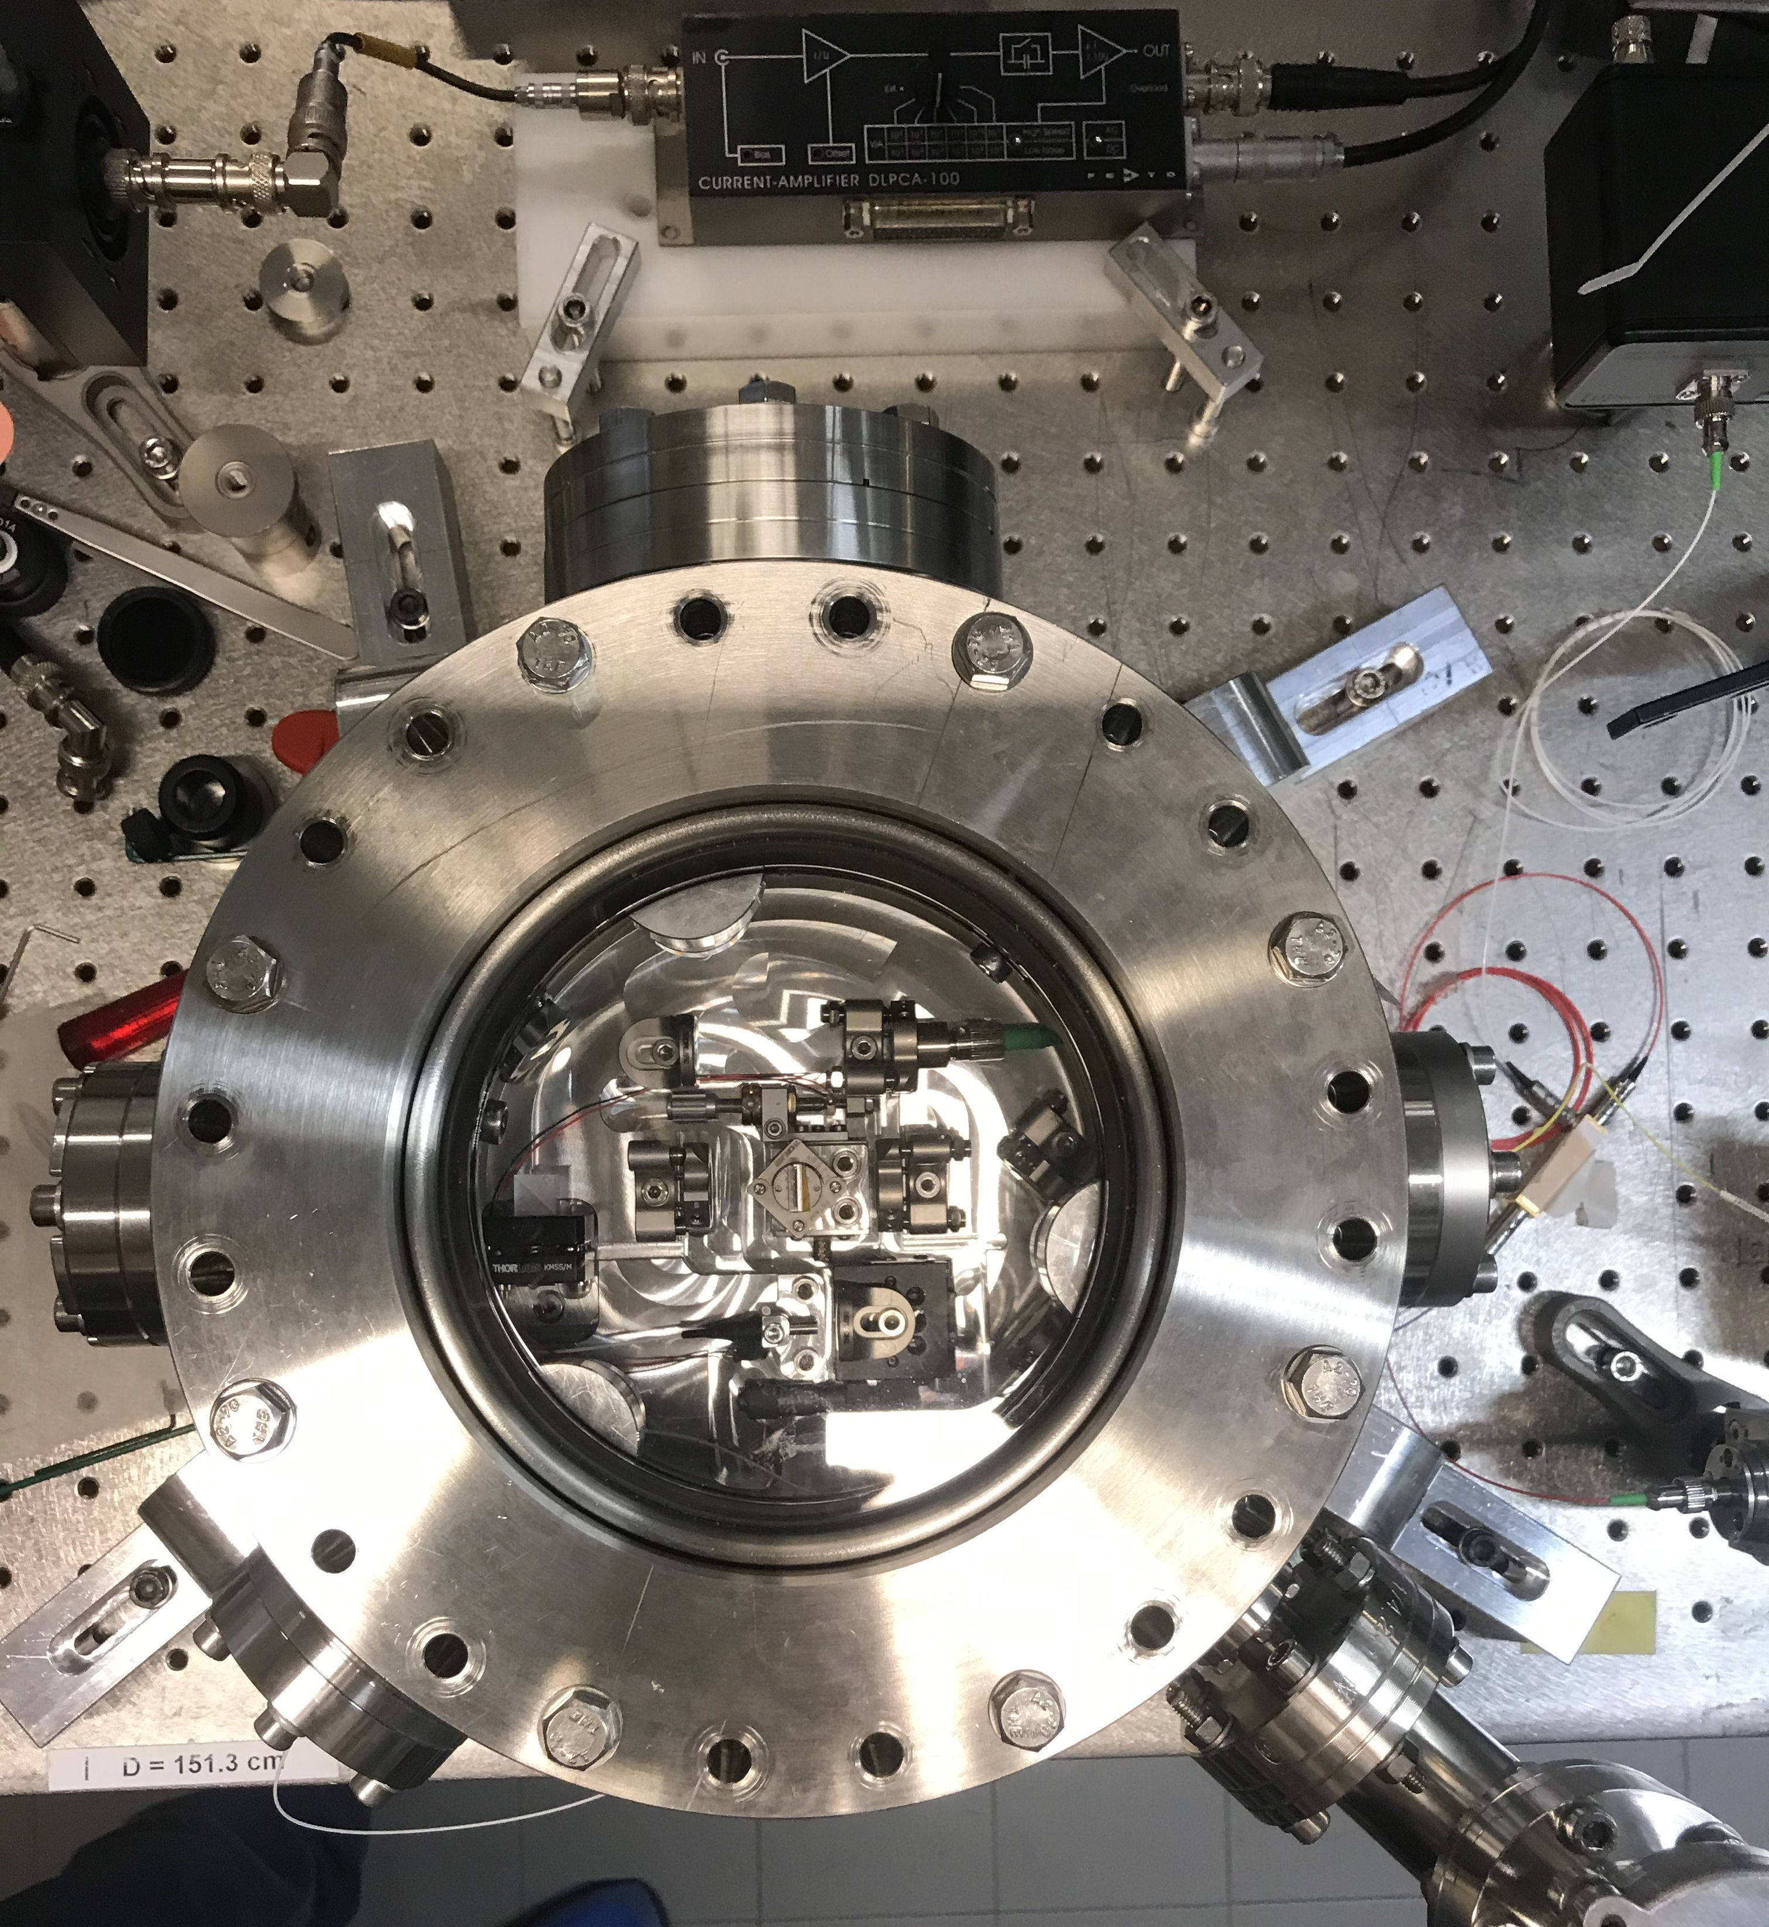
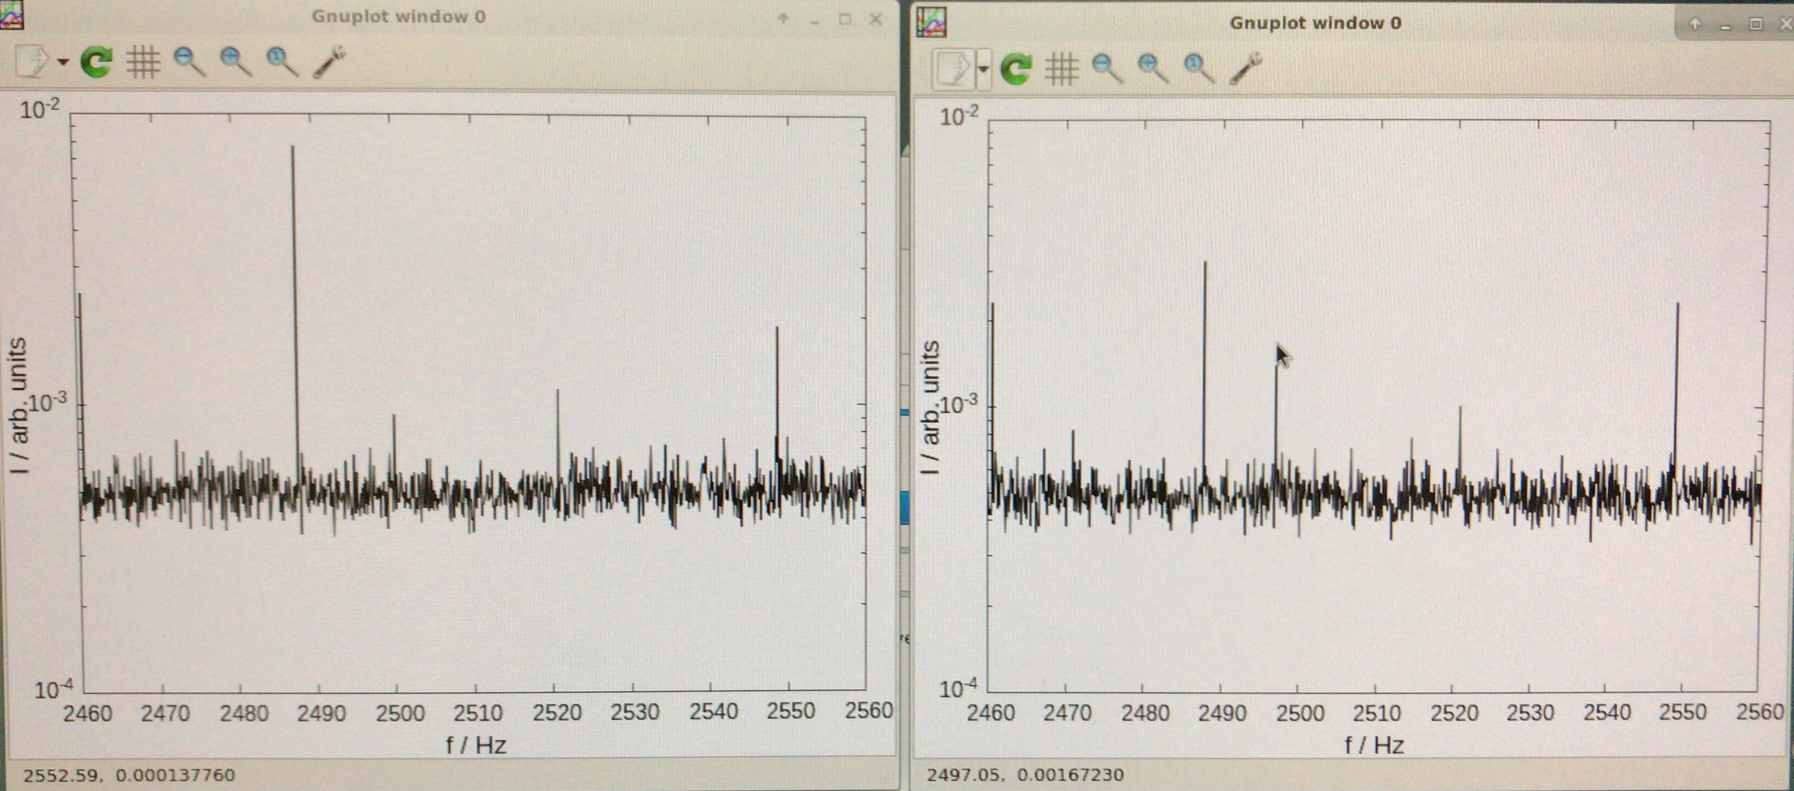
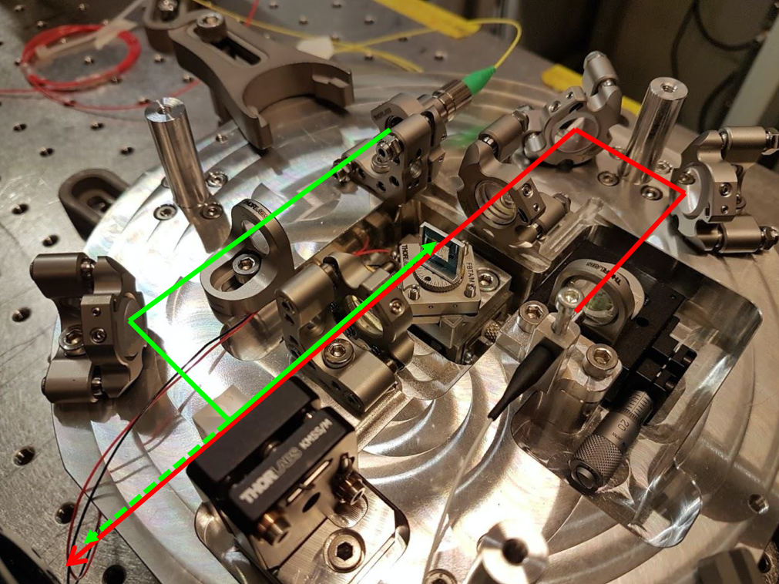
KWISP 3.5 calibration
KWISP 3.5 is home made
  stable lock under vacuum
  successful direct force calibration with built in auxiliary 532 nm laser beam (amplitude-modulated at a controlled frequency)
  Preliminary sensitivity estimate from direct calibration
  8∙10⁻¹² N⁄ √Hz @ 2.5 kHz
“no” peak
applied force peak
External force OFF
External force ON
Direct force calibration near the chopper expected frequency of operation (~2.5 kHz)

Slide 38
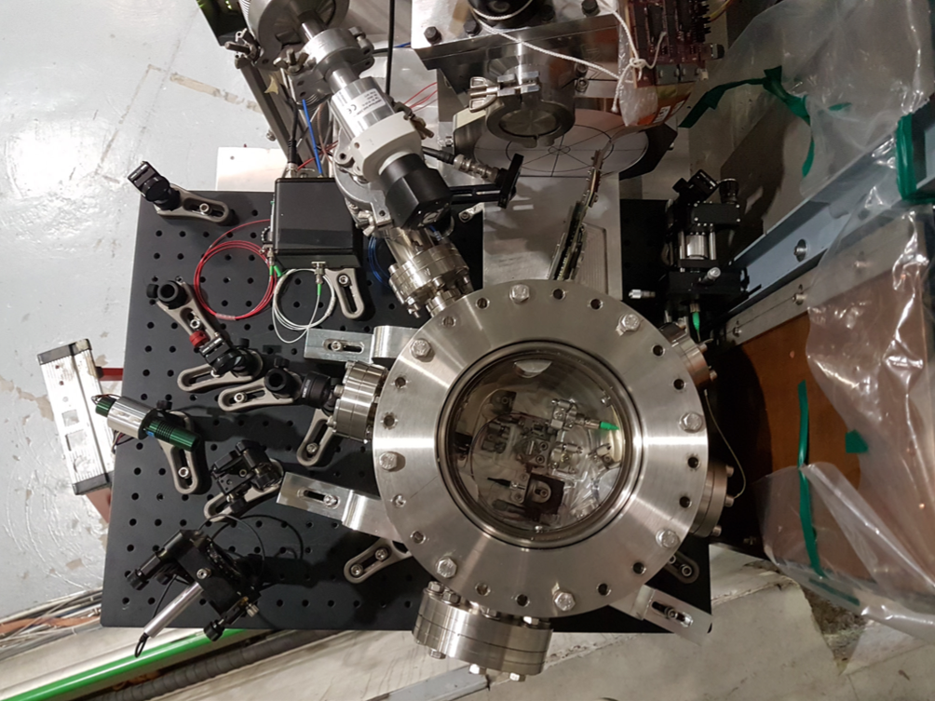
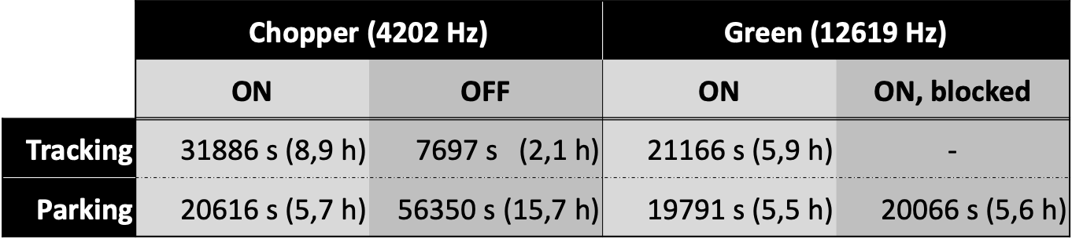
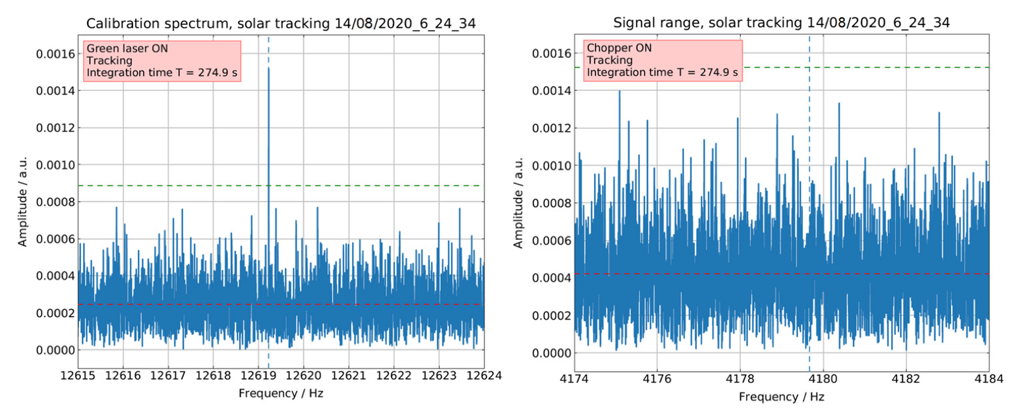
KWISP 3.5 preliminary sun-tracking runs
July 2020: Installation
August 2020: Sun-tracking- parasitically, no magnetic field needed
  Sun tracking data: 11 hours.
  Background & Calibration: 21.3 hours.
  Preliminary sensitivity 28 pN/√Hz
No solar signal yet
Minimum force detected in 275 s was ~3.3 pN, MORE DATA AVAILABLE: ~30000 sec. Therefore,
>10× better min detected force
calibration run
5σ level
tracking run
5σ level
Avg. noise level
Avg. noise level
calibration frequency
chopper frequency

Slide 39
KWISP next steps
>>> parasitically
KWISP 3.5
  Complete analysis of taken data
  faster online calibration (under way)
  continue taking solar data as long as possible
KWISP 1.5
  study long term stability

Slide 40
CAST conclusions
~2 months of data taken over the summer, now stopped up to mid of November due to water tower maintenance (not related to CAST).
Fast tuned & phase matched cavities pioneered by CAST.
The full previously granted data taking time of 6 months, which due to COVID-19 would extend into 2021, is essential to achieve the planned sensitivity.
The missing 4 months of data taking are extremely important for the theses of our students.
The estimated remaining data taking time for 2020 is less than 1 month. For the DM search the efficiency is
~18 h/24.

Slide 41
Backup slides

Slide 42
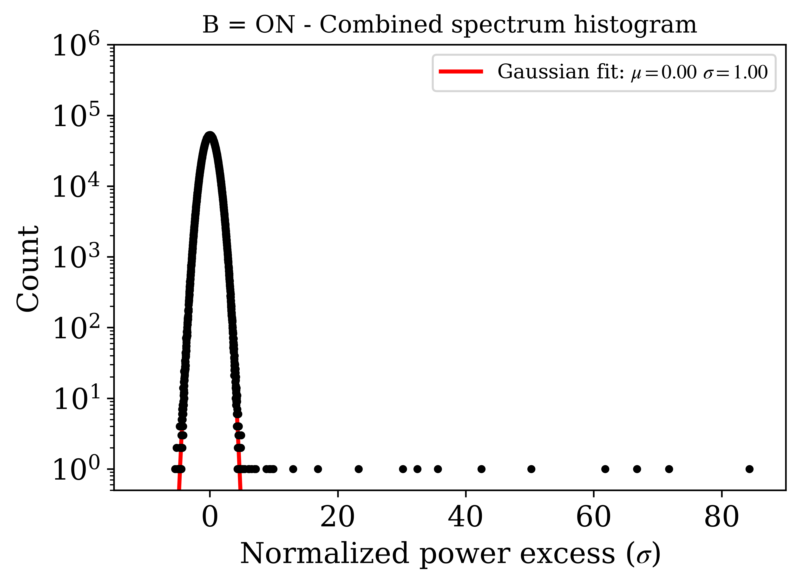
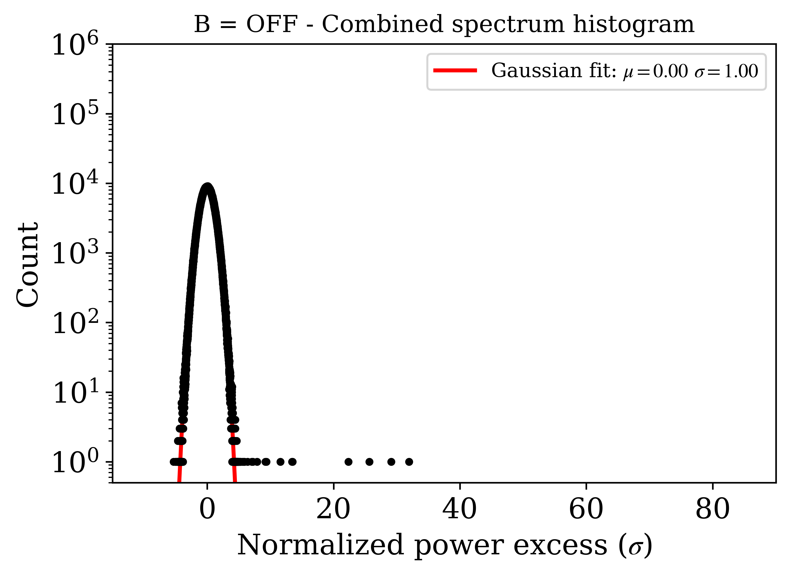
DATA ANALYSIS
Beyond the ~5kHz signal search
Histogram of the combined spectrum with a gaussian fit (in red). Combined spectra are more appropriate for DM transients due to non-restriction to a ~5kHz signal search.

Slide 43
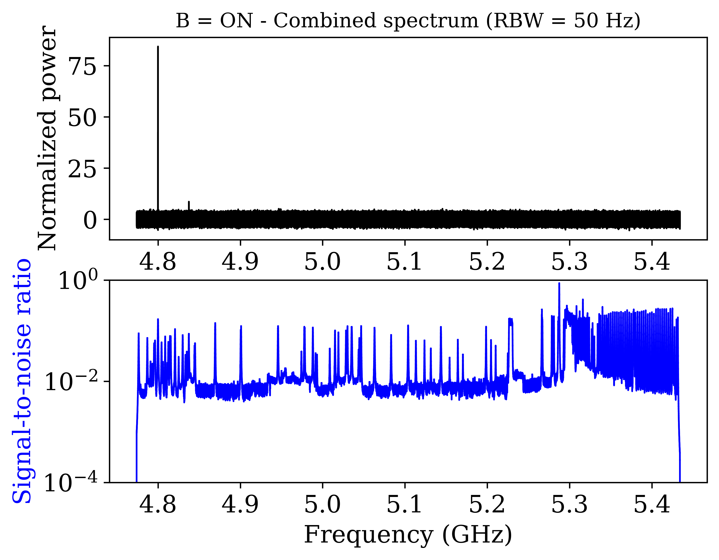
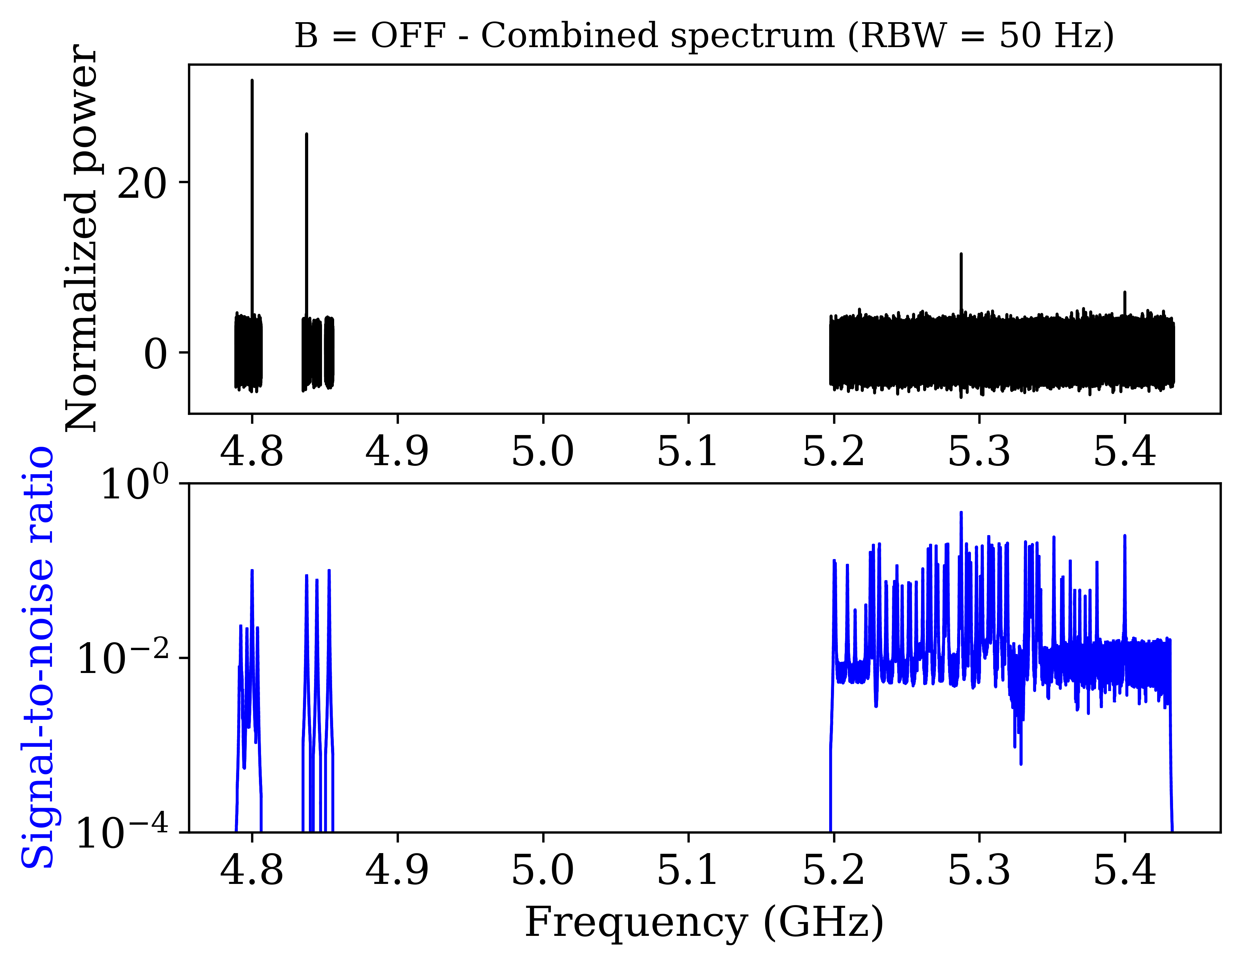
DATA ANALYSIS
Results
Combined spectra are more appropriate for transients (no width constraint).

