Slide 1
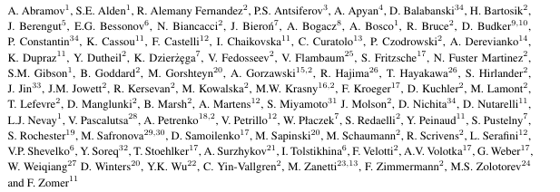
Gamma Factory:
Proof of Principle Experiment
SPSC-I-253
Yann Dutheil (CERN), Aurélien MARTENS (IJCLab Orsay),
Mieczyslaw Witold KRASNY (LPNHE Paris and CERN), on behalf of
The Gamma Factory study group
88 people from 34 institutes from 15 countries

Slide 2
Outline
Gamma Factory
Scientific context
Why a Proof of principle experiment ?
The Proof of principle experiment

Slide 3
Gamma Factory:
The scientific context

Slide 4
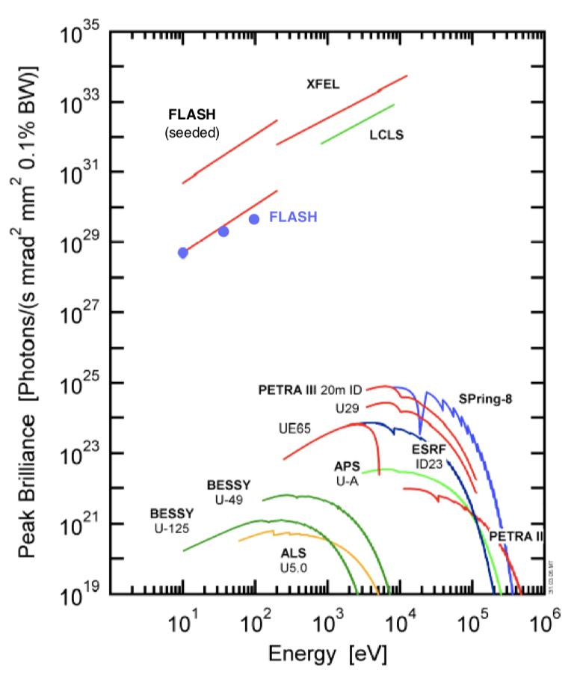
A striking fact
Weise, LINAC 2006 proceedings;
Few 100’s keV at most

Slide 5
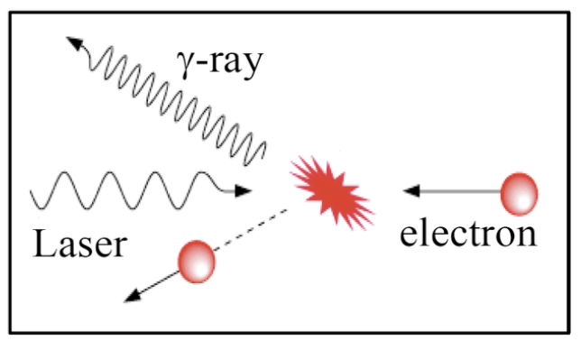
A striking fact
No bright photon source for nuclear and particle physics applications !
FEL and synchrotron impracticable
Weise, LINAC 2006 proceedings;
Inverse Compton scattering ?
Excellent monochromaticity but
O(1barn) cross-section is low !
ICS lie here
10’s keV—100 MeV
Example : HI𝛾S@Duke, 10¹⁰ ph/s, 1-100MeV

Slide 6
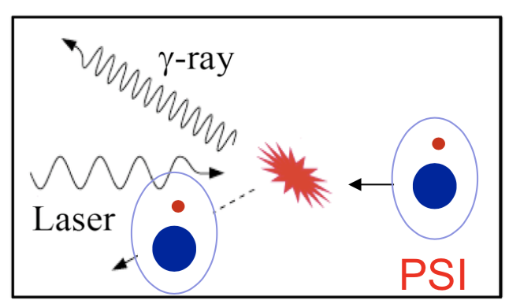
Physics concept
💡: Exploit high cross-section of atomic resonances & existing CERN accelerator complex
E. J. Bessonov & K.J. Kim Phys. Rev. Lett. 76, 431, M.W. Krasny arXiv:1511.07794,
D Winters et al 2015 Phys. Scr. 2015 014048
High-energy
PSI: Partially stripped ions
Very similar with Inverse Compton scattering but O(10⁹) larger cross-section !
For instance
H-like Xenon at LHC (𝛾=3000) → 180 MeV
Energy upshifting by a factor 4𝛾²
Li-like Calcium at SPS (𝛾=130) → 80 keV

Slide 7
Physics concept
💡: Exploit high cross-section of atomic resonances & existing CERN accelerator complex
A technique already employed for spectroscopy
also with relativistic ion beams (𝛾⋍1) at FAIR (ESR, 2005)
E. J. Bessonov & K.J. Kim Phys. Rev. Lett. 76, 431, M.W. Krasny arXiv:1511.07794,
D Winters et al 2015 Phys. Scr. 2015 014048
High-energy
PSI: Partially stripped ions
but Never used as a photon source so far !!!
Very similar with Inverse Compton scattering but O(10⁹) larger cross-section !
For instance
H-like Xenon at LHC (𝛾=3000) → 180 MeV
Energy upshifting by a factor 4𝛾²
Li-like Calcium at SPS (𝛾=130) → 80 keV

Slide 8
Physics concept
💡: Exploit high cross-section of atomic resonances & existing CERN accelerator complex
E. J. Bessonov & K.J. Kim Phys. Rev. Lett. 76, 431, M.W. Krasny arXiv:1511.07794,
D Winters et al 2015 Phys. Scr. 2015 014048
High-energy
PSI: Partially stripped ions
Very similar with Inverse Compton scattering but O(10⁹) larger cross-section !
👍🏻 PSI recycling in ring is very efficient (relative energy loss << beam energy spread)
👍🏻 Energy tunability provided by PSI species choice and ion beam energy (<400MeV w/ LHC)
👎🏻 Laser wavelength must be « tuned » to PSI species and beam energy
👎🏻 Laser must be placed in a harsher environment (compared to e⁻ accelerators)

Slide 9
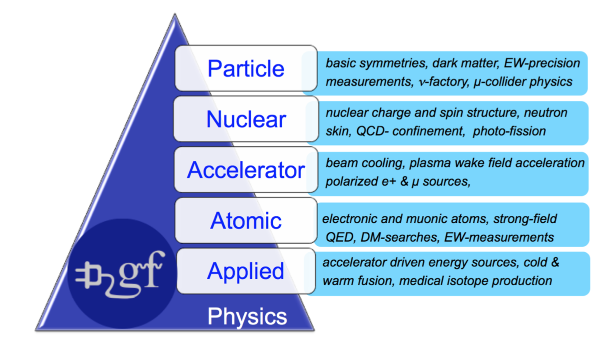
Implications of Gamma Factory
High potential to open new opportunities in many branches of physics
M. W. Krasny et al. SPSC-I-253, M.W. Krasny arXiv:1511.07794

Slide 10
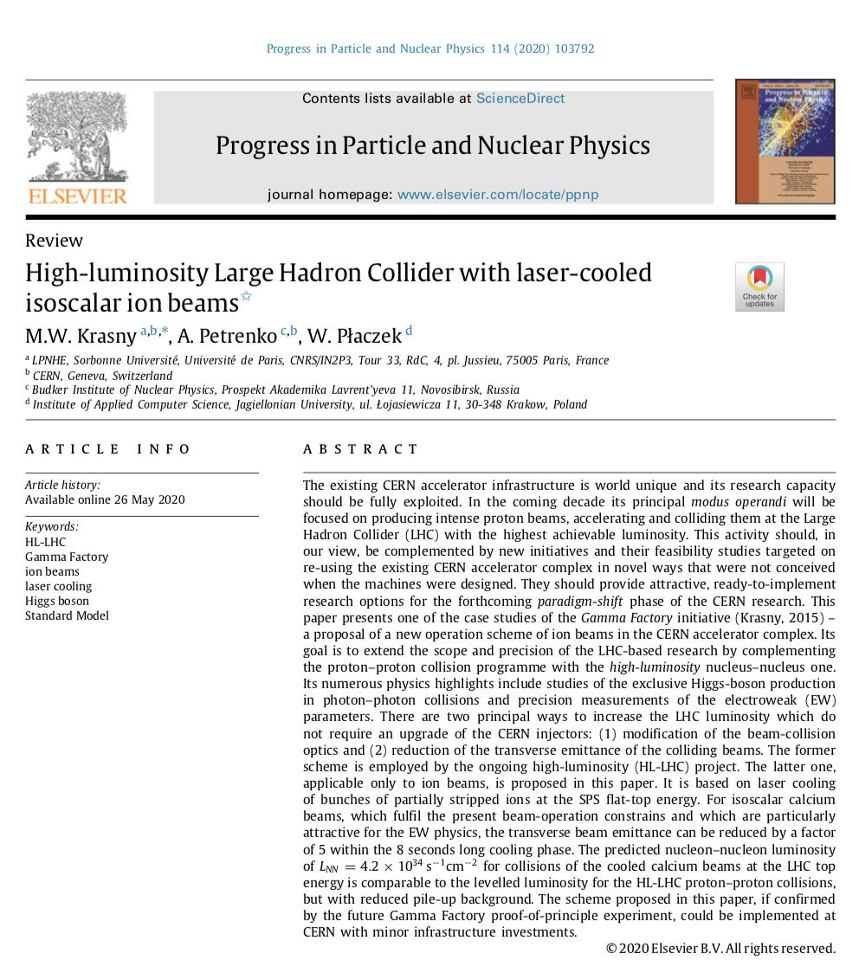
Implications of Gamma Factory
High potential to open new opportunities in many branches of physics
M.W. Krasny et al., Progress in Particle and Nulcear Physics. 114 (2020) 103792,
D. Budker etal., Ann. Phys. (Berlin) 2020, 532, 2000204

Slide 11
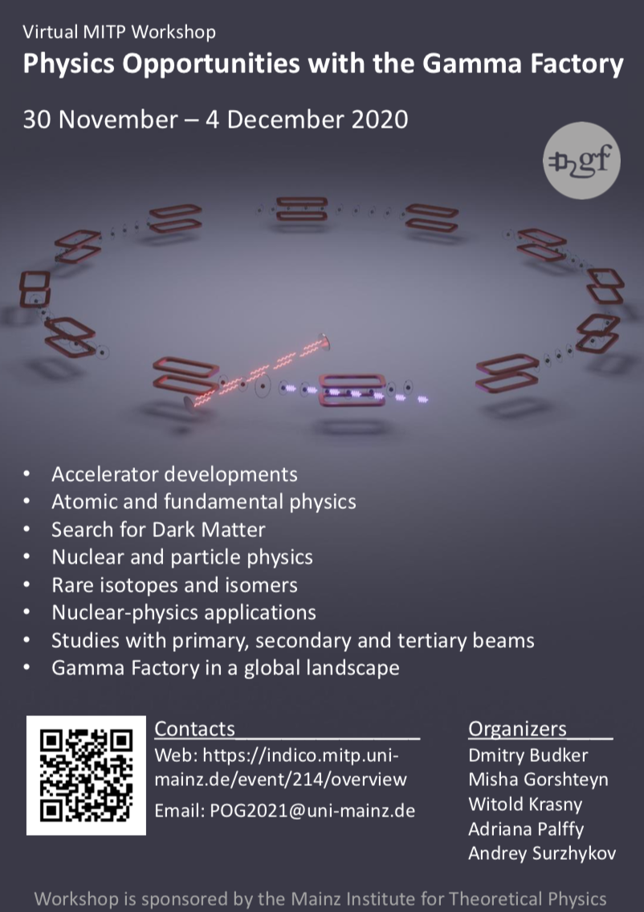
Implications of Gamma Factory
High potential to open new opportunities in many branches of physics
Currently being assessed for various « applications » of the concept

Slide 12
Gamma Factory:
Why a Proof of Principle experiment ?

Slide 13
Two critical milestones
Demonstration at the SPS that there is no showstopper for the operation GF concept
Quantitative evaluation of the Gamma Factory potential for various branches of physics
The ‘raison d’être’ of the Gamma Factory Proof of principle experiment
On-going detailed case-by-case studies
Necessary inputs to a further implementation at LHC

Slide 14
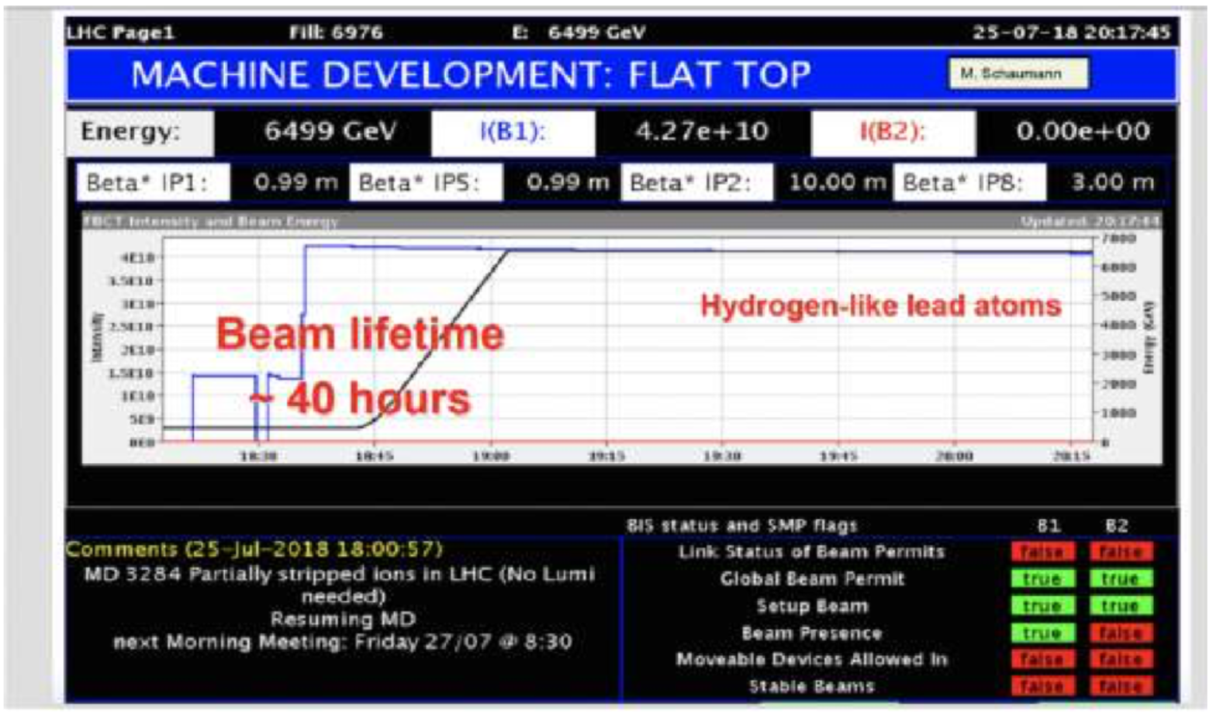
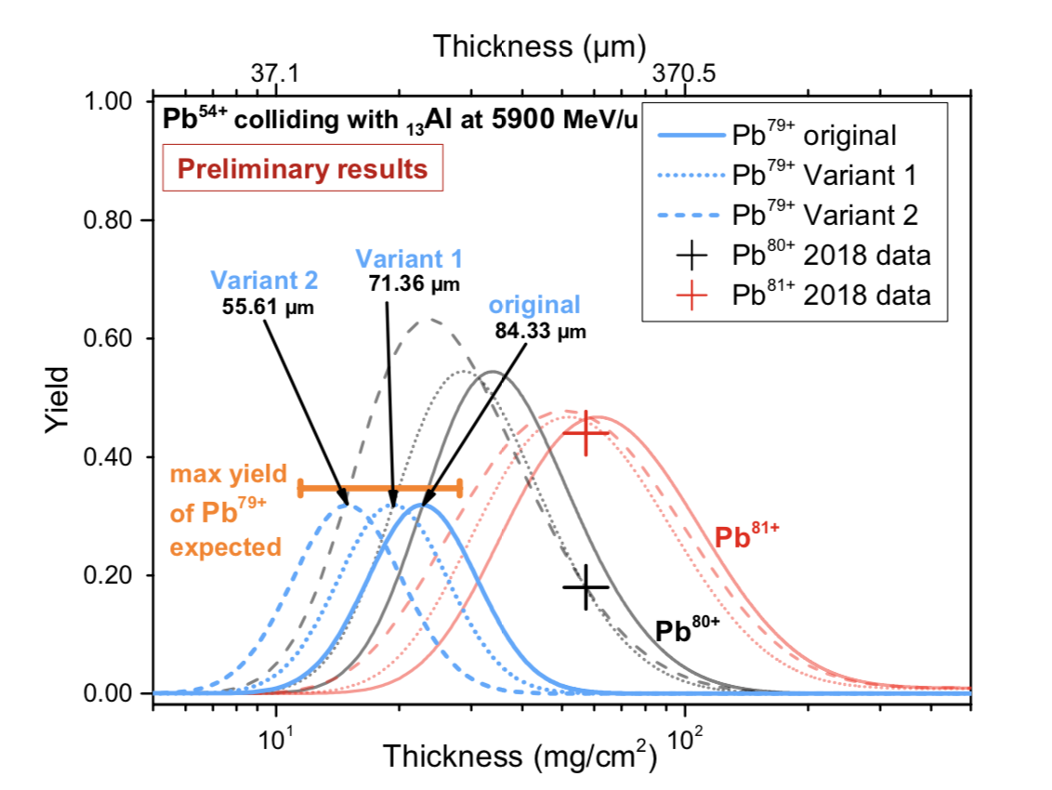
Atoms in the LHC !
1
Demonstration of efficient production, acceleration and storage of atomic beams in the CERN accelerator complex
Building up the physics cases for the LHC-based GF research programme and attracting wide scientific communities to use the GF tools in their respective research.
Elaboration of the Technical Design Report (TDR) for the (HL-)LHC-based GF research programme.
Extrapolation of the SPS PoP experiment results to the (HL-)LHC case and realistic assessment of the performance figures of the LHC-based GF programme.
6
5
4
Successful execution of the GF PoP experiment in the SPS.
Development of the requisite GF research programme simulation tools.
3
2
✓
2018 demonstration allowed us to estimate the Al-foil thickness optimized fo Pb⁷⁹⁺

Slide 15
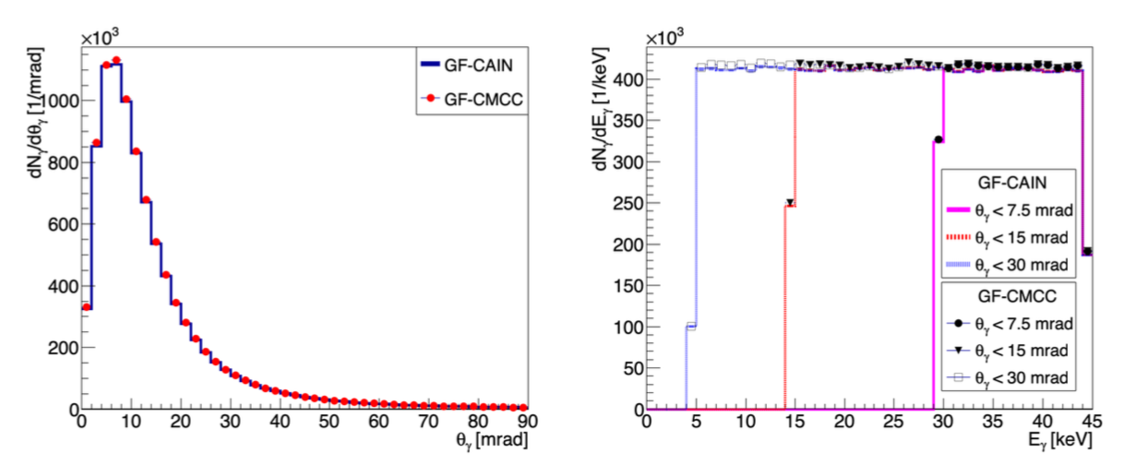
Simulation tools: cross-checked
1
5
Extrapolation of the SPS PoP experiment results to the (HL-)LHC case and realistic assessment of the performance figures of the LHC-based GF programme.
6
Elaboration of the Technical Design Report (TDR) for the (HL-)LHC-based GF research programme.
4
2
3
Successful execution of the GF PoP experiment in the SPS.
Building up the physics cases for the LHC-based GF research programme and attracting wide scientific communities to use the GF tools in their respective research.
Demonstration of efficient production, acceleration and storage of atomic beams in the CERN accelerator complex
Development of the requisite GF research programme simulation tools.
✓
✓
Two existing softwares improved for GF use + dedicated ones provide consistent
Excitation rates
Angular distributions
Energy distributions
Polarisation (on-going)
M. W. Krasny et al. SPSC-I-253

Slide 16
Where do we stand ?
1
5
Extrapolation of the SPS PoP experiment results to the (HL-)LHC case and realistic assessment of the performance figures of the LHC-based GF program.
6
Elaboration of the Technical Design Report (TDR) for the (HL-)LHC-based GF research program.
4
2
3
Successful execution of the GF PoP experiment in the SPS.
Building up the physics cases for the LHC-based GF research program and attracting wide scientific communities to use the GF tools in their respective research.
Demonstration of efficient production, acceleration and storage of atomic beams in the CERN accelerator complex
Development of the requisite GF research program simulation tools.
✓
✓
TODAY’s subject to approval
M. W. Krasny et al. SPSC-I-253, M.W. Krasny arXiv:1511.07794

Slide 17
Gamma Factory:
The PoP experiment
Testing the concept with minimum cost and nuisance

Slide 18
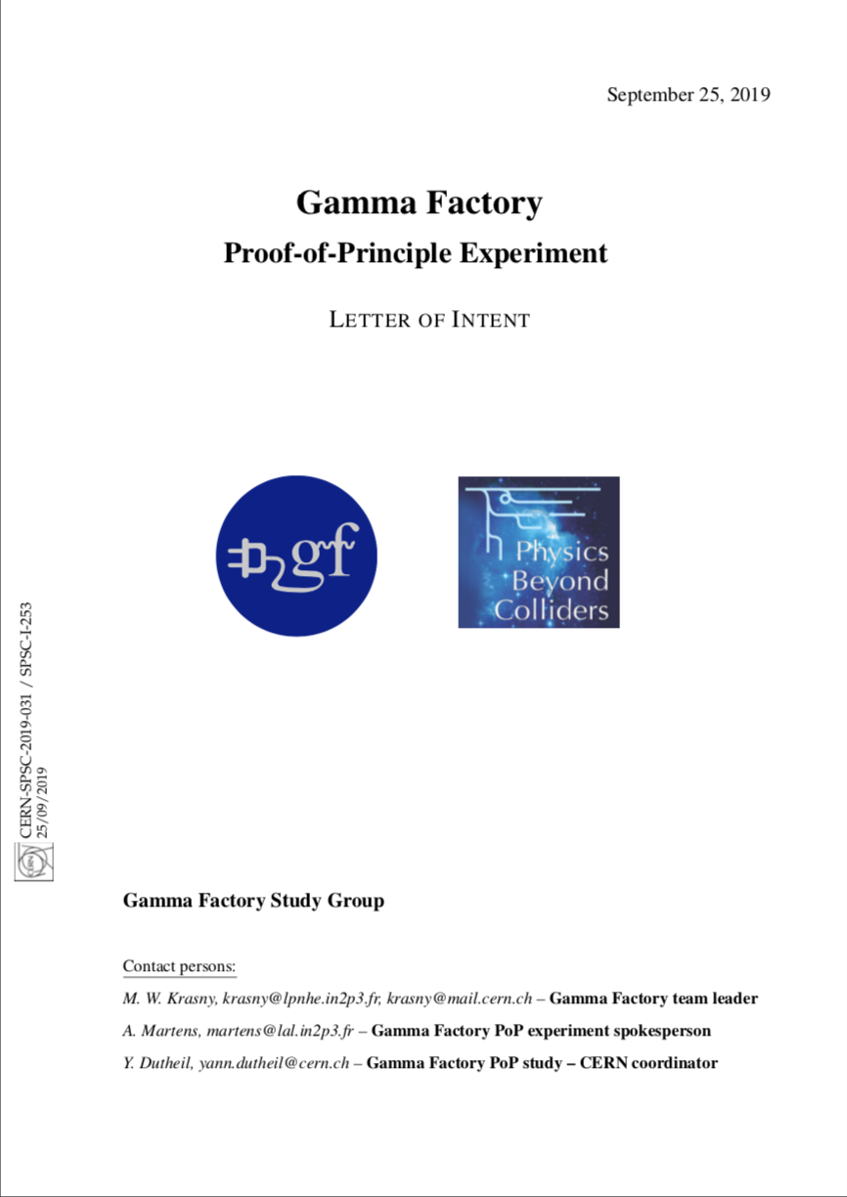
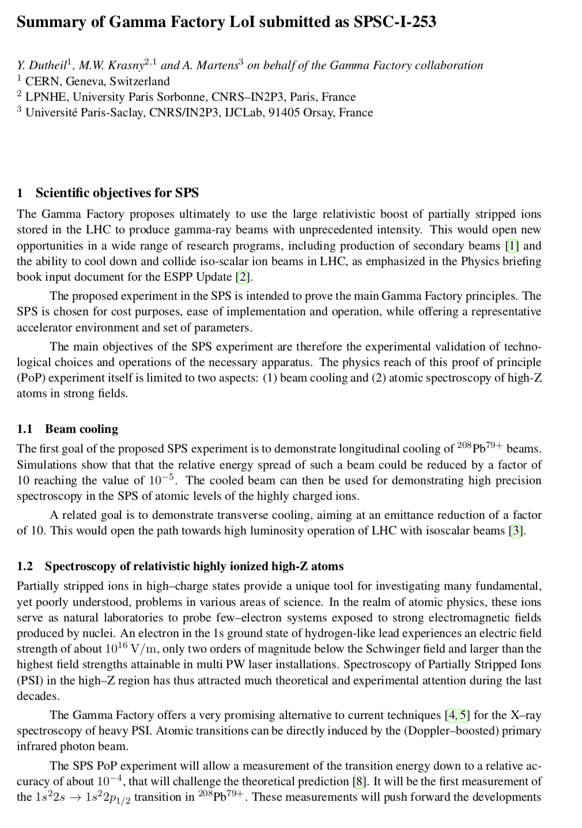
LOI submission and review
25/09/2019
LOI submission
23/01/2020
Questions received
18/02/2020
answer document issued
08/05/2020
Follow-up questions
28/05/2020
updated answer document issued
12/06/2020
invitation to SPSC meeting
M. W. Krasny et al. SPSC-I-253, M.W. Krasny arXiv:1511.07794
Also presented @ 257th LHC Injector and Experimental Facilities Committee : https://indico.cern.ch/event/861645/

Slide 19
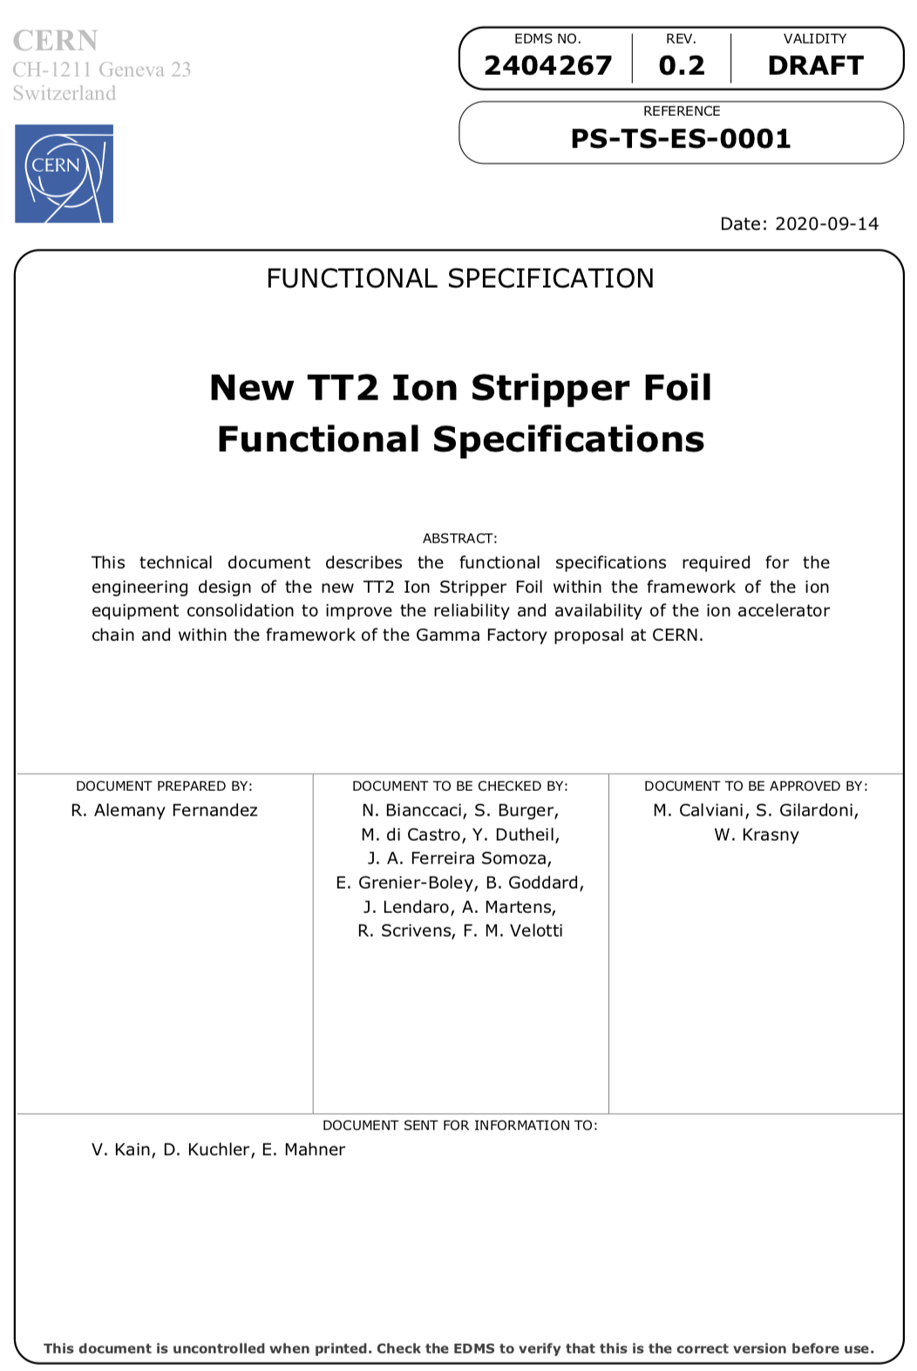
New ion stripper foils system
Common need with other experiments to add flexibility in stripping capability:
4 foils
Angle (thickness) can be tuned
Pulse to pulse operation !
35% stripping efficiency for Pb⁷⁹⁺
Will allow parasitic Gamma Factory Proof of principle operation

Slide 20
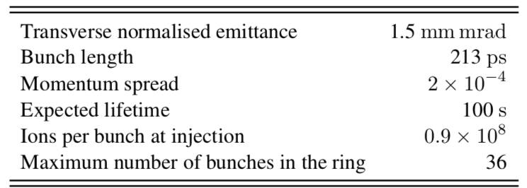
Beam parameters
As extrapolated from 2018 run meassurements and ordinary SPS operations with ions
Lifetime is large enough at flat top for Pb⁸⁰⁺
→ Extrapolated for Pb⁷⁹⁺: about 100s
75 ns
75 ns
150 ns
3 bunches/injection, 12 injections max.
M. W. Krasny et al. SPSC-I-253, M.W. Krasny arXiv:1511.07794
100 ns
100 ns
100 ns
150 ns
4 bunches/injection, 9 injections max.
Common harmonic frequency=40MHz

Slide 21
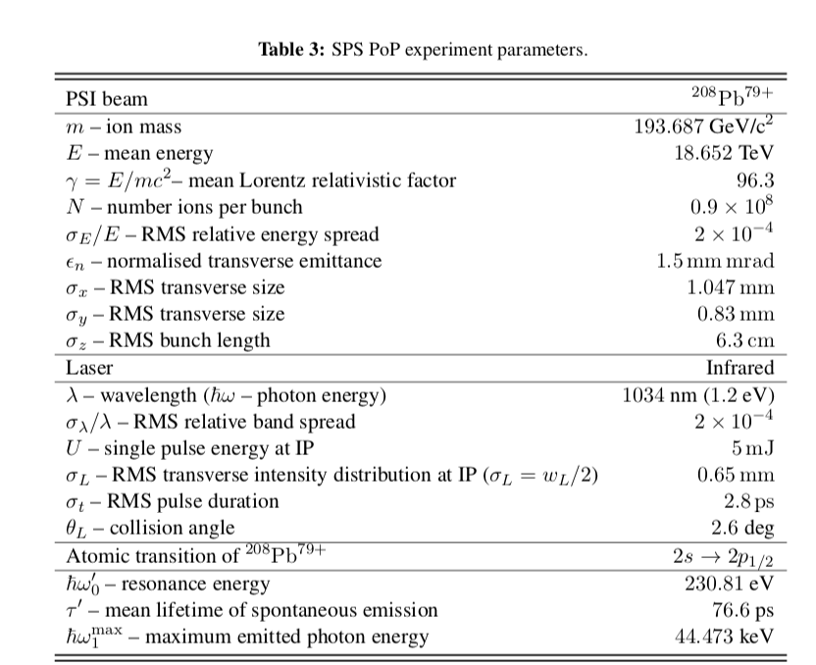




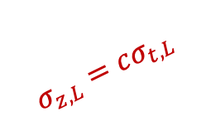
Collision scheme
$$σ_{x,y,L}$$
$$σ_{z,L}=cσ_{t,L}$$
$$θ$$
$$σ_{x,y}$$
$$σ_{z}=cσ_{t}$$
M. W. Krasny et al. SPSC-I-253
Beams must be aligned, synchronized
Not specific to Gamma Factory scheme

Slide 22
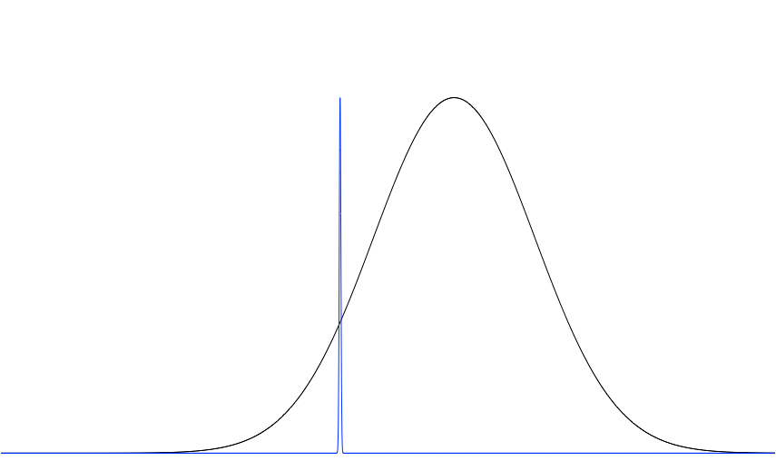
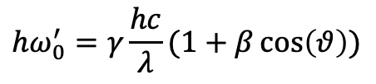
Spectrum matching
Linewidth of atomic resonance << bandwidth of laser spectrum (in ref. frame of atoms)
Probability density
At resonance:
$$hω_{0}^{′}=γ\frac{hc}{λ}(1+β\cos\left(θ\right))$$
energy
detuning

Slide 23
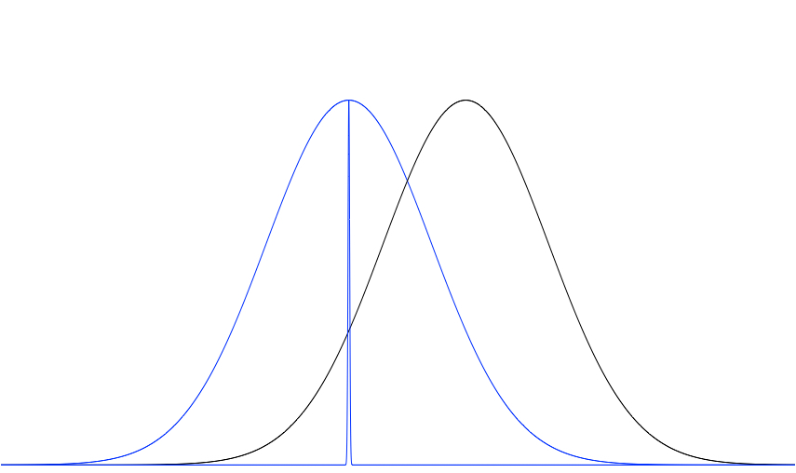

Spectrum matching
Atomic (PSI) beam energy spread ⋍ bandwidth of laser spectrum (in ref. frame of atoms)
Probability density
At resonance:
$$hω_{0}^{′}=γ\frac{hc}{λ}(1+β\cos\left(θ\right))$$
energy
detuning
A relatively high laser energy is required to excite nearly all atoms
Ultimately: 10¹⁷ ph/s
Excitation rate of atoms depend on their position in the energy spectrum

Slide 24
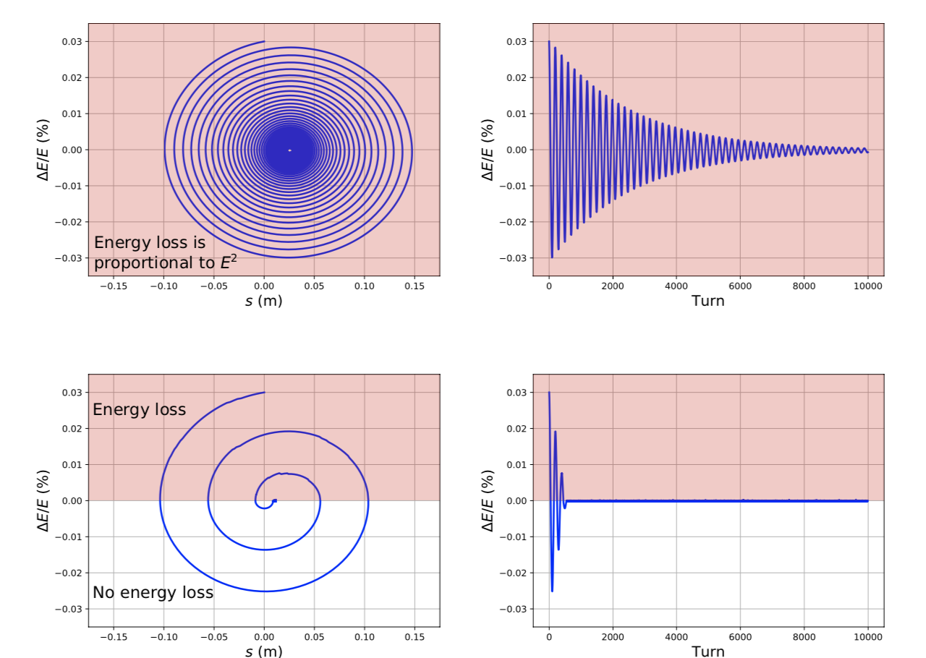
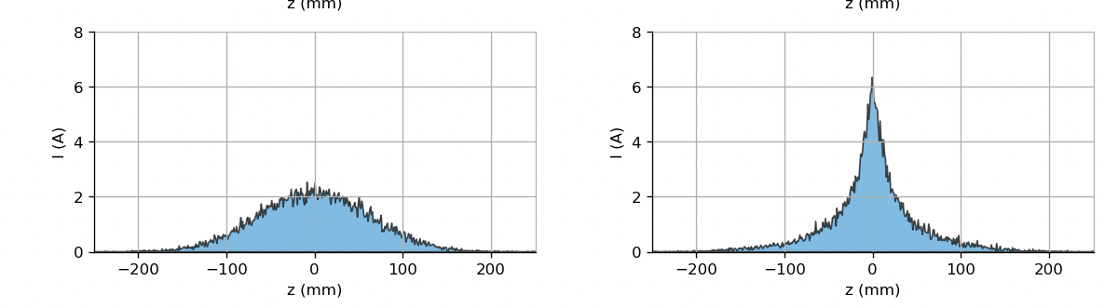
Ion beam cooling
No detuning
Ion beam efficiently cooled
M. W. Krasny et al. SPSC-I-253
Detuned laser spectrum
Observe it with wall current monitors
Large (horizontal) dispersion relation at the interaction point:
→ transverse cooling in a similar fashion by mis-aligning the beams

Slide 25
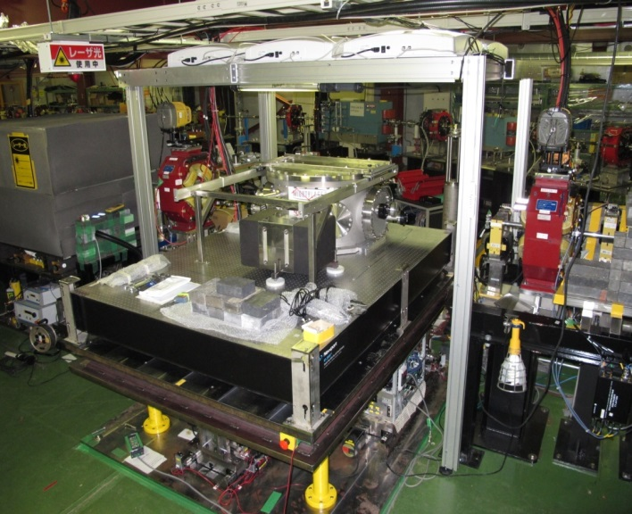
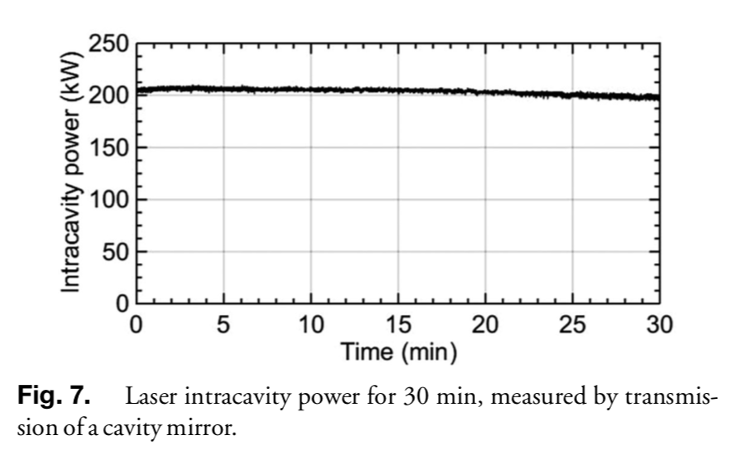
Laser system at the state of the art
Fabry-Perot resonator to reach about 5mJ at 40MHz→ 200kW already exists
L. Amoudry et al., Applied Optics 59 (2020) 116; Chaikovska et al., Scientific Reports 6 (2016) 36569
Built and operated by IJCLab (Orsay) team
State of the art system, already operated in low emittance KEK ATF ring
But: need to ensure the system can be operated fully remotely

Slide 26
Synchronisation & alignment
Not specific to Gamma Factory
Already realized in the past (for instance KEK ATF exp.)
Alignment provided by BPMs on the girder of optical cavity
H. Damerau et al. IPAC2016-THPMY039; Chaikovska et al., Scientific Reports 6 (2016) 36569
Only needs to be adapted to SPS specifics
Cavity tuning range is limited
Similar to AWAKE
Beam with constant revolution frequency at flat-top
Varying transverse beam alignment: use existing orbit correctors
Inputs from relevant experts at CERN : H. Damerau (RF) and V. Fedosseev (Laser)

Slide 27

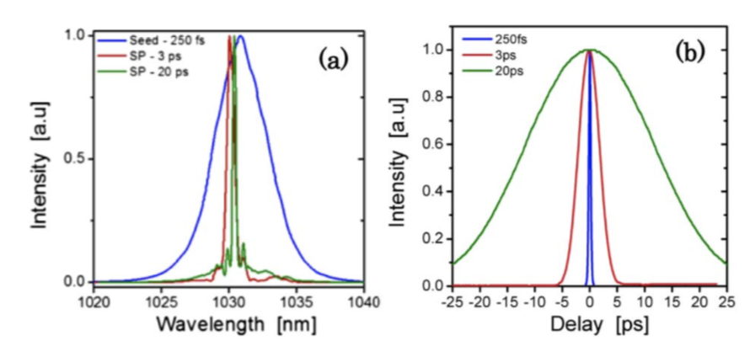
Optical system: laser and amplifier
Required quality factor of optical cavity
very low phase noise laser
Unique provider !
Required laser power and robust performances
Pouysegur et al. Opt. Lett. 40, 5184-5187 (2015);
Industrial system exist !
Laser pulse duration/spectrum tunable

Slide 28
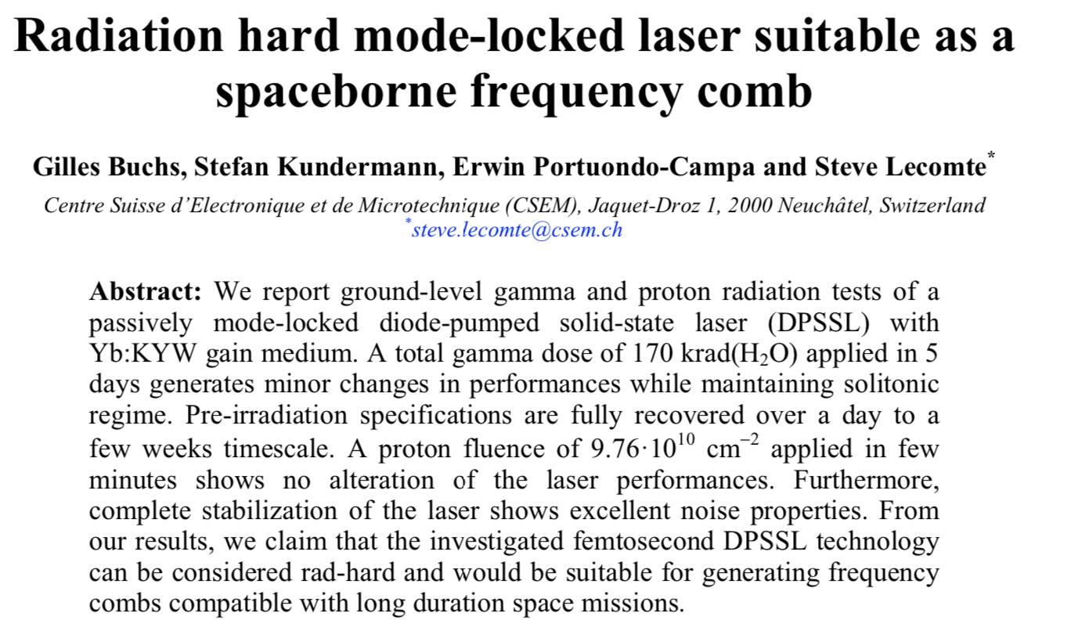
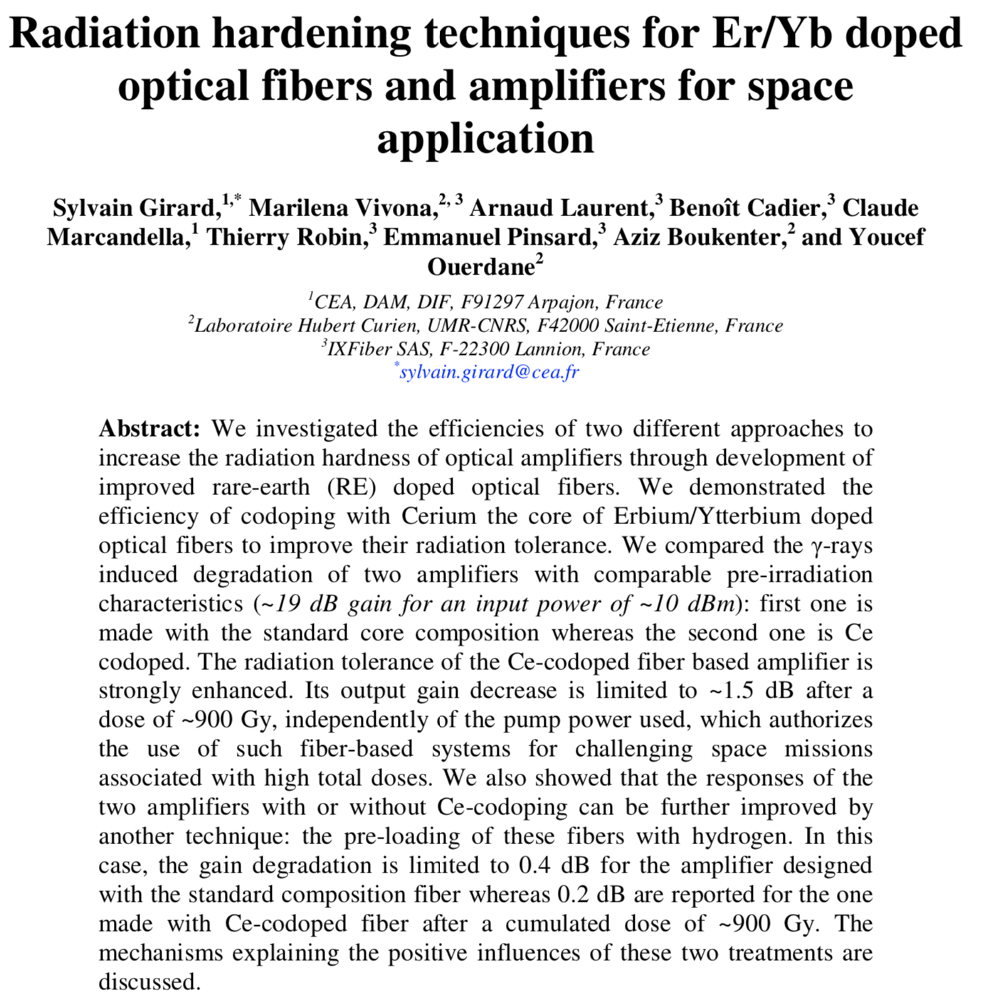
Radiation hardness
Ageing of laser system’s components is not expected to be limitation if TID<150krad
G. Buchs et al., Opt. Express 23 (2015) 9890 ; S. Girard et al., Opt. Express 20 (2012) 8457
Gamma Factory PoP laser will only operate a few weeks a year
Sensitive laser-system must be shielded (side TI18 tunnel)
With R2E team: FLUKA simulations to be done to decide on the need of extra shielding or not

Slide 29
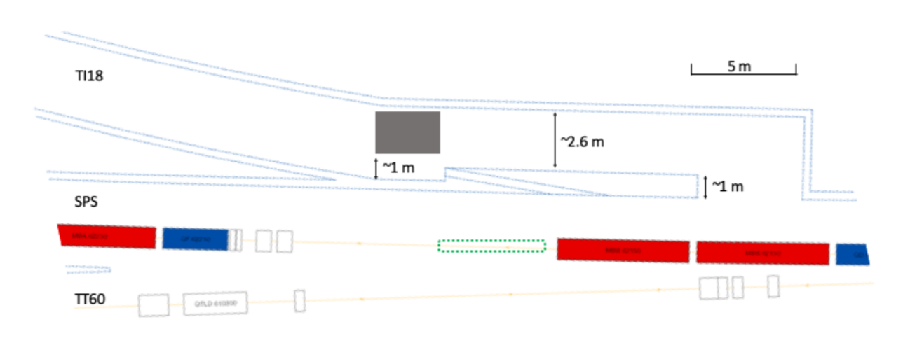
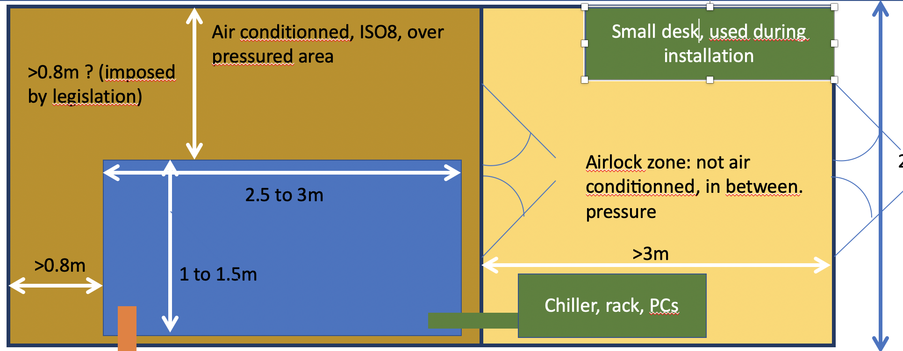
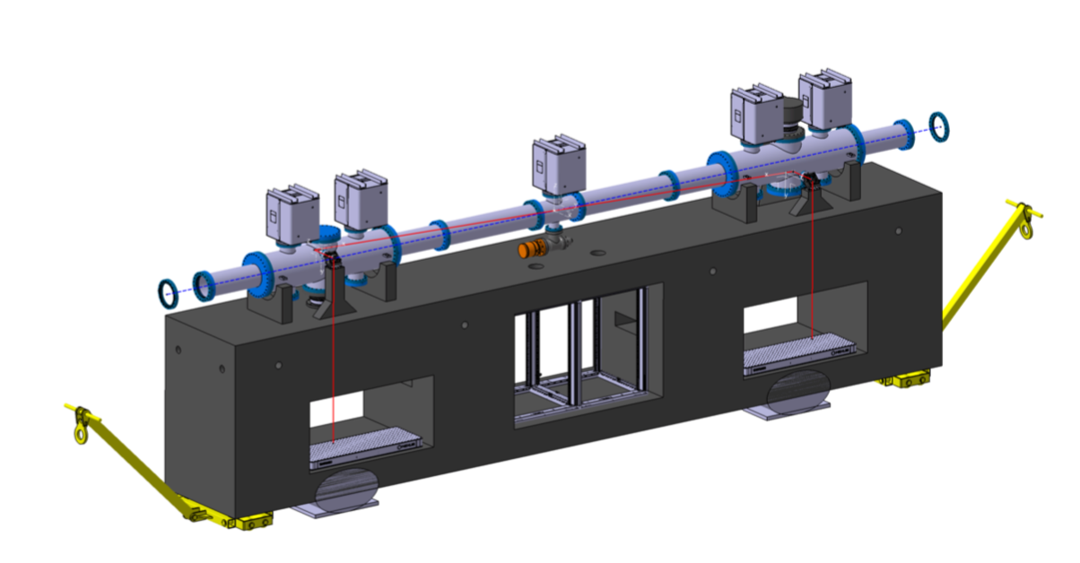
Optical system: integration
M. W. Krasny et al. SPSC-I-253
SPS half-cell 621 with side tunnel TI18

Slide 30
Optical system: integration
SPS half-cell 621 with side tunnel TI18
Thanks to Liam Dougherty for the help

Slide 31
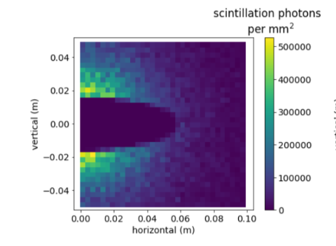
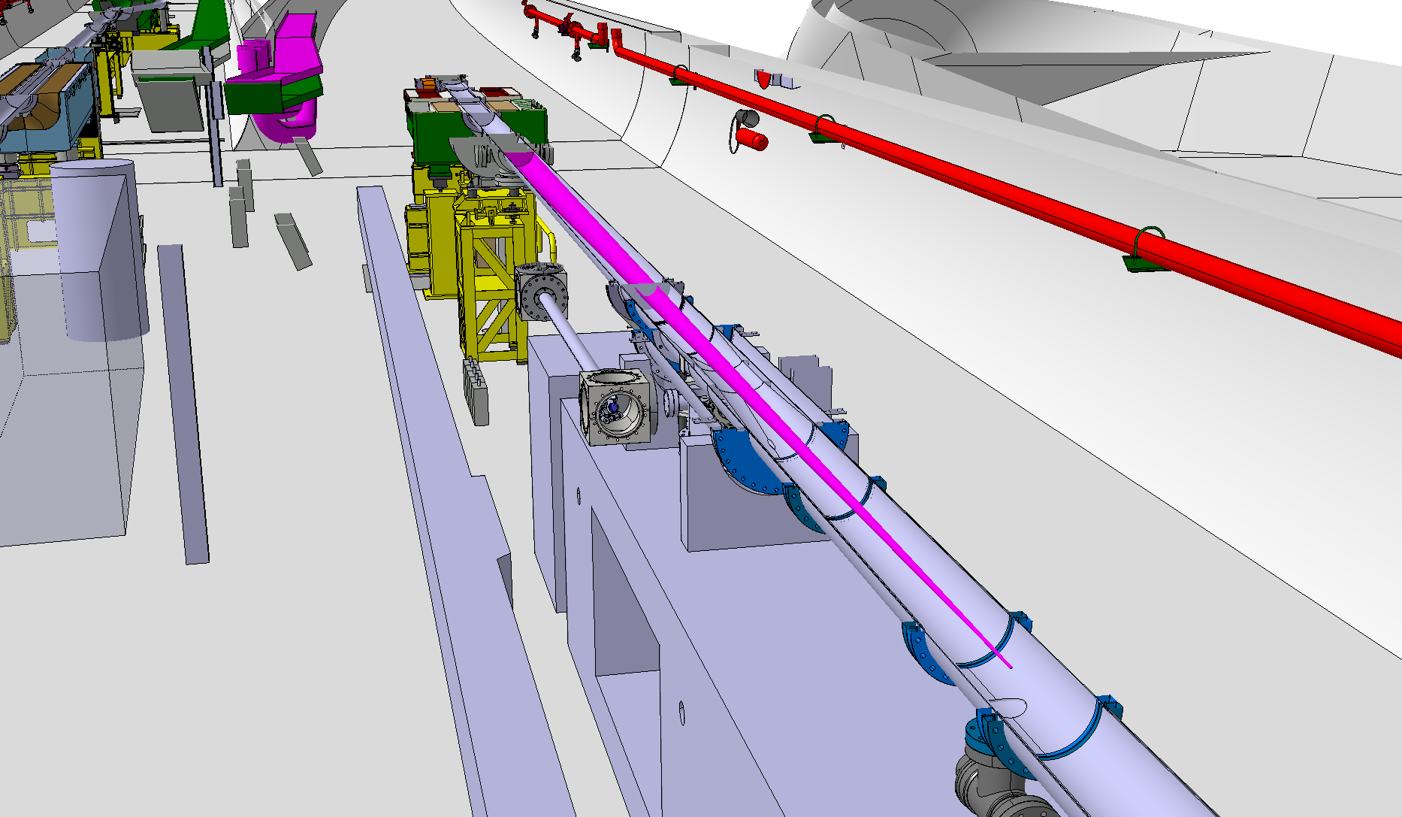
Detection system
‘BTV’ system: YAG:Ce + camera
Remotely controlled manipulator
M. W. Krasny et al. SPSC-I-253
Central opening for ion beam passage
Laser-ion interaction Point
Ion beam direction

Slide 32
Impact on regular SPS operations
Vacuum
Impedance
Parasitic operations
Optical cavity requires similar or better vacuum compared to SPS
Valves to break vacuum on a limited section of SPS → CERN experts
Past experience on low emittance KEK ATF
Remote operations
Require formal validation of final design by CERN experts
Will be addressed during cavity and laser system implementation in lab
Laser beam has no sizeable effect on proton/fully stripped hadronic beam
M. W. Krasny et al. SPSC-I-253

Slide 33
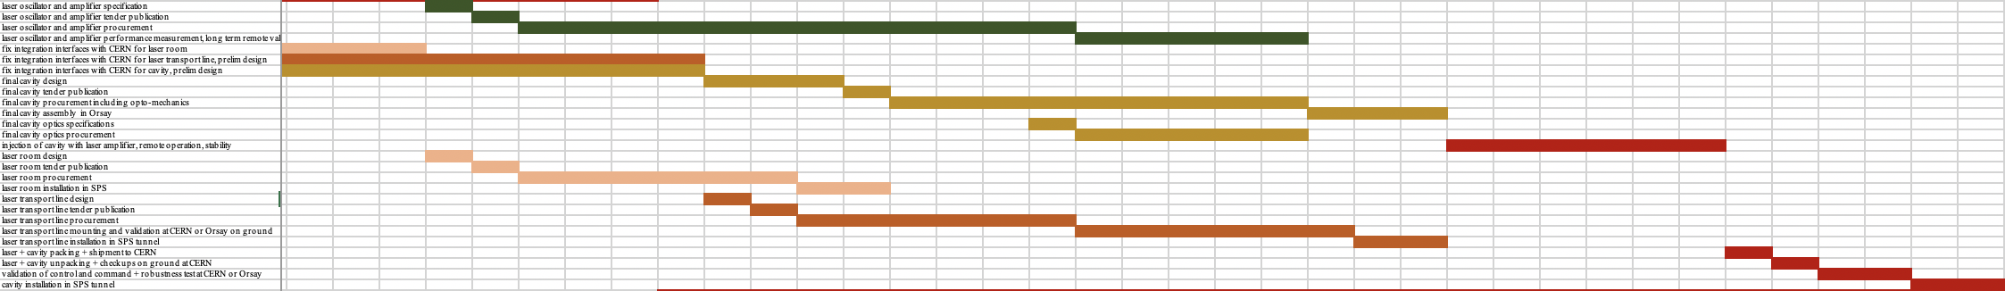
Project planning
2021
2022
2023
Operational after 2023-2024 YETS
M. W. Krasny et al. SPSC-I-253
6 months of operation of optical cavity in lab
Installation of laser beam transport line in 2022-2023 YETS
optical cavity assembly in fall 2022
Laser room in TI18 during 2021-2022 YETS

Slide 34
PoP milestones and beam requests
In 2024
Resonance finding
Optimisation and characterisation
Atomic physics precision measurement
Realize synchronization, alignment 4x8h in SPS supercycle // NA ops
Optimize interaction rate 8h dedicated beamtime
Cooling demonstration
Stable measured rate of photons over >5s 8h in SPS supercycle // NA ops
Show increase of beam current at constant charge 2x8h dedicated beamtime
First measurement of Pb79+ transition energy 8h in SPS supercycle // NA
Confront theory (strong field QED,…) to experiment 8h dedicated beamtime
Commissioning with PSI before yearly ion run 8h dedicated beamtime
Measure transverse beam size reduction 8h in SPS supercycle // NA
M. W. Krasny et al. SPSC-I-253

Slide 35
Summary
An international proto-collaboration of people
with very broad physics interests in the Gamma Factory concept;
that would like to demonstrate before LS3 generation of unprecedented rates of photons
and ion beam cooling with laser,
in order to trigger a new avenue for atomic measurements
and new opportunities for particle and nuclear physics

Slide 36
Summary
An international proto-collaboration of people
with very broad physics interests in the Gamma Factory concept;
that would like to demonstrate before LS3 generation of unprecedented rates of photons
The Proof of principle experiment for the Gamma Factory is a critical step
to allow this very broad physics programme to happen
and ion beam cooling with laser,
in order to trigger a new avenue for atomic measurements
and new opportunities for particle and nuclear physics

Slide 37
BACKUP

Slide 38
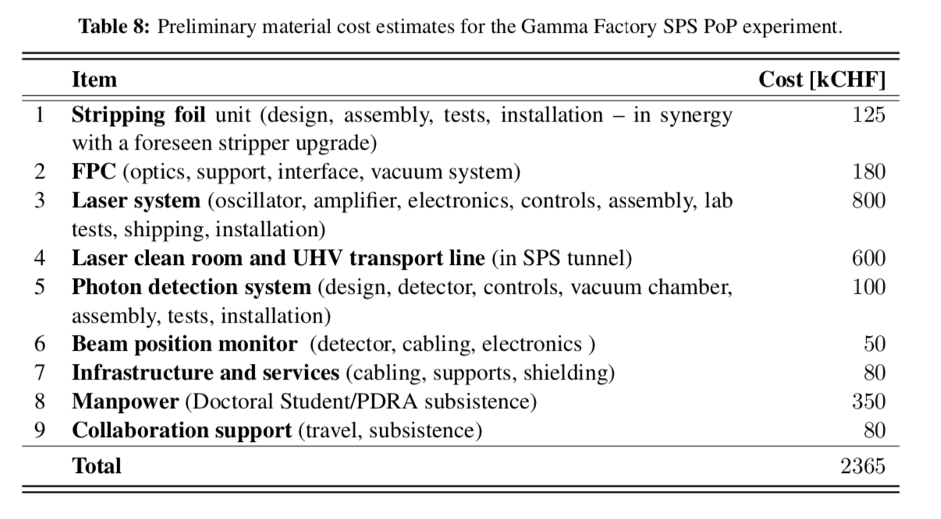
Project funding
Already covered

Slide 39
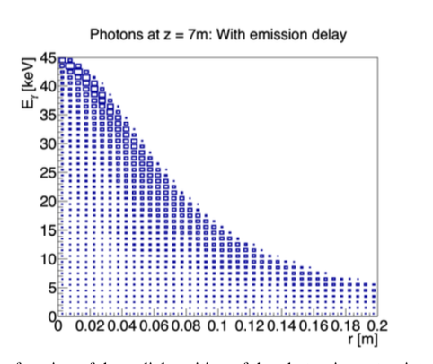
X-ray detector
‘BTV’ system: YAG:Ce + camera
Remotely controlled manipulator to go to garage position for non GF operations
Post LS3 upgrade ability to mesaure energy-position correlations, timepix ?
>10¹¹ visible photons/second
→ above sensitivity of standard camera

Slide 40
Optical system: laser and amplifier
Lock of laser to optical cavity of finesse 25k and length 7.5m
very low phase noise laser
Up to now: we know only one provider that delivered compliant performances
Risk mitigation:
reduce cavity selectivity i.e. finesse and gain (change coupling mirror, not expensive)
Use laser amplifier with higher average power to keep intracavity pulse energy high
Pouysegur et al. Opt. Lett. 40, 5184-5187 (2015)
Industrial system exist !
Laser pulse duration/spectrum tunability is an asset
Bottomline: such an industrial system, with spectrum/pulse duration tunability should be very robust compared to any home made solution

Slide 41
Why a Proof of Principle experiment ?
1
5
Demonstrate ion beam cooling: longitudinal and then transverse
6
Perform atomic physics measurement
4
2
3
Demonstrate stable and repeatable operation
Confront data to simulations
Demonstrate that an adequate laser system (5mJ@40MHz) can be (remotely) operated in the high radiation field of SPS and LHC.
Demonstrate that very high rates of photons are produced : almost all PSI’s excited for every bunch crossing

Slide 42
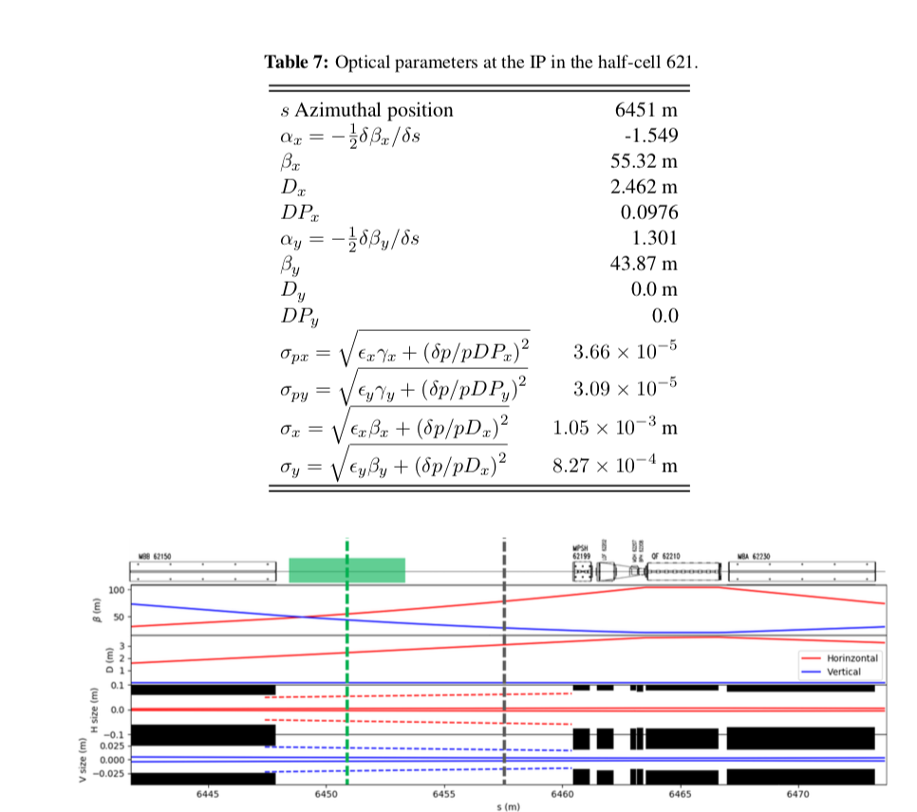

Slide 43
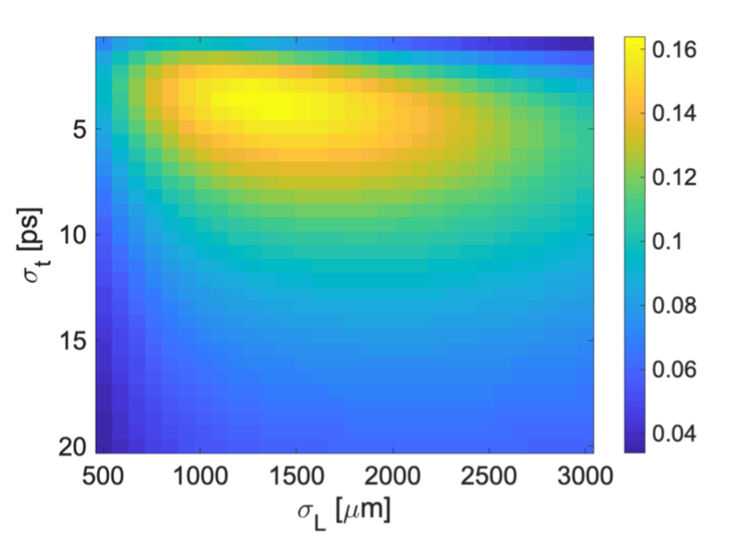
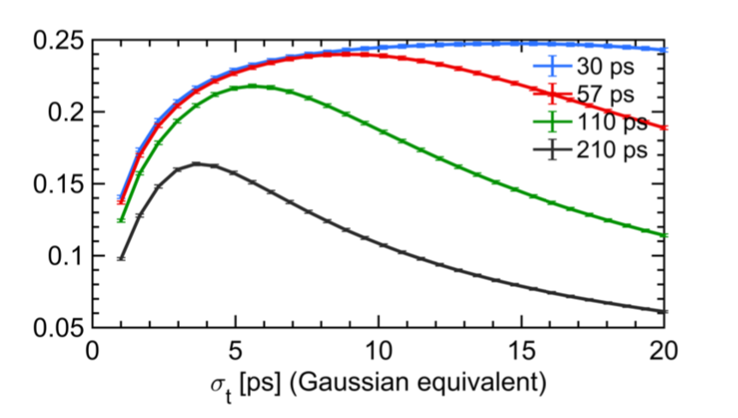
Optical system optimization
A muti-dimensional approach to optimize the laser beam parameters
Fraction of excited ions
Fraction of excited ions
𝜎_{X}
Optimum parameters depend on ion-bunch length
Laser pulse duration/spectrum tunability is an asset

Slide 44
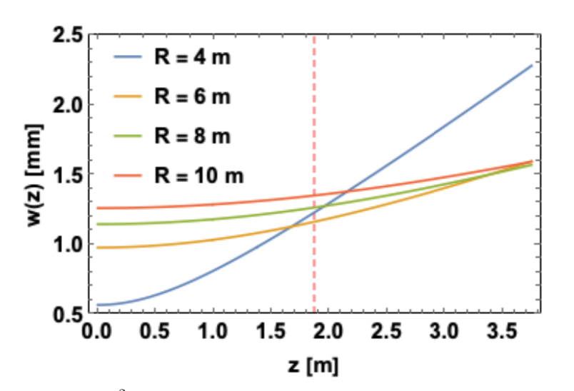
Optical system: design
A several mJ pulsed laser at 40 MHz is a natural candidate:
  Compatible with the atoms filling schemes
  Compatible with what one would naturally expect for LHC operations
  State of the art technology: pulsed laser (freq. comb) + amplifier + resonant cavity
A 2-mirror (plano-concave) cavity is considered:
→ simpler operation, delivers naturally beam sizes close to optimum
A 10m mirror Radius of curvature is preferred
We expect to operate the optical cavity with an enhancement factor >5000
>4.5mJ pulses @ 40MHz, 180kW in cavity

Slide 45
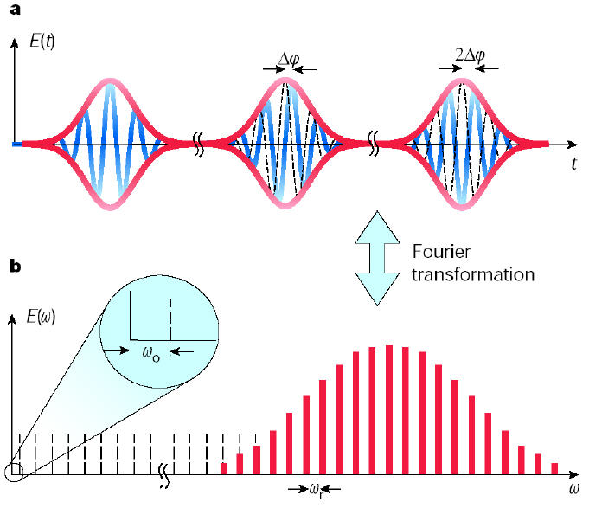



Laser phase noise
T=2π/ω_{r}
Δφ_{ce}
The whole comb must be locked:
dilatation (f_{rep})
translation (f_{CEP})
$$F= \frac{ν}{∆ν}=20000$$
$$ν=40MHz$$
T. Udem et al. Nature 416 (2002) 233
$$∆ν=2kHz$$
Phase noise of the laser must be low to lock to a high finesse cavity
Noise limits coupling

