Slide 1
Study of quadrupole-collective isovector valence-shell excitations (mixed-symmetry states MSSs) of exotic nuclei at HIE-ISOLDE
N. Pietralla¹, G. Rainovski^{1,2}, D. Mücher³, M. Axiotis⁴, C. Barton⁵, A. Blazhev⁶, M. Danchev², K. Gladnishki², S. Harissopulos⁴, R.-D. Herzberg⁵, D. Jenkins⁶, J. Jolie⁷, Th. Kröll¹, R. Krücken³, A. Lagoyannis⁴, J. Leske¹, T.J. Mertzimekis⁴, O. Möller¹, P.H. Regan⁷, N. Warr⁵
¹Institut für Kernphysik, Technische Universität Darmstadt, D-64289 Darmstadt, Germany
²Faculty of Physics, St. Kliment Ohridski University of Sofia, 1164 Sofia, Bulgaria
³Physik Department E12, Technische Universität München, D-85748 Garching, Germany
⁴Tandem Lab, Inst. of Nuclear Physics, NCSR "Demokritos", Athens, Greece
⁵Department of Physics, University of Liverpool, Liverpool L69 7ZE, UK
⁵Department of Physics, University of York, Heslington, York YO10 5DD, United Kingdom
⁶Institut für Kernphysik, Universität zu Köln, D-50937 Köln, Germany
⁷Department of Physics, University of Surrey, Guildford, GU2 5XH, United Kingdom

Slide 2
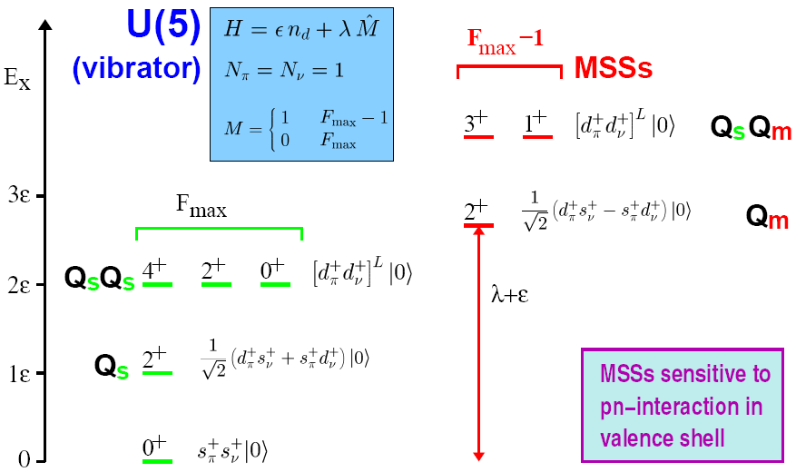
Physics case – what are the MSSs?
Simple Example: Harmonic Oscillator, N=2
1 _{N}
1 Wu
IBM-2 A. Arima, F. Iachello

Slide 3
MSSs in the N=80 isotones
The properties of MSSs are sensitive to the sub-shell structure
Theoretical confirmation
Quasiparticle-phonon model
N. Lo Iudice, Ch. Stoyanov, D. Tarpanov PRC 77, (2008) 044310
Splitting of M1 strength in ¹³⁸Ce is a genuine shell effect caused by specific shell structure and pairing correlations!
Large-scale shell model calculations
K. Sieja, G. Martínez-Pinedo, L. Coquard, N. Pietralla, PRC 80, 054311(2009)
Realistic SM calculations reproduce energy spacing between the 2⁺₁ and the 2⁺_{1,ms} in known cases ⇒ prediction for neighboring isotones.
Information on MSSs provides a tool to determine the pairing matrix elements of realistic interactions as they depend very sensitively on the treatment of core polarization corrections.
Experimental information on MSSs of ¹³²Te and ¹⁴⁰Nd is needed.
g_{7/2}
g_{7/2}⁻²
Z=50
h_{11/2}⁻²
N=80
N=82

Slide 4
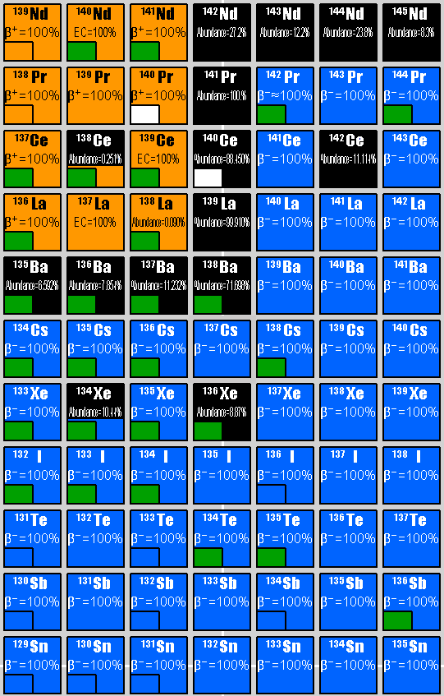
Is the shell stabilization a generic mechanism?
is the shell stabilization present when the proton excitations are formed in different sub-shell? - πd_{5/2}
d_{5/2}
identify the MSSs in ¹⁴⁰Nd and ¹⁴²Sm
how the shell stabilization depends on relative contributions of protons and neutrons to the collective wave function?
study the MSSs in N=84 isotones
g_{7/2}
50
80
82
84

Slide 5
Z=30 zinc isotopes: Measuring V_{pn} and its monopole component
N=40
⁷²Zn
⁷⁸Zn
E(2⁺_{ms})-E(2⁺₁) [keV]
Number of Neutrons

Slide 6
Conclusions
Identification of one-phonon 2⁺_{1,ms} is possible in Coulex on a carbon target with beam energy ~85 % CB ⇒ 3.8 ÷ 4.5 MeV/u and beam intensities ~10⁶÷10⁷ pps
⇒ HIE ISOLDE is absolutely necessary!
beams of interest:
- already developed at ISOLDE: ⁷²Zn-⁷⁸Zn (IS412), ¹³⁸Xe, ¹⁴⁰Ba (IS411, IS415) and ⁸⁸Kr (IS423).
- under development - ¹⁴⁰Nd and ¹⁴²Sm (IS496).
- need to be developed - ⁸⁴Ge and ⁸⁶Se.
beam purity: as high as possible; if possible we would like to use selective ionization (RILIS).
spatial properties of the beam: 3mm diameter beam spot size at target position.
time structure of the beam: slow extraction from EBIS is mandatory.

Slide 7
Theoretical confirmation
Microscopic description in the framework of the Large Scale Shell Model
K. Sieja, G. Martínez-Pinedo, L. Coquard, N. Pietralla (PRC 80, 054311 (2009))
Interaction: GCN5082 – realistic Bonn-C potential + empirical correction to the monopol part
Space: {0g_{7/2}, 1d_{5/2},1d_{3/2}, 2s_{1/2}, 0h_{11/2}} for both protons and neutrons – NATHAN and ANTOINE
Original interaction
Modified pairing
realistic SM calculations reproduce correctly the energy spacing between the 2⁺₁ and the 2⁺_{1,mss} in known cases ⇒ prediction for the neighboring isotones.
information on MSSs provides a tool to determine the pairing matrix elements of realistic interactions as they depend very sensitively on the treatment of core polarization corrections.
experimental information on MSSs of ¹³²Te and ¹⁴⁰Nd is needed.

Slide 8
¹⁴⁰Nd - status
Experiment
SM predictions
K. Sieja et al.
(PRC 80, 054311 (2009))
QPM predictions
Ch. Stoyanov
(priv. comunication)
E. Williams et al.,
Phys. Rev. C 80, 054309 (2009).
δ=0.186(85)
97(4)% M1
δ=-0.08(8)
99(1)% M1
GCN5082 - original
GCN5082 - modified

Slide 9
Experimental approach
Coulomb excitations in inverse kinematics on C target
predominantly one-step processes and clean γ-spectrum (no target excitations)
15h at 6.10⁹ pps!
10⁷pps for 2 weeks
1/25
1/250
10⁶pps for 2 weeks
To identify excited 2⁺ states (beyond the 2⁺₁) in vibrational nucleus (B(E2)~1Wu) with a 10% array for 2 weeks beam time we need 10⁵pps. For complete spectroscopy 10⁶-10⁷ pps will be needed!
1/2500
10⁵pps for 2 weeks
Feasible, but requires beam energy ∼85% CB (498 MeV for ¹⁴⁰Nd, 3.5-4 MeV/n)
HIE ISOLDE + MINIBALL

