Slide 1



n_TOF Facility: status report
E.Chiaveri/ CERN EN-STI-EET
INTC Meeting 23/24 June 2010

Slide 2
ITEMS
Milestones of n_TOF Facility
Work Area Type A
Borated Water Moderator
Commissioning
2010 Measurements
Conclusion

Slide 3
Milestones towards of nTOF Facility
14.07.2007 Presentation to the First External Panel Review
27.09.2007 Old Target removal
Study of possible solutions
14.02.2008 Presentation to the Second External Panel Review
14.03.2008 Decision to build the New Target
Target Design and Construction
Preparation of the Safety File
12.11.2008 Short commissioning of new target
15.04.2009 Installation of the new cooling system
Ventilation of primary area
Air-tight technical gallery
18.05.2009 Commissioning of the new Target
Physics Run
17.05.2010 Work Sector Type A
Borated Water Moderator

Slide 4
Why Working Sector Type A
Past:
- Upper limit of 1LA for open sources
- Higher than 1LA (~10mg 235U) needed a special container called ISO2919
=> with the following problems:
- difficult (expensive) to construct
- few companies could characterize it as ISO2919
- difficult to manipulate (position, alignment etc)
- measurement not in vacuum, presence of extra windows
- thick canning vs mg of target -> resulting in huge background

Slide 5
Why Working Sector Type A
Present:
- With the Working Sector Type A, the whole experimental area is acting like the container
- No restriction in the samples used
- Positioning directly in the vacuum with no additional windows
- Strong enhancement of signal / background
- Not a Class-A therefore no manipulation of the targets in situ.
- Safety procedures to follow

Slide 6
Technical requirements for the n_TOF Work Sector Type A (WSTA)
T. Otto, EDMS No. 473271 v.1
Fire resistance
  Walls F90 and doors T60
  Detection system in the area and ventilation ducts
  Isolation of Work Sector in case of fire
Ventilation system
  Under pressure in the Work Sector (higher hazard) – 60 Pa
  > 5 air renewal/hour (500 m³/h)
  Under pressure secured in case of power failure (CERN Safety Network or dedicated UPS)
Floor and walls
  Continuous and impermeable coating (floor coating raised 10 cm to wall)
Access protocol specification
  Material and personnel (“hot” and “cold” changing room)
  RP detectors
Decontamination system
  Wash basin (with water container retention vessel)

Slide 7
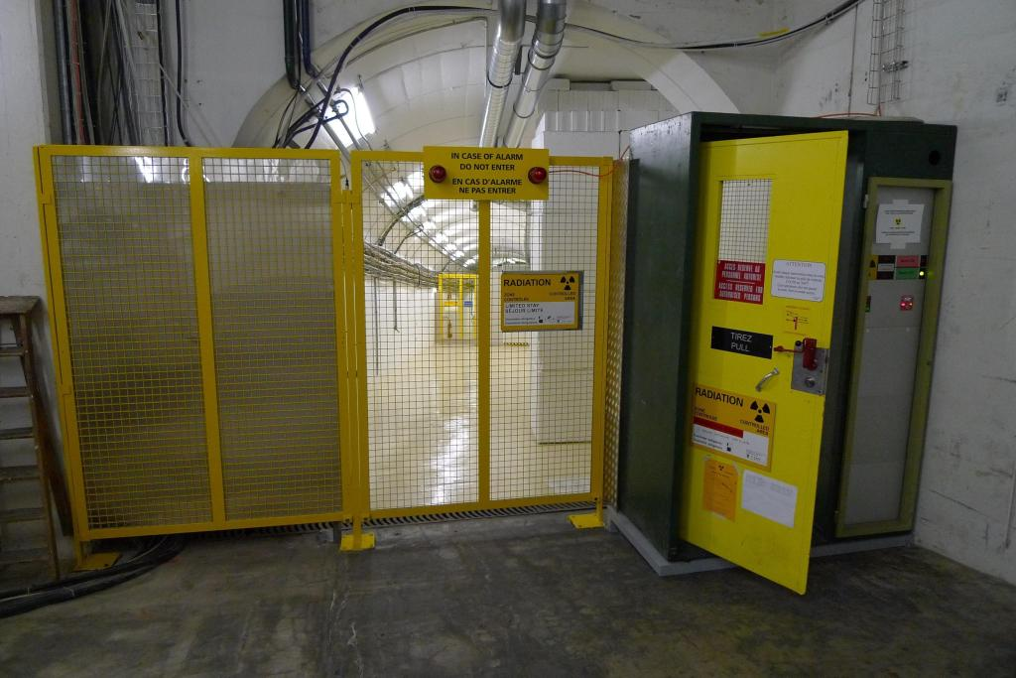
Entrance of n_TOF beam line

Slide 8
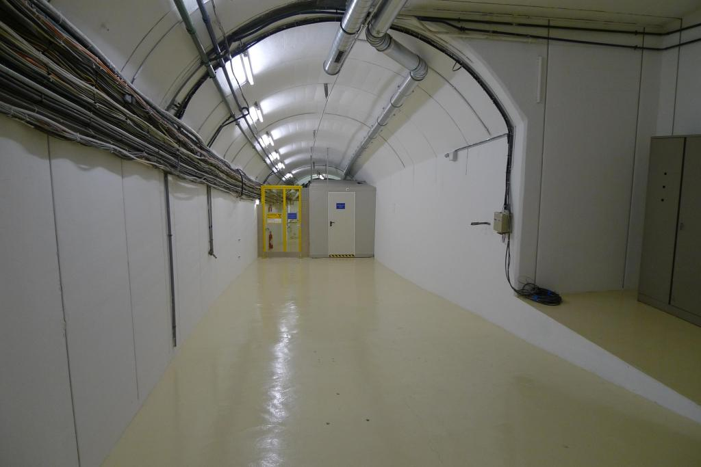
Entrance to the n_TOF beam line

Slide 9
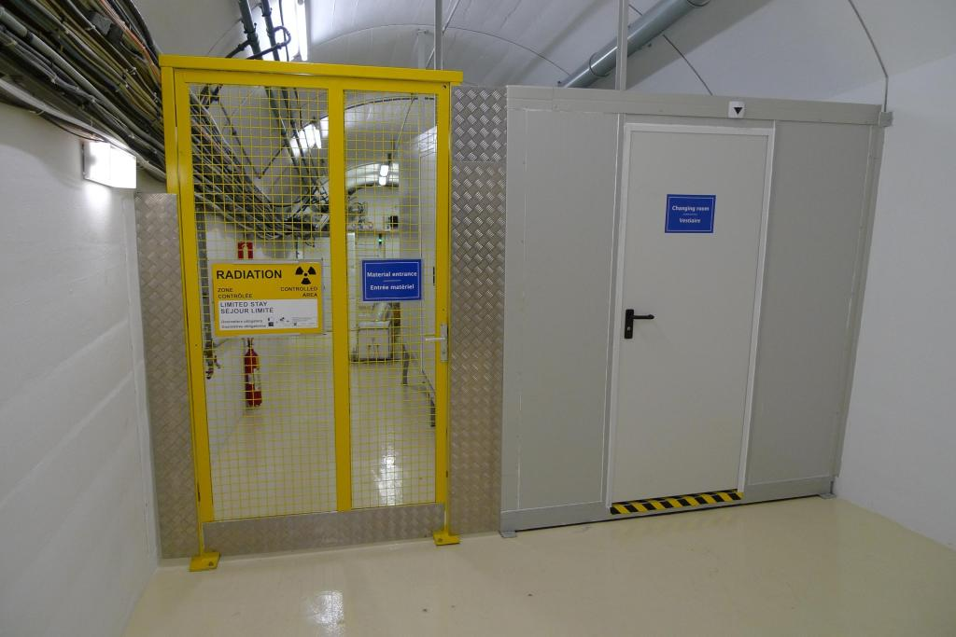
Material entrance
Changing room

Slide 10
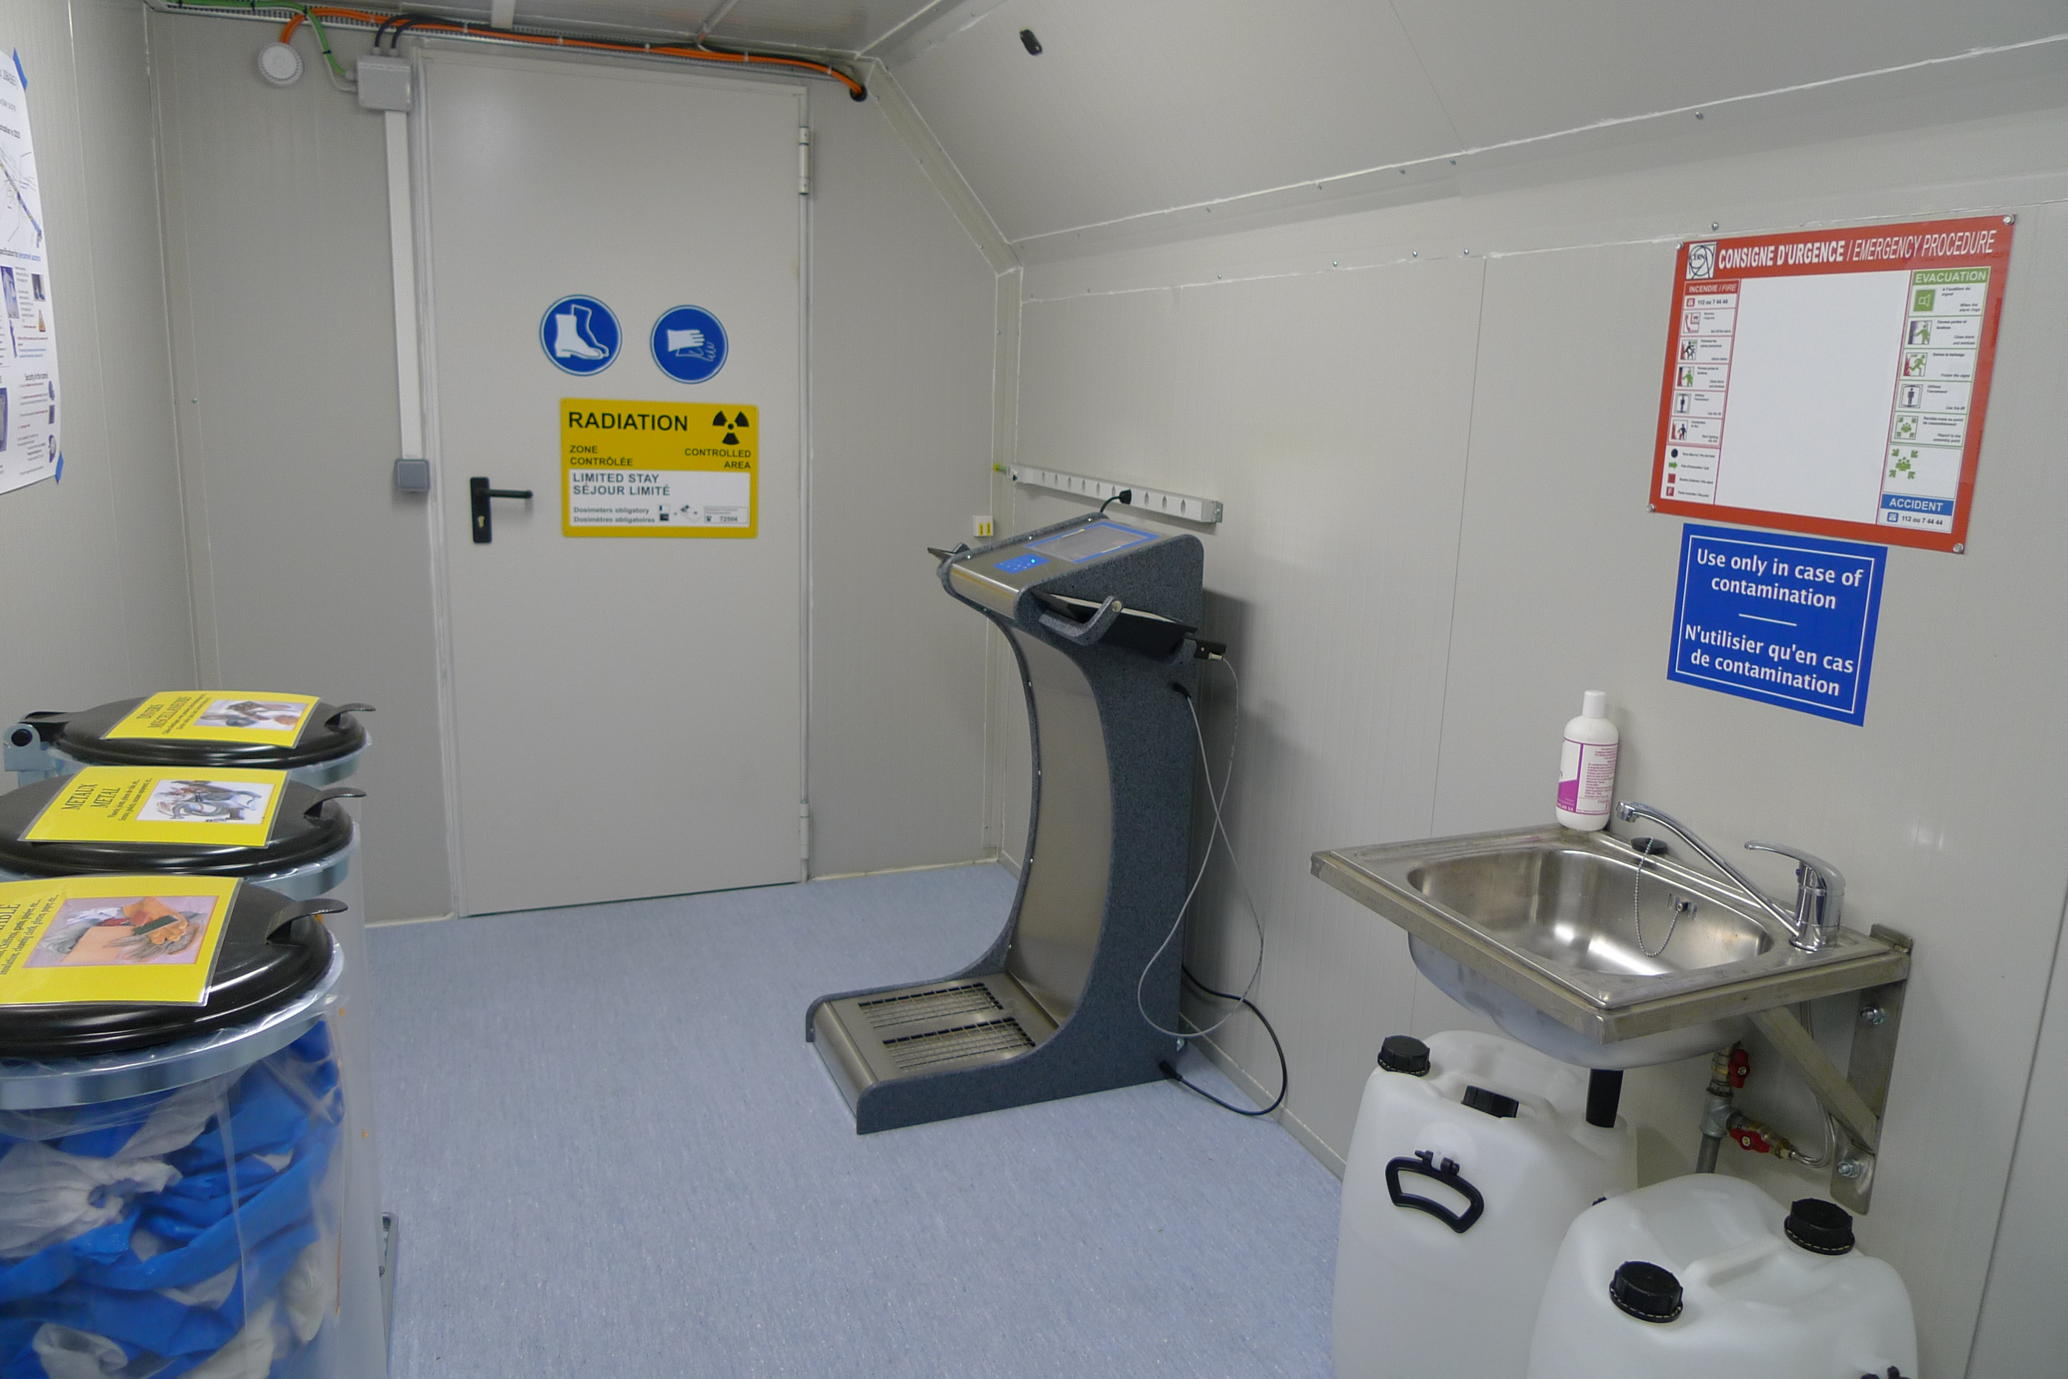
n_TOF changing room
n_TOF Changing room

Slide 11
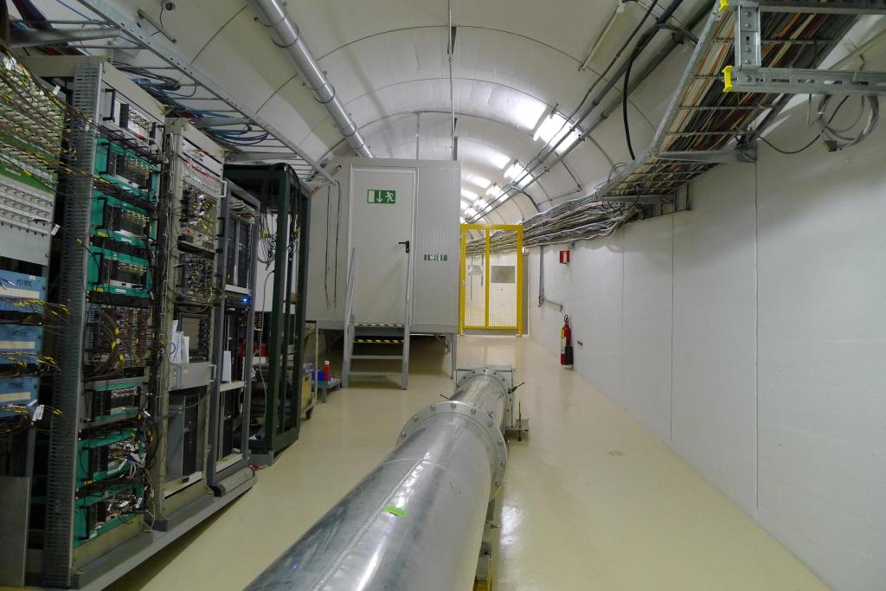
Escape line

Slide 12
n_TOF Experimental Area

Slide 13

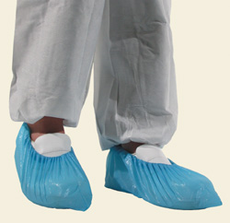


Specification for personnel access
Remove unnecessary clothing in the “cold” part of the changing room
Dress with provided working overalls and overshoes in the “hot” part of the changing room according to the specified WST
Overshoes always needed
If WSTA or WSTB the complete access will be overseen by RP personnel
The wearing of complete tyvek overall and overshoes is mandatory if the Work Sector is declared as A/B

Slide 14
SIR course for n_TOF
Users will have to deal with different working conditions with respect to the past
On-line course to train users
  avoid the need for continuous courses during the run period
SIR (Safety Information Register)
CERN safety self-training modules → test a the end
Basic Safety + Specific Risks (level 1+2+3)
2 modules foreseen for n_TOF
  General safety
  Access to the Work Sector
The courses will be mandatory to require NTOF access
NTOF access will be valid for 1 year (until the end of the run)
The course will be updated each year, according to the changes performed in the WS

Slide 15
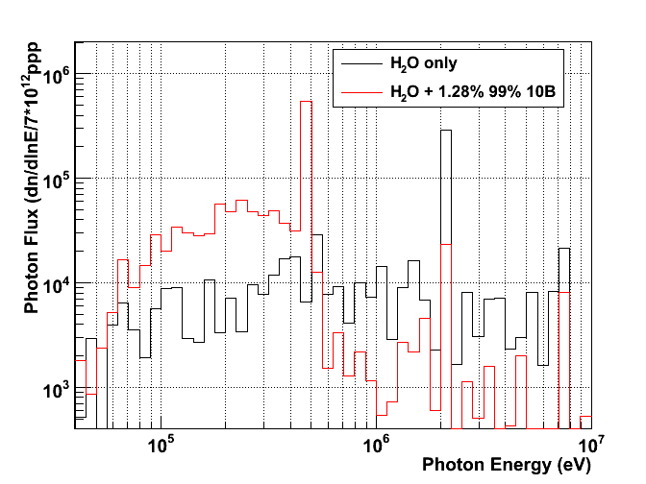
Borated water effect–
Photon Energy distribution
Effect of boric acid: → appearance of the 470 keV line + reduction of the 2.2 MeV
470 keV from ¹⁰B(n,α)⁷Li
2.2 MeV ¹H(n,γ)
7 – 7.5 MeV prompt γ on Fe, Al, Pb
511 keV e+e-

Slide 16
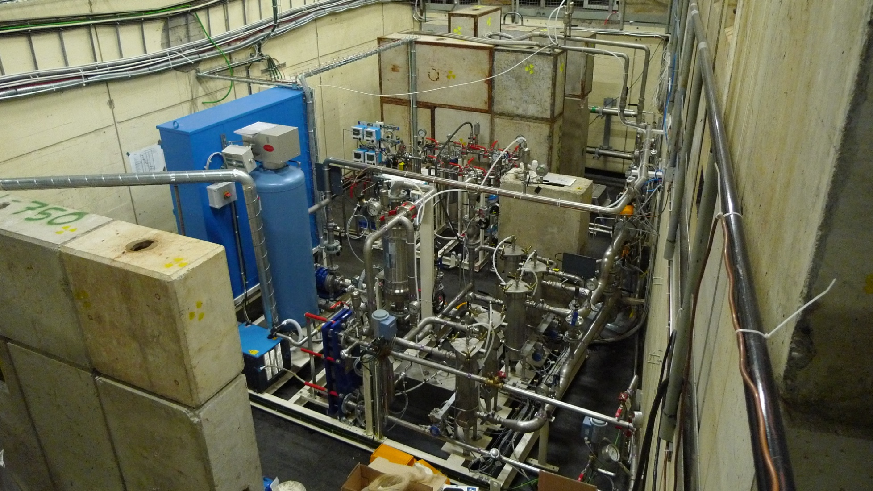
Cooling and moderator station
The target and moderator circuits are decoupled and work independently
Moderator system
Target cooling system

Slide 17
Alignment of n_TOF line
2009 run
Alignment the 2nd collimator (177 m from target) and detectors in the experimental area made with respect to the 1st collimator (135 m from target)
Observations:
  beam profile strongly asymmetric
  experimental fluence < simulations
Corrected by tilting the 2nd collimator by 2 mm (end of run) – empirical observation
2010 run
→ Alignment of 2nd collimator by looking directly at the spallation target!
Observations:
  1st collimator misaligned by 2 cm vertically and 1.5 cm radially!
  Gain of fluence ~20% with respect to 2009
Empirical optimization of 2nd collimator tilt (by n_TOF team)
Confirmation of fluence observation with the X-Y MicroMegas profile monitor
Experimental fluence in agreement with simulations within 5-10%

Slide 18
Safety File
nTOF Facility: EDMS 934369
- It is always a working document (not frozen) that reflects the actual
status of the facility
- Contains: Project, Installation, Operation and Decommissioning,
Descriptions and Procedures
- Latest version V0.12 released on 12.05.2010 with all information
concering the Class A and borated circuit
2) nTOF Detectors:
- Each detector has its own safety file.
- Currently in process of writing for: TAC, C6D6, uMegas, SiMON

Slide 19
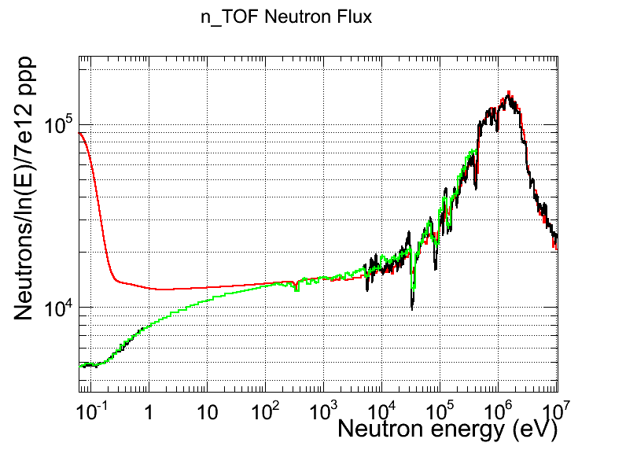
2009
2010

Slide 20
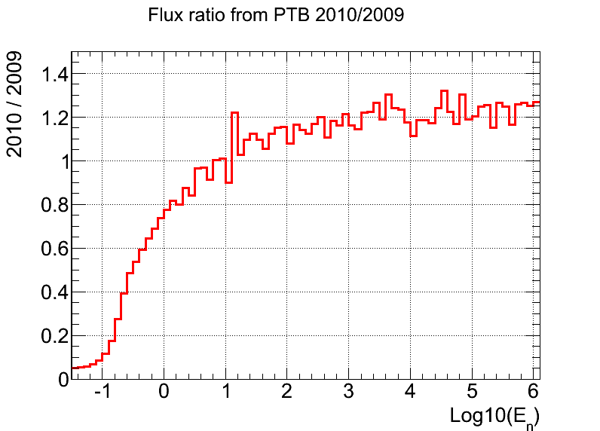

Slide 21
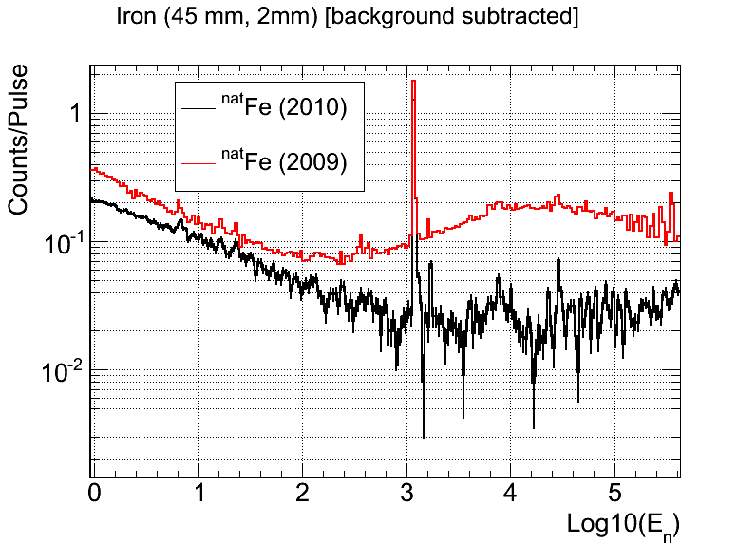

Slide 22
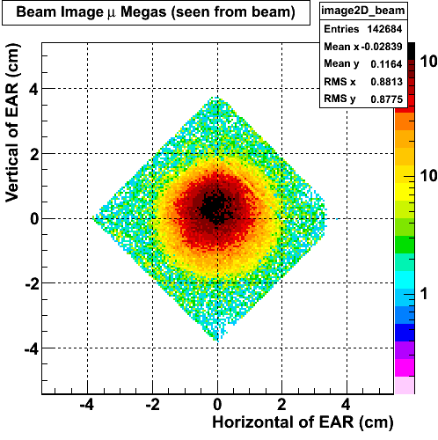
Symmetric Beam profile in the Experimental Area (2009)

Slide 23
Symmetric Beam profile in the Experimental Area(2010)

Slide 24
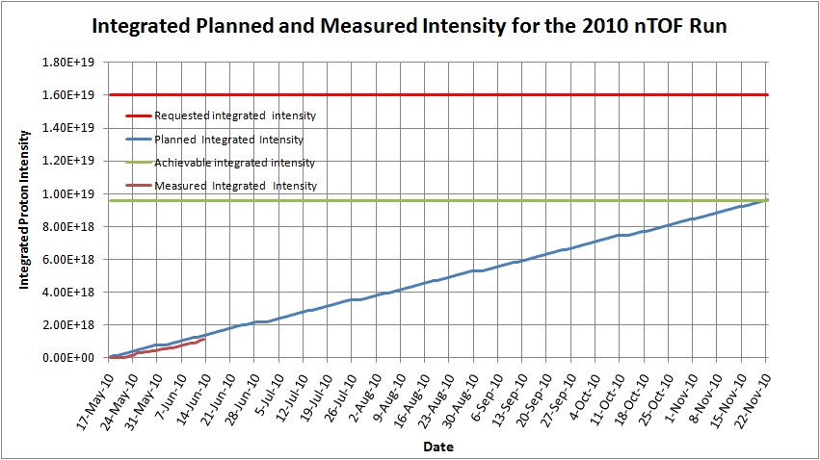

Slide 26

Plan of measurements 2010
Measurements | Protons (1x10¹⁷)
Start-up | 2
Commissioning | 18
C₆D₆: ⁵⁴Fe | 20
C₆D₆: ²⁴¹Am + calibration | 15
TAC: ²⁴¹Am + calibration | 20
TAC (capt+fiss): ²³⁵U | 7
FF angular distribution | 20
Total | 102
Proton reading unreliable until 15th June
E. Chiaveri / INTC Meeting 23/24 June 2010

Slide 27
2009-(2015) : Phase II experimental program
Capture measurements
Mo, Ru, Pd stable isotopes Fe, Ni, Zn, and Se (stable isotopes) ⁷⁹Se A≈150 (isotopes varii) ^{234,236}U, ^{231,233}Pa ^{235,238}U ^{239,240,242}Pu, ^{241,243}Am, ²⁴⁵Cm | r-process residuals calculation isotopic patterns in SiC grains s-process nucleosynthesis in massive stars accurate nuclear data needs for structural materials s-process branching points long-lived fission products Th/U nuclear fuel cycle standards, conventional U/Pu fuel cycle incineration of minor actinides (Work sector type A)
(*) approved by CERN Scientific Committee (planned for execution in 2009)

Slide 28
2009-(2015) : Phase II experimental program
Fission measurements
MA, ^{240,242}Pu,²⁴⁵Cm,^{241,243}Am ²³⁵U(n,f) with p(n,p’) ²³⁴U(n,f) | ADS, high-burn up, GEN-IV (Work Sector Type A) new ²³⁵U(n,f) cross section standard study of vibrational resonances at the fission barrier
Other measurements
¹⁴⁷Sm(n,α), ⁶⁷Zn(n,α), ⁹⁹Ru(n,α) ⁵⁸Ni(n,p), other (n,lcp) Al, V, Cr, Zr, Th, ²³⁸U(n,lcp) He, Ne, Ar, Xe n+D₂ | p-process studies gas production in structural materials structural and fuel material for ADS and other advanced nuclear reactors low-energy nuclear recoils (development of gas detectors) neutron-neutron scattering length

Slide 29
n_TOF facility Summary
Operation of a borated water moderation system
  Ready for 2010 run!
Work Sector Type A experimental area
  Convert the actual experimental area to a Work Sector Type A → no major restrictions on radioactive samples measurement
  Significant improvement in measurement capabilities
  Ready for 2010 run!
3. 2010/2011 experimental campaign :
  Angular distribution of fission fragments with PPACs (TOF14)
  Capture measurements with C₆D₆ (TOF13)
  Capture measurements on actinides with TAC
  Commissioning with borated water moderator (TOF12)
  Validation of simultaneous measurement of capture and fission reactions at n_TOF
  Measurement of the fission cross-section of ²⁴⁰Pu and ²⁴²Pu at CERN’s n_TOF Facility (TOFxx)
  Micromegas performance test for (n,α)measurement at n_TOF: ³³S(n,α) cross section

Slide 30
Acknowledgments
CERN Groups:
BE/OP
BE/BI
BE/ASR
DGS/RP
GS/ASE
GS/SEM
PH/DI
PH/SME
PH/UNT
EN/CV
EN/STI
EN/HE
EN/MME
EN/MEF
EN/EL
In particular: M.Calviani, C.Guerrero, E. Berthomieux,S. Andriamonje,V.Vlachoudis

