Slide 1



Measurement of the fission cross-section of ²⁴⁰Pu and ²⁴²Pu at CERN’s n_TOF facility
CERN-INTC-2010-042, INTC-P-280
Spokespersons: M. Calviani (CERN), E. Berthoumieux (CEA)
TC: V. Vlachoudis (CERN)
n_TOF Collaboration

Slide 2

Outline
Motivations
Detector description
Samples characteristics
²⁴⁰Pu, ²⁴²Pu count-rate evaluation
Beam time request

Slide 3
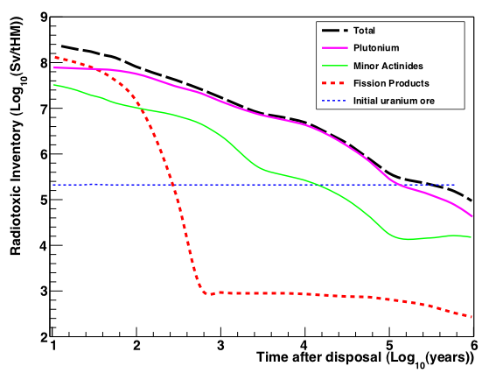
The issue of nuclear waste
Main problem of nuclear energy production are the transuranic actinides: Pu and MA (Np, Am, Cm…)
1.5% in mass but give the biggest contribution to radiotoxicity and heat after 100 y
Problem persists for more than 10⁵ y
Some isotopes are fissionable (proliferation and criticality concerns)
Generation-IV reactors are aimed to recycle large amount of spent fuel (actinides)
Dedicated Burners (ADS…)
Present generation reactors have a low burn-up efficiency and produce large amount of radioactive waste
In all cases a large reduction of actinides inventory is achieved by means of neutron-induced fission reactions

Slide 4
Motivations for fission measurements
 |  | Energy Range | Current Accuracy (%) | Target Accuracy (%)
U238 | Inel | 0.5 ÷ 6.1 MeV | 10 ÷ 20 | 2 ÷ 3
 | Capt | 2.04 ÷ 24.8 keV | 3 ÷ 9 | 1.5 ÷ 2
Pu241 | Fiss | 454 eV ÷ 1.35 MeV | 8 ÷ 20 | 2 ÷ 5
Pu239 | Capt | 2.04 ÷ 498 keV | 7 ÷ 15 | 4 ÷ 7
Pu240 | Fiss | 0.498 ÷ 1.35 MeV | 6 | 2 ÷ 4
Pu242 | Fiss | 0.498 ÷ 2.23 MeV | 19 ÷ 21 | 4 ÷ 7
Pu238 | Fiss | 0.183 ÷ 1.35 MeV | 17 | 3 ÷ 5
Am242m | Fiss | 67.4 keV ÷ 1.35 MeV | 17 | 3 ÷ 4
Am241 | Fiss | 2.23 ÷ 6.07 MeV | 9 | 2
Am243 | Fiss | 0.498 ÷ 6.07 MeV | 12 | 3
Cm244 | Fiss | 0.498 ÷ 1.35 MeV | 50 | 5
Cm245 | Fiss | 67.4 ÷ 183 keV | 47 | 7
Uncertainty reduction requirements for Gen-IV fast reactors
Objective is to meet integral parameters target accuracies
Aliberti, Palmiotti, Salvatores – Validation of simulation codes for future systems, NEMEA-4 Workshop, October 2007
OECD/NEA WPEC Subgroup 26, (2008)
The development of advanced nuclear systems requires data on minor actinides → Pu isotopes
n_TOF is a key facility

Slide 5
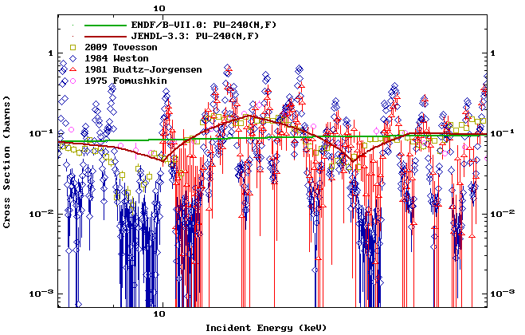
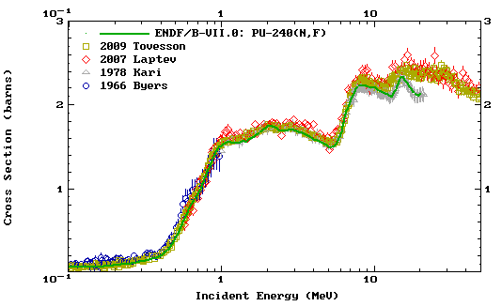
Motivations – ²⁴⁰Pu(n,f)
Energy range | Initial Unc. (%) | Target Unc. (%)
2.23 – 6.07 MeV | 5 | 3
1.35 – 2.23 MeV | 6 | 2-3
0.498 – 1.35 MeV | 6 | 2-4
0.454 – 2.03 keV | 22 | 9-13
NEA Nuclear Data High Priority list (May 2010)
OECD/NEA WPEC Subgroup 26, (2008)
Uncertainty request above fission threshold is challenging but feasible
Data in the keV region:
Important for fast reactors
Discrepancy up to 20-30%
8 keV – 20 keV
~10%
~8%
100 keV – 50 MeV
http://www.nndc.bnl.gov

Slide 6
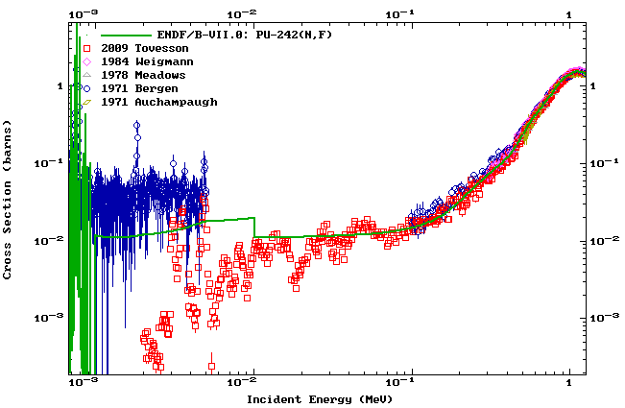
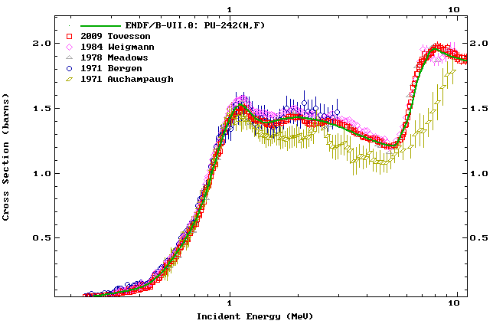
Motivations – ²⁴²Pu(n,f)
Energy range | Initial Unc. (%) | Target Unc. (%)
6.07 – 19.6 MeV | 37 | 15
2.23 – 6.07 MeV | 15 | 5-8
1.35 – 2.23 MeV | 21 | 4-7
0.498 – 1.35 MeV | 19 | 4-10
183 – 498 keV | 19 | 9
NEA Nuclear Data High Priority list (May 2010)
OECD/NEA WPEC Subgroup 26, (2008)
1 keV – 1 MeV
Disagreement up to 15% at the threshold
~25%
~15%
Step in ENDF/B-VII.0 and strong disagreement between measurements
100 keV – 10 MeV
http://www.nndc.bnl.gov

Slide 7
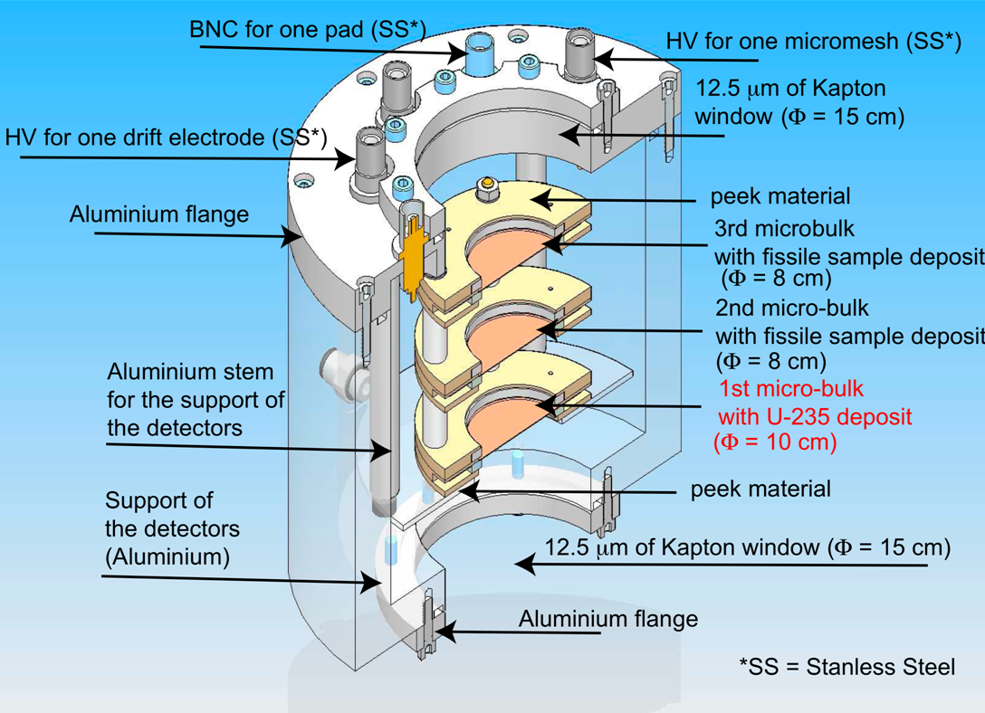
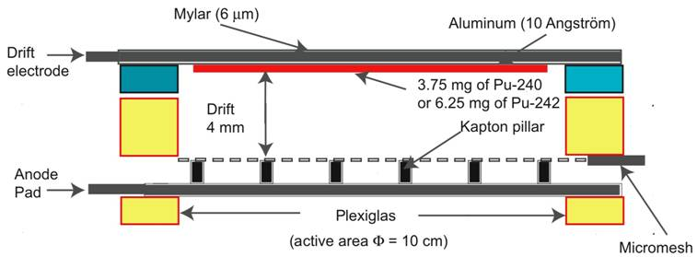
Detectors
We propose to perform ^{240,242}Pu(n,f) measurements:
Large area MicroMegas detector
10 cm active diameter
Presently working in the n_TOF EAR:
  ¹⁰B(n,α) and ²³⁵U(n,f)
Foreseen 10 samples in the beam for simultaneous measurement of the fission cross-section
Advantages:
Transparent detector (very low background)
Not very much sensitive to γ-flash → high energy
T. Papaevangelou et al., MPGD2009 Proceedings (2009)
S. Andriamonje et al., ND2010 Proceedings (2010)
M. Calviani et al., Phys. Rev. C 80, 044604 (2009) (FIC)
M. Calviani et al., NIM A594, 220-227 (2008) (FIC)

Slide 8
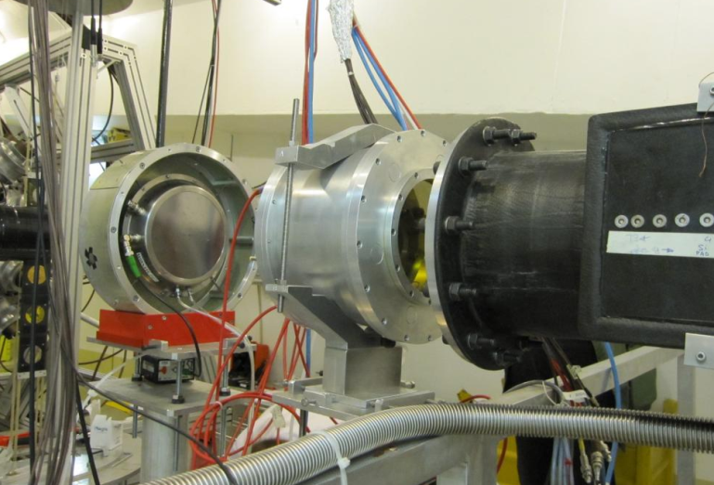
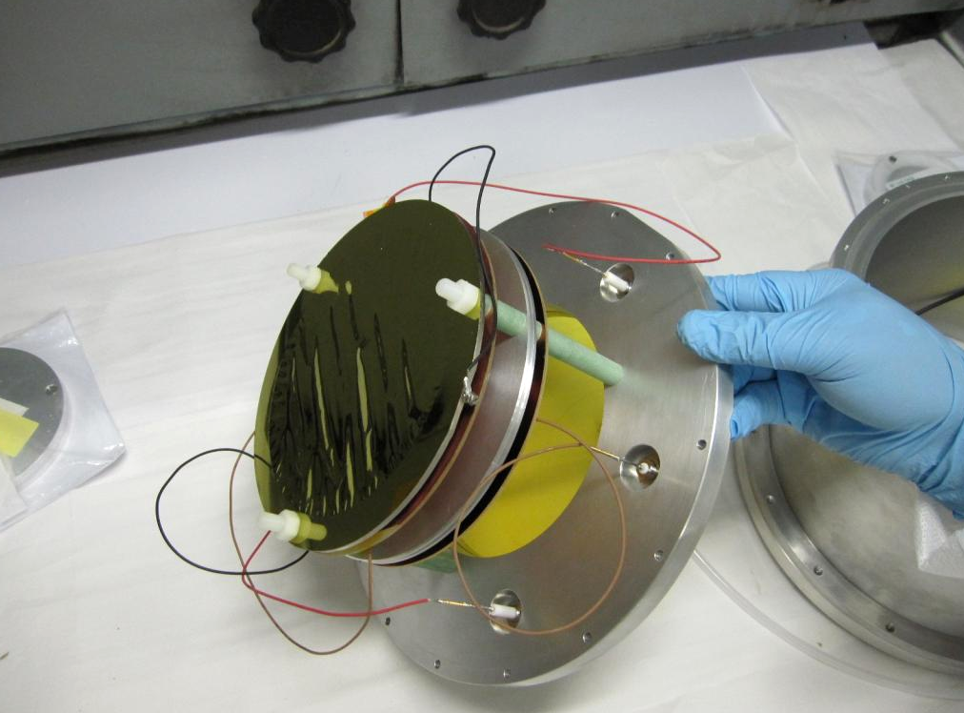
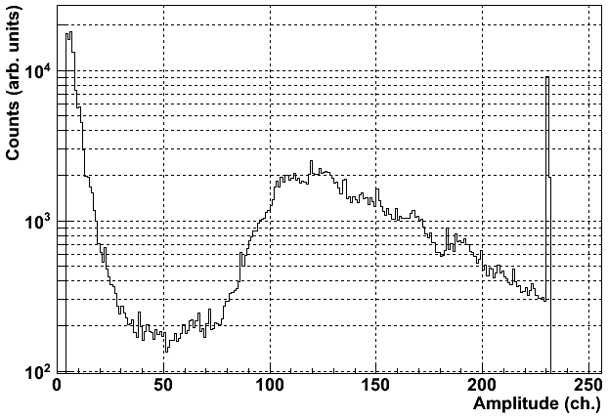
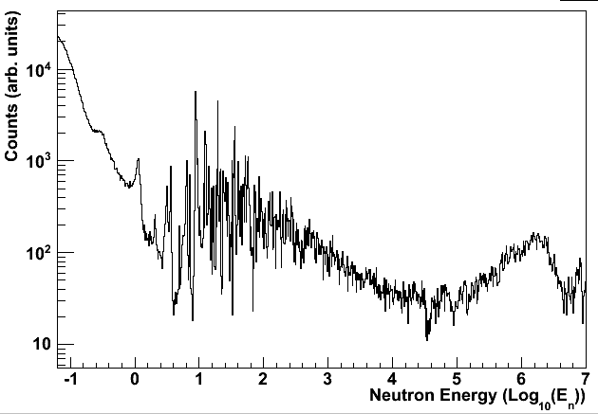
Detector performances - MicroMegas
10 cm diameter MicroMegas in n_TOF EAR-WSTA
10 cm diameter MicroMegas with ¹⁰B and ²³⁵U samples in ISOLDE Work Sector Type A
neutrons
α background
Fission yield from ²³⁵U sample in MicroMegas
Pulse height distribution from ²³⁵U(n,f)
fission fragments

Slide 9
Samples and radioprotection limits
²⁴⁰Pu sample |  | ²⁴²Pu sample
 |  | ²³⁸Pu | 0.004%
²³⁹Pu | 0.019% | ²³⁹Pu | 0.005%
²⁴⁰Pu | 99.879% | ²⁴⁰Pu | 0.019%
²⁴¹Pu | 0.001% | ²⁴¹Pu | 0.023%
 |  | ²⁴²Pu | 99.949%
Samples to be provided by IRMM, Belgium
A high purity material batch is already available at the Institute and a request has been submitted
²⁴⁰Pu: 15 mg (four samples of 25 MBq each)
²⁴²Pu: 25 mg (four samples of 7 MBq each)
Respects the “1 mSv criterion” established at CERN for radioactive isotopes
Chosen mass according to CR, α-activity and detection efficiency
Samples deposited on Ø=6 cm (flat beam)
Measurement at CERN now feasible, thanks to the new classification of the experimental area as
“Work Sector Type A”
See E. Chiaveri, “Report from n_TOF”

Slide 10
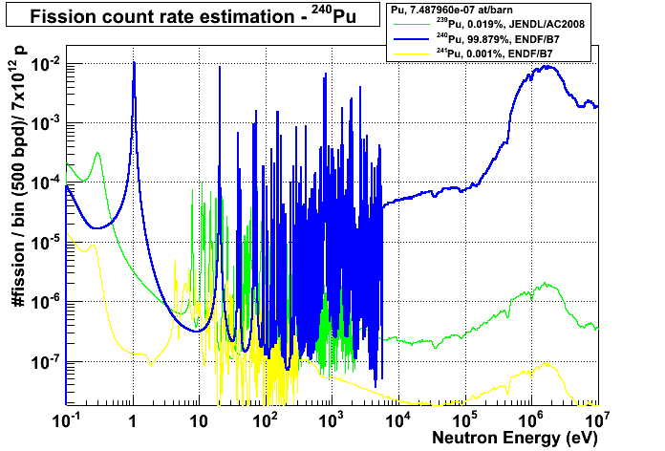
Countrates ²⁴⁰Pu (1/2)
Fission rate per proton bunch
15 mg ²⁴⁰Pu, 133 μg/cm²
> 300 eV the measurements is mostly unaffected by the presence of contaminants in the sample → measurement ok!
²⁴⁰Pu
²³⁹Pu
< 100 eV, most of the contaminant contribution is due to ²³⁹Pu(n,f): subtraction possible, with relatively small uncertainties
request
²⁴¹Pu

Slide 11
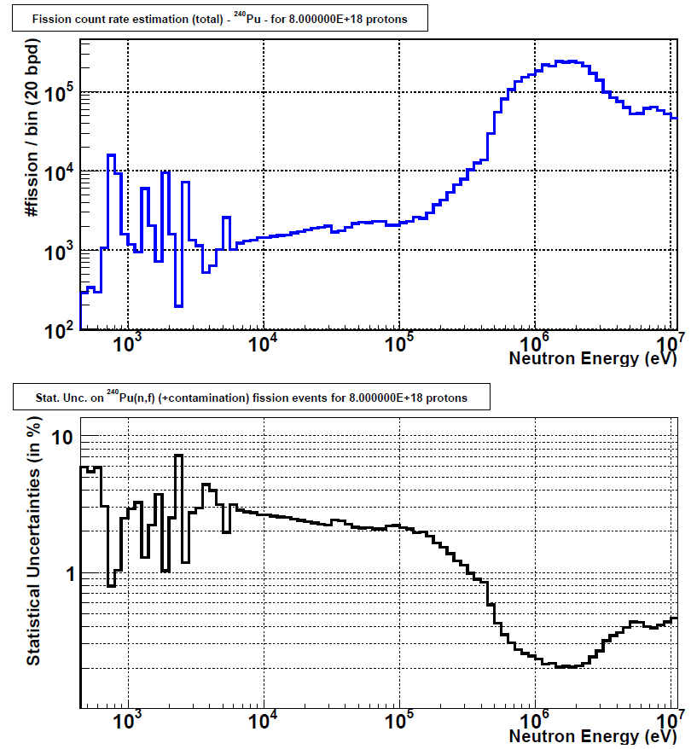
Countrates ²⁴⁰Pu (2/2)
Fission counts and statistical uncertainties using 8x10¹⁸ protons
With 20 bins/neutron energy decade (statistical uncertainty):
  Above 1 keV: <3%/bin
  Above threshold: <1%/bin
3%
Expected systematic uncertainties: ~3-4%
1%

Slide 12
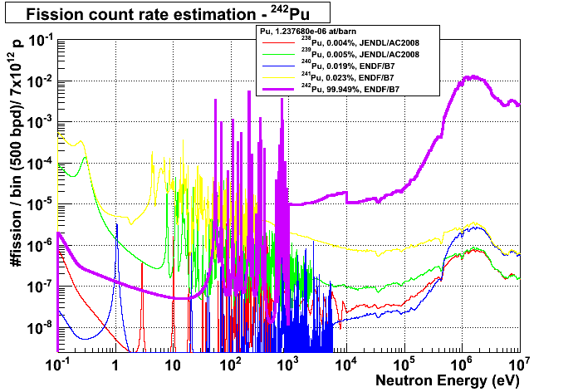
Countrates ²⁴²Pu (1/2)
Fission rate per proton bunch
25 mg ²⁴²Pu, 220 μg/cm²
< 100 eV, the contribution of the contaminants on the fission yield is > 2 orders of magnitude higher than that of ²⁴²Pu(n,f)
²⁴²Pu
Contaminant is predominant at low energies
²⁴¹Pu
> 1 keV the contribution of the fission yield due to the contaminants is < 1% → measurement ok!
²³⁹Pu
request

Slide 13
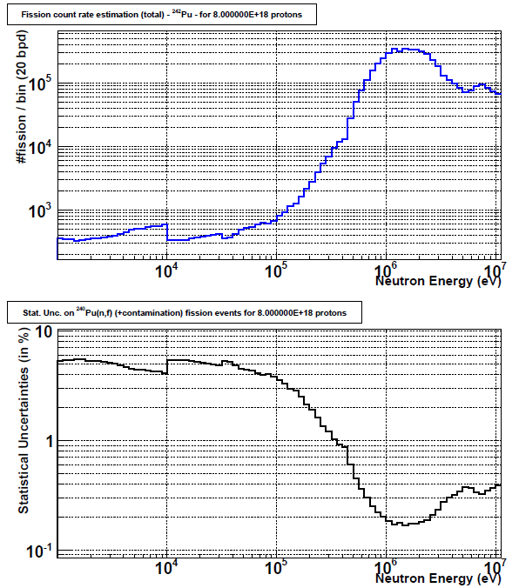
Countrates ²⁴²Pu (2/2)
Fission counts and statistical uncertainties using 8x10¹⁸ protons
With 20 bins/neutron energy decade (statistical uncertainty):
  1-100 keV: ~5%/bin
  >100 keV: <3%/bin
  above threshold: <1%/bin
5%
3%
Data adequate for Gen-IV reactors
1%
Expected systematic uncertainties: 4-5%

Slide 14
Beam time request
Isotope | Mass (mg) | Stat. Uncertainties (%) | # protons
²⁴⁰Pu | 15 | ≤ 2 (500 eV – 10 MeV) | 8x10¹⁸
²⁴²Pu | 25 | ≤ 3 (100 keV – 10 MeV)
²³⁵U | 5 | < 1 | n. d.
²³⁸U | 5 | < 1 | n. d.
Beam request sufficient to reach the goal of the measurement in the URR and threshold region and to study selected resonances at lower energie
Measurements relative to:
  ²³⁵U(n,f) cross-section is a standard from 150 keV to 200 MeV
  ²³⁸U(n,f) cross-section is a standard from 2 to 200 MeV
http://www-nds.iaea.org/standards/

Slide 15
Conclusions
Sensitivity studies for Generation-IV critical reactors, show that a drastic reduction of uncertainties on fission cross-section is needed for high mass plutonium isotopes
Present proposal aims at collecting data on ²⁴⁰Pu(n,f) and ²⁴²Pu(n,f)
Goal: reach an accuracy of around
  3-5% in the URR up to around 50 MeV for ²⁴⁰Pu
  6-7% for ²⁴²Pu
Requested protons: 8x10¹⁸

Slide 16
Thanks a lot for your attention

Slide 17
0.6 – 1 keV
Isotope | t_{1/2} (y) | Inh. Coefficient (Sv/Bq) | Authorization limit (L_{A}) (Bq) | Public protection (“1 mSv criterion”)
²³⁵U | 7.04x10⁸ | 2.56x10⁻¹³ | 800 | 3.9x10⁹ Bq | 4.9x10⁷ mg
²³⁸U | 4.47x10⁹ | 2.38x10⁻¹³ | 900 | 4.2x10⁹ Bq | 3.4x10⁸ mg
²⁴⁰Pu | 6.56x10³ | 4.10x10⁻¹² | 200 | 2.44x10⁸ Bq | 28.9 mg
²⁴²Pu | 3.74x10⁵ | 3.93x10⁻¹² | 200 | 2.54x10⁸ Bq | 1750 mg

