Slide 1


HIE-ISOLDE Status
Yacine Kadi on behalf of the HIE-ISOLDE project team
INTC Meeting, 23 June 2010

Slide 2

Outline
Project Organization
M&P Budgets
Status of External Funding
R&D Activities

Slide 3
Steering Committee
International Advisory Panel
1.1 Project Leader – Y. Kadi (EN/HDO)
1.2 Project Safety Coordinator – A.P. Bernardes
HIE-ISOLDE Project
1. Project Management
1.3 Technical Coordinator – M. Pasini BE/RF
1.4 Design Study Coordinator–R.Catherall EN/STI
HIE-LINAC
2. Linac Systems
2.1 Cavity RF BE/RF
1.5 Installation Coordinator – E. Siesling BE/OP
2.2 Cavity Design manufacturing EN/MME TE/VSC
1.6 Detailed Activity Planning – K. Foraz EN/MEF
2.3 Beam dynamics BE/RF-ABP
1.7 Budget and Planning – E.Delachenal EN/GMS
2.4 Cryomodules TE/MSC EN/MME
1.8 Administration – E. Cochet EN/GMS
2.5 Beam Instrumentations BE/BI
2.6 SC Solenoid TE/MSC
2.7 Beam transfer line (magnets) TE/MSC
8.1 Safety Coordinator GS/DI
2.8 Linac Integration EN/MEF
8. Safety
8.2 Radioprotection DG/SCR
2.9 Vacuum TE/VCS
8.3 Access System GS/ASE
2.10 Survey BE/ABP
3. Infrastructure
&
Integration
3.1 Civil Engineering GS/SEM
8.4 Access System GS/ASE
3.2 Integration EN/MEF
3.3 Cooling ventilation EN/CV
3.4 Electrical systems EN/EL
3.5 Cryogenic system TE/CRG
Work Breakdown Structure
3.6 Power converters TE/EPC
3.7 Industrial Control system EN/ICE
3.8 Beam Control system BE/CO
3.9 Interlocks TE/MPE
4. Installation
&
Commissioning
4.1 Single cavity test BE/RF
4.2 Cryomodule test BE/RF
4.3 Transport & Handling EN/HE
4.4 Planning & Installation EN/MEF
4.5 Linac commissioning BE/RF-OP
Design Study
5. Target Study
5.1 Target design EN/STI-HE
5.2 Front Ends EN/STI TE/EPC-ABT
5.3 Beam Diagnostics BE/BI
7. Injection & Beam distribution
6. Target Area and Class-A Lab Integration
6.1 Layout upgrade EN/MEF
7.1 Off line separator EN/STI
6.2 Cooling and ventilation EN/CV
7.2 Separator areas EN/STI
6.3 Electrical systems EN/EL
7.3 Experiment Hall EN/MEF
6.4 Vacuum TE/VCS
7.4 Beam lines BE/ABP
6.5 Survey BE/ABP
6.6 Civil engineering GS/SEM
6.7 LL Control system EN/STI

Slide 4
Management & Communication Structure
Steering Committee – M. Huyse
International Advisory Panel
Project Management – Y. Kadi
International Collaboration
Technical Coordination
M. Pasini
Physics Coordination
X. X
Linac System
M. Pasini
Infrastructure
and Integration
D. Parchet
Design Study
R. Catherall
Safety
A.P. Bernardes
Physics
WG
X.X
Beam Dynamics
Working Group
RF Accelerating Structures
Working Group
Cryomodules
Working Group
Linac Commissioning
Working Group
Infrastructure & integration
Working Group
Design Study
Working Group
Safety
Working Group

Slide 5
HIE ISOLDE Physics Coordination Group
ISOLDE Group Leader
ISOLDE Physics Coordinator
ISCC chairperson
Miniball spokesperson
T-REX, Separator
Storage Ring
Scattering light nuclei
HELIOS, ACTAR, Tilted Foil

Slide 6
Material Budget
4.8 MCHF from Ext. Funding already spent
Total remaining material budget of 35 MCHF shared between(2010 – 2015):
  External funding
    LINAC (17.7 MCHF)
  CERN budget
    Infrastructure (14.3 MCHF)
    Design studies for intensity upgrade (2.2 MCHF)
    Safety (0.8 MCHF)

Slide 7
Personnel budget
CERN Staff
  Resources defined by group leaders (105 FTE over 5 years)
Fellows (70 FTE)
  5 FTE paid on departmental budget
  9 FTE paid by Isolde Collaboration
  56 FTE paid by ITN3 Marie Curie Contract (20 fellows, CATHI proposal ranked 3rd/863)

Slide 8
Participating Institutes

Slide 9
Status of External Funding
(assured)
R&D activity, part of LINAC funded from K.U. Leuven – Belgium (4.3 MCHF + 4 FTE)
Contribution from ISOLDE Coll. (1.0 MCHF + 9 FTE)
Other beam quality investments (new RILIS, RFQ cooler, charge breeding) – funded by Sweden, UK and Germany
(4 MCHF)
Special Technical Training Program (2 FTE funded by Spain)

Slide 10
Status of External Funding
(applied for)
  Scandinavian-EU Interregional Package -> waiting for decision to fund 1 fully equipped low-beta cryomodule (cryostat, 2 SC solenoids, 6 low-beta SC cavities, instrumentation, QPS, etc…) => 1.5 – 2 MCHF + FTE’s
  KoRIA Project —> discussion to fund 1 fully equipped high-beta cryomodule (cryostat, 1 SC solenoids, 5 low-beta SC cavities, instrumentation, QPS, etc…)
  => ~1.5 MCHF + FTE’s
  Spanish Industry for Science Programme —> 2 proposals submitted:
      High-beta cryomodule + SC solenoid + SC cavities with tuning —>
      1 FTE, 965 kEuro
      Beam Instrumentation —> 4 FTE, 250 kEuro

Slide 11
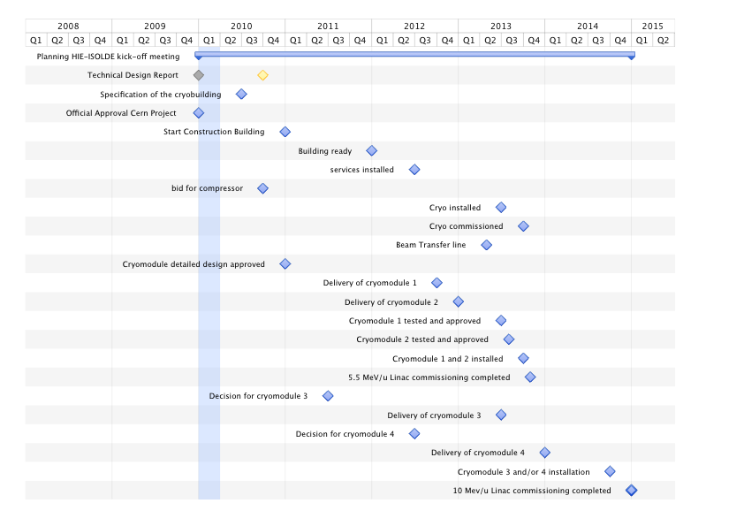
HIE-ISOLDE Schedule
PSB SHUTDOWN
Physics @ 5.5 A MeV
5.5 MeV/u Linac commissioned
10 MeV/u Linac commissioned

Slide 12
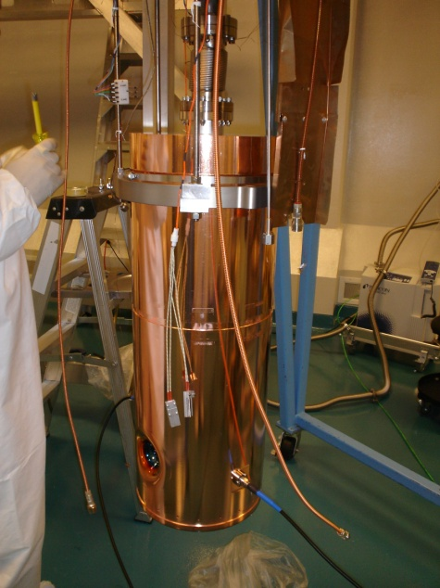
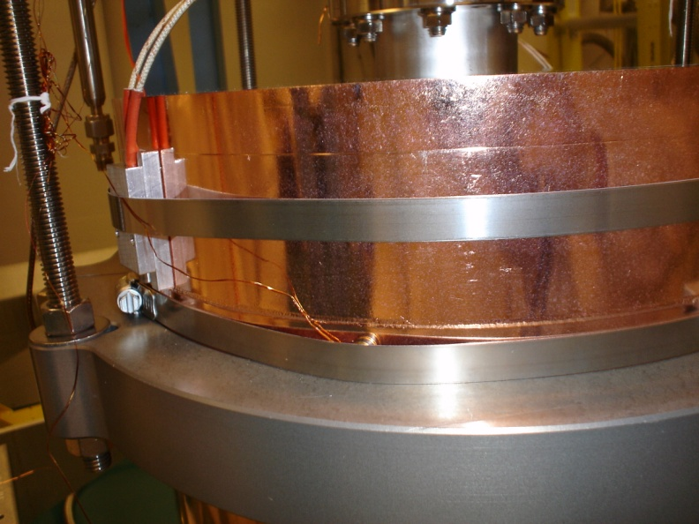
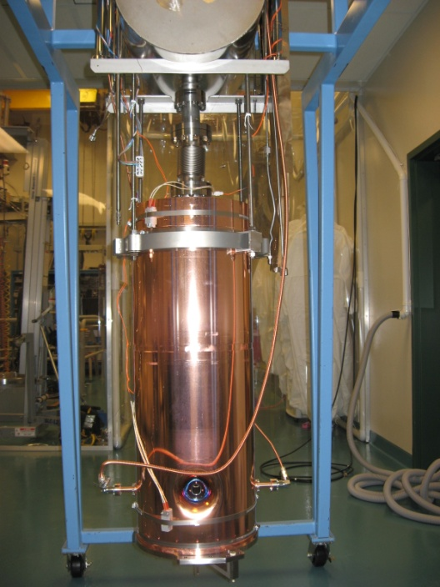
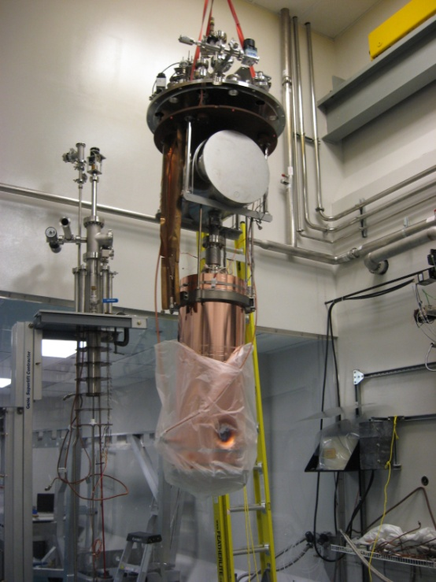
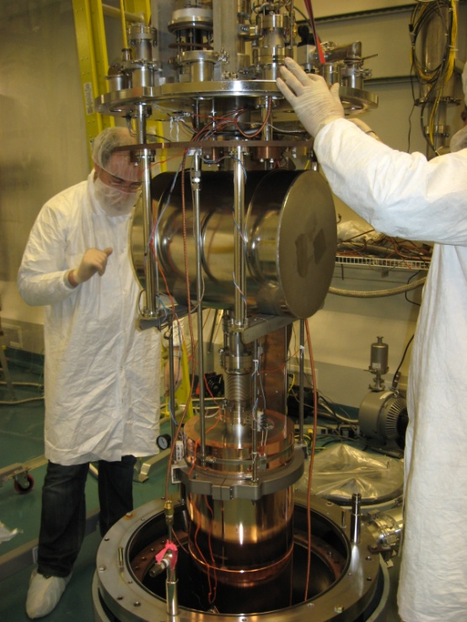
Test at TRIUMF:
Installation of the cavity in the cryostat
Notes:
Thursday March 25:Installation of the cavity in the TRIUMF cryostat completed, all electrical connections were checked and low level RF measurements were done. We inserted the cavity in the cryostat for pumping and pre-cooling (the heat screen was filled with LN2) Thursday March 25:Installation of the cavity in the TRIUMF cryostat completed, all electrical connections were checked and low level RF measurements were done. We inserted the cavity in the cryostat for pumping and pre-cooling (the heat screen was filled with LN2)

Slide 13
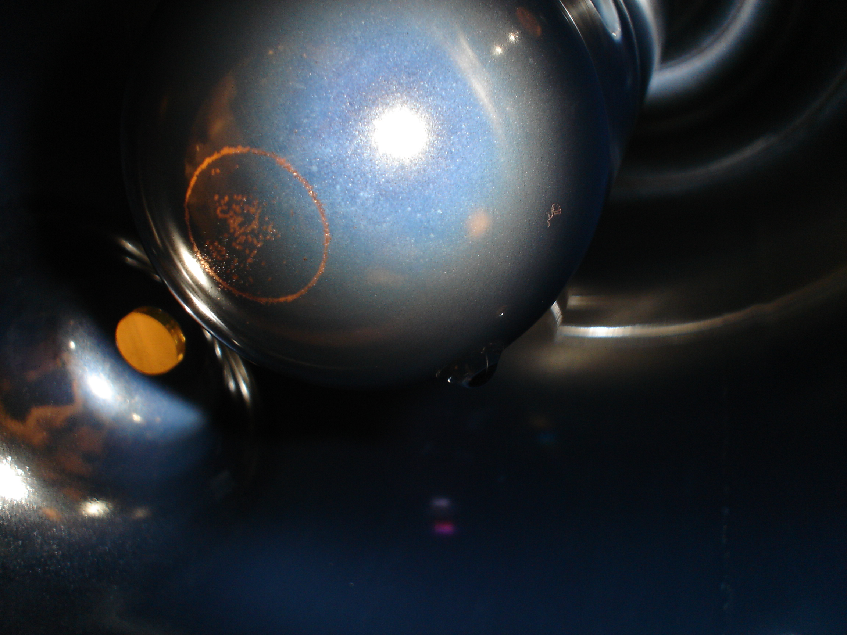
Test at TRIUMF: RF Measurements
The Q- value is a factor 10 lower then nominal, Q-slope is also very steep. (LIMITING factor)

Slide 14
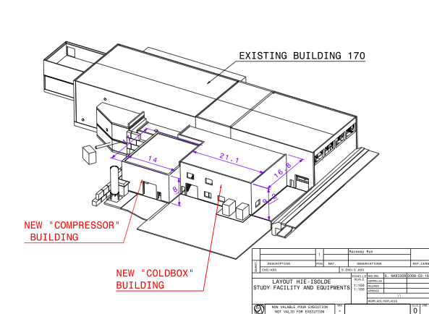
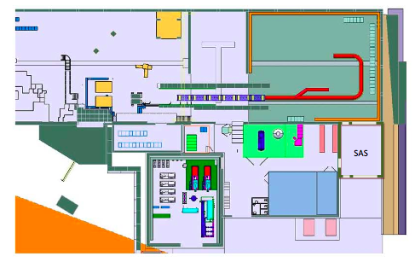
HIE-ISOLDE Layout

Slide 15
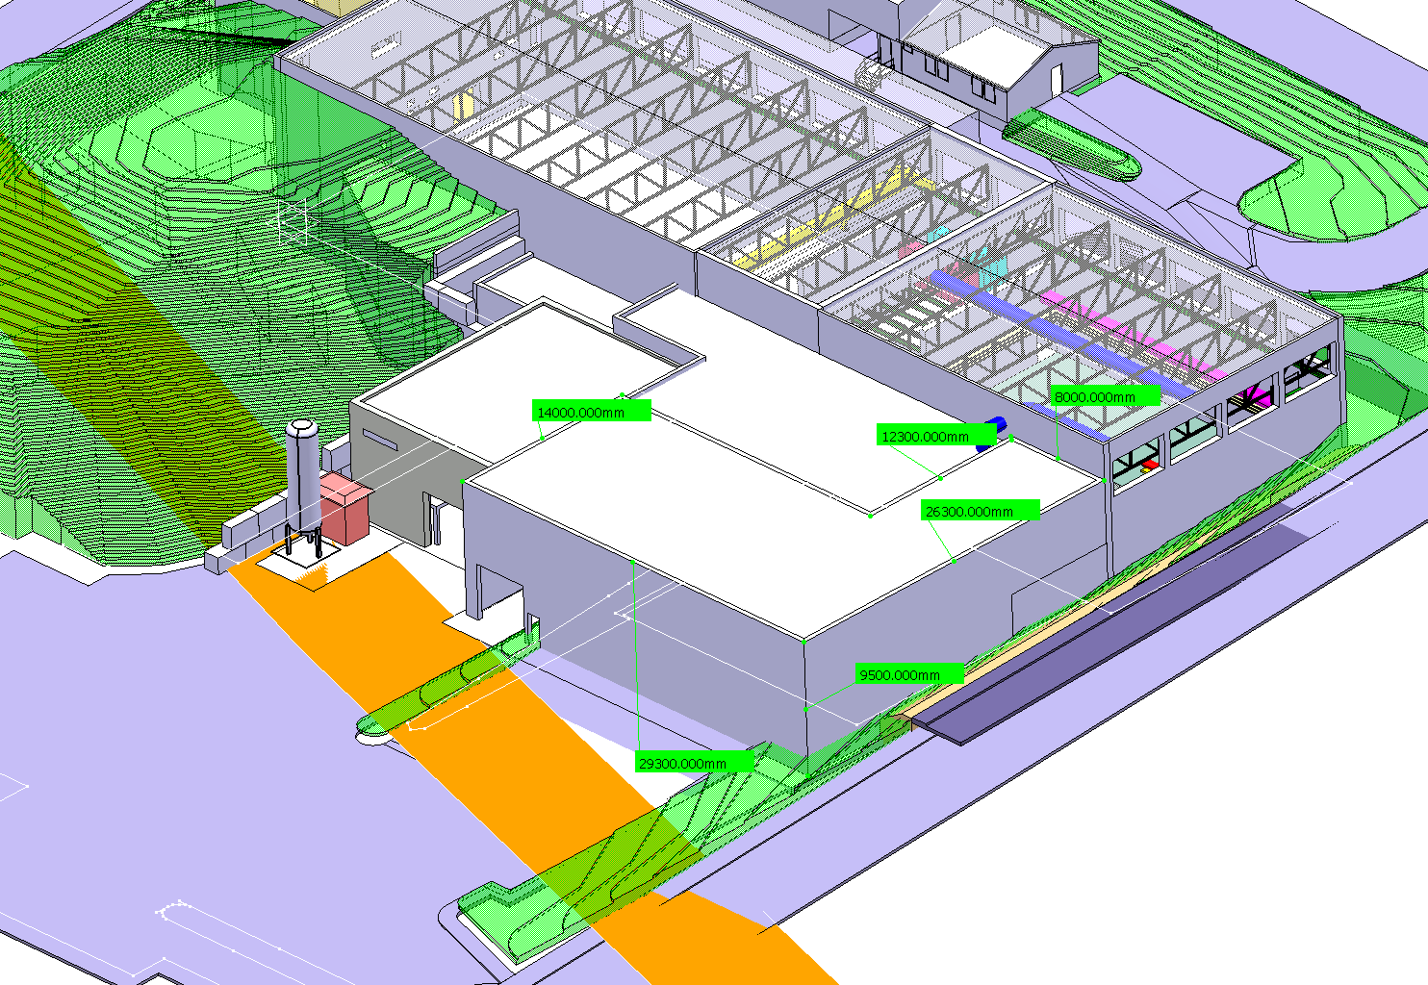
Possible extension for HIE-ISOLDE (Geneva side without labs)

Slide 16
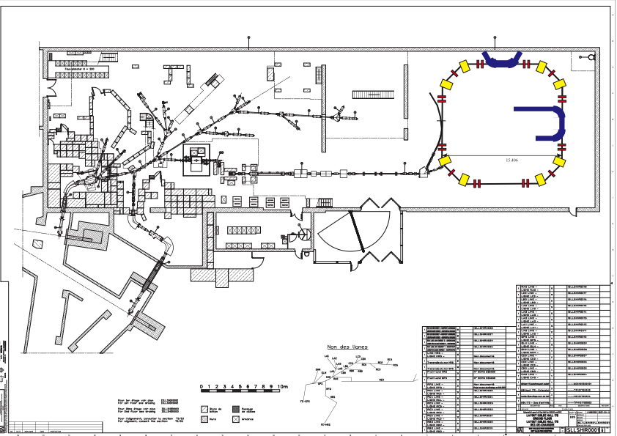
HIE-ISOLDE Storage Ring

Slide 17
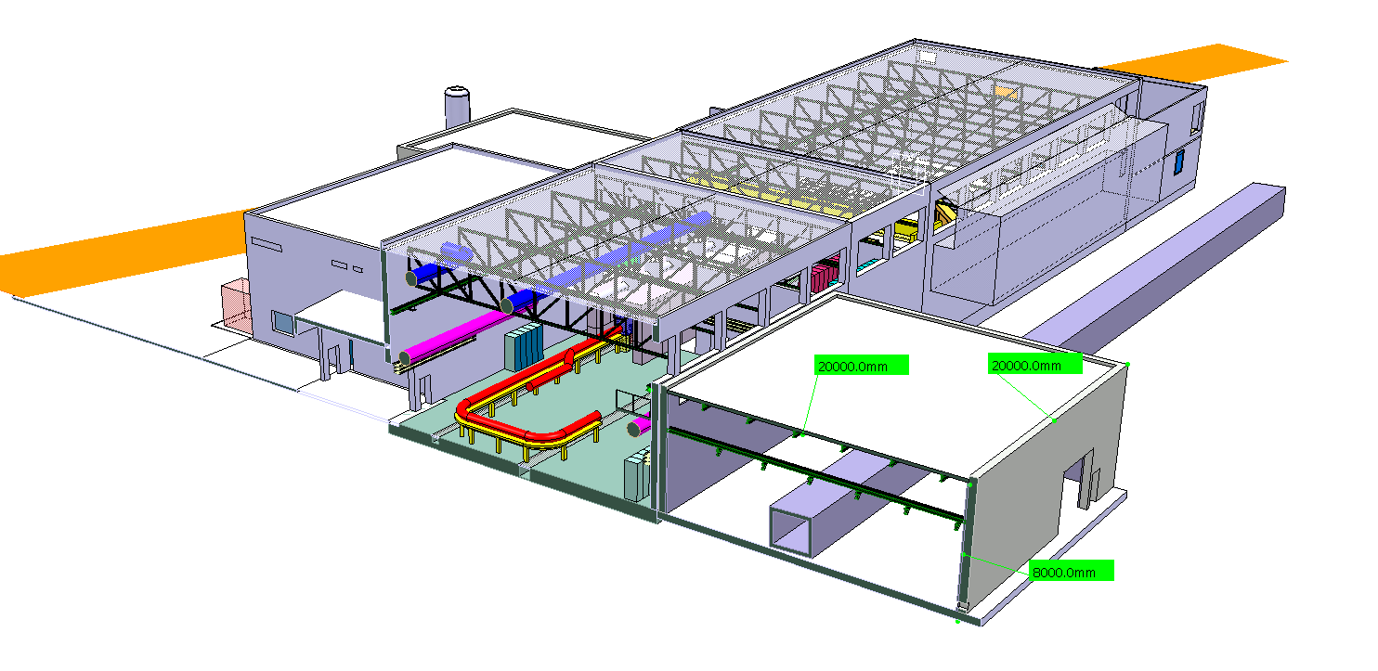
Possible extension for HIE-ISOLDE
(Jura side -> Storage Ring)

Slide 18
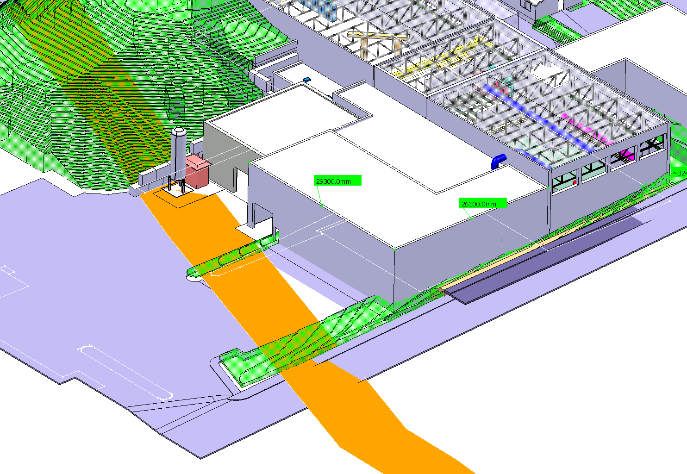
Possible extension for HIE-ISOLDE
(Geneva side including labs)

Slide 19
Summary
2010 CERN resources allocated -> 305 kCHF for civil engineering + 1007 kCHF for cryogenic system
Project included in MTP 2010 – Approval delayed by Council -> Sep. 2010
CATHI under negotiation
Submission of Spanish Grant proposal
Preparation of test bench at CERN of QWR resonators (new RF tests cryostat is planned to be ready end of June 2010)
New Cavity RF tests @ SM18 by mid-July 2010.
2nd prototype cavity (slightly modified) in fabrication
New layout of the facility
Tendering —> Civil Engineering (Sept. 2010 FC)
Cryogenics (Dec. 2010 FC)

