Slide 1
A HIE-ISOLDE spectrometer for nuclear reaction studies
 | Special INTC meeting for HIE-ISOLDE Letters of Intent , 23 June 2010, CERN
G. Tveten¹, J. Cederkall², S. Siem¹, A. Goergen¹, M. Guttormsen¹, P. Hoff¹, D. Di Julio², C. Fahlander², P. A. Butler³, D.T. Joss³, M. Scheck³, A. Blazhev⁴, J. Jolie⁴ , N. Braun⁴, P. Reiter⁴, N. Warr⁴, D. G. Jenkins⁵, R. Wadsworth⁵, S. Freeman⁶, J. Iwanicki⁷, P. Napiorkowski⁷, M. Zielinska⁷, M. Huyse⁷, P. van Duppen⁸, R. Raabe⁸, R. Krucken⁹, M. Aliotta¹⁰, T. Davinson¹⁰, Th. Kroll¹¹, J. Leske¹¹, N. Pietralla¹¹, T. Grahn¹², J. Uusitalo¹², R. Orlandi¹³, J. Pakarinen¹⁴, D. Voulot¹⁴, F. Wenander¹⁴
¹ University of Oslo, Norway, ² Lund University, Sweden, ³ Liverpool University, UK, ⁴ Cologne University, Germany, ⁵ York University, UK, ⁶ University of Manchester, UK, ⁷ Warsaw University, Poland, ⁸ Katholieke Universiteit Leuven, Belgium, ⁹ Technical University Munich, Germany, ¹⁰ Edinburgh University, UK, ¹¹ Technical University Darmstadt, Germany, ¹² University of Jyvaskyla, Finland, ¹³ CSIC-IEM, Madrid, ¹⁴ CERN

Slide 2
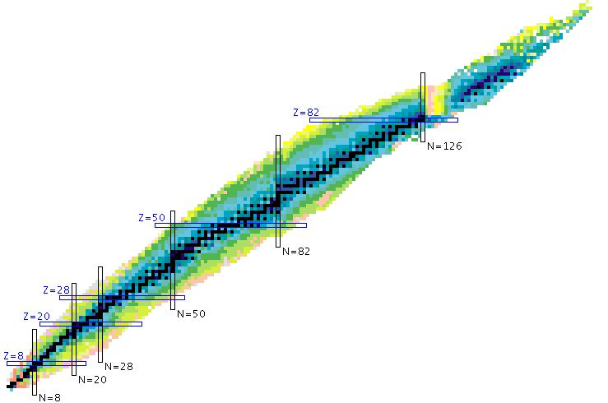
Background
An increase in available energy for the post-accelerated beam opens the door to nuclear reaction studies only possible at ISOLDE thanks to the large variety of RIBs. Many physics cases that require a spectrometer are being presented today. These include:
Transfer reactions in inverse kinematics
E.g. deuterated targets: (d,p) and (d,n)
Coulex up to higher energies than before

Slide 3
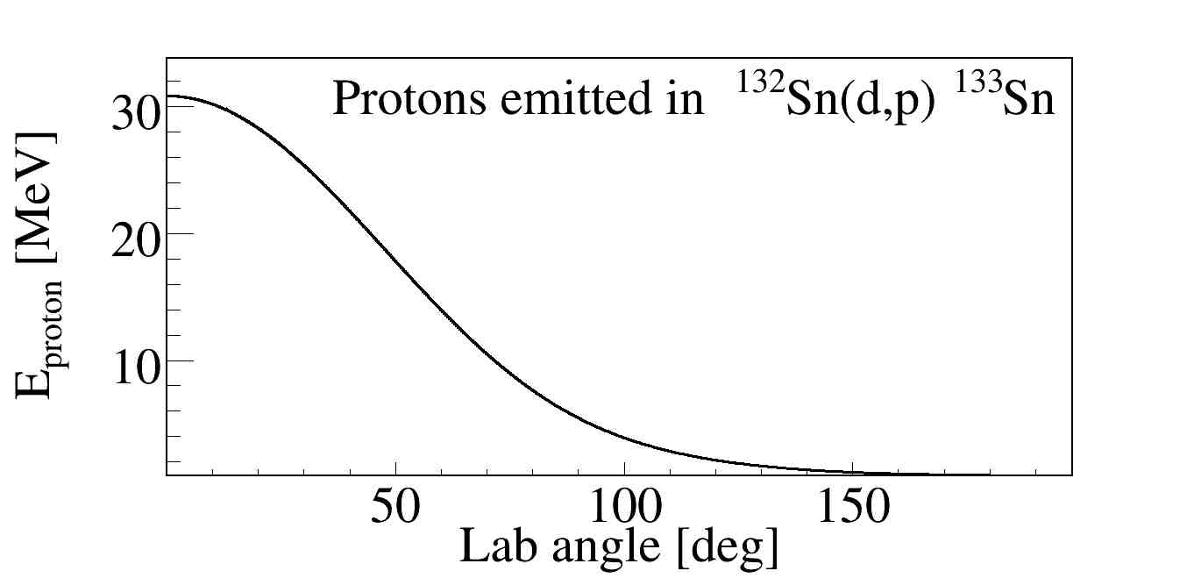
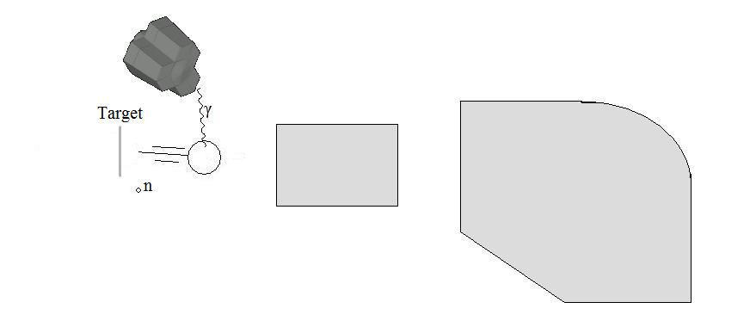
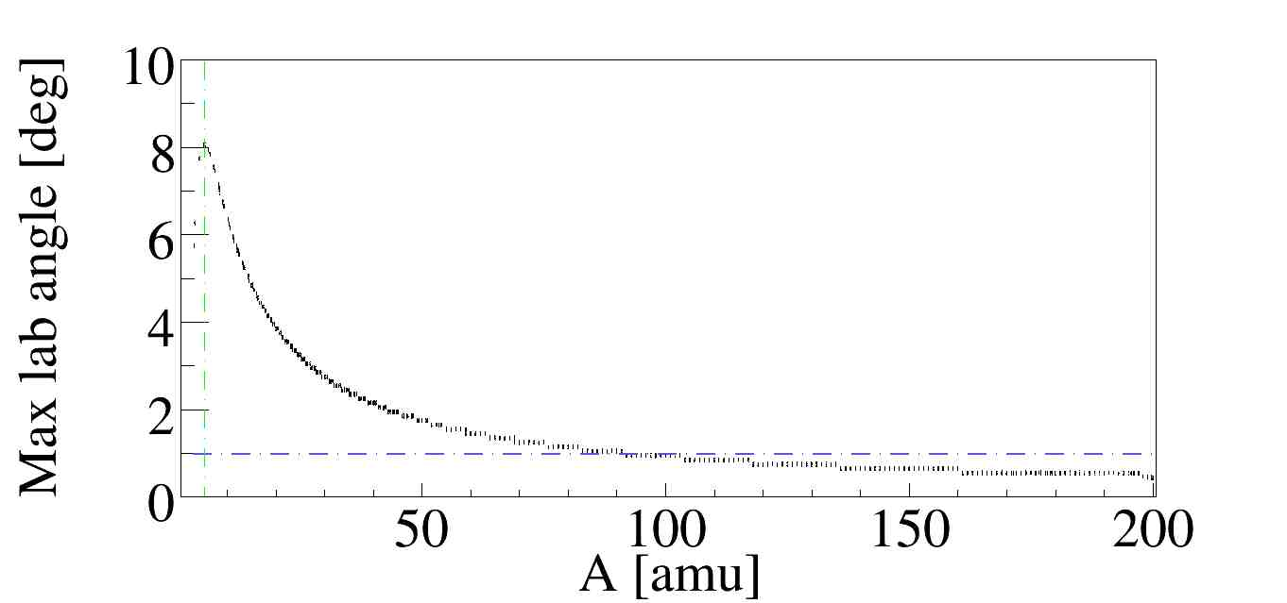
Why a spectrometer or separator?
Transfer reactions in inverse kinematics such as (d,p) and (d,n)
The heavy ion is ejected in a narrow cone along the beam direction
In cases where the light ejectile is a neutron a spectrometer may be the most efficient device for channel detection
The light ions ejected at backwards angles often have low energies
Beam
Nuclear transfer reactions in inverse kinematics often require a spectrometer for channel selection

Slide 4
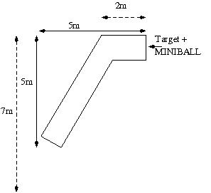
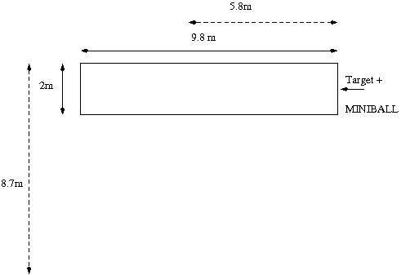
Floor space needs
Option A)
Option B)
The dotted option is the floor space used if the device is rotated 60 degrees

Slide 5
Beam requirements and infrastructure
Infrastructure requirements
Beam requirements
Floor space for rotation
9 m x 10 m or
7 m x 5 m
400 kW of cooling is foreseen
Water cooling
Safety as for usual for MINIBALL
Vacuum
Power for magnets and dipoles
2 mm beamspot (95% rms)
Angular divergence < 2 degrees
Long release time from EBIS
~100 ns bunch separation from the LINAC
dE/E < 0.5 FWHM
Variable energy
5 – 10 MeV/u beams
Instantenous rates < 10E5
Achromatic beam at the secondary target
For intensities and isotopes, see the physics LOI

