Slide 1
10MHz testing 2020
Ben Woolley

Slide 2
10MHz Tests 2020 –pt 1
13th July - Test cavity blew 400A fuses when pulsing with frequency sweep applied.
After this there were interventions in the tunnel to replace feedback amplifiers on some cavities.
Tests resumed end of August where we saw a glitch in the frequency at 5MHz caused by the CR29/2/8, DDS RF SYNTHESIZER.
  Unable to control FESA fields on the 1TFB boards.
  Due to misconfiguration of new CTRVs (needed because of the increase in cycles to 32.)
  Once we could switch to the internal MHS on the AVCs the glitch disappeared.

Slide 3
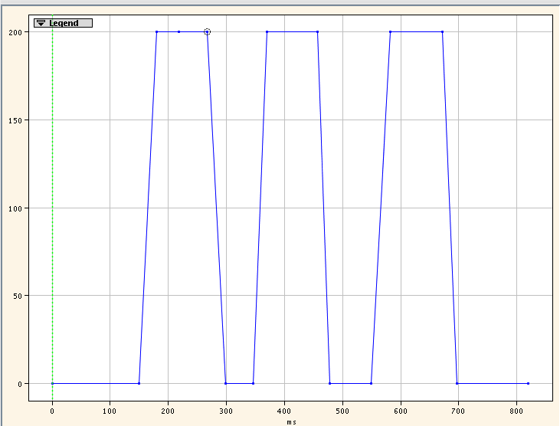
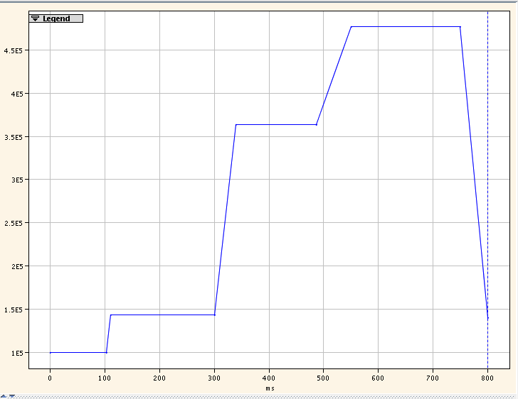
10MHz Tests 2020 –pt 2
Voltage Program
From 5th October the cavities were tested systematically.
Method:
  Fixed frequency of 3MHz and then slowly increase voltage to 20 kV over several cycles.
  Repeat for 5 MHz, 7.76 MHz, 9 MHz and 10.013MHz.
  Sweep cavity from 3MHz-10.13MHz-3MHz and increase voltage slowly over several cycles.
For the last few cavities we changed the method slightly to have 3 MHz, 7.76 MHz and 10.013 MHz pulses in each cycle.
As of mid-October all cavities are pulsing on RF test, TOF and LHC indiv 21.
Frequency Program

