Slide 1
Status of activities in PS central building
10 MHz cavity controller and coarse tuning front-ends in b. 359 racks
  Power and Ethernet connection → BE-CO
Number of optical patch cables for initial installation to be defined
  Agreed deadline: end of July → Proposal (link)
Racks for Finemet cavity (b. 151) exchanged
  Re-cabling of coupled-bunch feedback ongoing
Timing and function installation 20 MHz, 40 MHz and 80 MHz
  Installation and configuration completed
  Hardware restart timings (PAX.SBRH84/168) cabled to b. 151

Slide 2
Re-commissioning of LLRF equipment
  RF CPS eLogbook: http://elogbook.cern.ch/eLogbook/eLogbook.jsp?lgbk=382
  Ongoing and next steps
  Wall current monitor (WCM95) distribution
    Replacement of aging distribution amplifiers
  Preparation of LLRF equipment in building 151 (Ben)
  Ongoing: 2 GeV cycle with appropriate timing tree (Denis, Heiko)
  10 MHz cavities
    RF-IS pulsed all cavities of tuning groups A, B and D (locally)
    All 10 MHz pulsed with LLRF
    Next: Test groups of 10 MHz cavities together

Slide 3
Pulsing 10 MHz cavities with LLRF
  Individual System Tests (IST)
V_{prog} | AVC loop closed | Status
Test cavity | ✓ | Ok, but sweeping at full voltage to be validated | link
C10-11 | ✓ | Pulsing up to 6 kV at 3 MHz only | link
C10-36 | ✓ | Pulsing up to 18 kV | link
All other 10 MHz cavities | ✓ | Week 41 | C10-11 C10-36/46 C10-51/56 C10-66 C10-76/81 C10-86/91/96

Slide 4
40/80 MHz cavities
  Preparation of LLRF equipment in building 151 (Ben)
  AVC loop closed around cable (Ben)
  Issues with final amplifiers (access) delayed tests of digital cavity controller from weeks 42/43 to 45/46
  Cavities pulsing with analog AVC and timings (power RF)
  Next: pulsing cavities with digital cavity controller
  New measurements of probe attenuation, cables, distribution:
  Confirms observations with beam: C80-08 is the magic one!
  Analysis/measurements for 40 MHz cavities to be completed
 | Total probe attenuation | Calibration | Expected gap voltage at V_{prog} = 300 kV
C80-08 | 99.29 dB | 1.09 V/100 kV | 276 kV
C80-88 | 96.69 dB | 1.46 V/100 kV | 205 kV
C80-89 | 96.83 dB | 1.44 V/100 kV | 208 kV

Slide 5
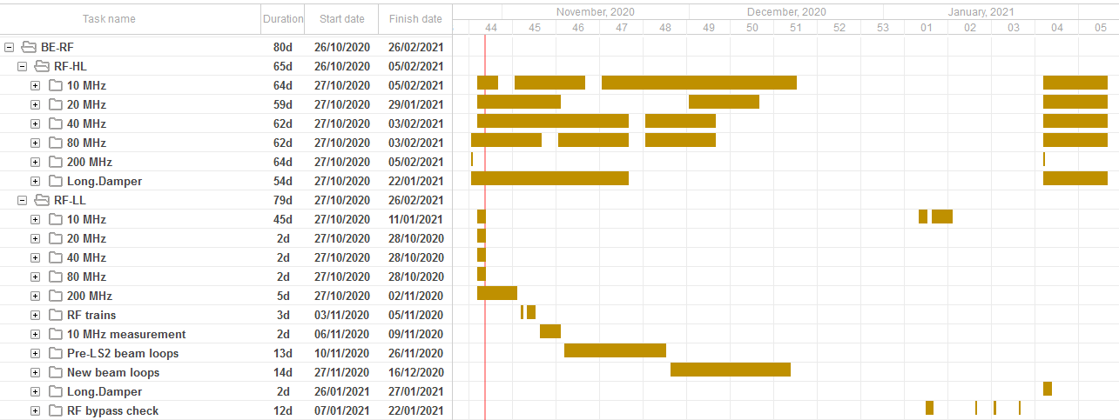
Hardware commissioning schedule
PS IST period finished on 23/10/2020 → PS transferred to BE-OP
RF agenda during hardware commissioning phase
Detailed online schedule at https://oss-coordination.web.cern.ch/gantt/latest

Slide 6
Outstanding items from ISTs
Moved from IST period to HWC:
Should have been completed during IST period (until 23/10) → PS-MPC report on 04/11
Item | Remark
New 200 MHz cavity controller | Test possible whenever ready, even after HWC
New ejection train distribution | New train distribution to be installed in parallel Move front-end to b. 353 by end of 2020
Digital demodulation front-end | Delayed to hardware commissioning
Beam loops front-end | Delayed to hardware commissioning
Item | Remark
20 MHz/40 MHz/80 MHz | Prepared, waiting for power RF availability
Digital radial position detection | Installation completed Internal functions now fully validated Final touch being applied?
Re-installation of coupled-bunch feedback | Ongoing, reshuffling of rack layout done Recabling

Slide 7
Status of projects in design office
 | Design |  | Status
Module | EDA | Orig. delivery
AVC surveillance | 04183 | 02/2020 | Tests with prototype (with TFT display)
VXS clock/sync adaptor | 04170 | 02/2020 | Tests with prototype (with TFT display)
TFT display module | 04171 | 02/2020 | Completed
RFSW6CH | 04196 | 06/2020 | Prototypes ready to test → SPS LLRF team
Quad SP2T | 02257 |  | Two modules completed
Clock MUX | n.a. | 06/2020 | Prototype working
Master clock divider | n.a. | 03/2020 | Not yet ready for design office
LIU budget code (69030) left with cost-to-completion of 15.7 kCHF
Budget analysis summary and needs based on past spending
Additional budget of 58 kCHF approved for 2021

Slide 8
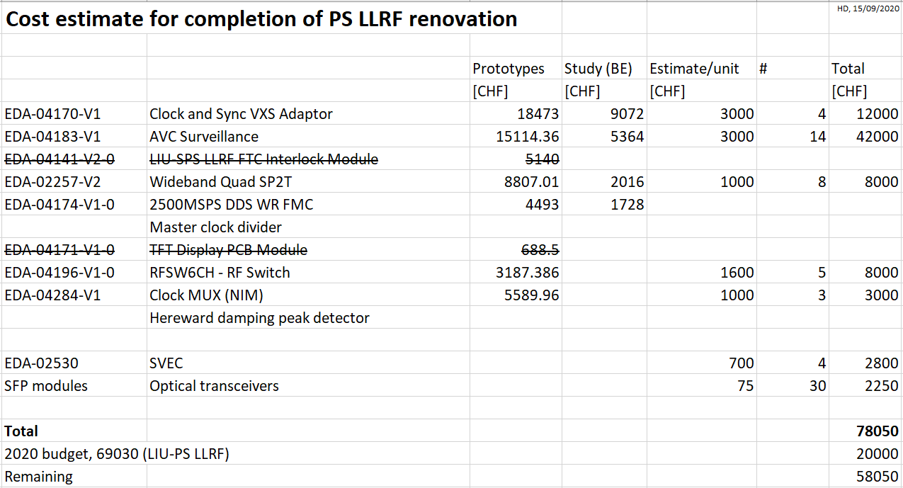
Budget supplement 2021

Slide 9
Tests of PSB hardware for PS beam control
09/2020
Hardware | Task | Date
PSB motherboard with ADC FMCs | Check PS MHS running sync. Through sync/tag adapter Check two mother boards | 10/2020
PSB motherboard with ADC FMCs | Phase measurement at two harmonics simultaneously with respect to clock reference Harmonics come from internal functions Check receivers on separate boards | 10/2020
PSB motherboard with SFP FMCs | SFP streams emission and reception PSB mother board + SFP FMC (hardware abstraction layer) | 10/2020
PSB motherboard with ADC FMCs | Matrix switch together with SFP FMC controlled by internal functions | 11/2020

Slide 10
FESA developments for PS-LLRF
10/2020
 | Hardware | FESA
Module |  | Class | Remark
AVC surveillance | New | 10/2020 | Firmware development started
Clock/sync adaptor | New | 09/2020 | To be done
Master clock, DDS-FMC | SVEC | 12/2020 | Low priority, postponed
Master clock divider | New | 12/2020 | Low priority, postponed
20/40/80 MHz cavity contr. | PS 1-TFB board | 03/2020 | New fields to be added to class
Coupled-bunch feedback | PS 1-TFB board | 12/2020 | Firmware work restarted
10 MHz cavity return measurements | PS 1-TFB board | 01/2021 | Modifications of existing class

Slide 11
FESA developments for PS-LLRF
10/2020
 | Hardware | FESA
Module |  | class | Remark
WR frequency program | SVEC | 12/2020 | Upgrade: redeployment/test
CTU | CTU | 11/2020 | Completed, testing → Diego
Fractional divider (AW./PS) | new | 06/2020 | FESA class completed, final tests
Radial position detection | PS 1-TFB board | 09/2020 | Completed, vertical slice test?
Internal function generator | n.a. | done | Completed and tested
Internal diagnostics | n.a. | 09/2020 | Waiting for final firmware
Synchronous 4-ch. receiver | PSB mother b. | xx/2020 | Firmware development
Fast data concentrator | PSB mother b. | xx/2020 | Firmware development
Slow data concentrator and distributor | SVEC | xx/2020
Beam loops calculation | PSB mother b. | xx/2020

