Slide 1
Hereward Damping Peak Detector for the PS accelerator.
Pierre Hawil

Slide 2
Table of contents
Introduction
Bloc schematic
Description of a few blocks I have worked on
Attenuation
Chosen configuration
Results in LTSpice simulations
Peak Detector RF
Several possibilities for the demodulation
Schematic of the several possibilities
PCB in Altium
Results of measurements doing on a bord
Configuration of the simple diode
ADL5511
Conclusion

Slide 3


Block schematic
LHC Low Level Chassis
New PCB to develop
Main Voltage Program
P1
VME
P2
Backplane
Demodulation and amplification
Serial stream
(CVORB)
FPGA
RF Peak Detector
ADC
New PCB to develop
SPI
10 MHz matrix
CVORB
Attenuator
AVC
Pick up
CVORB
Latch Enable &
Parallel Control
Bunch with quadrupole oscillation
Opto-isolated block
Pick
Up
RF Cavity
Beam f
CVORB

Slide 4
Attenuation
Configuration of attenuation we have chosen is
Two solutions exist

Slide 5
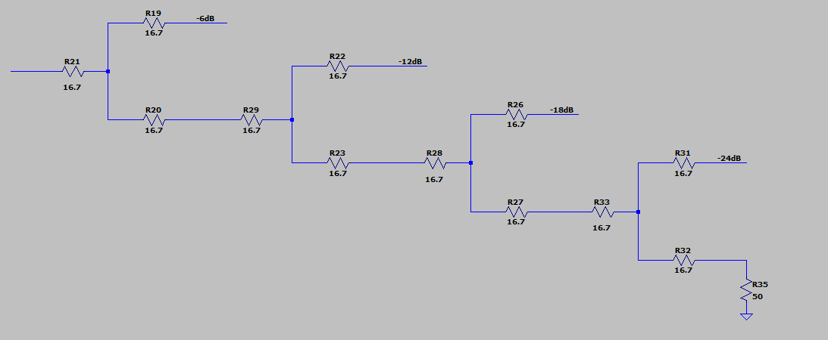
Attenuation
Resistive power splitters
Each splitter has 3 resistors of 16.7 because 16.7 * 3 = 50

Slide 6
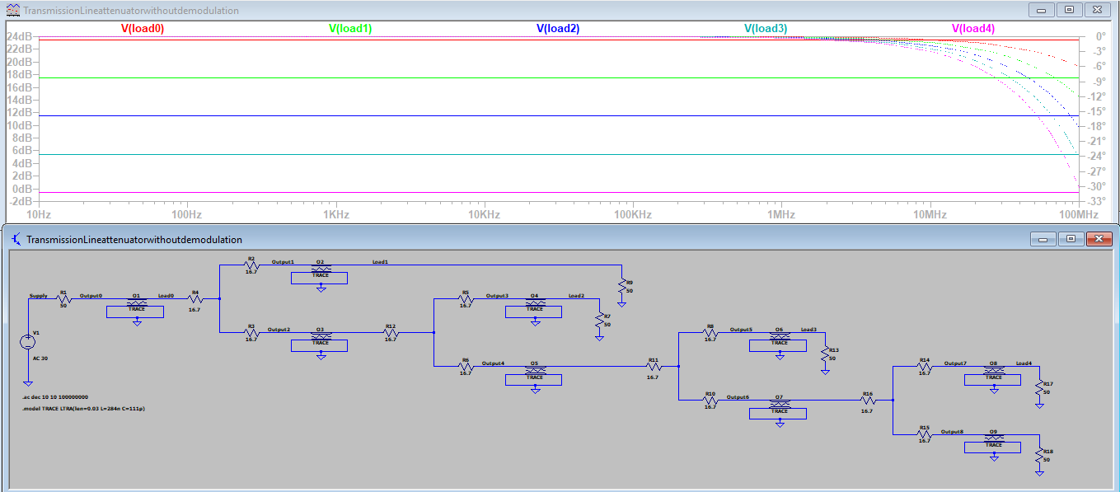
Results in LTspice
Parameters for Line transmission:
0.03 meter
284nH per meter (see next slide)
111pF per meter (see next slide)
Line transmission

Slide 7
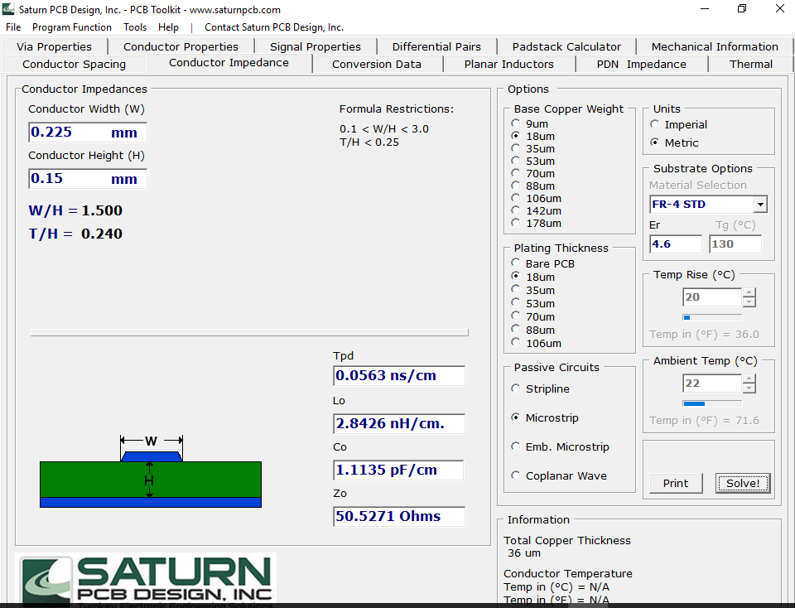
Origine of the values L and C

Slide 8
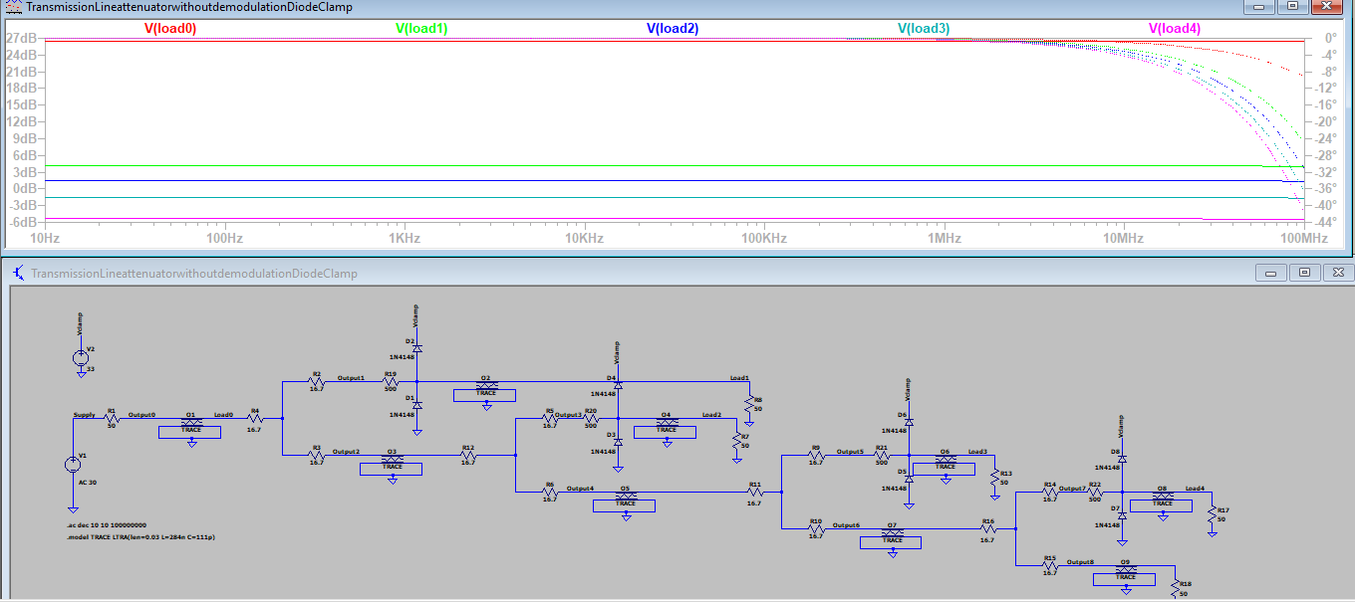
Results in Ltspice with diode clamp
Diode clamp before the loading => not OK

Slide 9
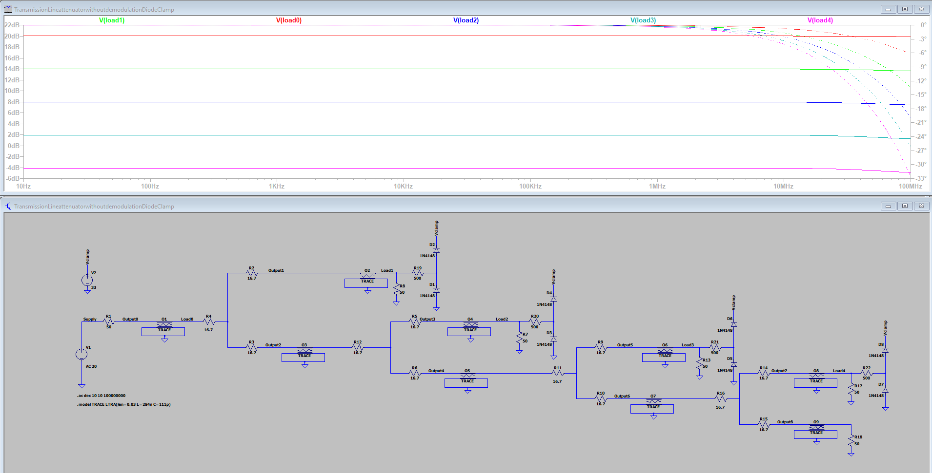
Results in Ltspice with diode clamp
Diode clamp after loading => OK

Slide 10

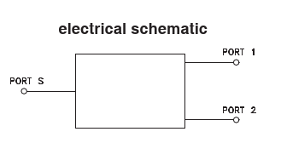
Attenuation
Using a Power splitter combiner instead of a Resistive power splitter ?

Slide 11

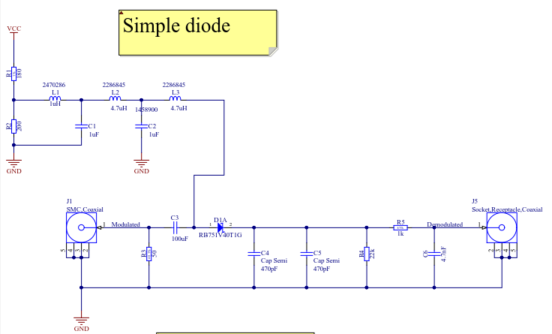
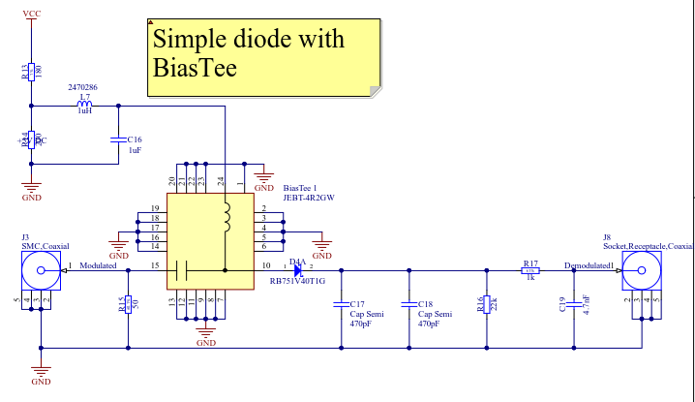
Schematic

Slide 12
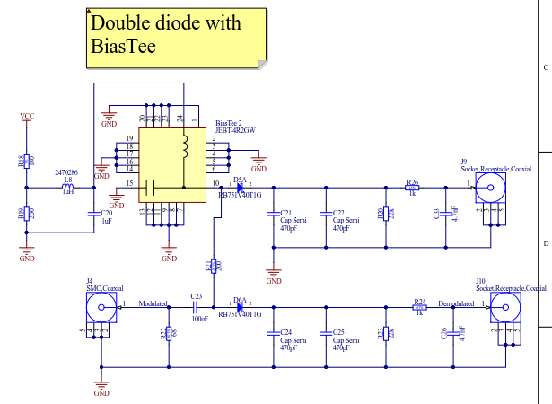
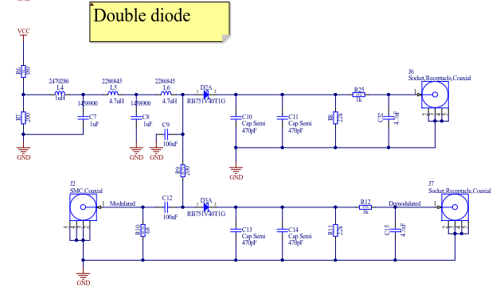
Schematic
The configuration has been duplicated because the demodulated signal goes to an ampli-op and it’s preferable to have the same configuration on the two inputs of the ampli-op.

Slide 13
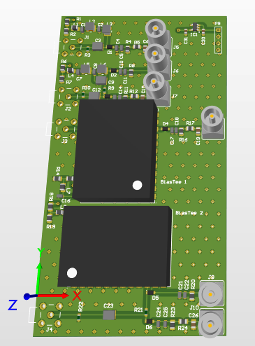
PCB realized in Altium

Slide 14
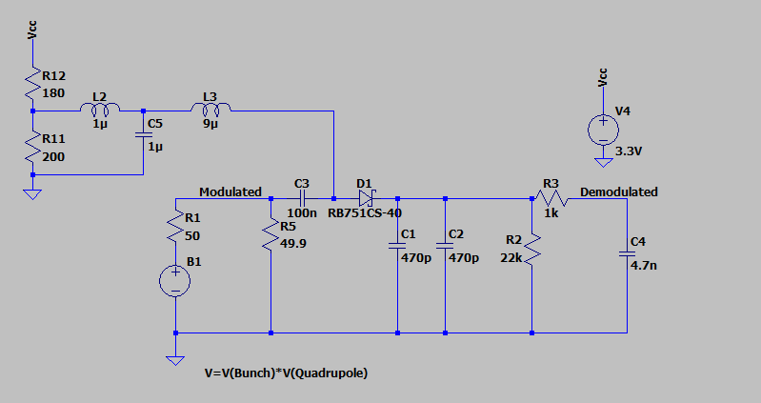
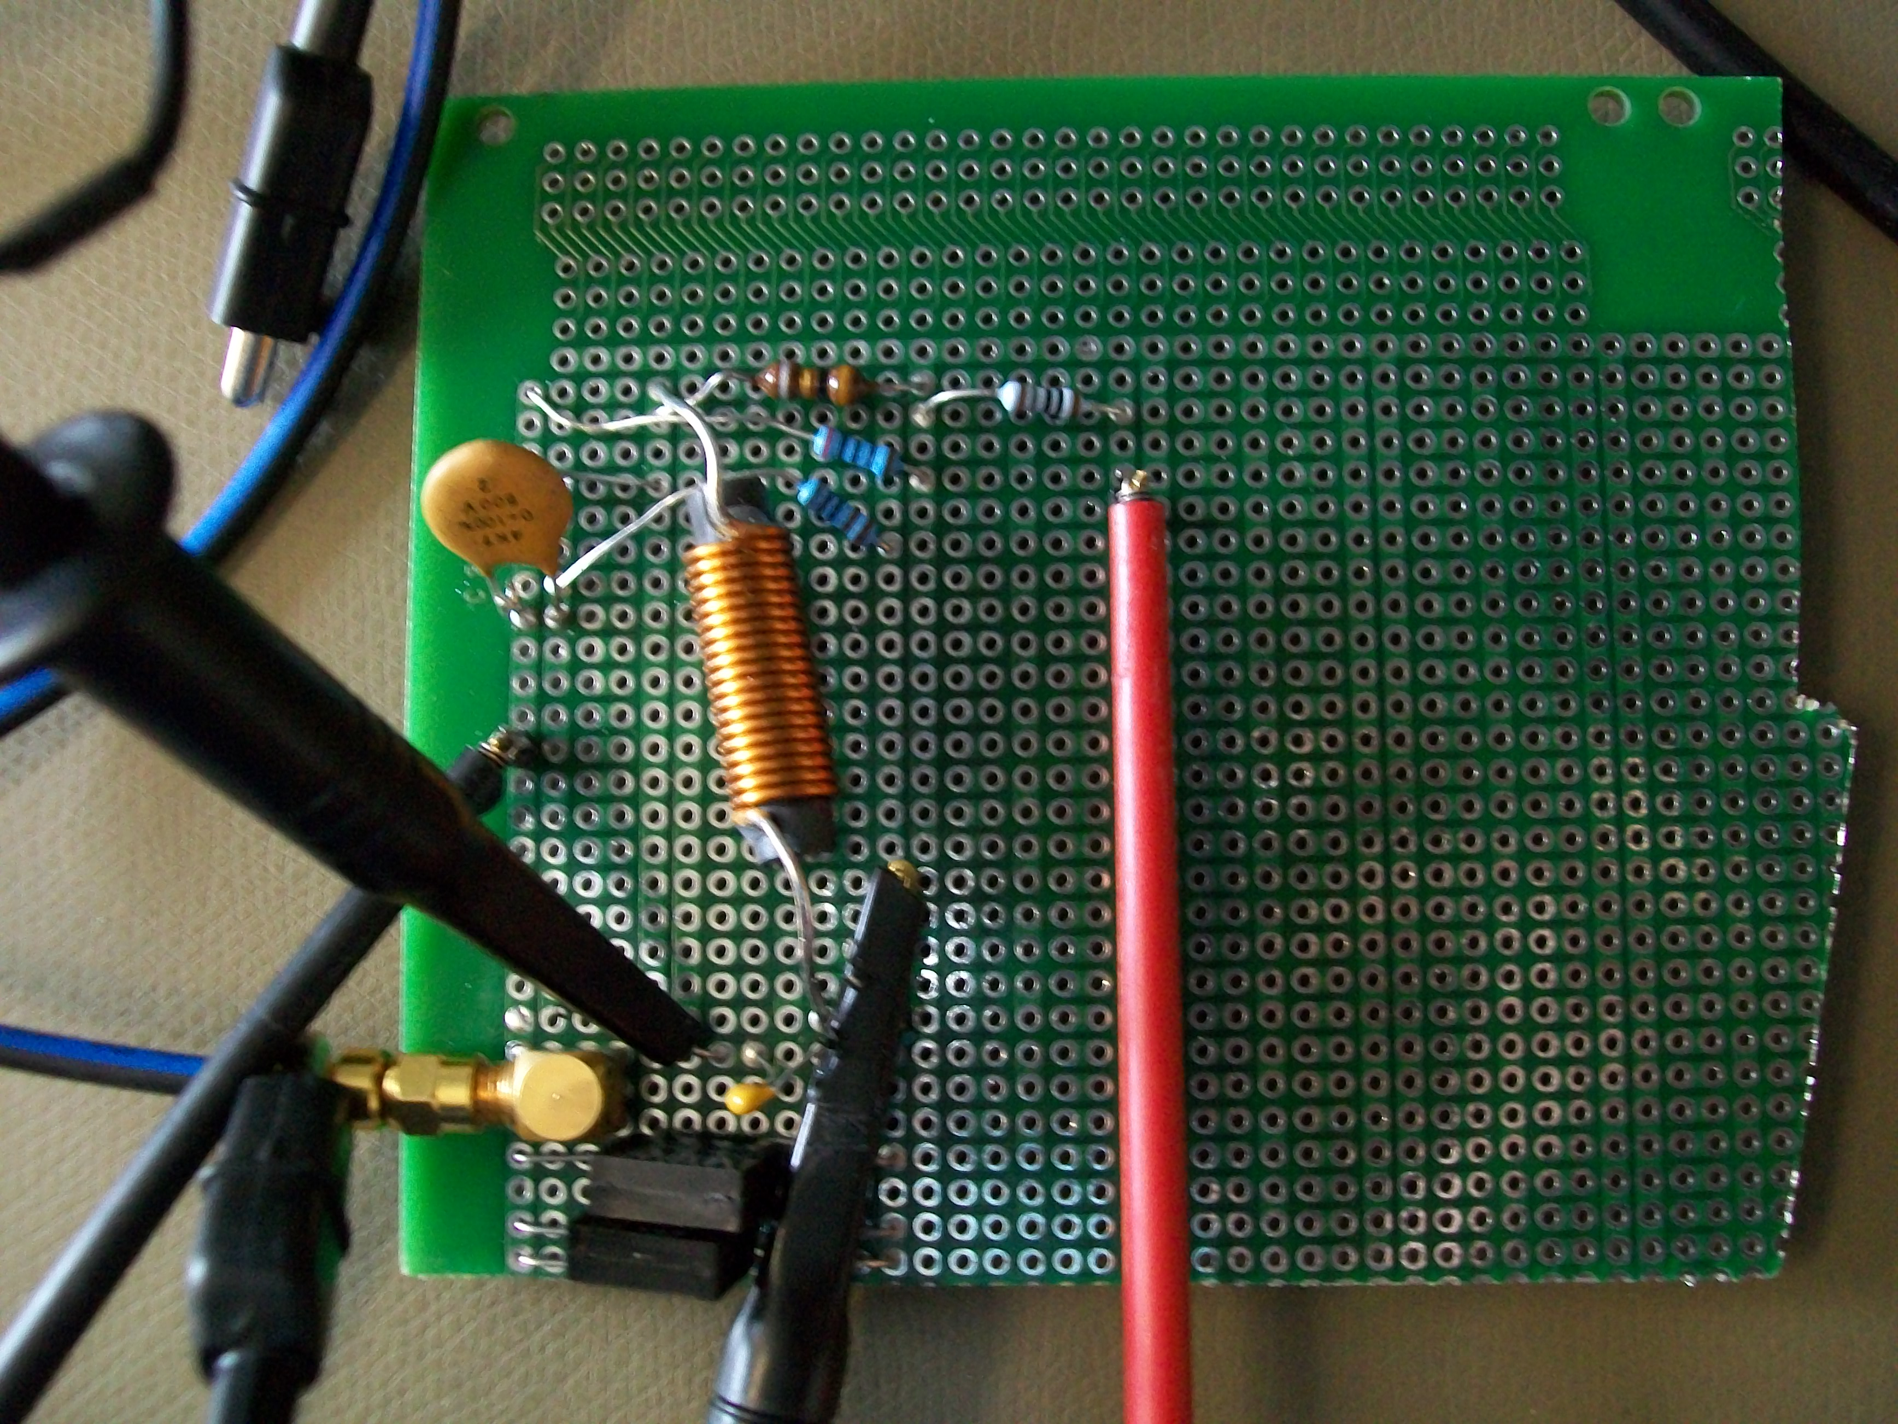
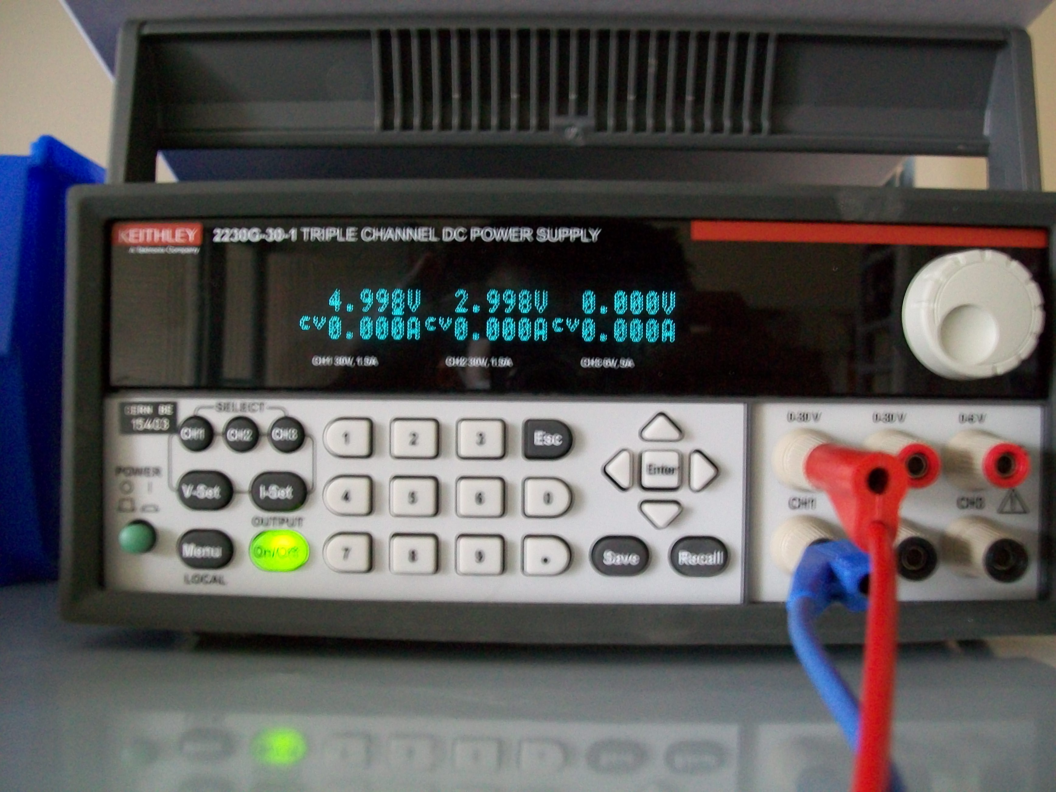
Breadbord of the simple diode configuration
Lab power supply

Slide 15
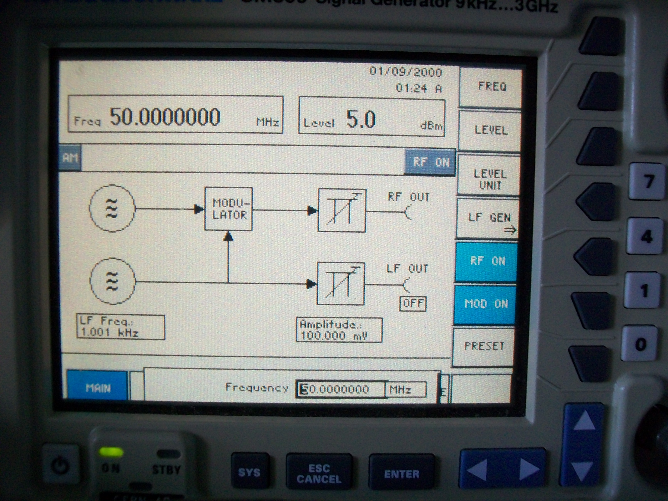
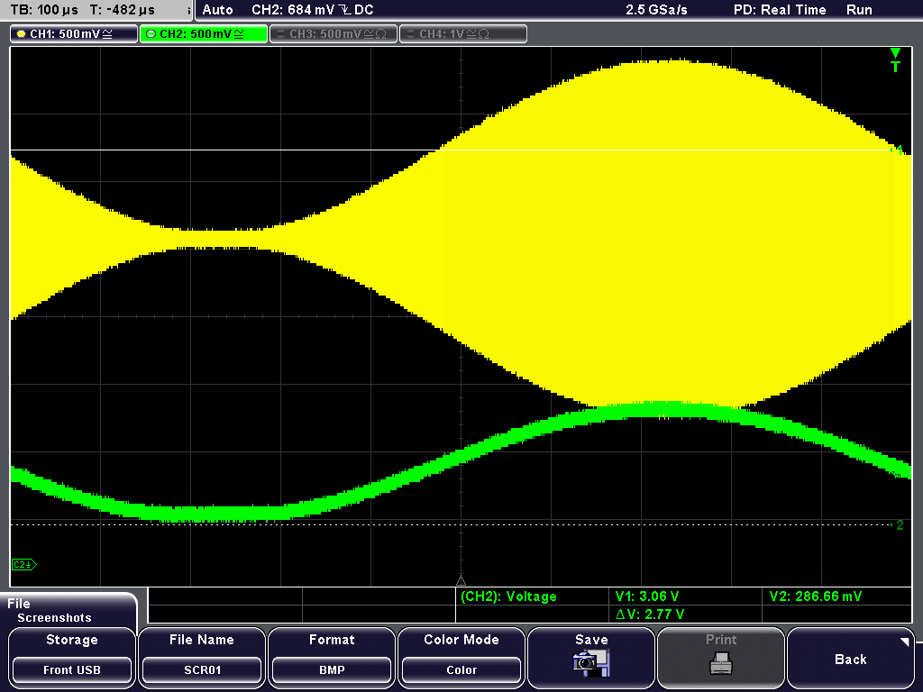
Simple Diode - Oscillograms
Carrier Frequency

Slide 16
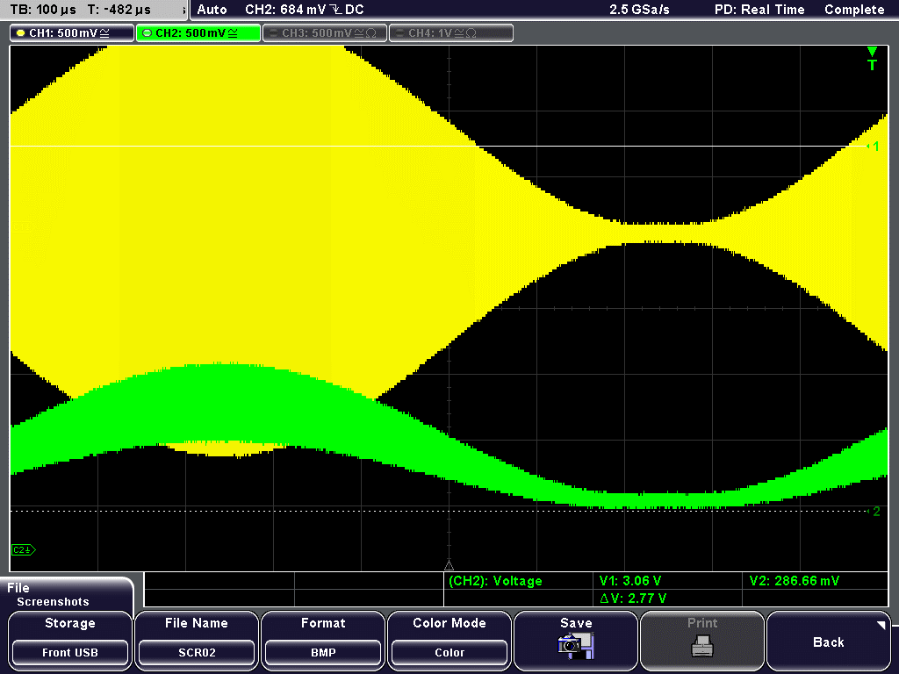
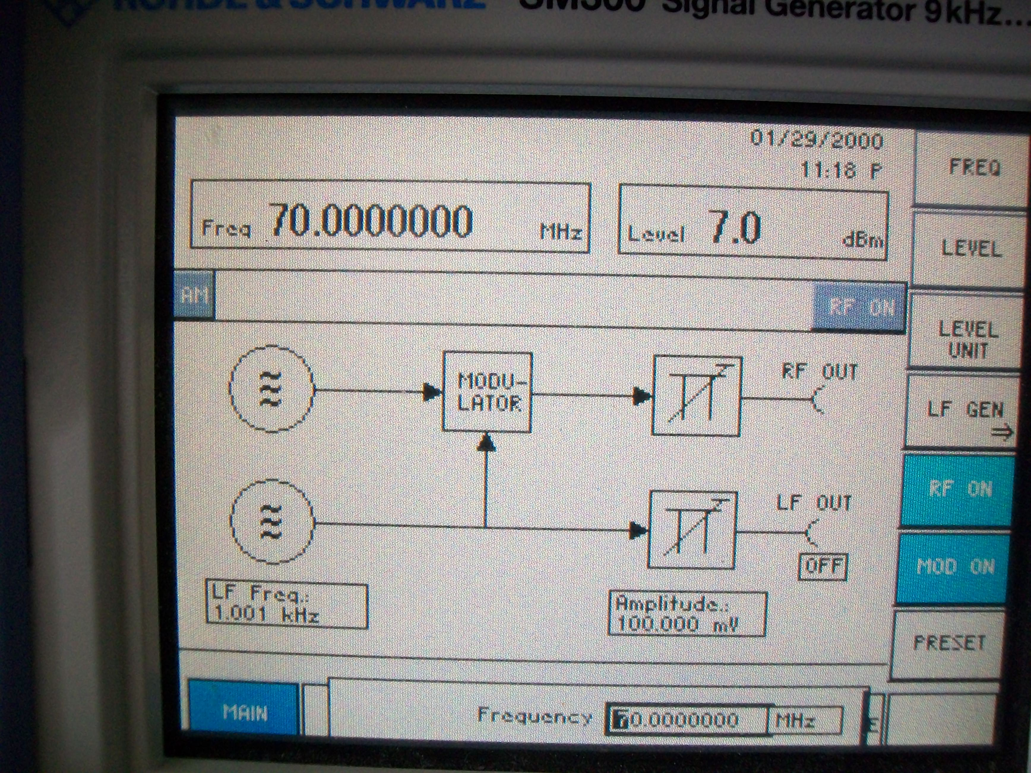
Simple Diode - Oscillograms
What happens if we goes up to 70MHz
Carrier Frequency

Slide 17
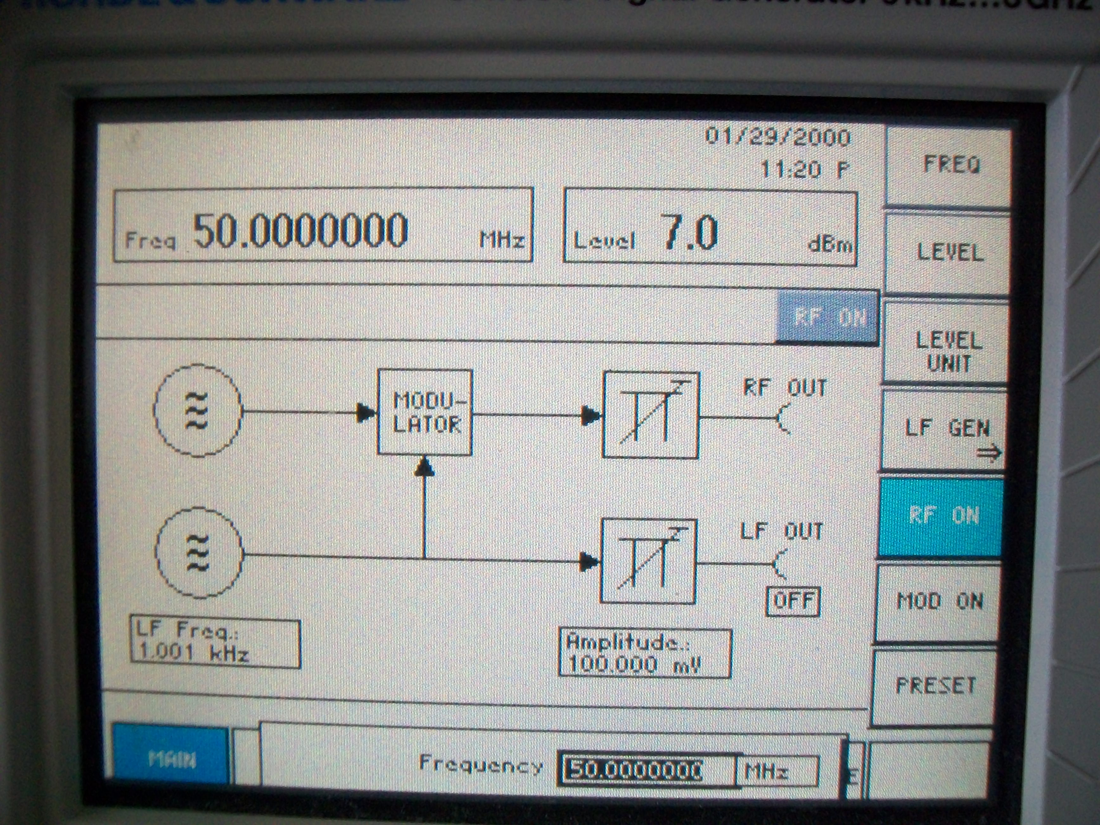
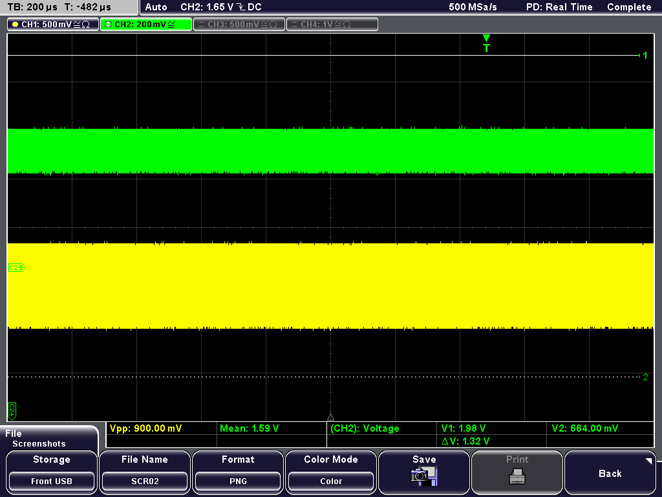
Making a plot of linearity
Carrier Frequency
Desactivate MOD ON
Change the Level (Input Power)
Write down the Vpp and Vmean values for the different levels

Slide 18
Plot of the linearity for the breadbord
Level from -31dBm up to 10dBm

Slide 19
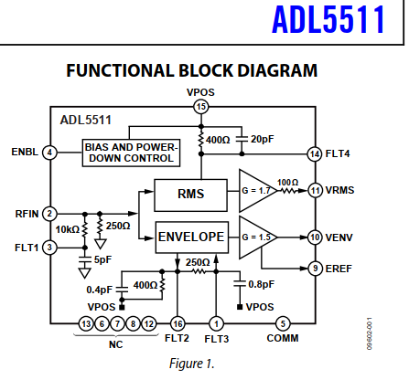
ADL5511
For the demodulation, instead of the configuration with a diode, we can choose an integrated circuit

Slide 20
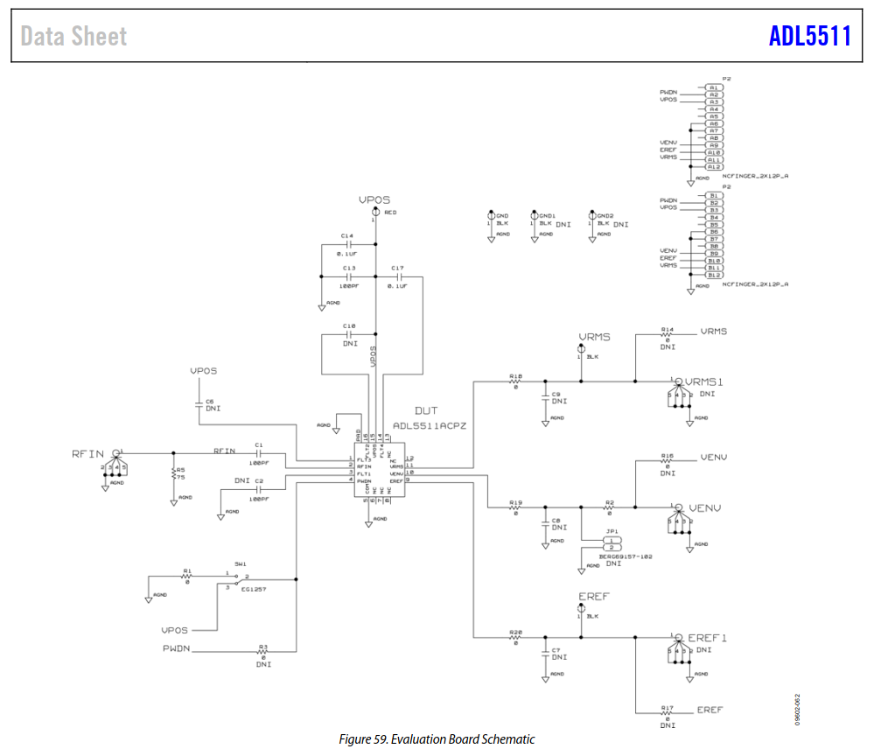
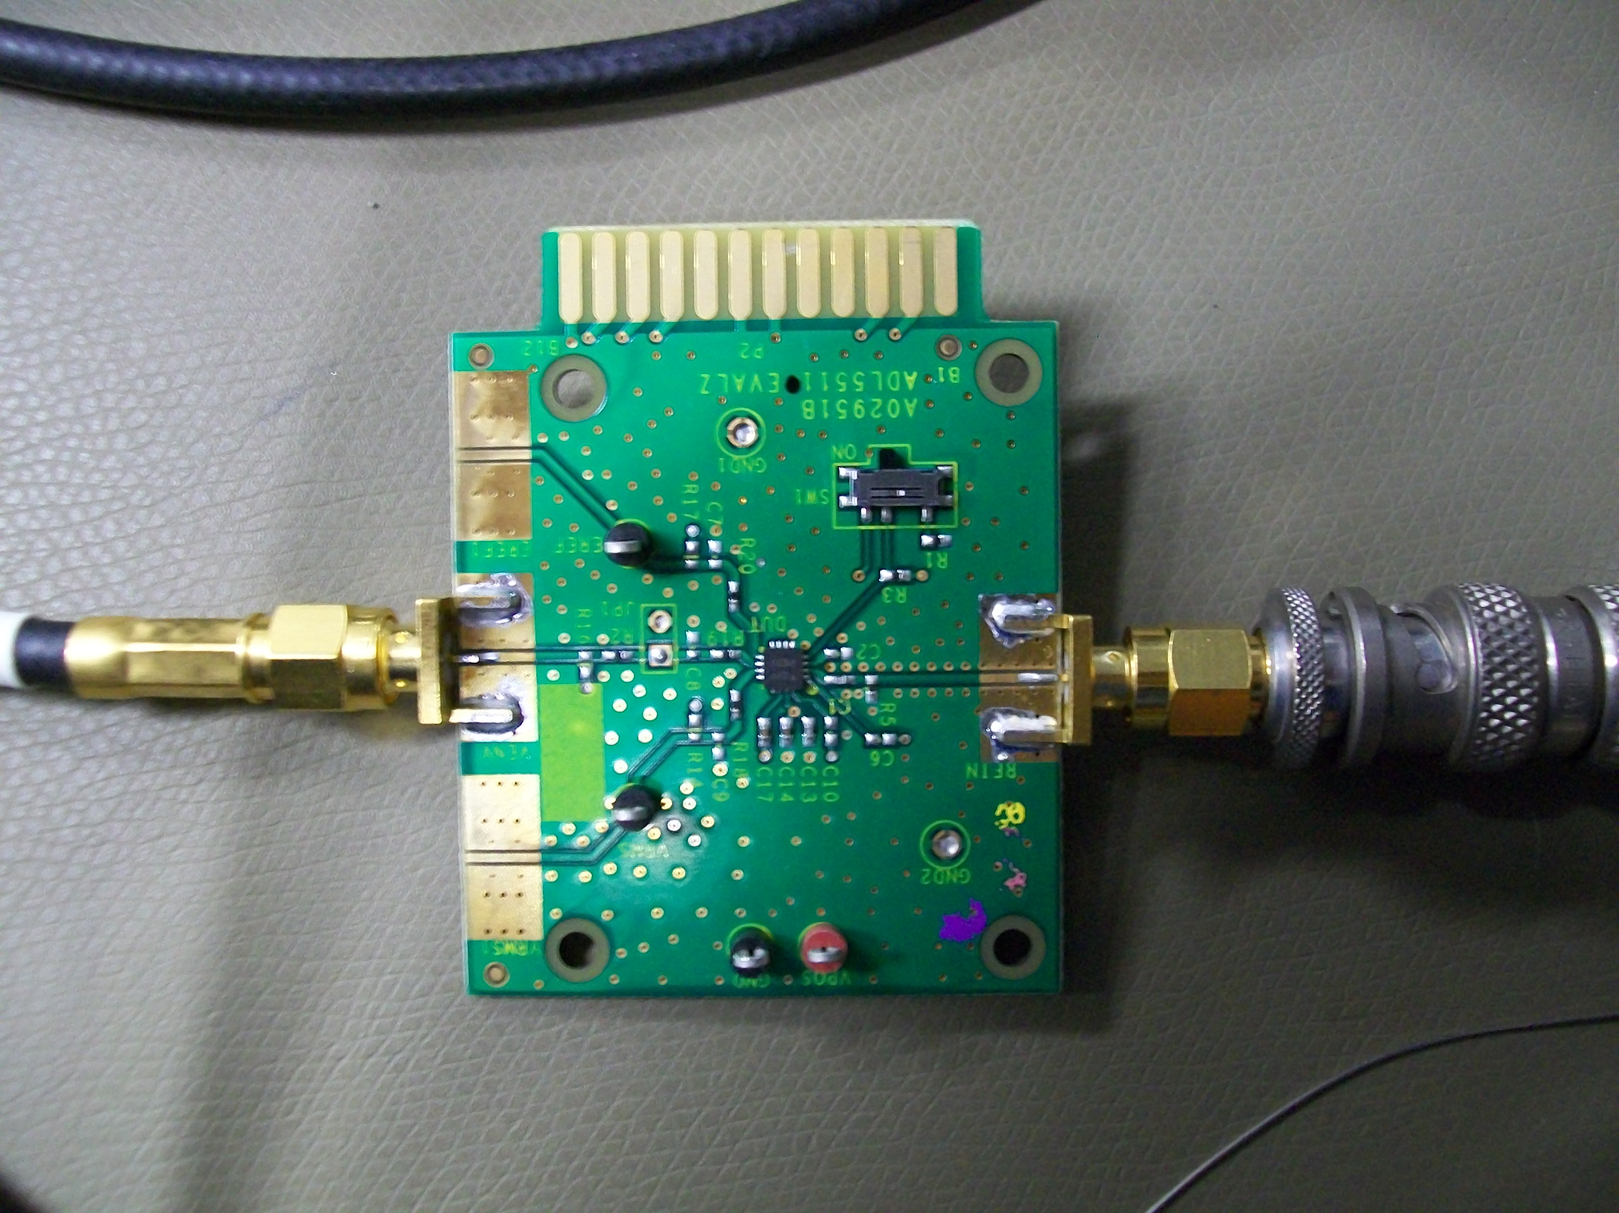
ADL5511 Evaluation board
Directly connected to the Lab Power Supply

Slide 21
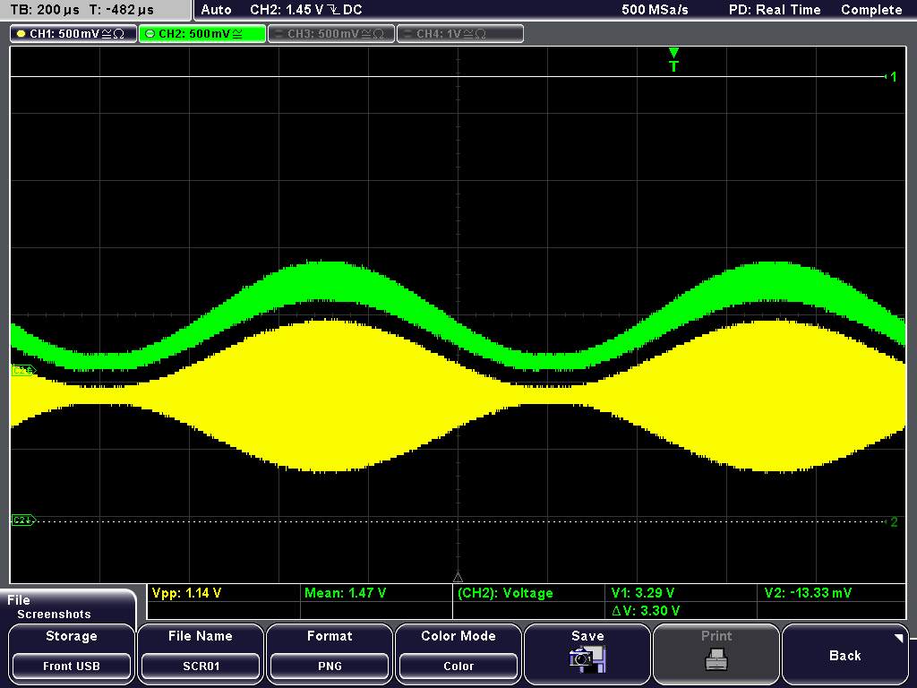
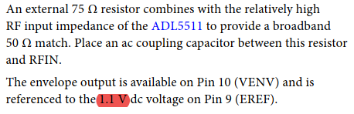
Oscillogram of demodulation
Carrier frequency = 200MHz
Offset = 1.1V
Datasheet

Slide 22
Plot of the linearity of the board evaluation

Slide 23
Conclusion
What have been done
Exploring several possibilities for making demodulation
Validate the demodulation with the values of the components I have chosen
Notice that an integrated circuit can be more linear than a diode
What will be done in the near futur
Finish the PCB in Altium
Order the PCB to eventually choose the best solution for demodulation

