Slide 1
BRAN-D ECR
S. Mazzoni, E. Bravin
TREX, 14/10/2020

Slide 2

The BRAN monitor
D2
TAN
Triplet
TAN
D2
IP
Neutral debris
(forward)
$∼$140 m
BRAN monitor
BRAN monitor
BRAN: Beam RAte of Neutrals
What: Machine luminosity monitors
Where: IP1,IP5, IP2, IP8
Use cases: Finding collisions, backup instrument for OP (if no data from experiments), cross-check experiments, sanity check, …
Precision: ~1% @ 1 Hz (absolute luminosity not necessary)
Challenges: Large dynamic range, radiation, limited space

Slide 3
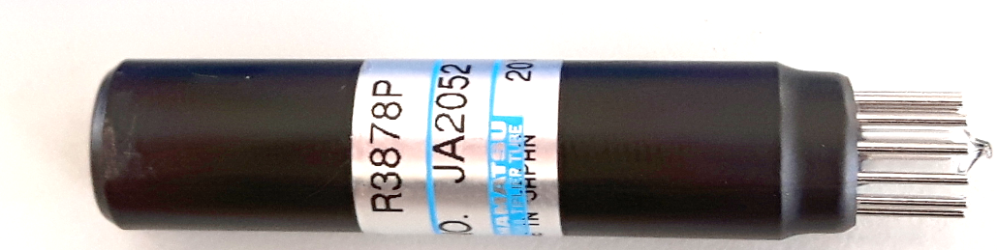
The BRAN-D prototype
Prototype developed within HL WP13 to test technology for HL-LHC.
Detection based on Cherenkov light produced in quartz rod
First prototype installed and tested during Run 2 (left of IP1) to study materials and detection methods
Main features of BRAN-D
  Cherenkov radiation produced in synthetic silica rods inserted in TANs.
  Light detected by 8 PMTs
  Designed to sustain a high radiation env. (IP1/5: 180 MGy/year): basic functionalities, effect of radiation on silica rods known, PMT housing can be exchanged by robot.
  Aperture (Light transmission) to PMT controlled by solenoids
Stainless
steel tube
Photomultiplier
(PMT)
Air gap
Quartz rod
Cherenkov
light
Charged particle

Slide 4
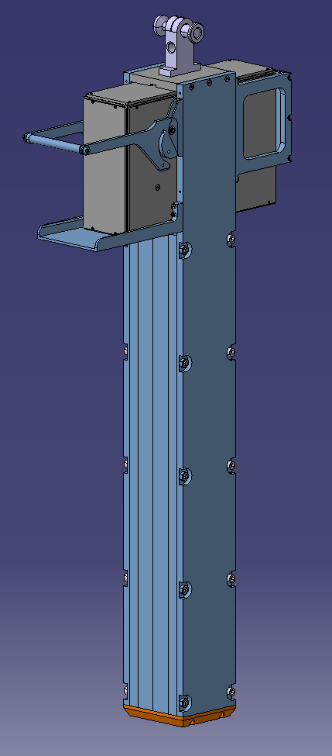
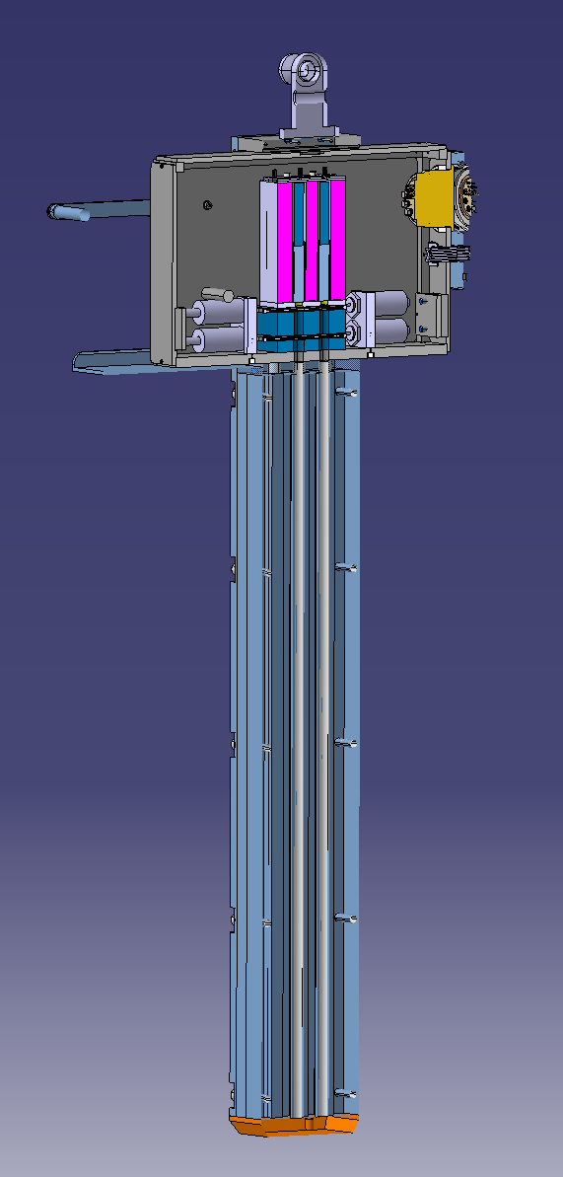
The BRAN-D prototype
At present, BRANs in IP1 and IP5 based on gas ionization have issues of declining performance, availability of spares.
Proposal: replace one side of both IPs with new “BRAN-D”: right side of IP1, left of IP5
BRAN-D installed during LS2, operated during LHC Run 3.
BRAN-D as a validation of technology for BRAN-Q.

Slide 5
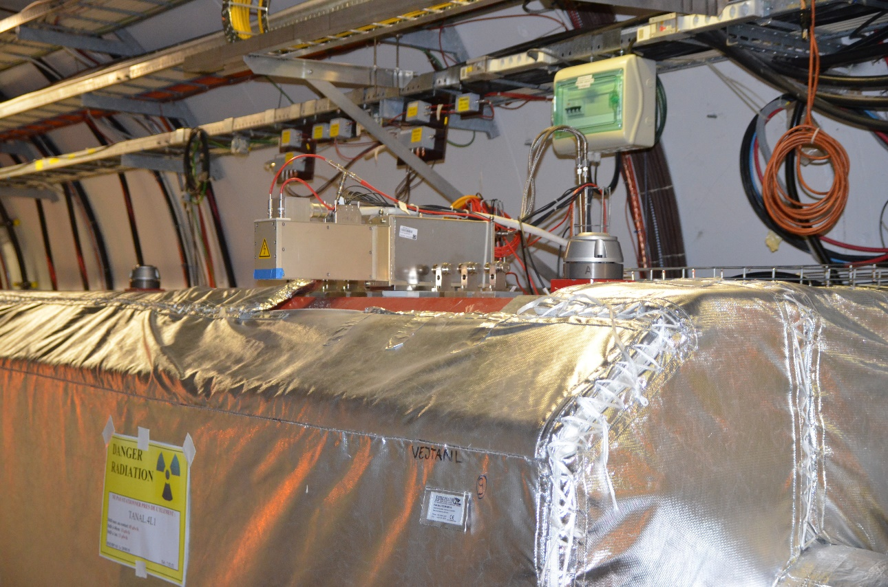
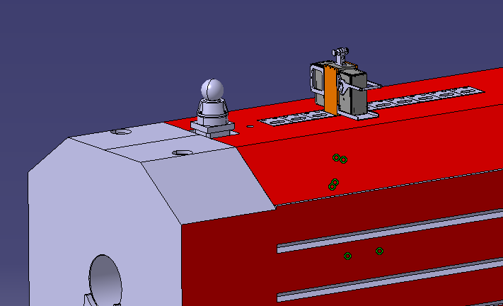
The BRAN-D ECR
LHC-BRAN-EC-0002 ready for approval.
BRAN-D respects envelope for accommodation in TANs and installation with crane in IP1 and IP5
Impact on other services:
  crane operation
  all cables are pulled except multiconnector HV cables for PMTs (week 40 TBC for IP1, end of Nov. for IP5)
  PMT housing can be replaced with CernBot 2.0. Gripper payload 70 N (worst case), tested once BRAN-D is assembled
Installation planned in July 2021 (compatible with cold machine)
BRAN-D
BRAN-A

