Slide 1
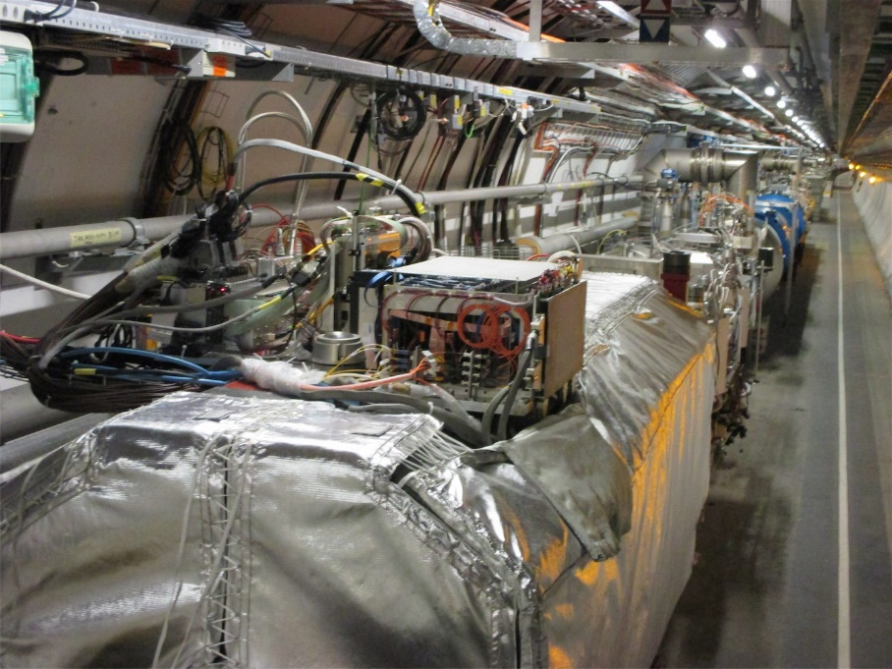

LHCf activities & requests in view of Run 3
TREX Meeting
30 September 2020
14 October 2020
Lorenzo Bonechi

Slide 2
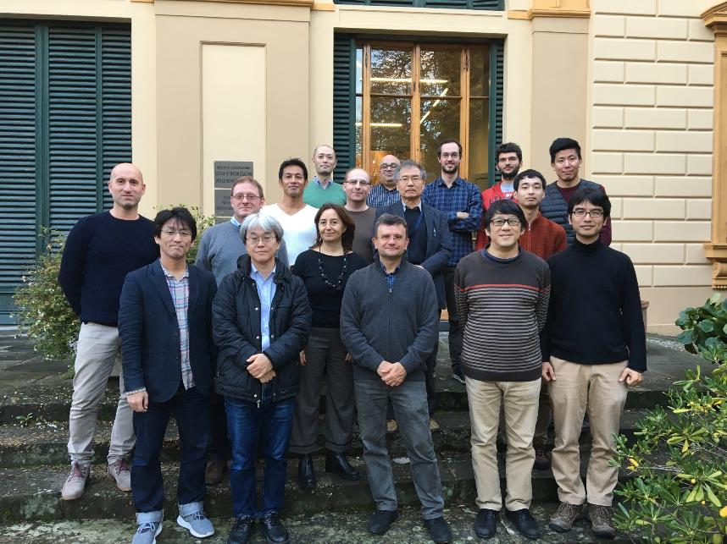
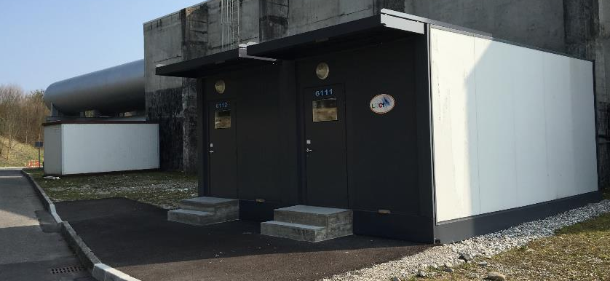
Outline
Contacts for the next LHCf run(s)
On-going and next works in view of Run 3
ATLAS premises hosting LHCf
Control &
Storage

Slide 3
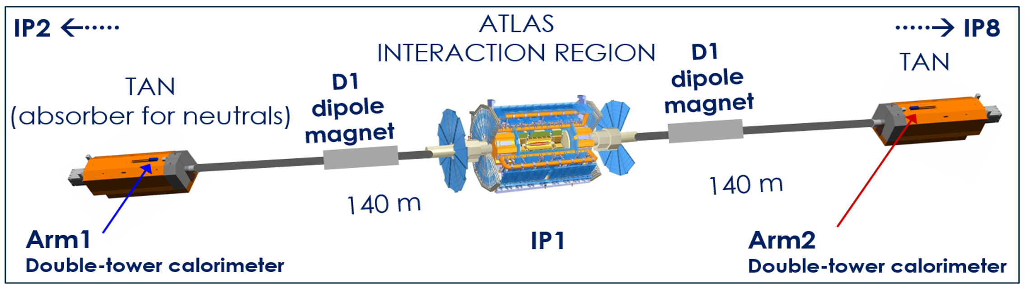
LHCf Arm1 and Arm2 installation points

Slide 4
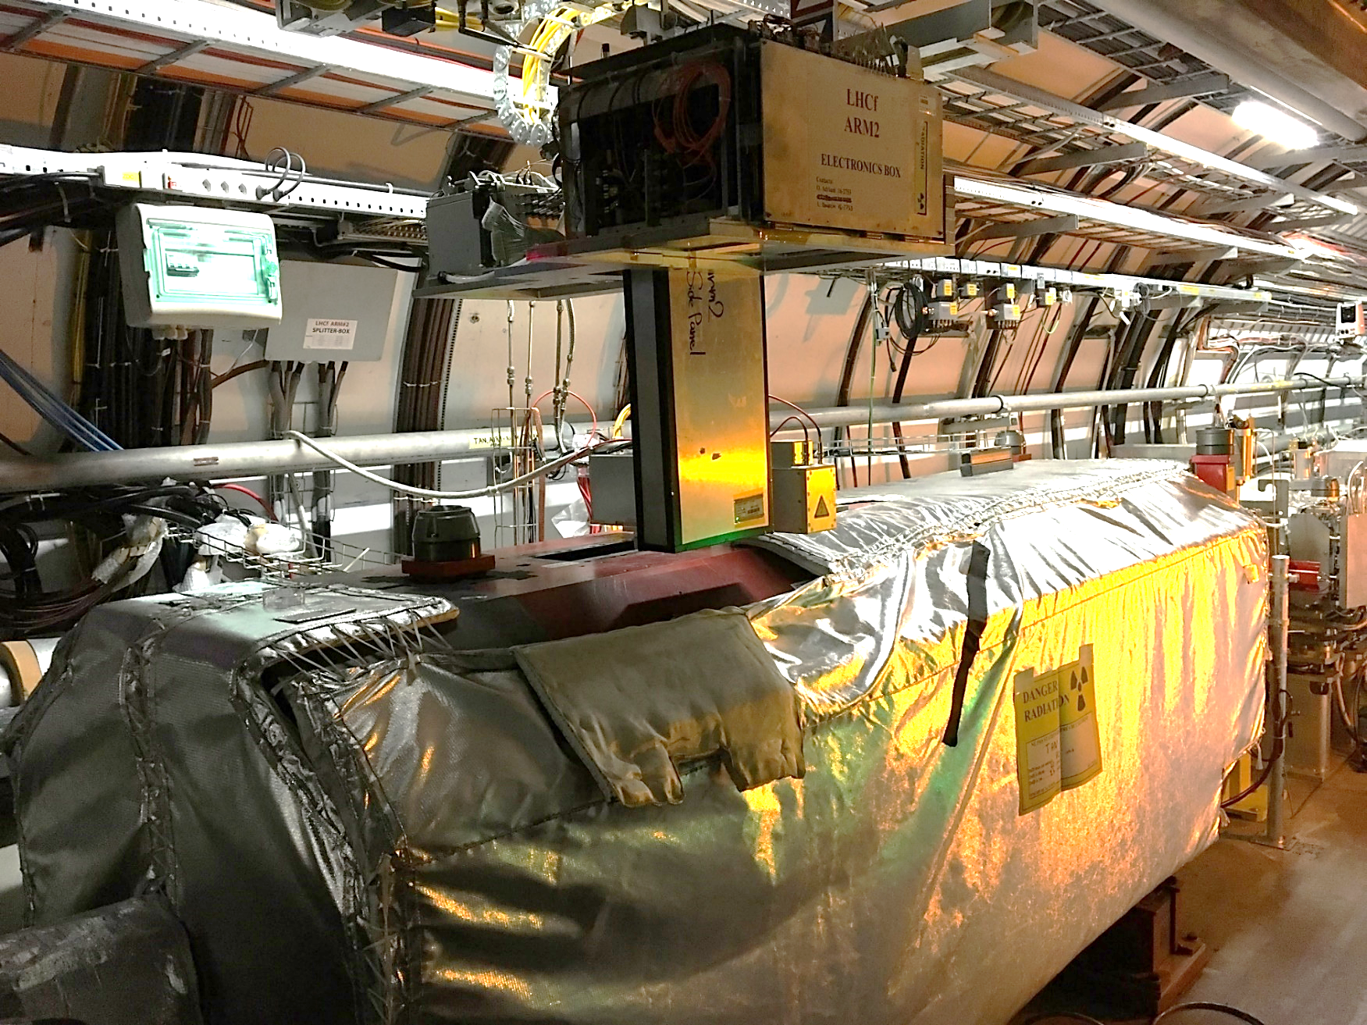
Arm2 detector
Electronic
box
Arm2
detector
TAN
SLOT

Slide 5
Contacts and discussions for Run 3
Teams involved
  LPC coordinators
  LHCC (meeting 02 Sep 2020)
  TREX
  EN-EL-FC team (fibers and cablings)
  SPS management
  ATLAS management
p+p run @ 13 or 14 TeV (approved)
  Foreseen “some time in early 2022”
  No particular problems found with the LHCf requested params (from LOI)
  The crossing plane will be vertical at IP1 → ok for LHCf
p+O run under discussion (Chamonix meeting, Oct-Nov 2020)
  After Run 3 TAN will be modified. The instrumentation slot will be less than 5 cm large (not compatible with LHCf) → LHCC and LPC are informed on this point.
  In case of approval of p+O in Run 3, the crossing plane will be the same as for p+Pb and Pb+Pb. LPC says it is possible to have it vertical because there is no preference for the Pb runs. We have to require that it is set vertical also for the Pb runs.

Slide 6

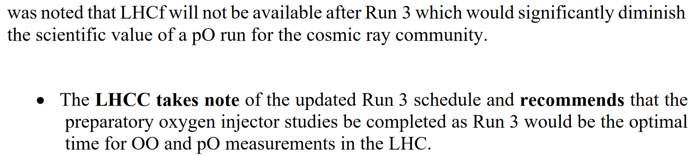
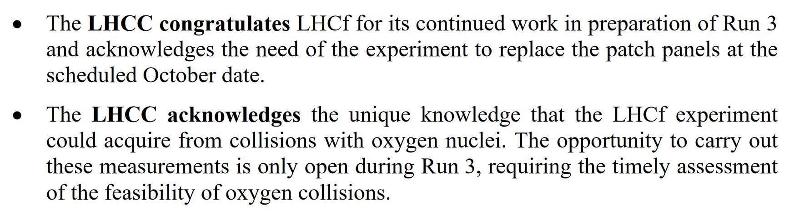
Discussion with the LHCC referees (01/09/2020)
EXCTRACT FROM MINUTES

Slide 7
Next activities in view of Run3
LHCf is in the upgrade phase
  New DAQ electronics for the silicon traking system of the Arm2 detector
Two main activities with an impact on the LHC are planned in the next months
  Replacement of two patch panels, one in USA15 and the other in the TAN region in sector LSS1R, at the ends of a bundle of optical fibres
    This work should be finalized in the second half of October 2020
  Test of the new DAQ electronics of the Arm2 detector
    Prototypes are already available
    Preliminary test in lab are necessary before testing at LHC
    Test of Arm2 DAQ prototypes at the LHC
    Production and test of the full new Arm2 DAQ system

Slide 8
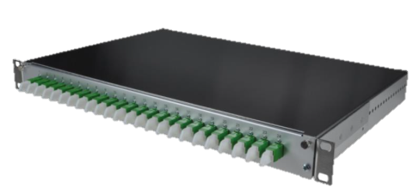
Replacement of patch panels for Arm2 optical fibers
    Situation before LS2
      communication problems during the last runs
      signal attenuation between detector and counting room
    Check of old optical fiber lines by OTDR (Dec. 2019)
      report received on February 2020
    New patch panels
      replace aged connectors presenting large signal reflections
      comply with new CERN standards
      replacement of 200 m long fibers from USA15 to tunnel is not required (more expensive and complicated)
    Work plan
      frequent contacts with the EN-EL-FC team at CERN
      survey completed on 23 Sep (CERN team + company)
      complete work planned (not yet officially) in the week 19-23 October

Slide 9
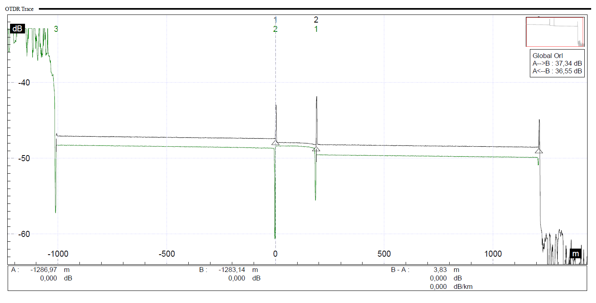
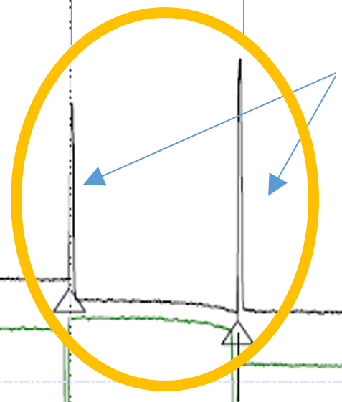
Test of Arm2 optical fibers
OTDR result
Optical Time Domain Reflectometer
Black track: from USA15 to TAN
Green track: from TAN to USA15. The arrow is shown upside down
LHCf fiber under test, approx 187 m
Beginning of track from USA15 to TAN
Reflection peaks: bad interconnection, mainly due to the connectors not in good condition
Reflection peaks: bad interconnection, mainly due to the connectors not in good condition
Beginning of track from TAN to USA15
1 km additional launch box was used to avoid entering directly in the LHCf fibre (the initial reflections might have masked the first part of the fibre under test)

Slide 10
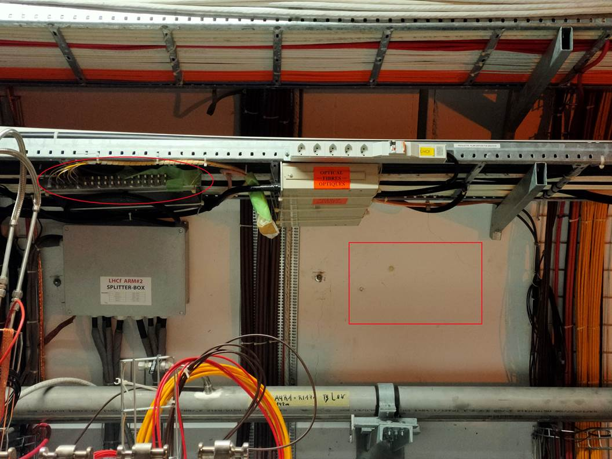
Positioning of new patch panel besides TAN (LSS1R)

Slide 11
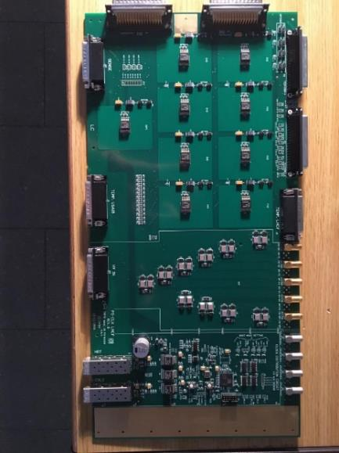
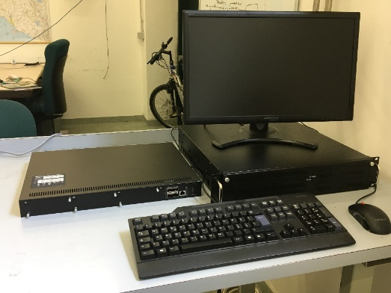
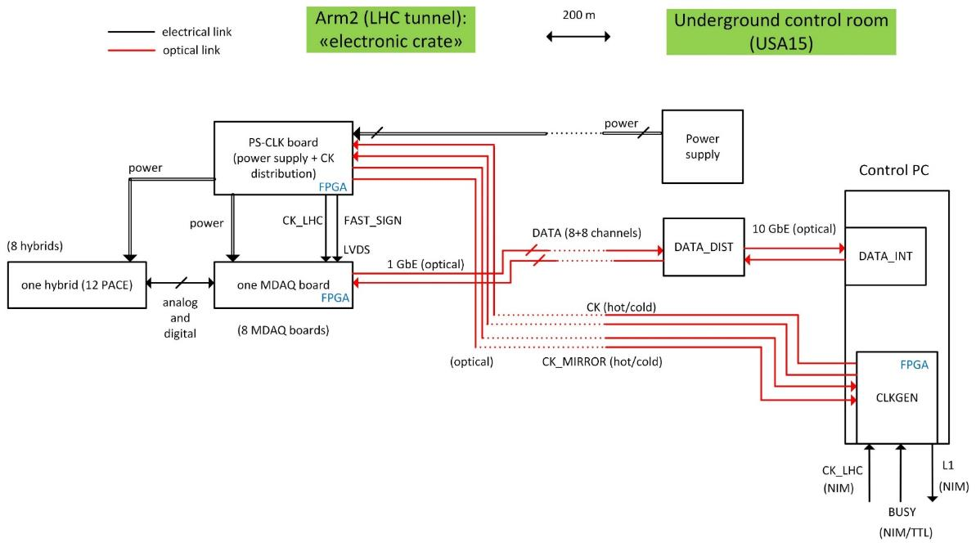
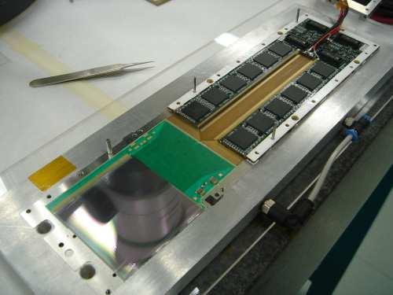
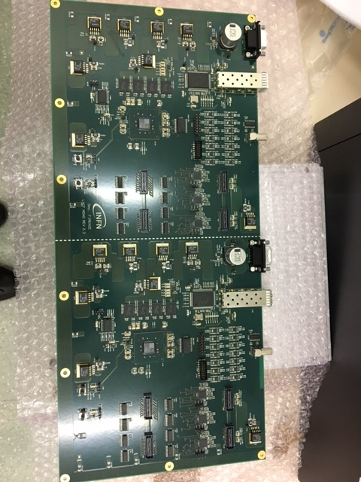
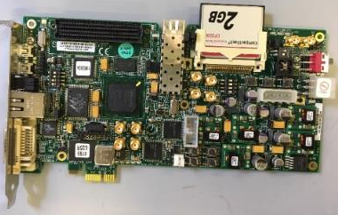
Status of the new Arm2 silicon DAQ electronics
CONTROL ROOM
(USA15)
TUNNEL SIDE
Devel. Kit for SPARTAN 6 logic
A piggy-back board with the necessary connectors is under development

Slide 12
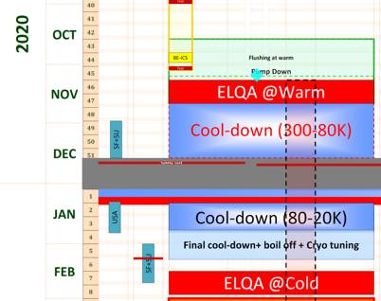
Summary of activities and requests for 2021-2022
NEXT WORKS
Preliminary test @ INFN Firenze of the prototypes of the Arm2 DAQ system: Oct-Dec 2020
Preliminary test of the prototypes of the new DAQ at LHC: Jan-Feb 2021
Production of the full DAQ system of the Arm2 detector
Test of the complete DAQ system at LHC (May-Jul → summer 2021)
Preparation of 72 x 300 ns delay lines for the trigger system (on-going)
Beam test at SPS in the second half of 2021
MAIN REQUESTS
Time slot to access USA15 and tunnel (LSS1R) in Jan-Feb 2021
Time slot to access USA15 and tunnel (LSS1R) in May-Jul → summer 2021
Permission to access the LSS1L zone
  Check of the global status of the Arm1 installation point
Organization of the installation of the two detectors for p+p 2022
  Balance test (near the lift)
  Remote handling for installation and removal
  Geometrical survey
  Temporary storage after removal
Planning for sector 12

Slide 13
BACKUP SLIDES

Slide 14
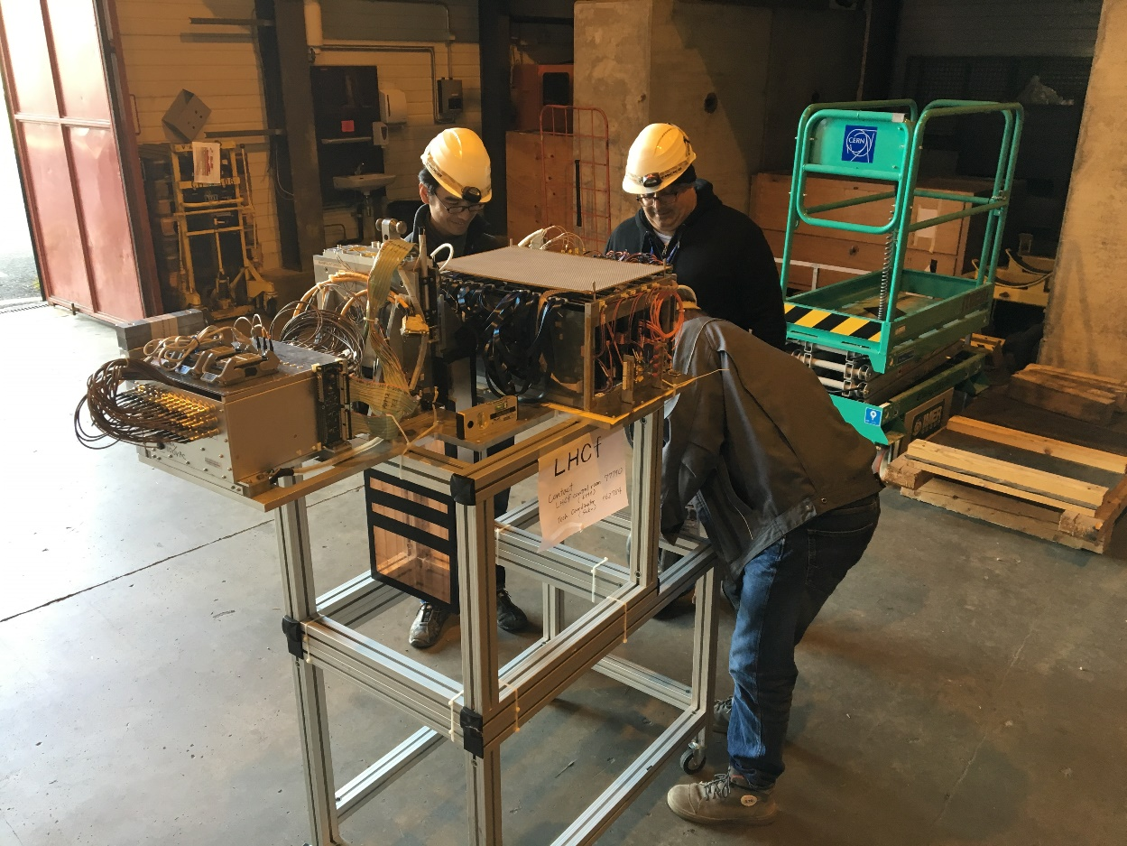
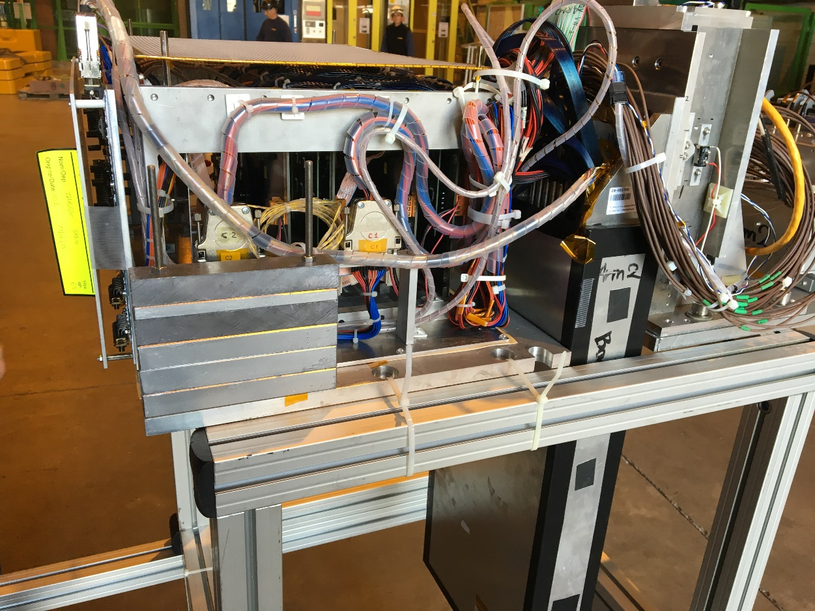
Balance test
This operation requires the use of a bridge crane

Slide 15
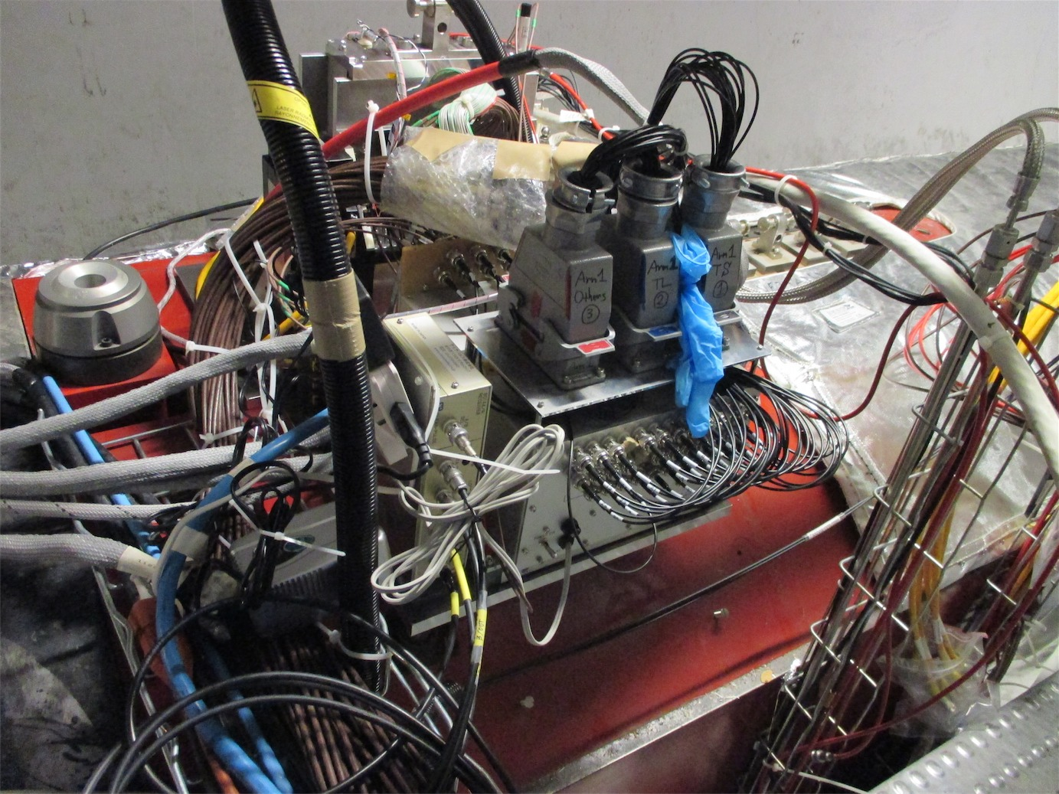
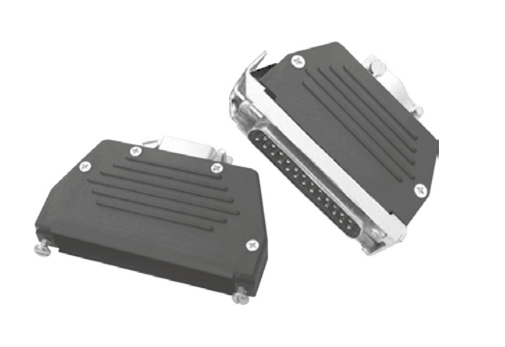
Connections for Arm1
Arm1
  Connection with cables from USA15
  3 big Harting connectors for 45 coaxial cables
  4 coaxial cables (BNC 75Ω)
  1 HV cable (LEMO REDEL)
  4 D-sub connectors for
  powers and slow signals.
Latch-type D-sub lock
for quick connection

Slide 16
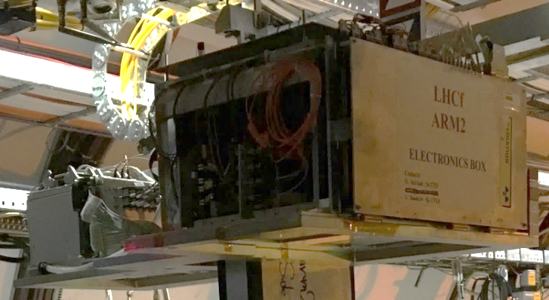
Few additional connections for Arm2
1
Silicon tracker
1
8
4
1
1
1

Slide 18
Connections (Arm2)

Slide 19
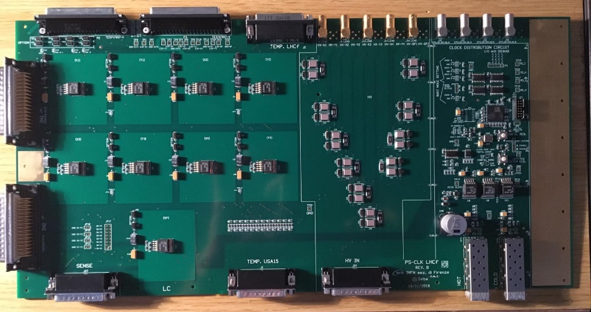
New power supply and clock distrib. (PS-CLK) board
LV distribution
T-sensors
HV distribution
CLK distribution

Slide 20
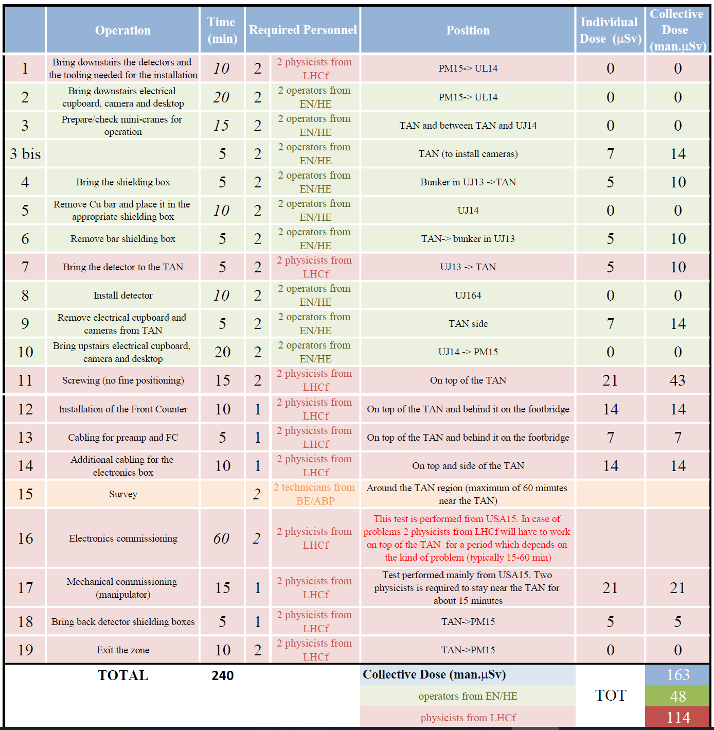
Approved installation procedure
Required Personnel |  | Position | Individual Dose (mSv) | Collective Dose (man.mSv)
2 | 2 physicists from LHCf | PM15-> UL14 | 0,0 | 0,0
2 | 2 operators from EN/HE | PM15-> UL14 | 0,0 | 0,0
2 | 2 operators from EN/HE | TAN and between TAN and UJ14 | 0,0 | 0,0
2 | 2 operators from EN/HE | TAN (to install cameras) | 0,7 | 1,3
2 | 2 operators from EN/HE | Bunker in UJ13 ->TAN | 0,3 | 0,5
2 | 2 operators from EN/HE | UJ14 | 0,0 | 0,0
2 | 2 operators from EN/HE | TAN-> bunker in UJ13 | 0,3 | 0,5
2 | 2 physicists from LHCf | UJ13 -> TAN | 0,3 | 0,5
2 | 2 operators from EN/HE | UJ164 | 0,0 | 0,0
2 | 2 operators from EN/HE | TAN side | 0,7 | 1,3
2 | 2 operators from EN/HE | UJ14 -> PM15 | 0,0 | 0,0
2 | 2 physicists from LHCf | On top of the TAN | 1,3 | 2,5
1 | 2 physicists from LHCf | On top of the TAN and behind it on the footbridge | 0,8 | 0,8
1 | 2 physicists from LHCf | On top of the TAN and behind it on the footbridge | 0,4 | 0,4
1 | 2 physicists from LHCf | On top and side of the TAN | 0,8 | 0,8
2 | 2 technicians from BE/ABP | Around the TAN region max 60 minutes near the TAN)
2 | 2 physicists from LHCf | This test is performed from USA15. In case of problems 2 physicists from LHCf will have to work on top of the TAN for a period which depends on the kind of problem (typically 15-60 min)
1 | 2 physicists from LHCf | Test performed mainly from USA15. Two physicists is required to stay near the TAN for about 15 minutes | 2,0 | 2,0
1 | 2 physicists from LHCf | TAN->PM15 | 0,3 | 0,3
2 | 2 physicists from LHCf | TAN->PM15 | 0,0 | 0,0
 |  | Collective Dose (man.mSv) | TOT | 11
 |  | operators from EN/HE |  | 4
 |  | physicists from LHCf |  | 7
OLD….. (pre-COVID19)
Contacts with the CERN radioprotection (RP) team
  (old) C. Adorisio (HSE-RP-AS)
  (new) F. Cerutti, G. Lerner,
Estimate of the expected doses assuming a reinstallation of LHCf at the first TS of Run 3 (2021)

Slide 21
Calibration of detectors at SPS in 2021
Preparation
  preliminary contacts with SPS coordinator and beam physicists on Jun-Aug 2020
    SPS could restart in mid July 2021
  first prelim discussion about the LHCf requests
    H4 line is suggested by the SPS beam physicists
  beam time request → February – March 2021
Joint operation with ATLAS ZDC
  improvement of energy resolution for neutrons
  preliminary discussion with ZDC and ATLAS management at CERN in May 2019
  possible combined data taking using the hadronic part of ZDC
  New meeting with ZDC held on 12 Oct 2020 to organize a combined beam test at SPS in late 2021

