Slide 1
LS3: de-cabling and cabling in LSS1 and LSS5
Paolo Fessia for the HL-LHC WP15

Slide 2
The reasons
The machine lay-out from LHC to HL is very different
  New equipment with new functions: crab cavities, DFX, DCM, TCLX, SC link, FRAS….
  Very different design of equipment already known in the LHC: D1 from conventional magnet to SC one
  Different position of the element fitting the optics requirement
New powering and cooling needs brought to the necessity to build a new system of underground galleries (US, UR, UL,…) known in jargon as the “doubldecker”. At Each IP side, two sets of 3 cores each, will be drilled in LS3 to join the double-decker with the LHC tunnel (see slide 3)
  From each UL 1 x QXL, 1 x SC link and 1 for signal cables
  From each UA 2 x RF guides and 1 for signal cables
The amount of cables to be installed will be larger. Topologically and functionally cables will be different from the ones required for RUN3. As consequence all the lay-out and dimensions of the cable trays must be revised, modified and new added
Presently in the 4 LSS 3241 cables shall be removed. Of this 676 will be reinstalled by the HL-LHC project because needed by the machine operation, but impacted by the civil engineering work. REMARK THIS DOES NOT INCLUDE CABLE RELATED TO EXPERIMENT AS THEY WILL BE DEFINITELY REMOVED.
Few key cables will be saved. These are the ones that can be protected during the CE works (see i.e. slide 4) and related to provide continuity to the safety loop and powering loop (i.e. 18 kV loop)
The removal of all the cables it is, and it has been the baseline for the HL-LHC project and it was discussed with ATLAS and CMS few years ago during on site visits

Slide 3
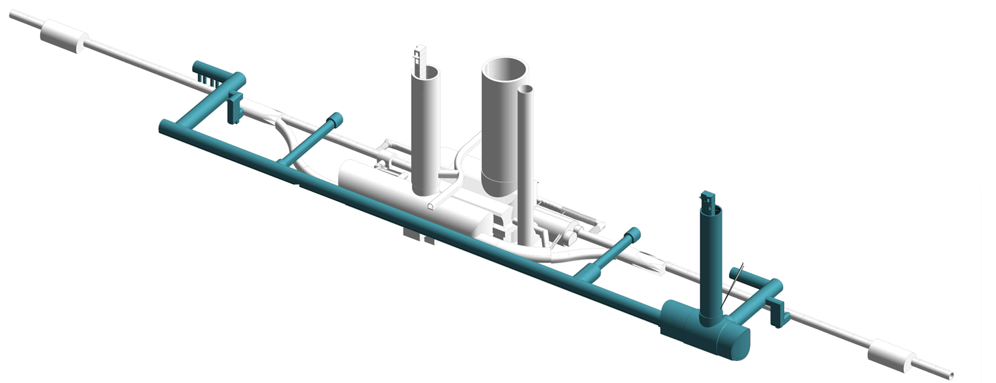
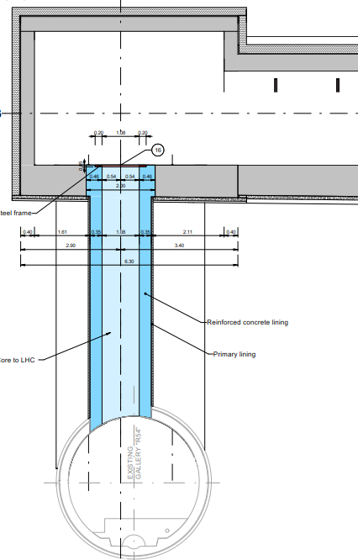
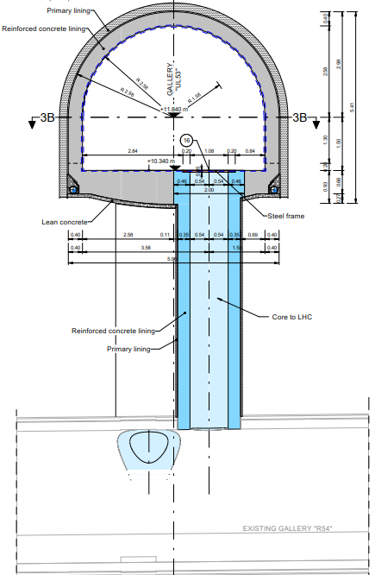
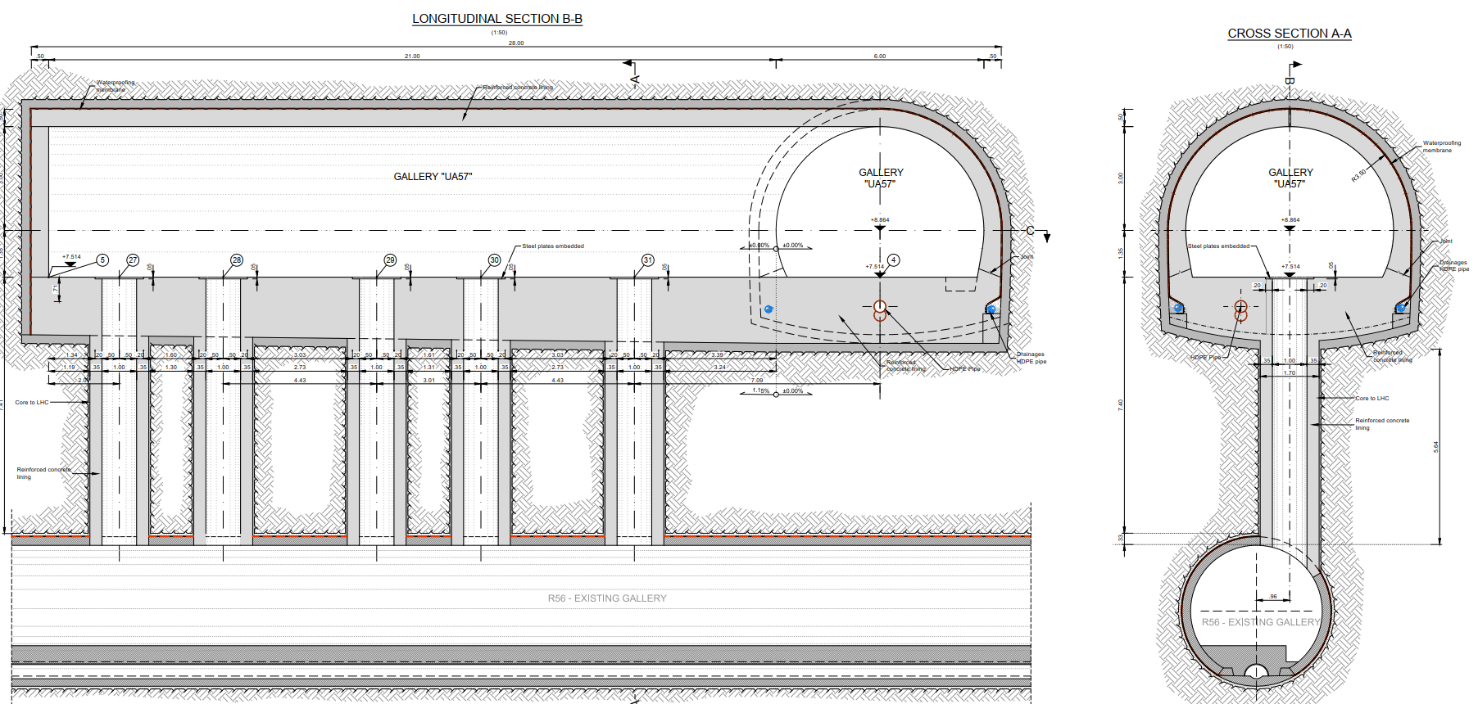
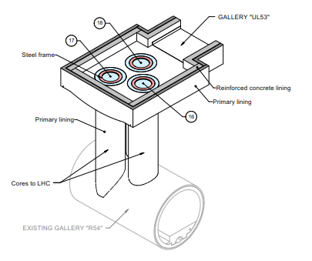
HL-LHC Vertical Cores – Scope and Geometry
UAx3
(3 pcs)
24 cores in total, 6 per IP side:
  3 in the ULs:
    QXL (cryogenic line)
    SC links
    Cabling (and TE-CRG warm helium recovery line)
  3 in the UAs:
    2 x RF waveguides
    Cabling, 2 DN40 CV pipes (compressed air and demineralized water), (and TE-CRG warm helium recovery line)
Internal Diameter: 1m, excavation length: 5 to 7m
UL cores positions are fixed.
UA cores have (limited) longitudinal flexibility in the unlikely case it will be required changes to optimize the crab cavity position.
ULx3
(3 pcs)
ULx7
(3 pcs)
UAx7
(3 pcs)
ULs
* Position fixed
UAs
* final core positions to be defined, liberty to move the cores position longitudinally

Slide 4
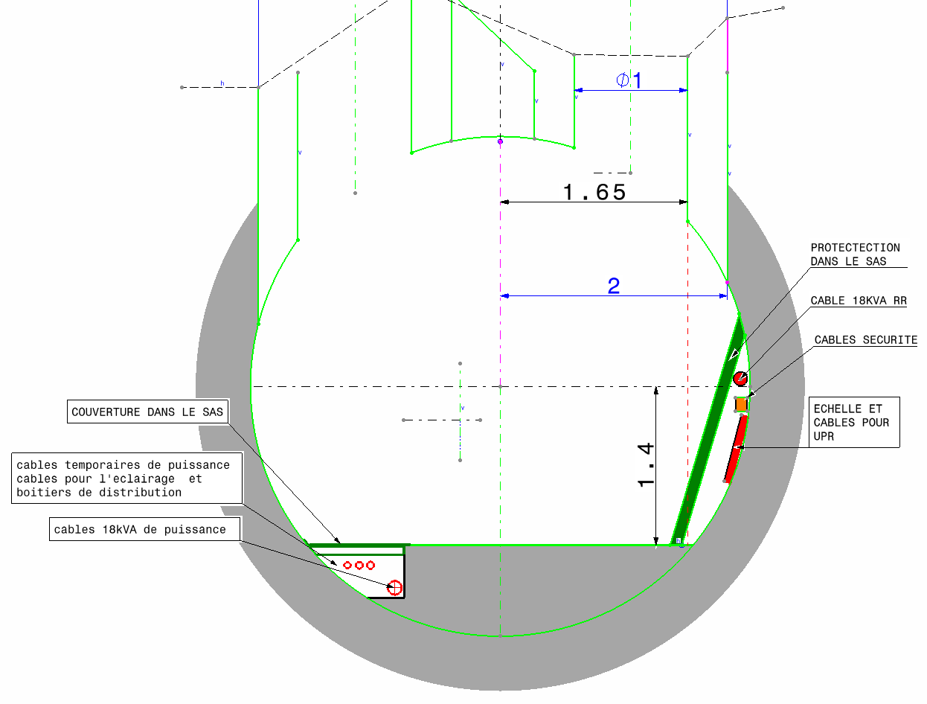
Set-up of Civil Engineering SAS
LHC Point 1
SAS in RI132 ad RI171 for cores in UL13 and UL17, respectively
18kV RR cable and EL safety cable trays must be displaced and protected;
SECTION B-B
SECTION D-D

Slide 5
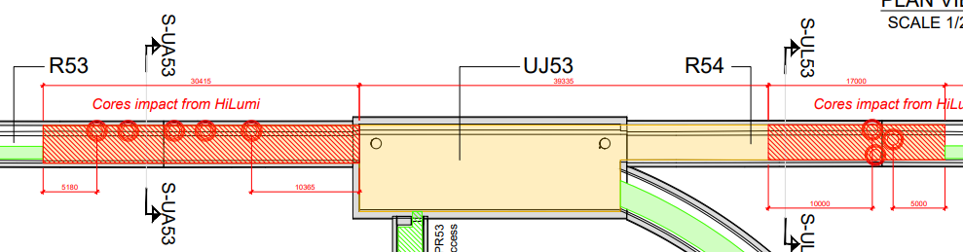
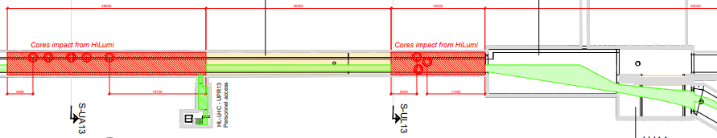
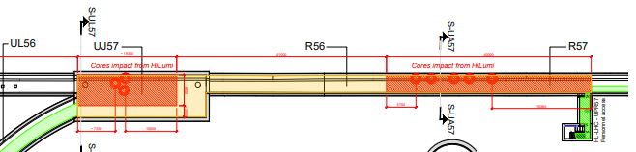
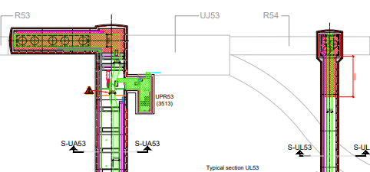
Set-up of Civil Engineering SAS for the core drilling
Per LSS: 2 SAS on the LHC tunnel, around the UL and UA location (CE drawings);
4 SAS per point on the HL-LHC side:
  UA: entire elbow until concrete walls; UL: 10m from the end of the UL.
The UPR should be out of the SAS on both sides (LHC tunnel and new HL-LHC galleries), doors must be installed on the SAS (TBD if access control is needed).
UPR galleries can be used to move between LHC and HL-LHC during the works.
P5L
P1
P5R

Slide 6
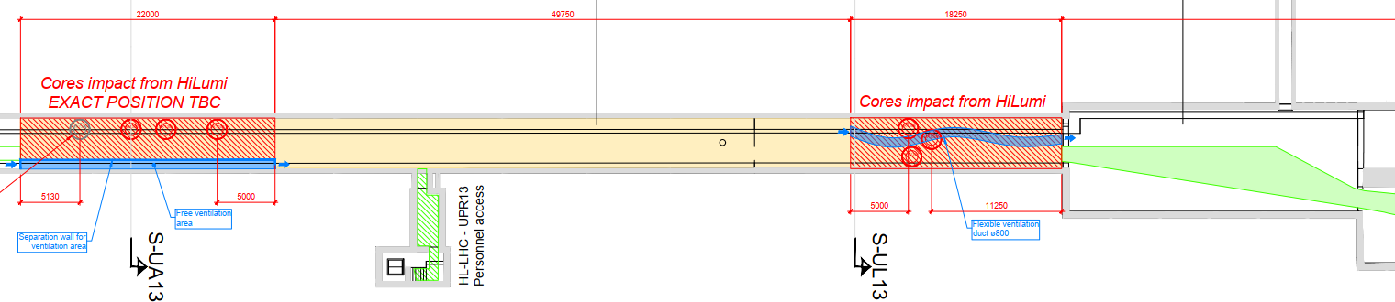
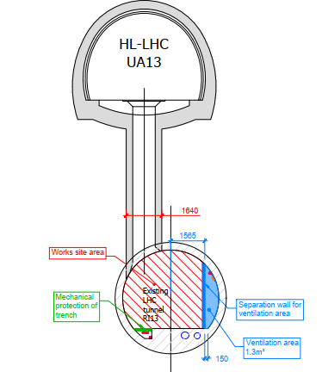
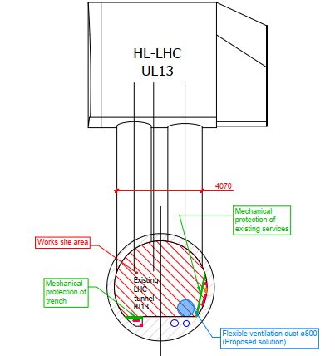
LHC Tunnel Ventilation (SAS-P1)
RI132
9000 m³/h
9000 m³/h
P1L, also valid for P1R

Slide 7
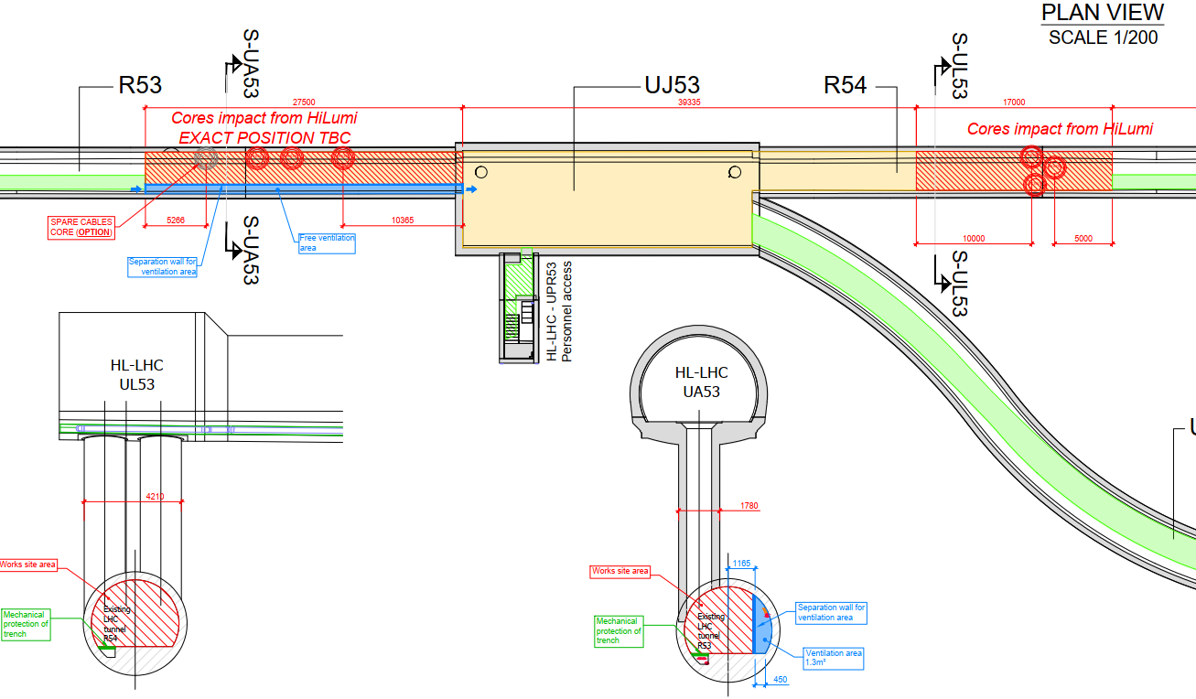
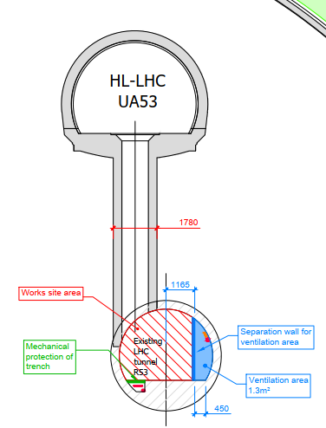
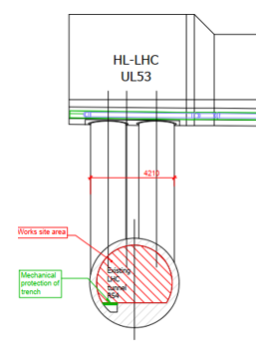
LHC Tunnel Ventilation (SAS-P5L)
R532
R541
9000 m³/h
9000 m³/h

Slide 8
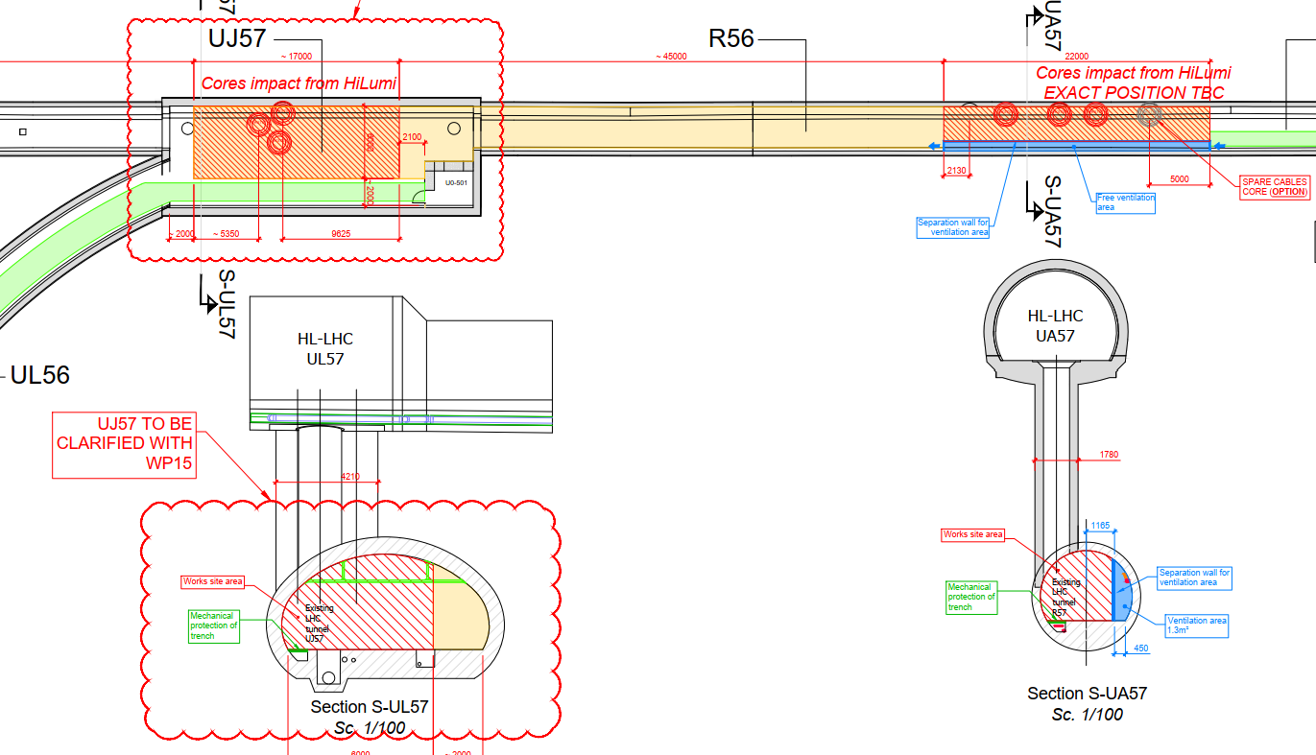
LHC Tunnel Ventilation (SAS-P5R)
R571
9000 m³/h

Slide 9
Summary
The HL core construction require removing the cables that if not will be destroyed by the excavation itself
The HL machine lay-out require different and many more cable then before
The future lay-out is very different from the present LHC one and it calls for a new cable trays approach
HL-LHC and WP15 is always available to actively discuss any options and request that could come from the experiments in order to determine which are the technical possibilities and best global optimization
For more information
  core construction reference HL-LHC integration meeting 24/04/2020 https://indico.cern.ch/event/897887/
  HL-LHC de-cabling and re-cabling campaigns of LSS1 and LSS5 EDMS 2378603

Slide 10
Spare slides some images of complex areas

Slide 11
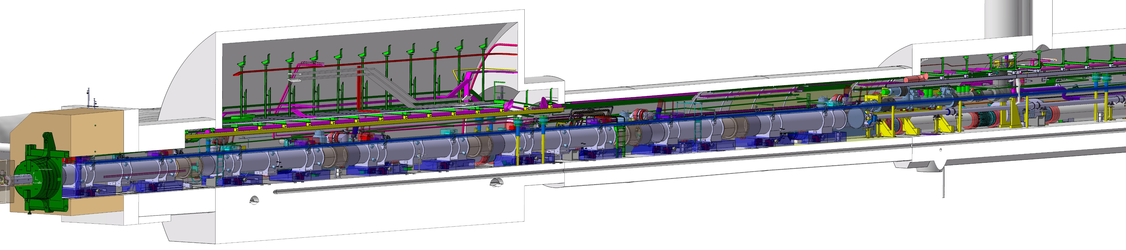



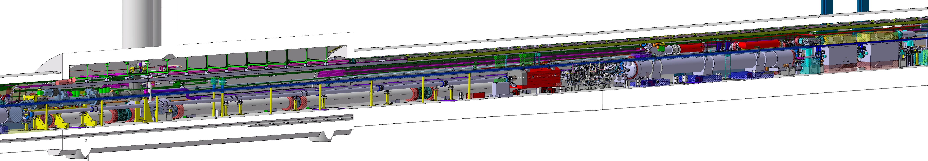
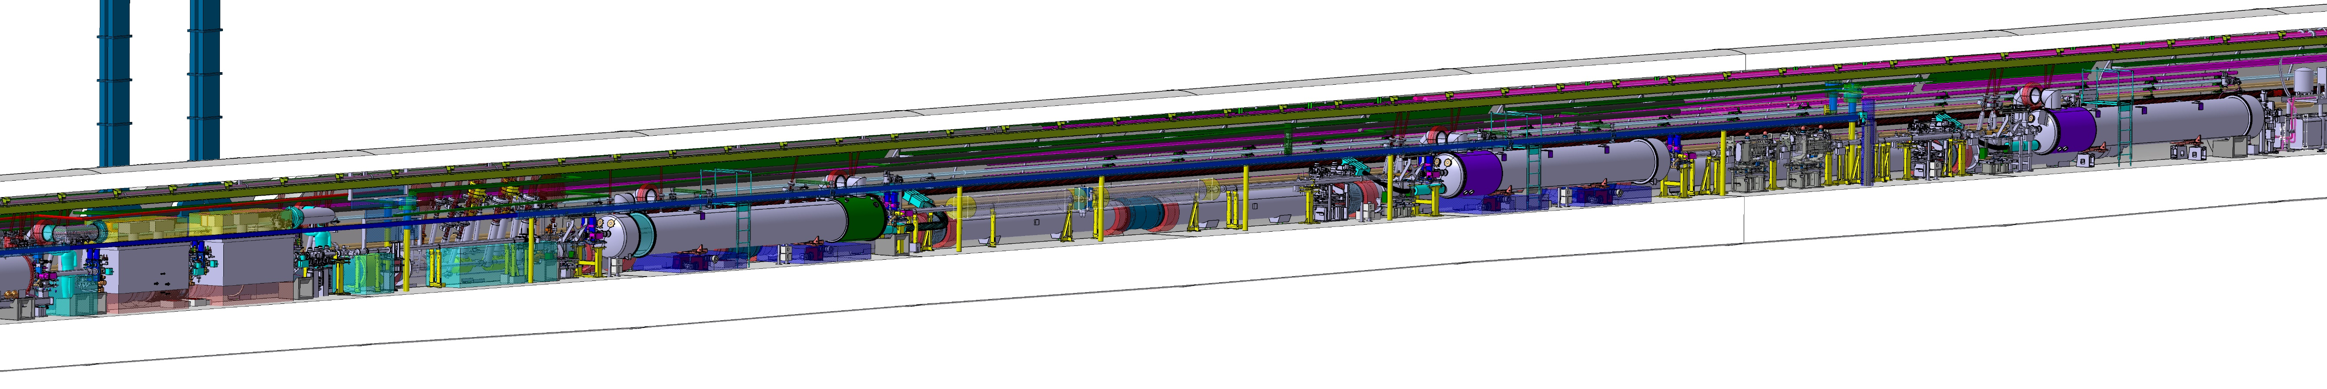
LSS-5R Overview
UL57
UJ56
UJ57
R562
DSHm
R561
DCM
DFX
CP
D1
Q2b
Q3
Q1
Q2a
TAXS
UA57
UL57
R571
DFM
UJ57
DSHm
CC1
CC2
TCTPXV
TCTPXH
TCLX
D2
TAXN
DCM
DFX
UA57
R571
TCTPH
TCL
TCLMC
Q6
TCLMB
Q5
TCTPV
BBLR
BBLR
TCL
BPTX
TCLMB
Q4
CC1
CC2
APWL

Slide 12
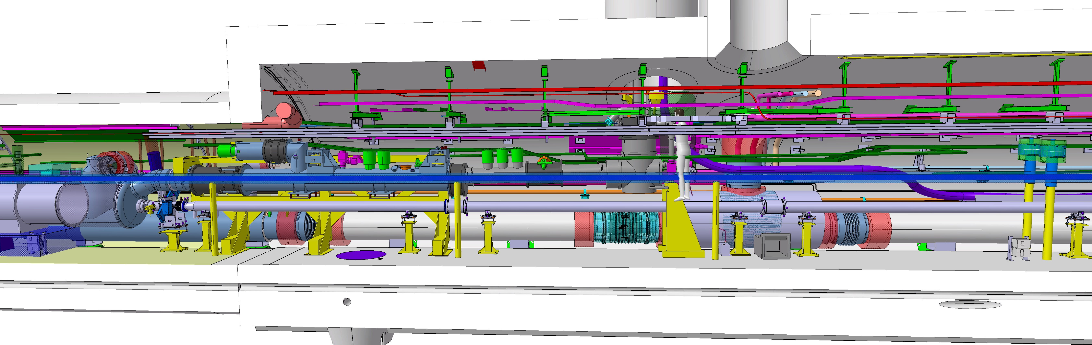
DCM-DFX

Slide 13
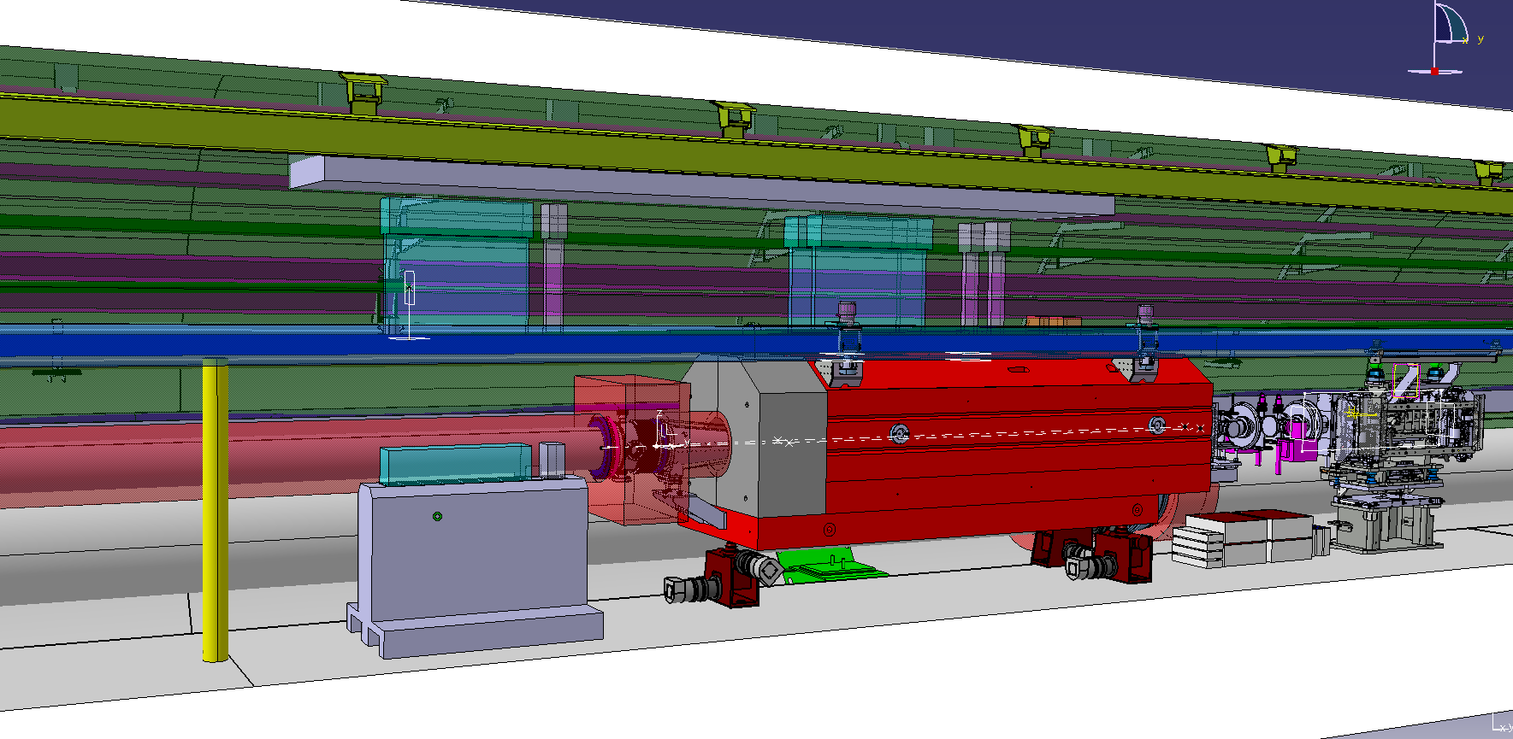
TAXN-ZDC
Volume reserved for new crane
ZDC/BRAN manipulation volume
R571
HLS
Collimator area
WPS
TAXN
Vacuum (D1-TAXN)
Sarcophagi
SU patch panels for the area
QXL

Slide 14
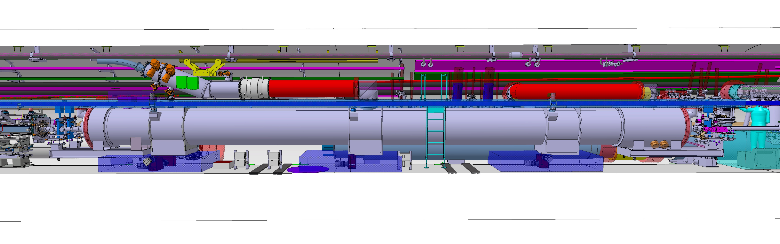
DFM-D2

