Slide 2

Education,
Communication and
Outreach at CERN
François Briard
IR-ECO group

Slide 3
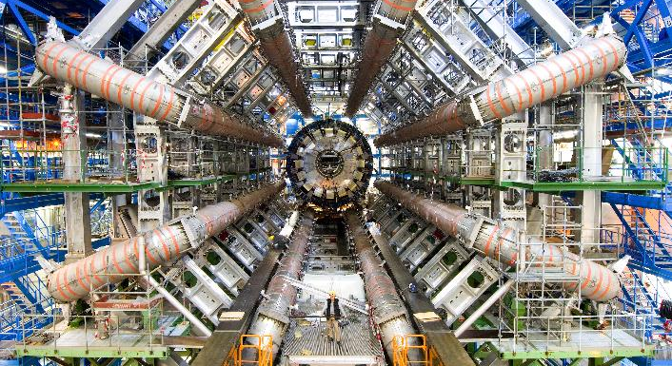

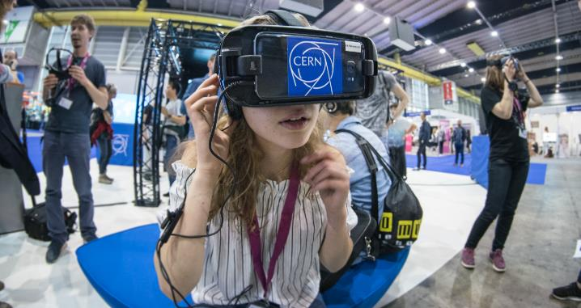
Why ?
Awareness
about CERN and its activities
Support
for CERN decision makers
Engagement
with the general public
Education
and inspiration for schools and teachers
Commitment
to explain general public what we do and why

Slide 4
Press Office, Publications,
Web, Social Media, VIP Visits
Audiences
Media,
Governments
Teachers
Schools
General Public
(local and global)
Teachers Programmes
Teachers Resources
Student Programmes
S’Cool LAB
Virtual Visits
Guided Tours
Exhibitions at CERN
Travelling exhibitions
Outreach events
(fairs, science museums,
arts, local events etc.)
Photography and Video
Graphic Design

Slide 5

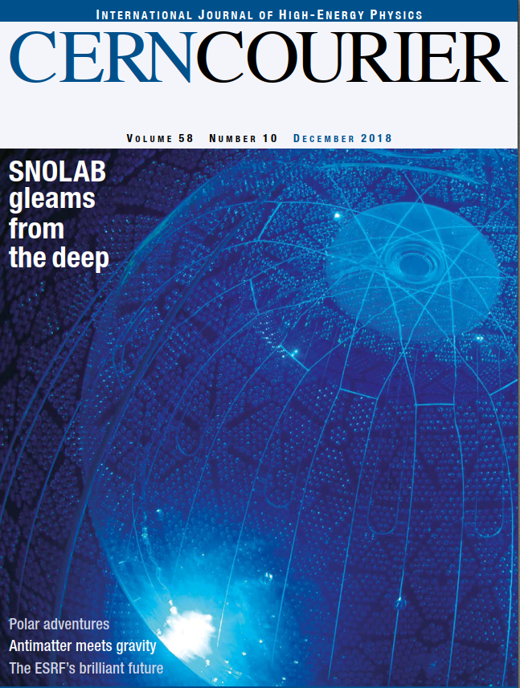
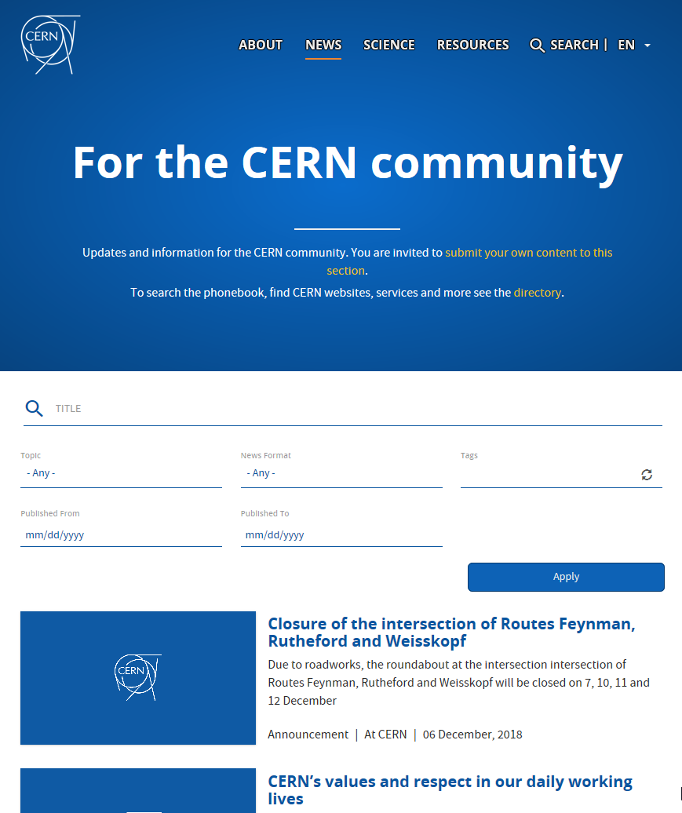
Communication
with scientific community
CERN community
Scientific community
Member States

Slide 6
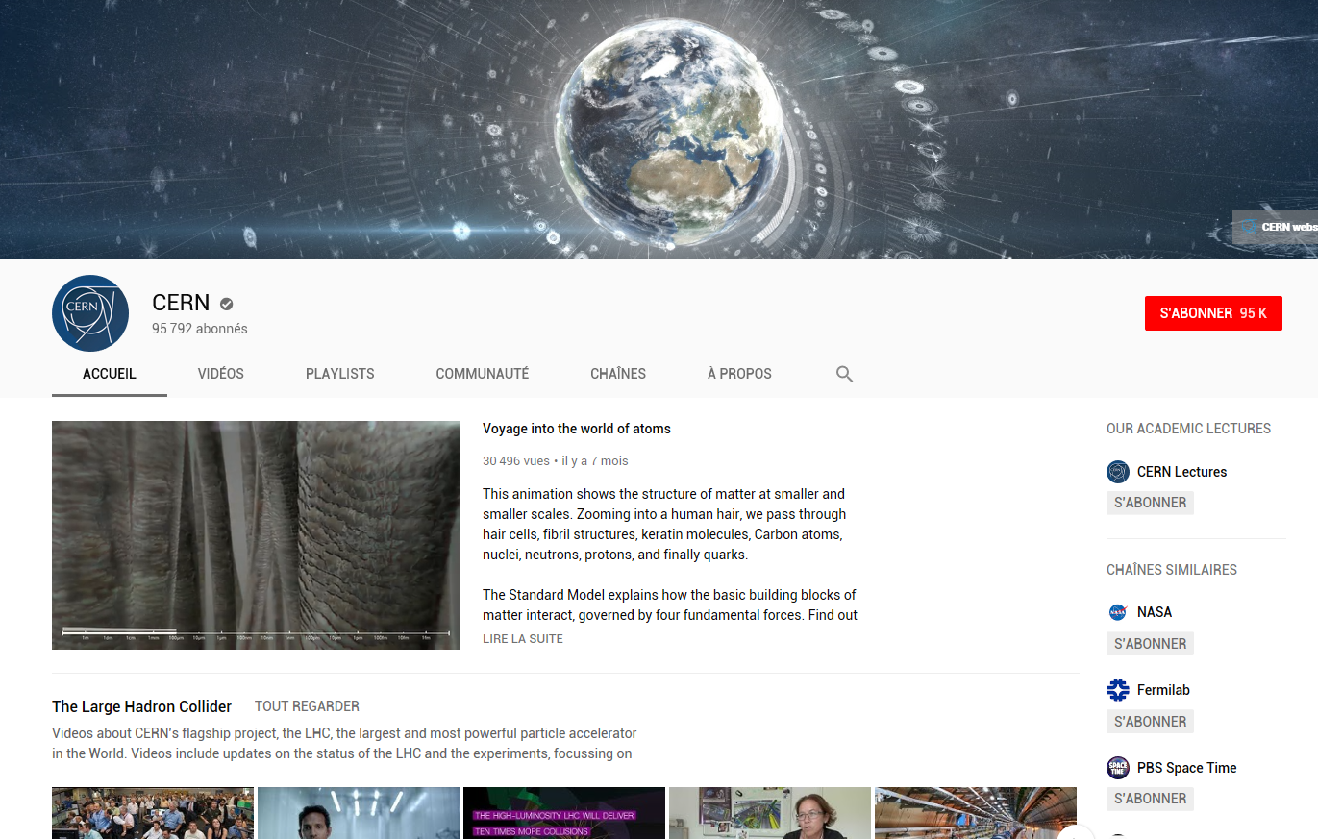
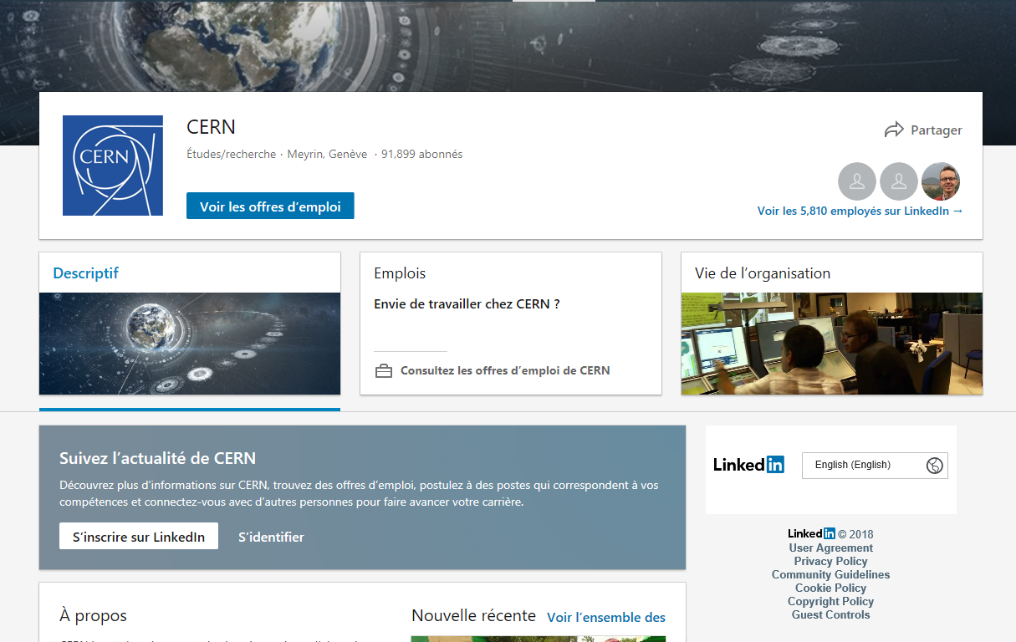
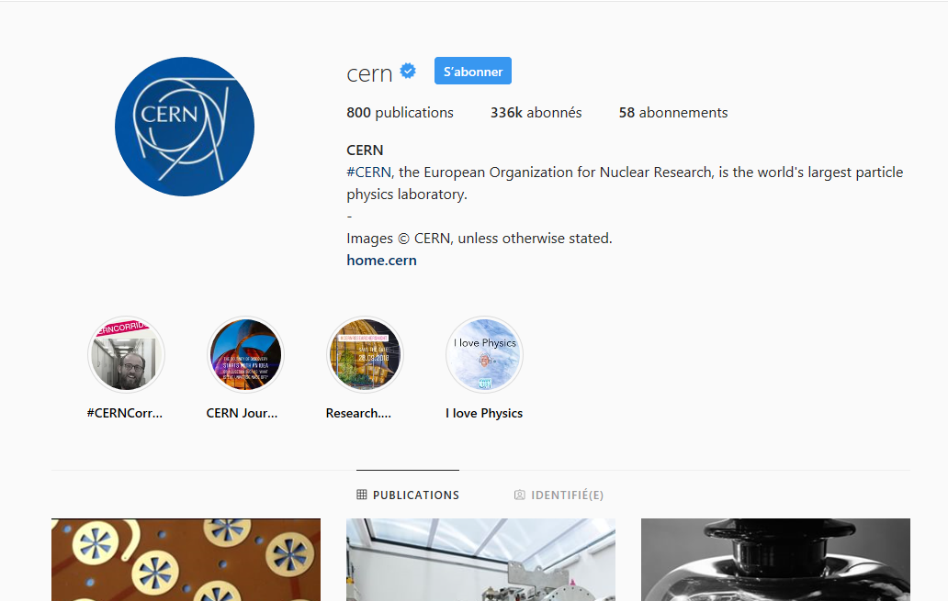
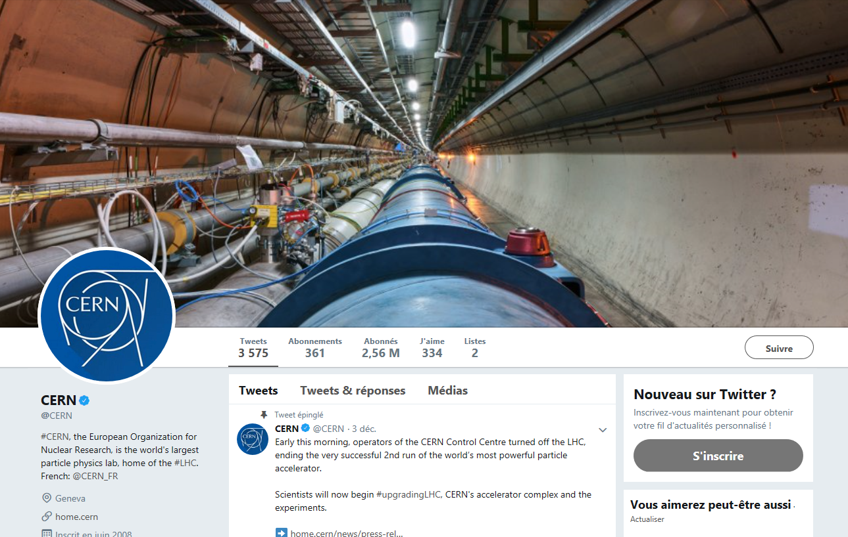
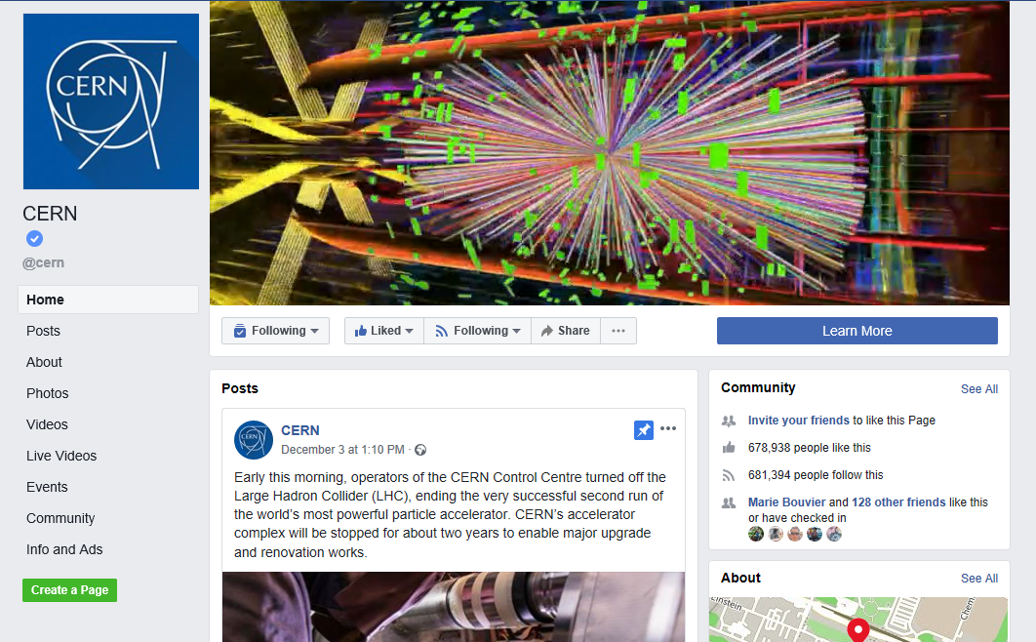
Communication
via social media
Twitter 2.5m
Facebook 700k
Instagram 500k
YouTube 100k
LinkedIn 135k

Slide 7
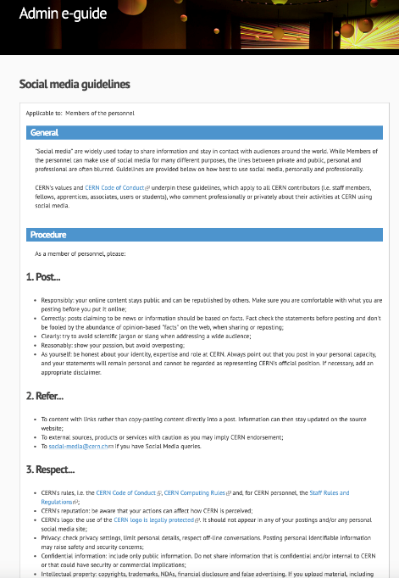
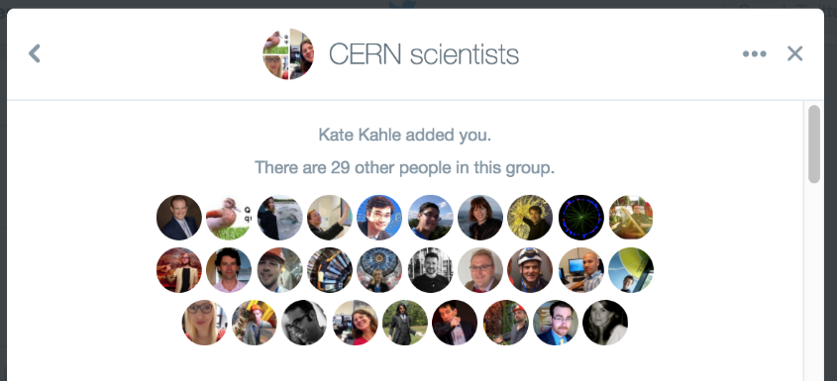
Social media ambassadors
https://cern.ch/communications/social-media
http://admin-eguide.web.cern.ch/en/procedure/social-media-guidelines

Slide 8

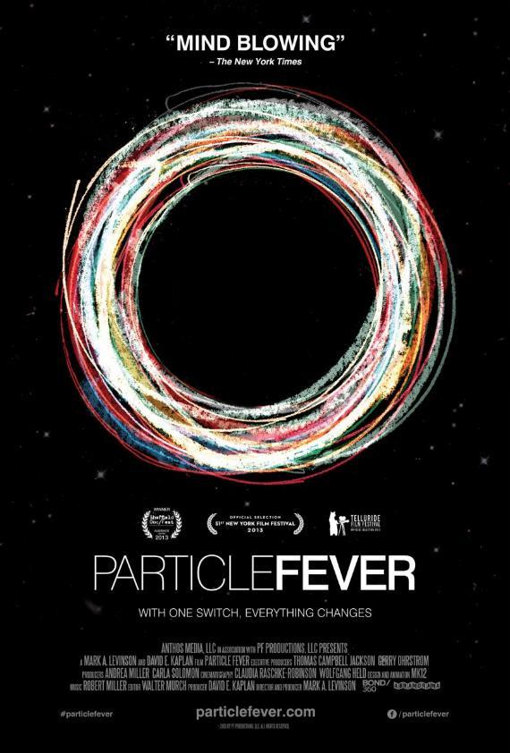



Communication
via media, TV, movies
Newspapers
Televisions, Radios
Movies
Documentaries
TV Shows
+500 journalists / year
~ 150 000 clippings/year

Slide 9
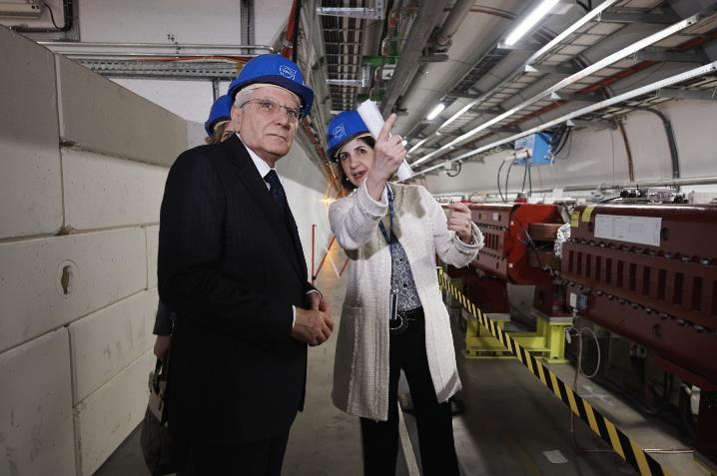
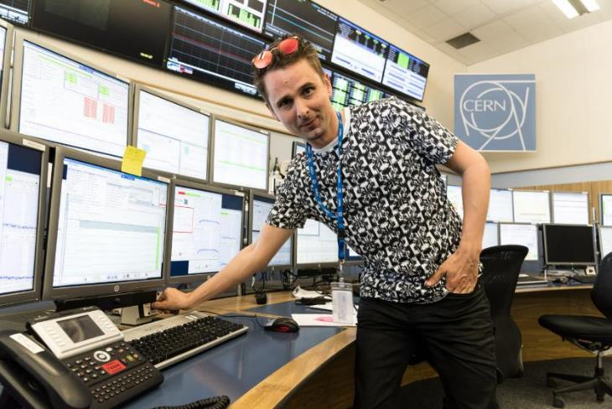
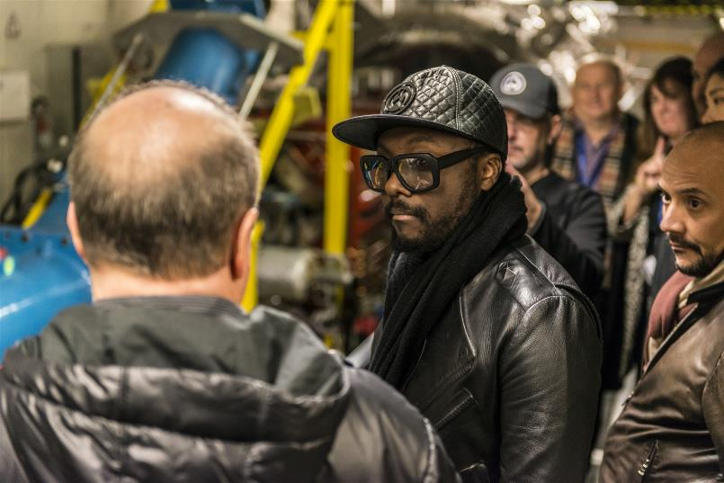
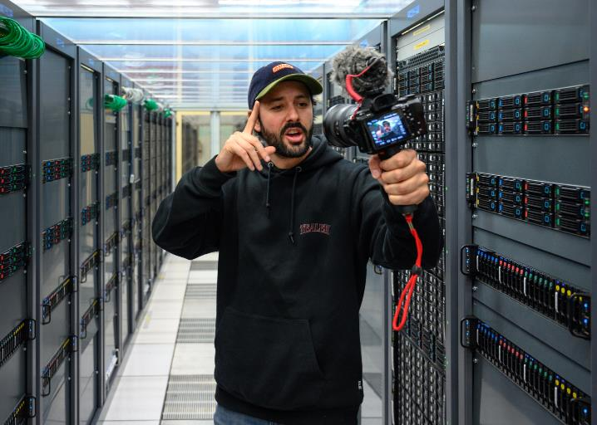
Communication
with decision-makers
and influencers
Protocol
VIP Visits
Popular culture

Slide 10
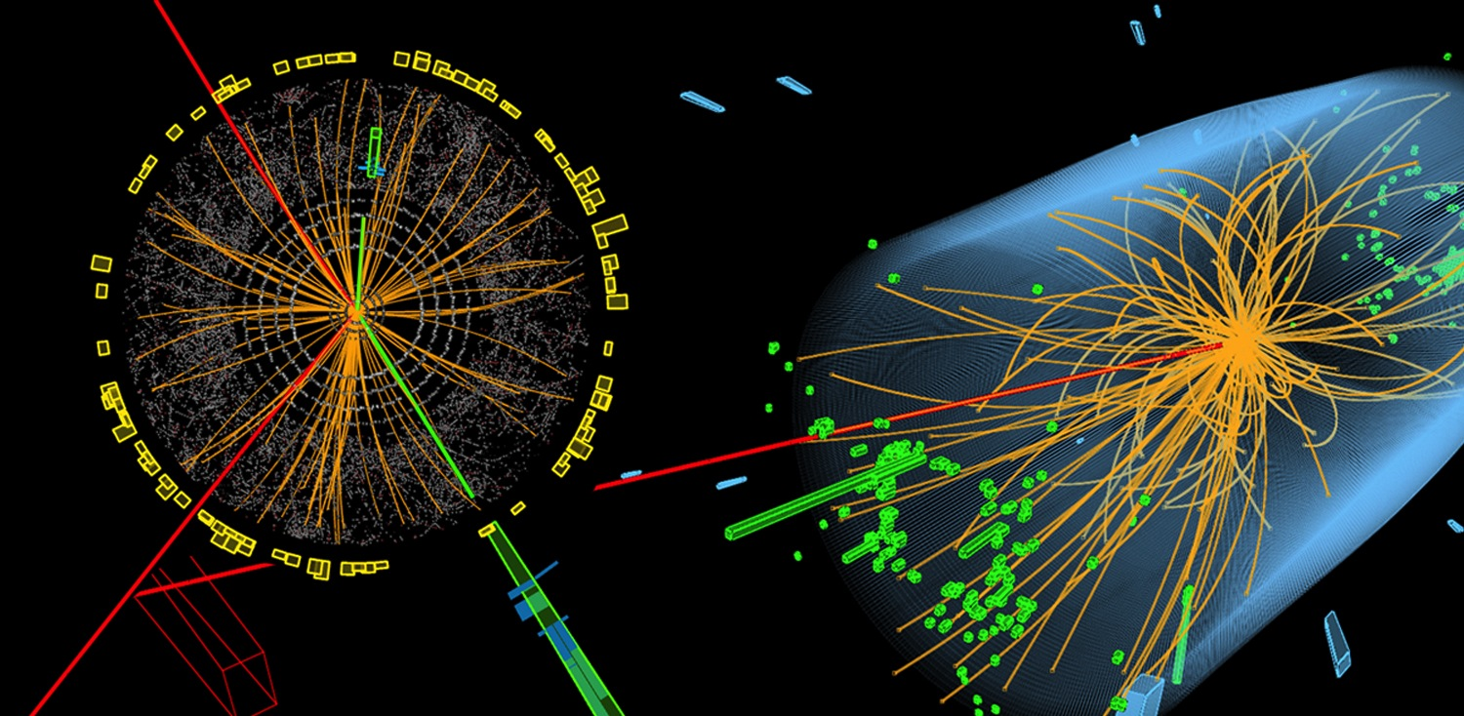
We have great stories to tell
Notes:
(you can question the audience for each image: do we produce electricity? do we produce bombs? Etc.)
The word «Nuclear» should not be misunderstood:
- CERN does not produce electricity (but consumes a lot)
- CERN does not produce military applications out of nuclear power (forbidden by CERN convention, and, anyway, all research results are made publicly available and there are scientists from many countries in each experiment… therefore no risk that exclusive military applications are developed).
- CERN studies the structure of matter. In the 50’s, the nucleus is the main object of study about matter. The word «Nuclear» comes from that.
Nowadays CERN is studying the components of the components of the nucleus. Therefore CERN can use (after being allowed by the Council) an alternative «branding» which is more accurate and less open to interpretation: « European laboratory for particle physics »

Slide 11
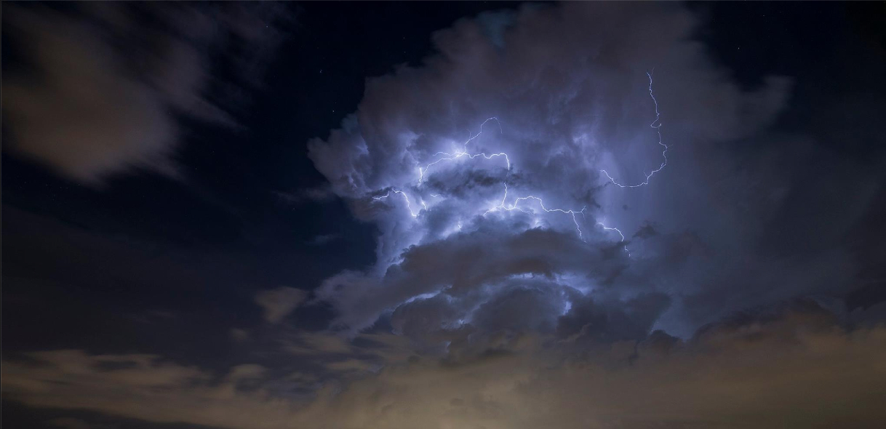
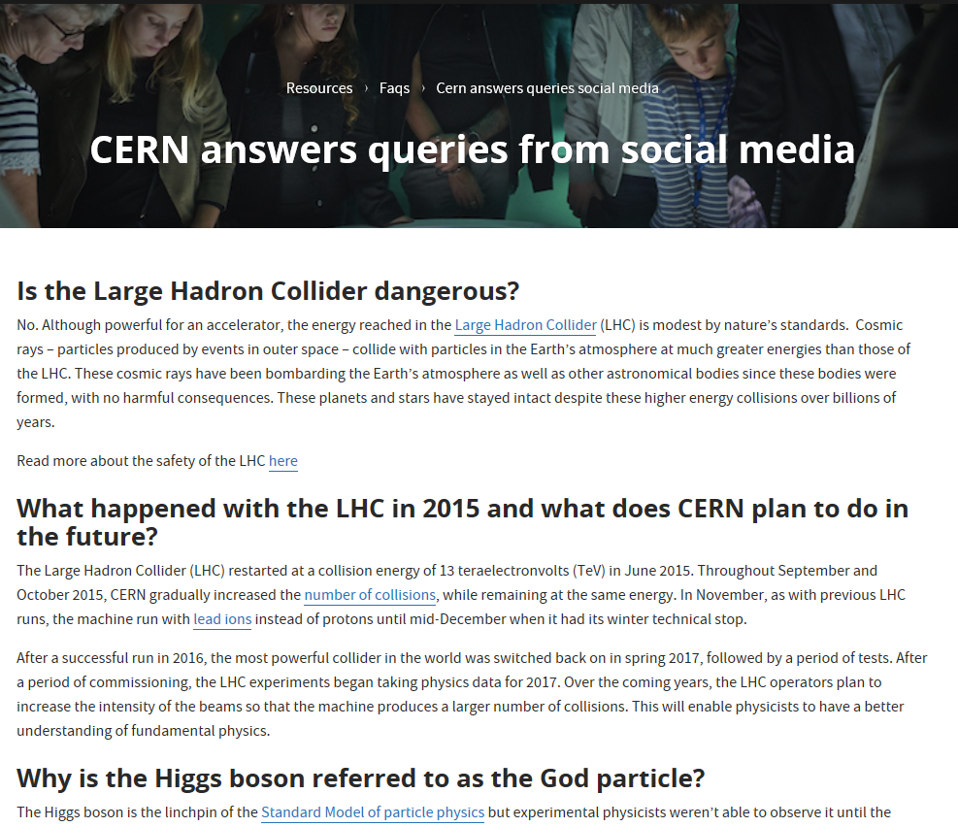
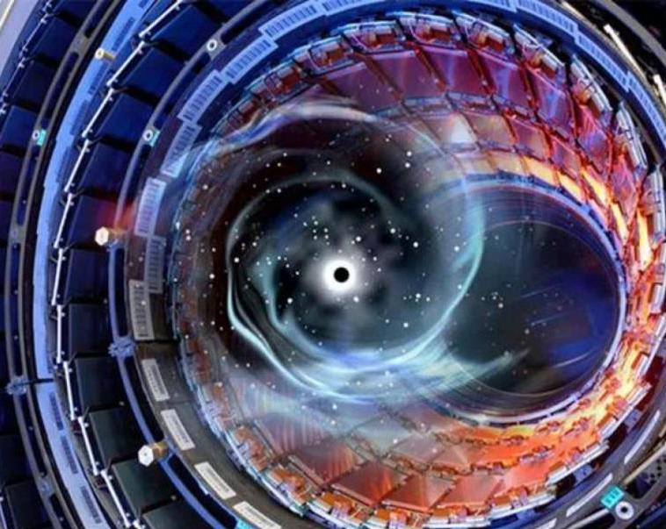
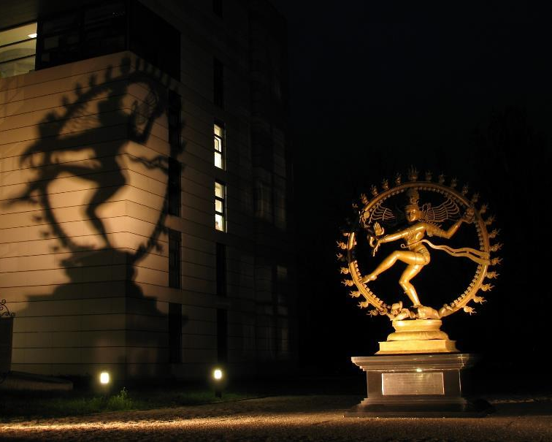
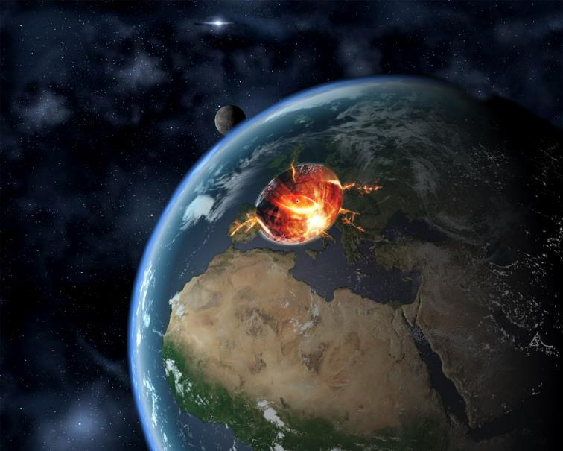
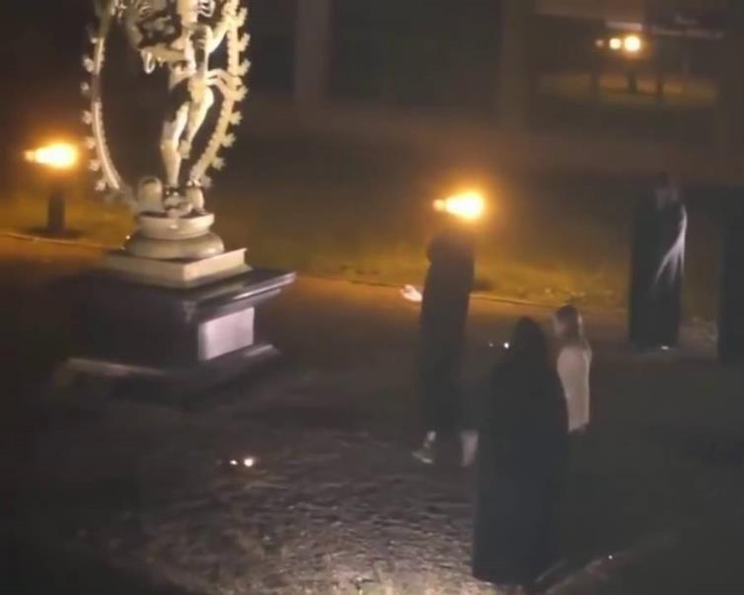
Sometimes others have great stories
about us too…
BLACK HOLE
DOORWAY TO HELL
PLANET X
We engage with
those stories
https://home.cern/resources/faqs/cern-answers-queries-social-media
HUMAN SACRIFICE
Photo: Joëlle Rodrigue
Notes:
(you can question the audience for each image: do we produce electricity? do we produce bombs? Etc.)
The word «Nuclear» should not be misunderstood:
- CERN does not produce electricity (but consumes a lot)
- CERN does not produce military applications out of nuclear power (forbidden by CERN convention, and, anyway, all research results are made publicly available and there are scientists from many countries in each experiment… therefore no risk that exclusive military applications are developed).
- CERN studies the structure of matter. In the 50’s, the nucleus is the main object of study about matter. The word «Nuclear» comes from that.
Nowadays CERN is studying the components of the components of the nucleus. Therefore CERN can use (after being allowed by the Council) an alternative «branding» which is more accurate and less open to interpretation: « European laboratory for particle physics »

Slide 12
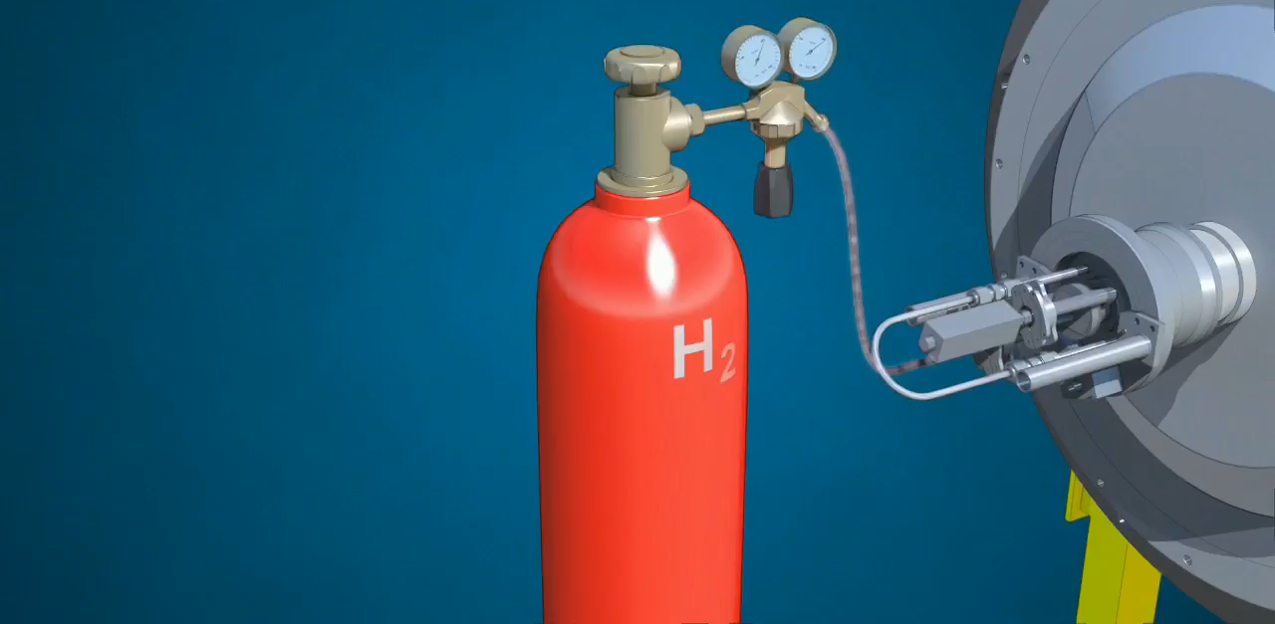
Media production
Audio
Video
Photos
3D
Virtual Reality / Augmented Reality
Interactivity
Movement capture
Notes:
But how do we produce protons and grant them the energy of a flying mosquito?
First we start with a bottle of hydrogen gas.
Hydrogen is quite close to what we want. It’s made of protons. With one electron orbitting around.
We send hydrogen gas through an electric field. Proton which has a positive charge goes through. Electron whic has negative charges bounces back and it removed. We are then left only with protons.
They are sent through the LINAC (LINear Accelerator) which uses alternating electric fields to either attract or push the protons. It is so efficient that after only 45m they have been accelerated to a 1/3 of the speed of light, that is 100’000 km per second. Needless to say that continuing in straight lines will be impractical.
We then send the protons to the Booster which will prepare bunches of protons in 4 superposed rings.
They are then sent in the PS (Proton Synchrotron). This machine is 600m circumference, was built in 1959 and is still in use! In 1.2 seconds it accelerate protons to 99% of the speed of light. Very efficient. But cannot go faster. We then need to transfer protons to the «2nd gear of our accelerator complex».
The SPS (Super Proton Synchrotron) build in 1976 and of 7km curcumference. In 3 seconds, it accelerate particle to 99.9% of the speed of light. Once again cannot go faster.
Then half of the particles are sent clockwise and half anti-clockwise into the LHC (Large Hadron Collider). This machine is the largest machine on Earth: 27 km circumference. It will take about 20 minutes to reach our maximum velocity: 99.9999991% of the speed of light which correspond to 7 TeV energy.

Slide 13
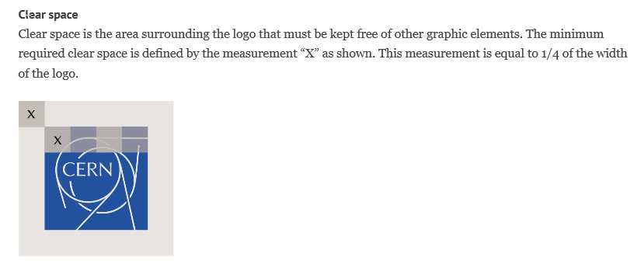



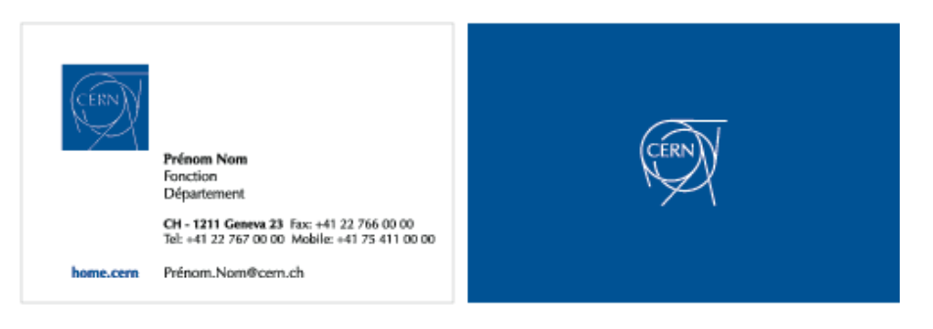
Graphic Design
Logos
Posters
Letterheads
Templates
Schemas
Etc…
Check guidelines
cern.ch/design-guidelines

Slide 14
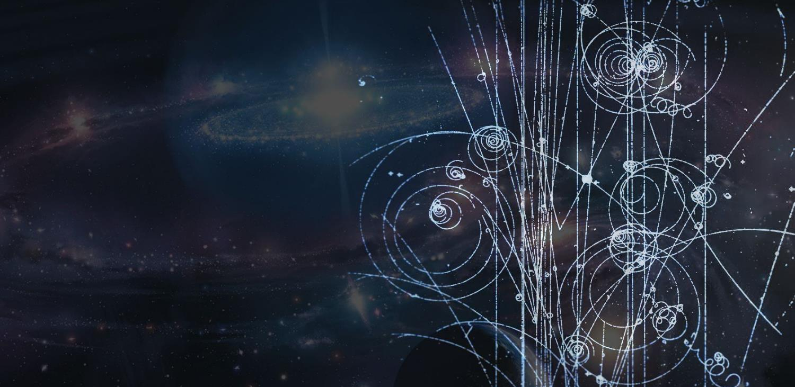
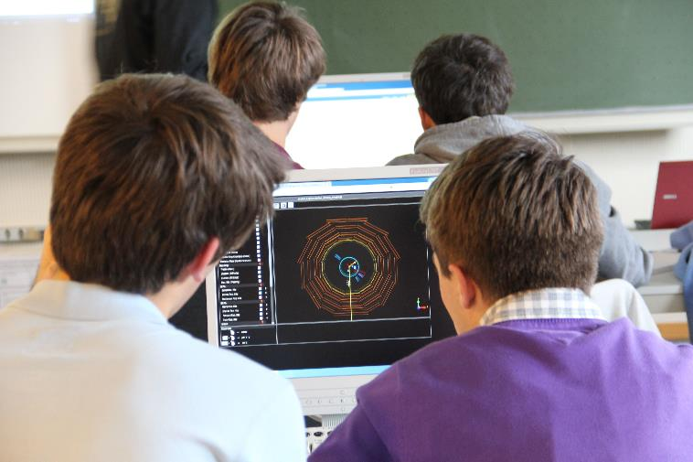
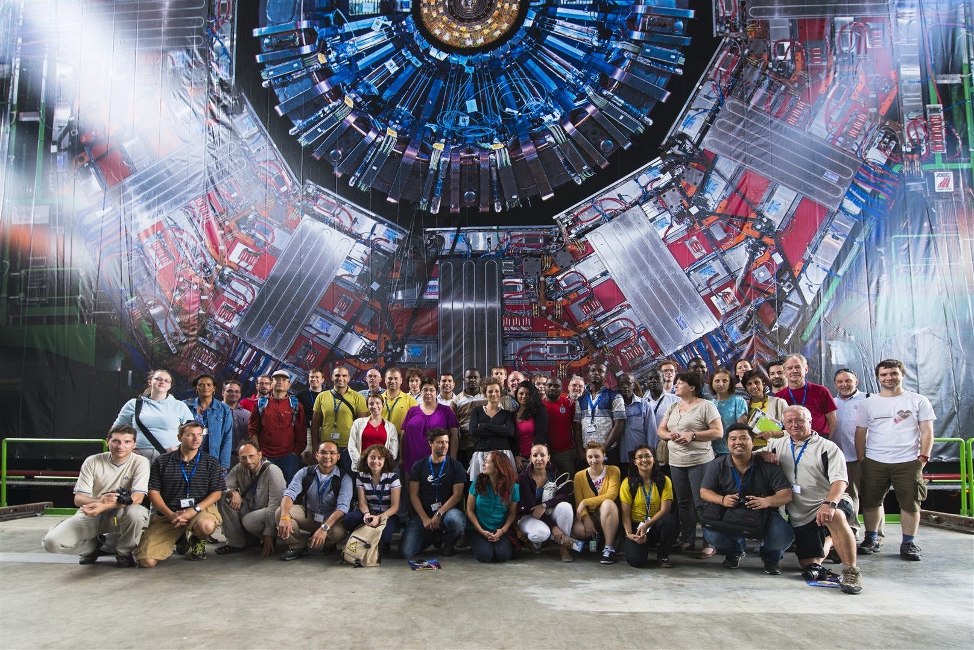
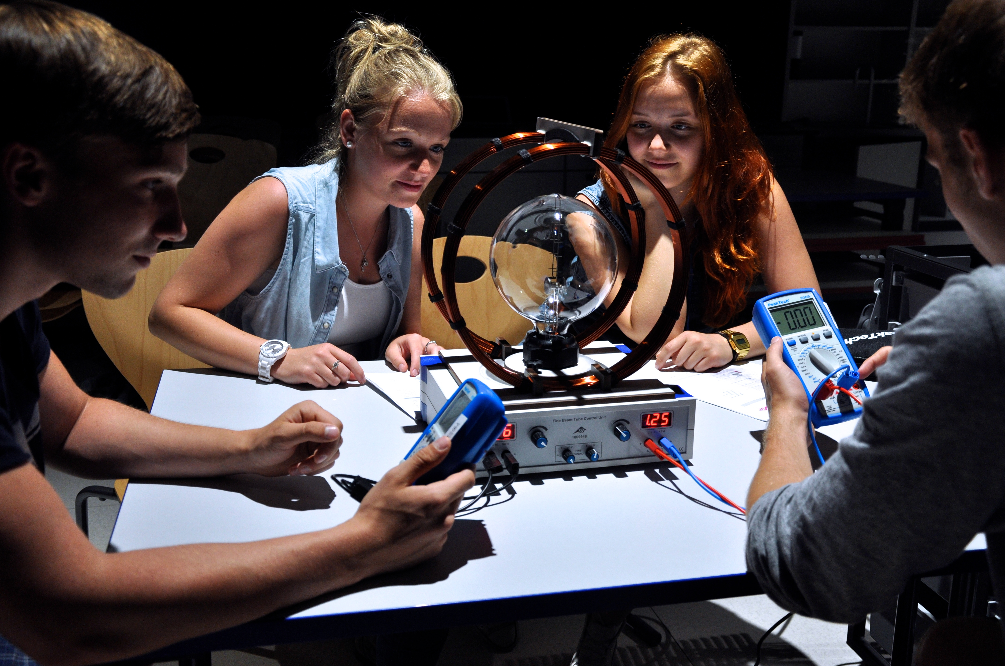
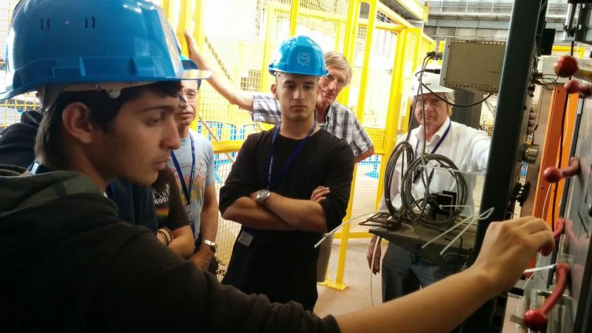
Teachers and schools
Teachers programmes
906 teachers; 55 countries in 2018
S’Cool LAB
7 000 students in 2018
Masterclasses
~10 000 students in 2018
Student programmes
>1 500 students in 2018

Slide 15
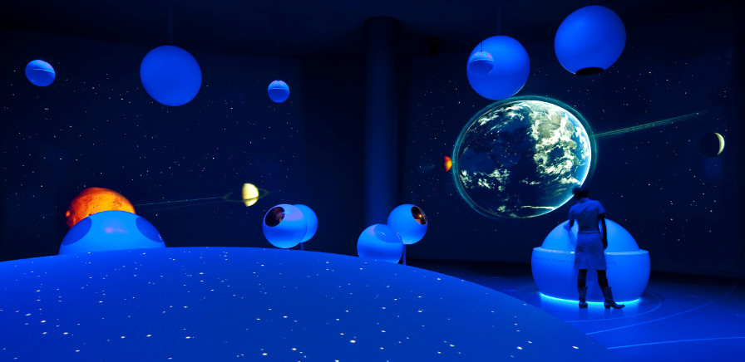
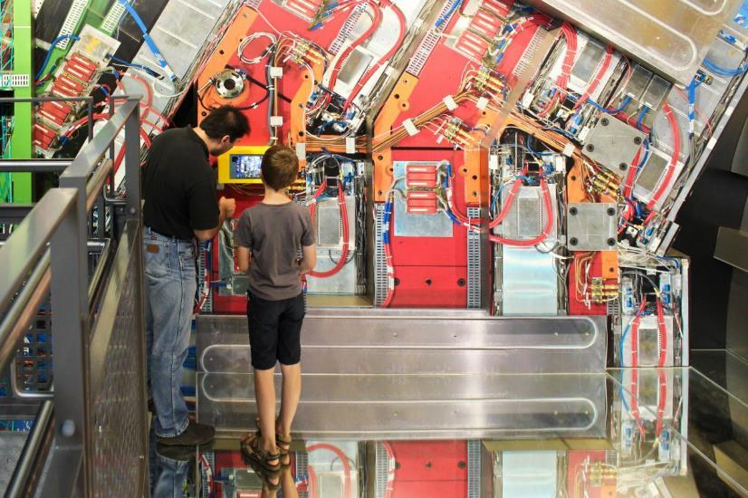
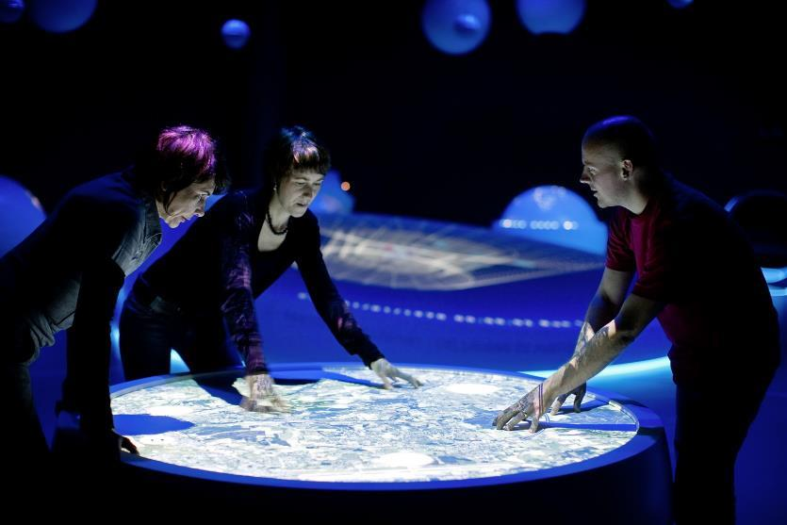
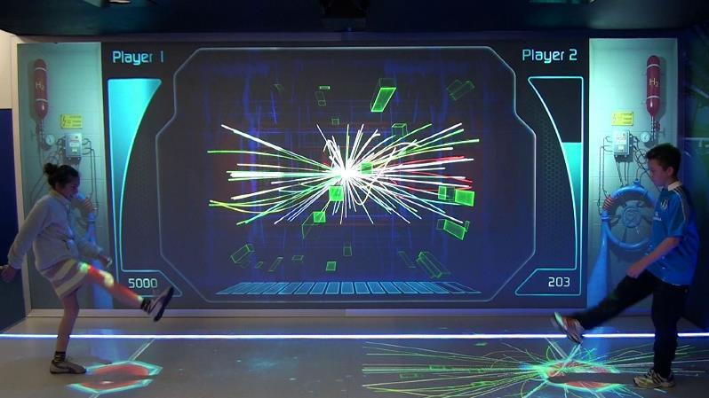
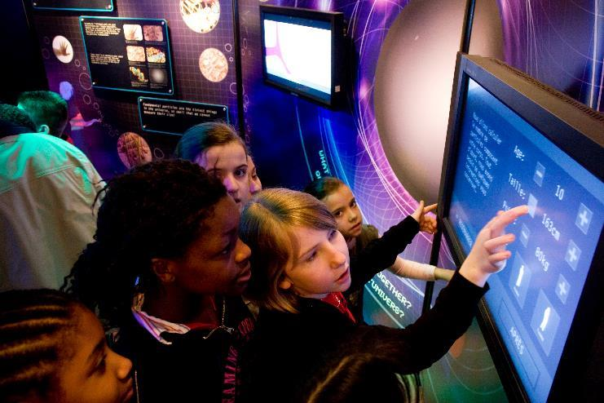
Exhibitions
Travelling
LHC Interactive Tunnel
Accelerating Science
> 500 000 visitors
16 countries
Permanent
Microcosm
Universe of Particles
> 100 000 visitors/year

Slide 16
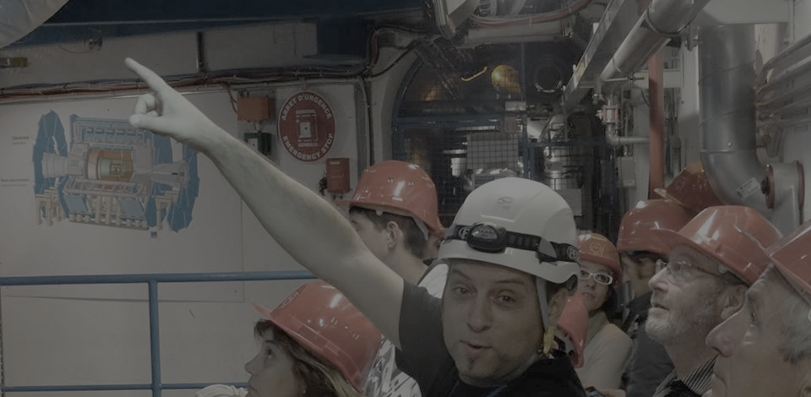
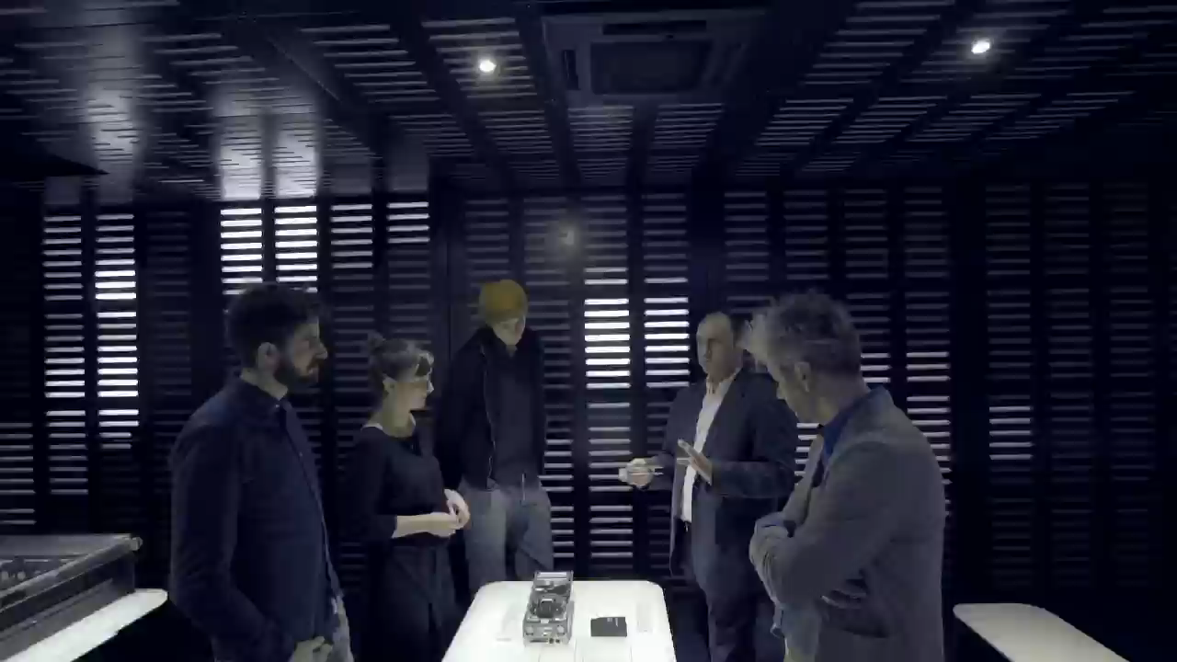
Guided Tours
Huge demand
~150 000 visitors/year
2 x more requests…
>80 countries
30 languages
46% schools
70% come from > 600km
Volunteer guides
Staff, fellows, users…
We provide training
Notes:
Present yourself
Your background
Your (dis)interest in science
Your current functions

Slide 17
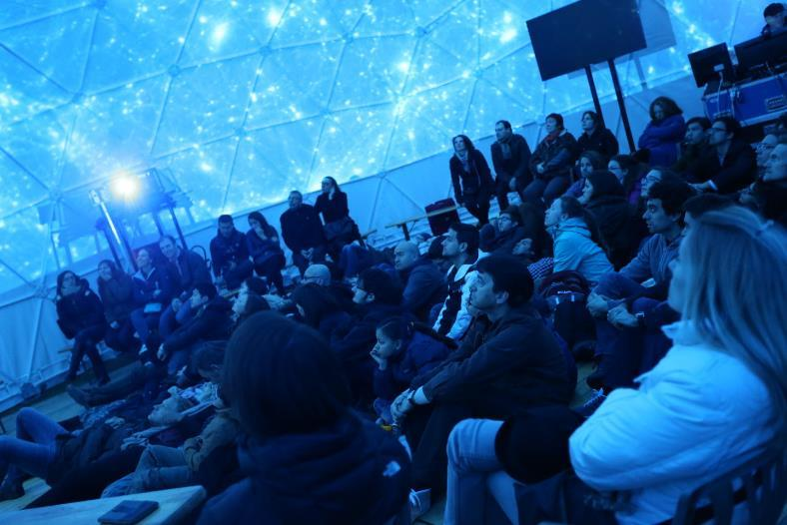
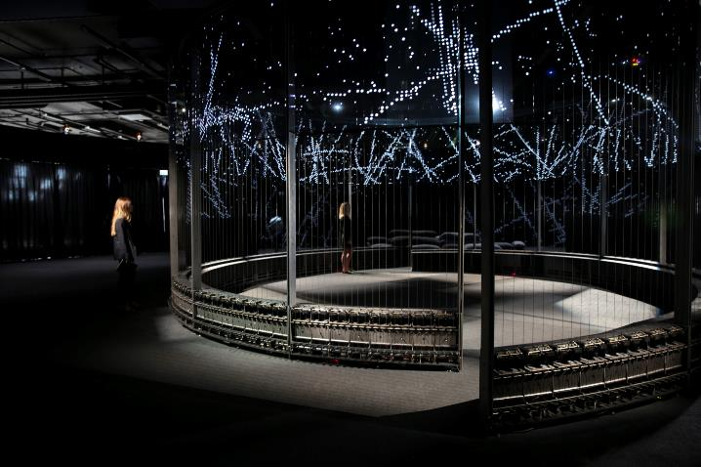
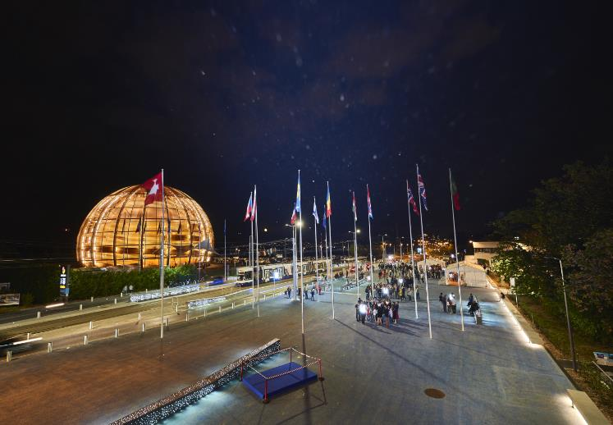
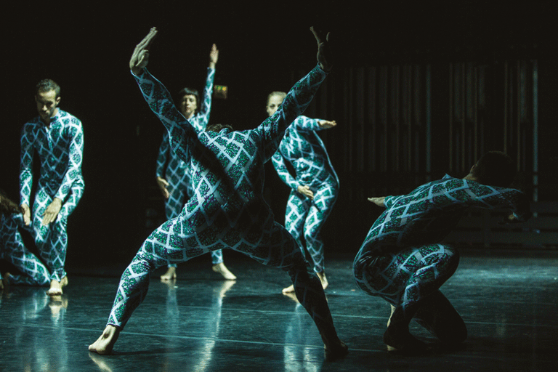
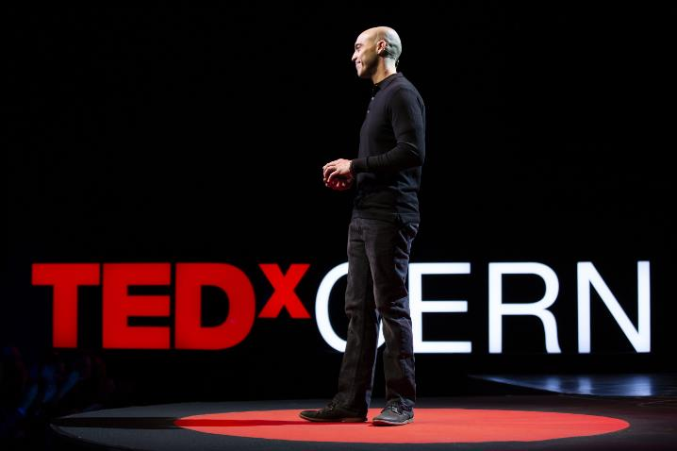
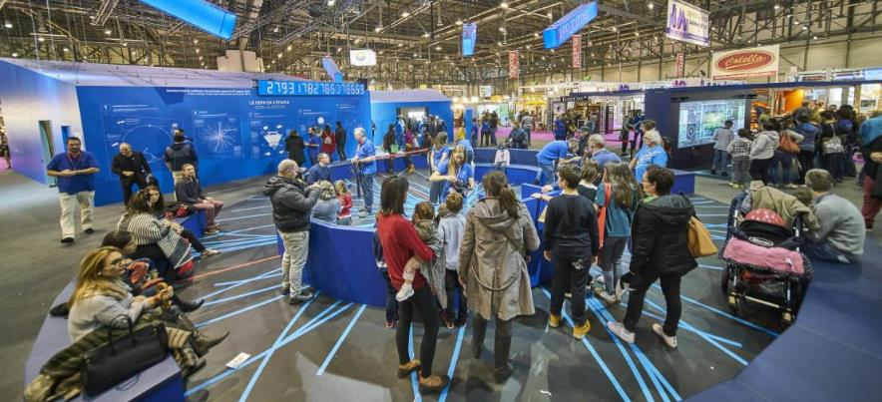
Events
Local events
Public conferences
Researchers Night
TEDxCERN
CineGlobe
Around the world
Arts@CERN
Science fairs
Member States celebrations
Music Festivals
Notes:
Present yourself
Your background
Your (dis)interest in science
Your current functions

Slide 18
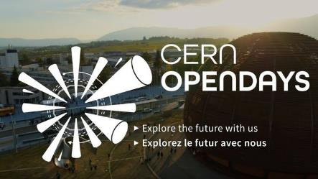
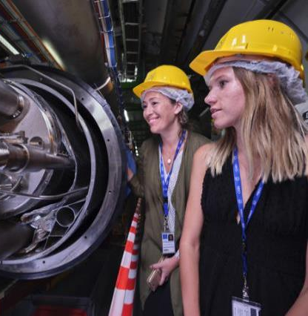
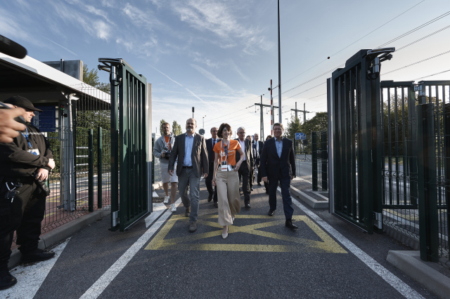
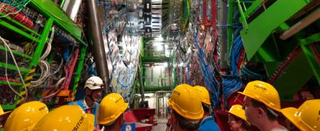
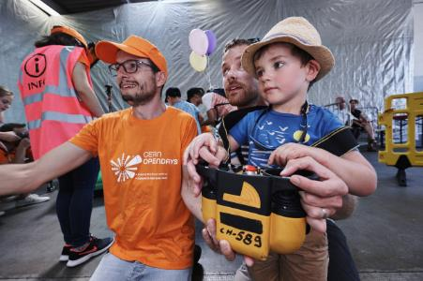
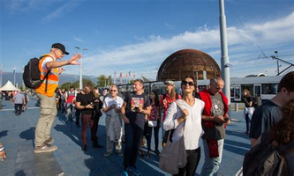


Slide 19

Science Gateway
A new centre for education and outreach
…as of 2022
Inspire
Educate
Engage
Treasure
Collaborate

Slide 20

We need you !
cern.ch/guides
cern.ch/volunteers
CERN Outreach Events Volunteers
Notes:
We have invented the web, so please use it! ;-)

Slide 21
https://cern.ch/communications

