Slide 1

Diversity & Inclusion Programme
Induction 2020
Louise Carvalho
Kristine Kotte-Eriksen
diversity-and-inclusion.web.cern.ch
Notes:
https://diversity-and-inclusion.web.cern.ch/

Slide 2
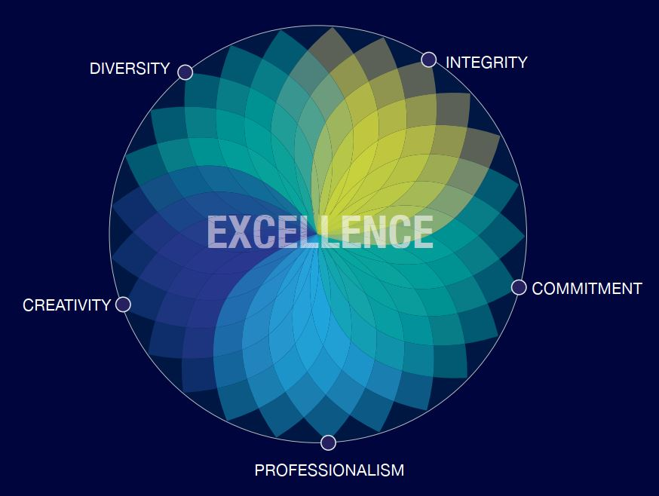


Slide 3


Slide 4
The Diversity & Inclusion Programme aims to enable, inspire and motivate our diverse personnel to create an inclusive and collaborative work culture.
“When we create a work environment in which we bring our full selves to work, that is when we experience our full potential.”
- Louise Carvalho, D&I Programme Leader.
Notes:
The D&I Programme are not in a position to handle individual cases. I will come back to our official response channels in case of incidents.

Slide 5
Diversity ranks No.1 as most appreciated workplace element
Mission/ Scientific Contribution
Pride
Benefits and Remuneration
Diversity | 256
Mission/Scientific Contribution | 251
Other | 187
Colleagues and Collaboration | 132
The work itself | 131
Work environment | 83
Challenges | 78
Technologies | 63
Benefits and Remuneration | 57
Pride | 32
Diversity
Tech- nologies
Other
Challenges
Colleagues
The work itself
Staff Survey 2019

Slide 6
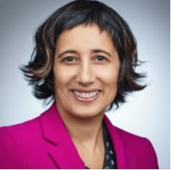
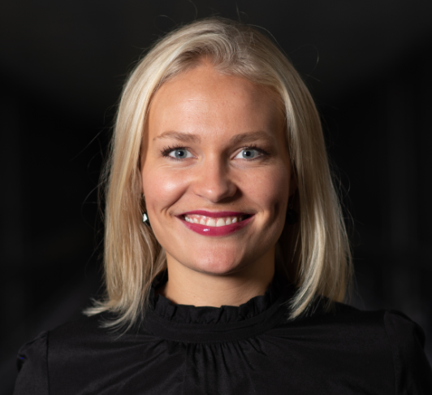
The Team
Louise Zelia Carvalho
Diversity & Inclusion Programme Leader
(and Legal Adviser)
Kristine Kotte-Eriksen
Diversity & Inclusion Analyst
Staff
50%
Fellow
100%

Slide 7
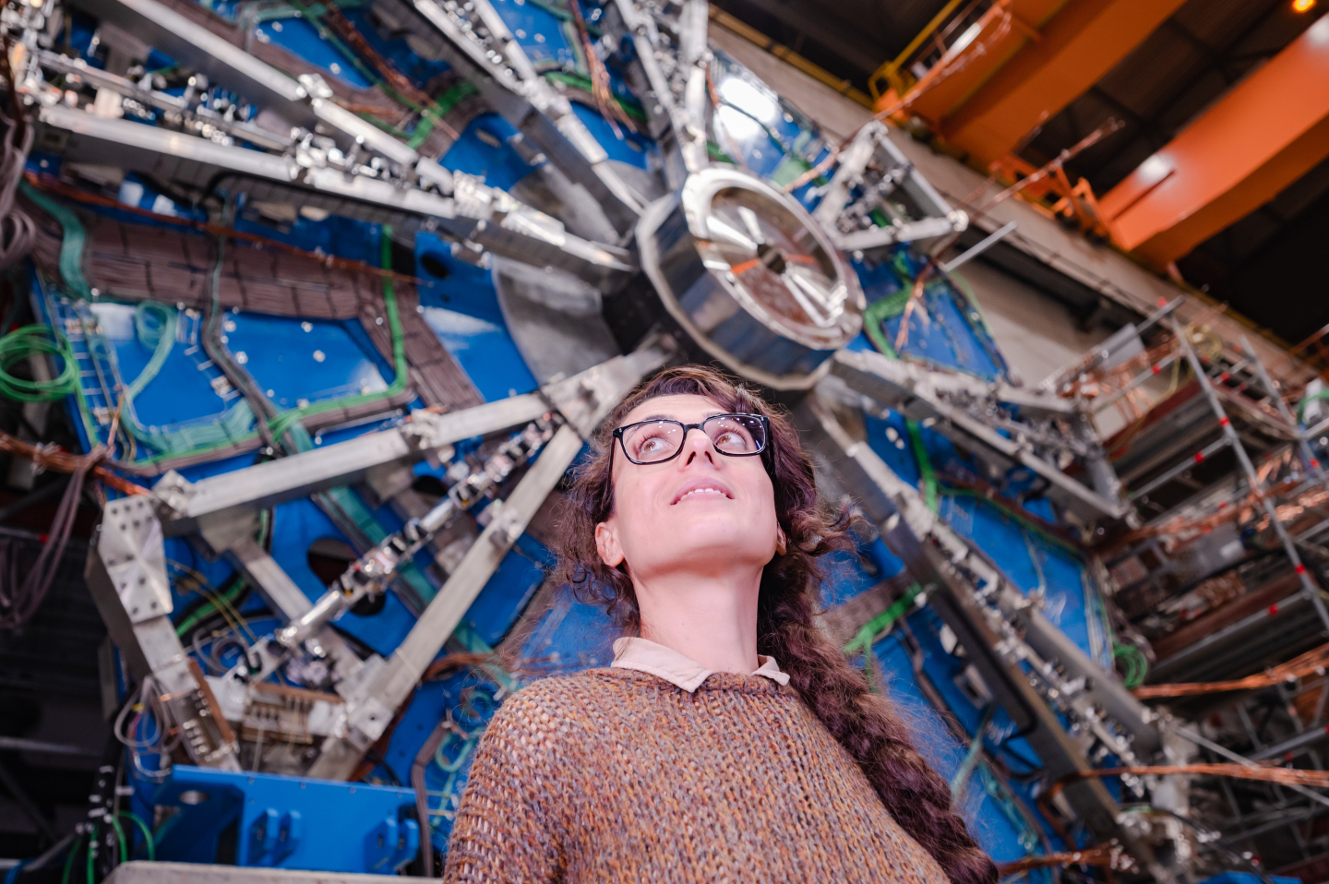
The Diversity & Inclusion Programme
Diversity Roundtable
Inclusive workplace
Family support
Anti-Harassment
Resources
Notes:
We have an advisory role within the Organization

Slide 8
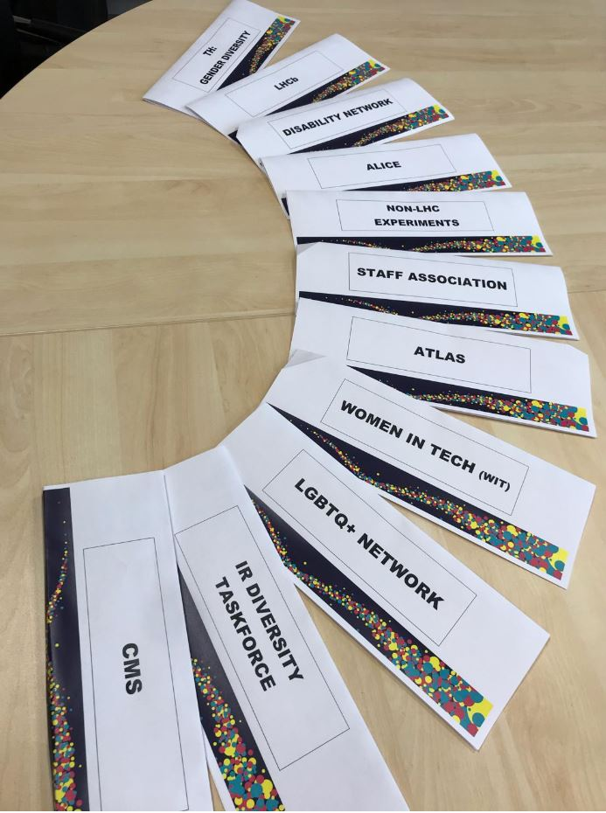
The
Diversity
Roundtable

Slide 9
D&I Roundtable
Roundtable
D&I representatives from across CERN meet every 2 months to discuss issues of shared concern and to exchange ideas how to enhance D&I at work.
Joint actions to raise awareness.
Produce Diversity Roundtable recommendations to the Director-General:
Notes:
The Diversity Roundtable meets 5 times a year.
Chaired by the D&I Programme.

Slide 10

Diversity Roundtable Recommendations
Roundtable
Diversity Roundtable Recommendations “whole-heartedly” approved by the DG 2020
Making CERN’s Science Gateway accessible and inclusive.
Gender-inclusive language for Staff Rules and Regulations.
Extension of Fellow’s employment contract following maternity leave.

Slide 11
Inclusive workplace
Inclusion

Slide 12



Your life @CERN brochure
Inclusion
Click here for brochure

Slide 13
Your life @CERN brochure
Inclusion
Part-time work
Teleworking
Dynamic leave scheme
Pre-retirement programme
Child care facilities
Support to dual careers
Leave for new parents
Other family-related leave
Accessibility
Return-to-work policy
Language courses
Support services
Click here for brochure

Slide 14

Disability
Inclusion
Short-term internship for STEM students with disabilities;
“This was an excellent experience. We have benefited not only from a smart and very productive student but also from integrating a co-worker with special needs into the team. It was a good change for the team (even though they might not have noticed) and definitely a good challenge for me. I guess that's what diversity is about.”
- Supervisor, Experimental Physics
«Je vous remercie infiniment de m'avoir donné la chance de faire ce stage au sein du CERN. L'université de Genève m'a accordé récemment un stage. En raison de cet engagement je ne vais pas pouvoir étendre mon contrat au CERN. Merci encore une fois d'avoir effectué tous les démarches pour m'accueillir et de votre proposition. »
- Intern, Experimental Physics
Support structures for people with disabilities
Notes:
The Disability Handbook has been published, printed and distributed. A tool for managers and supervisors of employees/students with disabilities.
“Short-term Internship for STEM students with disabilities”
Background of the project:
hired two students in EP department, both providing excellent feedback
been publicly acknowledged for the success of the programme at a prominent disability conference at the ILO, Geneva in Dec 2019
increased its competency on sourcing, hiring and retaining talent with disability, for example:
HR’s Talent Acquisition team has attended a workshop on talent with disability
Modified employment applications forms for candidates to disclose any special needs
Currently in a process of streamlining the feedback from students & supervisors, to improve future programmes.

Slide 15


Inclusive culture
Inclusion
NEW lanyard and card reel!
Moving, vibrant, merging particles: reflecting the diversity & inclusion at CERN
Increasing visibility of D&I allies
Notes:
Add that they will shortly be made available at Bldg 55 or from our offices in Bldg 5

Slide 16
Family support
Partner
support

Slide 17
Family support
Partner
support
Spouse / partner support
Spouse Welcome brochure
*Staff, Fellows, Administrative, Technical and Doctoral students
International Dual Career Network (IDCN)

Slide 18


Partner
support
18
IDCN Lake Geneva
CERN – Corporate Member of IDCN
Notes:
KKE: Merge slides 18 and 19. 19 has good info!

Slide 19
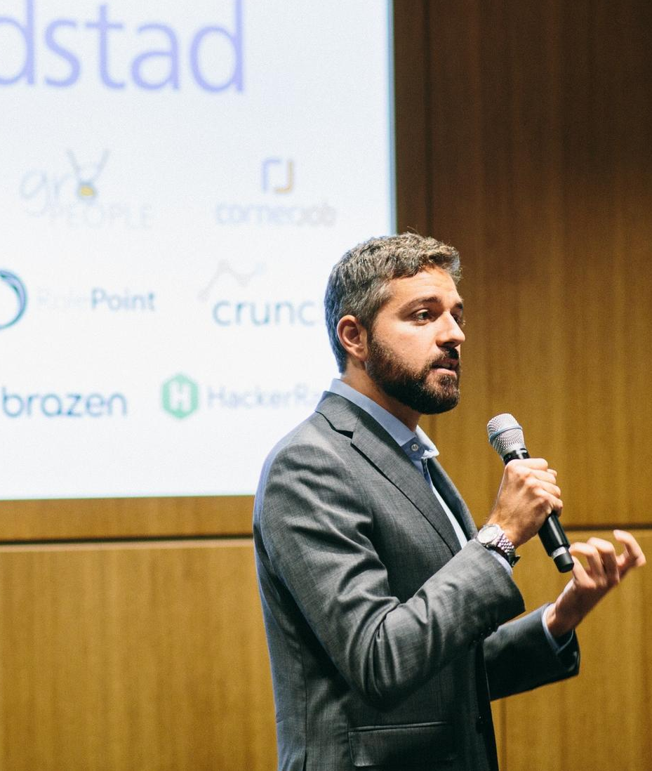

Partner
support
CERN
Corporate Member of IDCN
International Dual Career Network
Make relocation more attractive to employee partners.
Ensure the long-term success of international mobility.
Facilitate professional integration of the dual career partner.
Provide a professional network for the dual career partner.
Corporate Events
Career Mornings and Workshops

Slide 20


What you can expect from IDCN
Partner
support
An ally in your professional Swiss journey.
Help decoding Swiss job market and culture.
Enhance your visibility to top employers in the region.
To be in contact with other spouses in your same situation.
Opportunity to volunteer.
Find a job for you.
Do networking for you.

Slide 21
Partner
support
INTERNATIONAL DUAL CAREER NETWORK
CONTACT INFORMATION
General Information: geneva@idcn.info
Volunteer Opportunities: volunteer.geneva@idcn.info
Membership Questions: membership.geneva@idcn.info
Website: www.idcn.info
LinkedIn: IDCN Lake Geneva Region
Notes:
KKE: remove this slide, people can contact us if they want more info

Slide 22
Anti-Harassment
Legal framework & support structures
Anti-Harassment
Notes:
https://diversity-and-inclusion.web.cern.ch/anti-harassment

Slide 23
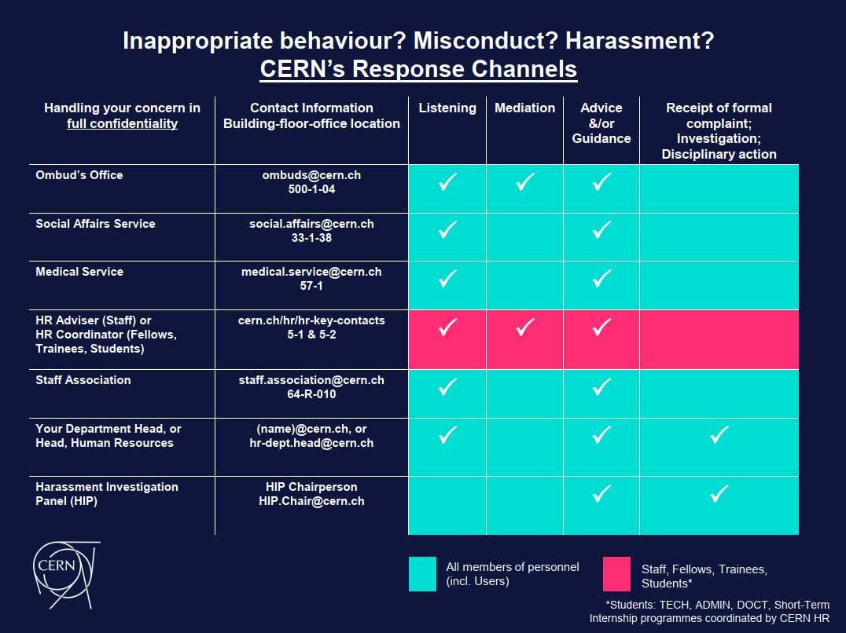
Formal response channels
Anti-Harassment
Notes:
https://diversity-and-inclusion.web.cern.ch/anti-harassment

Slide 24
Anti-harassment
Anti-Harassment
Ensure User community is also aware of policy and support structures
Accountability
“Strongly support what you are doing here”
“We appreciate this very much and would like to invite you to join our Weekly Meeting..”
“…delighted if you could present…”
"Thank you very much for this initiative, very good idea!"
Notes:
Presentation speaks to potential victims as well as would-be harassers, so that everyone knows there are complaint and support structures, as well as accountability for misconduct.

Slide 25
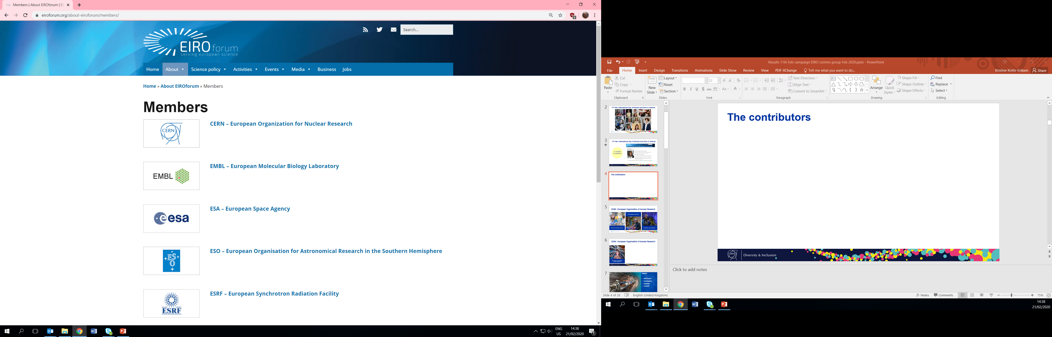
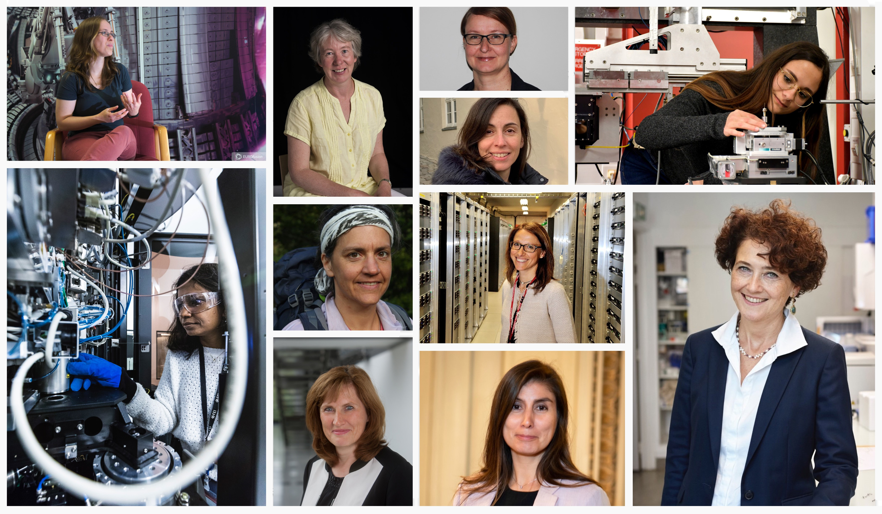
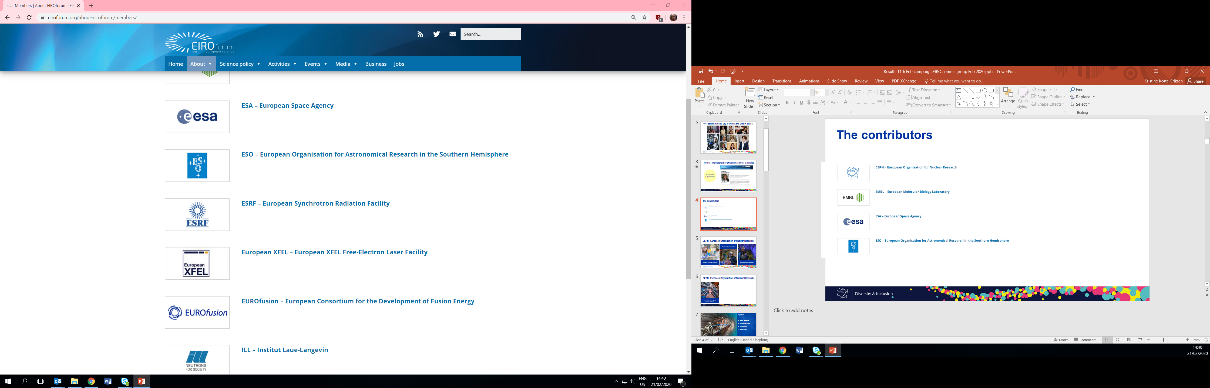
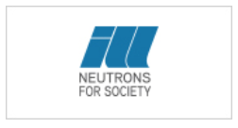
International Day of Women and Girls in Science: 11 Feb
Gender
EIRO Forum
7 science-based
IGO’s
Profile gallery and DG Statement
11th February 2020

Slide 26
Key contacts & resources
Mission/ Scientific Contribution
Ombuds Office
HR Key Contacts
Anti-Harassment Policy
Social Affairs Service
Medical Service
Psychologist
LGBTQ CERN
Disability Network
Staff Association
Pride
Benefits and Remuneration
Diversity
Tech- nologies
Other
Challenges
Colleagues
The work itself

Slide 27
Thank you for your attention.
Louise Carvalho / Kristine Kotte-Eriksen
The Diversity & Inclusion Programme

