Slide 1

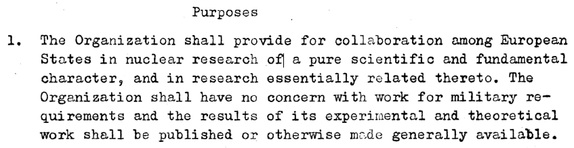
Le Service d’Information Scientifique
Convention establishing a European Organization for Nuclear Research, 1953
CERN Onboarding 2019
Tullio Basaglia, RCS-SIS

Slide 2
La mission du SIS:
Le Service d’information scientifique du CERN a pour mission de gérer, conserver et diffuser efficacement l’information scientifique afin de la rendre accessible et utilisable pour le CERN et pour la communauté mondiale de la physique des hautes énergies.
4 domaines d’activité: la Bibliothèque, la base de données INSPIRE, les Archives, l’Open Science
Tullio Basaglia
CERN Onboarding
2019

Slide 3
La Bibliothèque :
Assure que l’information scientifique produite au CERN soit préservée et généralement accessible
Distribue les publications CERN (“Rapports jaunes”, CERN Courier, publications du Particle Data Group)
Donne accès aux ressources d’information dans tous les domaines d’intérêt pour le CERN: physique, informatique, mathématiques, ingénierie, gestion
h
Tullio Basaglia
CERN Onboarding
2019

Slide 4
Notre offre:
150,000 livres et comptes rendus de conférences, dont 100,000 en format électronique
  2,000 journaux en ligne
  • 13,500 normes techniques
CERN Document Server: c’est là que vous trouvez ce que nous avons en stock: cds.cern.ch
Accessible de partout dans le monde – consultez les instructions ici: http://library.cern/resources/remote
« Acquisition guidée par le lecteur » : suggérez des nouvelles
acquisitions:
http://library.cern/services/suggest
Tullio Basaglia
CERN Onboarding
2019

Slide 5
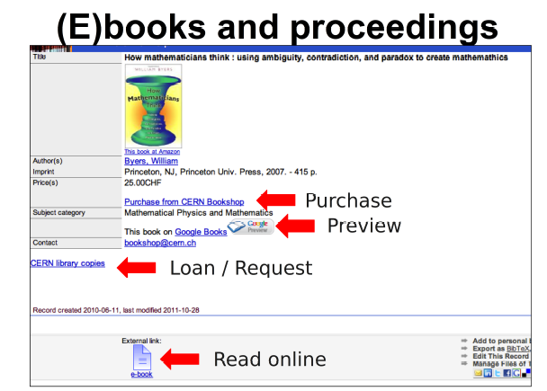
Scientific Information Service
Open access to literature and data
Tullio Basaglia
CERN Onboarding
2019

Slide 6
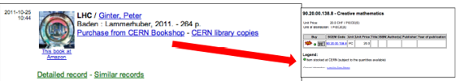

OpEn plus des collections de la Bibliothèque
Le Bookshop est à votre disposition dans les locaux de la Bibliothèque
  Vous pouvez acheter un livre pour vous ou pour votre groupe
  Paiement par carte de crédit ou cash ou budget code (EDH)
  Nous achetons n’importe quel livre pour vous (aussi des titres qui ne sont plus en stock chez l’ éditeur)
Prêt entre bibliothèques
  Livres, articles, normes, thèses…: nous pouvons les obtenir pour vous!
  Gratuit, rapide (il faut quelques heures pour un article en PDF)
  Taux de réussite très élevé (>95%)
Tullio Basaglia
CERN Onboarding
2019

Slide 7


INSPIRE:
CERN, DESY, Fermilab and SLAC have built the next-generation High Energy Physics (HEP) information system, INSPIRE. It combines the successful SPIRES database content, curated at DESY, Fermilab and SLAC, with the Invenio digital library technology developed at CERN. INSPIRE is run by a collaboration of CERN, DESY, Fermilab, IHEP, IN2P3, and SLAC, and interacts closely with HEP publishers, arXiv.org, NASA-ADS, PDG, HEPDATA and other information resources.
Tullio Basaglia
CERN Onboarding
2019

Slide 8
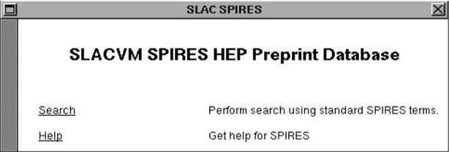
INSPIRE:
1991: First website in North America (after the Web was born at CERN)
Tullio Basaglia
CERN Onboarding
2019

Slide 9
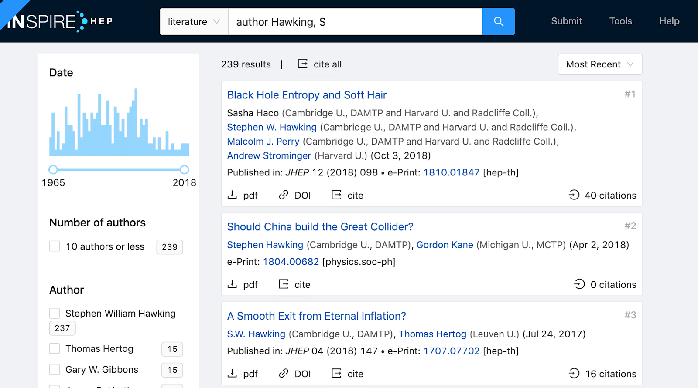
In 2019, we launched INSPIRE beta to replace the current INSPIRE in 2020.
Visit https://beta.inspirehep.net/ and send us your feedback!
Tullio Basaglia
CERN Onboarding
2019

Slide 10
INSPIRE and CDS: what is the difference?
INSPIRE covers HEP literature worldwide (mainly articles and preprints)
CERN Document Server focuses on CERN output and provides access to the collections of the Library and to the Bookshop’s stock
Tullio Basaglia
CERN Onboarding
2019

Slide 11
The Archive:
The CERN Archive is a repository for historical records about all aspects of CERN's activities, from the creation of CERN until the present day. The CERN Archive includes files of letters, memos, reports, notes and other documents created or received in the course of their duties by former Directors-General and other senior staff, by the CERN Council and subordinate Committees, by CERN Departments, and by selected Experiments and Committees. In addition to the CERN fonds, it also contains the Wolfgang Pauli Archive, a collection of correspondence, manuscripts and other material representing the scientific legacy of Wolfgang Pauli (Nobel Laureate, 1945). See: http://library.cern/archives
Tullio Basaglia
CERN Onboarding
2019

Slide 12
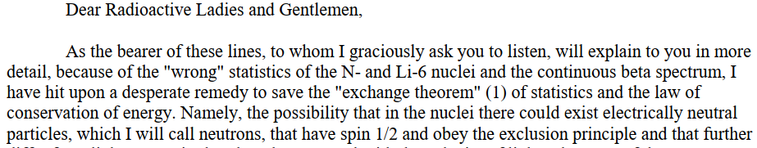
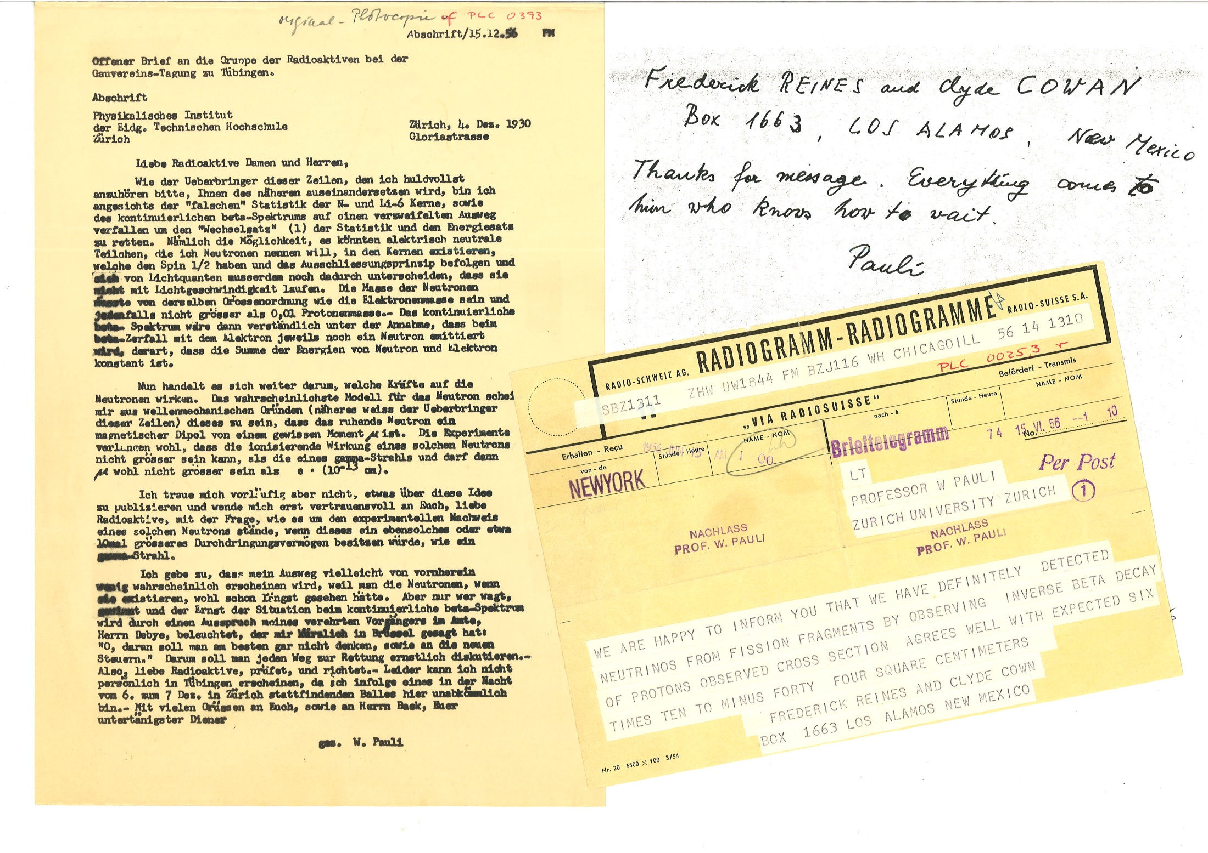
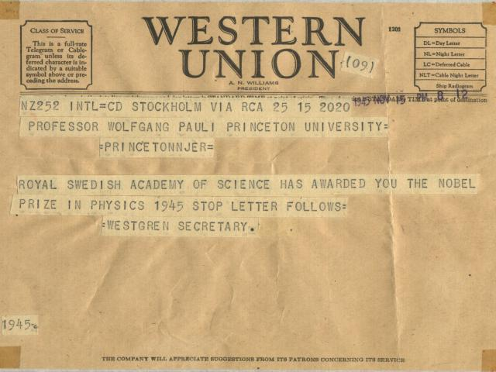
Tullio Basaglia
CERN Onboarding
2019

Slide 13




Open Science:
SCOAP³: Sponsoring Consortium for Open Access Publishing in Particle Physics
Freya: extending the infrastructure for persistent identifiers (PIDs)
CAP: CERN Analysis and Preservation and REANA: REproducible research data ANAlysis platform
Tullio Basaglia
CERN Onboarding
2019

Slide 14
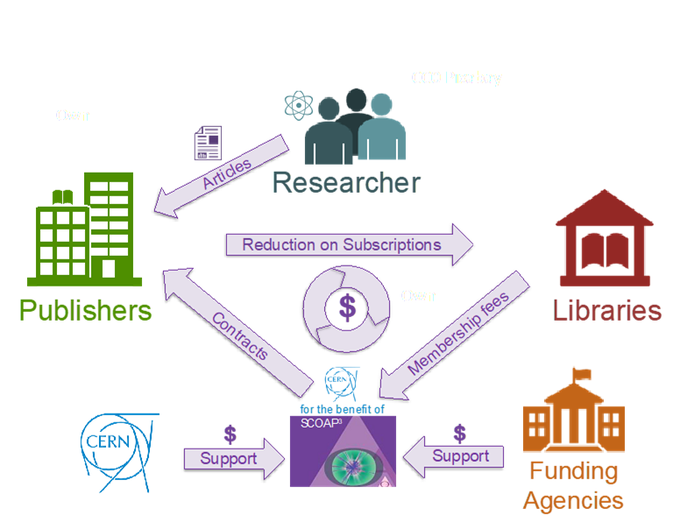
SCOAP³ – the largest Open Access initiative
SCOAP³ (Sponsoring Consortium for Open Access Publishing in Particle Physics) makes ~90% of HEP journal articles OA
3,000 partner libraries from 44 countries and 3 IGO’s
7,000 articles/year in 11 journals
Partner libraries redirect funds previously used to pay subscriptions
CERN is host organization and contractual counterpart of all stakeholders
Tullio Basaglia
CERN Onboarding
2019

Slide 15

FREYA Project
Connected Open Identifiers for Discovery, Access and Use of Research Resources
3-year project: 2017-2020, funded under Horizon 2020
Extend the infrastructure for persistent identifiers (PIDs) as a core component of open global research
Improve data discovery by extending and cross-linking PID core services, build on existing PID infrastructure (Crossref, DataCite, ORCID and identifiers.org).
Extend potential of PIDs by designing, developing and delivering innovative services for data discovery, resource identification and provenance tracking.
Integrate the PID Graph in disciplinary contexts and the European Open Science Cloud (EOSC) via disciplinary demonstrator systems.
Sustaining an open and trusted PID e-infrastructure provision for the benefit of the research community within the EU and globally.
Tullio Basaglia
CERN Onboarding
2019

Slide 16
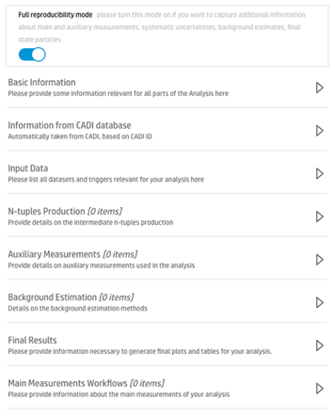
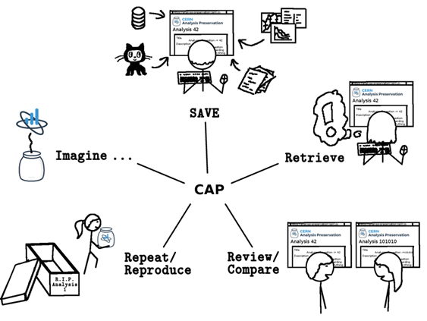
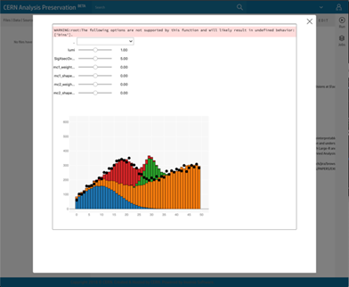
CERN Analysis Preservation – preserve the entire research process
Platform that enables the High-Energy Physics community to preserve and share their research objects (data, code, notes,…)
Piloted in collaboration with all the major LHC experiments
Versioning of data & code, using the publishing draft/record model
Integration with related scientific services and universal identifiers (i.e. ORCID, ROR)
Ongoing integration with CERN services that support remote execution and reuse (e.g. REANA)
Tullio Basaglia
CERN Onboarding
2019

Slide 17
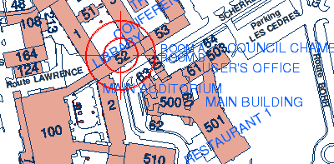
Comment nous trouver?
Scientific In
La Bibliothèque et le Bookshop sont
dans le bât. 52-1-052
Tél.: 72444
De partout dans le monde:
  Web site: http://library.cern
  CDS: http://cds.cern.ch/
  Email: library.desk@cern.ch
Ouvert 24h/24h, 7j/7j, 52/52 semaines
Personnel présent: lundi-vendredi, 8h30-19h00
(8h30-18h00 du 1/1/2020)
Open access to literature and data
Tullio Basaglia
CERN Onboarding
2019

