Slide 1
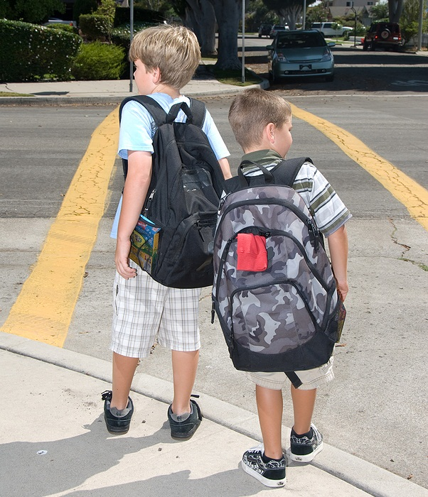

Cyber Security Awareness
Academic Freedom vs. Operations vs. Security
CERN Computer Security Team
“Protecting Office Computing, Computing Services, GRID & Controls”
Notes:
Measured duration: 15mins

Slide 2

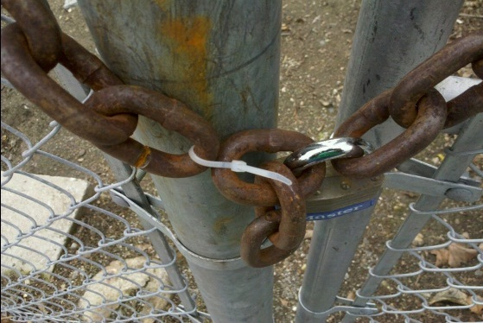
Security is a strong as
the weakest link.
There is no 100% security.
CERN’s reputation and
operation are at stake…
…incl. your computer, data & documents.
In CERN’s academic environment (as at home)
You are responsible for the security of
your computers, files, programs, services, ...
— we are not.
What comes next applies to CERN — and home!

Slide 3
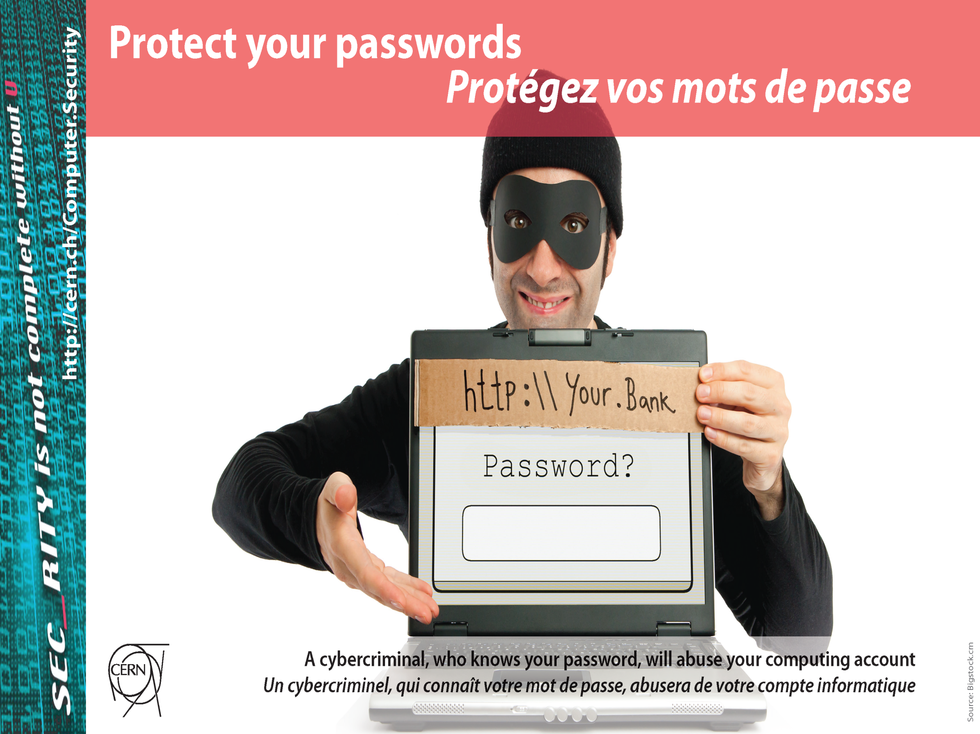

Slide 4
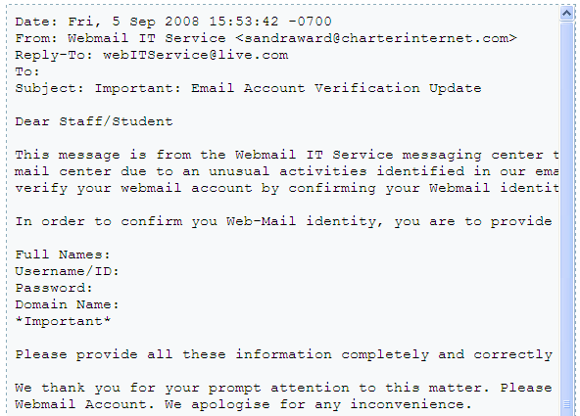
Your password is yours — only yours.
Make it complex.
Do not reuse it.
Change it regularly.
Also consider other credentials.

Slide 5


Slide 6
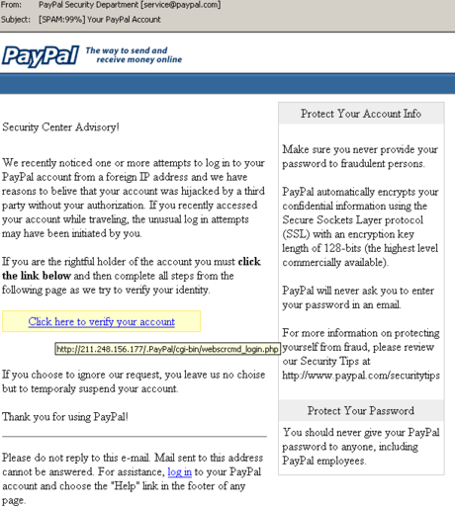

Stop — Think — Click.
Do not open unexpected or suspicious links,
e-mails or attachments.
Do not install untrusted software or plug-ins.

Slide 7
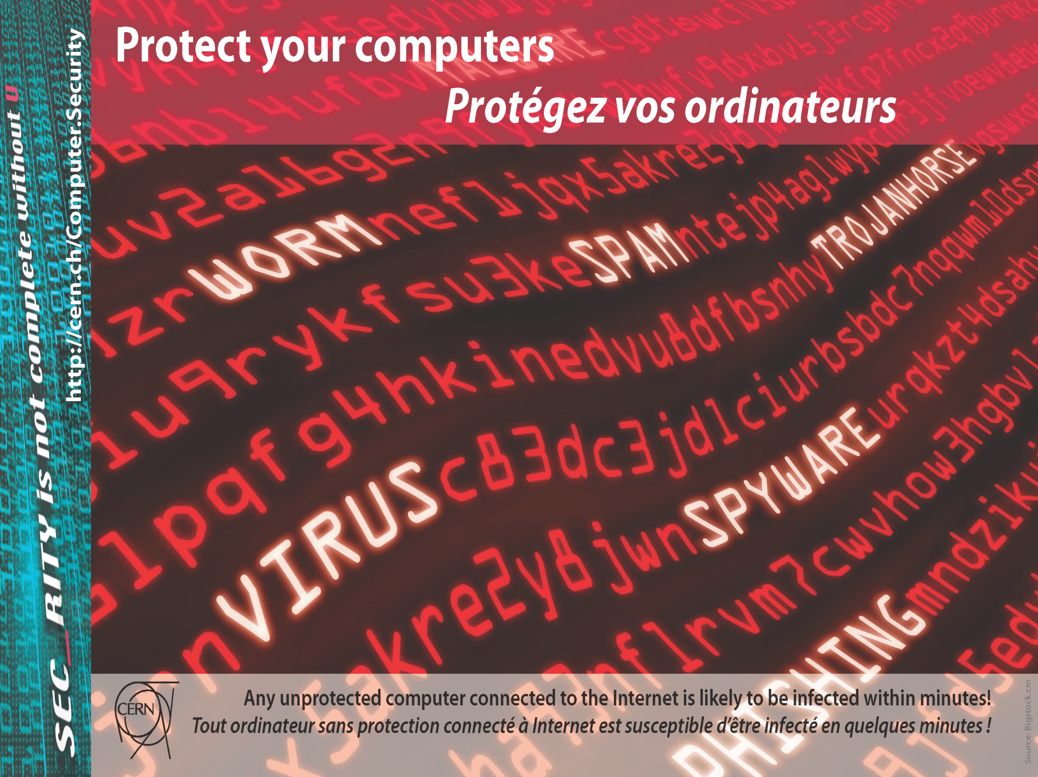

Slide 8
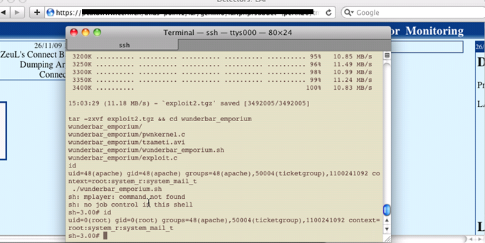
Keep all your systems
and software up-to-date.
Run anti-virus software.
Do not install untrusted software.
Lock your screen with a password when leaving.

Slide 9


Slide 10
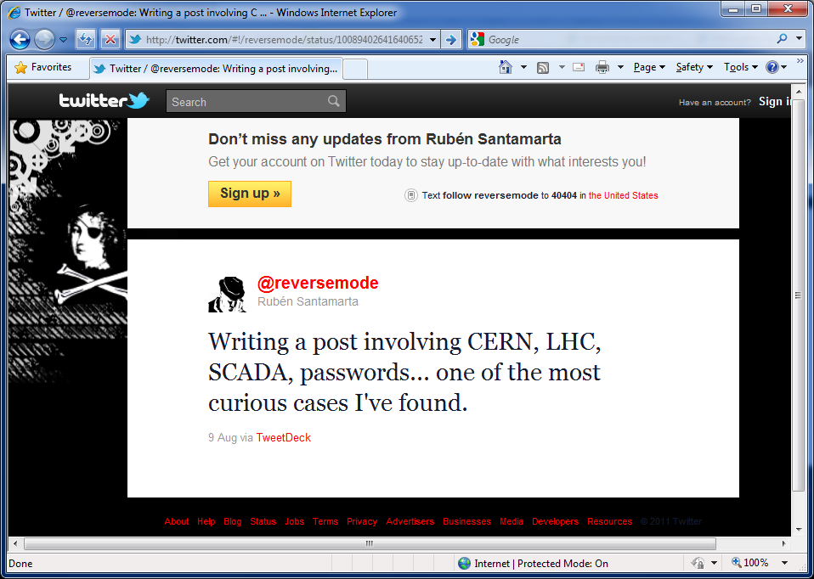
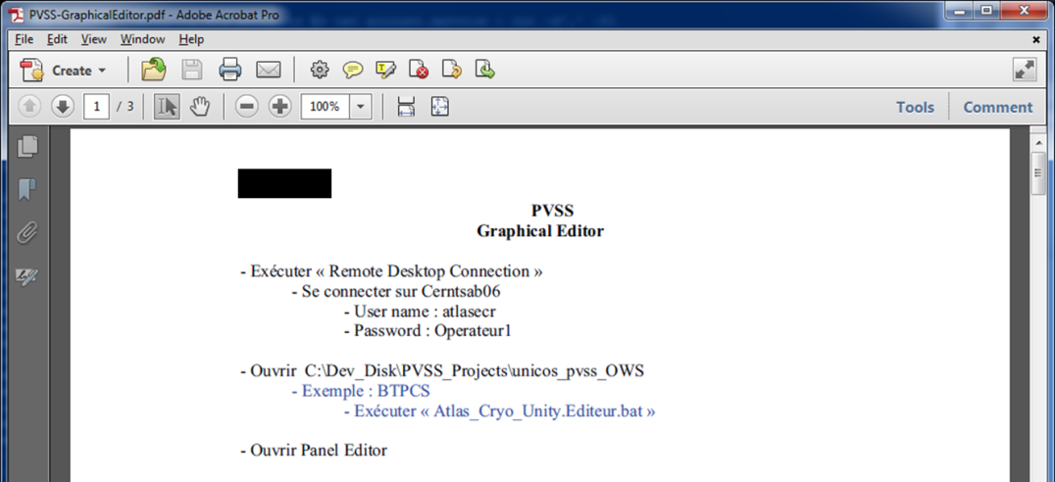
Restrict access to your documents and folders.
Follow the principle of least privilege.

Slide 11


Slide 12
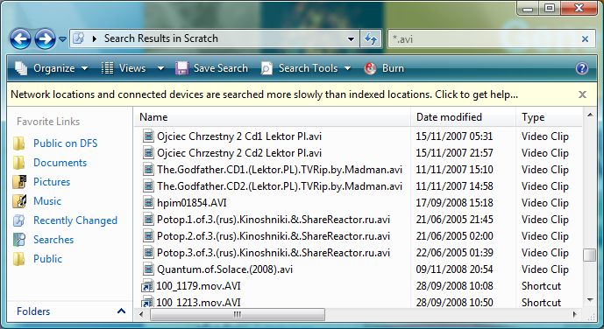
Do not distribute or share copyrighted material.
Refrain from file sharing applications and
file hosting services.

Slide 13
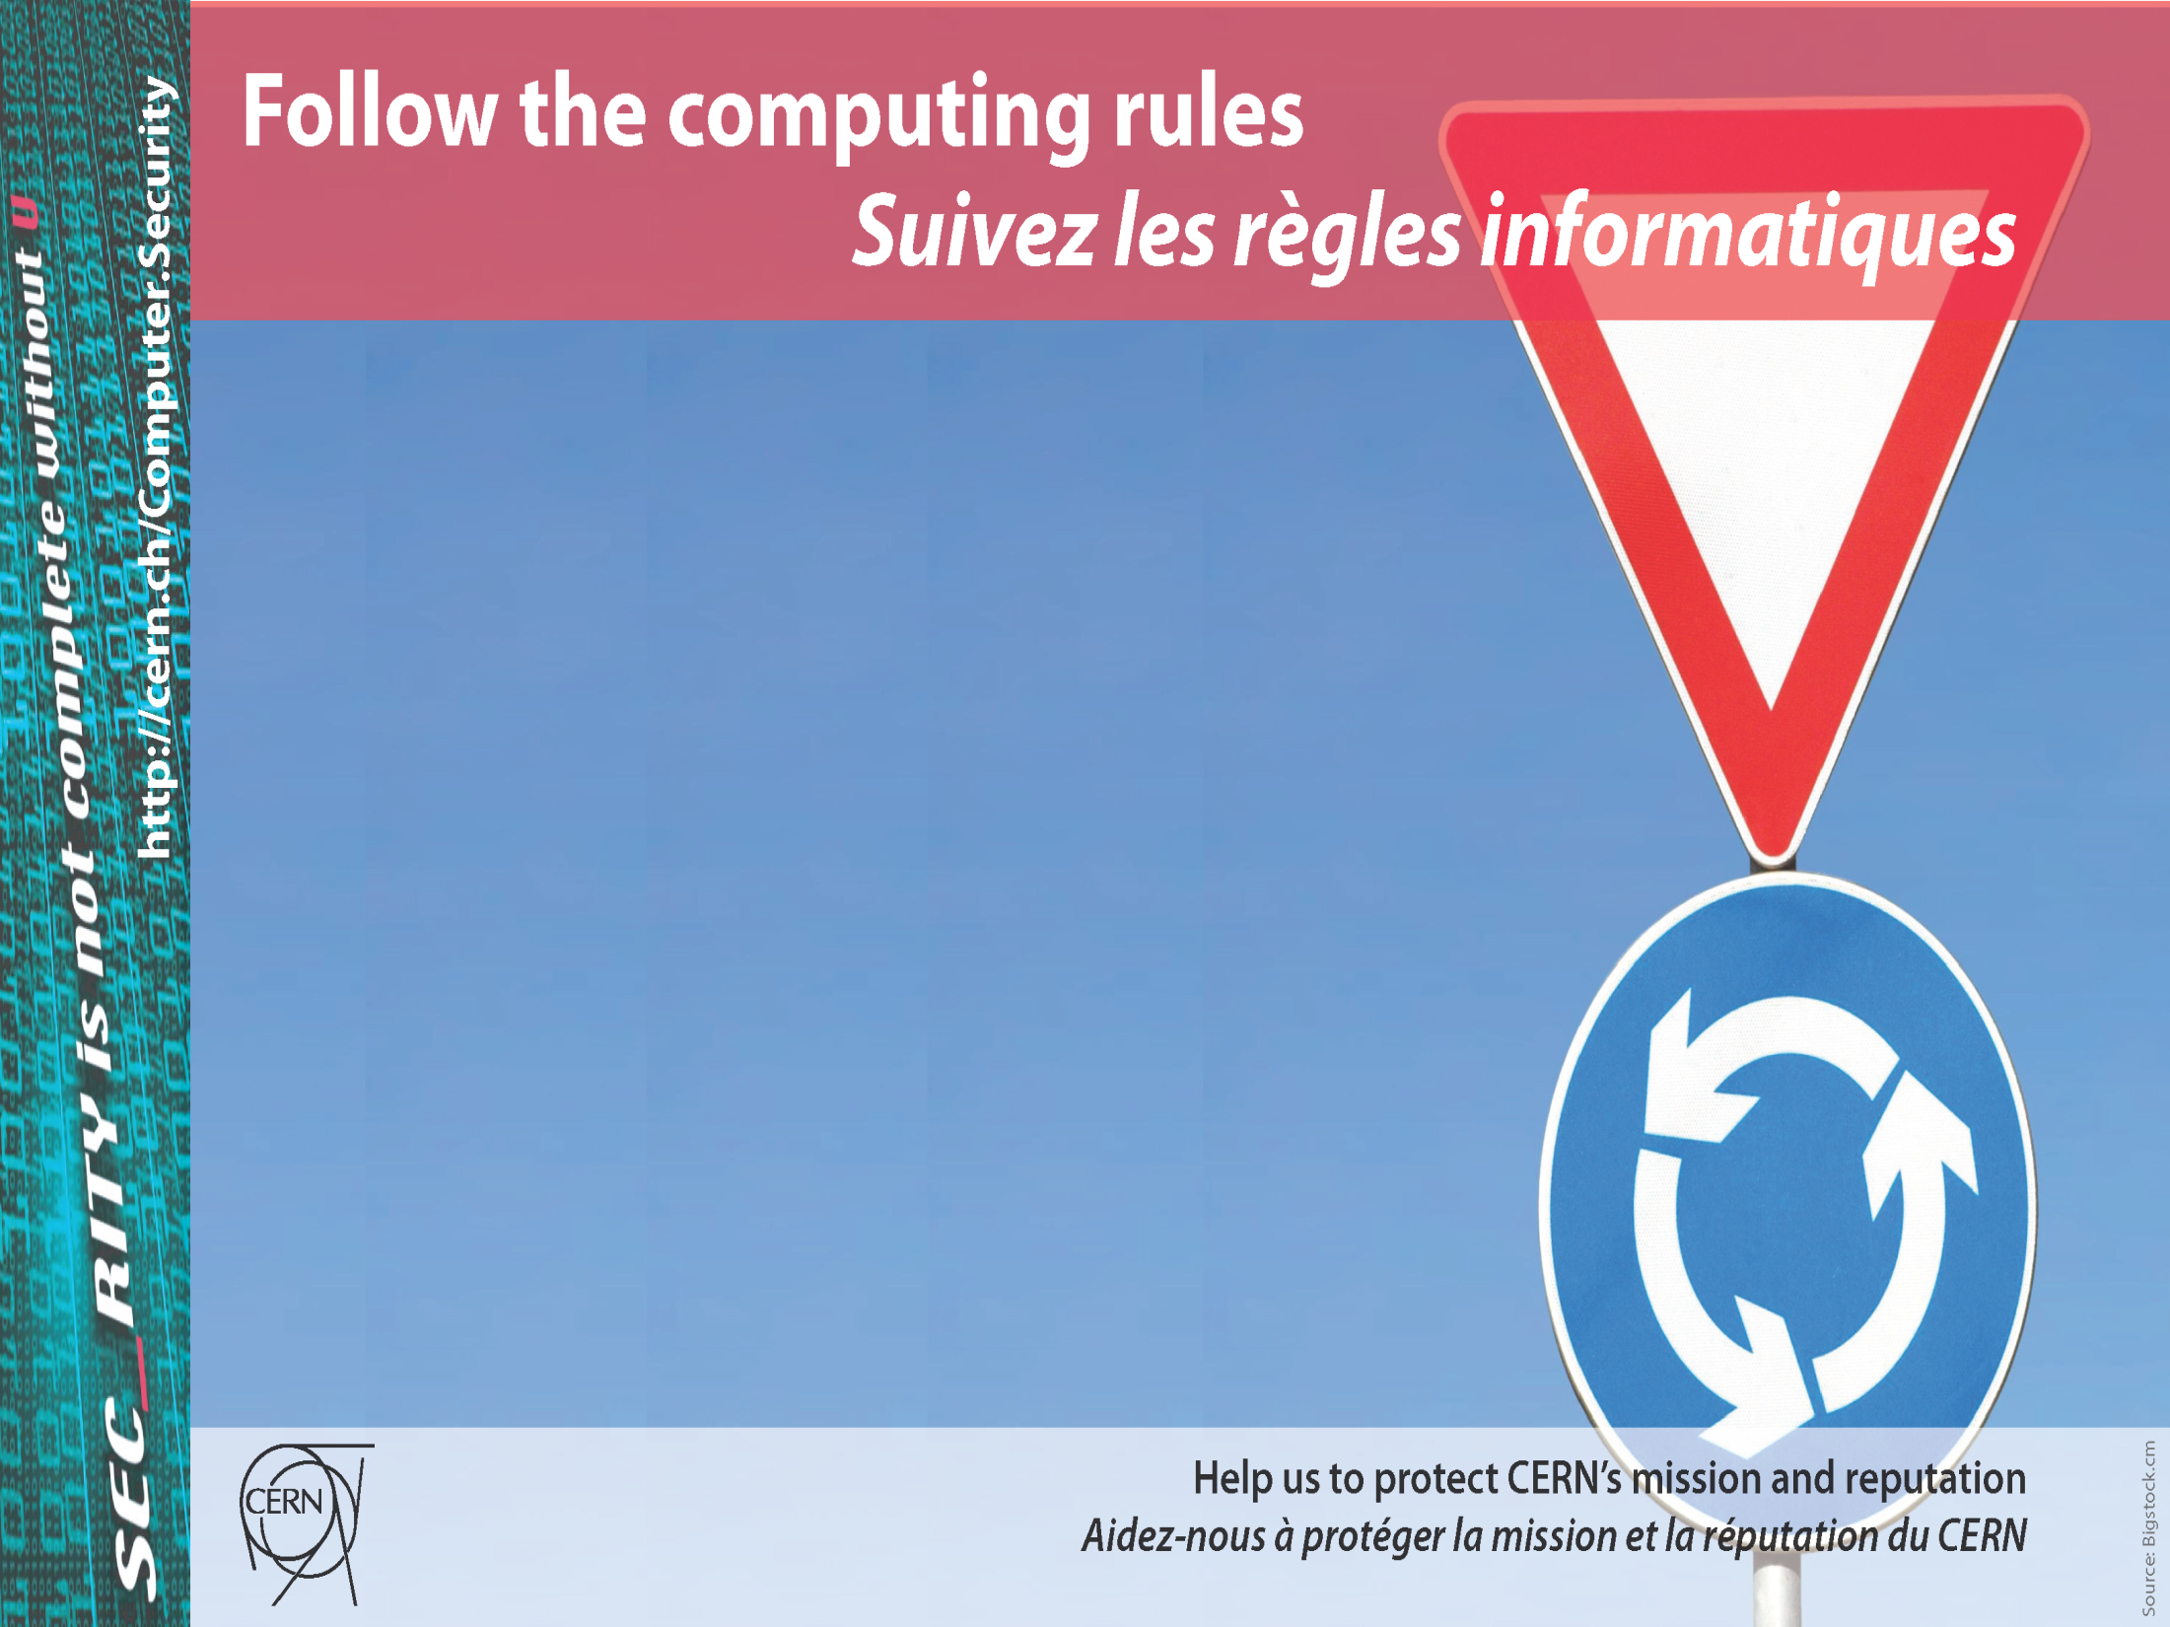

Slide 14
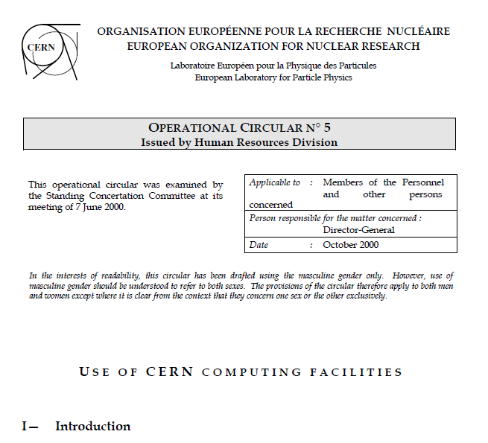
You committed to adhere to the Rules.
Your activity must not be illegal, commercial, political, offensive, …
Not allowed:
consultation of porn or other illicit material.

Slide 15
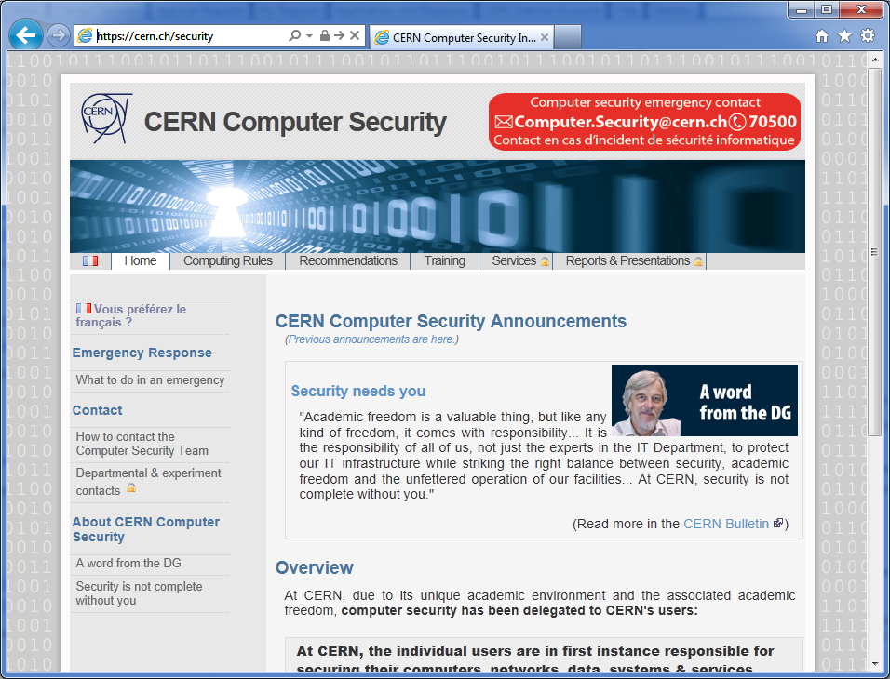

Slide 16
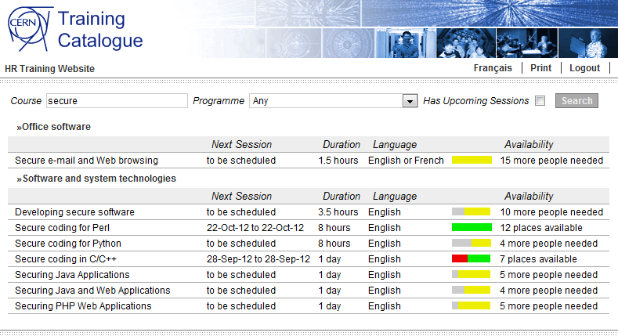
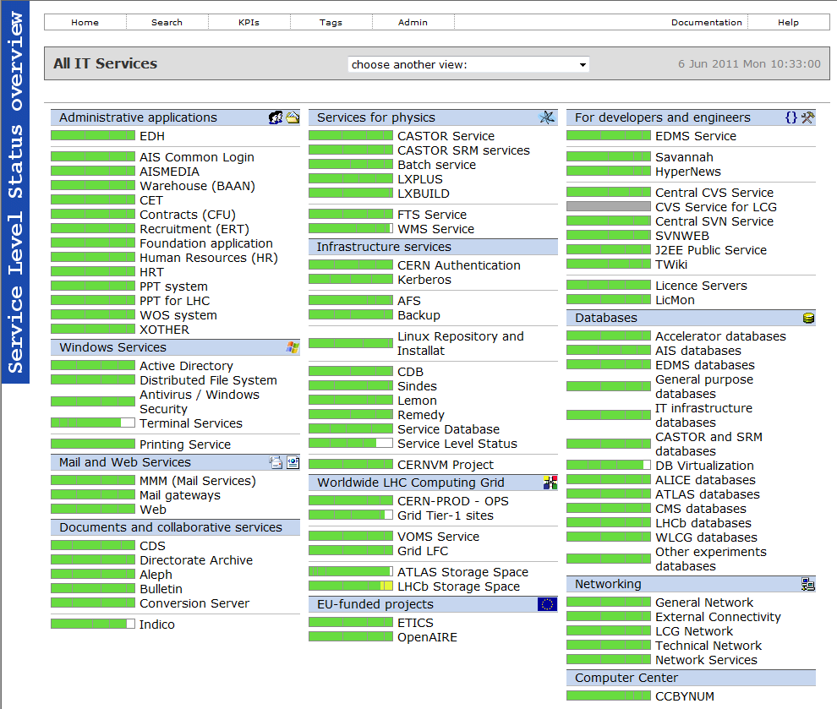
Don’t reinvent the wheel.
Focus on your core work.
Delegate your responsibility! Use central IT services &
Let IT take care of security.
Get training and help:
https://cern.ch/security
Computer.Security@cern.ch

Slide 17
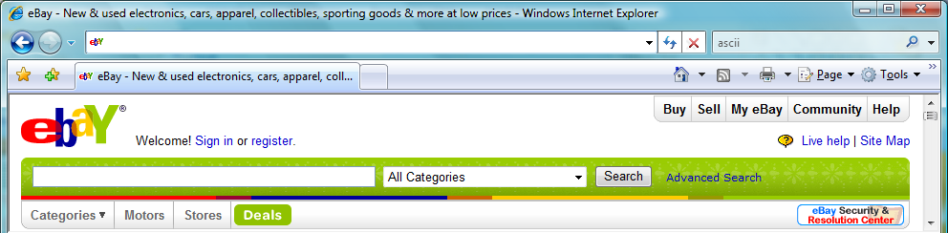

  What links to www.ebay.com ?
http://www.ebay.com\cgi-bin\login?ds=1%204324@%31%33%37 %2e%31%33%38%2e%31%33%37%2e%31%37%37/p?uh3f223d
http://www.ebaỵ.com/ws/eBayISAPI.dll?SignIn
http://scgi.ebay.com/ws/eBayISAPI.dll?RegisterEnterInfo&siteid=0&
co_partnerid=2&usage=0&ru=http%3A%2F%2Fwww.ebay.com&rafId=0
&encRafId=default
http://secure-ebay.com
✗
✗
This IS Not EVEN obvious
FOR EXPERTSs !
✓
✗
Notes:
OPTIONAL

