Slide 2
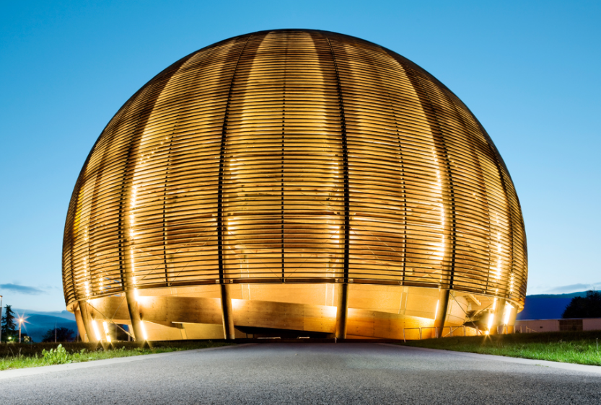
CERN People and the Organization
Anna COOK
Deputy group leader, Talent Acquisition group, HR
Onboarding quarterly session

Slide 3
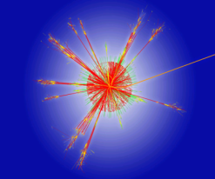
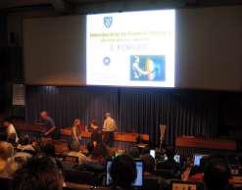
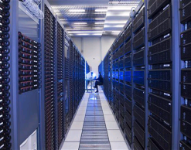
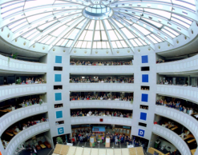
CERN’s Mission
To provide a unique range of particle accelerator facilities that enable research at the forefront of human knowledge
To perform world-class research in fundamental physics
To unite people from all over the world to push the frontiers of science and technology, for the benefit of all.
Research
Education
Technology
Collaboration

Slide 4
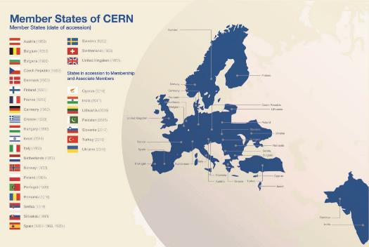

CERN
An International Governmental Organisation
Composed of Member and Associate Member States
With its:
  Own treaty
  Own bodies
  Own legal personality

Slide 5
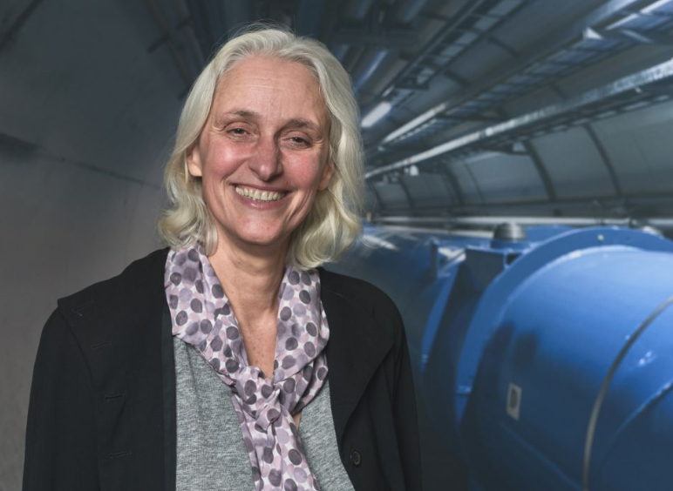
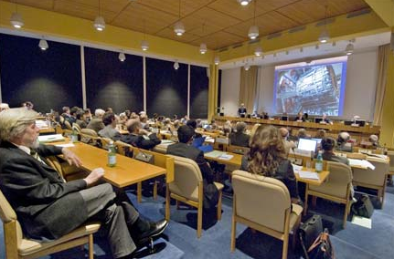
CERN’s Council
Composition: each Member State has two official delegates.
Council determines the Organization's policy in scientific, technical and administrative matters and approves the programme of activities.
Appoints the DG who in turn reports to Council.
Council President: Ursula Bassler.
https://council.web.cern.ch/en

Slide 6
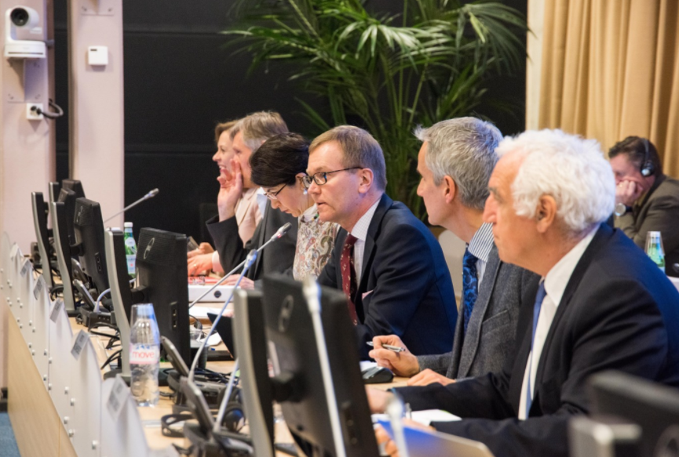
CERN’s Subordinate
bodies
  Finance Committee (FC)
    Advises Council on financial matters pertaining to the Organization’s functioning.
  Scientific Policy Committee (SPC)
    advise Council on scientific matters related to the Organization.
  Tripartite Employment Conditions Forum (TREF)
    studies aspects of CERN remuneration and employment conditions.
  Pension Fund Governing Board (PFGB)
    Advises Council on Pension Fund matters.
  Audit Committee (AC)
https://council.web.cern.ch/en

Slide 7
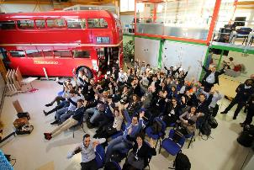
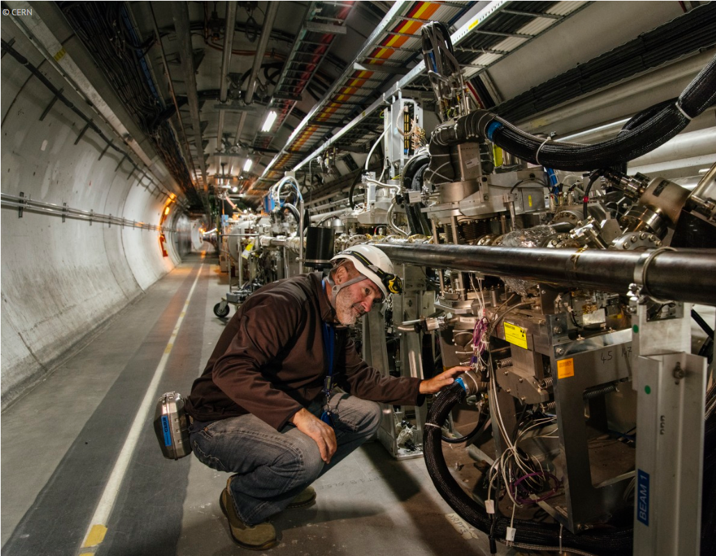

CERN’s People
Employed
(MPE)
Staff members
Fellows
Associated
(MPA)
Associates for the purpose of:
International collaboration (MPAc)
Users and other associates
Personnel
Training (MPAt)
-Students
-Trainees
- Apprentices
Exchange of scientists (MPAx)
e.g. Scientific/Corresponding Associates

Slide 8
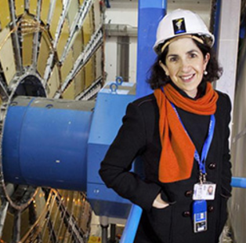
CERN’s Structure
  The DG is appointed by Council & acts as CEO and legal representative of the Organization (appointed for 5 years)
DEPTS
Director General
HSE
BE
TE
Finance and Human Resources
EP
EN
FAP
HR
SMB
IT
IPT
TH
Research and Computing
International Relations
DG Units
Accelerators and Technology
SECTIONS
GROUPS
EXPERIMENTS
TEAMS
SECTORS

Slide 9
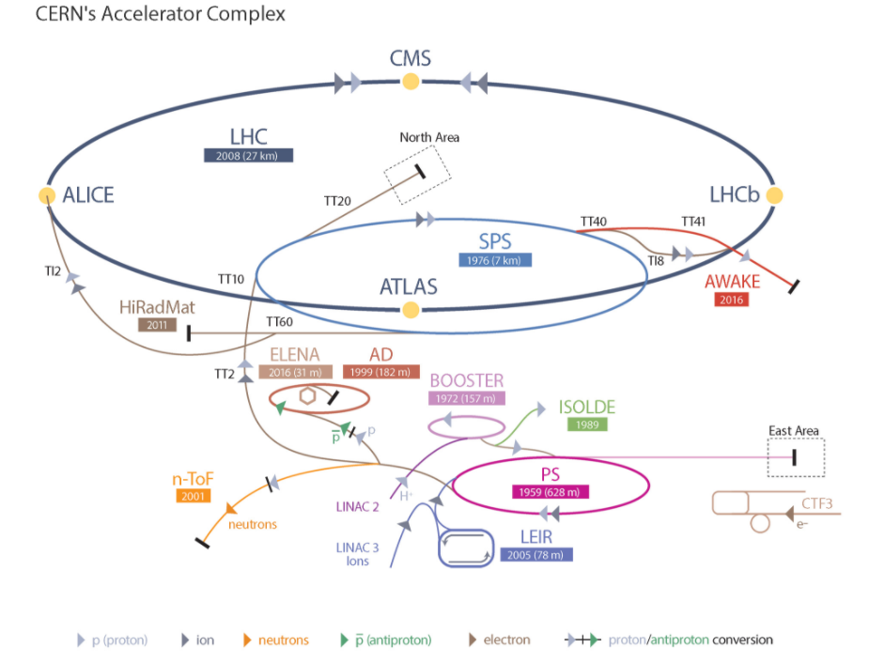






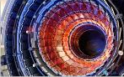
What is a Team ?
Affiliated to
One
Deputy
Deputy
TEAM
Deputy
Team Members
Participate to
One

Slide 10
CERN’s legal framework
Convention
Rules /
Statut
Regulations /
Règlement
And…..
Admin. Circulars /
circulaires administratives
Operation. Circulars /
circulaires operationnelles
Applicable to MoP
Applicable to ALL people on CERN site

Slide 11
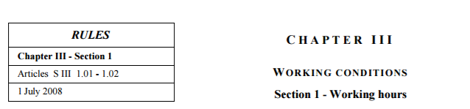
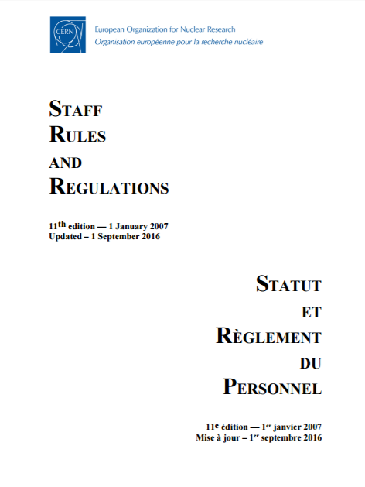
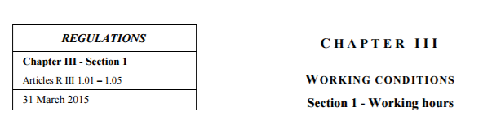

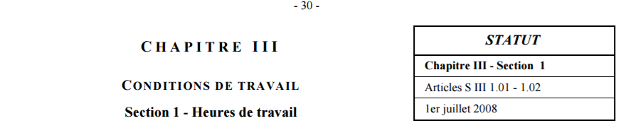
Staff Rules and Regulations

Slide 12
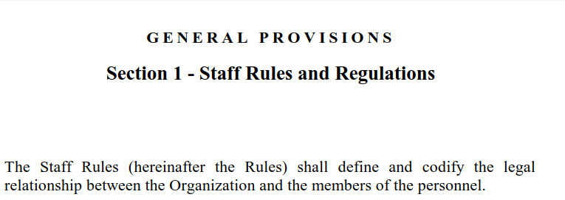
Staff Rules and Regulations

Slide 13
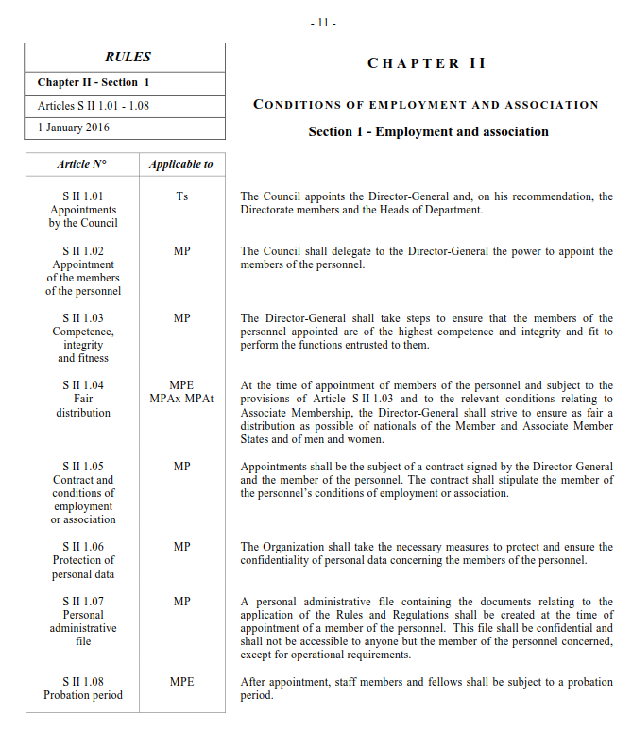
Staff Rules and Regulations

Slide 14
Staff Rules and Regulations
Define and codify legal relations CERN/MoP
Adopted by Council
Specify the application of the rules
Adopted by FC
Management proposal
Discussion process with Staff Association

Slide 15
Administrative and Operational circulars
Specify the application of Staff Regulations
Adopted by the DG
Do not arise from SRR
Internal operations of the Organization
Adopted by the DG
Discussion process with Staff Association

Slide 16
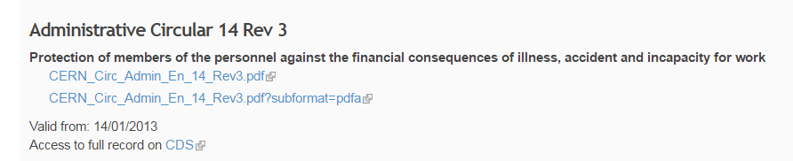
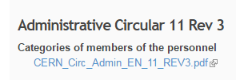
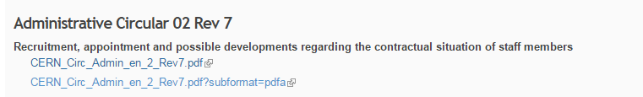

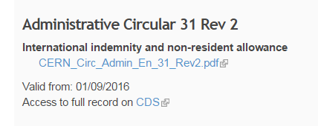
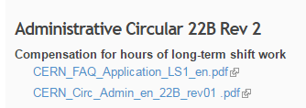
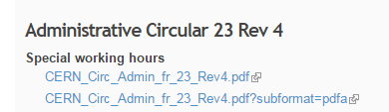
Administrative circulars
https://hr.web.cern.ch/documents

Slide 17
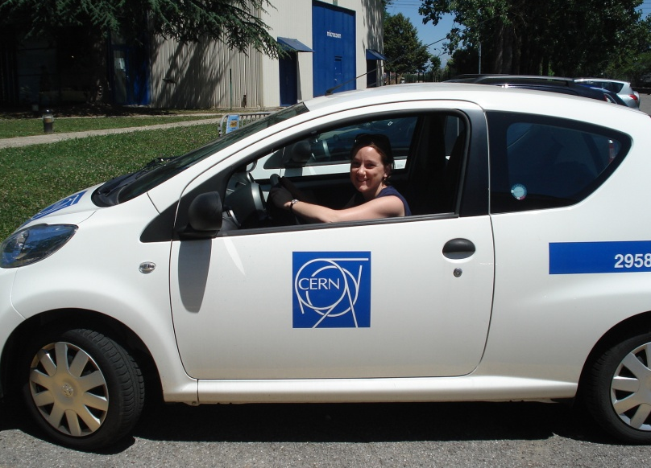
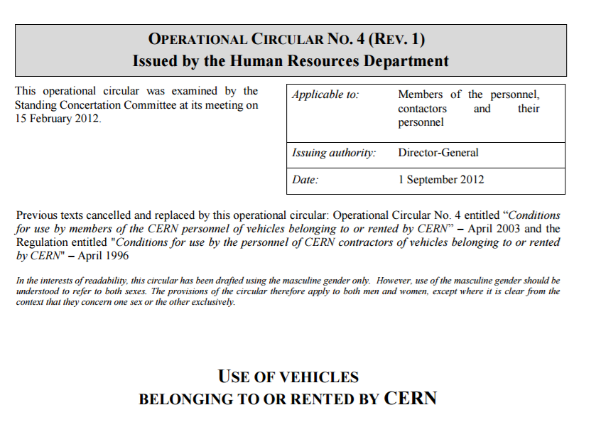
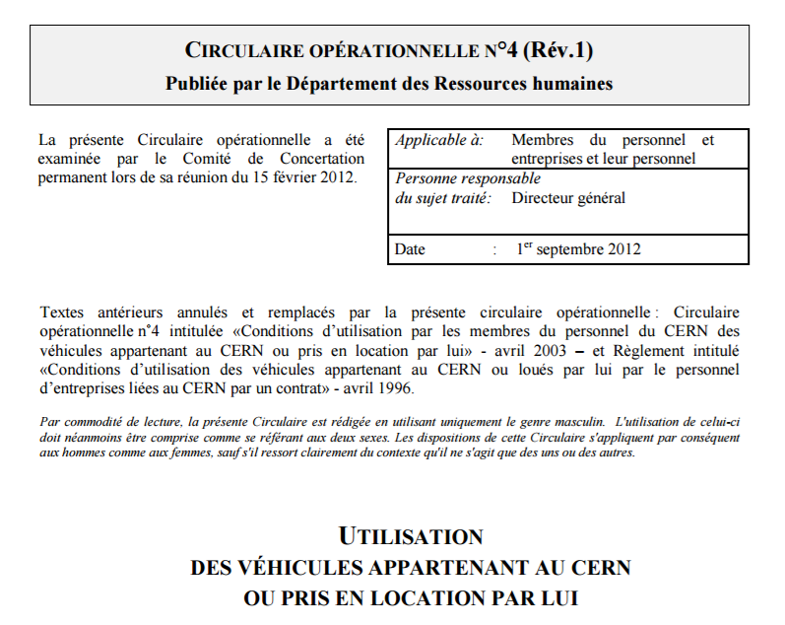
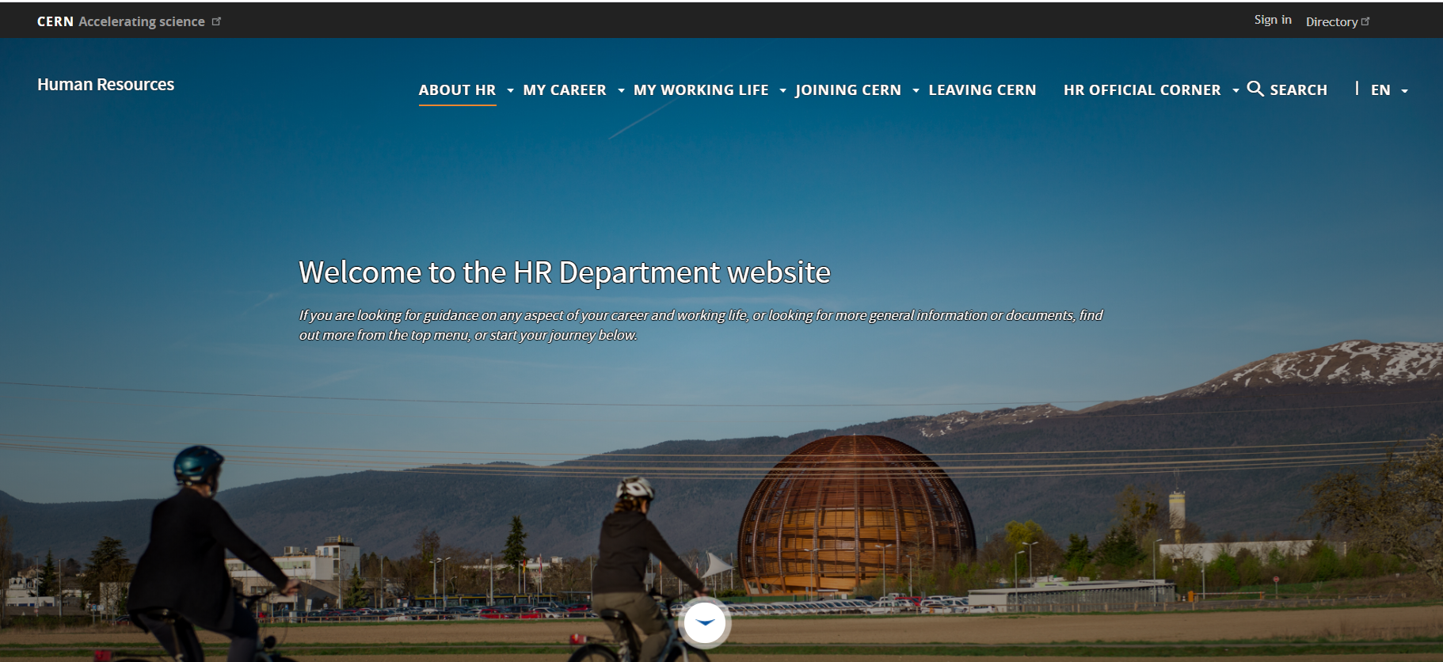
Operational circulars
cern.ch/hr

Slide 18
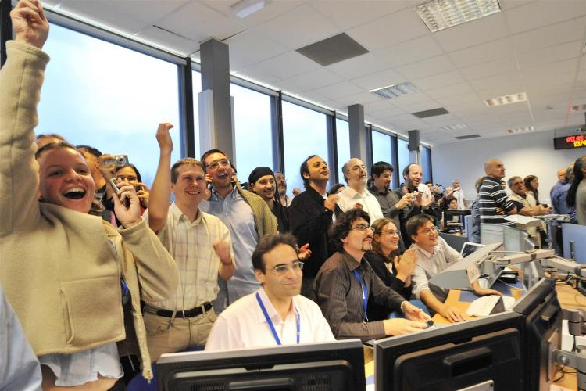
CERN people in numbers

Slide 19
Personnel evolution

Slide 20
Members of Personnel
Total MP : 17,663

Slide 21
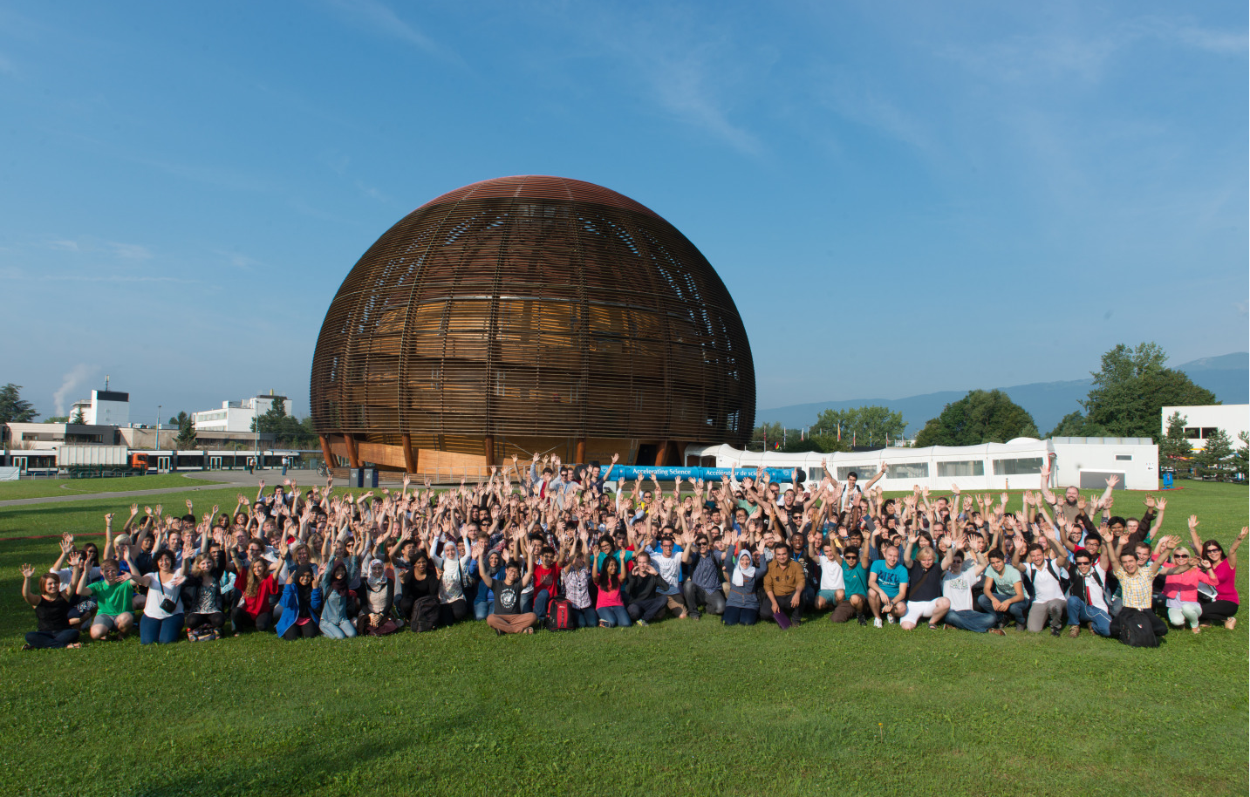
MPA for training
As at 31.12.2019 (except SUMM)

Slide 22
Staff by professional category

Slide 23
Gender

Slide 24
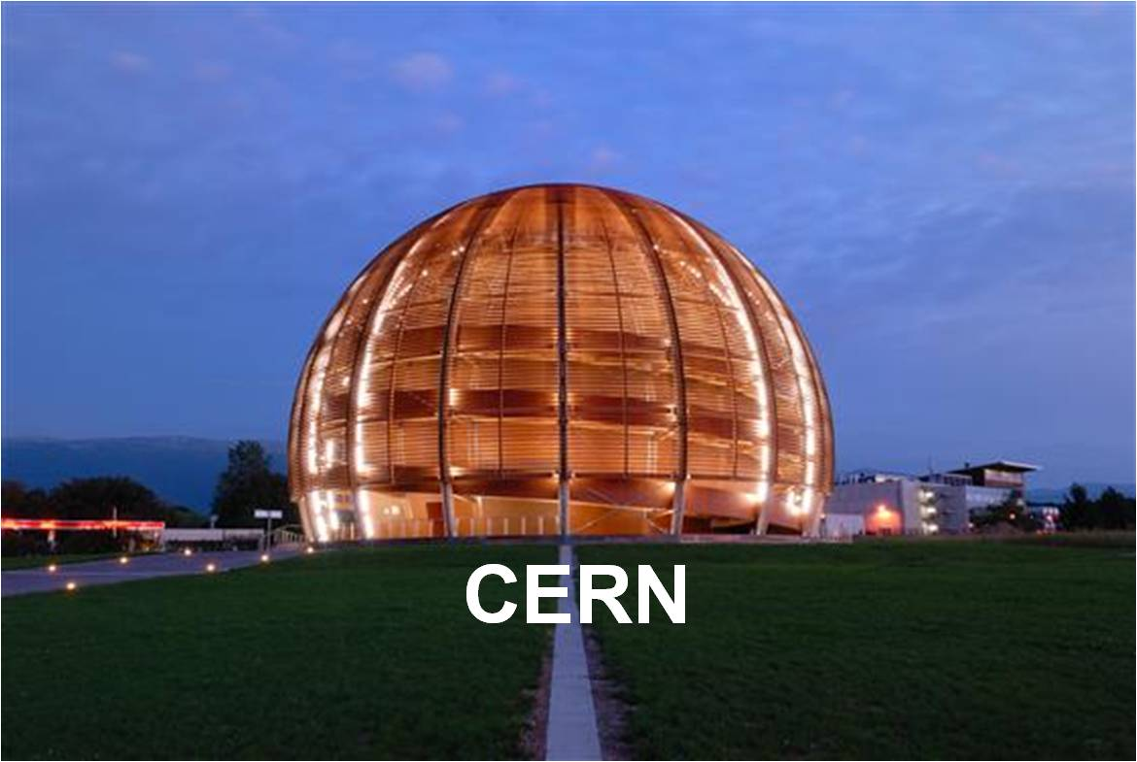
Joining CERN
Privileges and Immunities
Privilèges et immunités
International Civil Servant
Fonctionnaire International
Rights and Obligations
Droits et obligations

Slide 25
Privileges and immunities
The purpose is not to benefit individuals but to ensure the efficient performance of their functions.
Le but est non pas d’avantager des individus mais d’assurer l’accomplissement efficace de leurs fonctions.
Immunity from jurisdiction in the course of duties
Immunité de juridiction dans l’exercice des fonctions
Exempt from national income tax
Exempté de la taxation nationale
SRR, Chapter 1, Section 4, Privileges and Immunities
Notes:
Immunity from jurisdiction in the course of duties applies to individuals and means that the authorities of the Host States, in particular the police and the justice system, are not competent for CERN employees acting in the course of their duties. This protection is meant to allow the employee to perform his/her functions without impediment, for the benefit of the Organization. It is by no means to protect the personal interests of the employee.
This means, for instance, that employees cannot be arrested for acts performed in the course of their duties (in the interest of the Organization), that their statements and writings cannot be seized or be the subject of legal proceedings and that they cannot be summoned by the justice, either as a witness or as a party.
There are a few caveats to this though:
-the performance of duties is narrowly construed and there is a strict scrutiny performed by the Legal Service every time such matter is considered.
-in general, road traffic regulations violations are not considered to be covered, even if, for instance, someone went above speed limits between Prévessin and Meyrin in order not to be late at a meeting or to deliver urgent news. We have a lot of requests to ascertain immunities in order to not pay fines and, to my knowledge, we have always denied them. We would accept such request only in very exceptional and well justified cases.
-the DG can (and has - always with advice from the Legal Service) waive such immunities, provided it is in the interest of the Organization and it is in the interest of the delivery of justice. For instance, this can happen if a tribunal requests that a member of personnel testifies as a witness during a trial

Slide 26
Rights & Obligations
Rights
Remuneration
Leave
Social Protection
Droits
Rémunération
Congés
Protection sociale
Obligations
Performance
Pay contributions
Tact, Reserve
Independence, Loyalty
Obligations
Performance
Payer les cotisations
Tact, réserve
Indépendance, loyauté
Appeal (internal > ILOAT)
Recours (interne > TAOIT)
Disciplinary action
Sanctions disciplinaires

Slide 27
CERN Values
INTEGRITY
Behaving ethically, with intellectual honesty and being accountable for one’s own actions
COMMITMENT
Demonstrating a high level of motivation and engagement to the Organization
PROFESSIONALISM
Producing a high level of results within resource and time constraints and fostering mutual understanding
CREATIVITY
Being at the forefront of one’s professional field, furthering innovation and organizational development
DIVERSITY
Appreciating differences, fostering equality, and promoting collaboration
EXCELLENCE

Slide 28
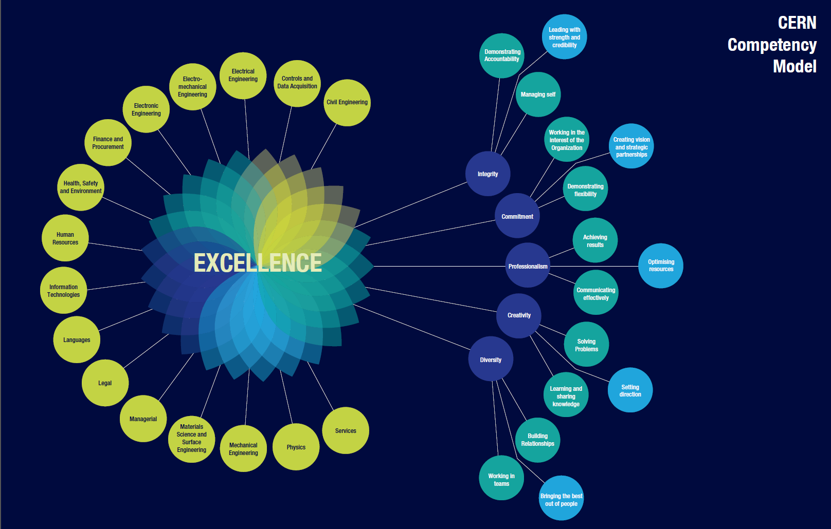
CERN Competency model

Slide 29

Code of Conduct

Slide 30
Conduct
SRR, Chapter 1, Section 3: Conduct
“Members of the personnel shall conduct themselves with due regard to the interests and proper functioning of the Organization.
Members of the personnel shall refrain from any act or activity:
a) which is incompatible with their functions, or
b) which would be morally or materially prejudicial to the Organization.
Members of the personnel shall exercise at all times the reserve and tact incumbent upon them by virtue of their international status…”

Slide 31

Code of Conduct
What does it address and to whom does it apply?
Common standards of professional behaviour based on CERN
values (vs. Code of Ethics)
Guide in helping us, as CERN contributors, to understand how to conduct ourselves, treat others and expect to be treated.
Applicable to all CERN contributors, i.e. not only staff members but also the user community, subcontractors, consultants...
What form does it have in practice?
Short (4 pages) and intentionally so, organized around the five CERN values
Extensive FAQ list available to increase understanding of how the Code applies to practical situations
It’s all about respect

Slide 32
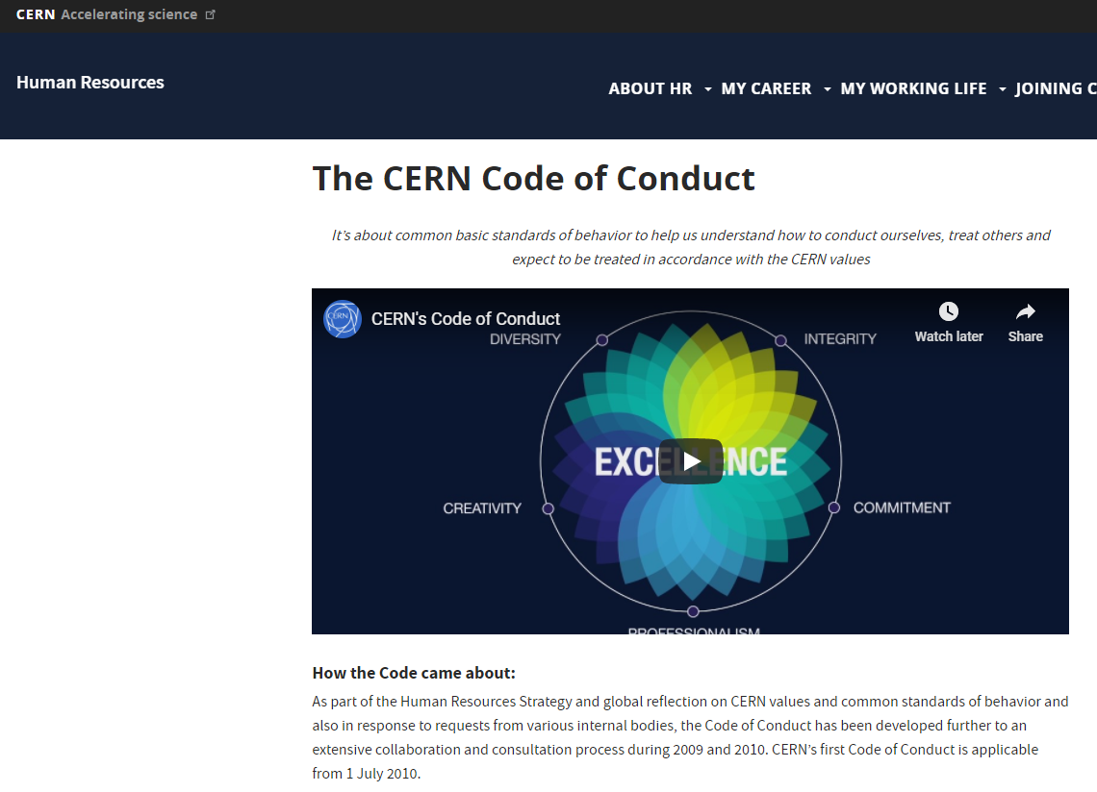
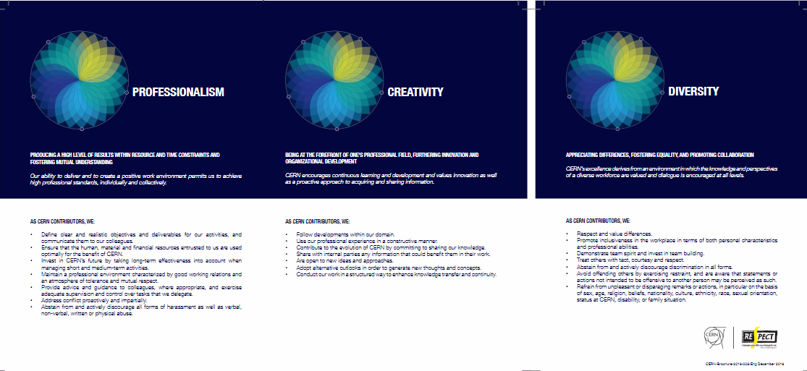
Code of Conduct
cern.ch/codeofconduct

Slide 33

Respect @ CERN
CERN’s values:
Integrity, commitment, professionalism, creativity and diversity.
Taken together, these values form the basis of respect for others, for the Organization and for its mission.
Watch the series of short videos, to showcase situations covering CERN’s five values: https://cern.ch/hr/cern-values
It’s an invitation for us all to reflect on the way our behaviour can impact our working environment and to think about how we can contribute to creating a respectful and inclusive working environment.

Slide 34


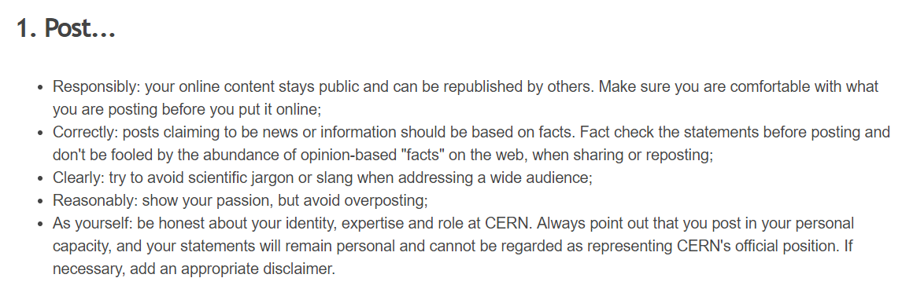


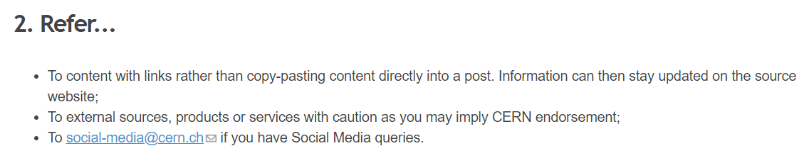
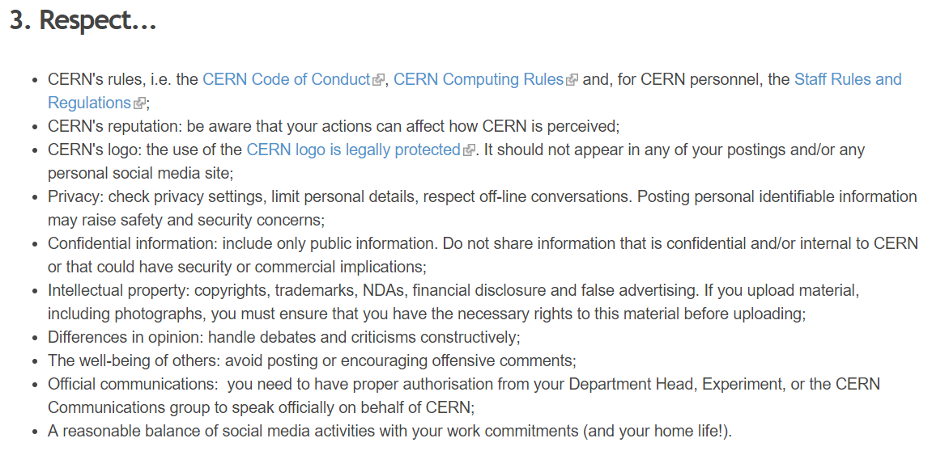
Social media guidelines
https://admin-eguide.web.cern.ch/en/procedure/social-media-guidelines

Slide 35
Integrity
VALUE INTERNAL POLICY
Conflict of Interest Policy:
Private interests ≠ CERN’s interests
    Recognise situations and avoid (e.g. gifts)
    If unavoidable, disclose
    In case of doubt, discuss with hierarchy
Anti-Fraud Policy:
Fraud = any act or omission to deceive others, or to achieve a gain resulting in a loss of funds or reputation for CERN
Zero tolerance approach
Investigation procedures, led by Internal Audit
- Report in good faith suspicions of fraud
https://cds.cern.ch/record/2007473

Slide 36
Key contacts in the event of questions
Your department secretariat (DAO)
And…
Users: the Users Office
Staff: Your Human Resources Adviser
Fellows and Students: Your programme coordinator

Slide 37
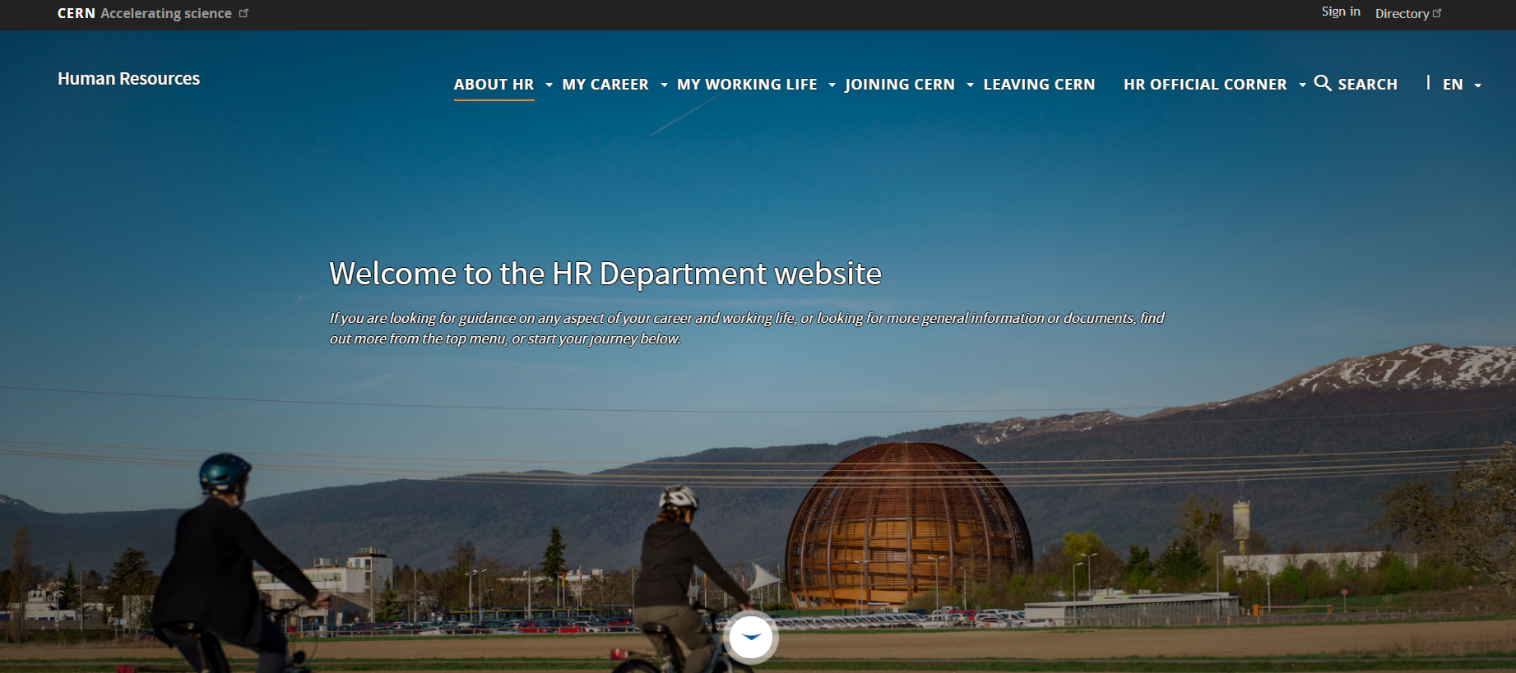
http://cern.ch/hr webpages
Joining CERN

Slide 38

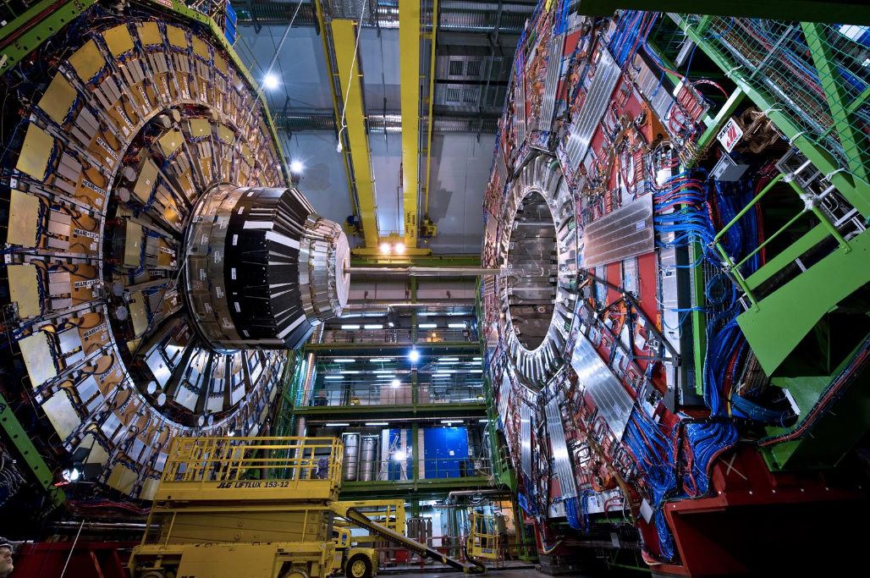

What CERN people say…
Excellent level of job satisfaction
Passionate personnel
Interesting & creative work which allows personal development
Pride to take part in fundamental research in particle
physics
Very pleasant “international campus” environment
(except buildings!)
Highly qualified colleagues
Variety of skills and professions
Effectiveness of continuous learning
Enriching international, multicultural place to work

Slide 39
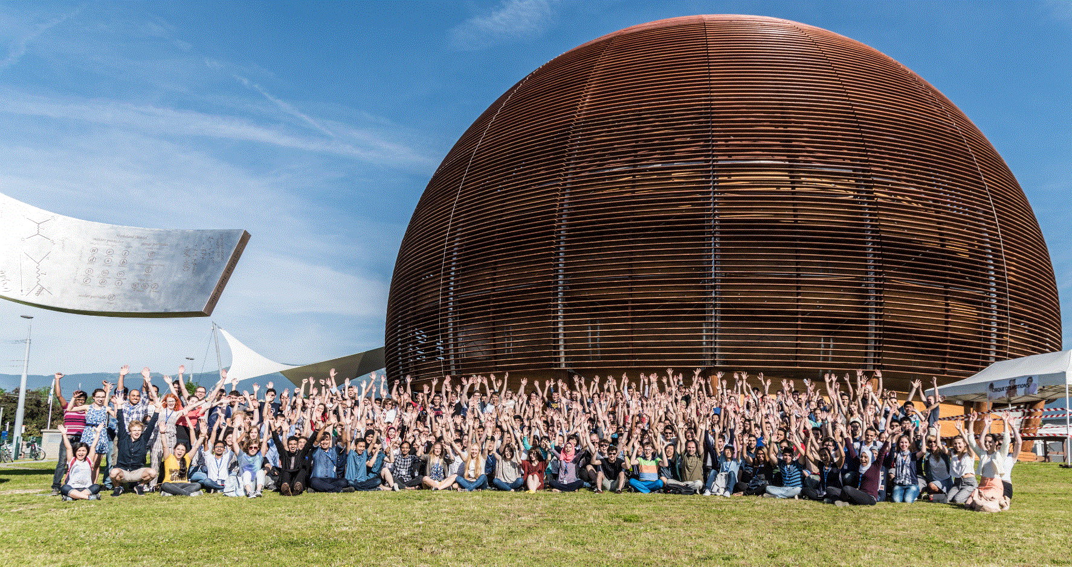
WE HOPE YOU WILL ENJOY YOUR TIME AT CERN!

