Slide 1



Darkside Masterclass
D.De Gruttola*, F. Carnesecchi, F. Coccetti, M. Garbini, D. Hatzifotadou, R. Nania, C. Pellegrino
*University and INFN of Salerno, Italy
Organized in classes also remotely connected between different countries
Lessons about the physics case and the experiment
Data analysis via Excel (and root)
Discussion of the results together with a small competition
Get a feeling of the physics case behind and of the Darkside experiment solution, making the students face also the (simplified) analysis steps that lead to the final results
Masterclass developed and realized by Centro Fermi
IPPOG Steering group meeting CERN15 October 2020

Slide 2
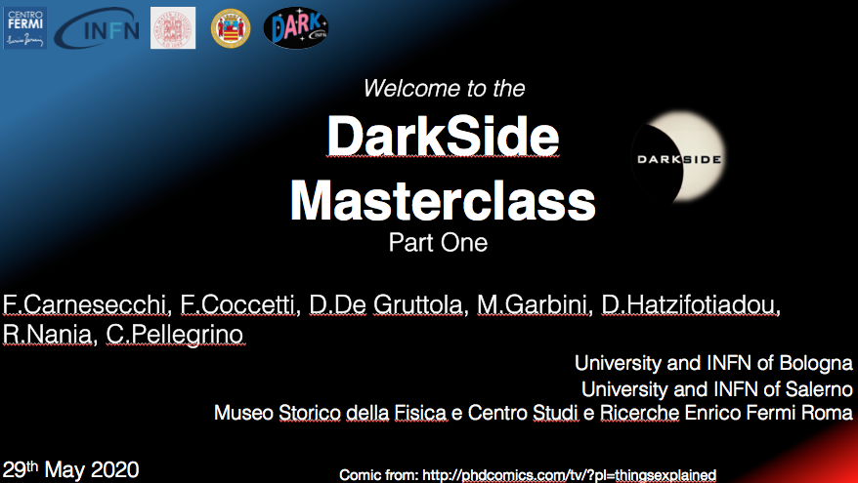
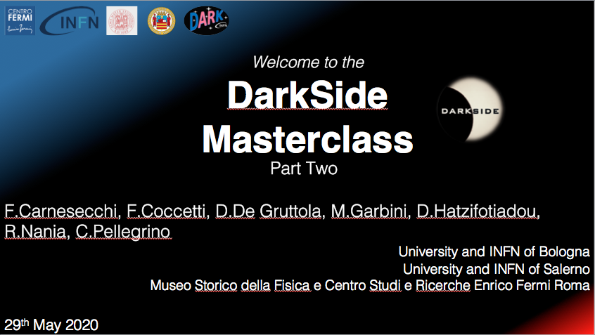
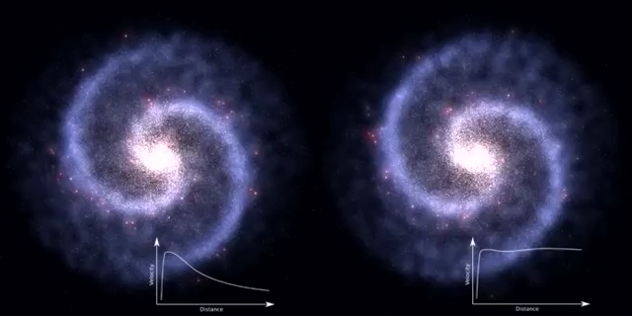
Darkside Masterclass
Duration of lectures → 30 min each
Part One → Lecture on Dark Matter
Part Two → Lecture on DarkSide experiment
Darkside-20k promotional video:
Students are asked to watch it
before the Masterclass event
http://darkside.lngs.infn.it/outreach/promotional-video-2/

Slide 3
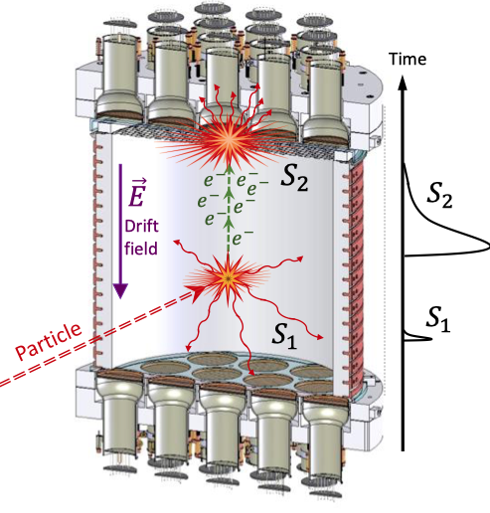
Darkside Masterclass
Lessons about the physics case and Darkside experiment: talks + event displays
Physic: what is Dark Matter
Gravitational effect not explained by visible matter
One explanation: the existence of an as-yet-undiscovered elementary Weakly Interacting Massive Particle (WIMP)
Darkside experiment: how to detect WIMP
WIMP-nucleus elastic collisions revealed by a detector capable of unambiguously identifying a small number of nuclear recoils
Dual phase (gas + liquid) Argon TPC for direct detection of WIMPs

Slide 4

Darkside Masterclass
Lessons about the physics case and Darkside experiment: talks + event displays
To let the students understand the working principle of the TPC and how to recognize a WIMP:
LAr-TPC – WIMP, S1 and S2 signals
NR/ER – S1 and charge in PMTs
Veto
Fiducial Volume

Slide 5
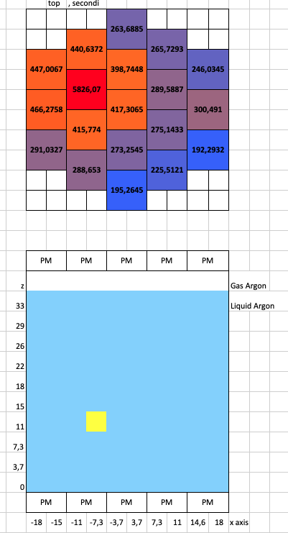
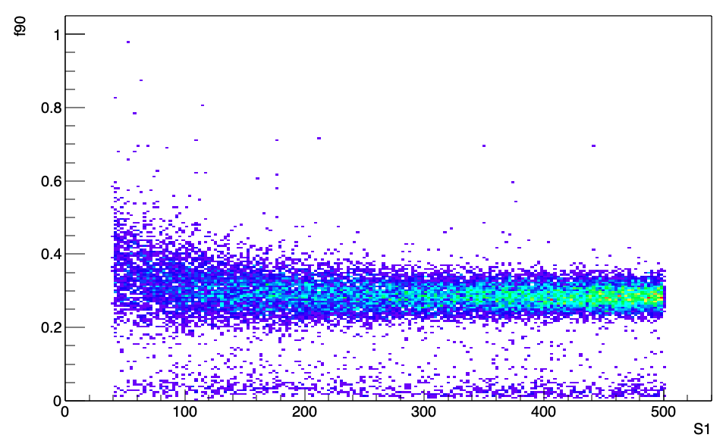
Darkside Masterclass
Data analysis via Excel, groups of 2-4 students working together on:
Reconstruction position part (few events): to exclude background signals
Analysis of events (~20000) of background and few “good” WIMPs. Plot of f₉₀ vs S1 and then apply some cuts: to select WIMPs signals
f₉₀
f₉₀ = fraction of S1 light detected in the first 90 ns of a signal
S1(pe)
Discussion of the results:
Small competition on searching for the simulated WIMPs signal (added on purpose)
Report on the results, provided by students

Slide 6
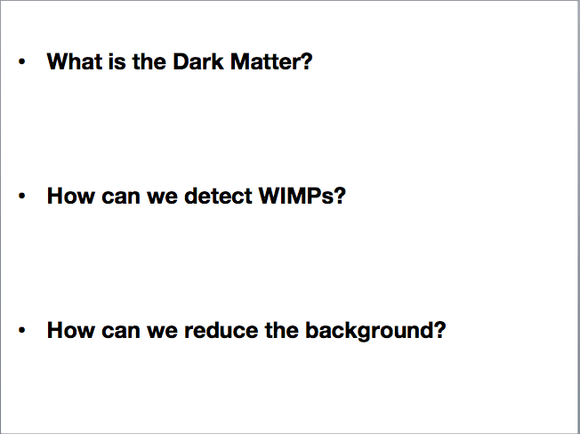
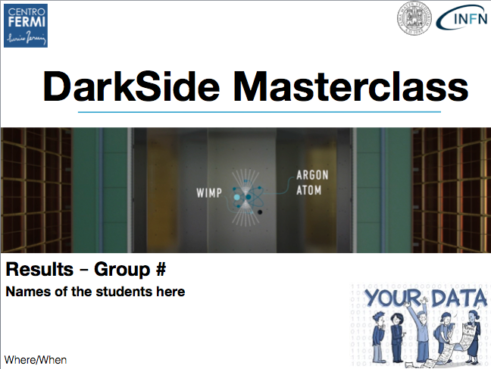

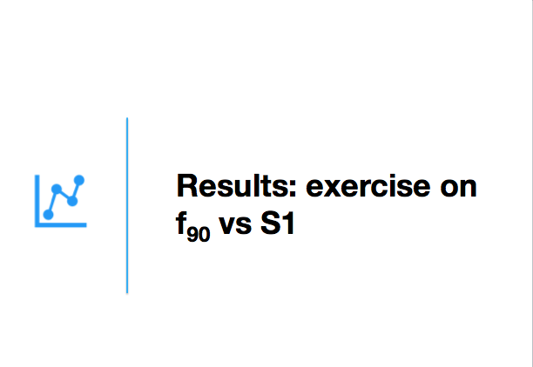
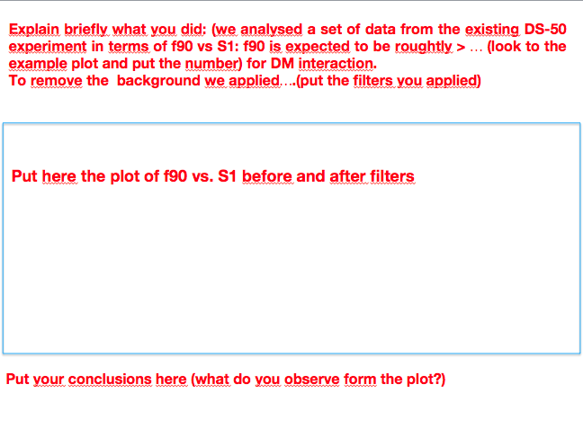
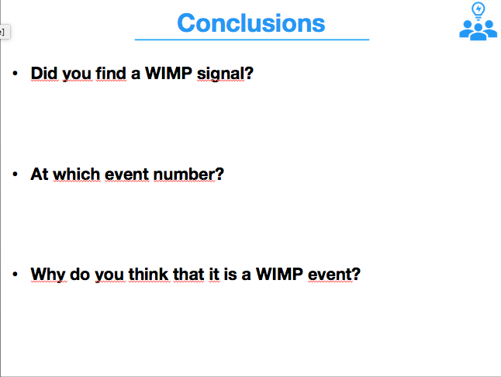
Darkside Masterclass
Discussion of the results
Skeleton for student results

Slide 7
Darkside Masterclass
In 2020 four events took place in several occasions in Italy:
• a test Masterclass in presence, in Liceo Quadri in Vicenza (one of the 100 schools of the EEE Project);
• a reduced version of the Masterclass during the event “Women in Science” in Cagliari;
• the first official DS Masterclass (inside the INFN Outreach group DARK), that was organized in remote mode due to the covid-19 lockdown; it involved four EEE schools;
• a Masterclass addressed to grad students, with a slightly more complex level, involving students of University of Napoli (remote masterclass);
The four listed events were successful and we received an encouraging feedback by the involved students (via a survey)

Slide 8



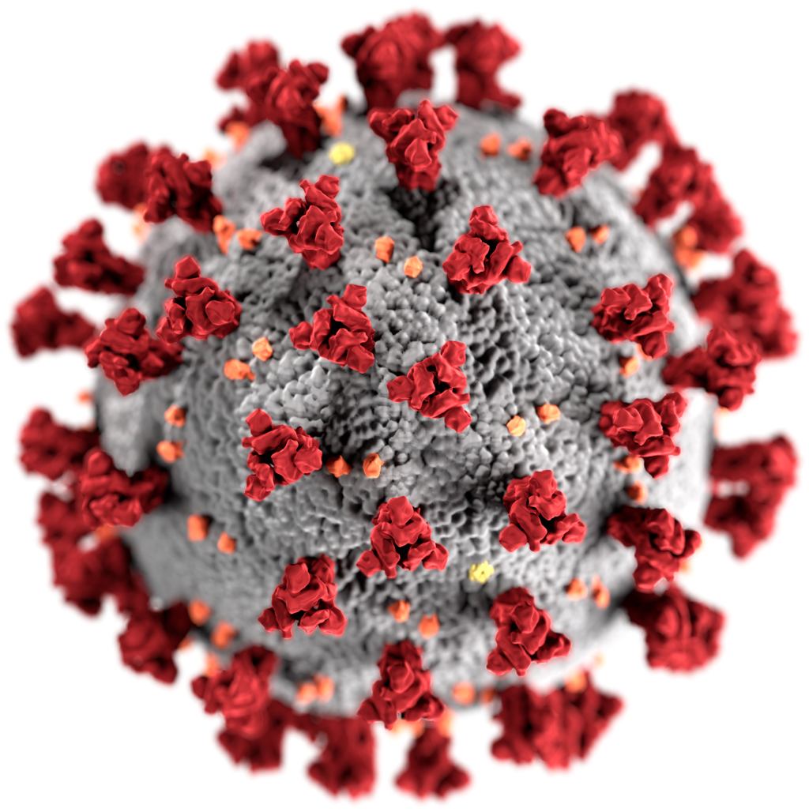
Darkside Masterclass
DS Masterclass is well tested and several events took place
Masterclass tools are official and available to all DarkSide members
It is now part of DARK project
30 Oct 2020 event is a DARK MATTER DAY event
Around 250 students (30 schools) in the participant list of the next event
We are glad to be part of IPPOG events
Looking forward to organizing a face to face event!
DARK
Poster of the next event (30 Oct 2020)

Slide 9
Darkside Masterclass
Back up

Slide 10
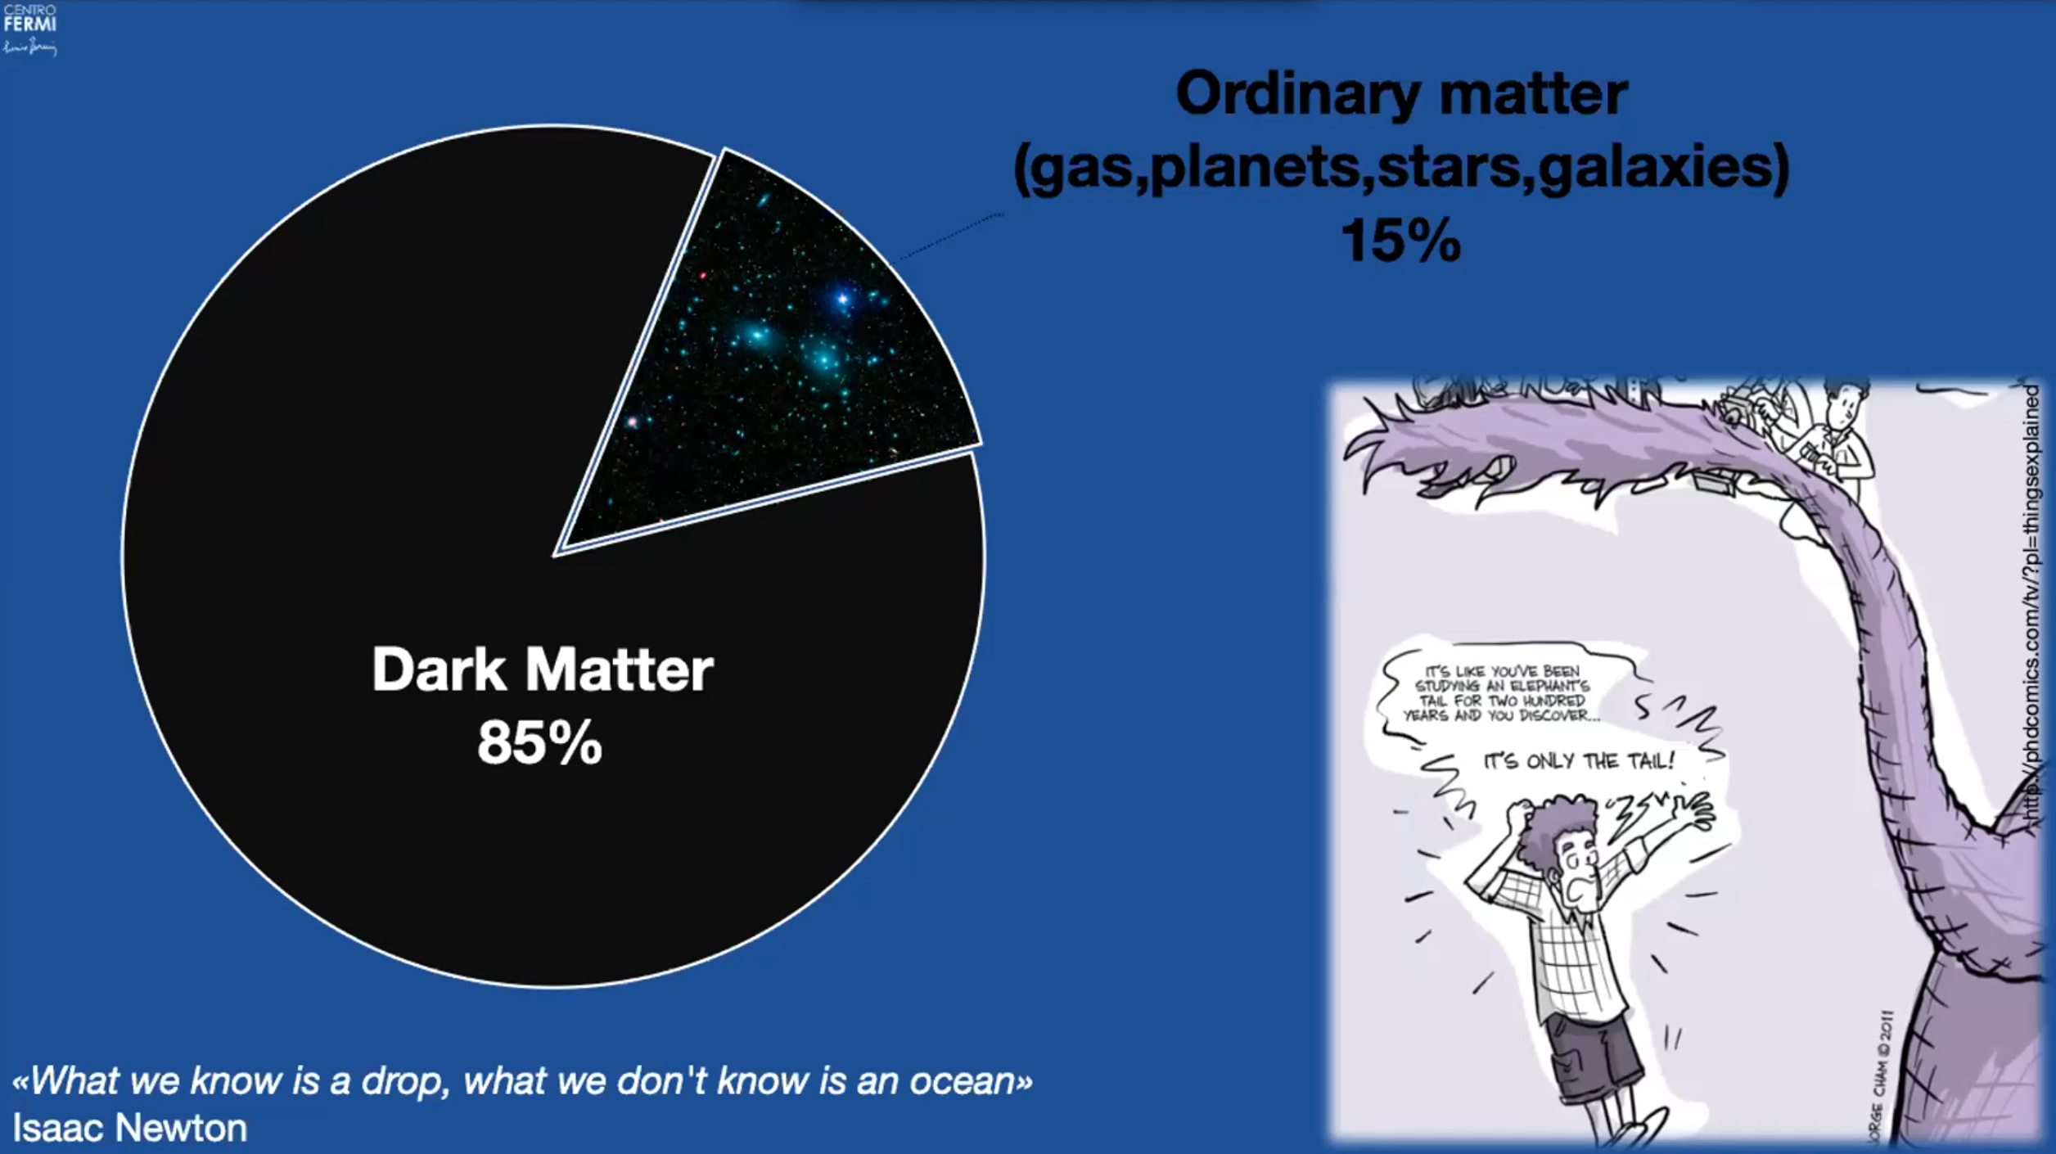
Notes:
Actually, all this represents just the 15% of all the matter in the Universe.
Moreover, in this 15% about 13.5% is made of intergalactic gas

Slide 11
Galaxy without dark matter
Galaxy with the presence of dark matter
Notes:
A galaxy like the Milky way. Focus the attention before on the bulk of the galaxy (about the same behaviour) and on the edge—> much faster for stars in the right one
On the right, what we observe→ can be explained with the hypothesis of a DM halo

Slide 12
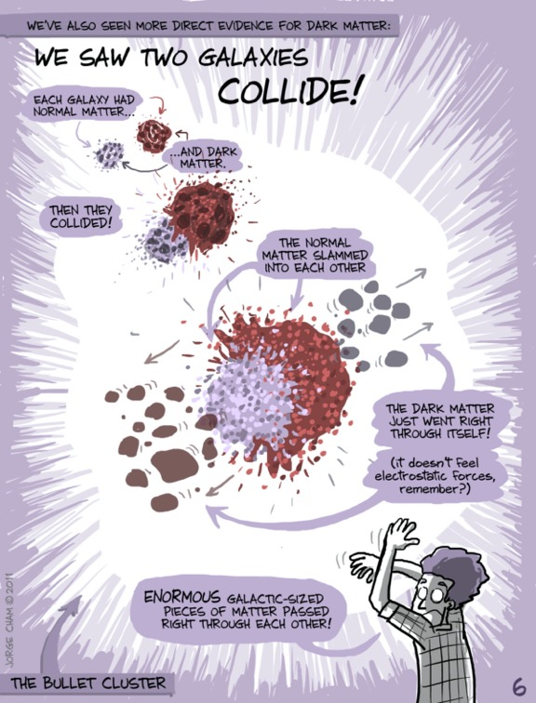
http://phdcomics.com/tv/?pl=thingsexplained
http://phdcomics.com/tv/?pl=thingsexplained
Notes:
Bullet cluster: 2 galaxy cluster that collided recently (in the galactic scale, ~ 100 millions years ago)
Red: ordinary matter (intergalactic gas)→ heated and slowed→ observed by X-Ray
Blu: DM (observed with gravitational lensing, a slide in the back up if needed)
Before collision: in the galaxy, the ordinary matter (visible) and the DM are in the same place
After collision : they are not coincident anymore
Moreover the ordinary matter shape is changed (shocked and slowed down) while the DM is not
Letion learned: This can be explained with DM and we also learned another characteristic of DM: it interacts weakly (both with itself and with ordinary matter)

Slide 13
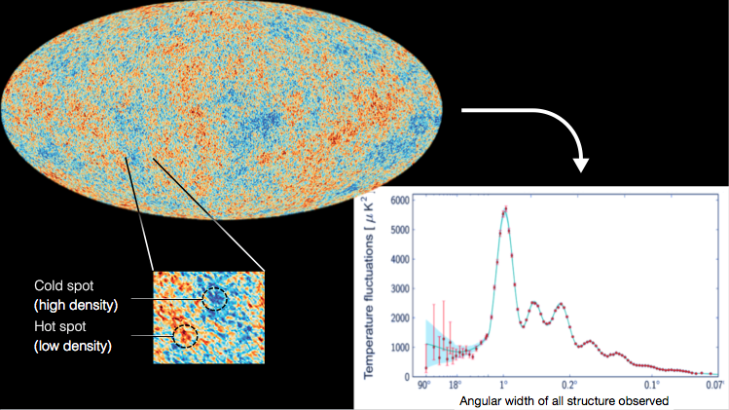
Cold spot
(high density)
Hot spot
(low density)
Notes:
CMB (explain)
Very small temperature anisotropies of a few parts in 100,000 , anyway fundamental
These observed fluctuations can be explained only with a model which considers the presence of DM. Moreover, it must exist in the proportion of 1:6 (15%: 85%)

Slide 14
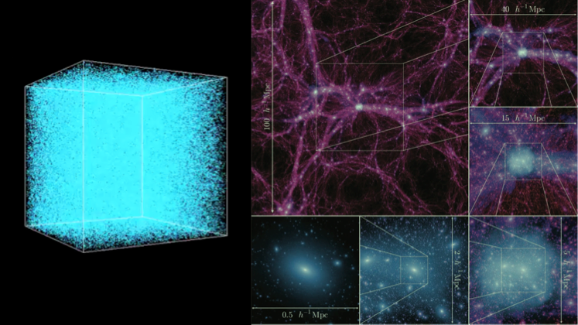
Notes:
Since the DM dominates the universe matter-> it had to lead the formation of the structure of the universe (galaxy, cluster of galaxy,…)
On the left, a simulation of the DM from the very early universe until now: at the beginning DM uniform in dots, then collapsing for gravitation, it forms these structures which are the stuff we call DM halos. At the end (image also reported in the figure) what we observe today (magnified, a galaxy)
These can be explained not only considering a DM but also with a Cold DM, which means that it should be ”slow “at the early universe, to have this bottom-up structure growing, that we observe today.

Slide 15
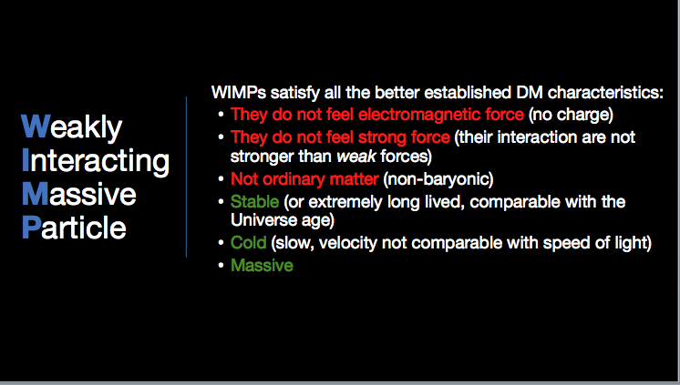
Notes:
Since the DM dominates the universe matter-> it had to lead the formation of the structure of the universe (galaxy, cluster of galaxy,…)
On the left, a simulation of the DM from the very early universe until now: at the beginning DM uniform in dots, then collapsing for gravitation, it forms these structures which are the stuff we call DM halos. At the end (image also reported in the figure) what we observe today (magnified, a galaxy)
These can be explained not only considering a DM but also with a Cold DM, which means that it should be ”slow “at the early universe, to have this bottom-up structure growing, that we observe today.

Slide 16
Going underground
All the material are as radiopure as possible
Gran Sasso Laboratory
1400 m of rock
Notes:
External background-> bring the detector deep underground
Internal background -> do not use “dirty” materials

Slide 17
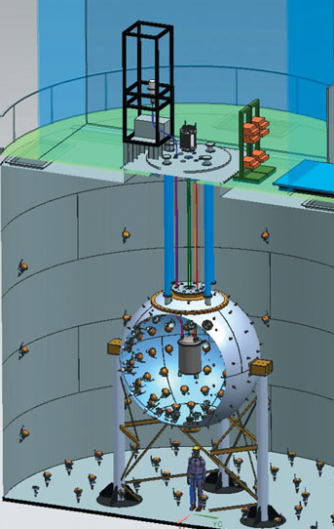
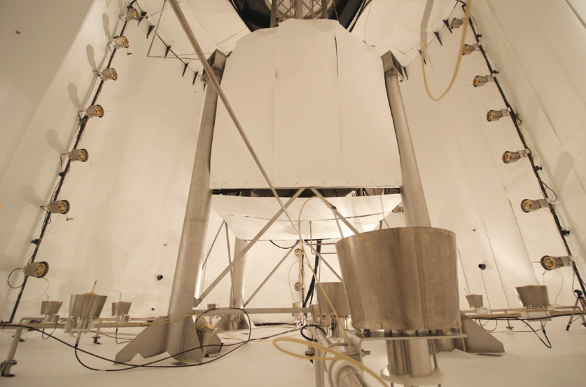
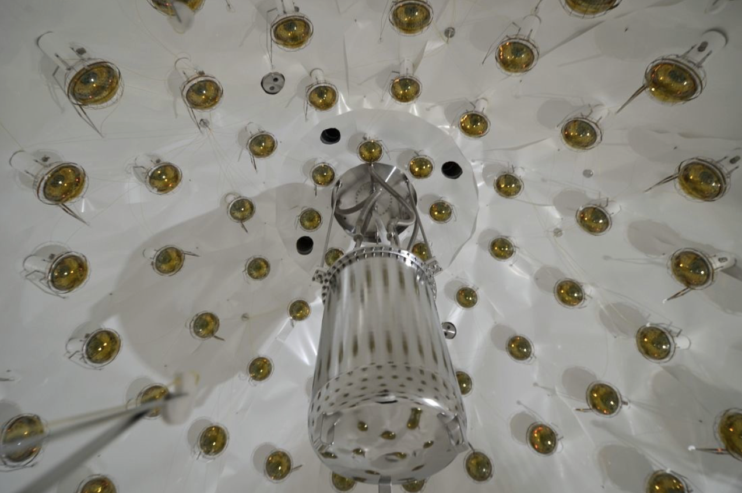
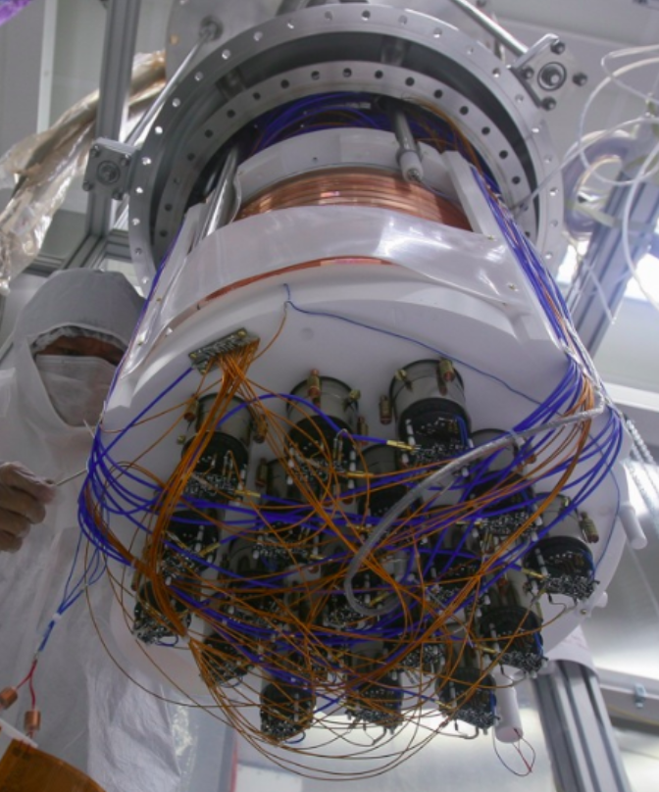
Cosmic-ray veto:
1 kton ultra pure Water Cherenkov
Neutron veto:
30 ton Borated Liquid Scintillator
Dark Matter Detector:
TPC 50 kg Liquid Argon from underground source depleted in ³⁹Ar

Slide 18
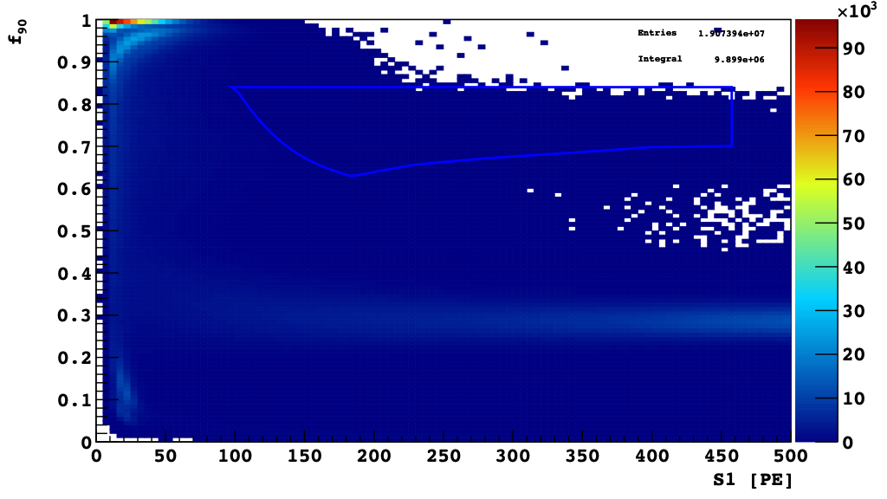
Before data cuts
WIMP region
f₉₀ = fraction of S1 light detected in the first 90 ns of a signal
= prompt light
Notes:
So we can try to use the f90 variable which is defined as…

Slide 19
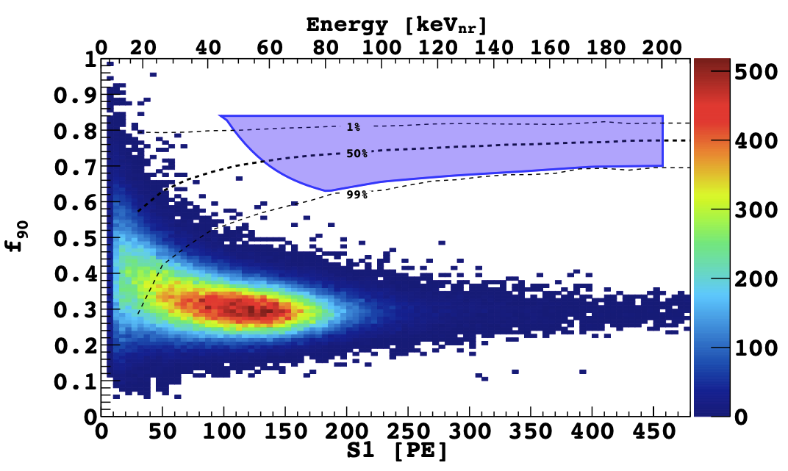
and after cuts
WIMP region
Notes:
And we can get this result
No DM candidate

