Slide 1



Industrial PhD
New applications for machine learning and transfer learning algorithms in the manufacturing industry and in particle physics.
Lorena Dieste

Slide 2

INDEX
Introduction
TMVA vs. SKlearn
The LHCb Analysis
Future work
2

Slide 3
Introduction

Slide 4
1. Introduction
An industrial PhD student participates in an industrial research or experimental development project directly related to his thesis, developed in a company and in a university.
Which company? → TripleAlpha
TripleAlpha is a technological firm specialized in data analysis applied to Production and Operations.
Which center? → IGFAE, LHCb experiment.
The Galician Institute of High Energy Physics is a joint research center of University of Santiago de Compostela and Xunta de Galicia.
4

Slide 5
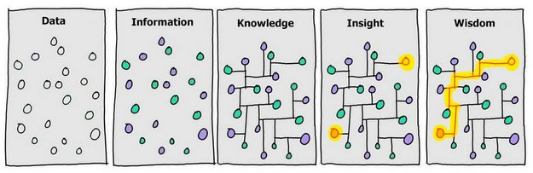

1. TripleAlpha
“We help companies to be more productive and profitable thanks to the optimization of production and logistic processes”
Merging Data Science with Manufacturing expertise

Slide 6
The title of the thesis is:
New applications for machine learning and transfer learning algorithms in the manufacturing industry and in particle physics.
The main goal is to find and use machine learning techniques that can be applied to improve the results for different fields, in the case of this study we will focus on particle physics and the manufacturing industry.

Slide 7
TMVA vs. Sklearn

Slide 8


2. TMVA vs Python
The first step is to compare the tools that are used for particle physics and find the one that gets better results:
  TMVA a ROOT (open-source data analysis framework) tool used by high energy physics and others.
  Python Machine Learning Tools as Scikit-Learn
  We will use different types of topologies representing different types of problems of High Energy Physics.
VS.
8

Slide 9
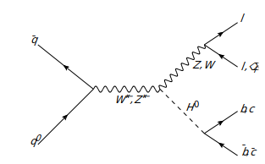
2. TMVA vs Python​
We studied three different types of topologies for this analysis:
KS0 → π⁺ π⁻ In this exercise our goal is to discriminate signal vs. Background.
Ds→ η' (→ µ⁺ µ⁻ ) + π . In this exercise our goal is to discriminate signal vs.. Background.
W+bb and tt cross sections. In this excercise our goal is to discriminate them with each other.
For now we use Monte Carlo LHCb to get the data for the analysis.

Slide 10
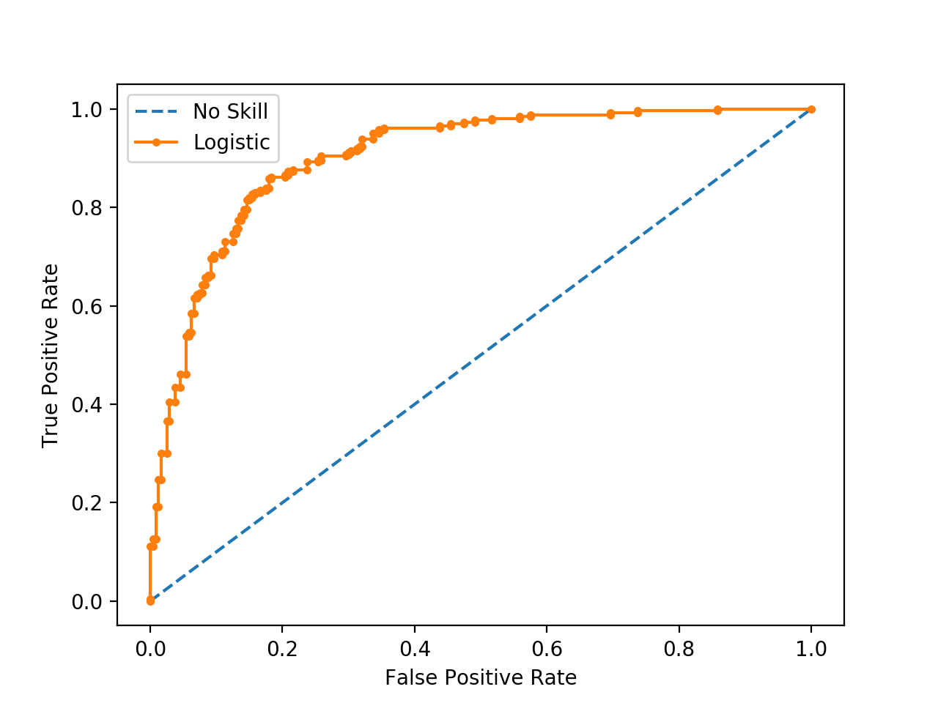
2. TMVA vs Python
To compare the quality of the results we used two figures of merit:
  The ROC curve: a plot that confronts the rate of True Positives vs. False Positives
  The correlation between the results and the mass
10

Slide 11
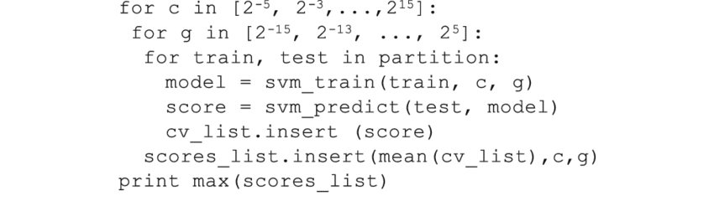
2. TMVA vs Python
To find our model we used Grid search. Grid search is used to find the optimal hyperparameters of a model which results in the most ‘accurate’ predictions.
In our case first we tried different models with different algorithms as:
BDT with AdaBoost
BDT with GradientBoosting
BDT with XGBoost
RandomForestClassifier
Neural Network
Logistic Regression.
For each one of this we run a Grid Search to find the optimal hyperparameters and after the process we selected the algorithm with the best results.
11

Slide 12
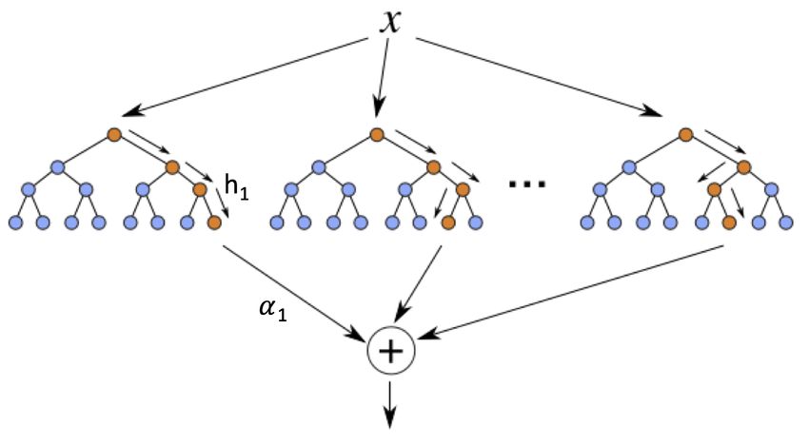
2. TMVA vs Python
The algorithm we decided to use in both platforms was BDT, using boosting AdaBoost. We also tried Gradient Boosting and XGBoost.
  BDT ( Boosted Decission Trees ) : is a machine learning technique for regression and classification problems, which produces a prediction model in the form of an ensemble of weak prediction models, typically decision trees.
Ref: Energy-Efficient Classification for Resource-Constrained Biomedical Applications - Scientific Figure on ResearchGate. Available from: https://www.researchgate.net/figure/Schematic-diagram-of-a-boosted-ensemble-of-decision-trees_fig2_325632132 [accessed 8 Oct, 2020]
12

Slide 13
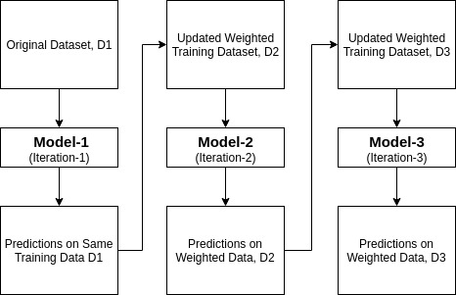
2. TMVA vs Python
Ada-boost or Adaptive Boosting is an iterative ensemble classifier, it builds a strong classifier by combining multiple poorly performing classifiers so that you will get a high accuracy strong classifier.
It assigns the higher weight to wrong classified observations.
The more accurate classifier will get high weight.
This process iterate until the complete training data fits:
  without any error
  reached to the specified maximum number of estimators.
To classify, perform a "vote" across all of the learning algorithms you built.
13
Notes:
Initially, Adaboost selects a training subset randomly.
It iteratively trains the AdaBoost machine learning model by selecting the training set based on the accurate prediction of the last training.
It assigns the higher weight to wrong classified observations so that in the next iteration these observations will get the high probability for classification.
t assigns the weight to the trained classifier in each iteration according to the accuracy of the classifier.

Slide 14
2. TMVA vs Python
KS0 → π⁺ π⁻ variables :
'd1_ip'
'd1_pt'
'd2_ip'
'd2_pt'
'doca'
'ipchi2'
'pt'
Correlation:
'mass'
14

Slide 15
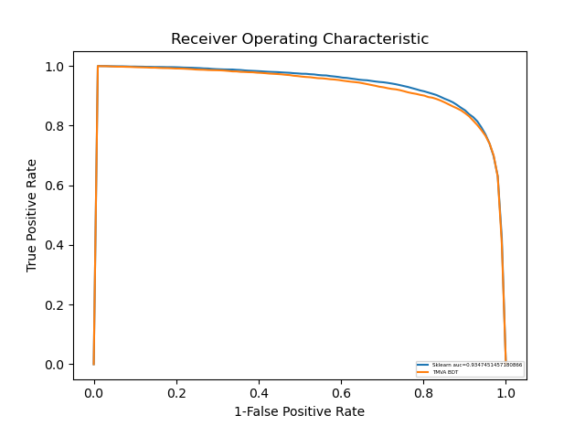
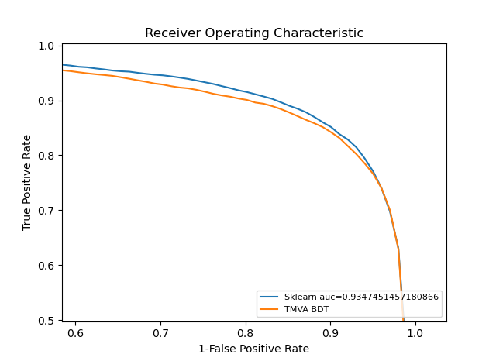
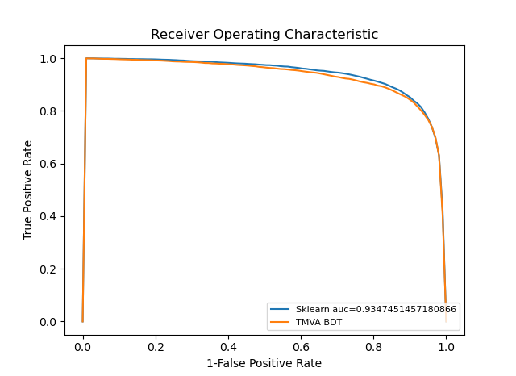
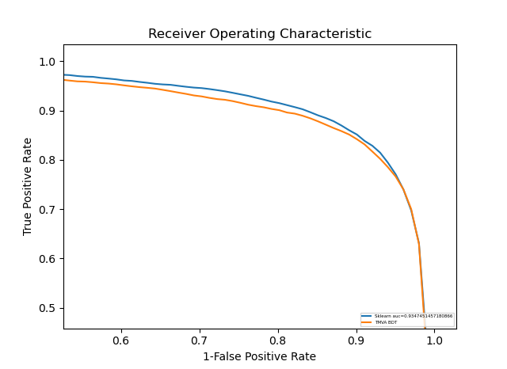
2. TMVA vs Python
KS0 → π⁺ π⁻ results ROC curve:
Zoom of the results:
The curve for sklearn is slightly better
15

Slide 16
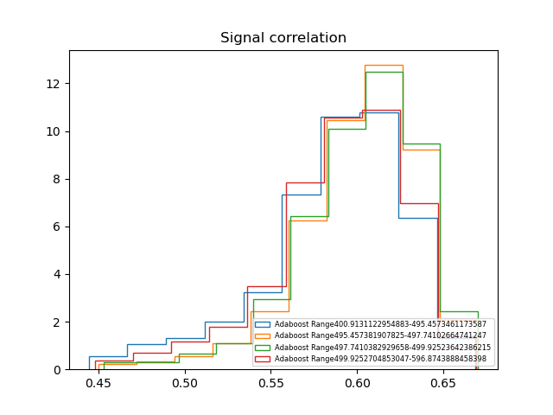
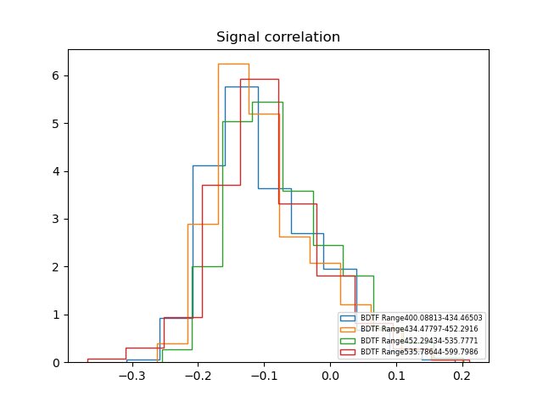
2. TMVA vs Python
KS0 → π⁺ π⁻ results for signal correlation:
We can observe that there is no correlation.
16

Slide 17
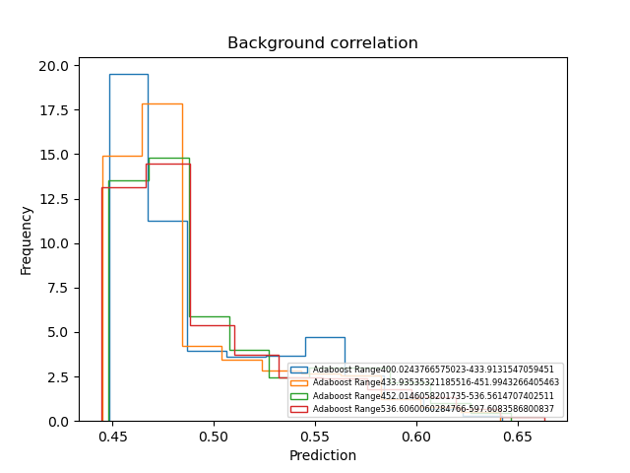
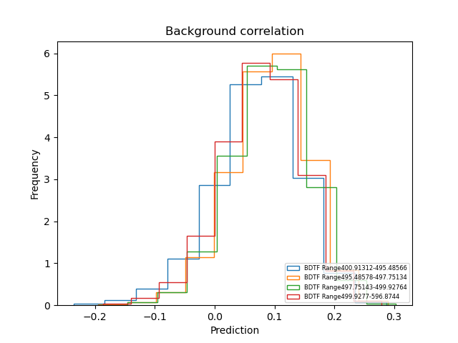
2. TMVA vs Python
KS0 → π⁺ π⁻ results for background correlation:
We can observe that there is no correlation.
17

Slide 18
2. TMVA vs Python
Ds→ η' (→ π⁺ π⁻ µ⁺ µ⁻ ) + π variables :
'etap_IPCHI2_OWNPV'
'etap_FDCHI2_OWNPV'
'etap_VCHI2PERDOF'
'etap_PT'
'Ds_IPCHI2_OWNPV'
'Ds_FDCHI2_OWNPV',
'Ds_VCHI2PERDOF'
'Ds_PT'
'pi_PT',
'pi_IPCHI2_OWNPV'
'pip_eta_PT'
'pip_eta_IPCHI2_OWNPV'
'pim_eta_PT'
'pim_eta_IPCHI2_OWNPV'
'mup_PT'
'mup_IPCHI2_OWNPV'
'mum_PT'
'mum_IPCHI2_OWNPV']​
​
Correlation:
'Ds_M'
'etap_M'
18

Slide 19
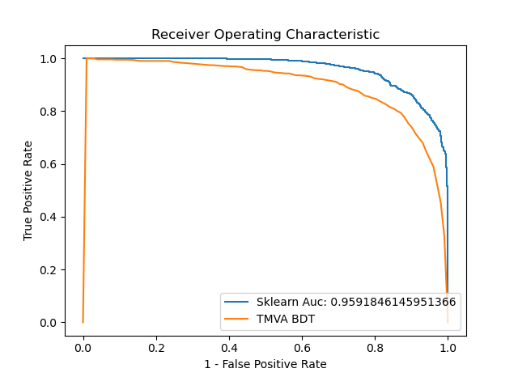
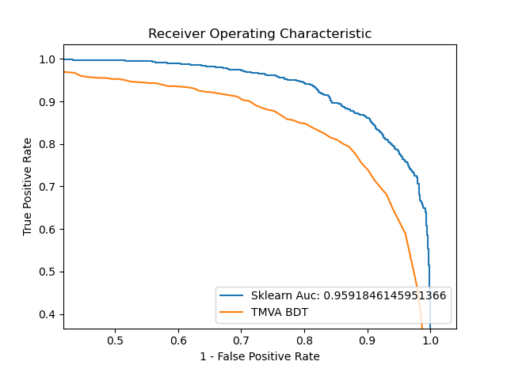
2. TMVA vs Python
In Ds→ η' (→ µ⁺ µ⁻ ) + π we used a K-fold to be able to use all the data for training, the results of the ROC curve:
Zoom of the results:​
The curves for sklearn have a visible improvement
19

Slide 20
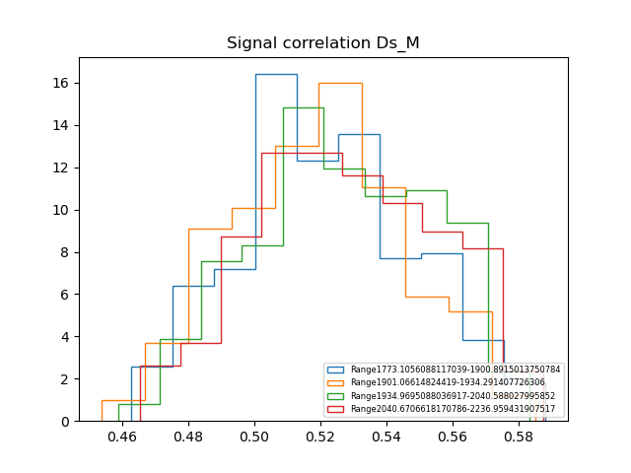
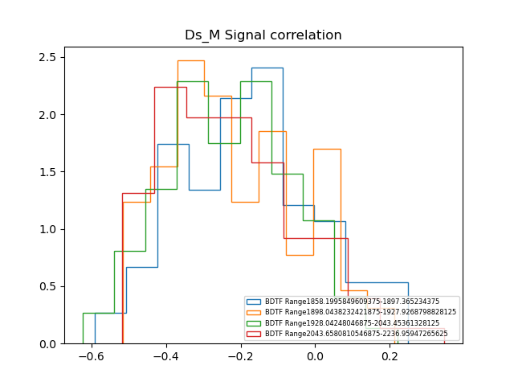
2. TMVA vs Python
Second experiment results for signal correlation:
We can observe that there is no correlation.

Slide 21
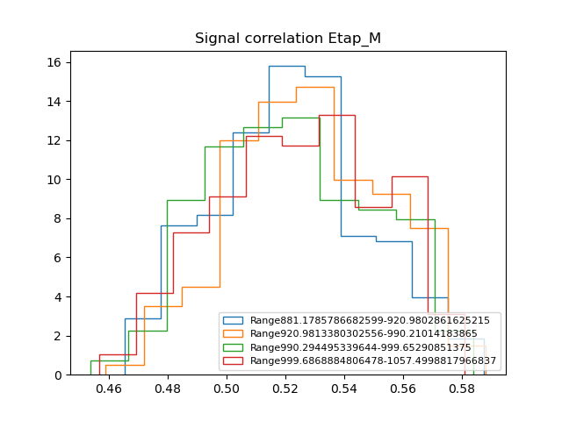
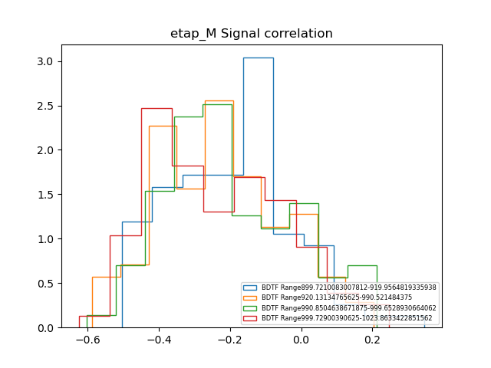
2. TMVA vs Python
In this example the particle decays from one corps to another and we have two masses, Ds_M and Etap_M
We can observe that there is no correlation.

Slide 22
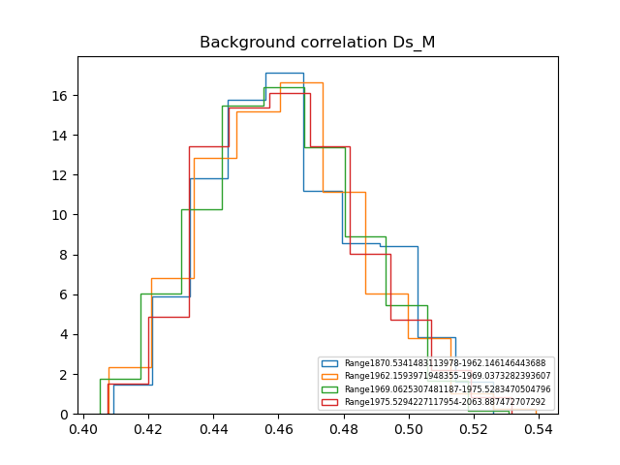
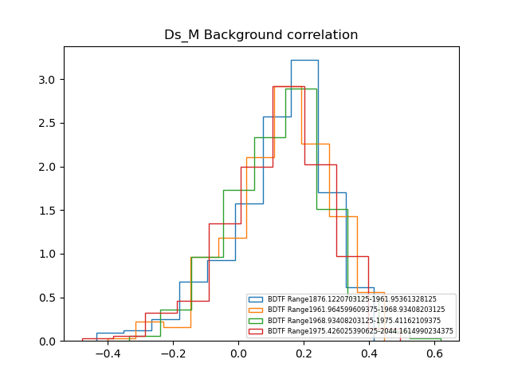
2. TMVA vs Python
Second experiment results for background correlation:
We can observe that there is no correlation.

Slide 23
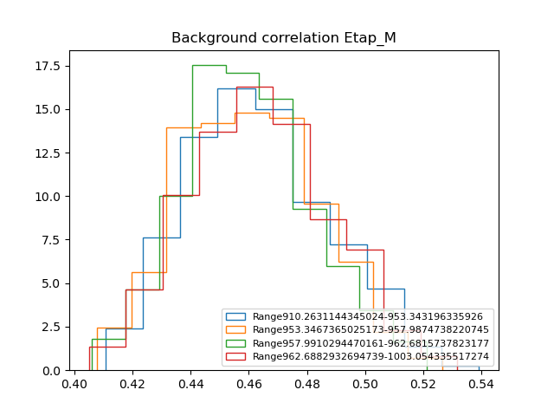
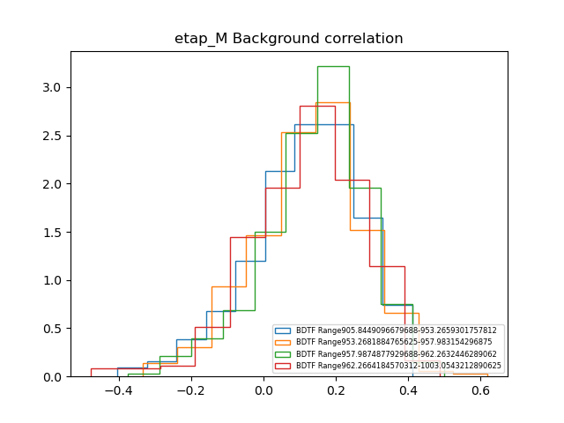
2. TMVA vs Python
Second experiment results for background correlation:
We can observe that there is no correlation.

Slide 24
2. TMVA vs Python
W+bb and tt :
"Lepton_ETA"
"Lepton_PT"
"DiJet_PT"
"HP_DR_JET0_LEPTON"
"HP_DR_JET1_LEPTON"
"Jet0_JetWidth"
"Jet1_JetWidth"
"HP_CosThetaBoost"
"HP_DR_JET0_JET1"
"ULE_CELLjet0_PT"
"PF_ETA_VAR_ERatio_12_3456"
Correlation:
"DiJet_M"
24

Slide 25
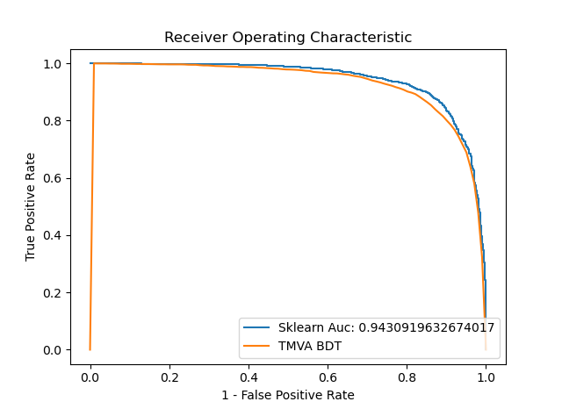
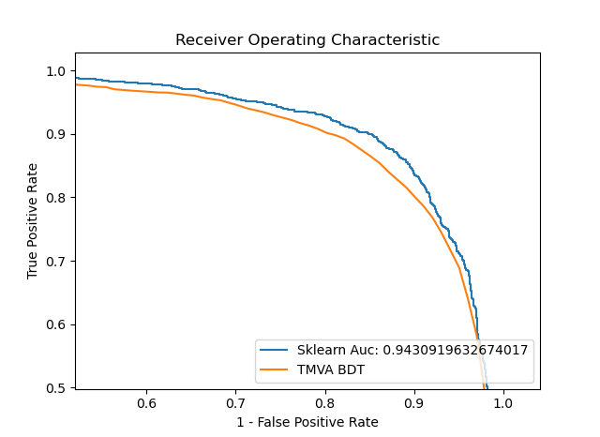
2. TMVA vs Python
W+bb and tt results ROC curve:
Zoom of the results:​
The curve for sklearn is better than the TMVA’s
25

Slide 26
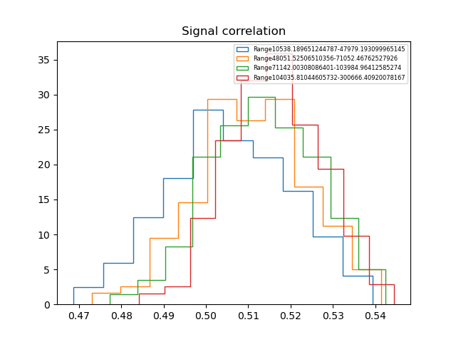
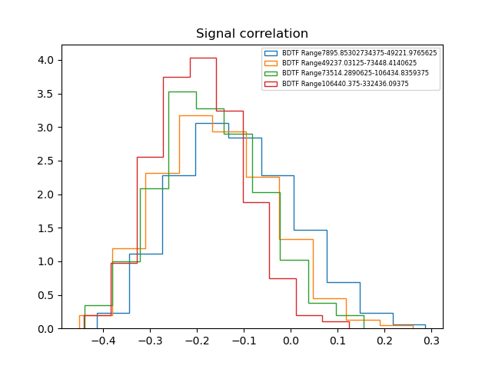
2. TMVA vs Python
Third experiment results for signal correlation:
We can observe that there is no correlation in both results.

Slide 27
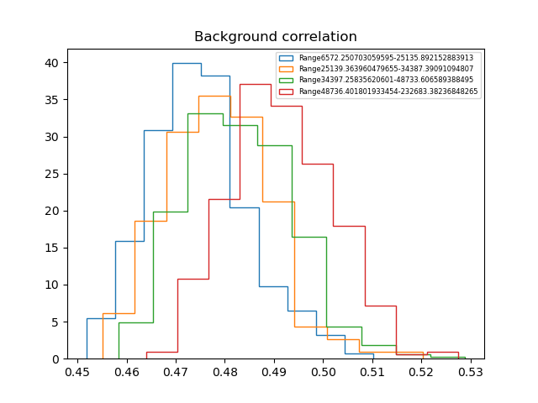
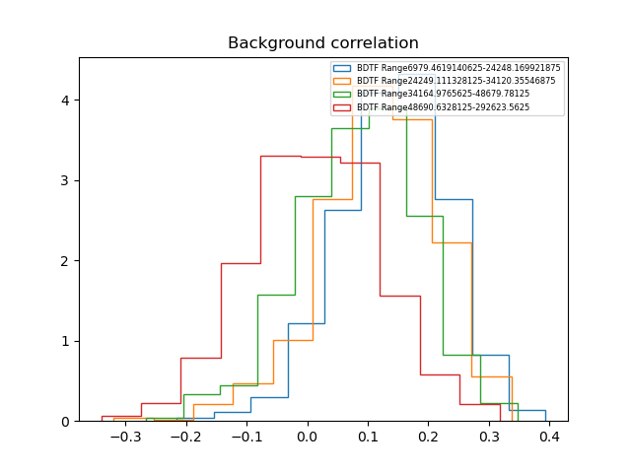
2. TMVA vs Python
Third experiment results for background correlation:
We can observe that there is correlation in both results.

Slide 28
2. Conclusions
After three different results we concluded that the best results were available using Scikit-Learn instead of TMVA.
    The ROC Curves in all cases we better for the scikit-learn results using the same parameters
    The correlation with the mass behaved similarly enough in both cases
    In conclusion the results obtained using Scikit-learn are prefered than the TMVA ones for the same problem and same specifications.

Slide 29
2. Future Work
We need to keep proving with different data that this conclusion is correct and not just a singular occasion in this specific data.
We will use Pythia to generate data for the next analysis in order to avoid the use of LHCb data that can't be used for publications outside the CERN.
We need to prove why the results under the same specifications work better for our module in scikit-learn Python than our module in TMVA Python.

Slide 30
LHCb Analysis

Slide 31
3. LHCb
Another line of work of the thesis is to help in different analysis in the LHCb collaboration.
We got three different groups of data:
      Ds→ η' (→π⁺ π⁻ µ⁺ µ⁻ ) + π
      Ds→ η' (→ µ⁺ µ⁻ ) + π
      Ds→ η (→ µ⁺ µ⁻ ) + π
In this case we want to measure the branching fractions of the decays that are theoretically predicted, this experimental measurement is useful for understanding Chiral Perturbation Theory. [1]
1.GAN, L., KUBIS, B., PASSEMAR, E. Y TULIN, S.
Precision tests of fundamental physics with $\eta$ and $\eta^\prime$ mesons
31

Slide 32
3. LHCb
Our goal was to create a Python module, using the same Machine Learning algorithm as before (BDT), to get the results of the classification for the three different types of data:
      Ds→ η' (→π⁺ π⁻ µ⁺ µ⁻ ) + π
      Ds→ η' (→ µ⁺ µ⁻ ) + π
      Ds→ η (→ µ⁺ µ⁻ ) + π
We used as data the LHCb RUN2 dataset including 2016, 2017 and 2018. As the data we had was not extensive we decide to use a K-fold of the different years as training for the others. We compared the variables of the different years to prove that the data was similar enough to train the models.
32

Slide 33
3. LHCb
Ds→ η' (→ π⁺ π⁻ µ⁺ µ⁻ ) + π variables :
'etap_IPCHI2_OWNPV'
'etap_FDCHI2_OWNPV'
'etap_VCHI2PERDOF'
'etap_PT'
'Ds_IPCHI2_OWNPV'
'Ds_FDCHI2_OWNPV',
'Ds_VCHI2PERDOF'
'Ds_PT'
'pi_PT',
'pi_IPCHI2_OWNPV'
Ds→ η' (→ µ⁺ µ⁻ ) + π' :
'etap_IPCHI2_OWNPV'
'etap_FDCHI2_OWNPV'
'etap_VCHI2PERDOF'
'etap_PT'
'Ds_IPCHI2_OWNPV'
'Ds_FDCHI2_OWNPV'
'Ds_VCHI2PERDOF'
'Ds_PT'
'pi_PT'
'pi_IPCHI2_OWNPV'
Correlation:
'Ds_M'
'etap_M'
'pip_eta_PT'
'pip_eta_IPCHI2_OWNPV'
'pim_eta_PT'
'pim_eta_IPCHI2_OWNPV'
'mup_PT'
'mup_IPCHI2_OWNPV'
'mum_PT'
'mum_IPCHI2_OWNPV']​
​
Correlation:
'Ds_M'
'etap_M'
33

Slide 34
3.LHCb
Ds→ η (→ µ⁺ µ⁻ ) + π:​
'eta_IPCHI2_OWNPV'
'eta_FDCHI2_OWNPV'
'eta_VCHI2PERDOF'
'eta_PT','Ds_IPCHI2_OWNPV'
'Ds_FDCHI2_OWNPV'
'Ds_VCHI2PERDOF'
'Ds_PT'
'pi_PT'
'pi_IPCHI2_OWNPV'
Correlation:
'Ds_M'
'eta_M'
Isolation for Ds→ η (→ µ⁺ µ⁻ ) + π
And Ds→ η' (→ µ⁺ µ⁻ ) + π:
'Ds_VertexIsolation_VTXISODCHI2ONETRACK'
'Ds_VertexIsolation_VTXISODCHI2TWOTRACK'
'pi_TrackIsolationBDT_TRKISOBDTTHIRDVALUE'
Isolation for Ds→ η' (→ π ⁺ π ⁻ µ⁺ µ⁻ ) + π
'Ds_VertexIsolation_VTXISODCHI2ONETRACK'
'Ds_VertexIsolation_VTXISODCHI2TWOTRACK'
34

Slide 35
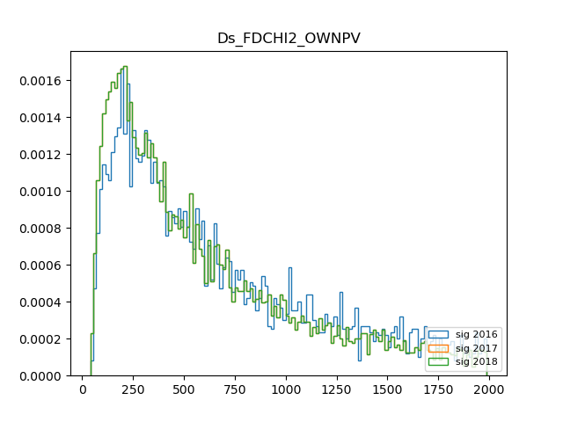
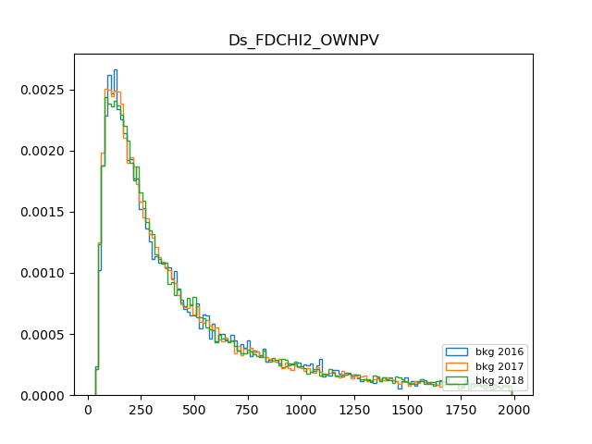
      Ds→ η (→ µ⁺ µ⁻ ) + π

Slide 36
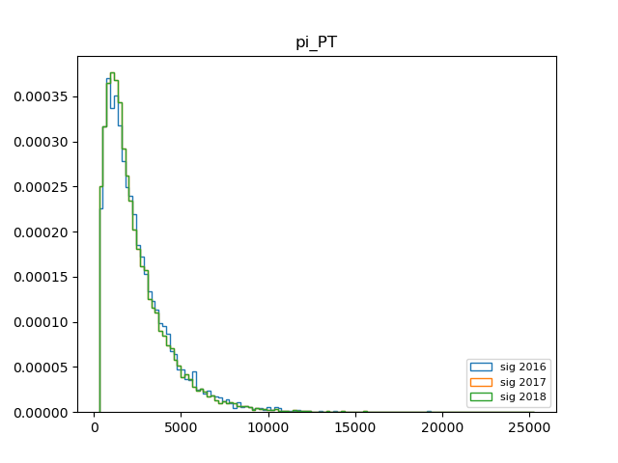
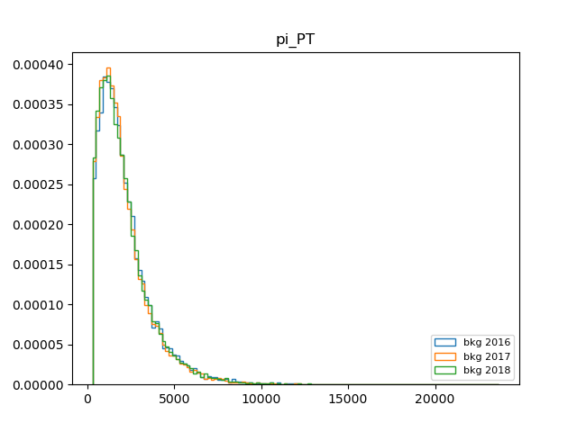
      Ds→ η' (→ µ⁺ µ⁻ ) + π

Slide 37
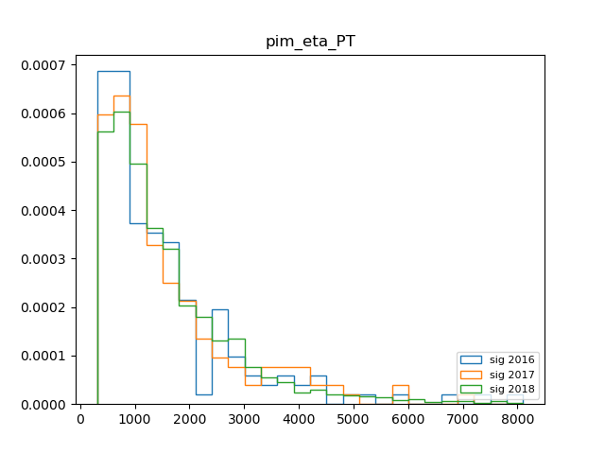
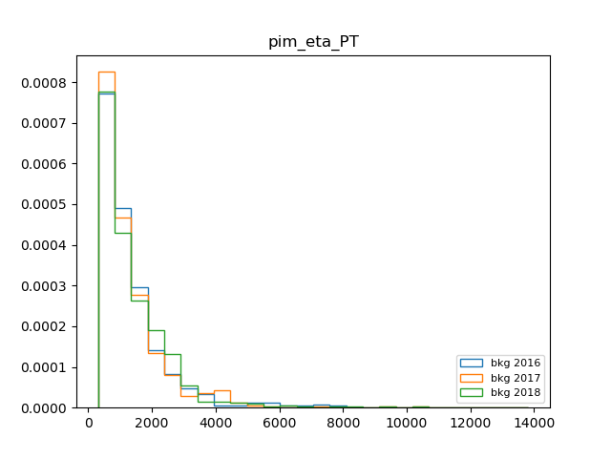
      Ds→ η' (→π⁺ π⁻ µ⁺ µ⁻ ) + π

Slide 38
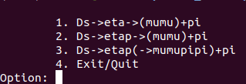
To measure the quality of the results we used same options as before:
The ROC curve: a plot that confronts the rate of True Positives vs. False Positives
The correlation between the results and the mass
We got all the results for each analysis and each year (2016, 2017, 2018), in total 9 different classifiers.

Slide 39
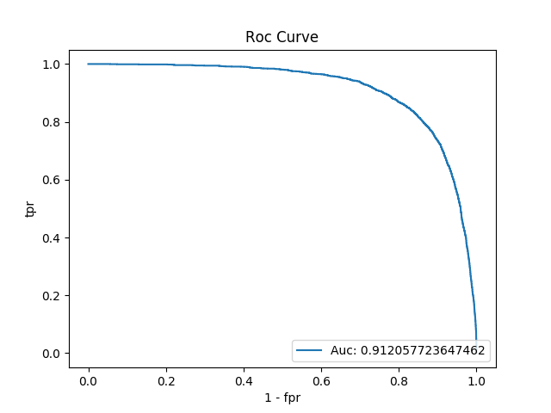


3. Results
      Ds→ η (→ µ⁺ µ⁻ ) + π
2016
2017
2018
39

Slide 40



3. Results
      Ds→ η' (→ µ⁺ µ⁻ ) + π
2016
2017
2018
40

Slide 41
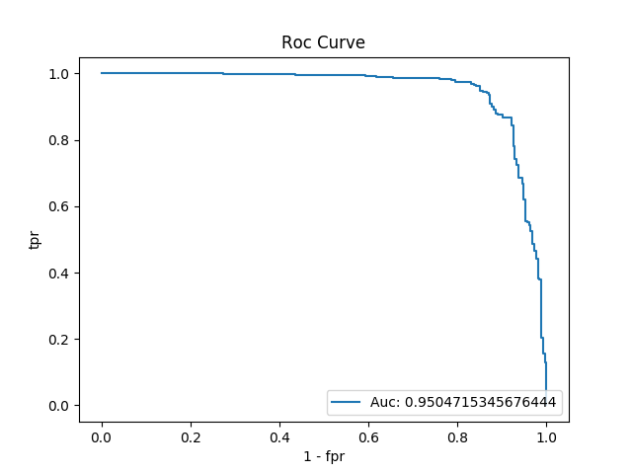
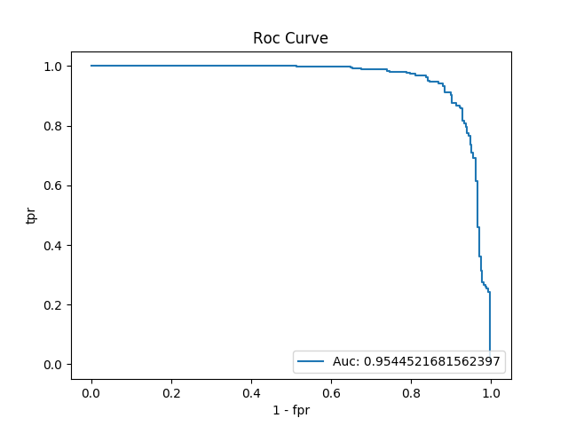
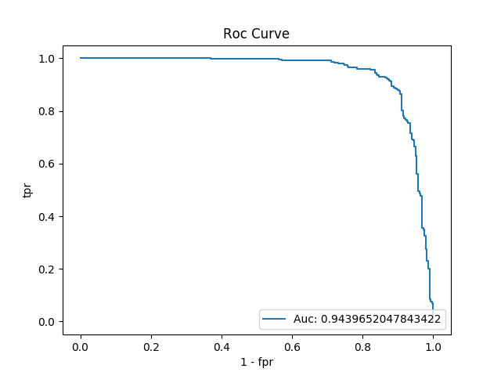
3. Results
      Ds→ η' (→π⁺ π⁻ µ⁺ µ⁻ ) + π
2016
2017
2018
41

Slide 42
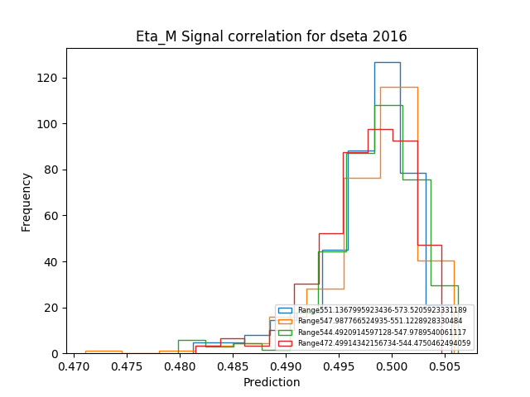
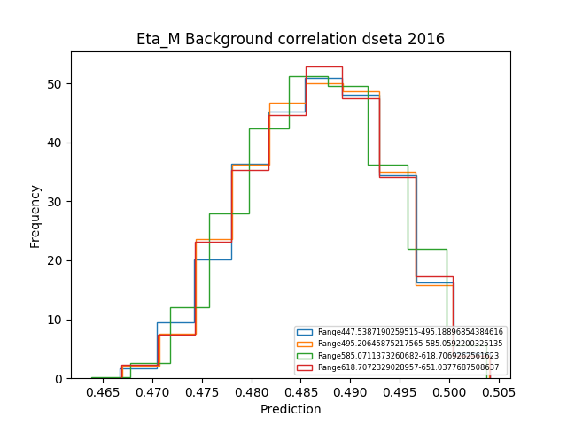
3. Ds→ η (→ µ⁺ µ⁻ ) + π
eta_M 2016
42

Slide 43
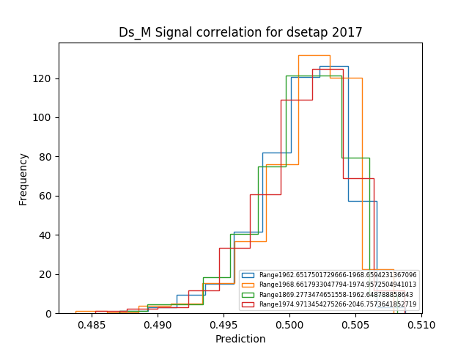
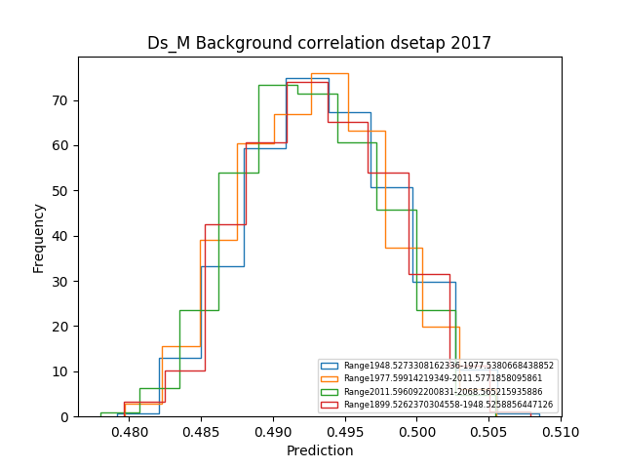
3. Ds→ η' (→ µ⁺ µ⁻ ) + π
Ds_M 2017
43

Slide 44
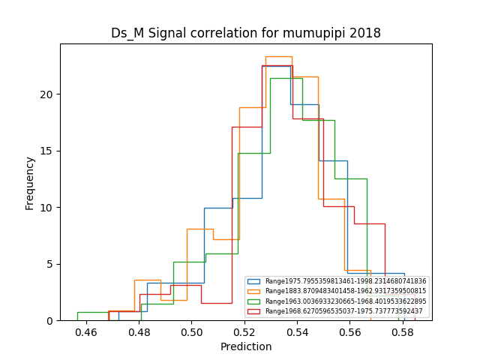
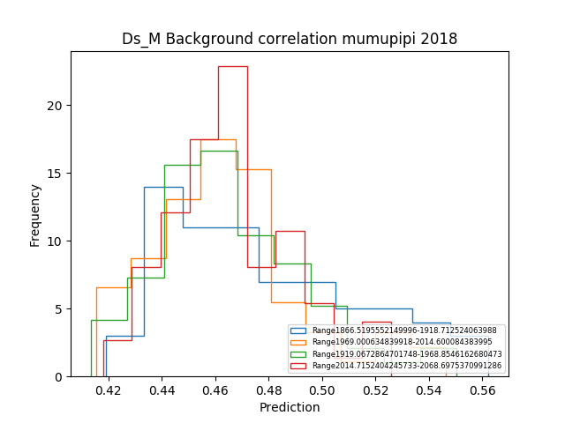
3. Ds→ η' (→π⁺ π⁻ µ⁺ µ⁻ ) + π
Ds_M 2018
44

Slide 45
Future work

Slide 46
As we showed before the future lines of work are:
The necessity of proving with different data that this conclusion is correct and not just a singular occasion in this specific data.
Proving why the results under the same speifications work better for our module in scikit-learning Python than our module in TMVA Python.
The development of Machine Learning model to solve problems related to the industry.
    So far we started a project related with a company in the textile sector to detect and solve failures in the system.

Slide 47


