Slide 1

MKPL impedance measurements with and without serigraphy
M. Barnes, O. Bjorkqvist, C. Zannini
Ack.: P. Blaise, L. Ducimetiere, Y. Sillanoli

Slide 2
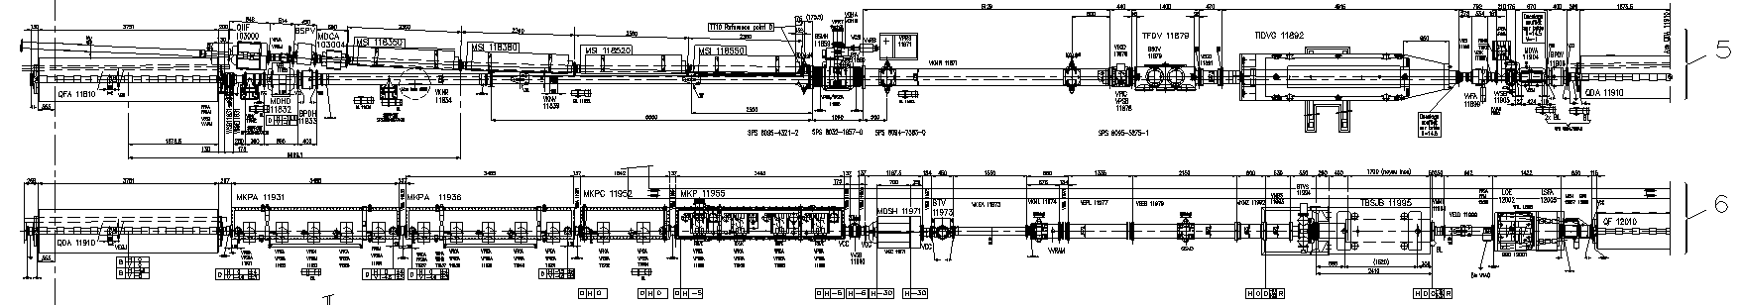
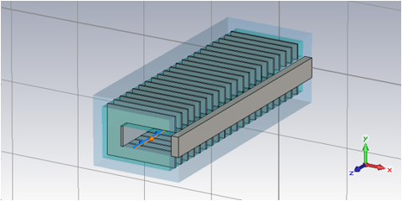
MKP configuration
MKP-S
MKP-L
#1
#2
#3
#4
Beam

Slide 3

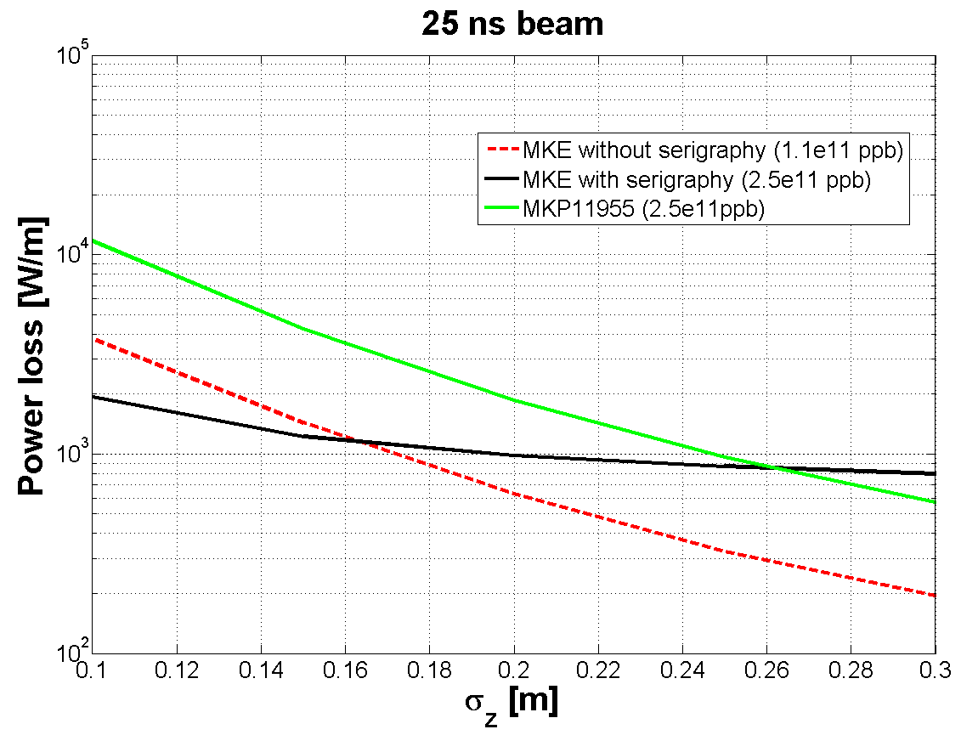
Beam induced power loss
Beam induced heating
MKP-I: Impedance considerations, C. Zannini et al., LIU-SPS 50 ns Injection System for Pb Ions Review, 4 October 2013 (slides).
Present MKPs could strongly suffer of beam induced heating with high intensity beam

Slide 4
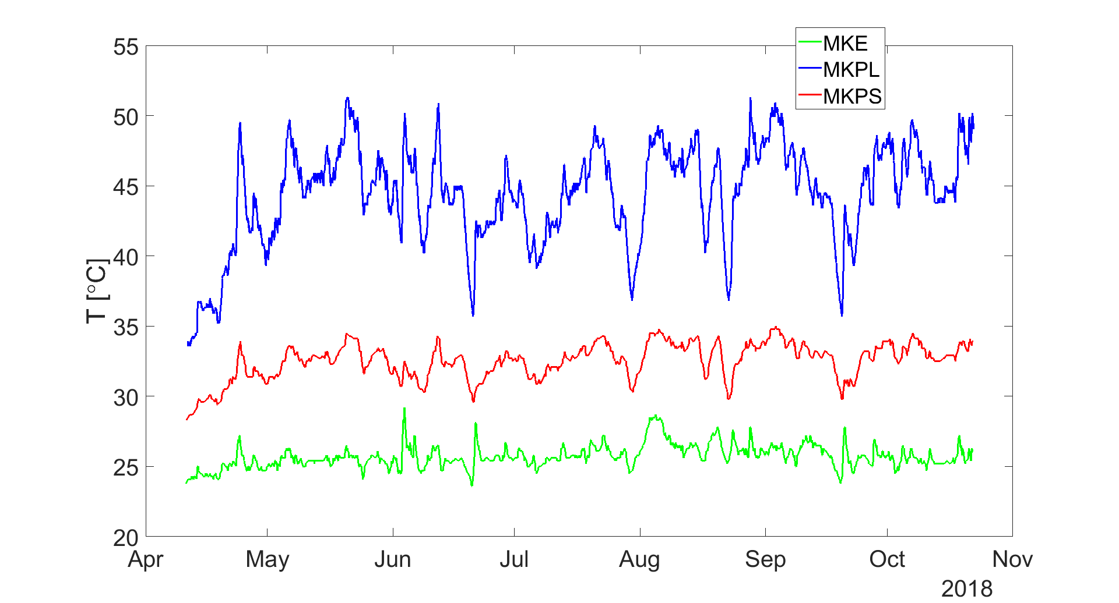
2018 thermal behavior of MKPL,MKPS and MKE
Reached high temperatures even without dedicated scrubbing, just from nominal operation and high intensity studies on Thursdays

Slide 5
M. Barnes
Operational Scenarios for SPS
Confident: Below Tc (Curie Temp.)
Could exceed Tc: risk of mis-kicking beam
Risk of mechanical damage
Very low risk of damage
Not OK (> Tc)
Basic table courtesy Hannes Bartosik, Giovanni Rumolo & Carlo Zannini

Slide 6
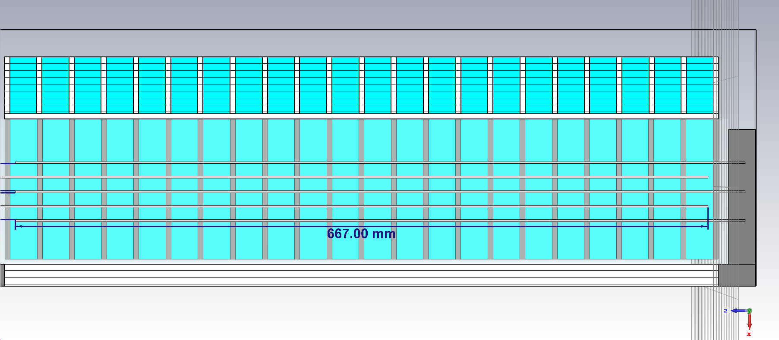
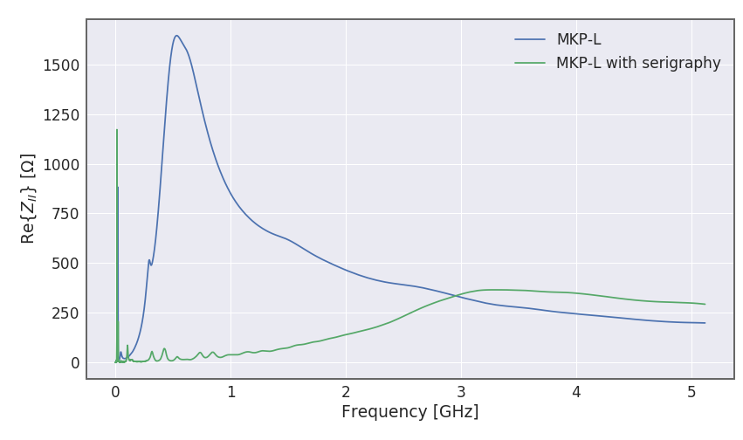
MKP impedance reduction
  Concept with longitudinal serigraphy exists (4, 5 and 6 stripes)
M. Beck
CERN-THESI015-374
Q20 | PL per LHC fill cycle
MKP-L | 874 W
MKP-S | 234 W
MKP-L ser. (6 stripes) | 28 W
MKP-L ser. (4 stripes) | 99 W
Impact on beam stability has been studied and estimated to be negligible
C. Zannini, I. Karpov, Impact of new MKP-L serigraphy, summary from BD analysis. Presented at the LIU-SPS coordination meeting, March 2020.

Slide 7
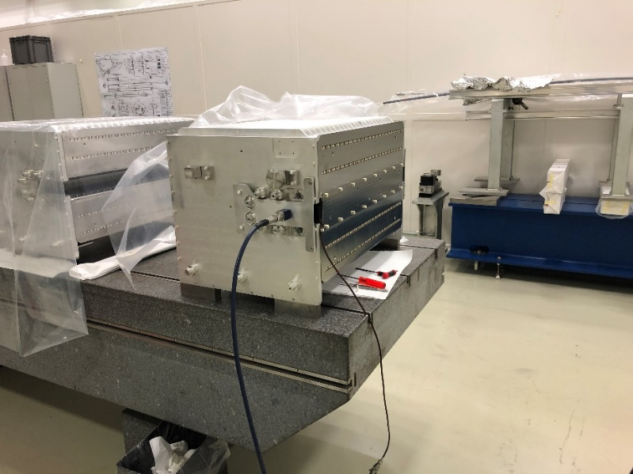
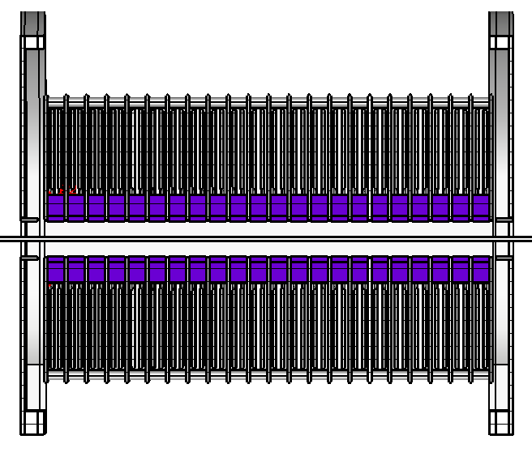
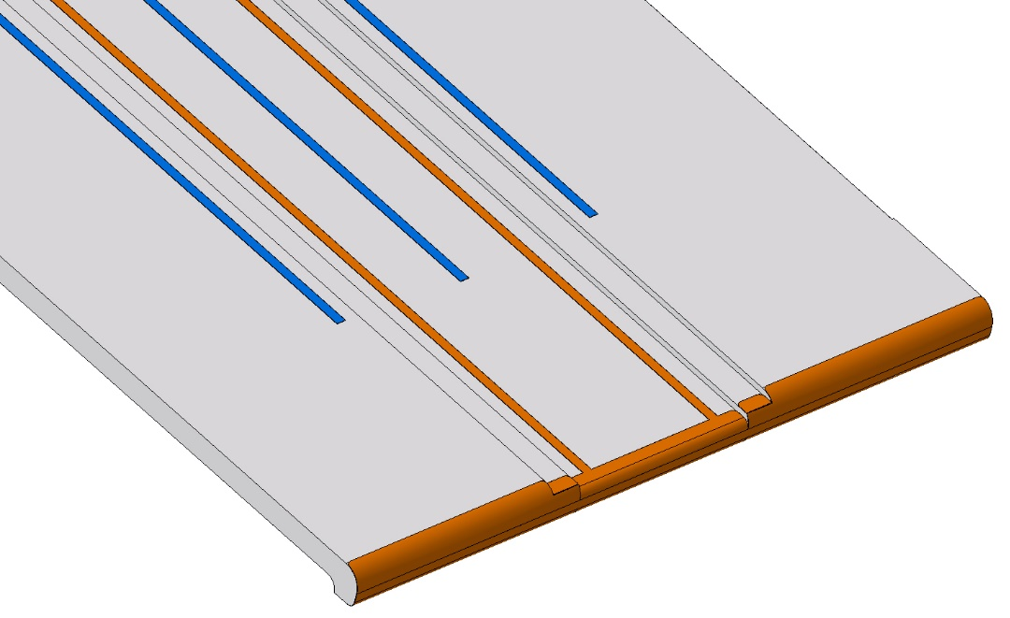
MKP impedance measurements
Port1
Port2
Alumina plate
Matching resistor
Silver serigraphy

Slide 8
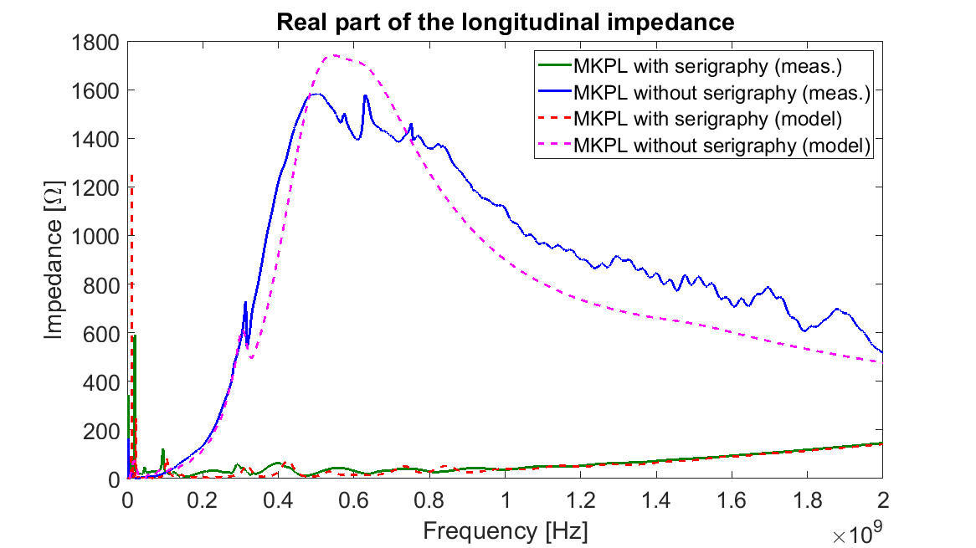
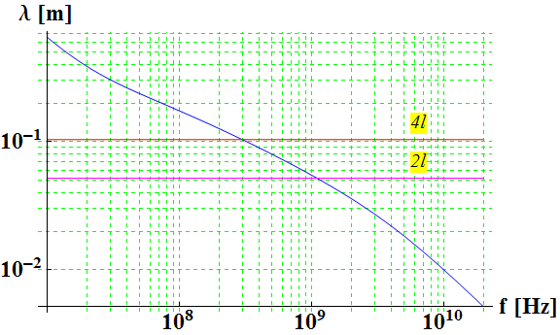
MKP impedance measurements
Good agreement between simulation models and measurements
Frequency shift of the peak due to serigraphy
probably due to the effect of wire and terminations

Slide 9
Summary
The MKPL was predicted to suffer of beam induced heating with LIU beam already in 2013
  2018 temperature data confirm the criticality of the kicker
The MKPL is expected to limit operation and scrubbing during run III
Impedance mitigation solution is available and validated with impedance measurements
  Ongoing: simulation of the measurement setup (C. Antuono)

Slide 10
Thank you very much for your attention

