Slide 1
Design Office CAD meeting 15.10.2020
Release States in SmarTeam
Tests and use cases in Atlas Design Office
Tatiana Klioutchnikova in collaboration with
Marta & CAD Support team

Slide 2
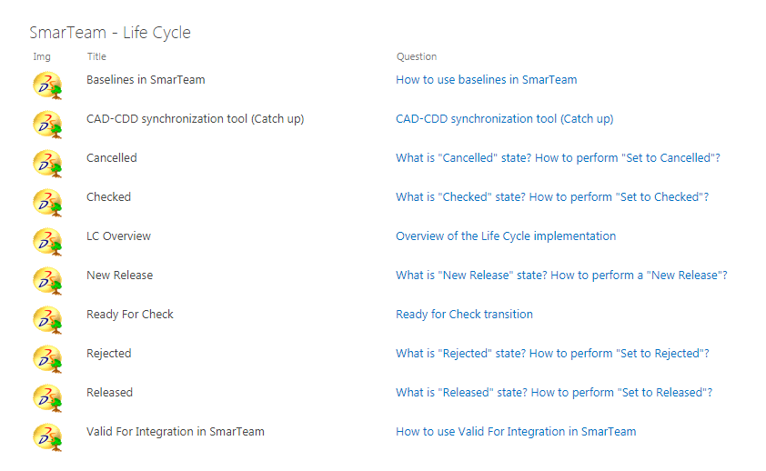
Description of Release states in documents obtained from
CAD support team
Index
HELP Documents on CAD Support Web page
Release with design
Release for catalog
Release for integration
Proposals for Integration
  Valid for Integration
  Integration Baseline

Slide 3
Release states overview
Release with design
Used by all designers for new design
Release for Catalogue
Not usual operation in Atlas design office
Release for integration
Very important feature for corresponding cases (but very limited cases)
Valid for Integration
The most convenient procedure for 3D integration models validation, but it has limitations. Needs further development.
Integration Baseline
Next step of tests. Procedure for future developments

Slide 4
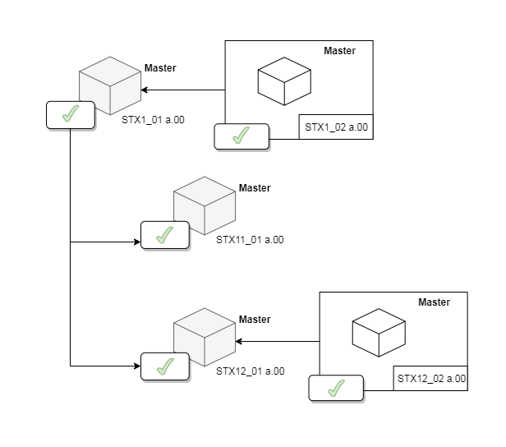
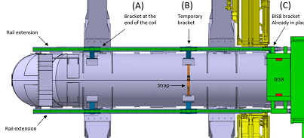
Release with Design (already in production)
3D and 2D are released using CDD rules
Ready for check (In SmarTeam) – Check – Released (In CDD)
Use cases:
Mechanical designs (Parts or Assemblies) with equipment codes and drawings
Release of 3Ds in the assembly context
Propagation through the assembly
Use cases:
Release of simplified elements, skeletons, in context of one assembly
Release of integration assemblies could be possible today if….
Create a CDD code for integration
Project the top assembly into a drawing
Start the release design propagating to all assembly if needed
We have big number of ATLAS integration models, we do not want to create additional drawings serving only for releasing the models.
We had such practice in the past with EUCLID, so called “Standard models” in fact – integration models.
There are those drawings and CDD codes still existing.
We can make a test to link the integration models that we use now with existing old drawings and make Release with propagation.

Slide 5
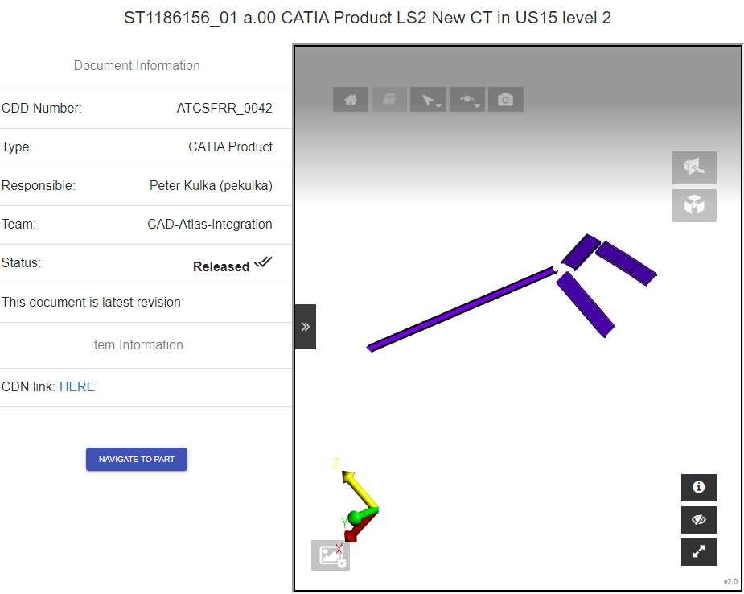
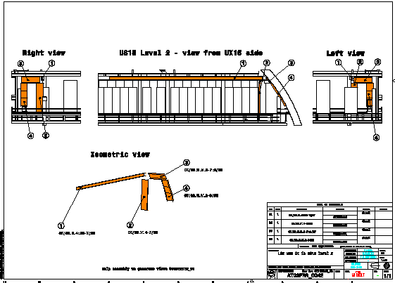
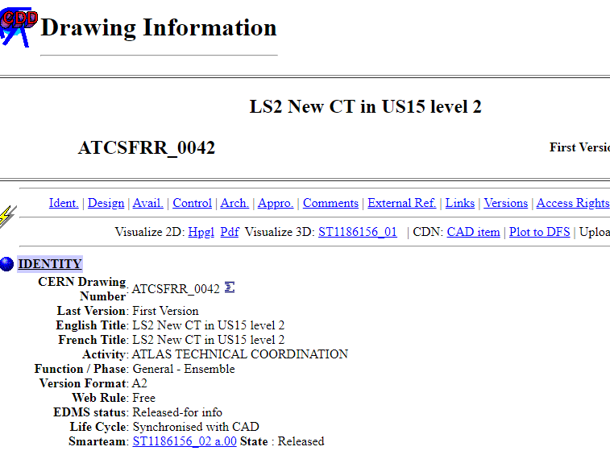
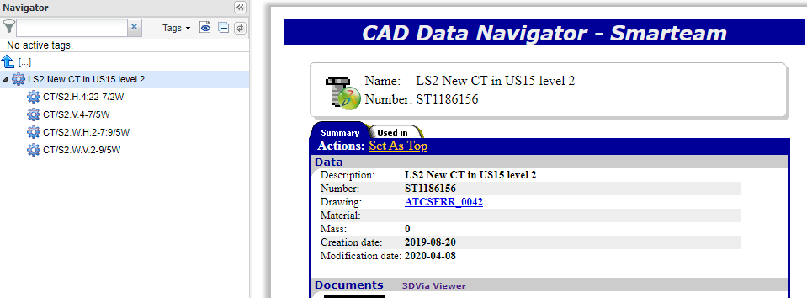
Release with Design ==> 3D visualization from CDD in viewer

Slide 6
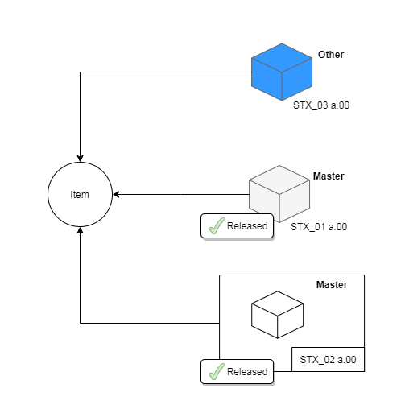

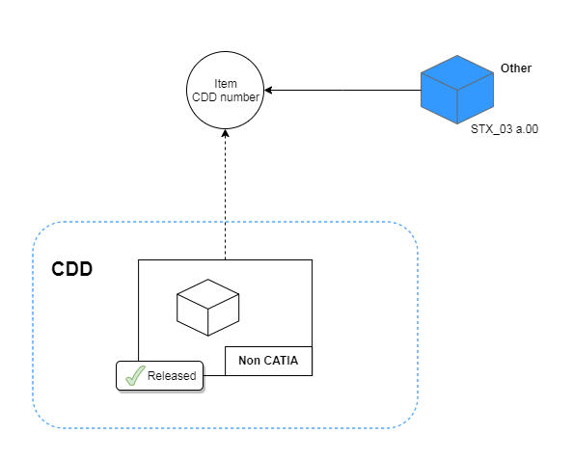
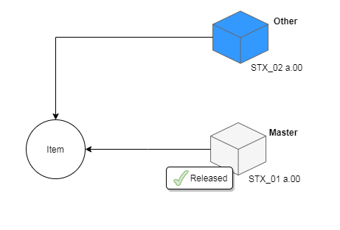
Release for Integration (already in production)
3D Model for integration that represents a released 3D or 2D design.
Use cases:
Simplified model of a released element
CATIA 3D REPRESENTATIONS OF FOREIGN CAD TOOL DRAWINGS RELEASED IN CDD
TESTED
TESTED
3D Simplification of an element
Released in the normal lifecycle
3D Simplification of an element
Released for Catalog
Released by propagation in one assembly
3Ds representing elements
Released from another CAD tool
These use cases are very important and can be used for Release of corresponding models.

Slide 7
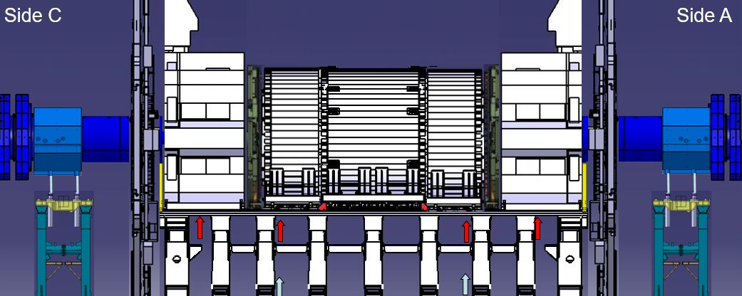
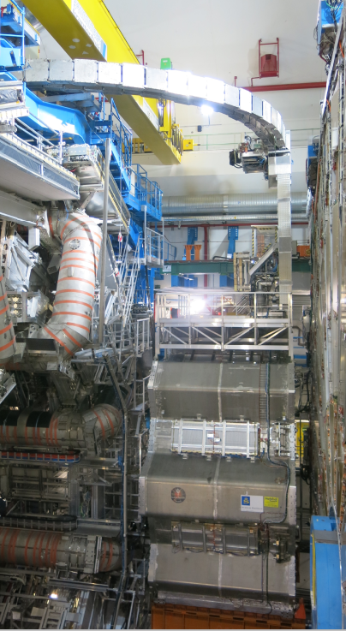
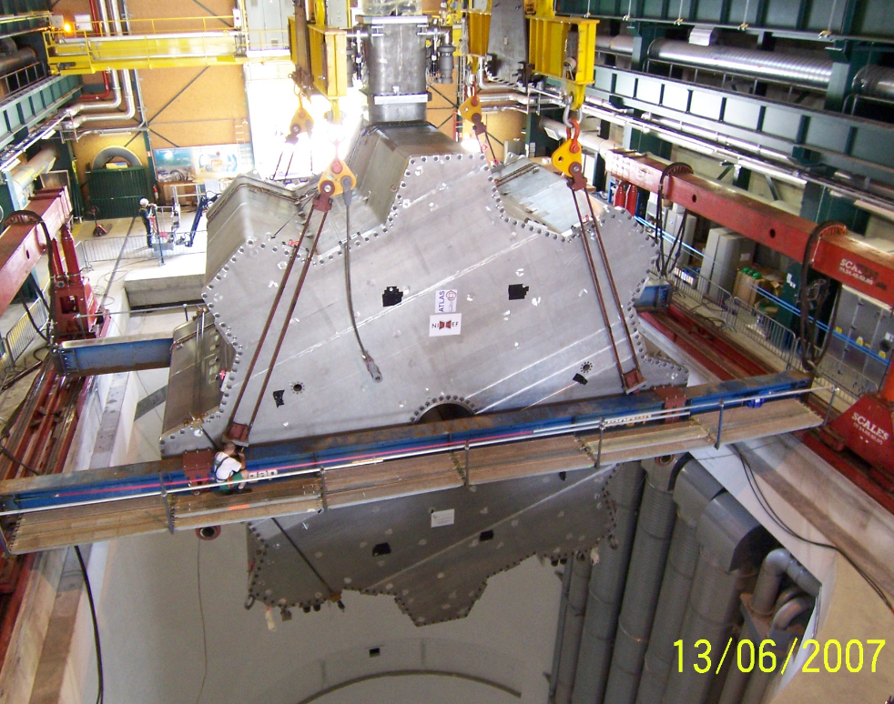
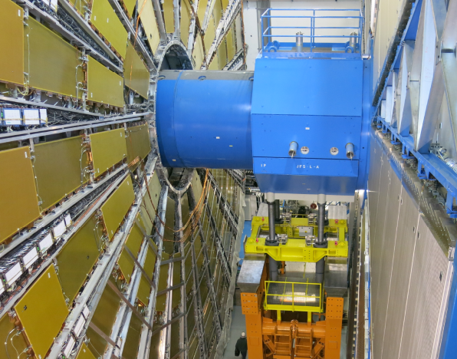
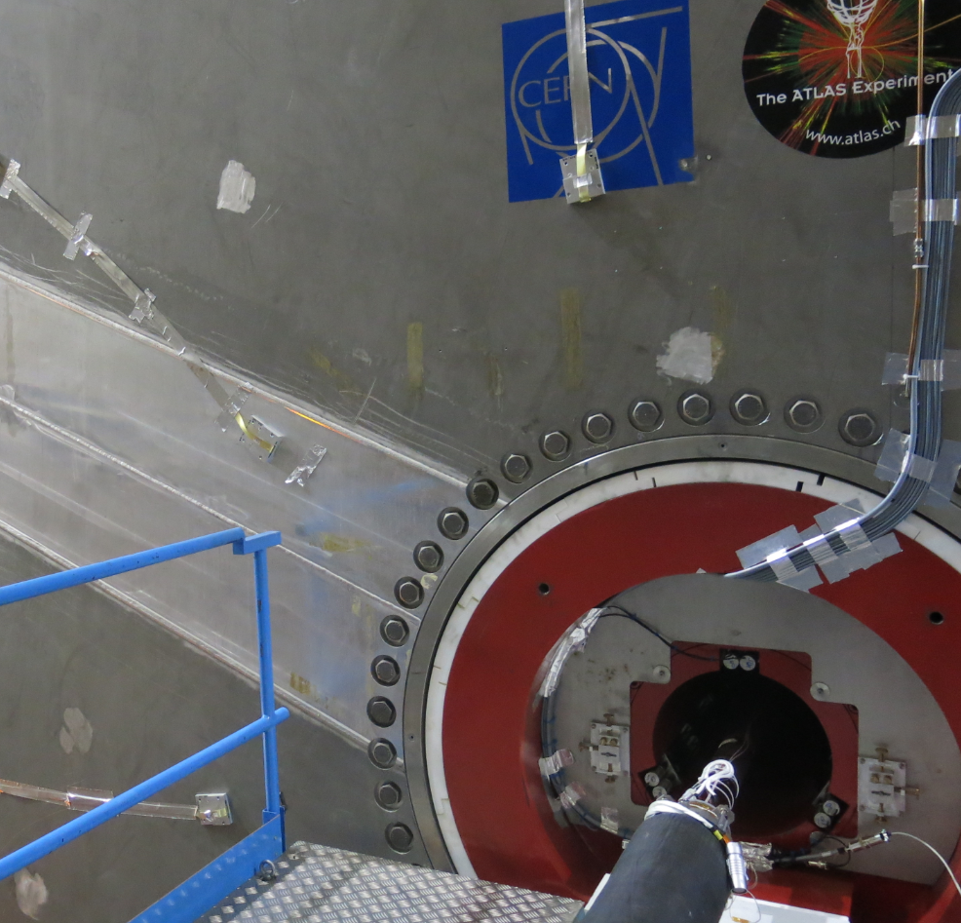
Use case in Atlas : change of interface ATLAS – machine for HL => modification of Atlas Forward and End-Cap Toroid shieldings
Atlas Forward shielding
End-Cap Toroid Magnet
Part of Forward Shielding
Inside End-Cap Toroid (JTT)

Slide 8
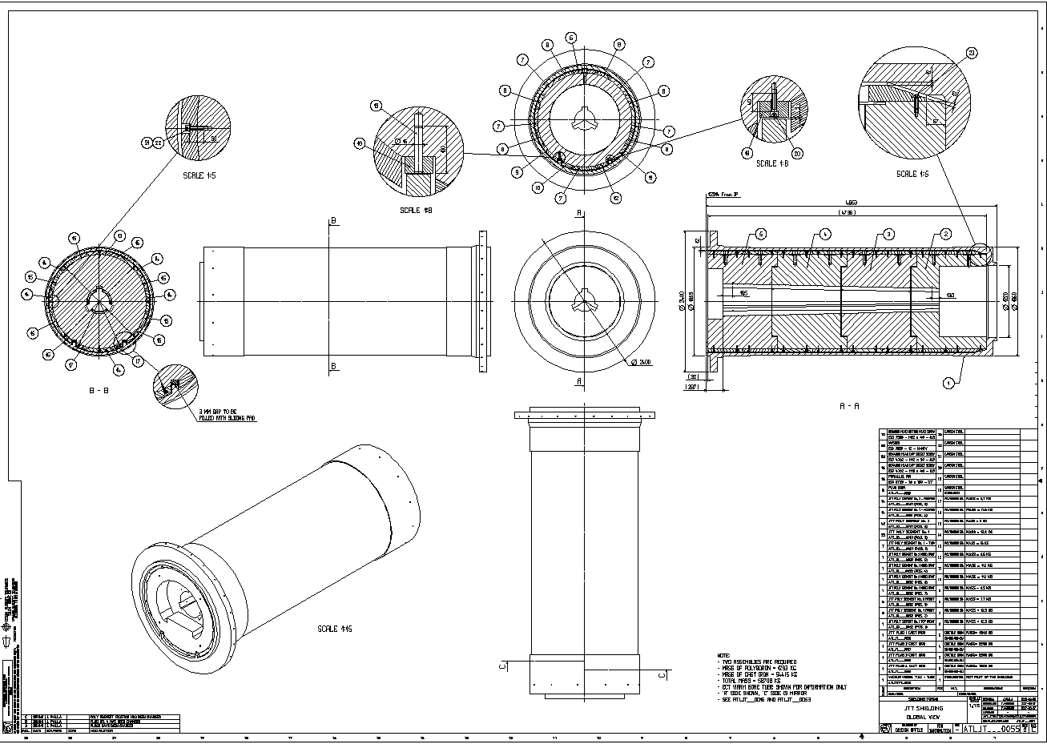
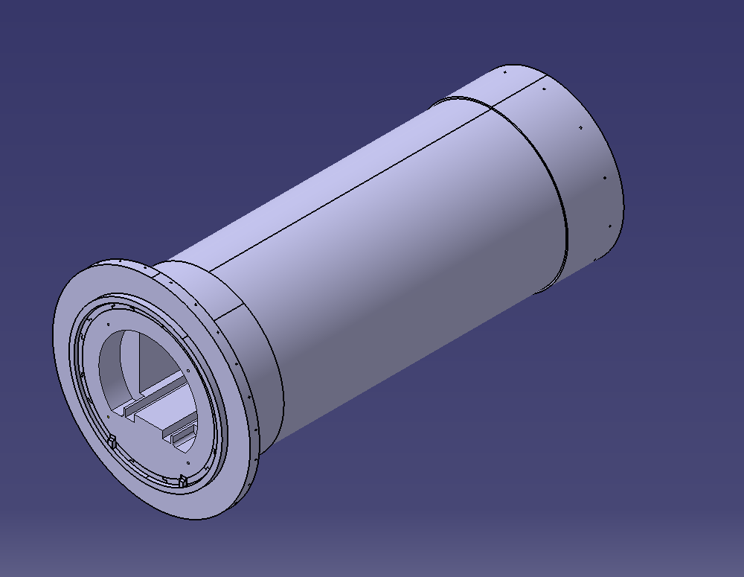
Release of old EUCLID models and drawings for future modifications
( Example of JTT shielding)
Modifications in some parts of JTT need to be done for the Upgrade.
The purpose is:
to keep the same ST number for the model
To keep the same CDD number for the drawing
To link model to the drawing
To make RELEASE of 3D + drawing
To create new release of 3D+ drawing
JTT drawing is controlled and archived on CDD
3D model from EUCLID: link with drawing is lost after migration
This case has been already presented in details in the DO CAD meeting on 24.05.2019

Slide 9
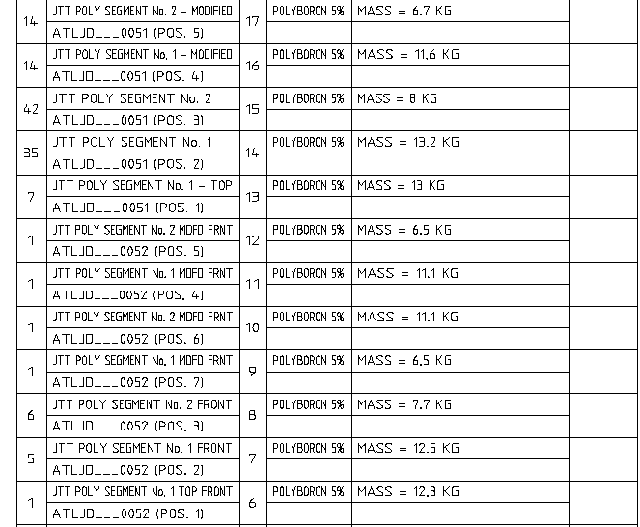
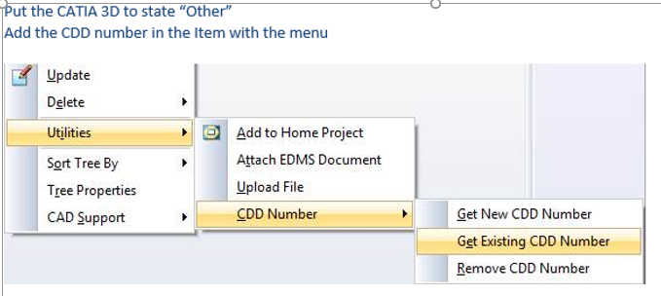
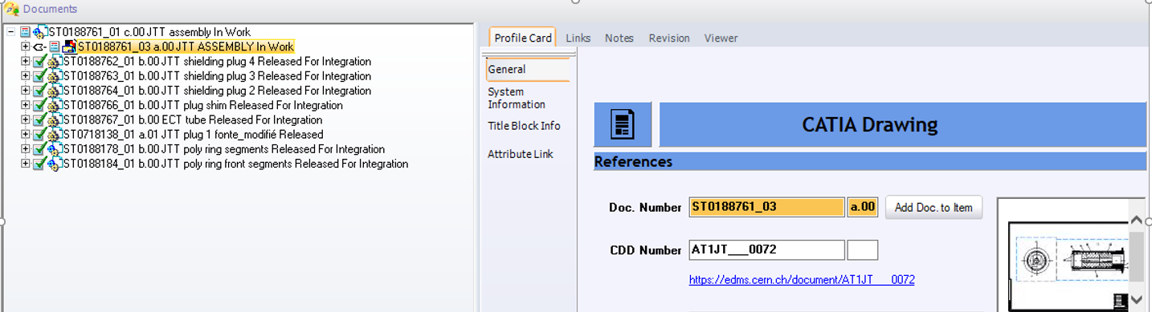
OPERATIONS:
1. link 3D and drawing to the same Item + add CDD number to the Item:
2. Make this operation for all parts in the BOM
In this particular case it appeared to be that many parts are defined in the same drawing:
Many different POLY SEGMENTS in ATLJD___0051 and 0052
Result of the operation
We are very proud of the result that we achieved. The operations were not evident for the first time.
Many thanks to Marta for help!
Nevertheless, it is very much time consuming and it is not possible for us to do it for all old Euclid parts. We can only do it when we need some modifications.

Slide 10
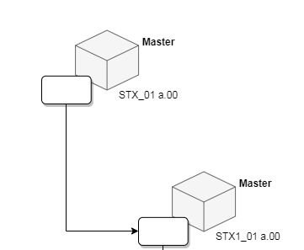

Valid for Integration 2.0
The aim of this feature is to provide the option of validating for integration 3D documents.
Documents in state “Valid For Integration” are equivalent to “Released” documents with the difference that they don’t have any associated drawing that passed through the CDD controls. However they passed all the 3D quality checks of "Ready for Check"
Use cases:
  Validate Scans
  Validate objects found in the tunnel without references
Lifecycle state: valid for integration.
SmarTeam state: Released (green tick).
Pre-requisites:
  Ready for Check OK. (With exception of all related drawings and CDD numbers
  Integration access rights.
Benefits:
  Green tick.
  Compatible with having inside other released objects.
Potential Risks:
  Danger usage those elements in normal assemblies.
  Traceability is lost since CDD is used for this
  No component can have a drawing unless this drawing is already “Released”.
VALID FOR INTEGRATION FEATURE ( EDMS Reference 2145011 )
The command “Set Valid For Integration” allows any user with proper access rights to validate a structure without drawings (3D part or product). Once finished the process, these structures will show a green tick and will be usable as “Released” elements inside other mechanical assemblies.
Nevertheless, it is important to be careful when using “Valid For Integration” elements in mechanical assemblies. Generally, these elements are simplifications or they could not have assigned any CDD number.
The use cases of the validation of scans or of objects which are found in the tunnel without any reference can benefit from this feature.

Slide 11
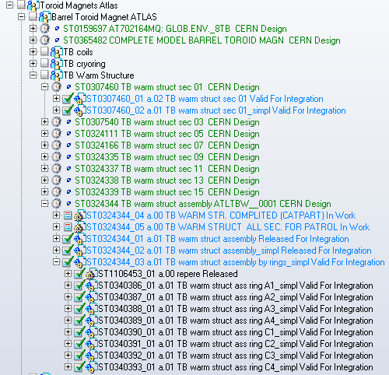
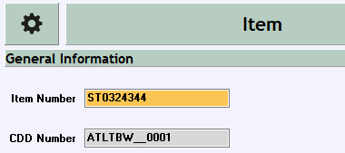
Example: Release of Barrel Toroid Warm Structure
Linked to a CDD drawing
Released with the same drawing
Not linked to a CDD drawing

Slide 12
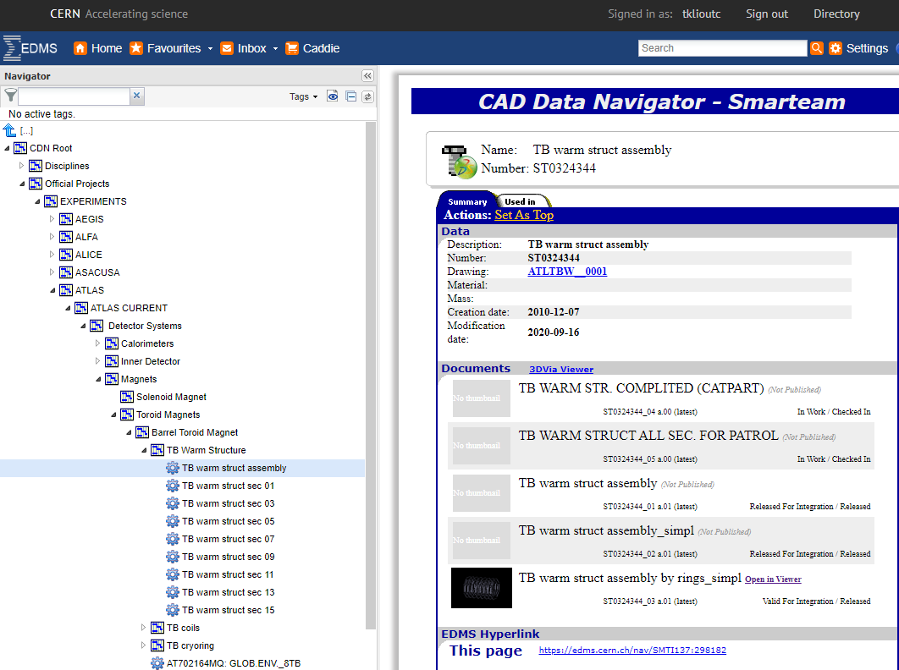
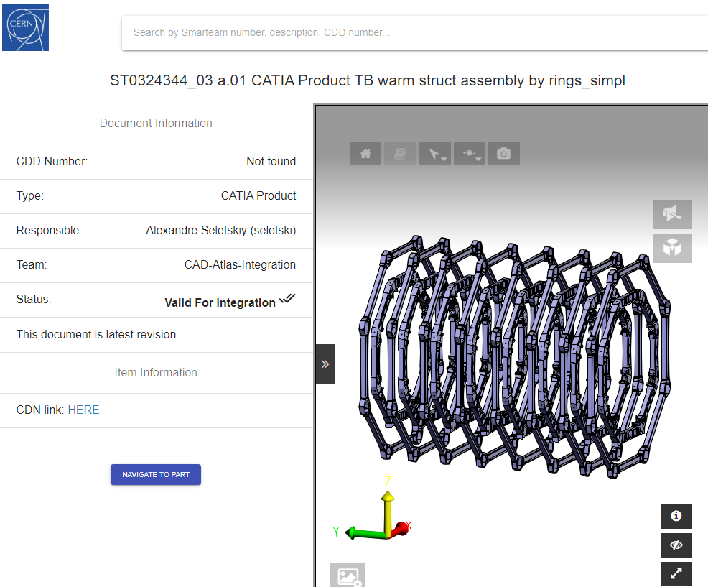

Slide 13
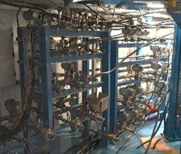
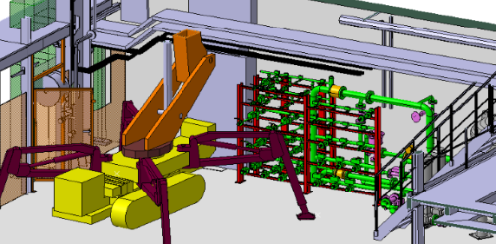
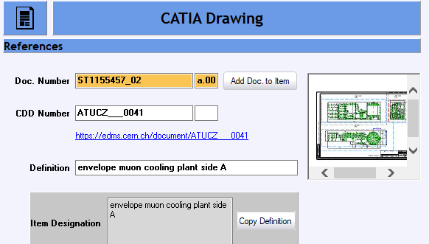
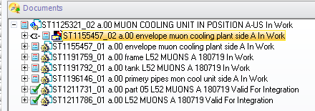
Test “Valid for Integration” for external step model
The procedure works perfectly well for parts imported as step file from foreign CAD systems.
It did not work for the assembly in this case because there is a drawing linked to the assembly (envelope drawing).

Slide 14
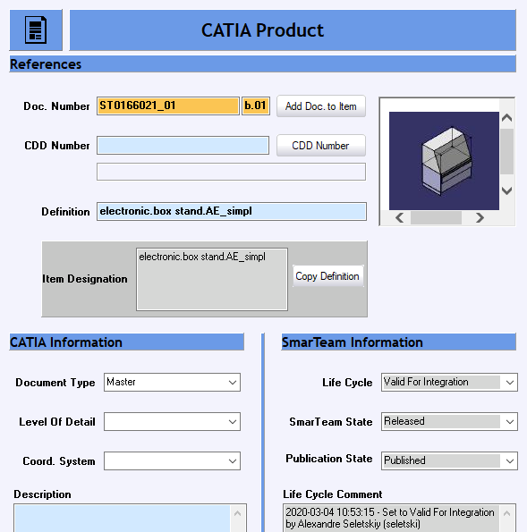
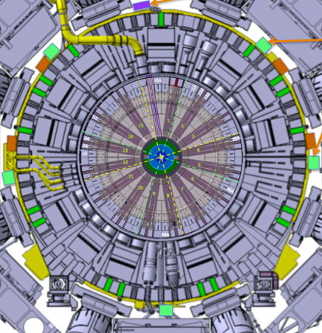
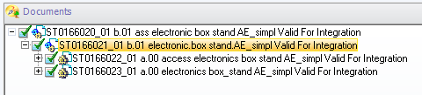
Test “Valid for Integration” for old Euclid object
First test done for LAr calorimeter electronic box model
Done with success!

Slide 15
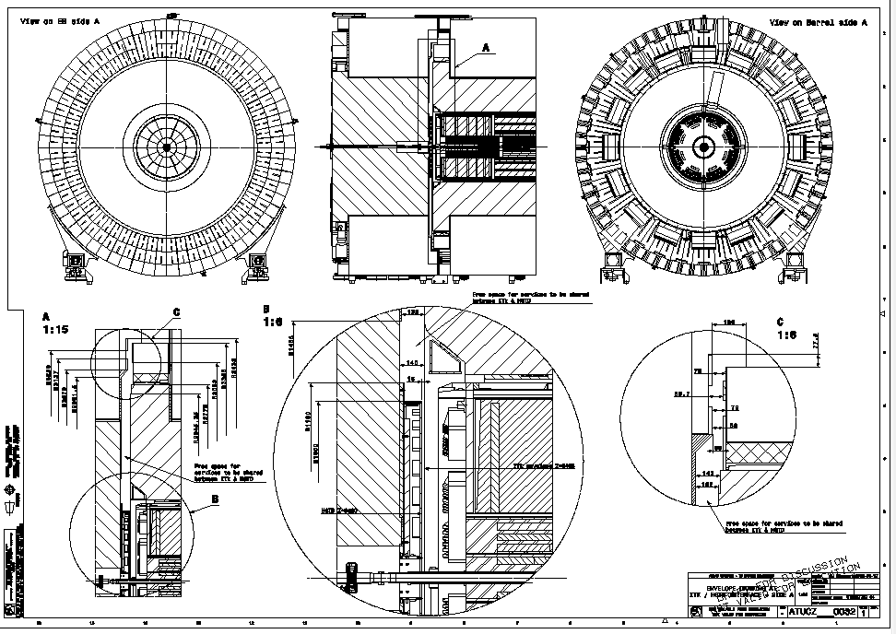
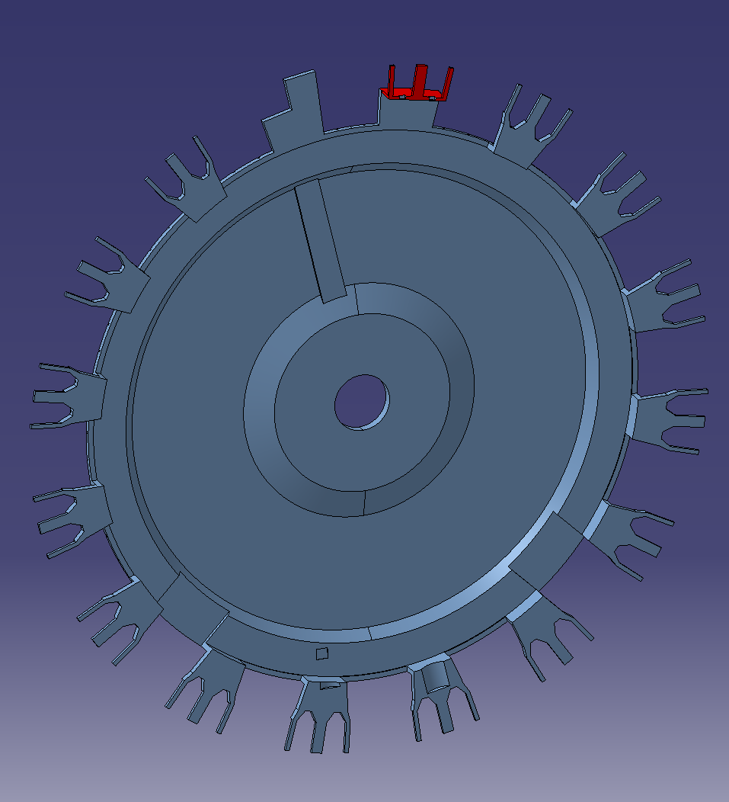
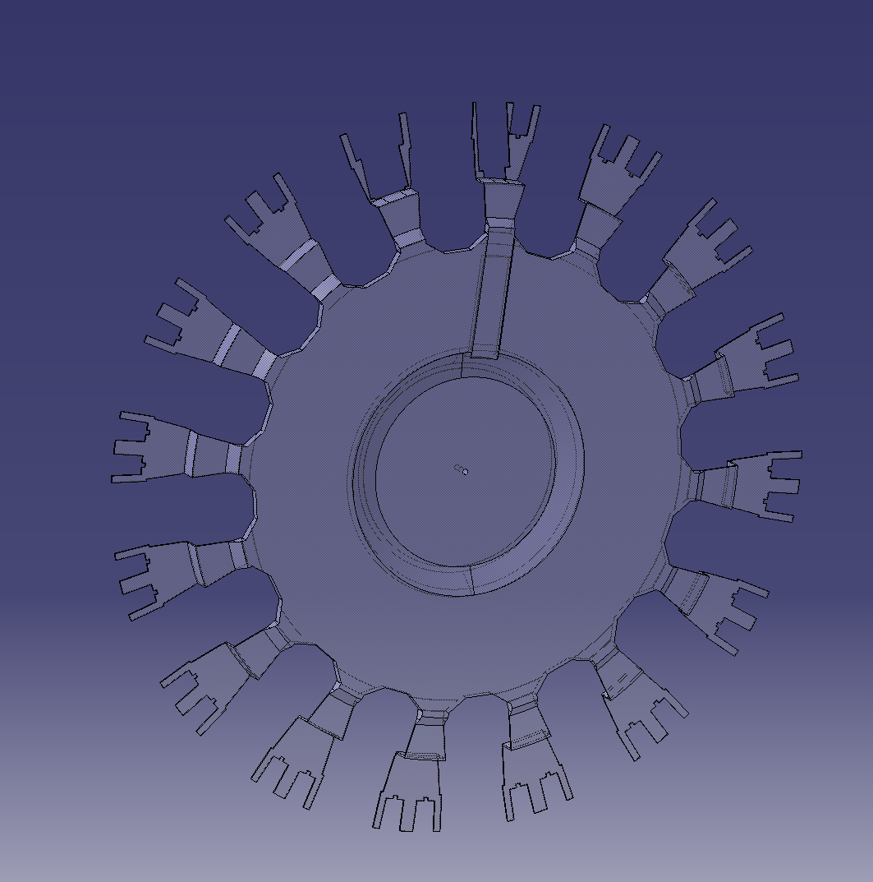
Test “Valid for Integration” for Integration models (Calorimeter)
End-Cap
Calorimeter
Barrel
Calorimeter
Drawing defining Interface between Barrel and End-Cap calorimeters.
HGTD envelope
ITK envelope
HGTD
Detector
Inner
Tracker
Calorimeters Integration models and their parts have been projected to hundreds of drawings during more than 10 years.
How can we make “Valid for integration” for such models with requirement “no component can have a drawing” ?

Slide 16
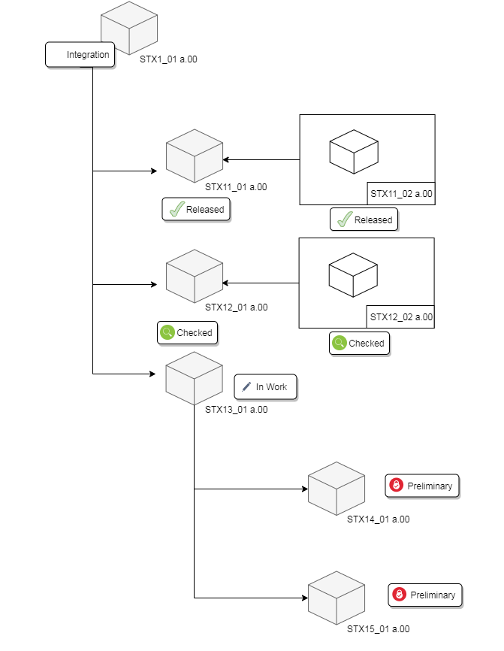
Integration Baseline – next step of tests
The integration baseline feature allows to freeze any integration structure, in order to keep a trace.
This feature sets all documents belonging to a structure to “Preliminary” if they are not already in this state or further and tags all of them as a part of a Baseline.
Use case:
  Agreement between integration and services independent of the document state.
Integration Baseline
Components
  Lifecycle state: Preliminary.
  SmarTeam state: Checked in
Top assembly
  Lifecycle state: Integration baseline preliminary.
  SmarTeam state: Checked in
Pre-requisites:
  Integration access rights.
Benefits:
  Freezes the structure. Traceability of the snapshots.
  Green light for the services to use the integration assembly.
  No need of other rules
Risks:
  In case of modification is necessary to do another baseline
Preliminary

Slide 17
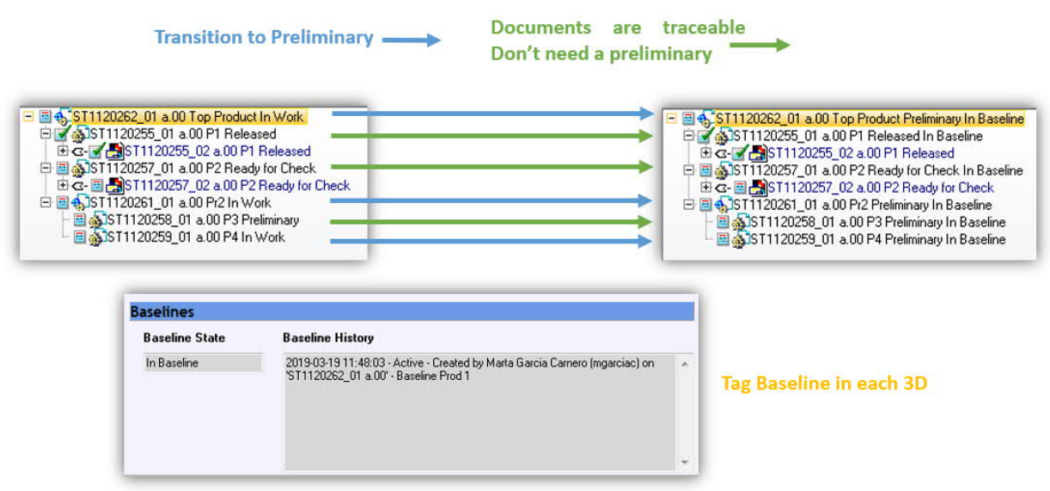
Integration Baseline – next step of tests
Integration Baseline procedure looks very promising for the new design process for upgrade projects in collaboration with external institutes or industry.
We plan to identify some real cases and test this procedure.

Slide 18
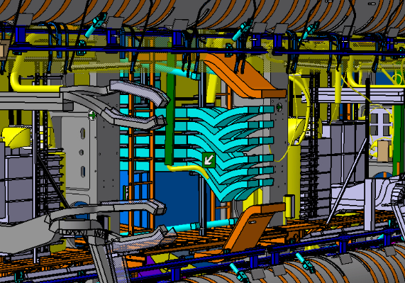
Conclusions
Big “Thank You” to CAD support team for impressive progress in lifecycle developments, creating tools for release of 3D integration models and drawings.
Several new functionalities have been created with corresponding help documents on CAD support web page.
First tests show positive feedback
It is necessary to make more tests of real use cases and organize discussions with CAD support to understand the ways of improvements and optimization of the procedures
It is important to find a way to release different types of 3D models (ex. Cable trays, electronic boxes, cooling , cryogenic equipment, etc.) without taking into account links to drawings
It is in our interest to release immediately 3D models that have been updated for different studies and models corrected after scans ( Toroid sectors, Z0, USA15 ….)
Need to find a way to deal with accumulated data created by means other than classical design

