Slide 1

Some thoughts about the MCBXF design shimming
E. Todesco
13 October 2020

Slide 2
CONTENTS
The torque issue
The straight part
Possible strategy

Slide 3
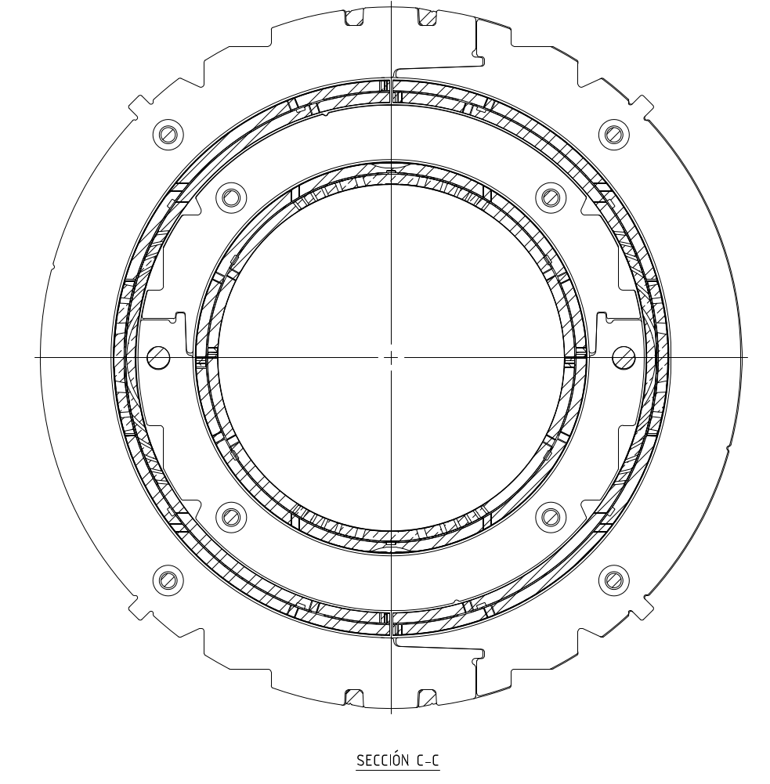
TORQUE IN THE HEADS
Torque in the heads
  Modification of present design to have a mechanical lock in the heads appears not to be possible at this stage
  Therefore it must be kept by friction
Strong evidence from training data that the quenches are in the heads, with overwhelming quantity in the inner layer
The quenches in the inner layer can have two sources
  1- Torque of the inner coil with respect to the inner collar
    The assembly has some interference, but the sliding is likely to create quenches – on the other hand, since the collars are totally free to move, probably they will follow the active part (coil), see next
  2 - Torque of the inner collar-inner coil with respect to the outer coil/outer collar
    The assembly has no interference, but it is not clear if the global rotation of the ensemble collars/coil provokes quenches

Slide 4
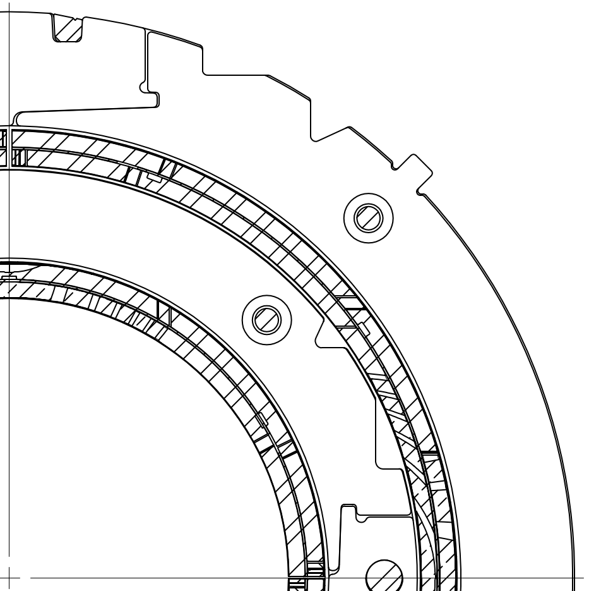
TORQUE IN THE HEADS
Analysis of the first case: inner coil sliding on the inner collar
  Initial torque per meter (of magnet), just out of the heads, is T=140 kN m / m
  The corresponding shear stress is σ_{t}=T/(2πr²) = 2.9 MPa
  To block this movement with friction we need σ_{r}~5σ_{t}~15 MPa
  This corresponds to a azimuthal stress of σ_{θ}~9σ_{r}~135 MPa (this is a thin ring, see Appendix)
  Today we put about 40 MPa, it should slide at 25% of torque
σ_{r}
σ_{t}
σ_{θ}

Slide 5
TORQUE IN THE HEADS
Analysis of the first case: inner coil sliding on the inner collar
  If we want to avoid this training we should considerably increase the preload in the heads (with 40 to 80 Mpa we should be able to double the torque, reacing 50% of the torque without training)
  The preload profile in the heads should not go to zero, as it is in usual magnets, since the aim of this preload is not to preload the conductor but to keep the torque

Slide 6
TORQUE IN THE HEADS
Analysis of the second case: inner coil and collars torquing
  Torque per meter (of magnet) is T=140 kN m / m
  The corresponding shear stress is σ_{t}=T/(2πr²) = 1.7 MPa
  To block this movement with friction we need σ_{r}~5σ_{t}~8 MPa
  This corresponds to a azimuthal stress of σ_{r}~3σ_{t}~24 MPa
  Today we put 0 MPa, i.e. there is no contact – coil is kept by axial loading only, we can claim that somewhere between the end of locking and the end plate, it turns
This rotation could be the source of training
σ_{r}
σ_{t}
σ_{θ}

Slide 7
TORQUE IN THE HEADS
Analysis of the second case: inner coil and collars torquing
  How to block this rotation by friction
  Shimming radially between inner collar and outer coil, nominal is 1 mm
  An additional shim of 50 μm would give a strain on the 10 mm thick coil of 5 mstrain
  With a 20 GPa modulus, this gives 100 MPa at room temperature (at room temperature– it appears very sensitive, but possible – Fuji paper should be used)
  The preload loss room temperature to 1.9 K should be negligible (ring over ring, same material, small thickness of coil in between)
σ_{r}
σ_{t}
σ_{θ}

Slide 8
TORQUE IN THE HEADS
The outer layer is training much less, but we consider the same computations for completeness
  Torque per meter (of magnet) is T=140 kN m / m
  The corresponding shear stress is σ_{t}=T/(2πr²) = 1.5 MPa
  To block this movement with friction we need σ_{r}~5σ_{t}~7 MPa
  This corresponds to a azimuthal stress of σ_{r}~12σ_{t}~100 MPa
  Today we put 40 MPa, i.e. there is no contact – it should slide at 40% of torque
The outer collars are locked on the yoke so they do not move
σ_{r}
σ_{t}
σ_{θ}

Slide 9
CONTENTS
The torque issue
The straight part
Possible strategy

Slide 10
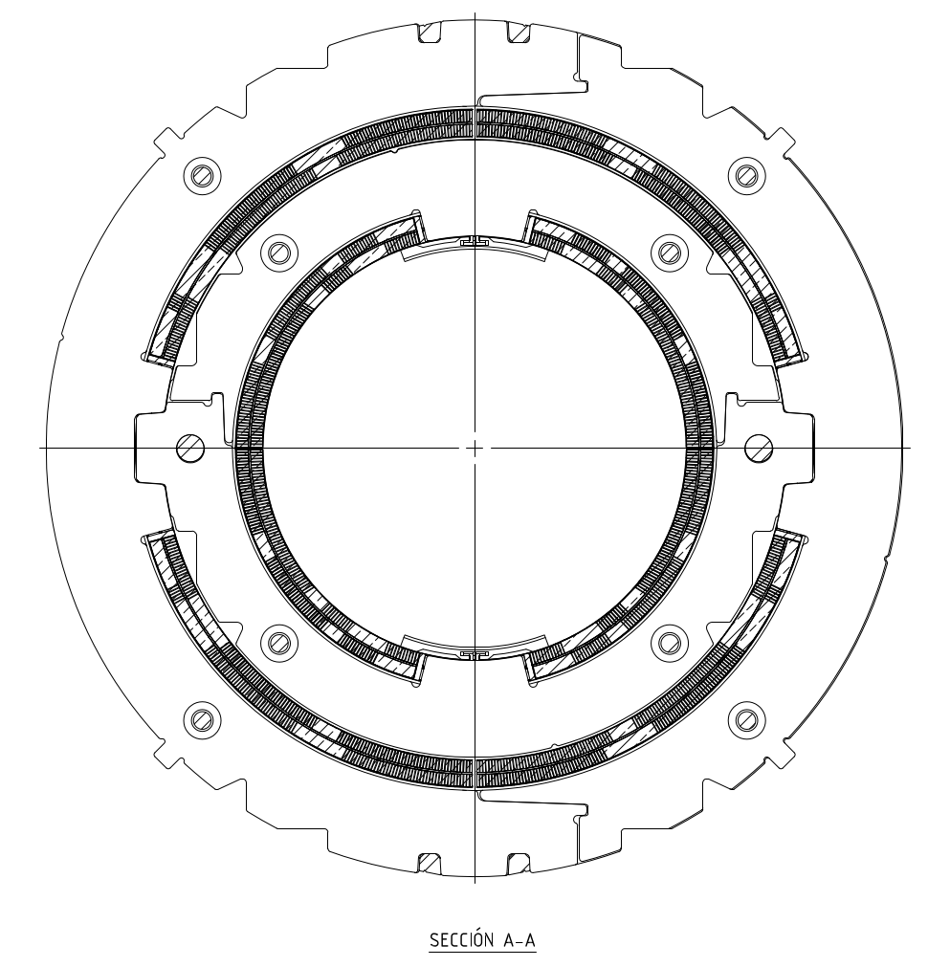
THE STRAIGHT PART
In the straight part, collars are locked and coils are blocked by poles
The main worry is the preload level in the inner layer
  Under individual powering, the minimal preload required to be always in compression is 25 MPa
  When both layers are powered, this goes to 40 MPa
Contrary to an ordinary dipole, there is a component of the forces pushing the coil inward – therefore the coil has alwas to be compressed
  Today we had 40 MPa preload in MCBXFBP1
  This level appears not to guarantee operation –unless we can prove that radiation is not degrading the CTD101K properties
  I would consider much safer zone a preload of the order of 70 MPa (at 1.9 K)

Slide 11
THE STRAIGHT PART
We have no measurement of the prestress loss for the second prototype
  I would suggest instrumenting it since there was an iteration on coil insulation that could change the preload loss from room temperature to 1.9 K
We should explore all possibilities to give more preload, in the range 60-80 MPa

Slide 12
PROPOSAL OF NEXT STEPS
MCBXFBP2b
  Second assembly with radial shimming in the inner collar / outer coil
  Fuji paper test to assess the level of preload, with two-three steps of 25 mm (0-50-100 MPa)
  Only outer dipole disassembled
MCBXFBP2c
  Third assembly exploring the limit of possible preload, aiming at 80 MPa uniform along the magnet length in the inner layer
  Instrumented collars to measure the level of preload in the straight part at 1.9 K and possibly
  Developing instrumented collars to measure preload in the coil heads

Slide 13

APPENDIX
Ratio between azimuthal and radial stress in a thick cylinder under outer pressure
σ_{r}
$$\frac{σ_{r}}{σ_{θ}}=\frac{1−{\left(\frac{r_{1}}{r_{2}}\right)}^{2}}{1+{\left(\frac{r_{1}}{r_{2}}\right)}^{2}}$$
r₂
r₁
σ_{θ}

