Slide 1
Status of WATCHMAN Calibration Requirements Study
David Hadley
Warwick COVID Meeting, 2020-10-13

Slide 2
Light Injection System for WATCHMAN Calibration
Based on a system designed for Hyper-K and installed in Super-K
Optical system may be used for:
Gain
Timing
Monitoring target medium optical properties
Reflections
Real time monitoring as well as data for offline analysis

Slide 3
What are WATCHMAN Requirements?
WATCHMAN is different to Hyper-K and Super-K
Research goals
Tank size
Maybe WBLS?
May lead to different optimisations for the optical calibration system:
Number and placement of sources,
Absolute light levels injected,
Timing and spatial light profile of sources

Slide 4
Analysis Plan
Aim: Study the impact of optical properties of the medium on systematic uncertainties for WATCHMAN analysis
Plan:
  ⬜ Simulate WATCHMAN with varied water properties
  ⬜ Evaluate the impact on the reconstruction
  ⬜ Run the standard WATCHMAN sensitivity analysis on these data sets
  ⬜ Derive target precision on water properties required to meet WATCHMAN sensitivity goals
  ⬜ Feed these requirements back into calibration system design

Slide 5
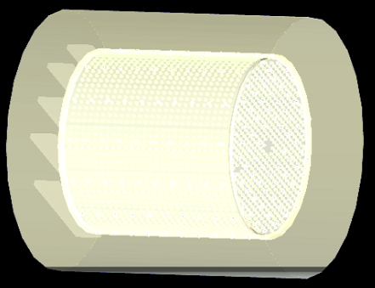
Recent Activity
Spending a lot of time getting to grips with the WATCHMAN software stack…

Slide 6
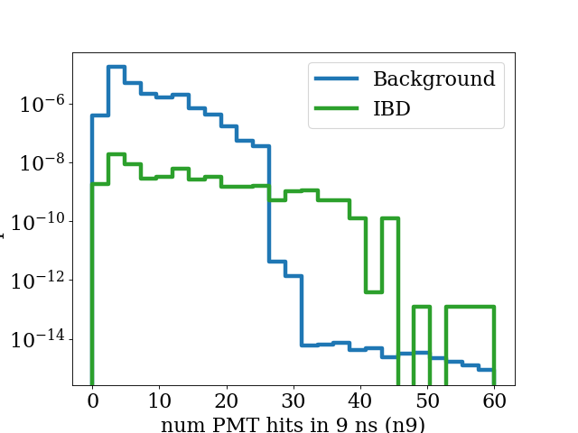
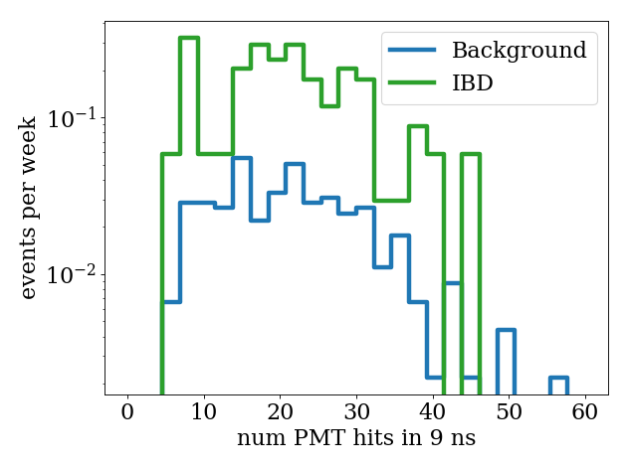
Fixed Issue with excessive backgrounds reported in a previous simulation meeting
Previous Result
New Result
(*Missing some backgrounds. Current simulation is not stable.)

Slide 7
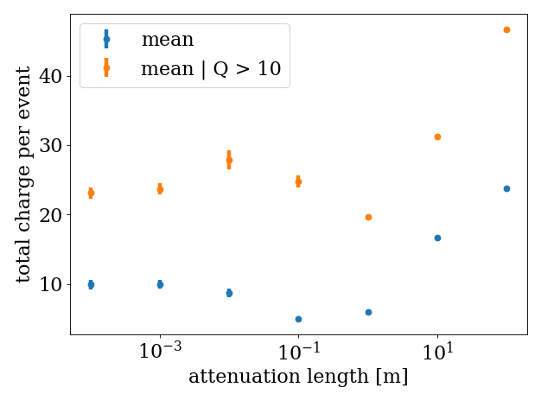
Demonstration of Successfully Modifying Monte Carlo Water Parameters

Slide 8
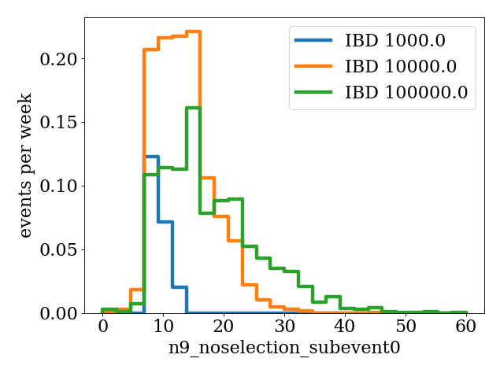
Evaluation of the Impact of Water Properties on Reconstruction is in Progress

Slide 9
Analysis Plan
Aim: Study the impact of optical properties of the medium on systematic uncertainties for WATCHMAN analysis
Plan:
  ✅ Simulate WATCHMAN with varied water properties
  ⬜ Evaluate the impact on the reconstruction
  ⬜ Run the standard WATCHMAN sensitivity analysis on these data sets
  ⬜ Derive target precision on water properties required to meet WATCHMAN sensitivity goals
  ⬜ Feed these requirements back into calibration system design

Slide 10
Backup

