Slide 1
Mechanical design, integration and tooling
HL-LHC WP13
Beam Instrumentation
D. Gudkov, G. Schneider, M. Krupa

Slide 2
Content
Mechanical differences between the three types of BPMS: Q1, Q2a-D1, D2
Quasi-symmetric D2 BPM design
Design of bodies
  Details
Design of copper inserts
Synergies with TE/VSC: tungsten blocks, thermal links
Installation situation in cryostats
Alignment procedure and tooling
Status of Design Documentation

Slide 3
Mechanical differences between the three types of BPMs: Q1, Q2a-D1, D2
Picture | Type | Dimensions | Tungsten Absorbers | Aperture Shape
 | Directional coupler | D184xL270.6 | yes | Octagonal
 | Directional coupler | D184xL270.6 | no | Octagonal
 | button | D154xL398.4 | no | Circular
Q2a-D1
“b-type”
Q1
“a-type”
“d2-type”
D2

Slide 4
Mechanical differences between the three types of BPMs:
Q2a-D1 (B-type)
Cooling tube (x4)
Body
Thermal link
Octagonal-round transition
Cooling tube support
Tungsten Absorber (x4)
Electrode (x4)
Electrical feedthrough
Octagonal-octagonal transition

Slide 5
Mechanical differences between the three types of BPMs:
Q2a-D1 (B-type), details
Cut through thermal link
Cut through springs
F
Feedthough-Electrode M2.5 Interface
Thermal link (Absorber – Tube)
Spring
(4 mm stroke = 40 N)

Slide 6
Mechanical differences between the three types of BPMS:
Q1 (A-type)
Cooling tube (x4)
Body
Octagonal-round transition
Electrode (x4)
Electrical feedthrough
Cooling tube support
Octagonal-octagonal transition

Slide 7
Mechanical differences between the three types of BPMS:
D2
Body
Round-octagonal transition
Electrical (button) feedthrough (x4)
Cooling tube (x4)
Round-round transition

Slide 8
Mechanical differences between the three types of BPMS:
Quasi-symmetric D2 BPM design
LHCBPMQBCZB0001
3 mm
188.5 mm
194.5 mm
3 mm
LHCBPMQBCZA0001
Identical interfaces on both sides of the body
Any type of transition can be installed on any side
Octagonal-round transition can only be installed in one orientation (controlled by extra hole on the body face)

Slide 9
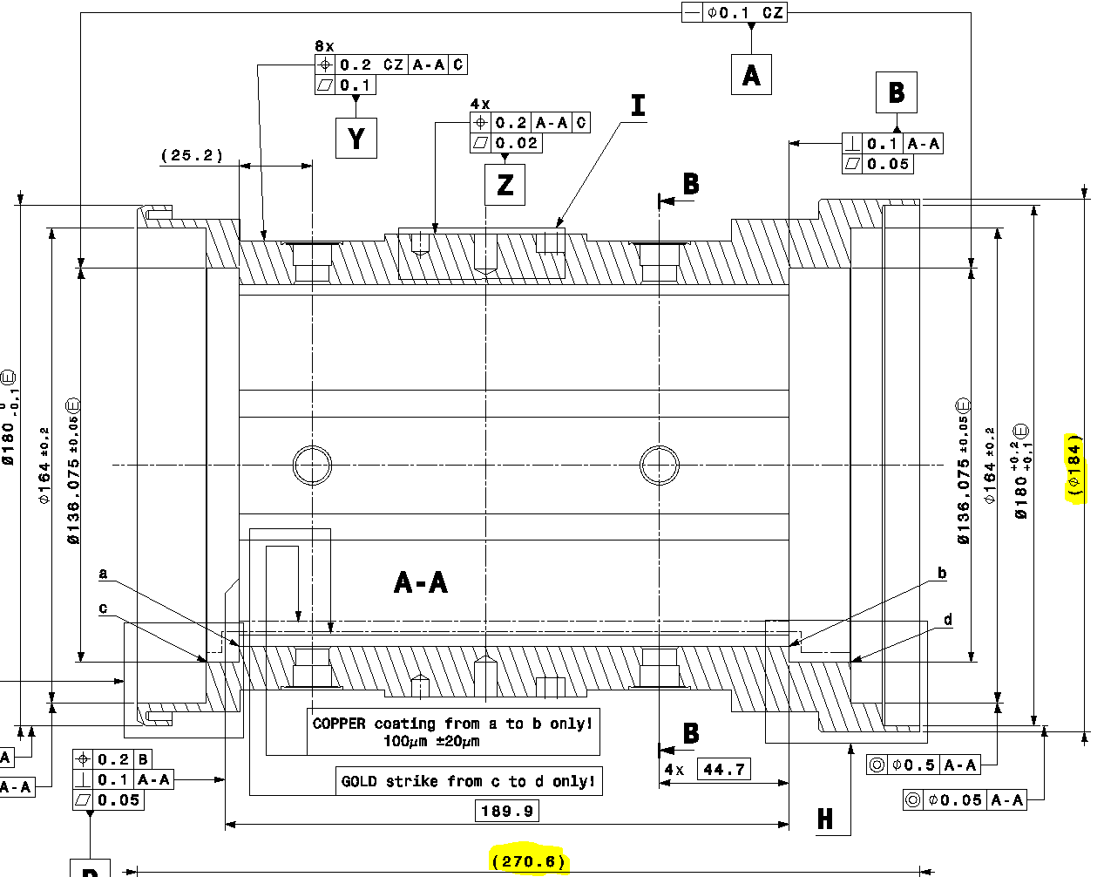
BPM Bodies Design
BPMQSTZB (Type B), LHCBPMQST_B0009
Material: CERN material spec. 1001 for 1.4429 round, forged blanks
Machined ConFlat interfaces (see next slide)
Octagonal shape (electroerosion wire cutting)
Copper electroplating 0.1 mm (with gold flash for adhesion)
2
1
3,4

Slide 10
BPM Bodies Design. Details
BPMQSTZB (Type B), LHCBPMQST_B0009
Machined CF16 ConFlat interfaces were modified to address the following issues:
M4 screws break risk
Limited availability of M5 class 100 grade screws on the market
M4 taps are difficult to machine
M4 and M5 vented screws are difficult to make.
The decision was to switch to M6 screws:
M6 taps are easier machine (cutting tool with inner cooling are available)
Fewer risks in using M6 screws
Class 80 M6 grade screws can be used (standard available)
Study was made and feasibility proved
Standard CF16
Modified CF16 for BPMs

Slide 11
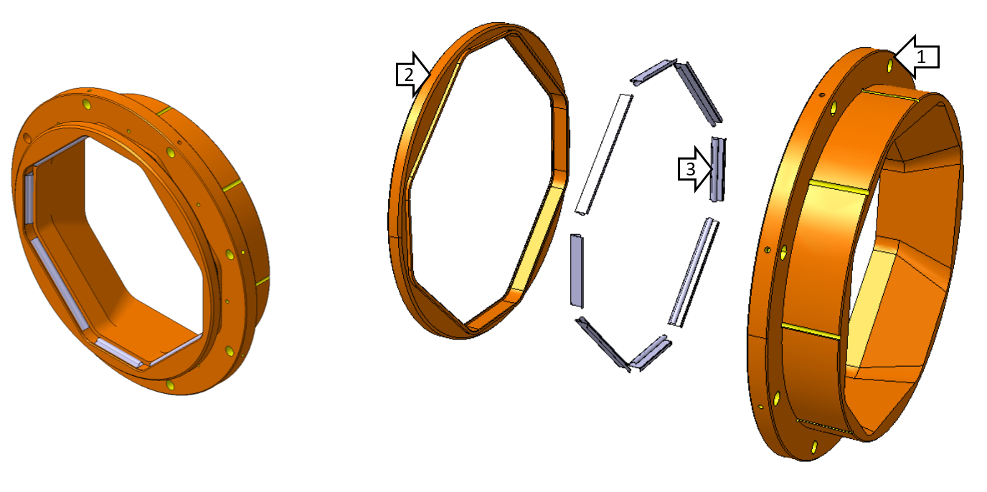
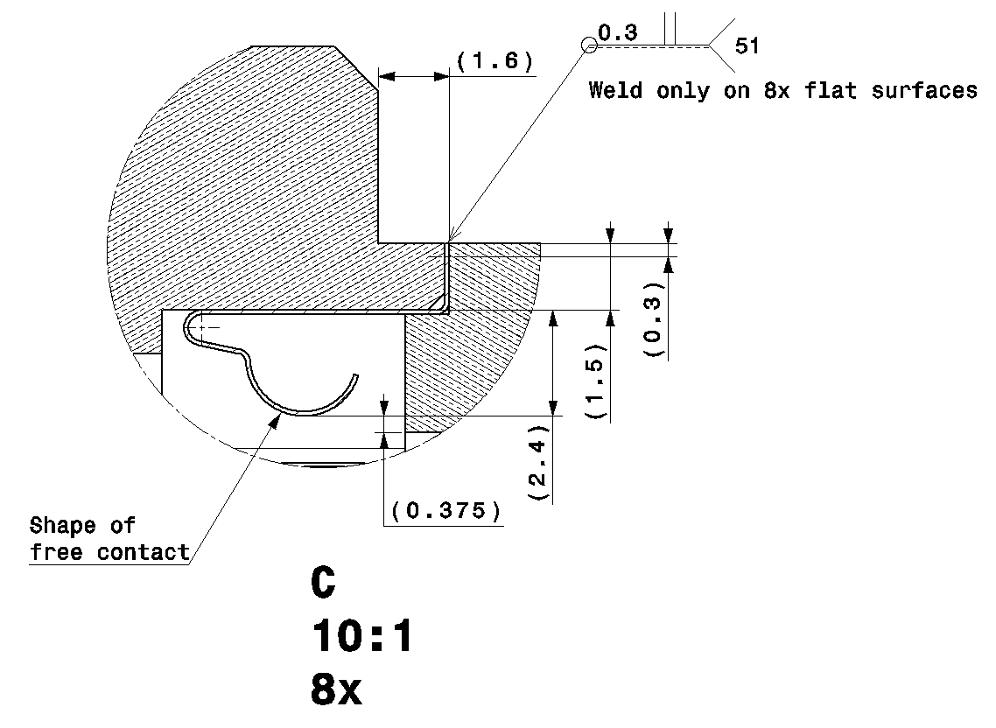
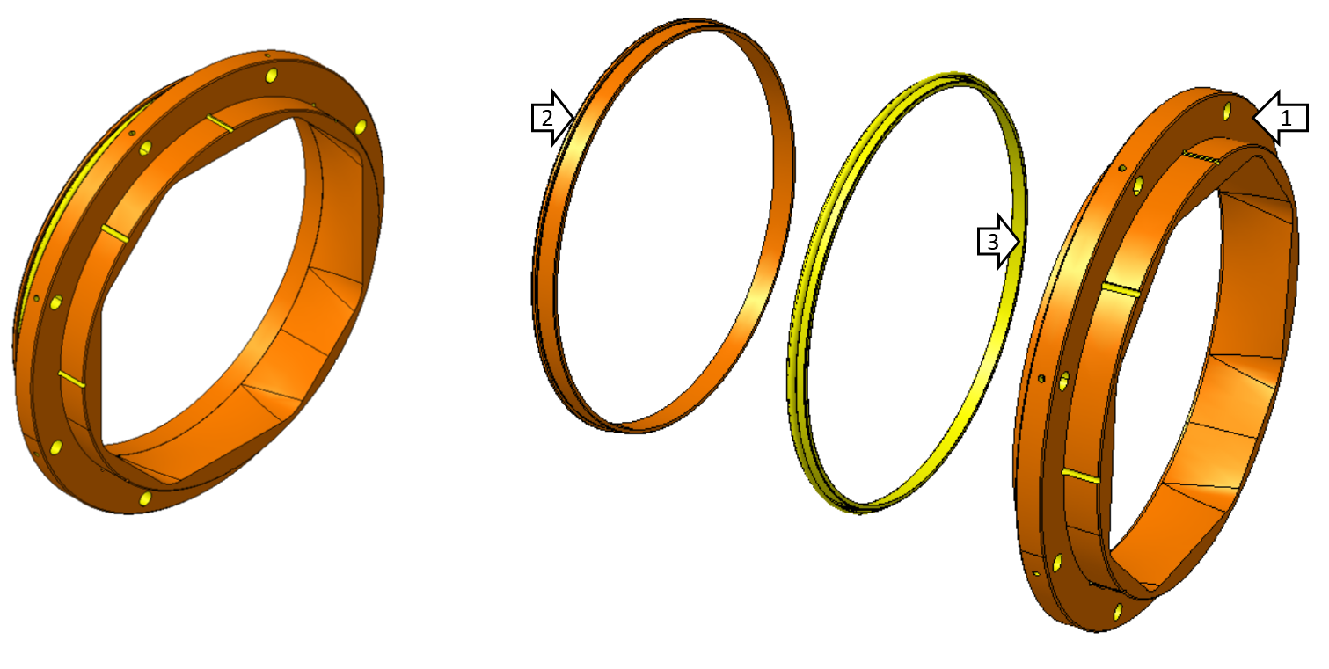
BPM Transitions Design
(LHCBPMQST_B0003 and LHCBPMQST_B0004)
Machining of bases and inserts, cutting and forming of RF contacts
Cleaning of parts
Metrological
control
Electron-beam welding
Metrological control
Packaging
Welding quality control
LHCBPMQST_B0003
LHCBPMQST_B0004
    Electron-beam welding

Slide 12
Synergies with TE/VSC: tungsten blocks, thermal links
Tungsten absorber – Copper strip – Interface plate assembly (LHCBPMQST_B0026)
Weld or braze interface plate and cooling strip
Braze interface plate-cooling strip subassmbly to the tungsten absorber
Packaging
Quality control
Tungsten absorbers will be supplied by the TE-VSC
Copper strip and interface plate are welded (ultrasound welding)
Then the strip-interface plate subassembly is brazed to tungsten block
3
1
2
Tungsten absorber
Copper strip
Interface plate (is laser-welded to the cooling tube)
CERN Workshop has developed the manufacturing process which will be used to produce 100 pcs. subassemblies (process developed for VSC BS)

Slide 13
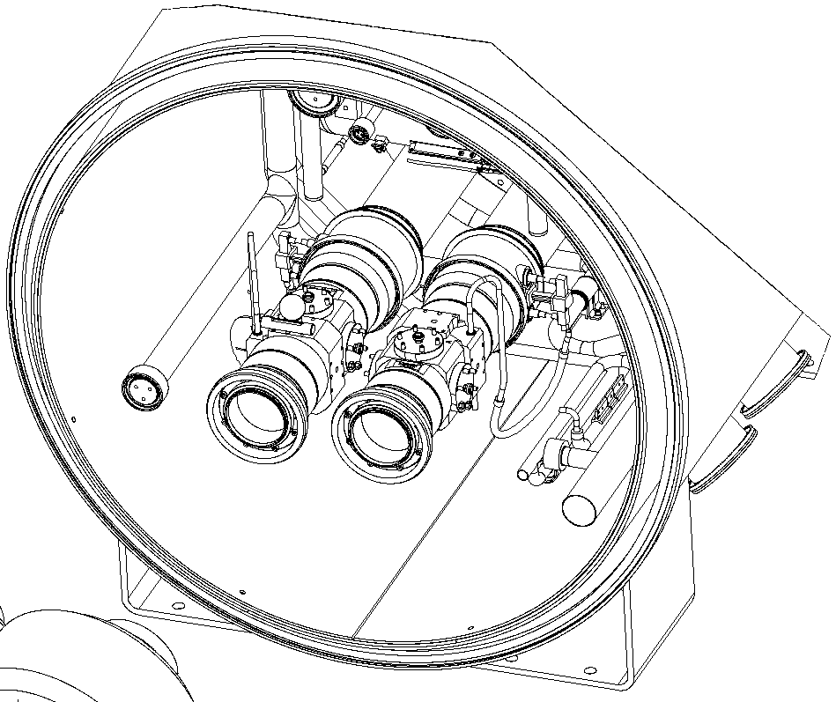
Installation situation in cryostats
D2 (LHCBPMQBCZA0002)
BPM interfaces were discussed and agreed with TE-VSC
3D and 2D were prepared to study the integration of welding machines
For successful installation: first weld BPM, then weld cooling tubes

Slide 14
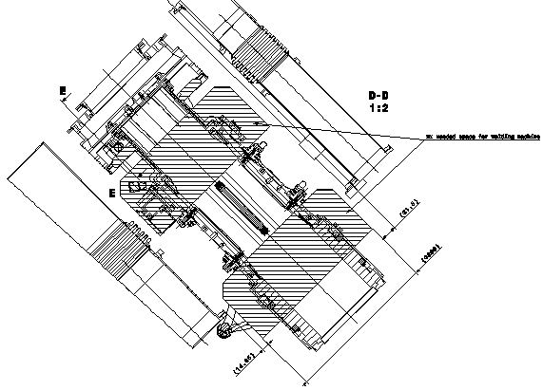
Installation situation in cryostats
Type B (LHCBPMQSTZB0003)
BPM interfaces were discussed and agreed with TE-VSC
3D and 2D were prepared to study the integration of welding machines
For successful installation: first weld BPM, then weld cooling tubes

Slide 15
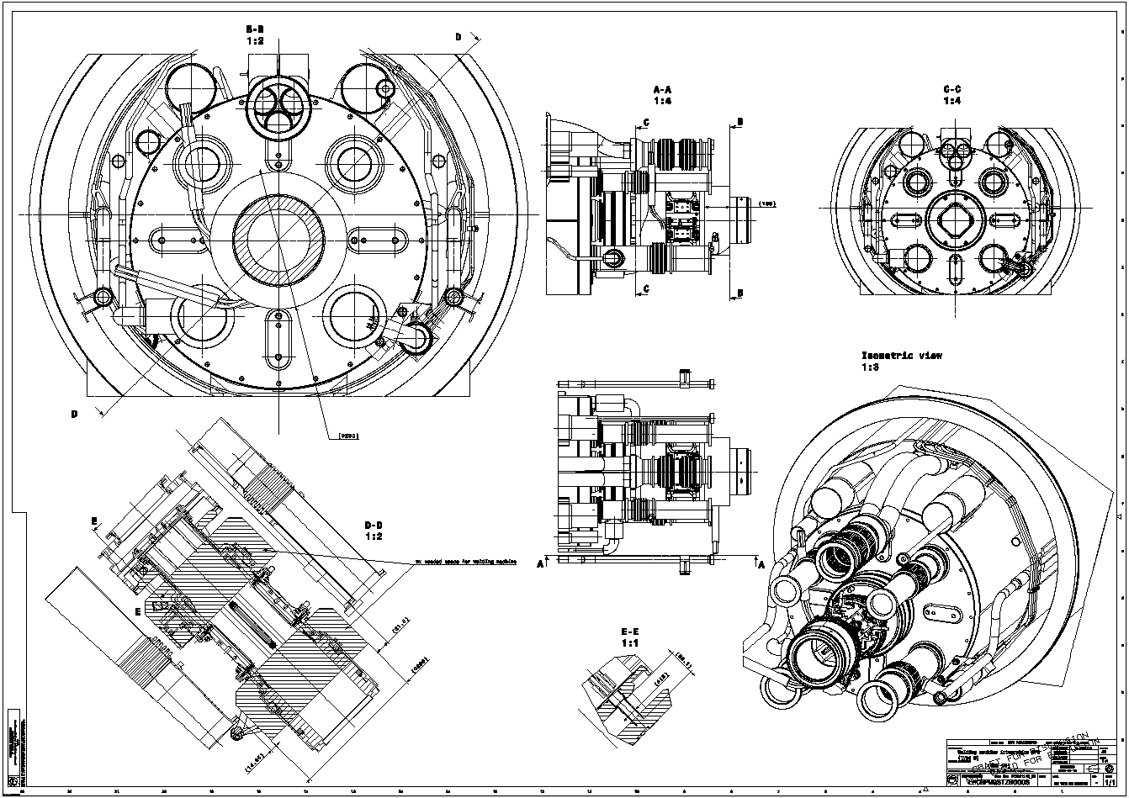
(LHCBPMQSTZB0003)

Slide 16
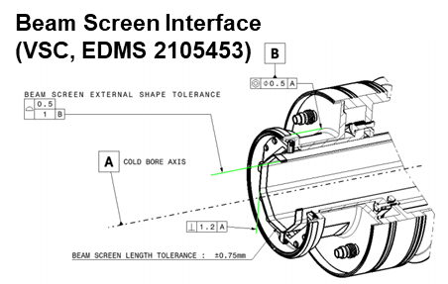
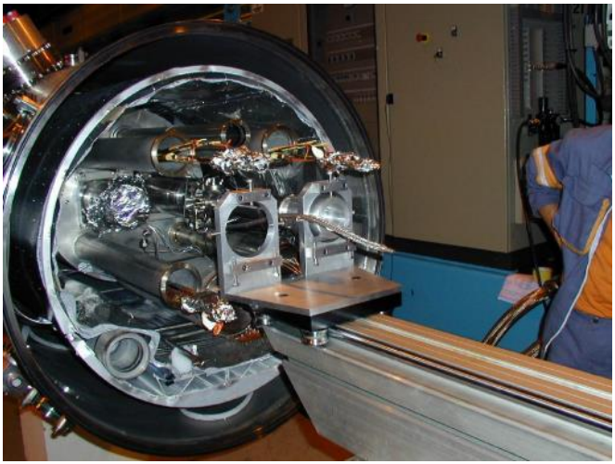
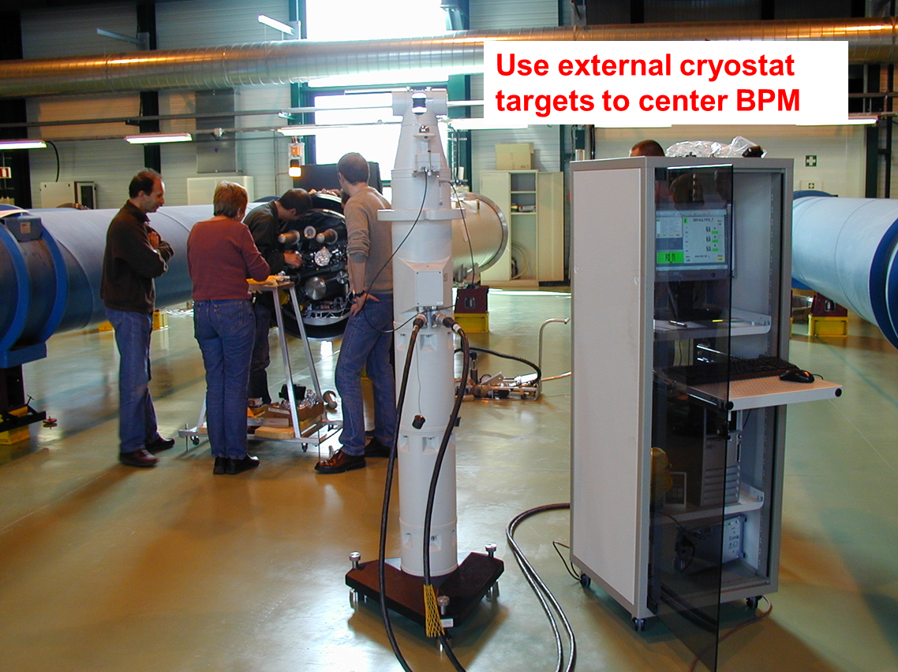
Alignment procedure and tooling
Use experience from LHC construction
  Proven installation alignment principles
  The assembly sequence is defined in memorandum EDMS 2105453
Installation and alignment sequence:
Install BPM installation and alignment tool (to be designed)
Install BPM
Align BPM to optimum position with help of screws and level gauges. The offset between this aligned BPM location to the nominal position, i.e. the misalignment, must be recorded.
Spot weld the BPM to the vacuum end tube at 8 points. The order of these welds should be such that any movement reduced the misalignment (i.e. starting with the point towards which the BPM should move).
Verify and record the position of the upstream end of the BPM after cool-down of the spot welds, the measurement must be recorded.
Final orbital weld. This weld should start at the point towards which the BPM should move to improve misalignment.
Verify and record the final position of the upstream end of the BPM after the welding process is complete. The measurement must be recorded.
Leak check of BPM beam screen weld.
Install and weld the cooling tubes, total 8 welds.
Leak check of cooling connection tubes, 8 welds.

Slide 17
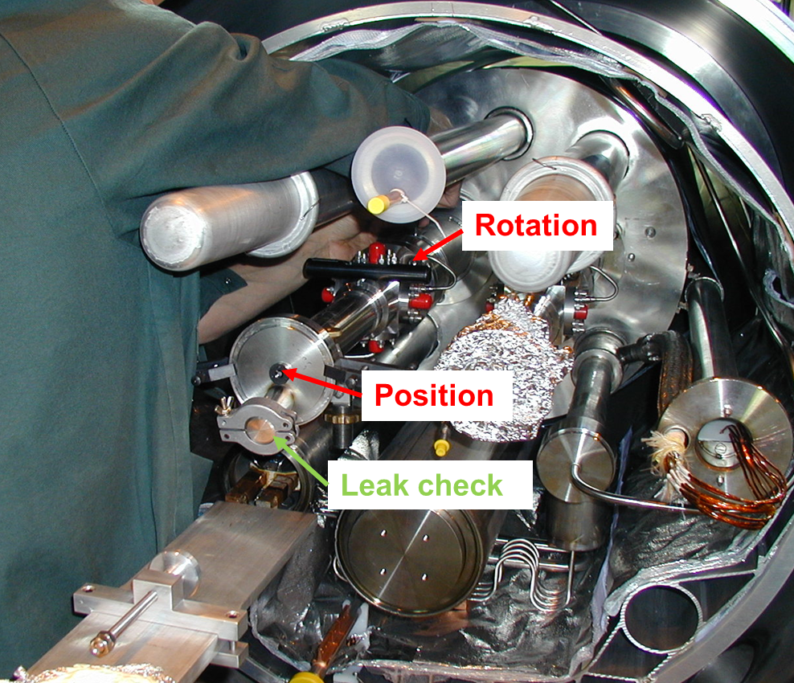
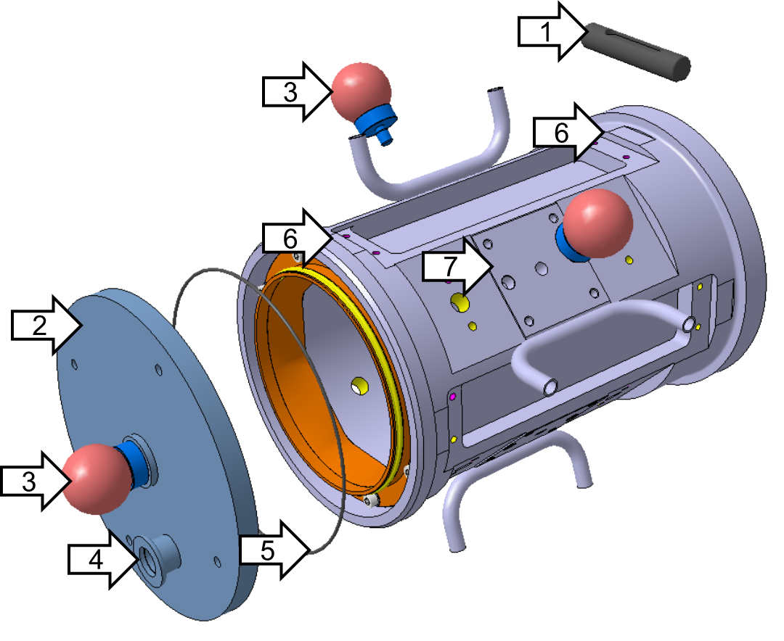
Alignment procedure and tooling
1. Level gauge WYLER Spirit Level 159-080-151-100
2. Alignment and vacuum sealing flange
3. LEICA TARGET 1,5“
4. KF16 port for leak tightness test
5. O-ring FPM D168 mm d2 mm
6. Flat surfaces on the BPM body
7. Features for alignment and handling
Dummy interface BPM is in production for future integration test
Targets and gauge were agreed with P. Bestmann

Slide 18
Status of design documentation
3D models are ready to prepare manufacturing drawings
Preliminary versions of 2D manufacturing drawings are ready (all the details necessary for manufacturing)
Minor details on 2D manufacturing drawings to be completed and drawings to be updated
Integration study is underway but no showstoppers for manufacturing of BPM components
  BPMQSTZB LHCBPMQSTZB0001
  BPMQSTZA LHCBPMQSTZA0001
  BPMQBCZA/B LHCBPMQBCZA0001 and LHCBPMQBCZB0001

Slide 19
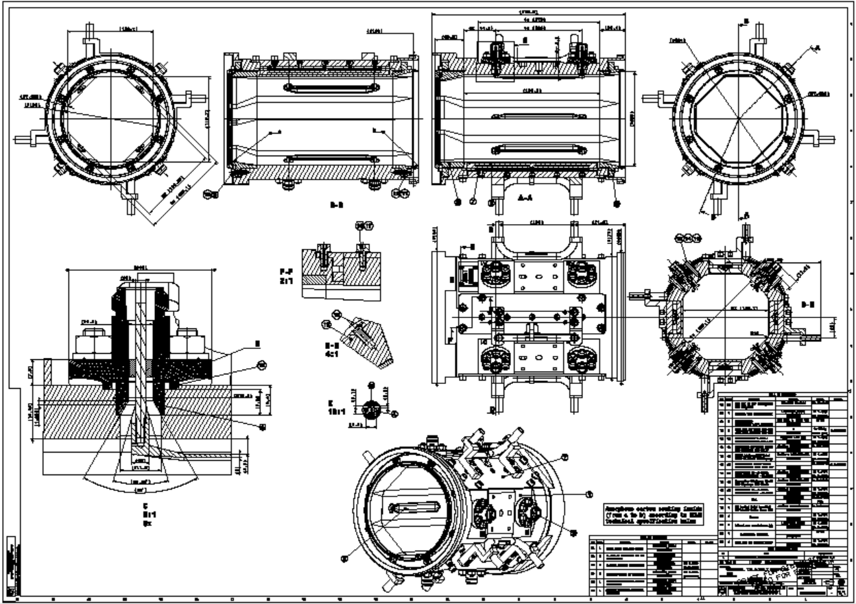
Status of design documentation

Slide 20
Thank you for your attention!
Special thanks for the input and discussions: N. Chritin, A. Demougeot, N. Kos, G. Favres, E. Rigutto, L. Prever-Loiri, R. Veness, K. Scibor, P. Bestmann, P. Costa Pinto, W. Vollenberg, P. Garritty, C. Garion, F. Santangelo, H. Garcia Gavela, M. Thiebert

Slide 21
backup

Slide 22
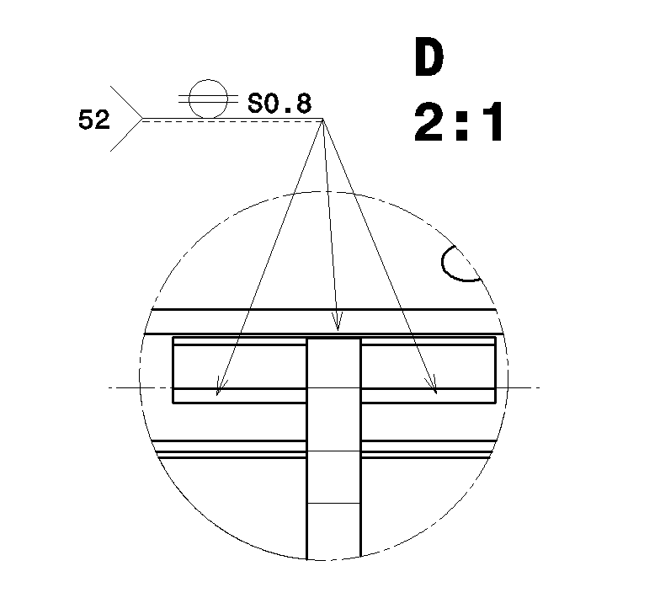
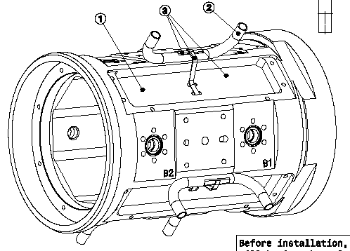
BPM Design Overview. BPMQSTZB
Body, welding tungsten – cooling subassembly (LHCBPMQST_B0002)
Last welding step
The tungsten blocks are put into the pockets on the body
The interface plate is welded (laser) to the cooling tubes

Slide 23
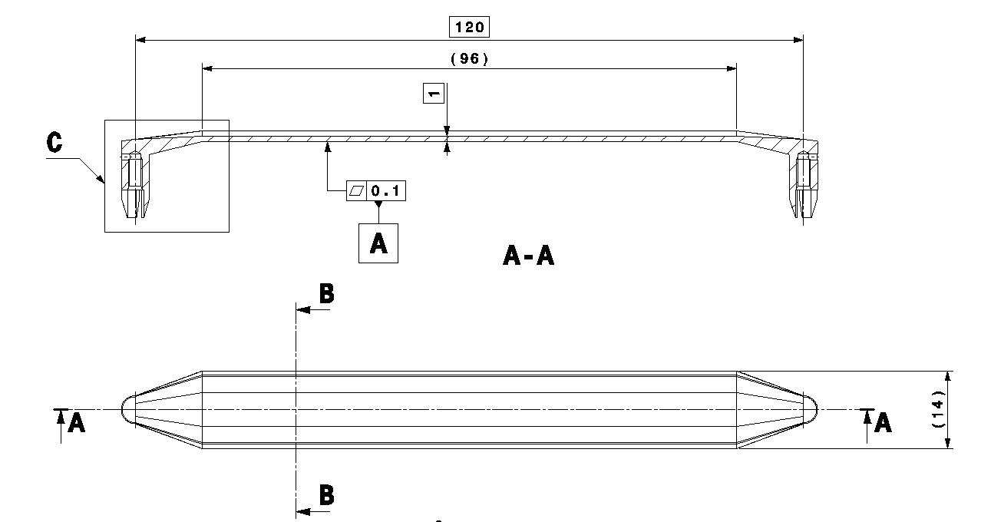
BPM Design Overview. BPMQSTZB
Electrodes (LHCBPMQFT0003)
Machining of electrodes
Cleaning of parts
Metrological
control
Gold flash/Copper coating
Coating control
Packaging
ACc
Iterative design, several prototypes have been manufactured
Design optimization is still underway, one more iteration is most likely OK
Material: CERN material spec. 1000 for 1.4429 round, forged round bars

Slide 24
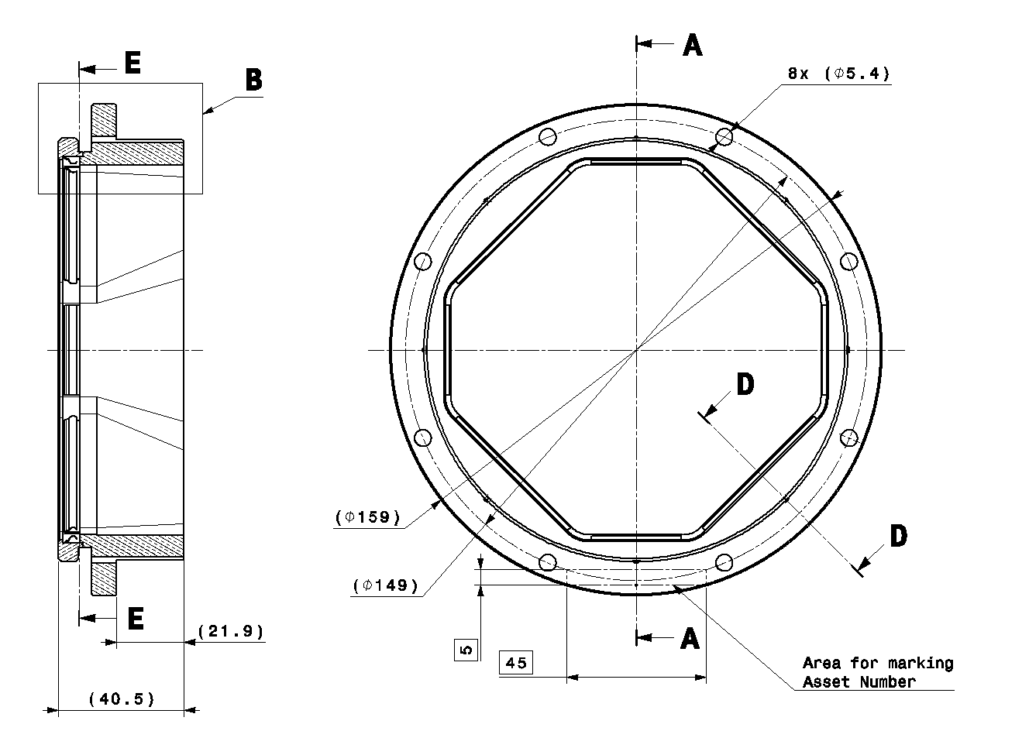
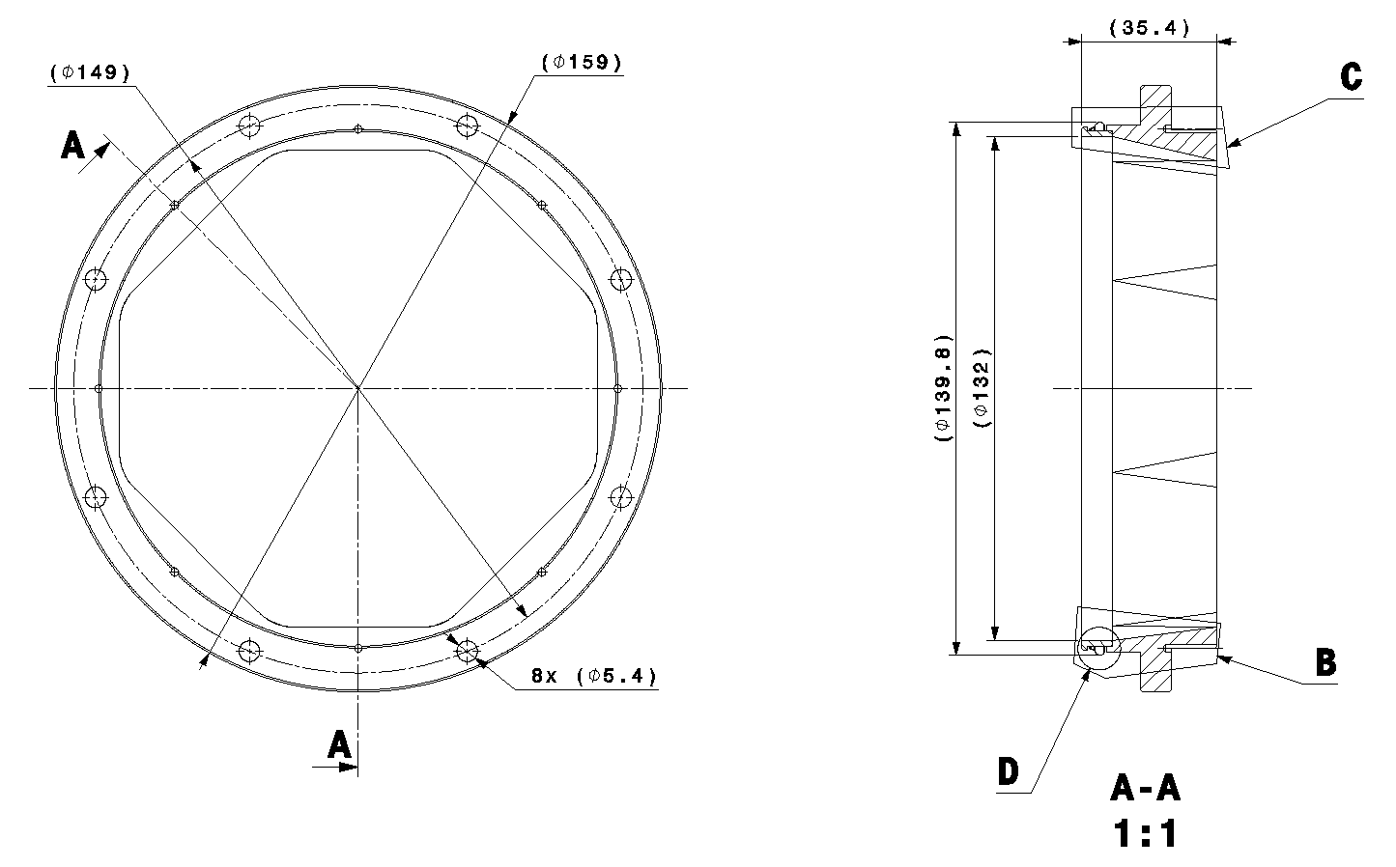
BPM Design Overview. BPMQSTZB
Transitions (LHCBPMQST_B0003 and LHCBPMQST_B0004)
LHCBPMQST_B0003
LHCBPMQST_B0004
CERN material spec. 2000 for Oxygen-Free Electronic copper sheets – transition parts
CuBe 17410 – electric contacts
Electrical contacts are supplied in form of 600 mm strips

