Slide 1
HL-LHC BPM final design review https://indico.cern.ch/event/965501/
V. Baglin, P. Fessia, T. Lefevre, M.Zerlauth
19.11.2020
Acknowlegmenets: G. Schneider, M. Bozzolan, M. Krupa, D. Gudkov

Slide 2
Charter
To confirm that we are ready to hand over the design of the various different BPMs for the HL-LHC Interaction Regions to BINP for preparing the production.
To freeze the interfaces and integration aspects impacting all of these BPMs.

Slide 3
Questions to Panel members
Does each BPM design meet the functional requirements?
The characteristics to be assessed in particular are: beam position measurement capability, beam coupling impedance, electron cloud mitigation, cooling including temperature and heat-load management, vacuum integrity, collision debris absorption (where applicable).
Is each BPM design sound and optimised for ease of production and cost?
Design aspects to be assessed in particular are: selected raw materials, machined conflat flanges, synergies with TE/VSC designs (thermal links, RF fingers), coating materials, tooling for BPM alignment, copper inserts, welding lips, cooling capillaries.
Is the BPM integration within each cryo-assembly well defined?
The integration issues to be assessed in particular are: definition of interfaces to the downstream and upstream components, BPM installation procedure including use of the necessary tooling, routing of the cryogenic cables installed within the cryo-assembly, location of cryostat flanges, mock-up plans.
Does the procurement and mechanics production plan promise a successful delivery?
Production aspects to be assessed in particular are: selected machining methods, division of responsibilities between CERN and BINP, production capabilities at BINP, prototyping plan, quality assurance plan, documentation, coating and assembly procedures, non-conformity treatment.
Are the project budget and schedule clear and in line with the HL-LHC project?
Parts of the project to be assessed in particular are: alignment with the global HL-LHC schedule, missing expenses, overlooked tasks.

Slide 4
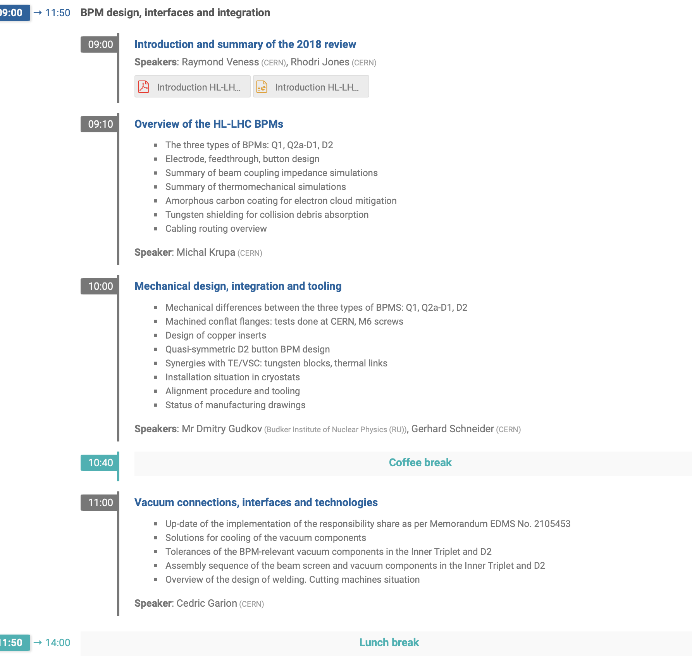
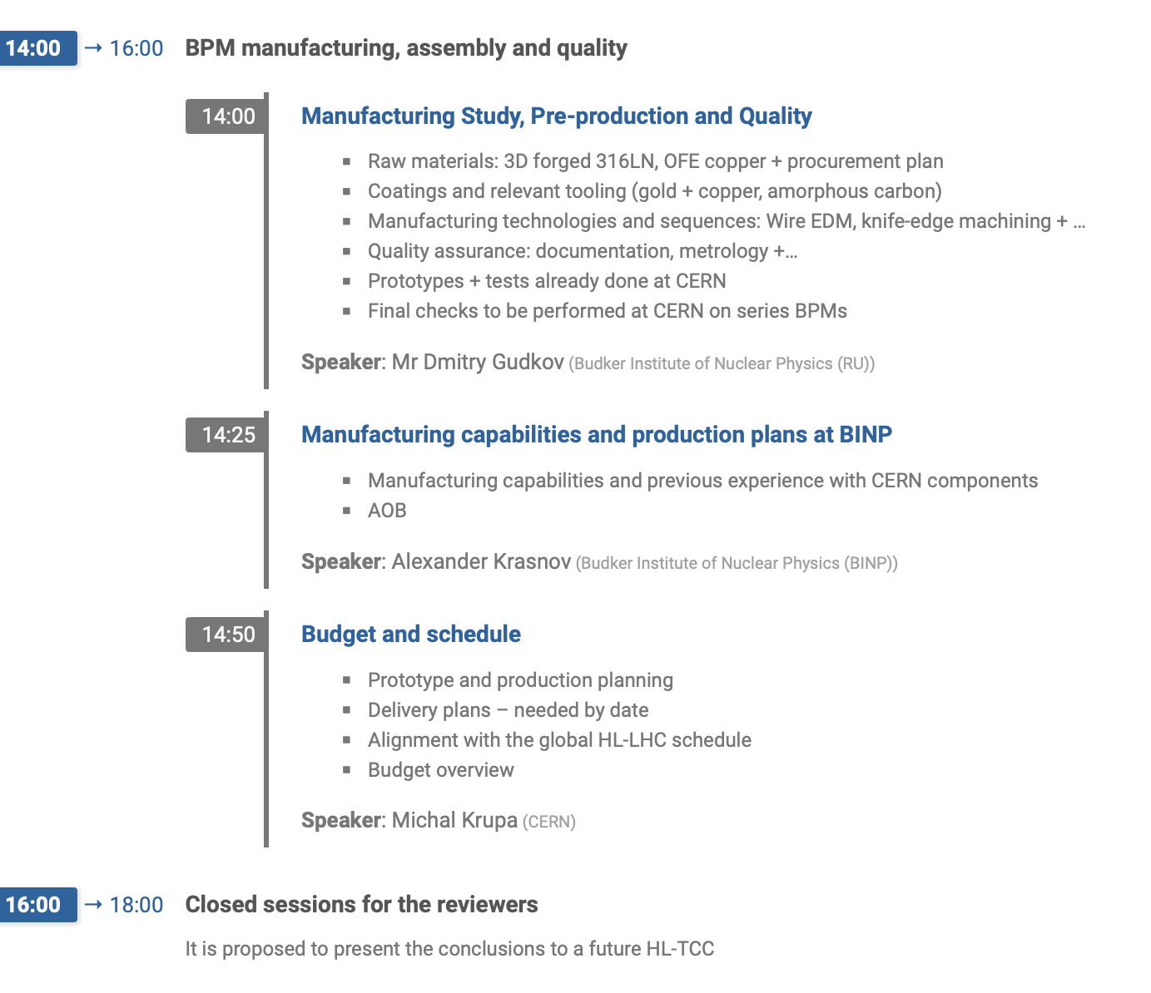
Timetable

Slide 5
Executive Summary
The panel would like to thank and congratulate the organisers, speakers and participants for their efforts in the preparation and conduction of this important design review of the HL-LHC BPMs
We have been presented with a comprehensive overview of the current status of development and preparations towards the series production planned at BINP in the framework of the Russian in-kind contribution
The panel consider the presented design to be sound and the related interfaces well defined and sufficiently validated to proceed with the pre-series production at CERN
A detailed production readiness should be conducted towards the end of Q1/2021

Slide 6
Introduction
Findings
  Conceptual design review held in May 2018, documented in LHC-BPMSQTB-ER-0001
  Emphasized the need of claryfing and freeze interfaces and integration aspects with surrounding environment (between BE-BI, EN-SMM, TE-VSC and TE-MSC as per as per EDMS 2105453)
  Need to confirm readiness to start CERN internal manufacturing of pre-series
  Assess readiness to hand over design to BINP for preparation of production
Comments
  BPM Functional Specification as per EDMS 2394486 currently under review
Recommendations
  RAS

Slide 7
Overview of the HL-LHC BPMs
Findings
ECR for descoping of warm directional couplers for D2 still pending approval
3 different types of BPMs are installed in triplet and D2, total of 44 new BPMs B type is the most complex including the tungsten shielding
  A type simplified B-type
  D2 simpler design with capacitive button pickups (very similar to today's LHC BPMs)
  2 full spares are foreseen for each (matching number of spare magnets)
  Pre-series could potentially serve as spares well (should not be immediately descoped)
Tungsten shielding connected with same principle to cooling tube as was developed for triplet beam-screens, however with only 1 connection / block
(Mis)alignment of tungsten absorbers wrt to the ones in BS can be tolerated up to 2mm

Slide 8
Overview of the HL-LHC BPMs
Findings
No detailed information was presented wrt to cooling requirements and how important the quality of the thermal link is?
  Targeting 1.1 of SEY for all BPMs, max of 1.65W in body and 40mW in electrode at bunch intensities >2.1 E11pbb
  Solid Cu is not perceived to require requalification (in Cryo lab some setups would however be available to do such test rather quickly)
For impedance considerations, all transitions <15 deg are qualified as acceptable by ABP
e-cloud mitigation achieved with amorphous carbon coating of BPM body and electrode
  The isolating ceramic inserts are in direct view of beam. It could be studied if they can be placed in the shadow of the electrode. This is not expected to be of big concern, however the efficiency of coating in such configuration would have to be studied carefully

Slide 9
Overview of the HL-LHC BPMs
Comments
The electrode shape has been optimised for better directivity, it remains to be validated with cold cycles if the new fixed design does not result in mechanical constraints (despite using same material for body and electrodes)
The reason of the high e-cloud contribution in the CP could not be explained to the reviewers during the presentation and should be clarified with WP2 (B. Salvant)
While test have been performed by the VSC colleagues for the cooling connection, no quantitative reliability assessment is available
  (Nota bene: For the IT case tests in cryo labs have shown that even 25W/m can be easily absorbed due to redundancy - BPM more exposed due to single connection)
The detailed cable routing from the BPM towards the flange remains to be finalized
Upgraded feedthroughs and seals (including lessons learnt) are the only non-welded components (was not done for LHC components neither)
With no BPM in IT string test, there is no possibility to check and guarantee alignment tolerances after installation and through thermal cycles
Final BPM models to be provided for integration into service module

Slide 10
Overview of the HL-LHC BPMs
Comments
The presented heat loads estimations are taking into account collision debris, e-cloud, impedance and the measured signal. Another iteration in collaboration with EN/MME to converge on final numbers
  Nota bene: Current estimation of Cryo is a induced heat load of about 23W@1.9K per LSS, which translate into operational costs/LSS side of around 115kCHF over the HL lifetime
  Have to find right balance between engineering optimisation and engineering/operational cost has to be found (coating of electrodes probably marginal gain wrt to additional technical risk)
The change towards a BPTX type instead of APWLs (ECR in preparation) should be formalized - out of scope of this review
In conjunction with the project, synergies with other (existing) mock-ups (EN/MME, TE/CSV) should be explored to maximise thei ruse and representativeness

Slide 11
Overview of the HL-LHC BPMs
Recommendations
  R1: Provide a complete list and scheduling of tests foreseen to validate design/integration (e.g. BPM response, thermal cycles, integration mock-ups) between first prototype and series production and identify possible mitigation measures
    Simulate and Measure matching of transitions once BPM is built
  R2: Test on surface and in representative conditions all the operations that shall be performed in the tunnel. Take into account the potential singularities in surrounding environment (Q1 is different in IP1 and IP5….)
    Develop an appropriate procedure and work dose plan
    Cross-check locations of feedthrough ports against TITANs
    All cabling between BPM and flanges planned to be done before transport. Installation in tunnel to be validated as plan B (as was required for LHC)

Slide 12
Mechanical design, Integration and Tooling
Findings
  Cooling tubes are laser welded onto body, with additional supports to avoid detachment during handling. Nozzles are welded once installed in cryostat to the flexible cooling tubes
  Supports of cooling tube cannot provide (much) redundancy for thermal connection
Comments
  More robust design of flange using M6 screws is supported
    leak-tightness to be demonstrated with finally chosen machining method for series production @ BINP
  Multi-layer concept was retained in favor of (simpler) of solid copper to avoid additional validation (but exploit synergies with VSC design). This has been weighed against a more complexity welding process of multi-layer, need of well cleaned surfaces,....
Recommendations
  R3: Provide reference to worst-case simulation of a broken thermal link and quantify resulting impact on heat load and BPM performance (i.e. confirm redundancy is not required)
  R4: Finalize BPM design drawings and design of alignment tool for welding of BPM to beam-screen in due time before PRR

Slide 13
Vacuum connections, interfaces and and technologies
Findings
  3 types of BS foreseen, Q1 type (16mm Tungsten inserts) and Q2 type (6mm Tungsten insertes), D2 type (without absorber)
    D2 cross-section (and tolerances) recently approved after production
  Beam screen design and simulation process well advanced, including thermal analysis of heat transfers
    Already tested with 80cm long prototype – expect 330mW/m of induced heat load by beam screen on cold bore for HL operation
  Design of interconnection absorber well advanced and simulated
  Welding of cooling tubes done with spot welding (idem as laser spot welding)
  Interface assembly with CP is the most cumbersome, solution should be found to achieve integration (current leads are already installed before integrating vacuum system).
    Optimisation ongoing but no change of BPM design expected. Remains to be validated with mock-up on surface.

Slide 14
Vacuum connections, interfaces and and technologies
Comments
Currently no tooling available nor (budget) planned for cutting/repair of interfaces in these locations
Out of scope but important action to follow: Assure with project that all cutting machine needed for repair are already included the scope, otherwise request addition of missing ones
Contractual organisation of welding to be delegated to MME colleagues (as done for LHC BS assembly)
  Plan B is manual welding, which only works in case of sufficient access and availability of qualified personnel -> Validate Plan B as well (e.g. in case of leaks, maintenance)
D2 interfaces were recently changed the end covers modified on the downstream side where BPM is installed. This could have an implication on the tooling to bend capillaries.
Recommendations
R5: (Re-)validate (in conjunction with VSC, MME) the integration in IT interconnection with mock-up of service module of magnet with BPM prototype/pre-series. This should include the full cycle of installation, cutting and de-installation

Slide 15
Manufacturing and Assembly procedure
Findings
BPM body - 2 manufacturing types tested, ball milling provides smoother surface (with same machining time)
Octogonal shape realised with electroerosion wire cutting due to length of object, after copper electroplating <RA3.2
Coating only necessary for octogonal shape
Design of handling + process tools ongoing but yet to be completed, idem for carbon coating, some of which start to be urgent (Q1/2021 - Q3/2021)
  Assure link with schedule and planning of required services

Slide 16
Manufacturing and Assembly procedure
Comments
BINP drawings and production methods to be validated by CERN and entered as well in CDD
Use of O-ring (used for stacking BPMs) – albeit out of view of sputtering sources could change vacuum gas composition in vessel and could hamper quality of coating?
  At project level, should review load of the amorphous carbon coating installation
The conflat surface to be machined is a critical aspect and needs to be carefully proven to be leak tight ¹
Lead times for forged 316 LN blanks could as long as 6 months and should be assumed conservatively
Recommendations
R6: Clarify exchange on tooling and procedures to be identical to those of CERN (or assure their qualification if different, e.g. CERN does additional cleaning step before copper coating)
R7: Detailed QA process and checkpoints (e.g. vacuum acceptance test, metrology, mechanical aspect,..) should be defined for precision/delicate items, including on-site visits for their follow-up
¹ The leak tests performed using CERN standard copper DN16 conflat seals always demonstrated the leak tightness with a sensitivity of 2*10-10 mbar.l/s." The full report is available on EDMS 2302967

Slide 17
Manufacturing capabilities and production plan at BINP
Findings
  BINP has already successfully contributed to a wide range of project in the accelerator domain
  State of the art machining equipment is available
Comments
  For some manufacturing steps (e.g. electroerosion), BINP might have to further subcontract.
  Successfully machining of CF flanges by milling to be demonstrated as it was not possible to reproduce the necessary quality of results in CERN workshop
Recommendations
  R8: QA and calibration/validation and accurate qualification of (pre-)series, production and control methods should be defined and implemented (in particular if manufacturing steps need to be further subcontracted by BINP)

Slide 18
Budget and schedule
Findings
No detailed information for schedule and spending profile was presented
Spare strategy foresees 2 spares per BPM type (following spare magnet strategy)
Comments
Following a potential magnet exchange, BPMs can ‘recuperated’ from a defective magnet, cutting possible between 2-3 times
Pre-series production @CERN to start only when design is considered ‘frozen’
Coaxial cables have been source of many problems in the past - now company maintains delivery dates for compliant cables but needs to be carefully followed up and delays considered conservatively

Slide 19
Budget and schedule
Recommendations
R9: Establish before the PRR an integrated planning for pre-series and series production, including dependencies on the required services (work-shop, aC coating, VAC qualification...)
  Clarify with WP3 the latest moment for the first installation of BPM in the cryo assembly to define start of series-production (IT String use-case)
  Assume conservatively the lead times for (critical) raw material and components (i.e. 316LN)
R10: Start pre-series production only after final validation through full integration test in representative mock-ups
  Simplified body can be used but should include fully nominal designs for transitions such as RF fingers
R11: Spare components for the most critical parts and raw materials should be assured beyond the 2 fully assembled spares

Slide 20
Start of pre-series @ CERN
Review members endorse to proceed to pre-series production at CERN
Recommendations
Take final decision for thermal link. Review members support adopting simple(r) copper links, omitting extensive requalification step following experience of VSC colleagues
Completion of integration study with representative mock-ups and BPM (pre-)series designs

Slide 21
MANY THANKS TO ALL OF YOU -
To all speakers, organizers, panel member and participants
for preparing and participating to this important review to validate the design of the HL-LHC BPMs

Slide 22
Questions?

