Slide 1








FCC Status and Plans
Michael Benedikt, CERN
on behalf of the FCC collaboration and FCCIS DS team
LHC
PS
SPS
FCC
http://cern.ch/fcc
Work supported by the European Commission under the HORIZON 2020 projects EuroCirCol, grant agreement 654305; EASITrain, grant agreement no. 764879; ARIES, grant agreement 730871, FCCIS, grant agreement 951754, and E-JADE, contract no. 645479
photo: J. Wenninger

Slide 2

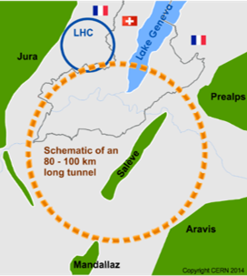
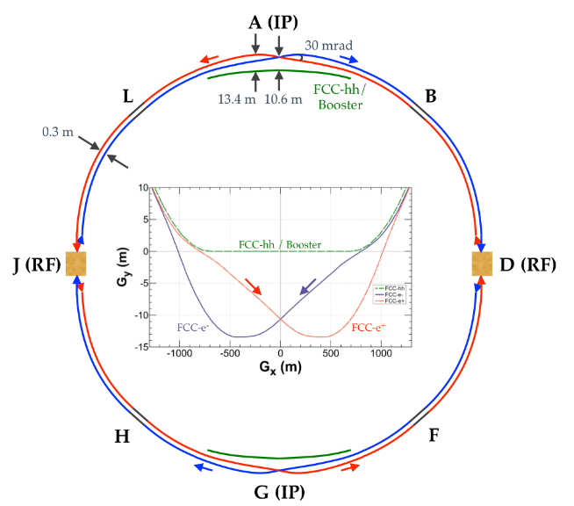
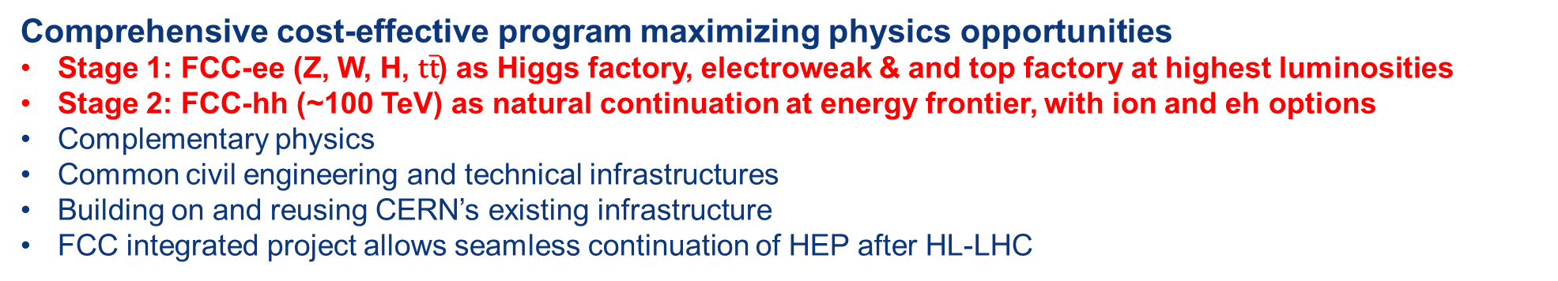
The FCC integrated program
inspired by successful LEP – LHC programs at CERN
Comprehensive cost-effective program maximizing physics opportunities
Stage 1: FCC-ee (Z, W, H, $\text{t}\overline{\text{t}}$) as Higgs factory, electroweak & and top factory at highest luminosities
Stage 2: FCC-hh (~100 TeV) as natural continuation at energy frontier, with ion and eh options
Complementary physics
Common civil engineering and technical infrastructures
Building on and reusing CERN’s existing infrastructure
FCC integrated project allows seamless continuation of HEP after HL-LHC
FCC-ee
FCC-hh
Notes:
The FCC study and program comprises of two accelerators: the Lepton Collider FCC-ee and the Hadron Collider FCC-hh.
The aim of this setup is devise a comprehensive, cost-effective program to maximizing the physics opportunities.

Slide 3
FCC integrated project technical schedule
1
2
3
4
5
6
7
8
9
10
11
12
13
14
15
16
17
18
15 years operation
34
35
36
37
38
39
40
41
42
43
~ 25 years operation
70
Project preparation &
administrative processes
Permis-sions
Update
Permissions
Funding strategy
Funding and
in-kind contribution agreements
Funding and
in-kind contribution agreements
Geological investigations, infrastructure detailed design and tendering preparation
Tunnel, site and technical infrastructure construction
FCC-ee dismantling, CE & infrastructure adaptations FCC-hh
engineering design, energy efficiency, maintainability
conductors & high-field magnet technology
FCC-ee accelerator R&D and technical design
FCC-ee accelerator construction, installation, commissioning
FCC-hh accelerator R&D and technical design
FCC-hh accelerator construction, installation, commissioning
Set up of international experiment collaborations, detector R&D and concept development
FCC-ee detector technical design
FCC-ee detector
construction, installation, commissioning
FCC-hh detector R&D,
technical design
FCC-hh detector
construction, installation, commissioning
Superconducting wire and magnet R&D, short models
Long model magnets, prototypes, preseries
16 T magnet industrialization and
series production

Slide 4
From ESPPU 2020 document
      Core sentence and main request “order of the further FCC study”:
      “Europe, together with its international partners, should investigate the technical and financial feasibility of a future hadron collider at CERN with a centre-of-mass energy of at least 100 TeV and with an electron-positron Higgs and electroweak factory as a possible first stage. Such a feasibility study of the colliders and related infrastructure should be established as a global endeavour and be completed on the timescale of the next Strategy update.”

Slide 5
FCC feasibility study: main challenges
Financial feasibility
Cost of tunnel: ~5.5 BCHF; FCC-ee: ~5-6 BCHF; FCC-hh: ~17 BCHF (if after FCC-ee)
cannot be funded only from CERN’s (constant) budget + “one-off” contributions from
non-Member States → need new mechanisms (global project funding model; EC? private?)
First priority of feasibility study: find ~ 5 BCHF for the tunnel from outside CERN’s budget
Technical and administrative feasibility of tunnel
highly-populated area; two countries with different legislative frameworks
land expropriation and reclassification
high-risk zones
environmental aspects
First priority of feasibility study: no show-stopper for ~100 km tunnel in Geneva region
Technologies of machine and experiments
huge challenges, but under control of our scientific community
pressing environmental aspects: energy, cooling, gases, etc.
First priority of feasibility study: magnets; minimise environmental impact; energy efficiency and recovery
Gathering scientific, political, societal and other support
requires “political work” and communication campaign for “consensus building” with governments and other authorities, scientists from other fields, industry, general public, etc.
→ can FCC be a facility also for other disciplines (nuclear science, photon science, etc.)?
→ creative and proactive ideas for technology transfer from FCC to society
Fabiola Gianotti:
“CERN vision and goals
until next strategy update”
FCCIS Kick-Off, 9 Nov. 2020

Slide 6
Feasibility Study of FCC integrated project
Feasibility study to be delivered end 2025 as input for ESPP Update expected for 2026/2027, to enable a project decision:
Feasibility study of the 100 km tunnel (infrastructure aspects, administrative aspects, local authorities, environment, energy, etc.)
High-risk areas site investigations included, to confirm principle feasibility
Host-state related processes, to allow start of construction early 2030ies.
CDR+ for colliders and injectors, including key technology proofs.
HFM program intermediate milestones, in line with long-term R&D plan.
Physics and experiments CDR + for FCC integrated project.
Financing concept & organization model for project and operation phases.
For all these activities the sequential nature of implementation of the colliders and the overall timeline needs to be taken into account!

Slide 7
FCC roadmap towards stage 1
>2030
start tunnel
construction
>2036
machine
installation
>2040 first
ee collisions
2028 approval
2026/7
ESPPU
>2030 - 37
element production
2025/26
Feasibility proof
>2026 - 30 full
technical design
2014 FCC
study kickoff
2020
ESPPU
2025/26
Financing model
Operation concept
2020 FCCIS
kickoff
2013
ESPPU
2018 FCC CDR
today
2020 2025
FCC Feasibility Study
FCCIS H2020 DS
2012 Higgs discovery announced
2011 circular Higgs factory proposal

Slide 8
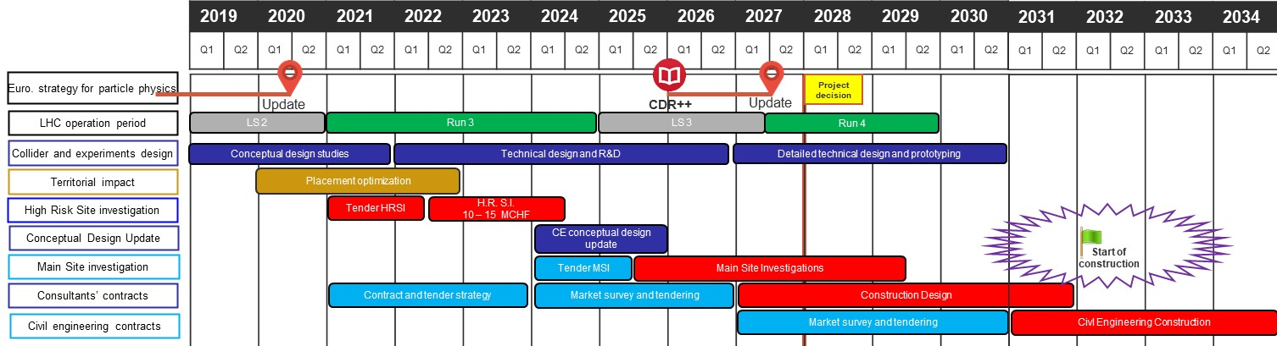
CE preparatory activities 2020 - 2030
Technical schedule of main processes leading to start of construction begin 2030ies
For proof of principle feasibility: High risk area site investigations, 2022 – 2024
Followed by update of civil engineering conceptual design and CE cost estimate 2025

Slide 9
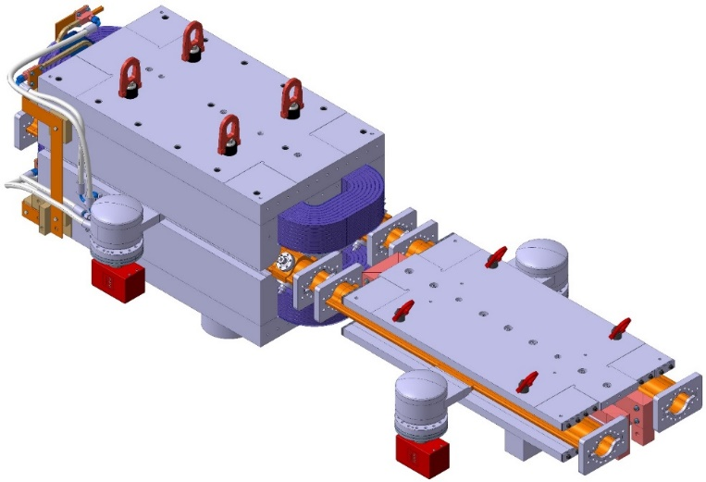
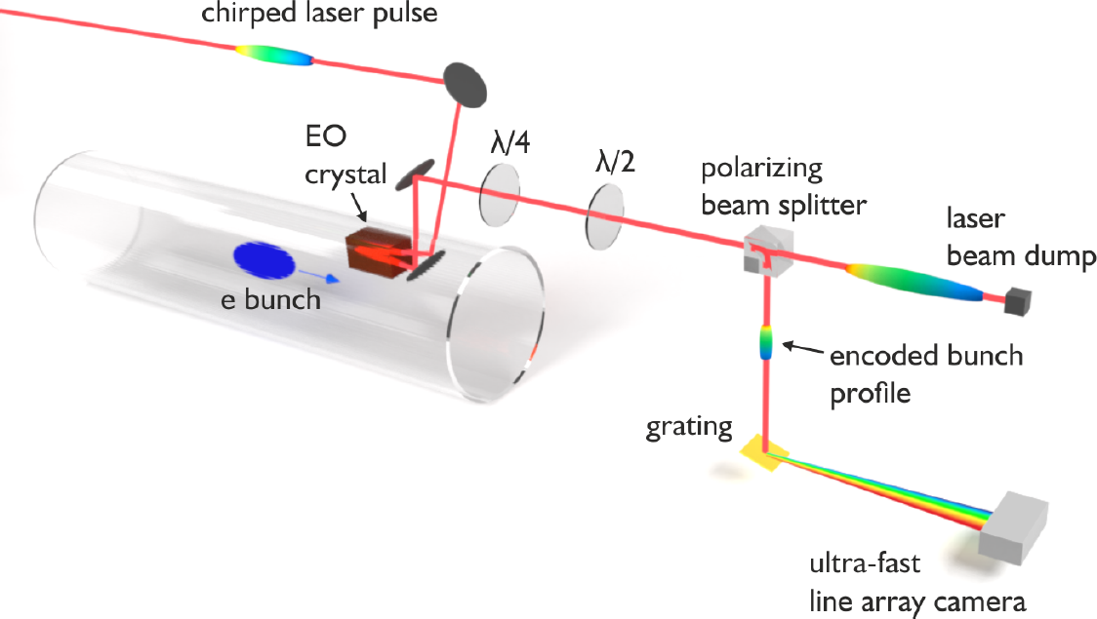
FCC key deliverables: prototypes by 2025
FCC-ee complete arc half-cell mock up
including girder, vacuum system with antechamber + pumps, dipole, quadrupole + sext. magnets, BPMs, cooling + alignment systems, technical infrastructure interfaces.
key beam diagnostics elements
bunch-by-bunch turn-by-turn longitudinal charge density profiles based on electro-optical spectral decoding (beam tests at KIT/KARA) ; ultra-low emittance measurement (X-ray interferometer tests at SuperKEKB, ALBA) ; beam-loss monitors (IJCLab/KEK?) ;
beamstrahlung monitor (KEK); polarimeter ; luminometer

Slide 10
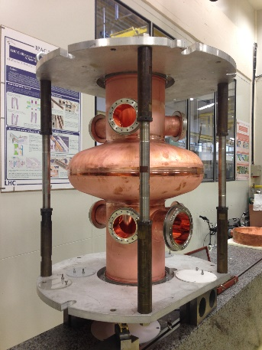
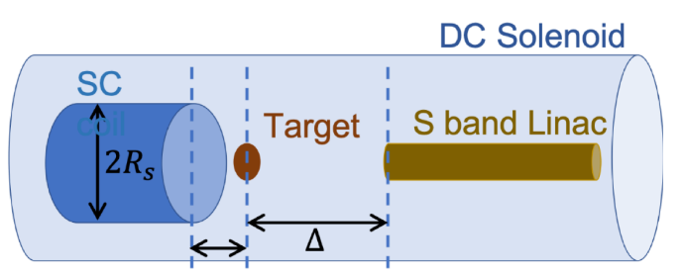
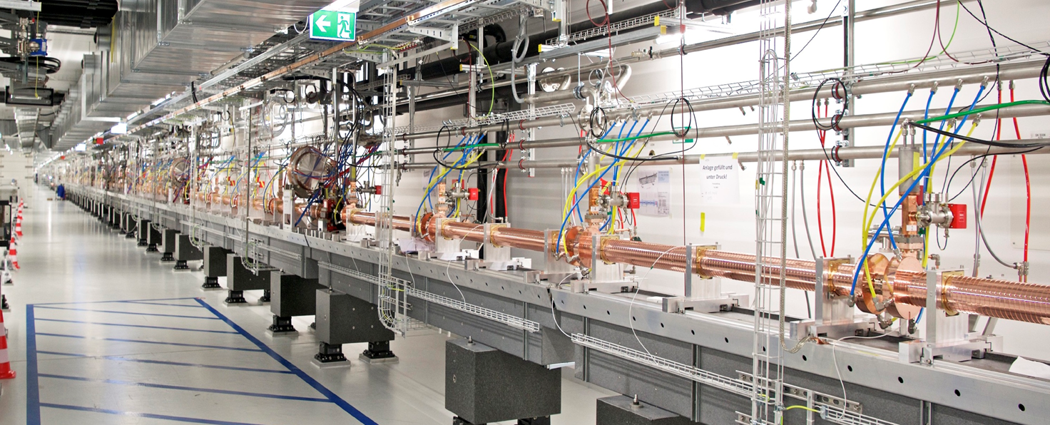
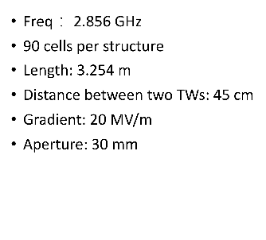
FCC key deliverables: prototypes by 2025
high-yield positron source
target with DC SC solenoid or flux
concentrator
400 MHz SRF cryomodule,
+ prototype multi-cell cavities for FCC ZH operation
High-efficiency RF power sources
positron capture linac
large aperture S-band linac
beam test of e⁺ source & capture linac at SwissFEL – yield measurement
SwissFEL linac
Strong support from Switzerland via CHART II program 2019 – 2024 for FCC-ee injector, HFM, beam optics developments, geology and geodesy activities.

Slide 11
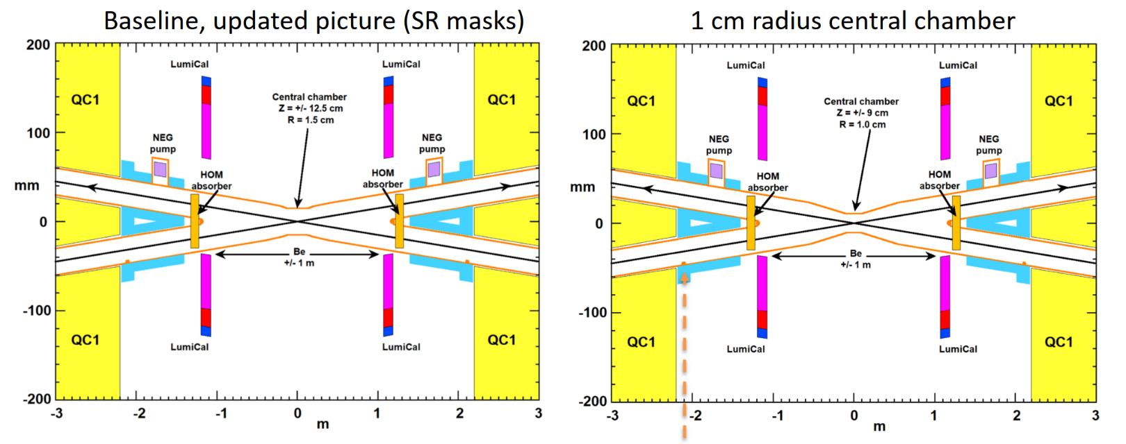
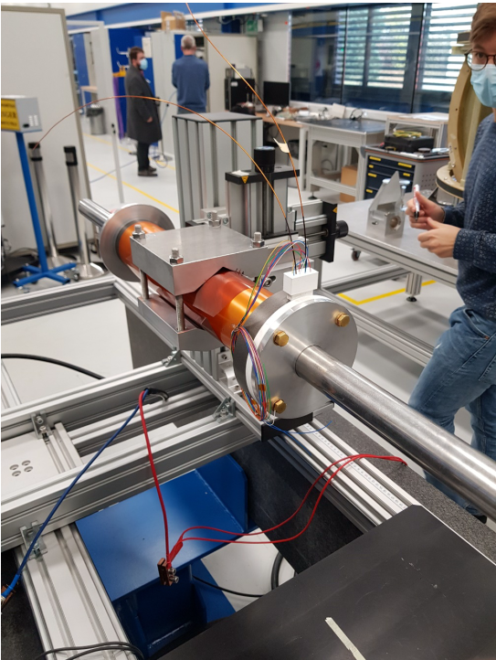
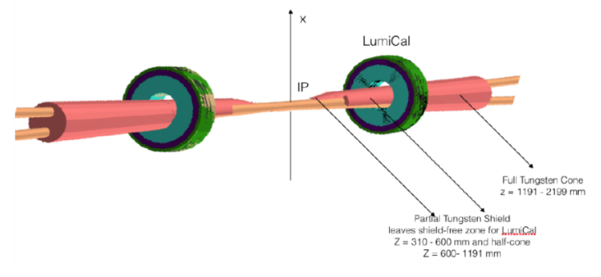
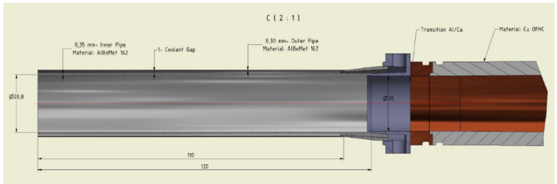
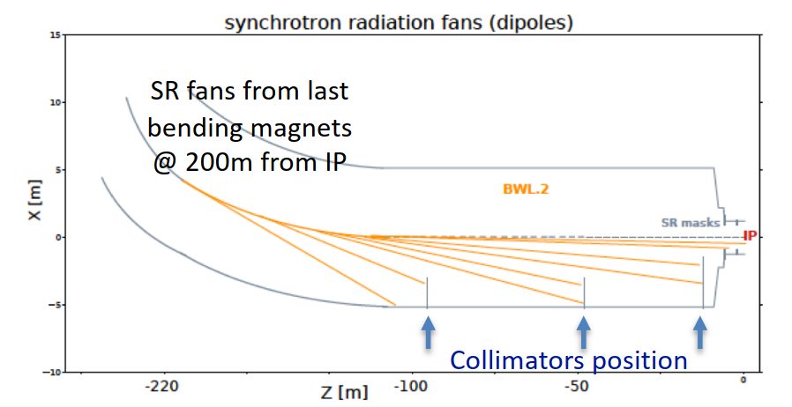
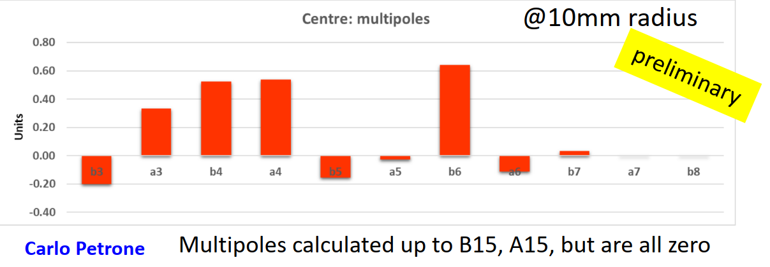
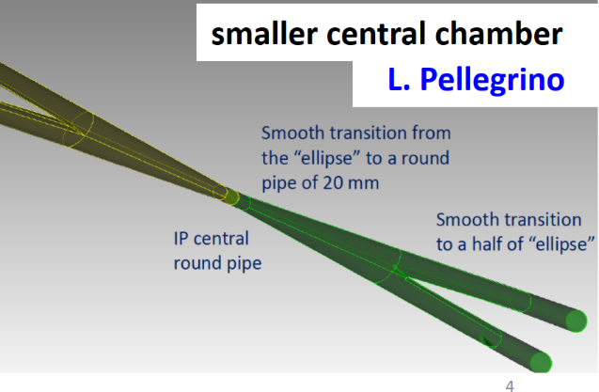
FCC-ee Machine Detector Interface
M. Boscolo
smaller IR chamber,
no longer trapped HOM
start of 3D mechanical
design & integration
Q1 prototype, measured
multipoles very small, confirming
design approach
M. Sullivan
M. Dam
M. Koratzinos
L. Pellegrino
M. Lückhof

Slide 12
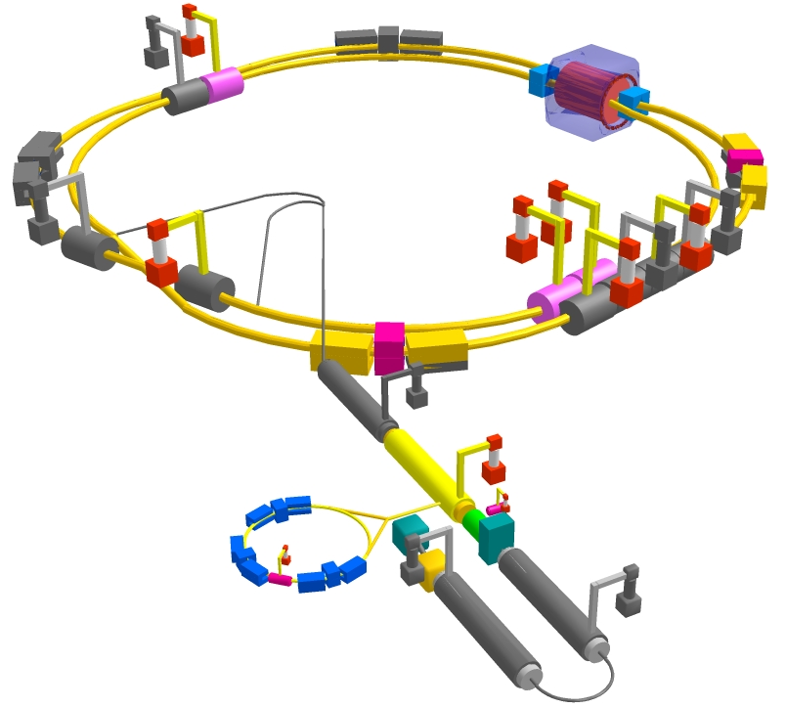
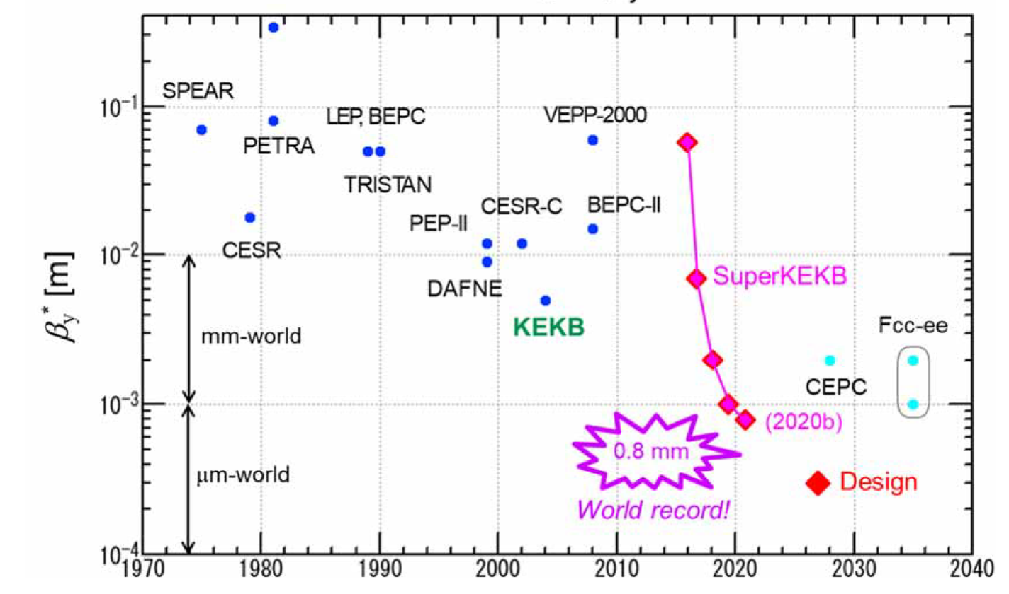
SuperKEKB – pushing luminosity and β*
Design: double ring e⁺e⁻ collider as B-factory at 7(e⁻) & 4(e⁺) GeV; design luminosity $\sim$8 x 10³⁵ cm⁻²s⁻¹; β_{y}* $\sim$0.3 mm;
nano-beam – large crossing angle collision scheme (crab waist w/o sextupoles); beam lifetime$\sim$5 minutes; top-up injection;
e⁺ rate up to $\sim$ 2.5 10¹² /s ; under commissioning
M. Tobiyama, K. Oide
SuperKEKB is demonstrating FCC-ee key concepts
β_{y}* = 0.8 mm achieved in both rings – using the
FCC-ee-style “virtual” crab-waist collision scheme
Y. Funakoshi, Y. Ohnishi, K. Oide

Slide 13
Potential EIC – FCC collaboration
NSLS-II, EIC & FCC-ee beam parameters
 | NSLS-II | EIC | FCC-ee-Z
Beam energy [GeV] | 3 | 10 (20) | 45.6
Bunch population [10¹¹] | 0.08 | 1.7 | 1.7
Bunch spacing [ns] | 2 | 10 | 15, 17.5 or 20
Rms bunch length [mm] | 4.5 - 9 | 2 | 3.5 (SR)
Beam current [A] | 0.5 | 2.5 (0.27) | 1.39
RF frequency [MHz] | 500 | 591 | 400
Similarity of several parameters strongly suggests collaboration to exploit synergies in areas such as beam instrumentation, SRF, vacuum system with SR handling, etc.
→ Two dedicated sessions at FCC-IS kick-off meeting towards EIC-FCC collaboration.

Slide 14
H2020 DS FCC Innovation Study 2020-24
Topic | INFRADEV-01-2019-2020
Grant Agreement | FCCIS 951754
Duration | 48 months
From-to | 2 Nov 2020 – 1 Nov 2024
Project cost | 7 435 865 €
EU contribution | 2 999 850 €
Beneficiaries | 16
Partners | 6
Beneficiaries
Partners

Slide 15
Objectives of FCCIS (Description of Action)
O1: Design a circular luminosity frontier particle collider with a research programme to remain at the forefront of research
O2: Demonstrate the technical and organizational feasibility of a 100 km long, circular particle collider
O3: Develop an innovation plan for a long-term sustainable research infrastructure that is seamlessly integrated in the European research landscape
O4: Engage stakeholders from different sectors of the society
O5: Demonstrate the role and impact of the research infrastructure in the innovation chain, focusing on responsible resource use and managing environmental impacts

Slide 16


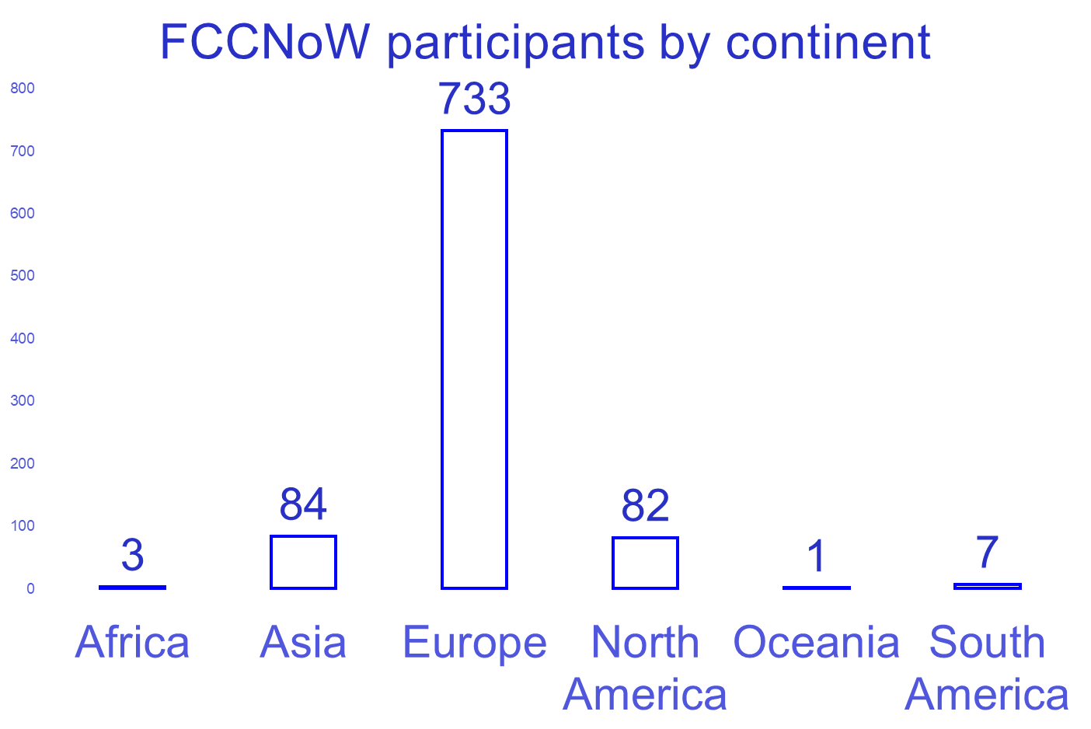
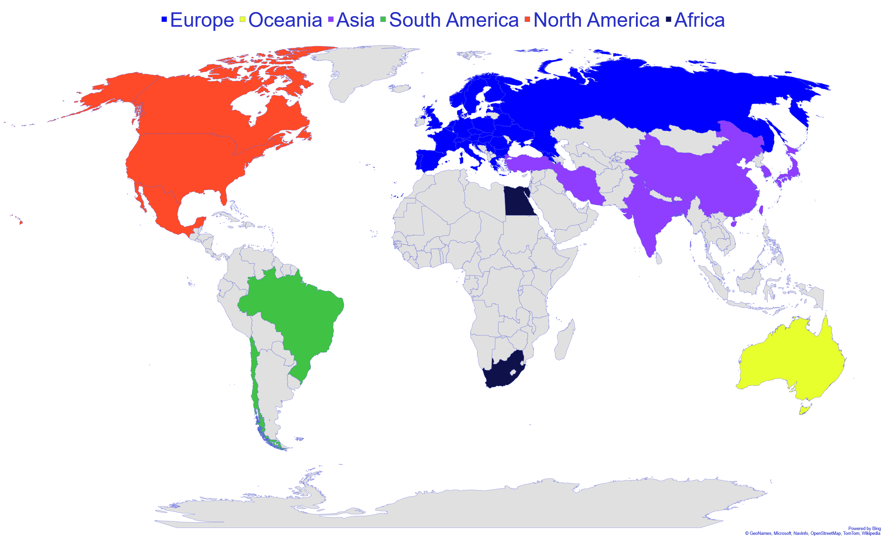
FCC November Week
Kick-Off FCC Innovation Study
  (organisers M. Benedikt, J. Gutleber, F. Zimmermann)
FCC-ee Collider Design (WP2)
Integrate Europe (WP3)
Impact & Sustainability (WP4)
Leverage & Engage (WP5)
4th FCC Physics & Experiments Workshop
  (organisers A. Blondel, M. Mangano, M. Dam, P. Janot)
Physics Prospects, Detector development, Collaboration Forming,
Physics Benchmark Measurements, New Ideas and Challenges, Detector Technologies, Experimental Environment, and Machine- Detector Interface.
http://cern.ch/FCCNoW2020
910 registered participants

Slide 17
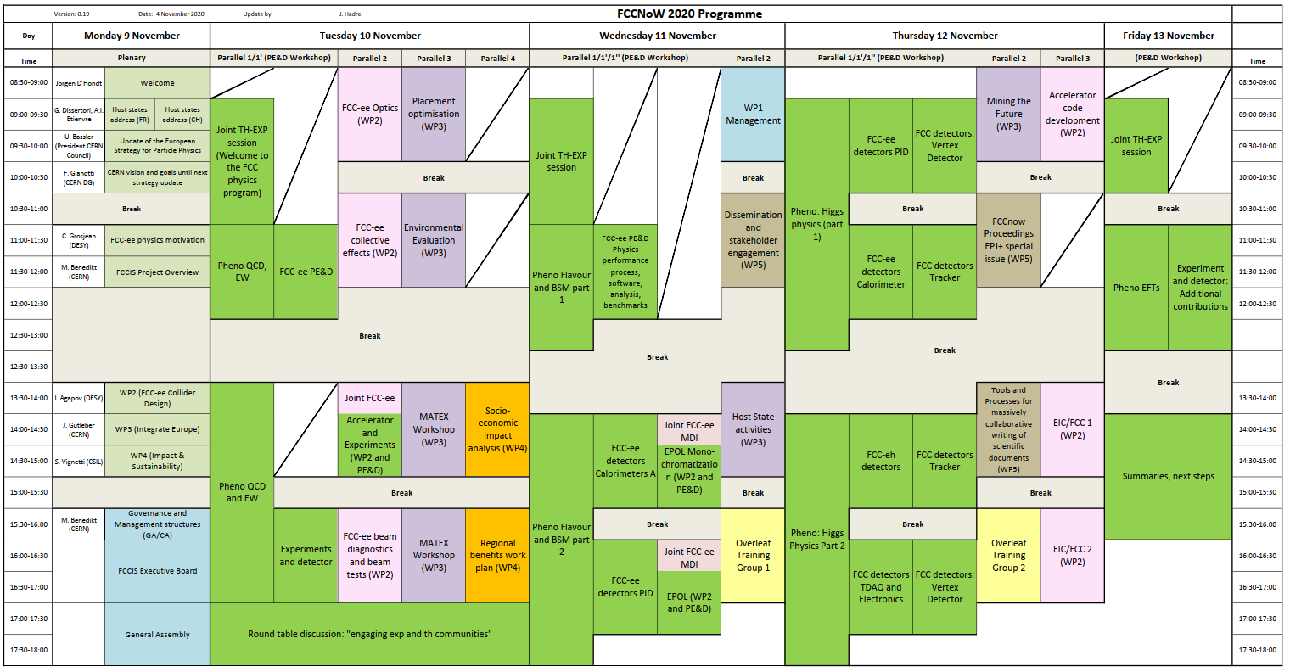

FCC November Week Programme at a Glance
FCC / CHART2
code
development
FCCIS
FCCIS
FCCIS
FCCIS
P&E
P&E
P&E
FCCIS
FCCIS
FCCIS
P&E
plenary talks
setting the stage
P&E
FCCIS
FCCIS
FCCIS
FCC/EIC
P&E
P&E
FCCIS governance
P&E
P&E
FCCIS
FCCIS
FCCIS
FCCIS
Executive Board
FCC/EIC
General Assembly
Round Table

Slide 18
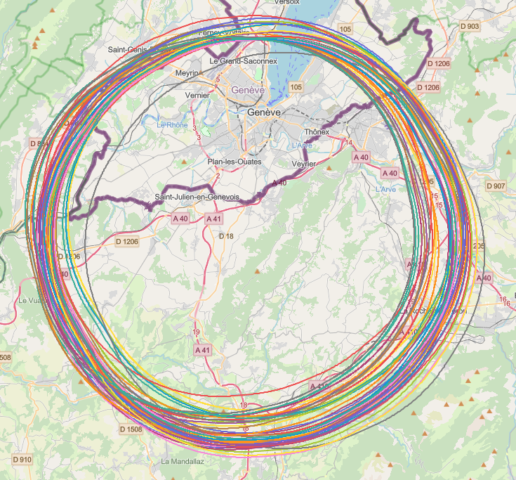
Collider placement optimisation
Overall layout and placement optimisation process across both host states
Following the "avoid-reduce-compensate" directive of European and French regulatory frameworks
Process integrates diverse requirements and constraints:
  performance permitting world-leading scientific research
  technical feasibility of civil engineering and subsurface constraints
  territorial constraints on surface and subsurface
  nature, accessibility, technical infrastructure, and resource needs & constraints
  economic factors including development of benefits for, and synergies, with the regional developments
  …
Collaborative effort of technical experts at CERN, consultancy companies and government notified bodies

Slide 19

Status of Global FCC Collaboration
Increasing international collaboration as a prerequisite for success:
links with science, research & development and high-tech industry will be essential to further advance and prepare the implementation of FCC
141
Institutes
30
Companies
34
Countries
EC
H2020

Slide 20
Status and Outlook
1st phase of FCC design study completed → baseline machine designs, performance matching physics requirements, in 4 CDRs
Integrated FCC programme submitted to European Strategy Update 2019/20 → Request for feasibility study as basis for project decision by 2026/27
Next steps: concrete local/regional implementation scenario in collaboration with host state authorities, accompanied by machine optimization, physics studies and technology R&D, performed via global collaboration and supported by EC H2020 Design Study FCCIS, to prove feasibility by 2025/26
Long term goal: world-leading HEP infrastructure for 21st century to push the particle-physics precision and energy frontiers far beyond present limits.

Slide 21
Spare Slides on
FCC CDR Status

Slide 22
FCC-ee collider parameters (stage 1)
parameter | Z | WW | H (ZH) | ttbar
beam energy [GeV] | 45 | 80 | 120 | 182.5
beam current [mA] | 1390 | 147 | 29 | 5.4
no. bunches/beam | 16640 | 2000 | 393 | 48
bunch intensity [10¹¹] | 1.7 | 1.5 | 1.5 | 2.3
SR energy loss / turn [GeV] | 0.036 | 0.34 | 1.72 | 9.21
total RF voltage [GV] | 0.1 | 0.44 | 2.0 | 10.9
long. damping time [turns] | 1281 | 235 | 70 | 20
horizontal beta* [m] | 0.15 | 0.2 | 0.3 | 1
vertical beta* [mm] | 0.8 | 1 | 1 | 1.6
horiz. geometric emittance [nm] | 0.27 | 0.28 | 0.63 | 1.46
vert. geom. emittance [pm] | 1.0 | 1.7 | 1.3 | 2.9
bunch length with SR / BS [mm] | 3.5 / 12.1 | 3.0 / 6.0 | 3.3 / 5.3 | 2.0 / 2.5
luminosity per IP [10³⁴ cm⁻²s⁻¹] | 230 | 28 | 8.5 | 1.55
beam lifetime rad Bhabha / BS [min] | 68 / >200 | 49 / >1000 | 38 / 18 | 40 / 18

Slide 23
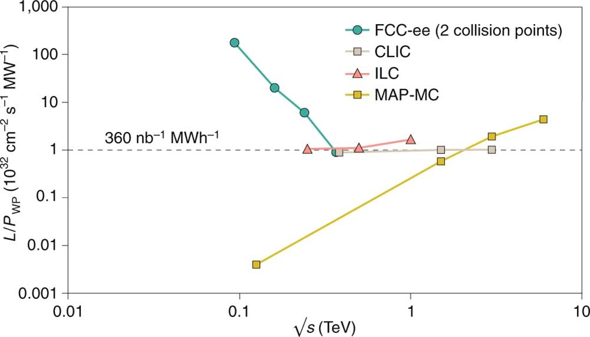
FCC-ee: efficient Higgs/electroweak factory
Luminosity L per supplied electrical wall-plug power P_{WP} is shown as a function of centre-of-mass energy for several proposed future lepton colliders.

Slide 24
FCC-hh (pp) collider parameters (stage 2)
parameter | FCC-hh |  | HL-LHC | LHC
collision energy cms [TeV] | 100 |  | 14 | 14
dipole field [T] | 16 |  | 8.33 | 8.33
circumference [km] | 97.75 |  | 26.7 | 26.7
beam current [A] | 0.5 |  | 1.1 | 0.58
bunch intensity [10¹¹] | 1 | 1 | 2.2 | 1.15
bunch spacing [ns] | 25 | 25 | 25 | 25
synchr. rad. power / ring [kW] | 2400 |  | 7.3 | 3.6
SR power / length [W/m/ap.] | 28.4 |  | 0.33 | 0.17
long. emit. damping time [h] | 0.54 |  | 12.9 | 12.9
beta* [m] | 1.1 | 0.3 | 0.15 (min.) | 0.55
normalized emittance [μm] | 2.2 |  | 2.5 | 3.75
peak luminosity [10³⁴ cm⁻²s⁻¹] | 5 | 30 | 5 (lev.) | 1
events/bunch crossing | 170 | 1000 | 132 | 27
stored energy/beam [GJ] | 8.4 |  | 0.7 | 0.36

Slide 25
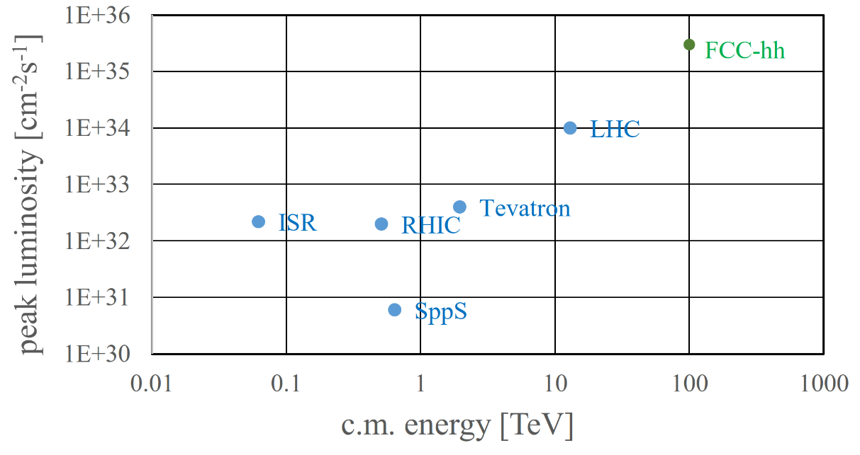
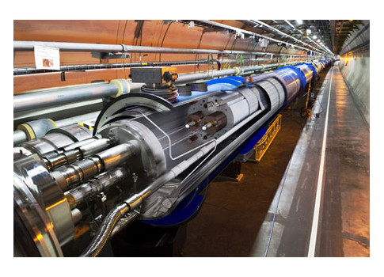
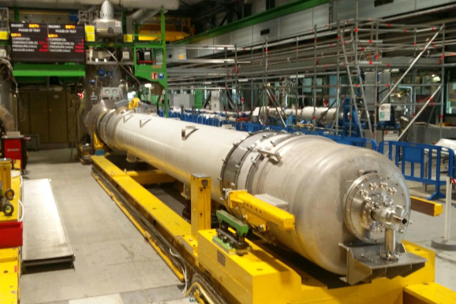
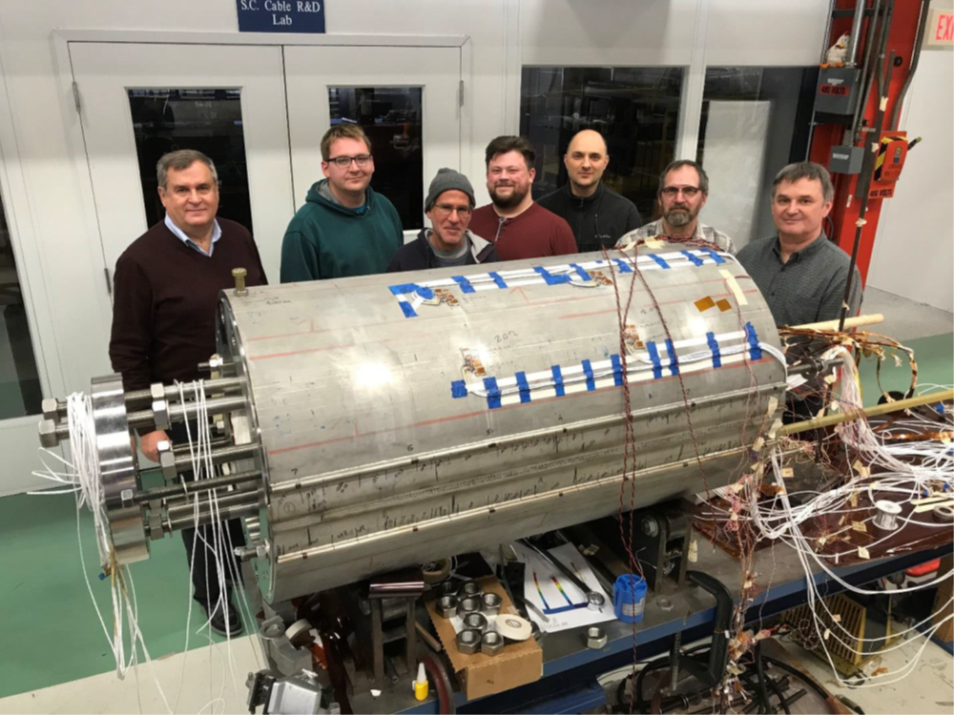
FCC-hh: highest collision energies
order of magnitude performance increase in both energy & luminosity
100 TeV cm collision energy (vs 14 TeV for LHC)
20 ab⁻¹ per experiment collected over 25 years of operation (vs 3 ab⁻¹ for LHC)
similar performance increase as from Tevatron to LHC
key technology: high-field magnets
from
LHC technology
8.3 T NbTi dipole
via
HL-LHC technology
12 T Nb₃Sn quadrupole
FNAL dipole demonstrator
14.5 T Nb₃Sn

Slide 26
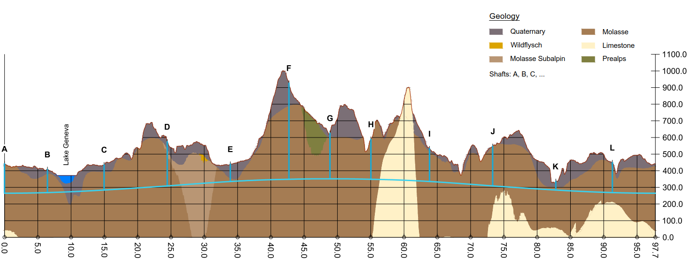
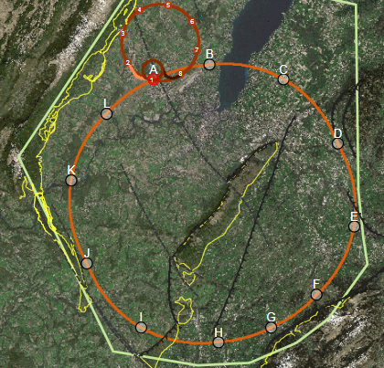
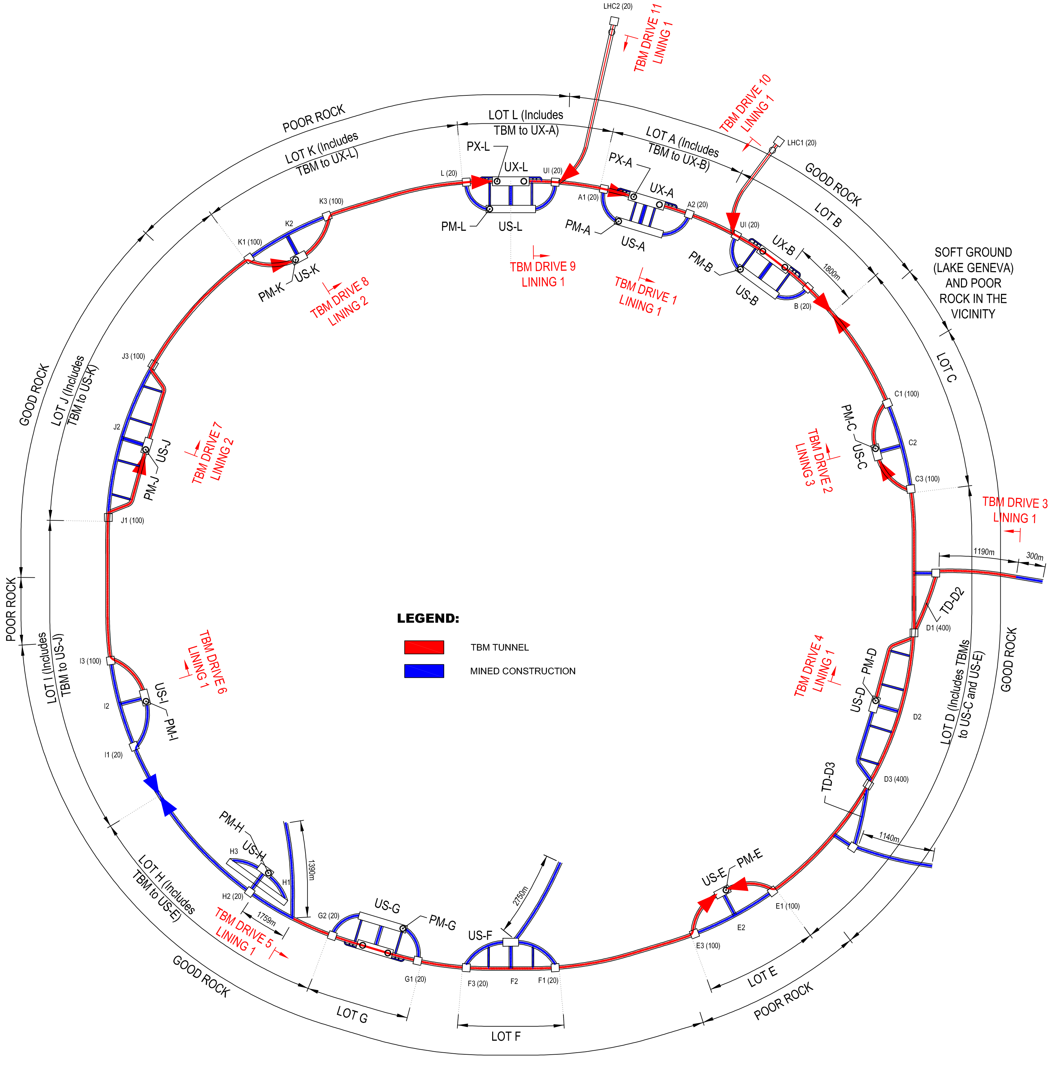
FCC implementation - footprint baseline
Present baseline position was established considering:
lowest risk for construction, fastest and cheapest construction
Molasse rock preferred for tunnelling, avoid limestone with karstic structures
90 – 100 km circumference
12 surface sites with few ha area each

Slide 27
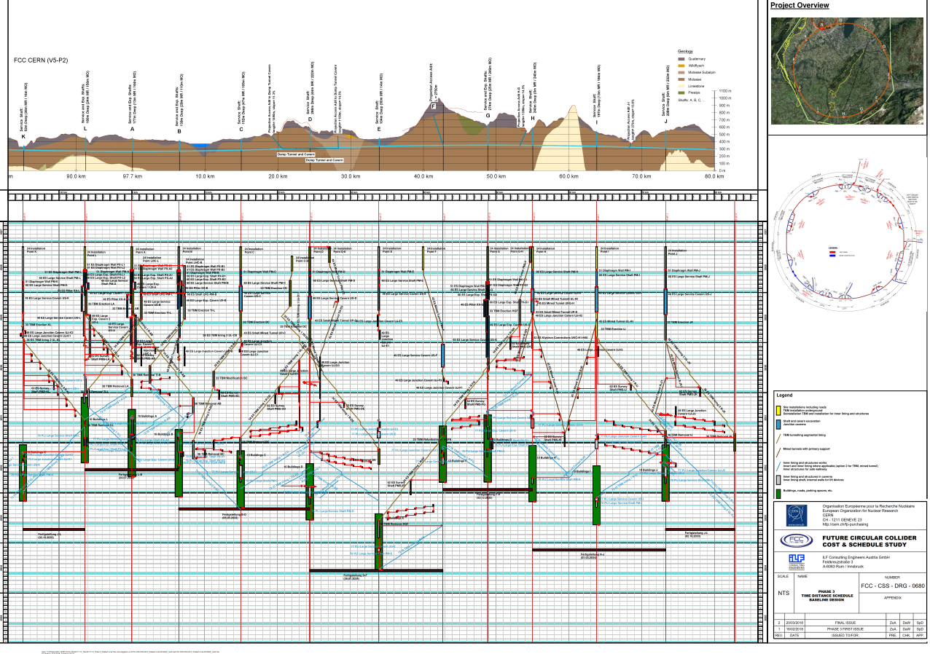
Civil Engineering construction schedule
4.5yrs
6.5yrs
Total construction duration 7 years
First sectors ready after 4.5 years

Slide 28

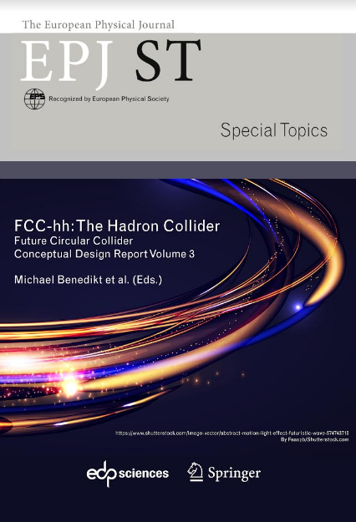
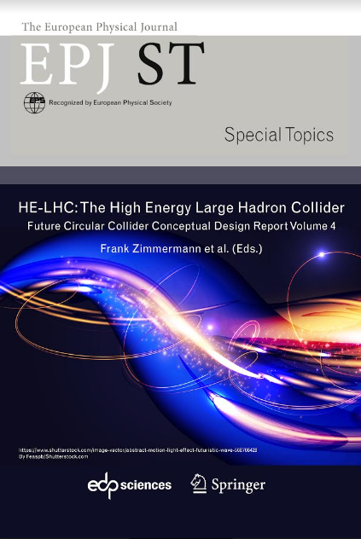
FCC CDR and Study Documentation
FCC-Conceptual Design Reports:
  Vol 1 Physics, Vol 2 FCC-ee, Vol 3 FCC-hh, Vol 4 HE-LHC
  CDRs published in European Physical Journal C (Vol 1) and ST (Vol 2 – 4)
  EPJ C 79, 6 (2019) 474 , EPJ ST 228, 2 (2019) 261-623 ,
  EPJ ST 228, 4 (2019) 755-1107 , EPJ ST 228, 5 (2019) 1109-1382
Summary documents provided to EPPSU SG
  FCC-integral, FCC-ee, FCC-hh, HE-LHC
  Accessible on http://fcc-cdr.web.cern.ch/
>1350 contributors from > 350 institutes,
a truly global effort as suggested by EPPSU 2013

