Slide 1
Experience with FCC-ee Lattice in MAD-NG
Leon van Riesen-Haupt, Laurent Deniau

Slide 2
Previous MADX-SAD Comparisons
Comparison of SAD and MAD-X for FCC-ee studies 11/09/2019
  Linear Optics
  Momentum Detuning
  Amplitude Detuning (Tracking)
Comparison of SAD and MAD-X for FCC-ee studies 06/11/2019
  Radiation effects
  Emittance
Radiation Integrals in MADX 20/05/2020
  Radiation Integrals in General
  Change of Radiation integrals with Momentum

Slide 3
Previous MADX-SAD Comparisons
Comparison of SAD and MAD-X for FCC-ee studies 11/09/2019
  Linear Optics
  Momentum Detuning
  Amplitude Detuning (Tracking)
Comparison of SAD and MAD-X for FCC-ee studies 06/11/2019
  Radiation Effects
  Emittance
Radiation Integrals in MADX 20/05/2020
  Radiation Integrals in General
  Change of Radiation Integrals with Momentum

Slide 4
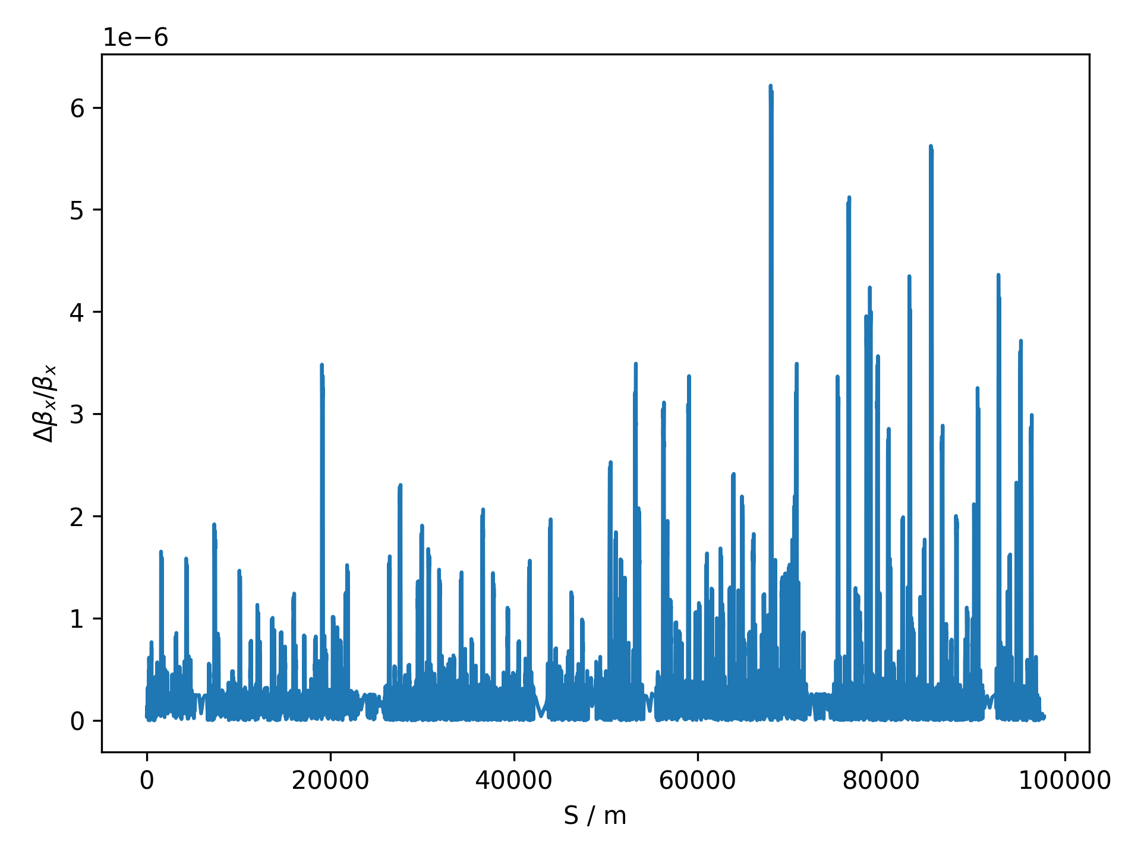
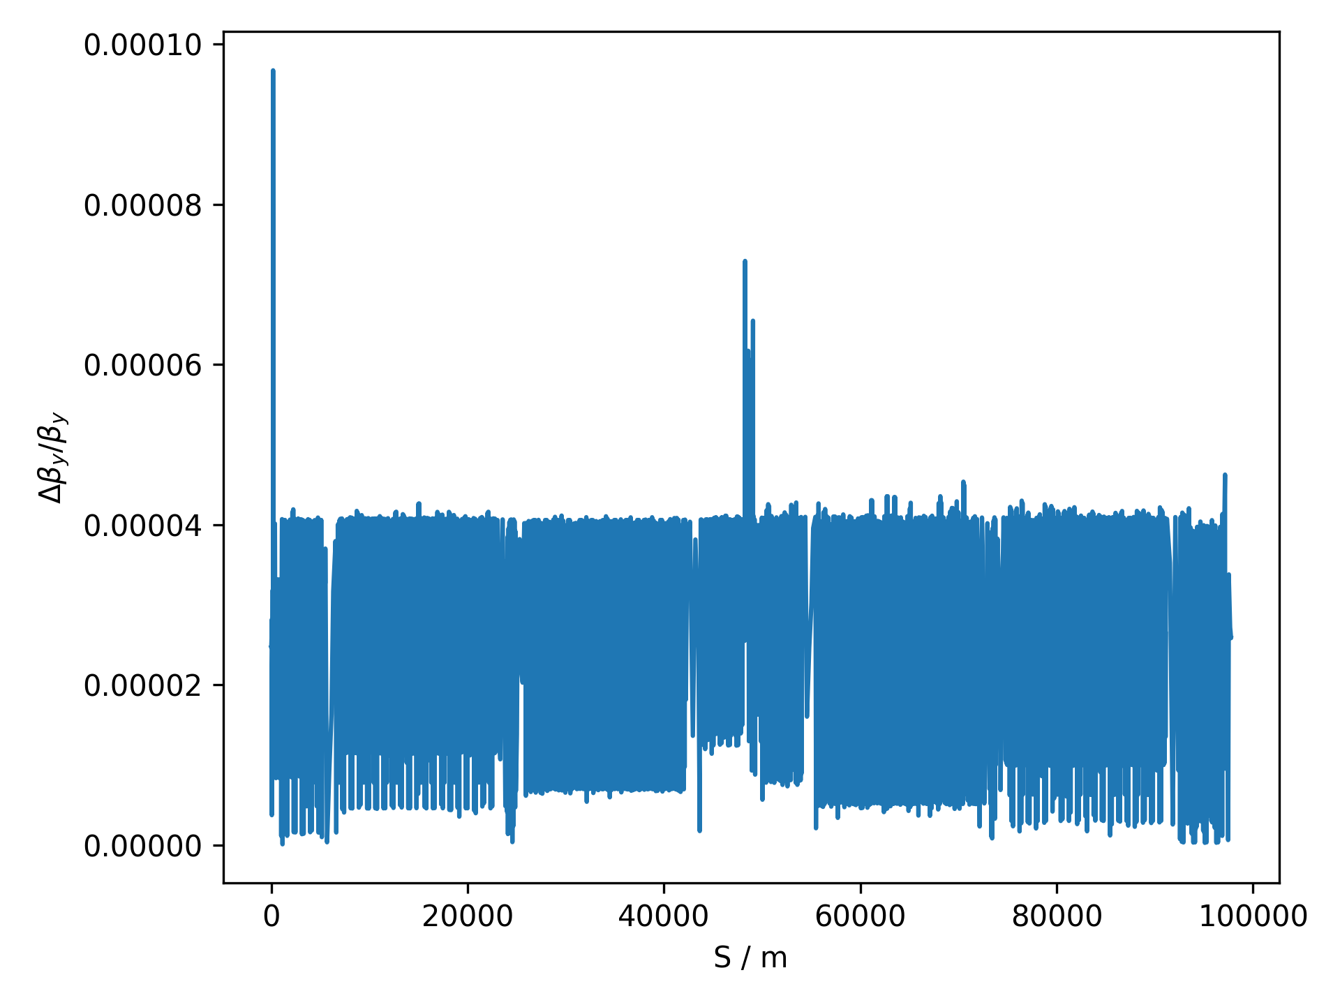
Beta Beat

Slide 5
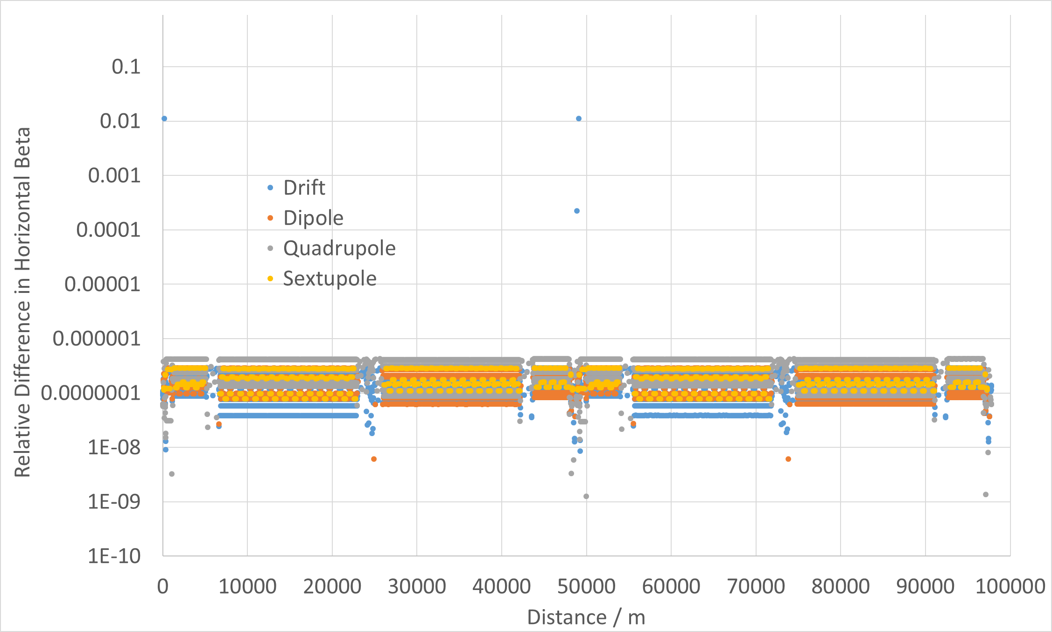
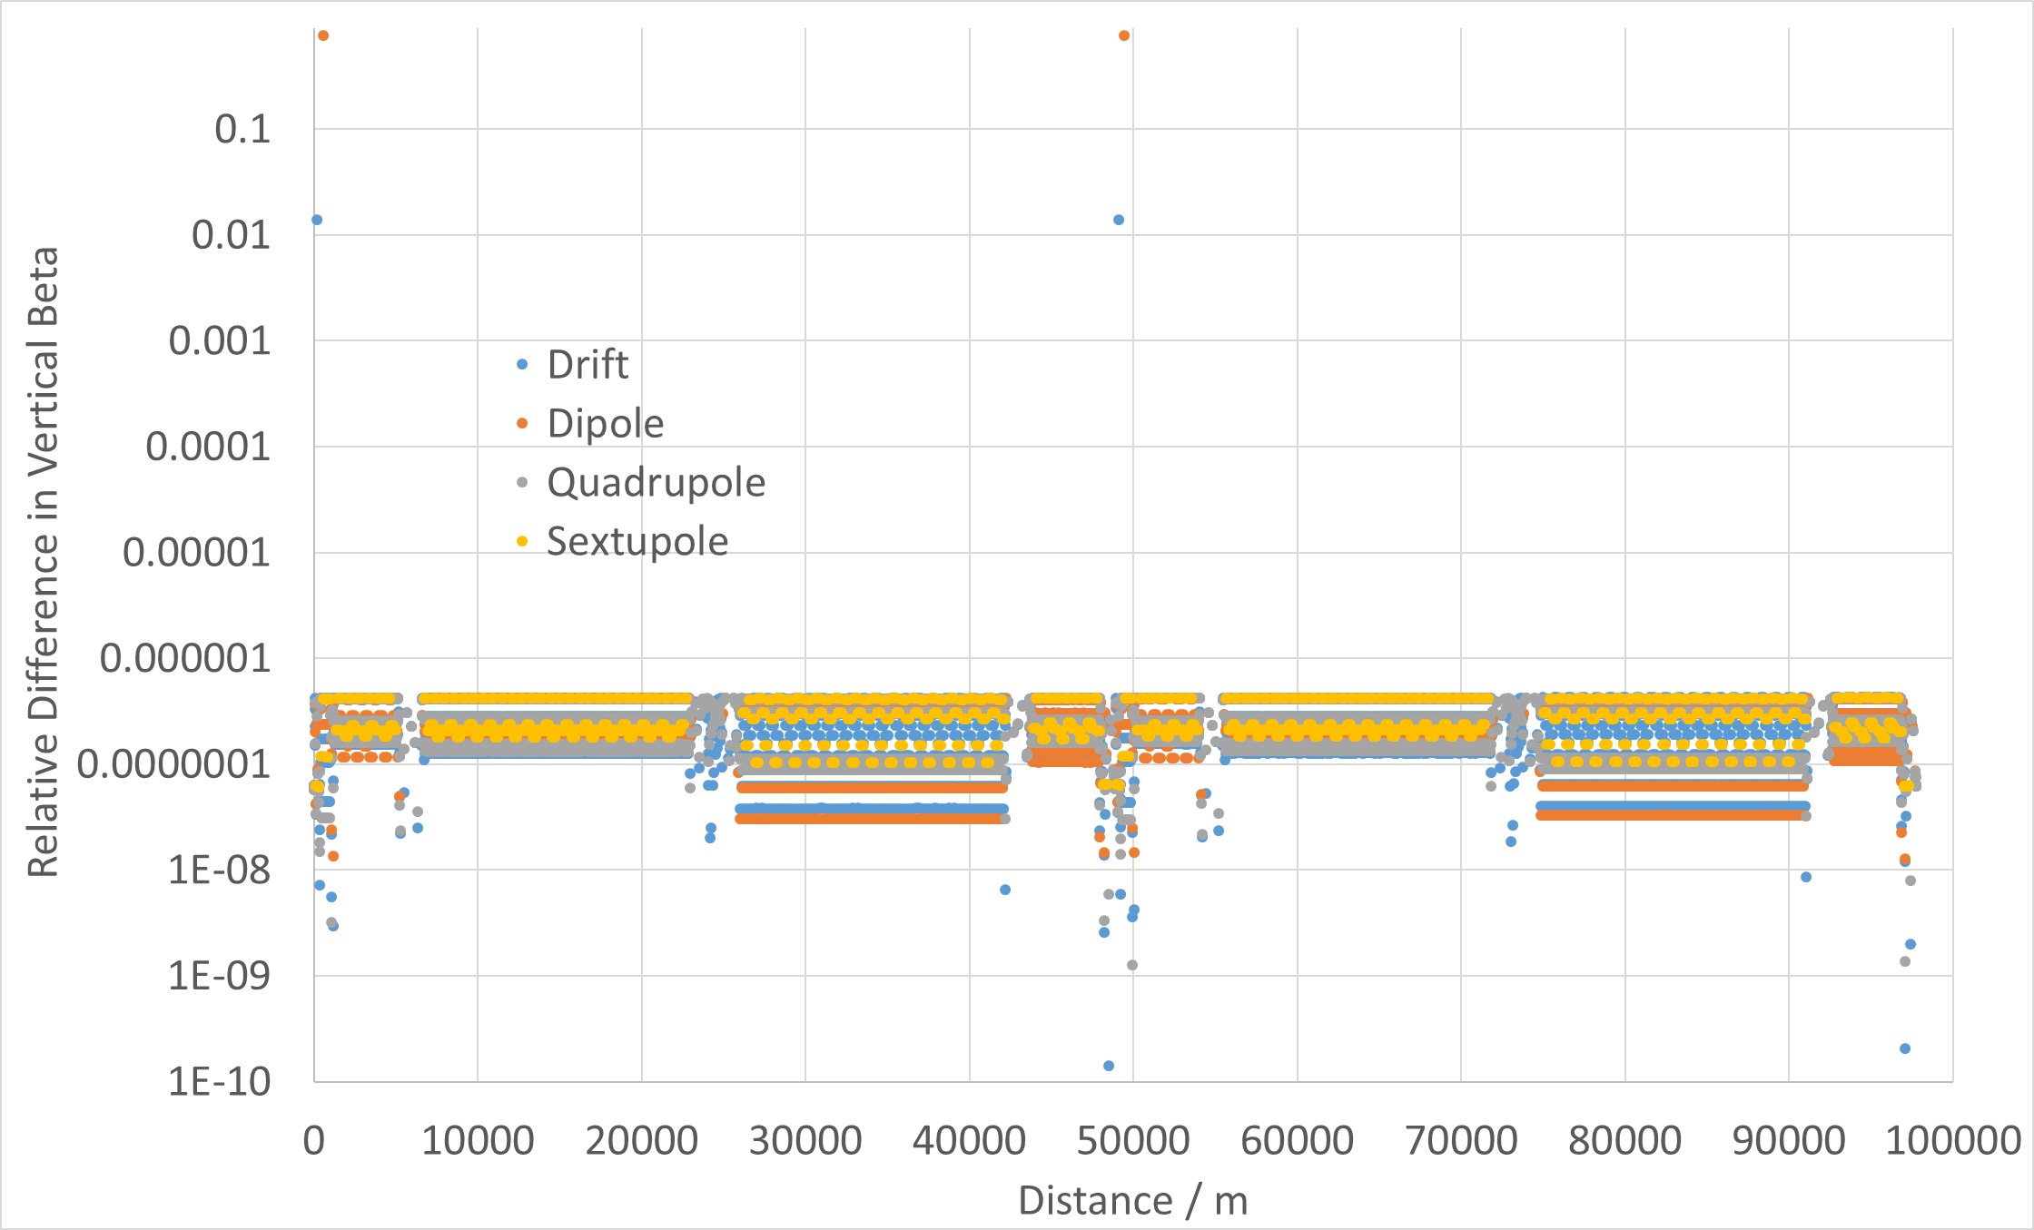
Comparison to MADX-SAD Study
Comparison of SAD and MAD-X for FCC-ee studies 11/09/2019

Slide 6
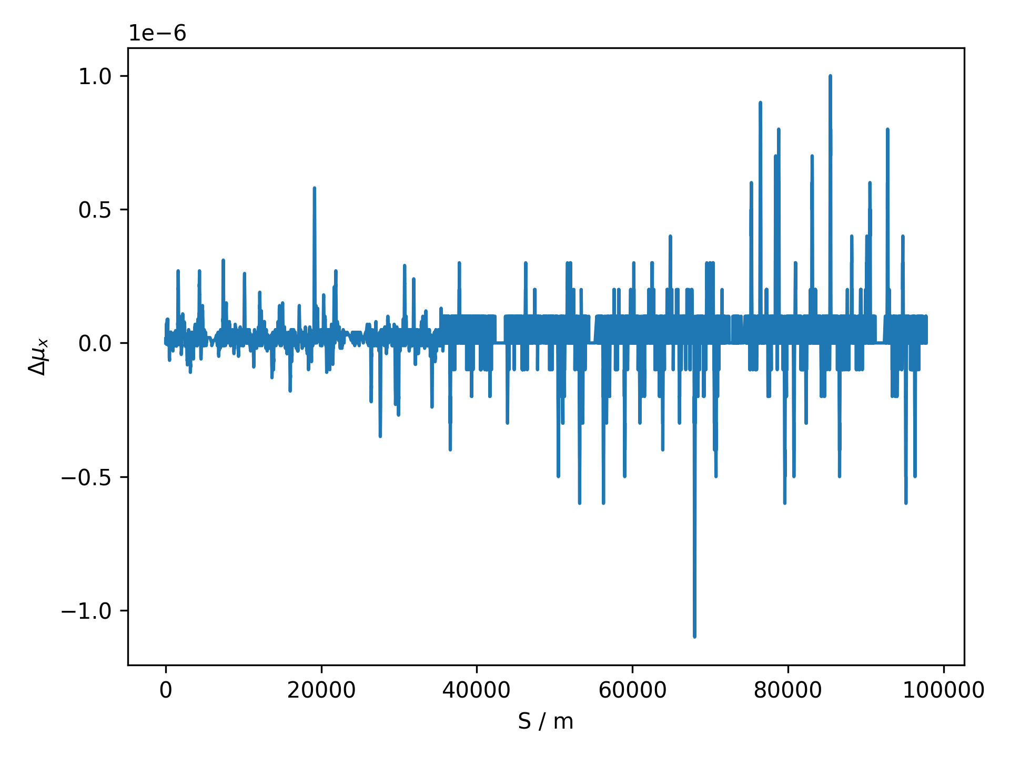
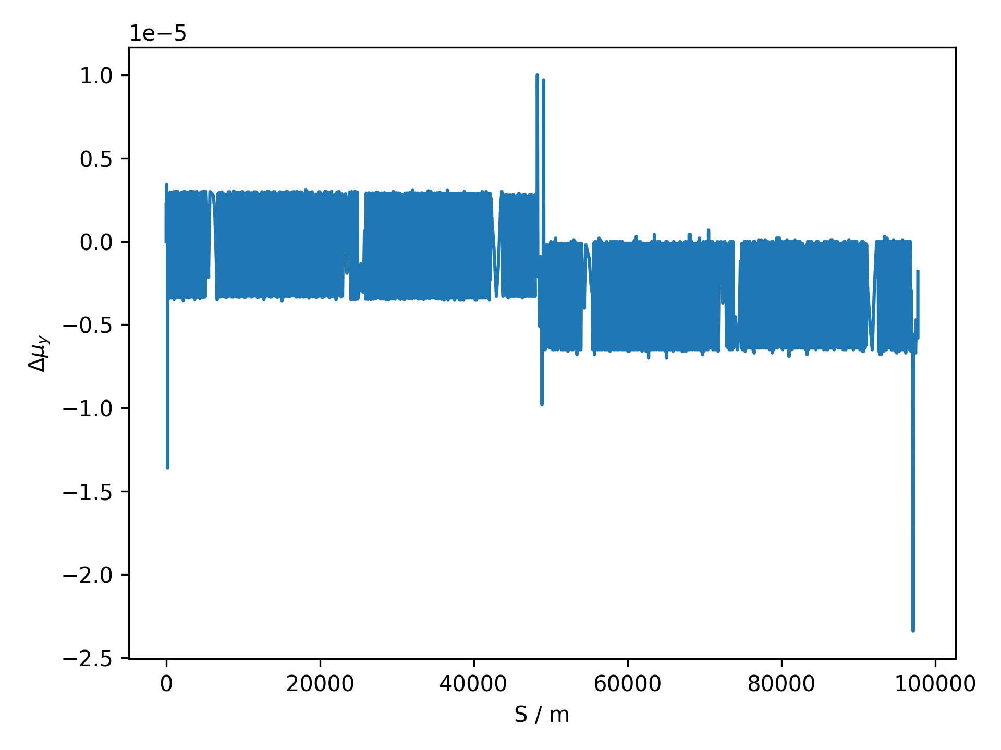
Phase Advance

Slide 7
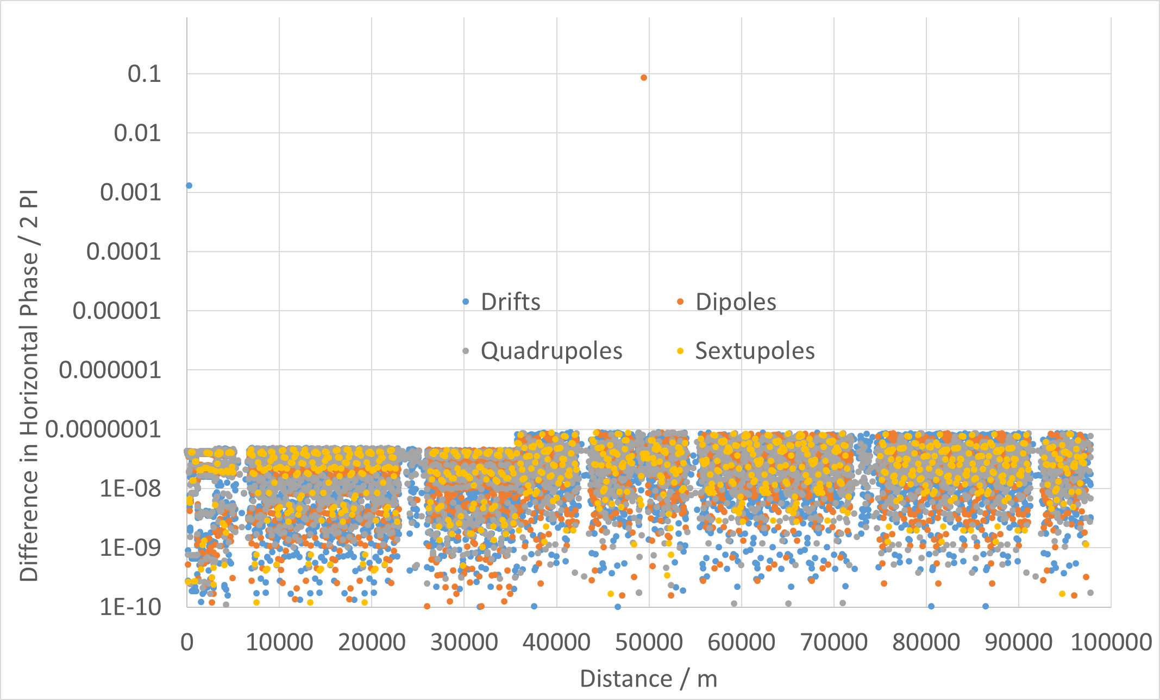
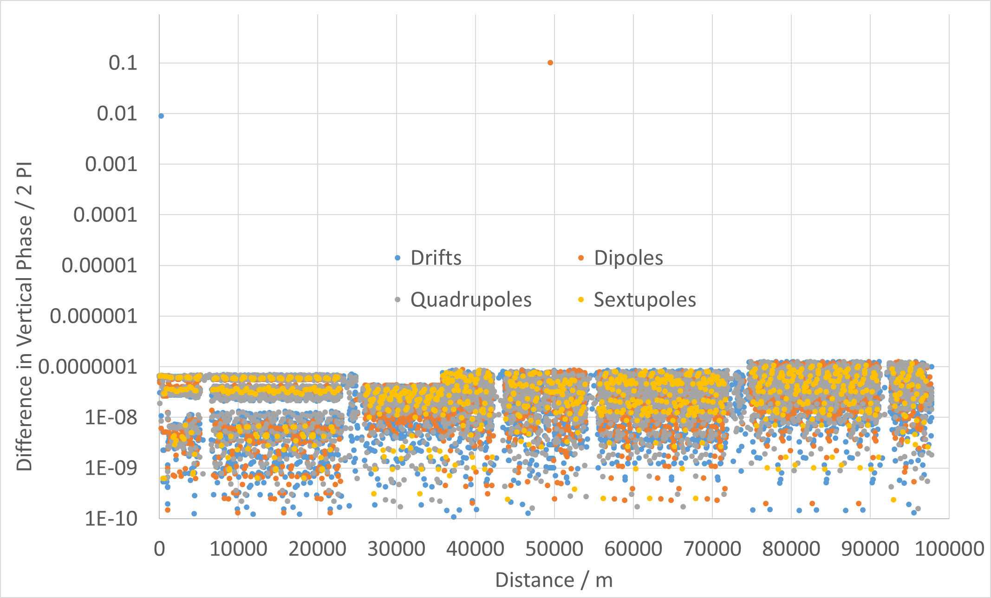
Comparison to MADX-SAD Study
Comparison of SAD and MAD-X for FCC-ee studies 11/09/2019

Slide 8
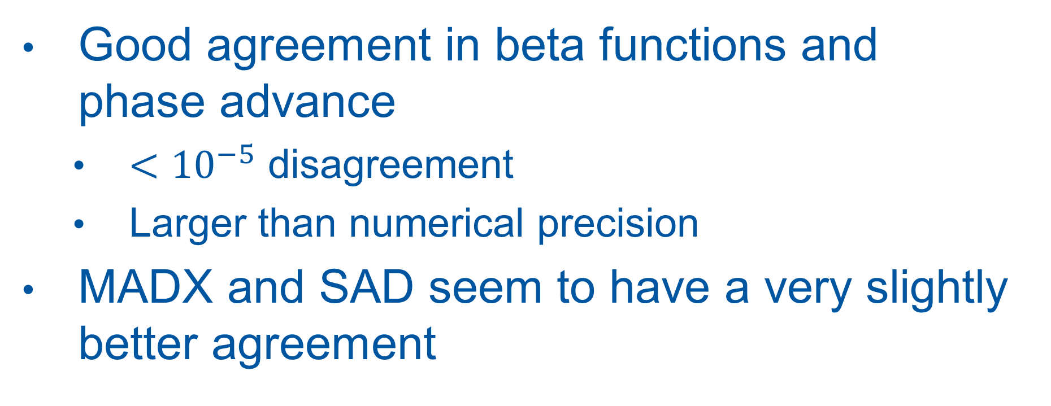
Linear Optics Comments
Good agreement in beta functions and phase advance
  $<{10}^{−5}$ disagreement
  Larger than numerical precision
MADX and SAD seem to have a very slightly better agreement

Slide 9
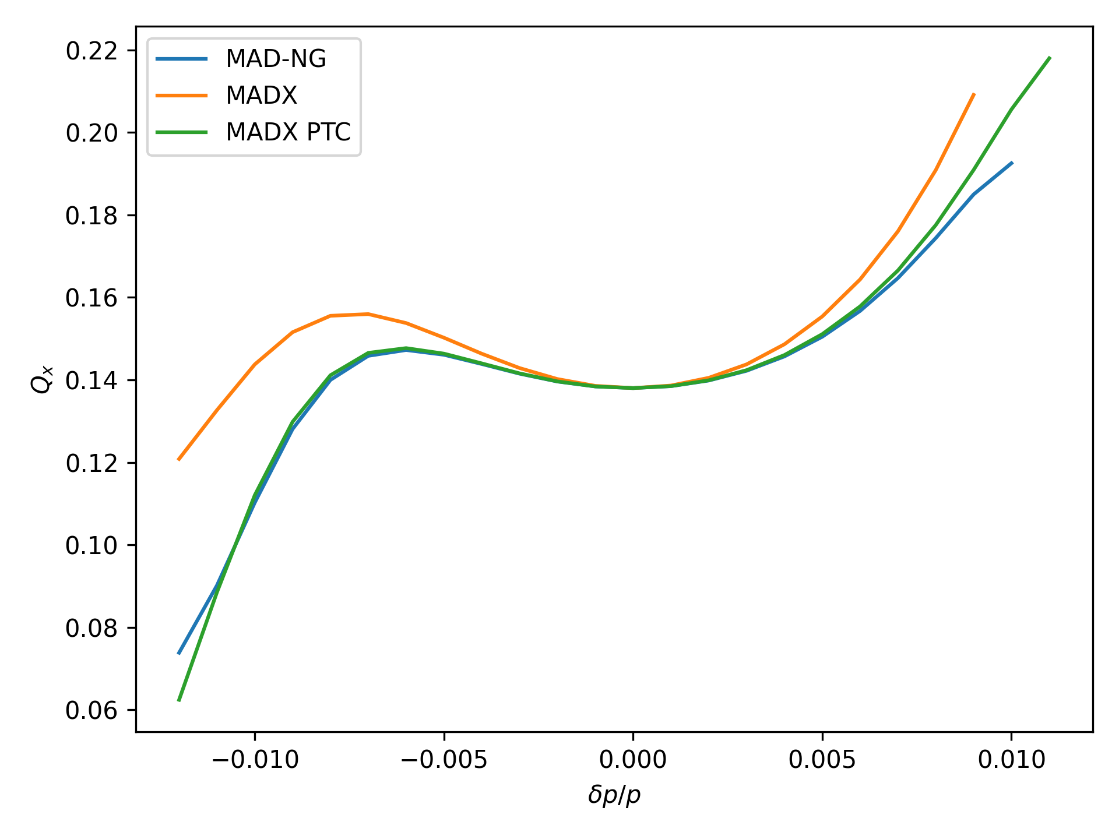
Horizontal Momentum Detuning

Slide 10
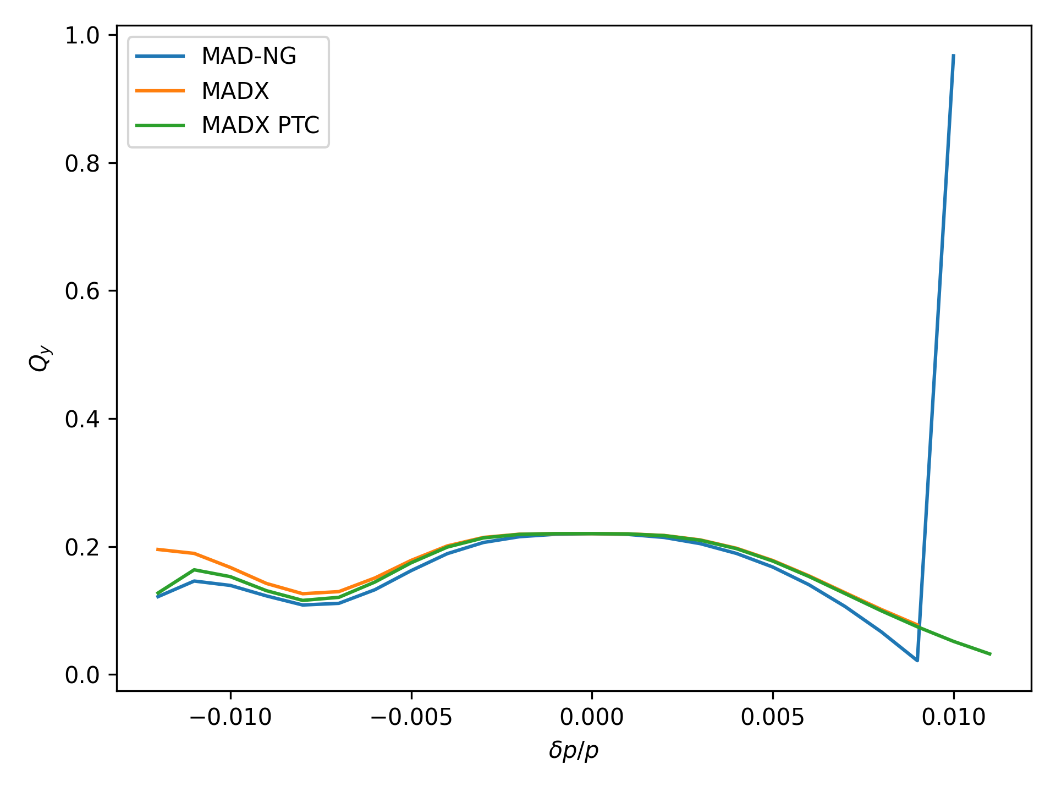
Vertical Momentum Detuning

Slide 11
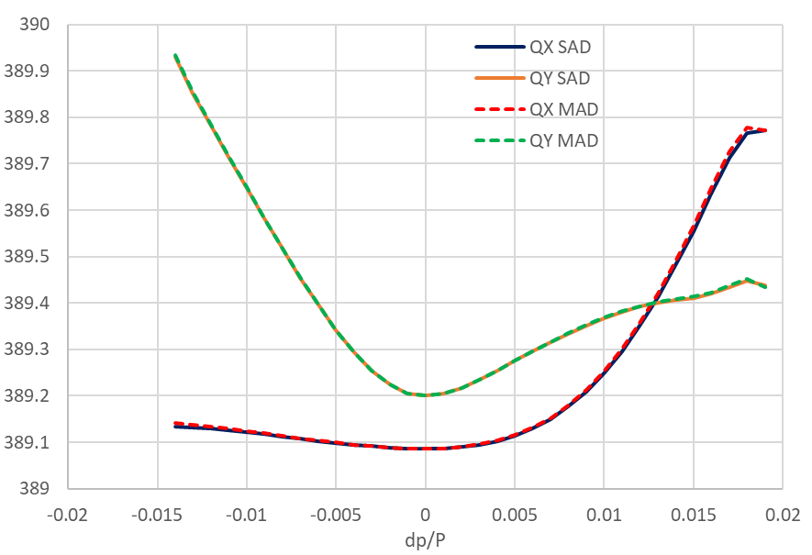
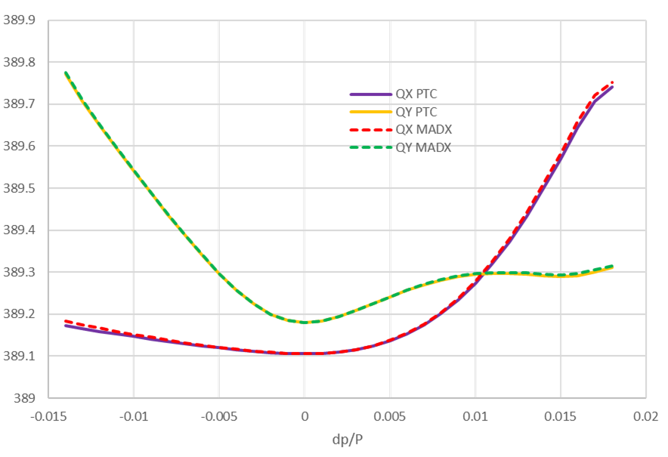
Comparison MADX-SAD (Different Lattice)
Comparison of SAD and MAD-X for FCC-ee studies 11/09/2019

Slide 12
Momentum Detuning Comments
Very Good agreement with PTC
  Somewhat expected
Good Agreement with MADX
Previously demonstrated MADX, PTC and SAD have good agreement
Time taken for Twiss at 23 momenta (on lxplus):
Program | MADX | PTC | MAD-NG
Time Taken | 49.309s | 22m39.948s | 2m2.321s

Slide 13
Amplitude Detuning
Computed from tracking
Requires to track various particles over 1000 turns
Significantly slower in MAD-NG than in MADX PTC
  Tracking one particle for 1000 turns takes:
    53.085s in MADX PTC
    24m31.792s in MAD-NG
  Did not manage to track equal number of particles for horizontal detuning in MAD-NG

Slide 14
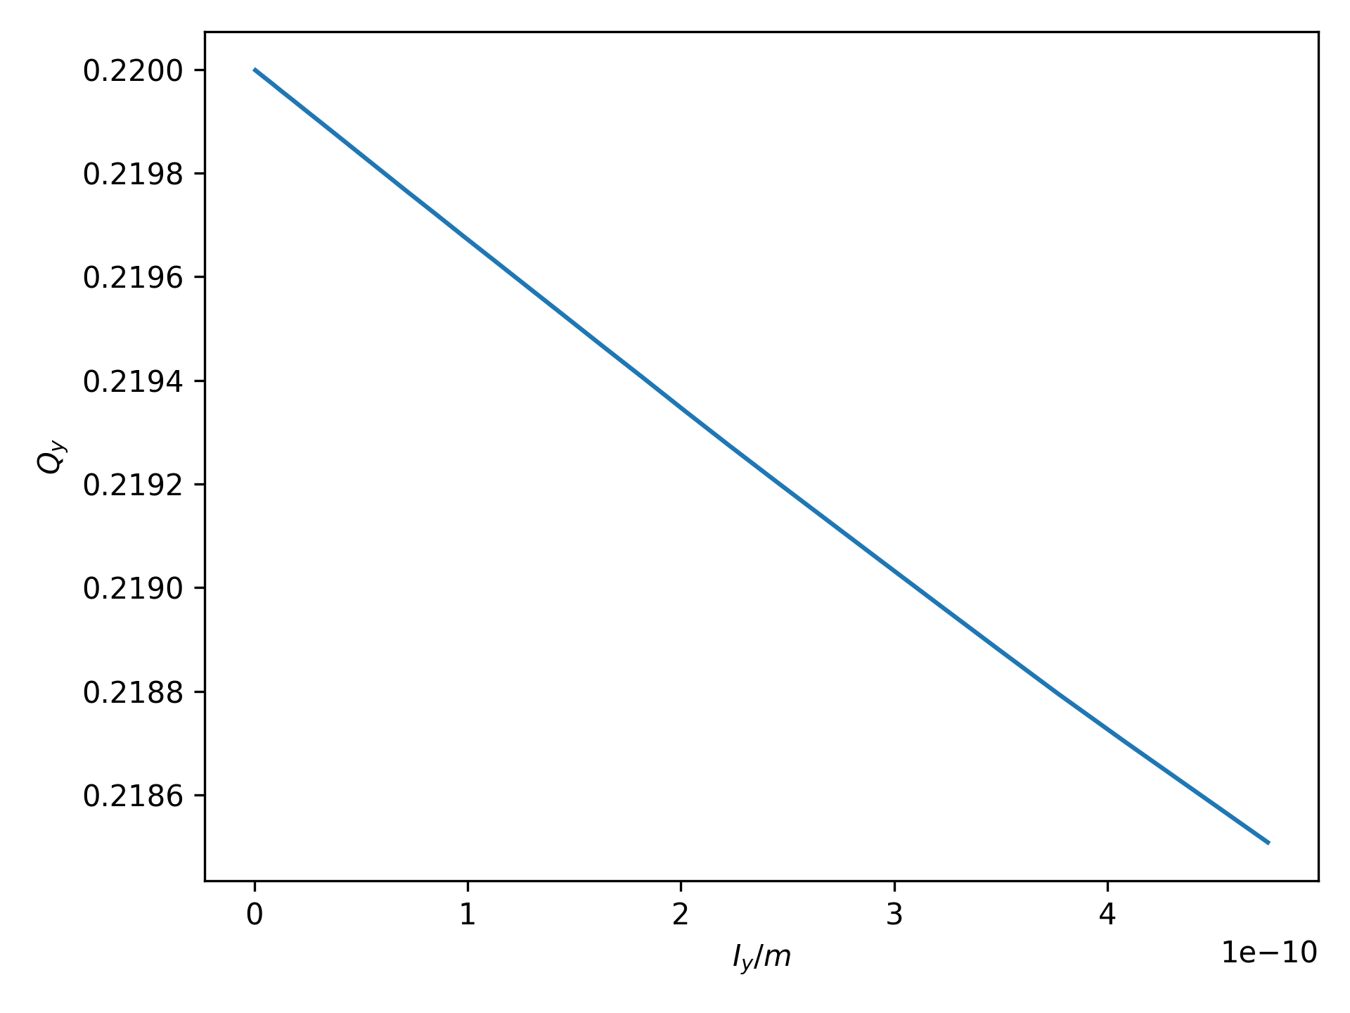
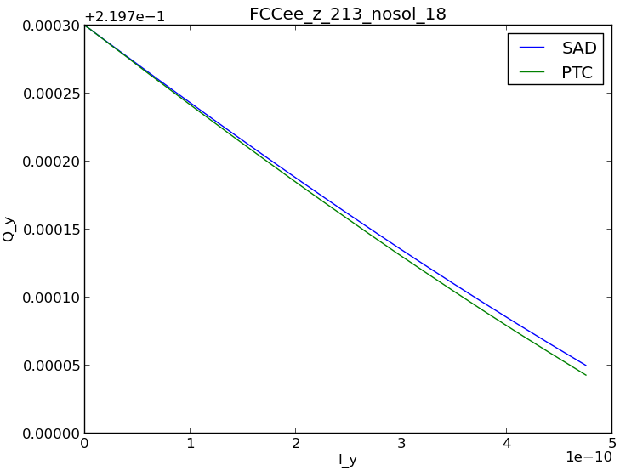
Amplitude Detuning Y
MAD-NG
Comparison of SAD and MAD-X for FCC-ee studies 06/11/2019

Slide 15
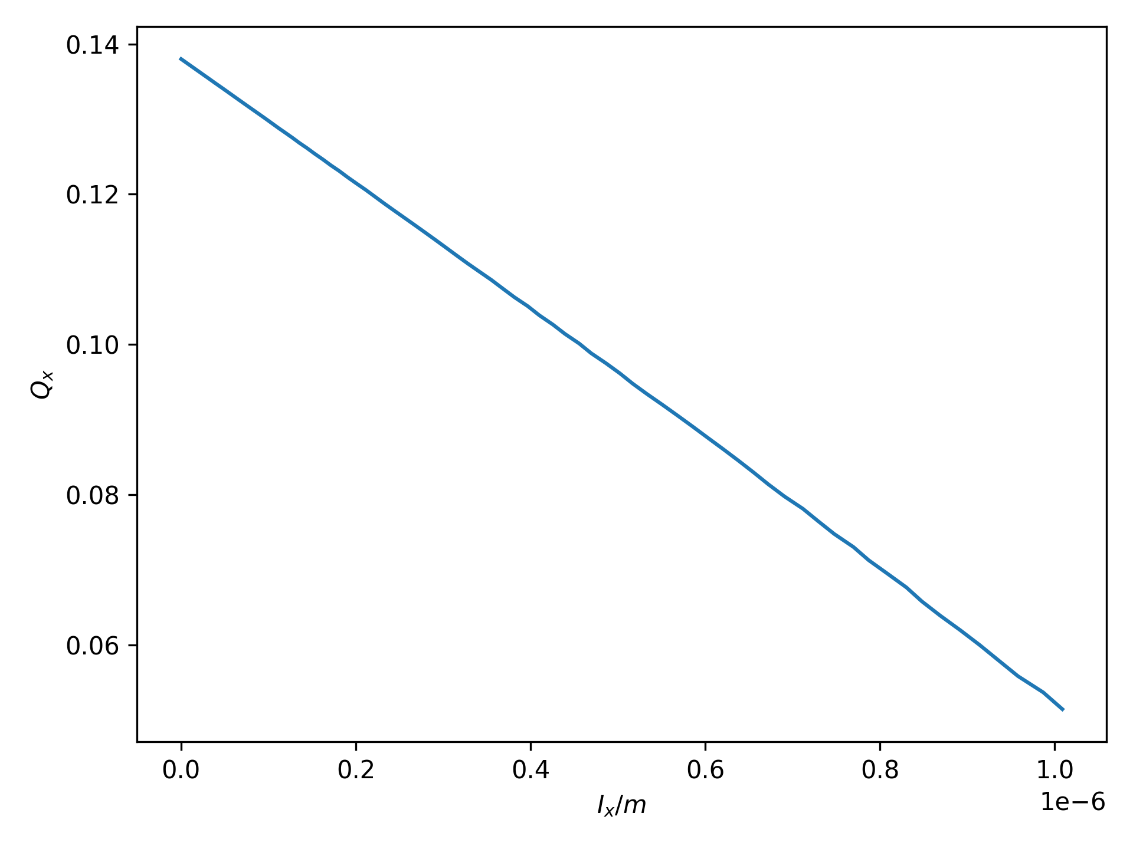
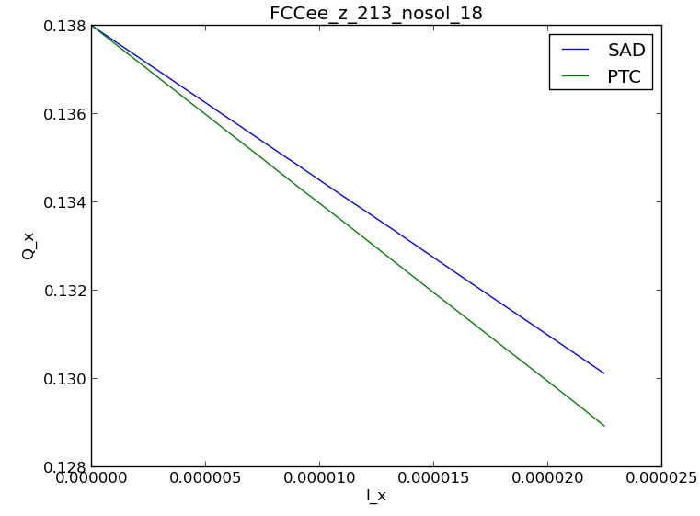
Amplitude Detuning X
MAD-NG
Comparison of SAD and MAD-X for FCC-ee studies 11/09/2019

Slide 16
Amplitude Detuning Discussion
Tracking in MAD-NG significantly slower than in MADX PTC
Detuning seems a lot larger than what is seen in MADX and SAD tracking

Slide 17
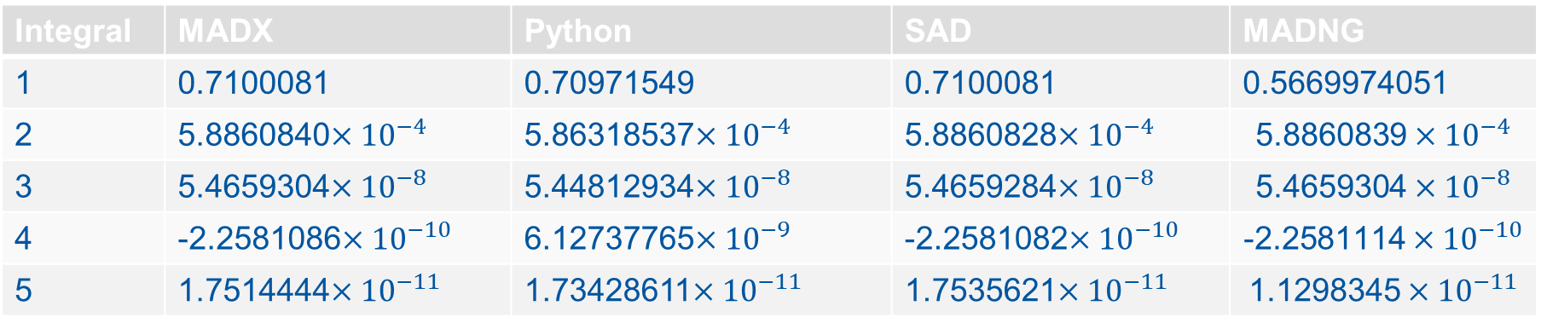
Radiation Integrals
Integral | MADX | Python | SAD | MADNG
1 | 0.7100081 | 0.70971549 | 0.7100081 | 0.5669974051
2 | 5.8860840$×{10}^{−4}$ | 5.86318537$×{10}^{−4}$ | 5.8860828$×{10}^{−4}$ | $$\text{5.8860839}×{10}^{−4}$$
3 | 5.4659304$×{10}^{−8}$ | 5.44812934$×{10}^{−8}$ | 5.4659284$×{10}^{−8}$ | $$\text{5.4659304}×{10}^{−8}$$
4 | -2.2581086$×{10}^{−10}$ | 6.12737765$×{10}^{−9}$ | -2.2581082$×{10}^{−10}$ | $$\text{-2.2581114}×{10}^{−10}$$
5 | 1.7514444$×{10}^{−11}$ | 1.73428611$×{10}^{−11}$ | 1.7535621$×{10}^{−11}$ | $$\text{1.1298345}×{10}^{−11}$$
Radiation Integrals in MADX 20/05/2020

Slide 18
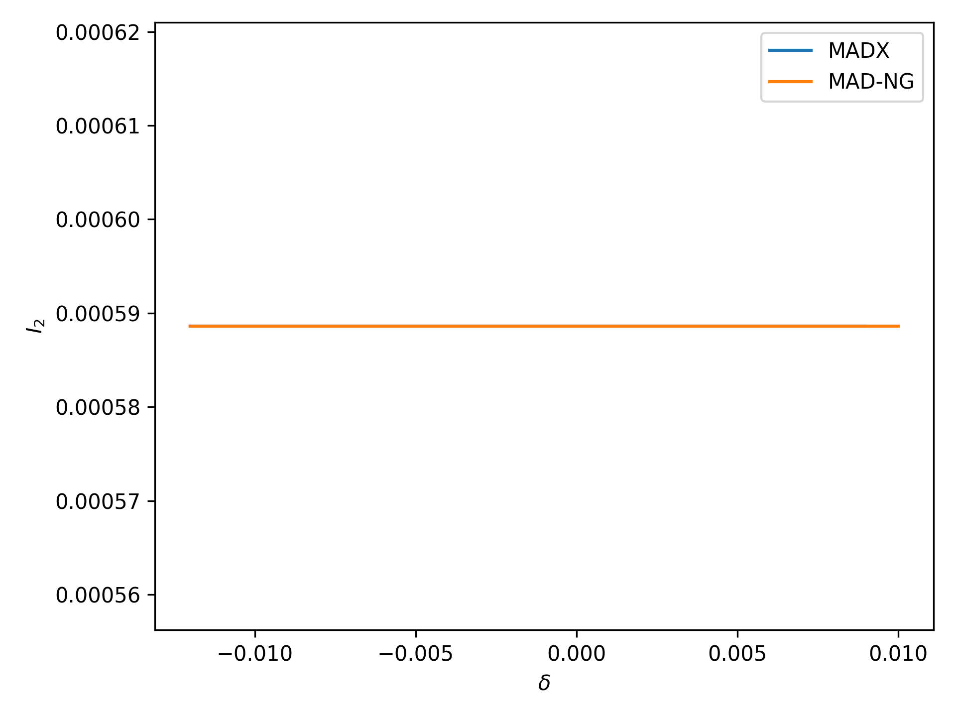
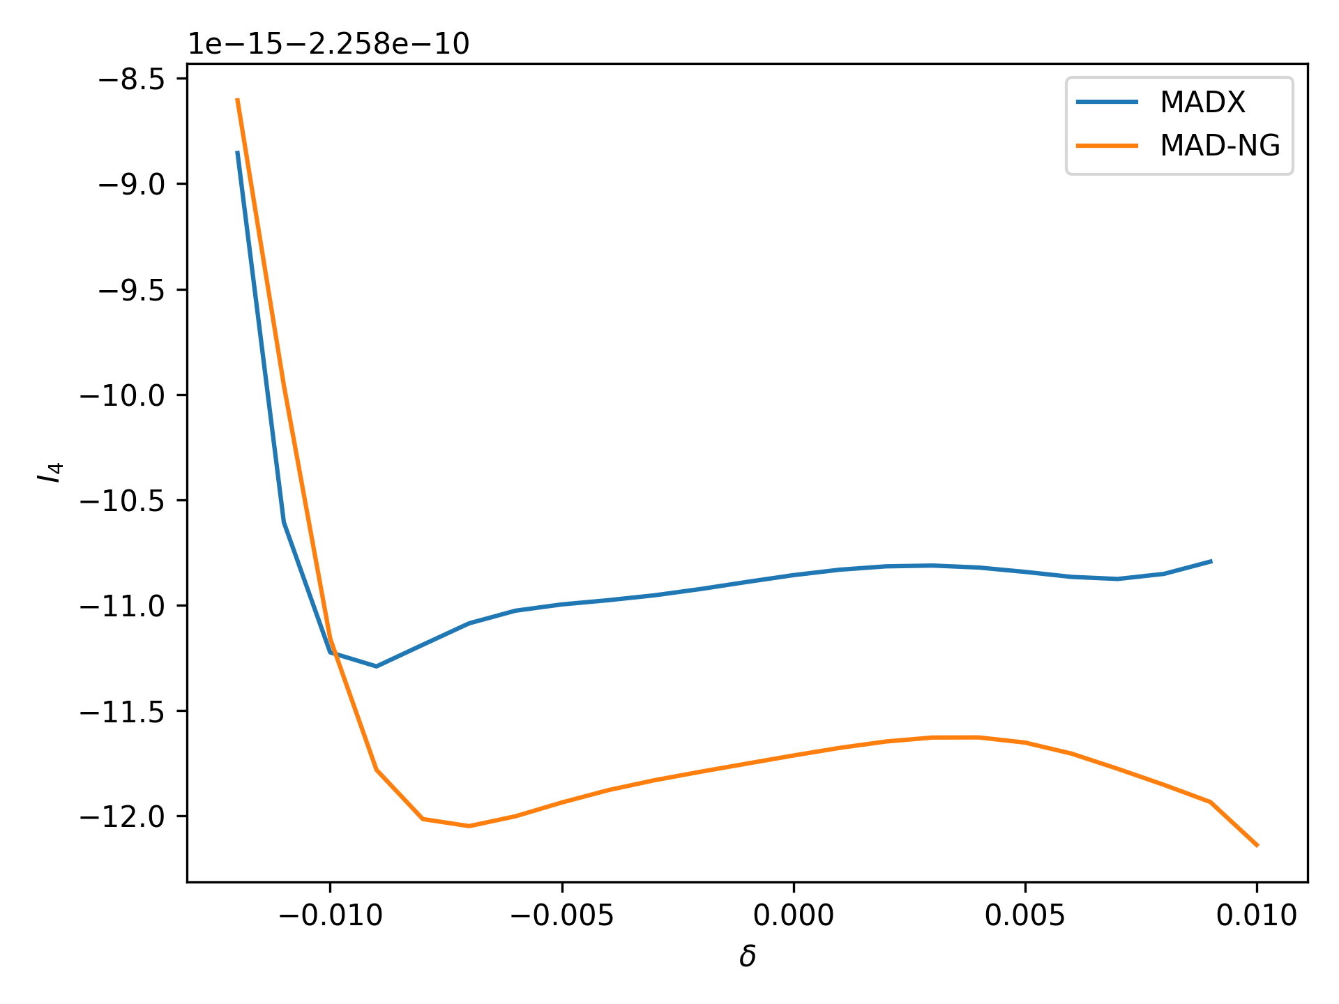
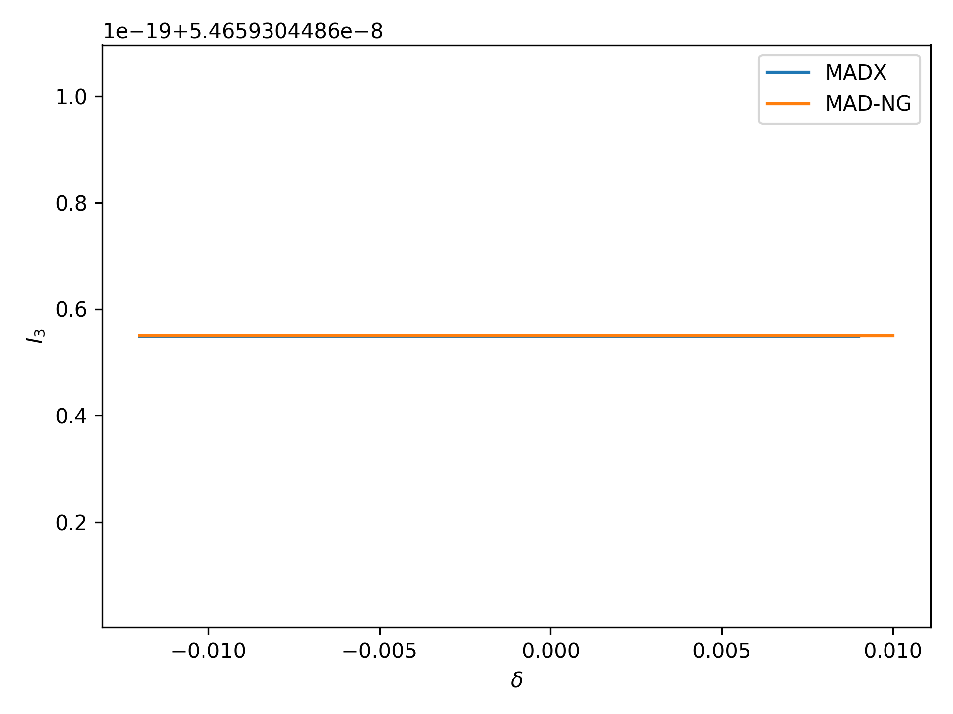
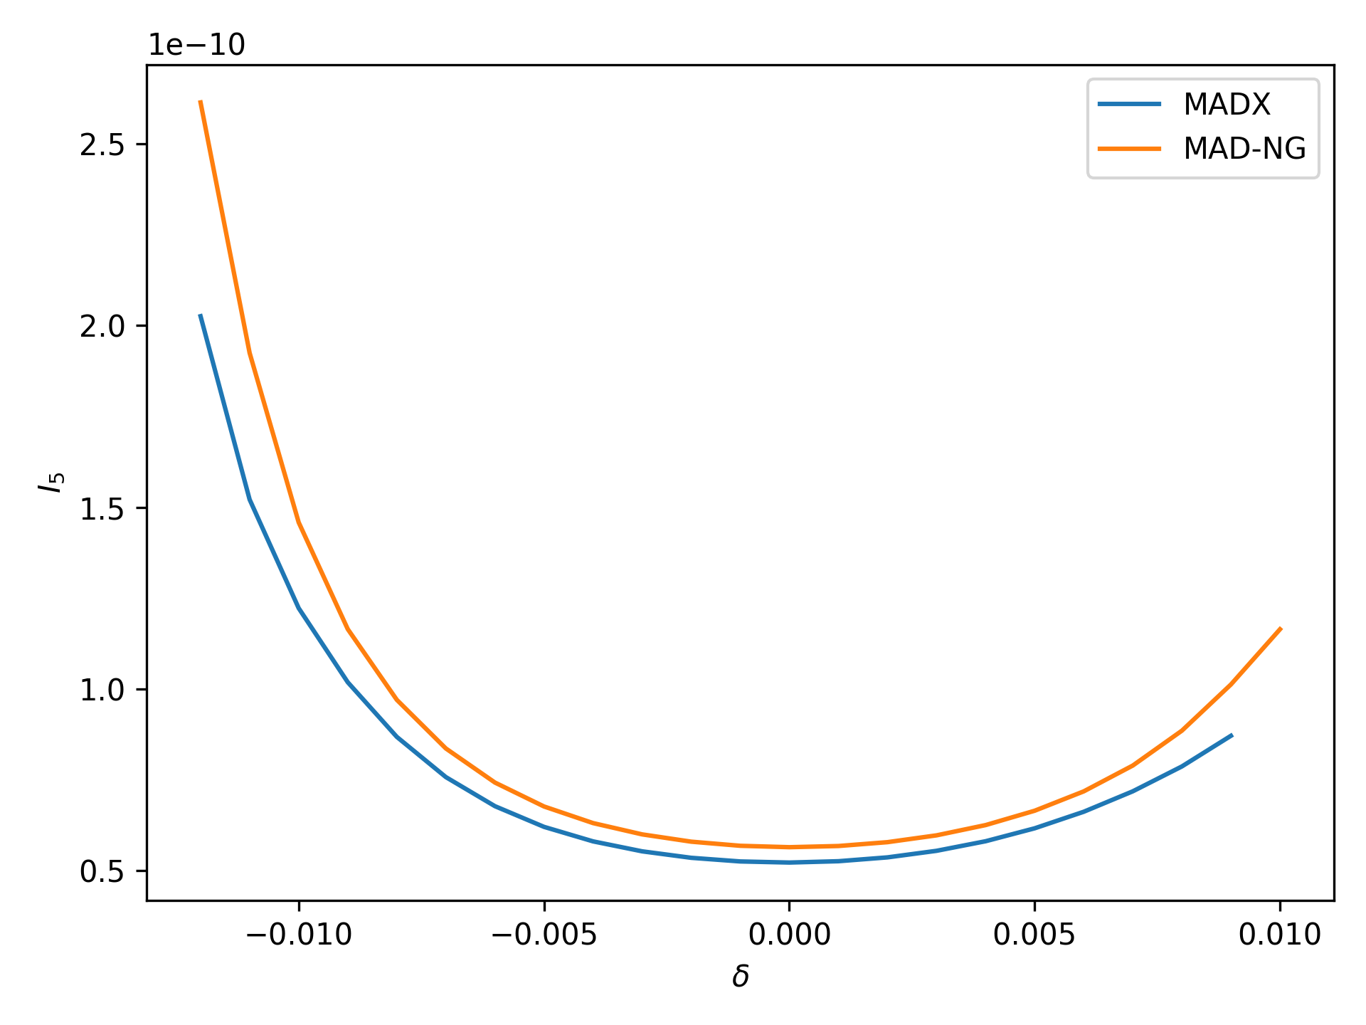
Variation of Radiation Integrals

Slide 19
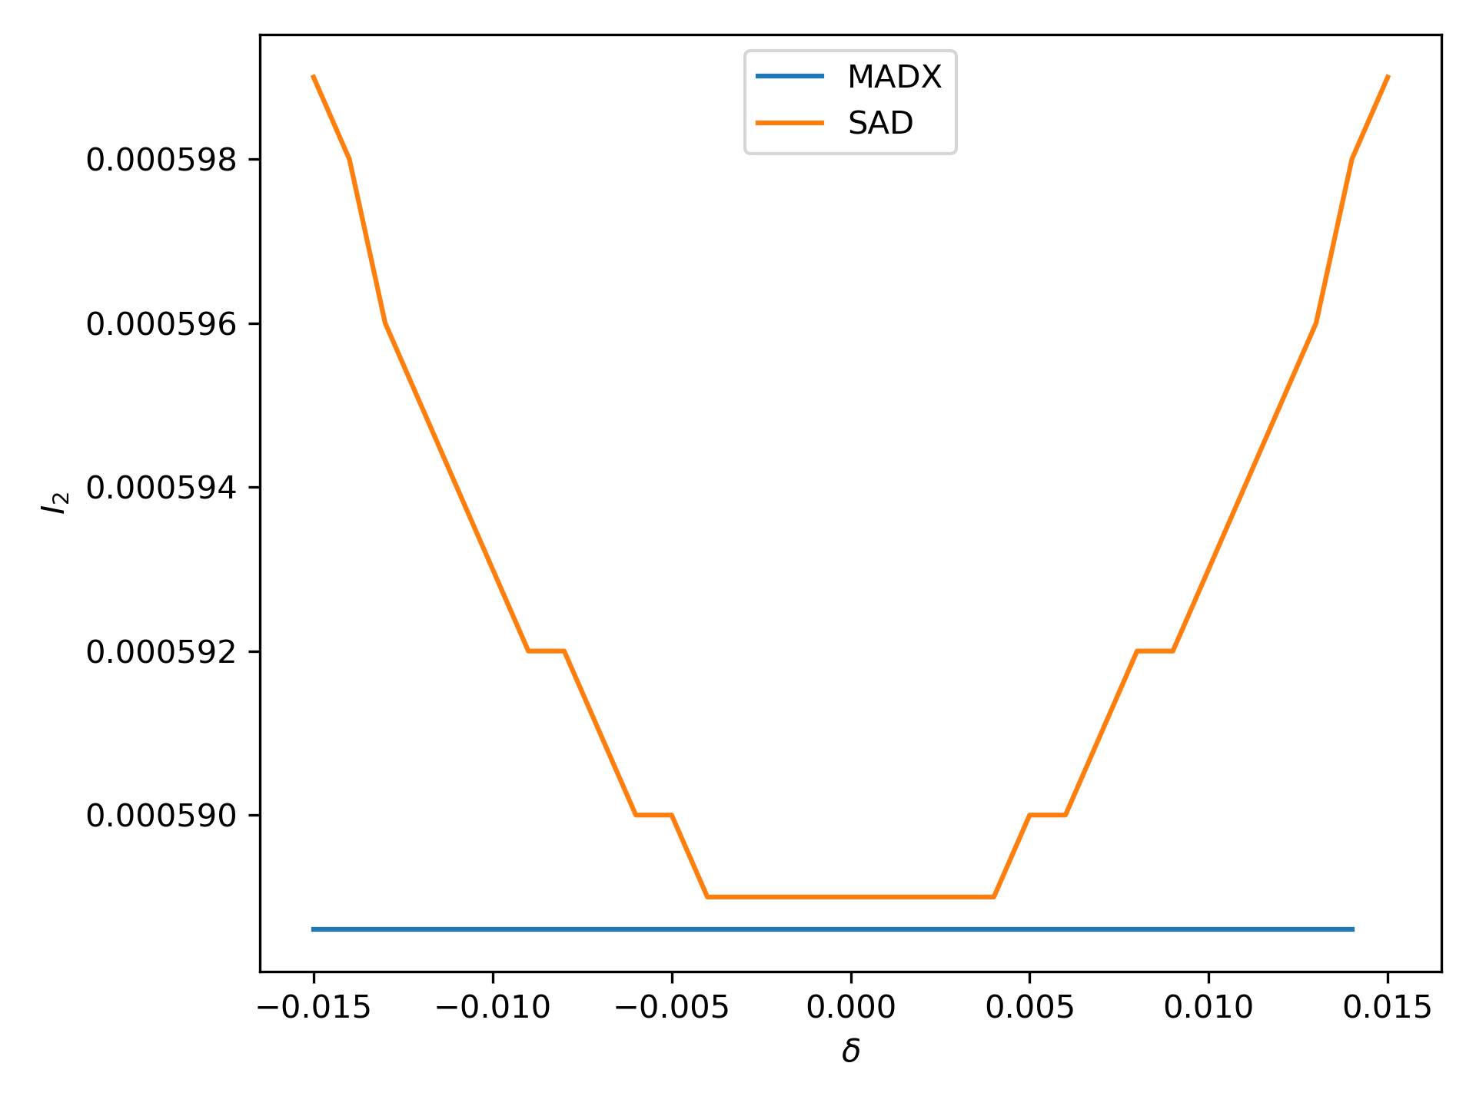
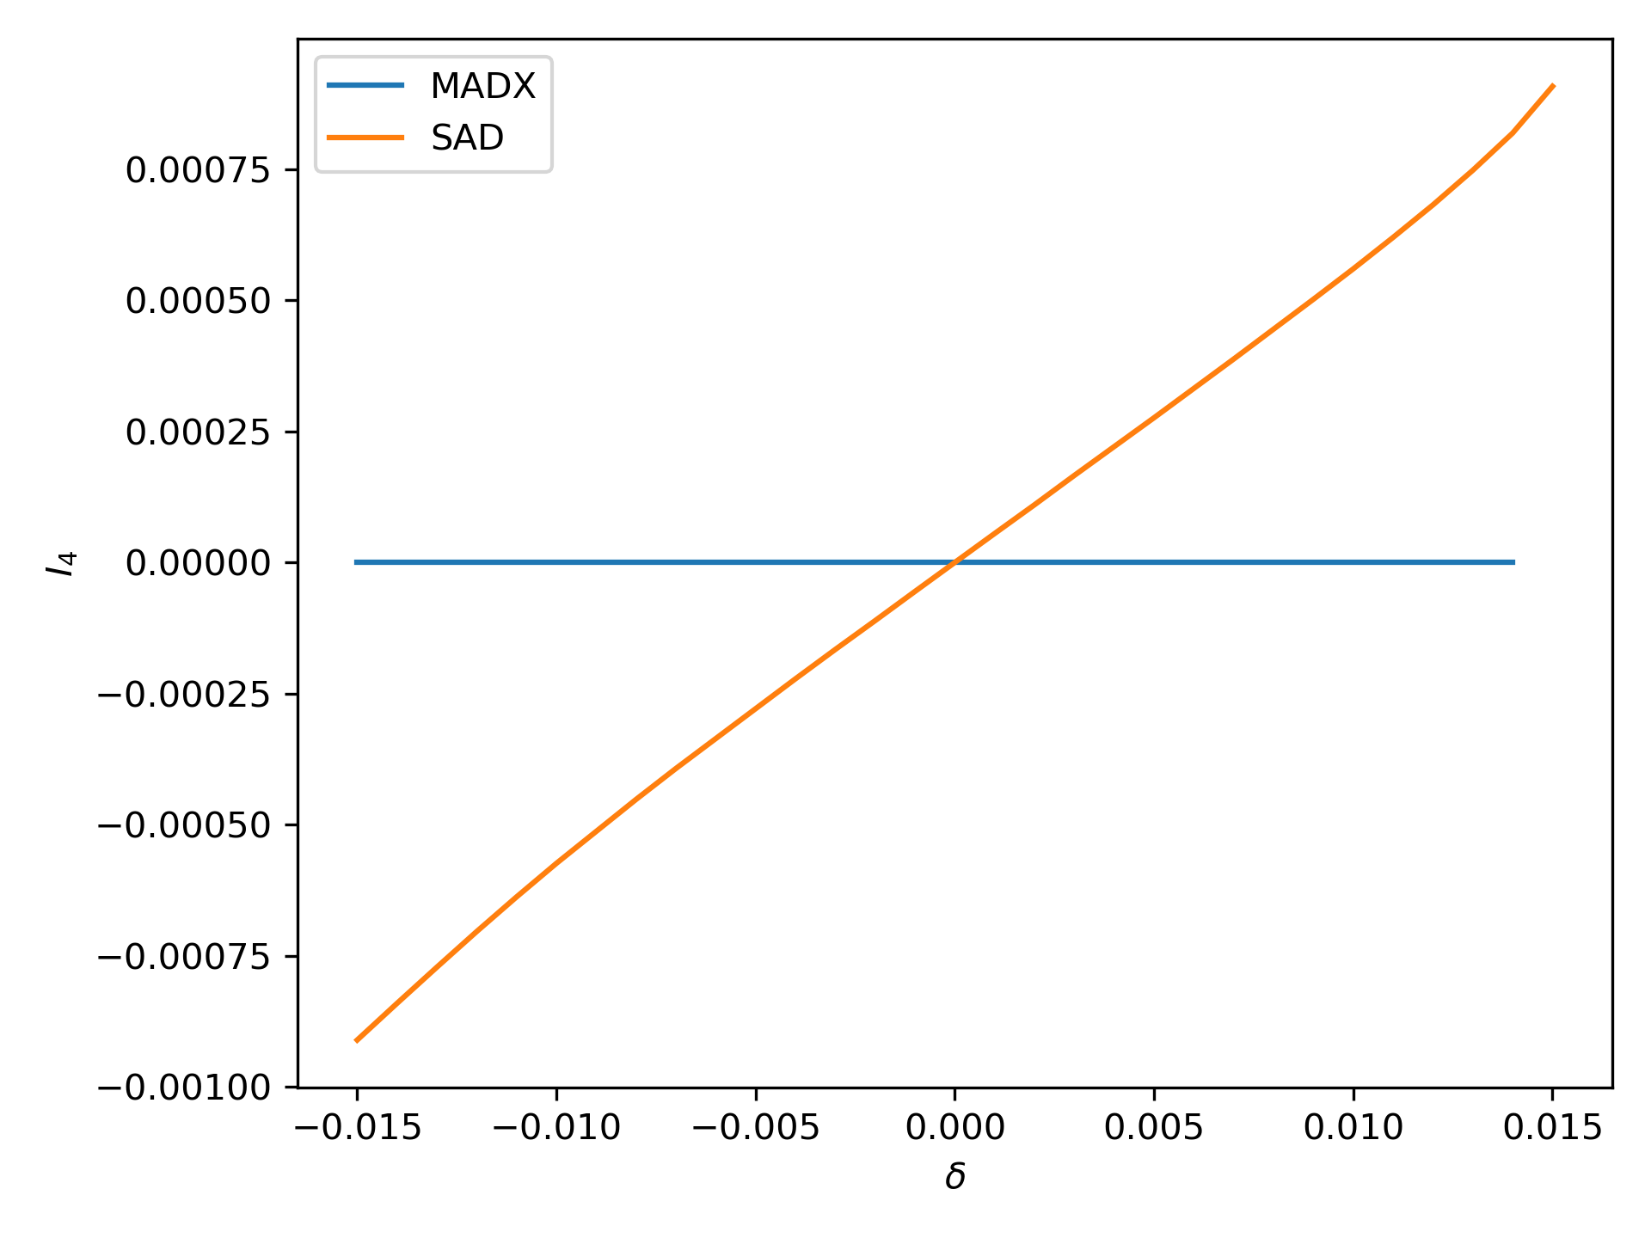
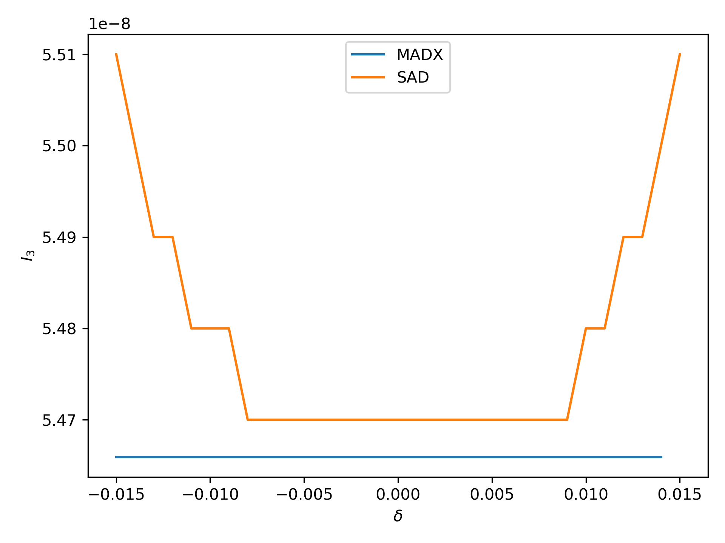
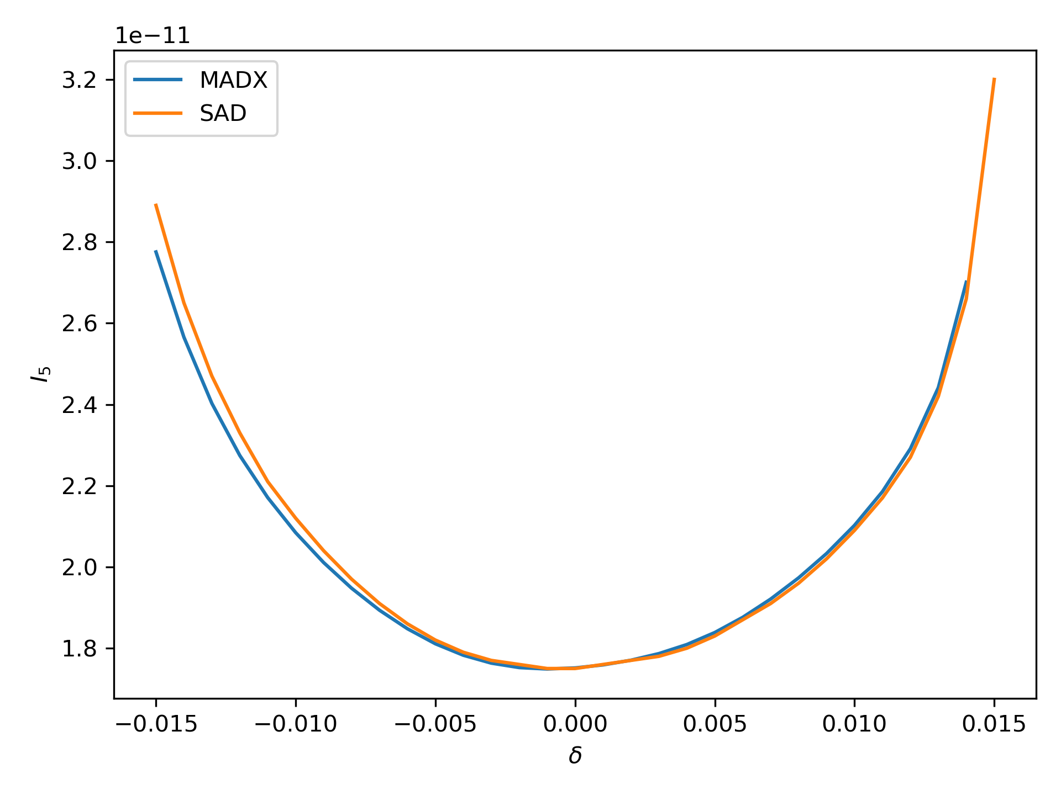
Radiation Integrals in MADX 20/05/2020

Slide 20
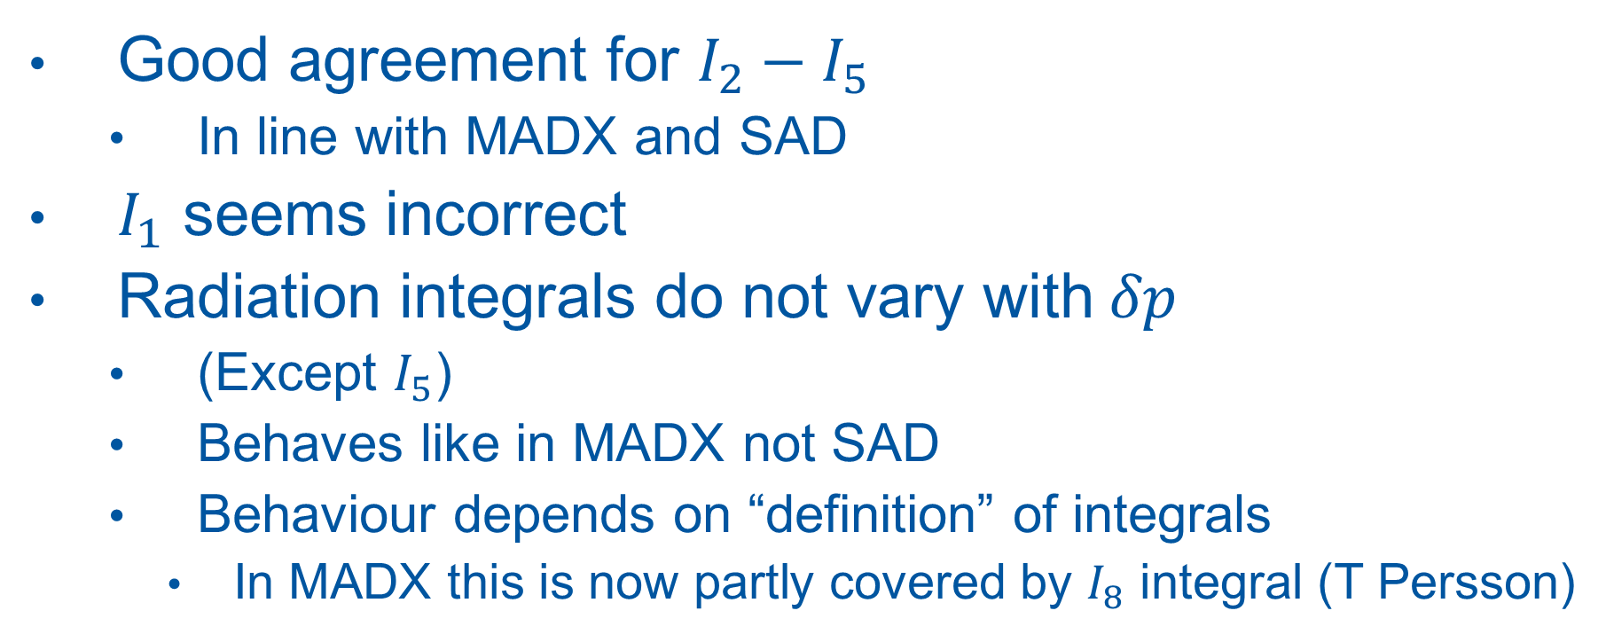
Radiation Integrals Comments
Good agreement for $I_{2}−I_{5}$
  In line with MADX and SAD
$I_{1}$ seems incorrect
Radiation integrals do not vary with$δp$
  (Except $I_{5}$)
  Behaves like in MADX not SAD
  Behaviour depends on “definition” of integrals
    In MADX this is now partly covered by $I_{8}$ integral (T Persson)

Slide 21
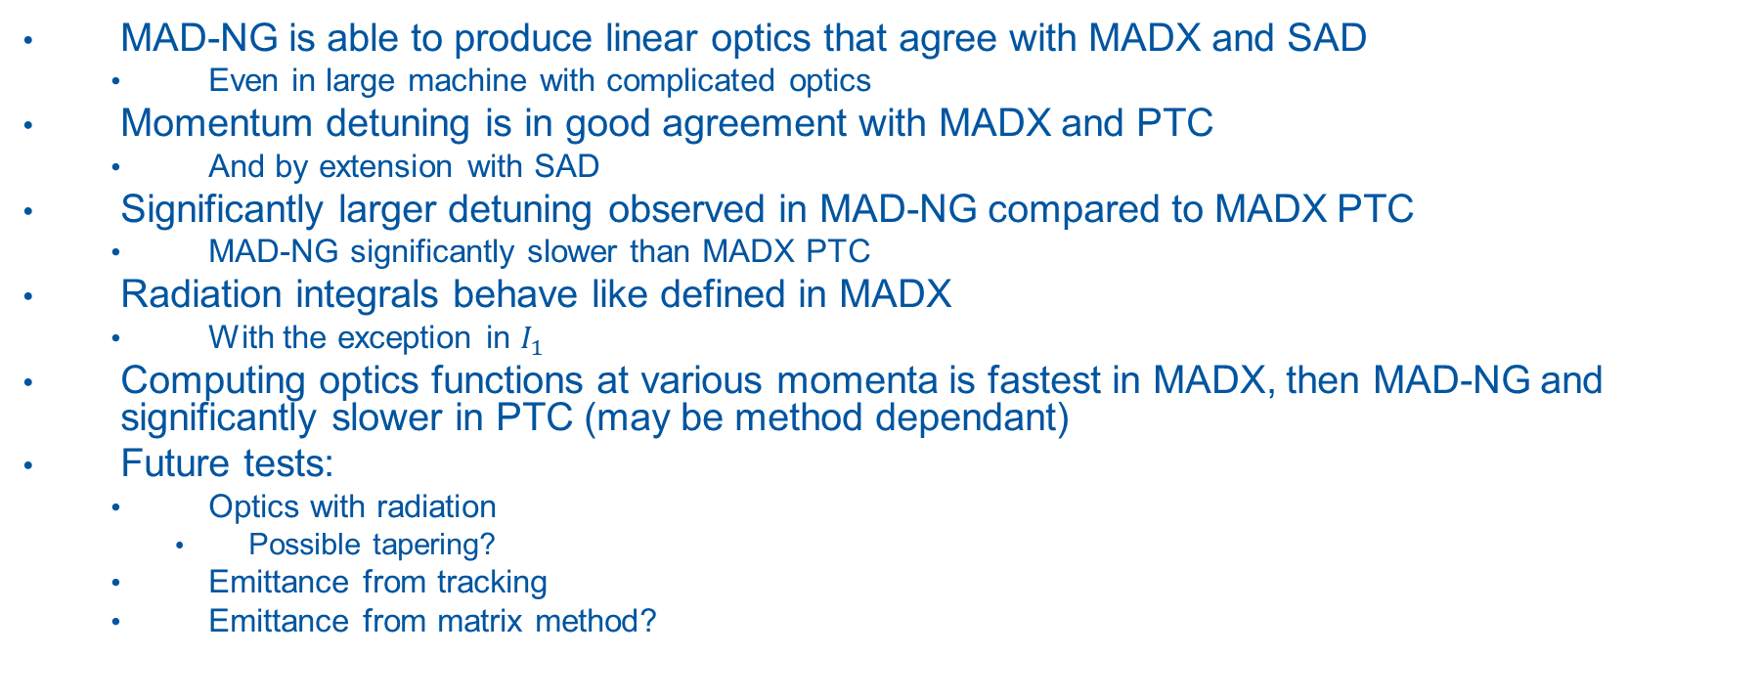
Conclusions
MAD-NG is able to produce linear optics that agree with MADX and SAD
  Even in large machine with complicated optics
Momentum detuning is in good agreement with MADX and PTC
  And by extension with SAD
Significantly larger detuning observed in MAD-NG compared to MADX PTC
  MAD-NG significantly slower than MADX PTC
Radiation integrals behave like defined in MADX
  With the exception in $I_{1}$
Computing optics functions at various momenta is fastest in MADX, then MAD-NG and significantly slower in PTC (may be method dependant)
Future tests:
  Optics with radiation
    Possible tapering?
  Emittance from tracking
  Emittance from matrix method?

Slide 22
Backup

Slide 23
Some Technical Details
MADNG version 0.9.2
  Flags used in twiss:
    method=6, nslice=3, cofind=true, ptcmodel=true
  Flags used in tracking:
  method=6, nslice=3, ptcmodel=true
PTC Model Flags:
  time=true,model=2,method=6,nst=3,exact=true
  Flags used in twiss:
    ICASE=6, no=2, closed_orbit=true, deltap_dependency = true
  Flags used in tracking:
    icase=6

