Slide 1



General scaling laws of space charge effects in field emission
A. Kyritsakis, M. Veske, F. Djurabekova

Slide 2
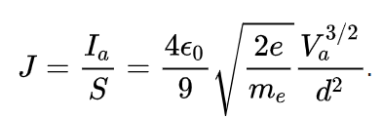
SC-limited field emission
Child-Langmuir law (1911):
Anode
V
d
-
-
-
Cathode

Slide 3
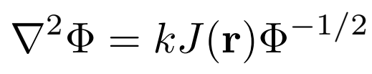

SC-limited field emission
Poisson & continuity equation:
Anode
V
d
-
-
-
Cathode

Slide 4
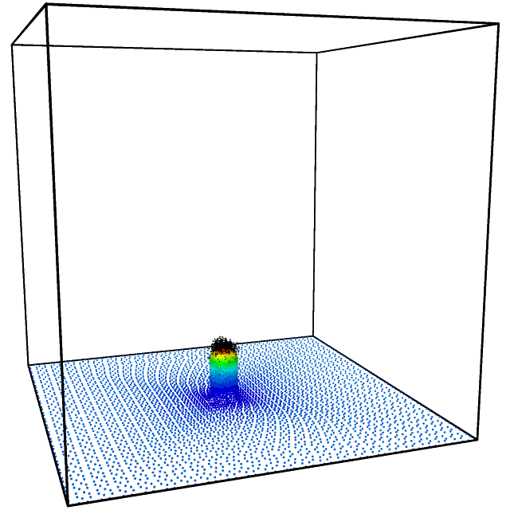
SC-limited field emission
Particle-in-cell simulation
Child-Langmuir:
  1D, planar, SC limited (F = 0)
Langmuir-Blodgett:
  1D, sphere-cylinder, SC limited
Stern et al:
  1D, planar, general (F > 0)
Barbour et al:
  Real geometry -> 1D planar
  Equivalent Planar Diode

Slide 5
SC-limited field emission
Equivalent Planar Diode (EPD)
  Often overestimates SC suppression
  Underestimates charge density
Corrected EPD
  Any 3D emitter is equivalent, regarding SC, to a planar diode of certain characteristics, determined by a single geometry dependent correction factor ω

Slide 6
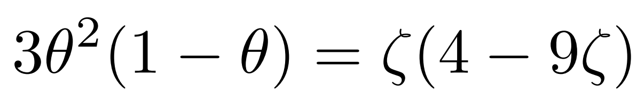
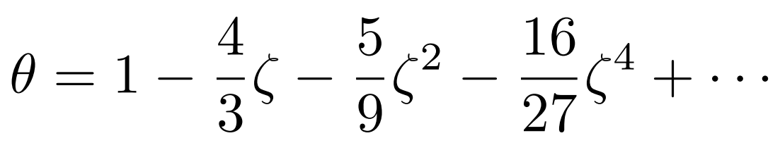

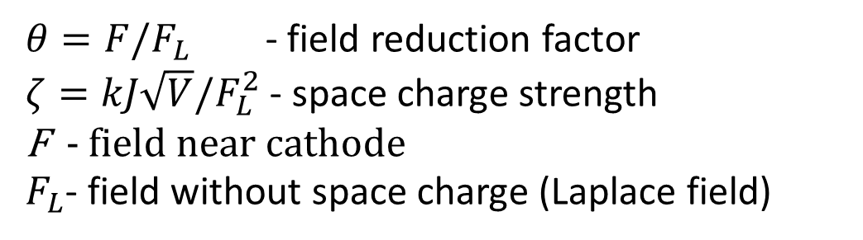
EPD
$$≈$$
$θ=F/F_{L}$ - field reduction factor
$ζ=kJ\sqrt{V}/F_{L}^{2}$ - space charge strength
F - field near cathode
$F_{L}$- field without space charge (Laplace field)
Notes:
Theta - how much field is reduced by SC
Zeta - the more SC you have, the more zeta; zeta 0 - no SC, zeta grows, theta grows also

Slide 7
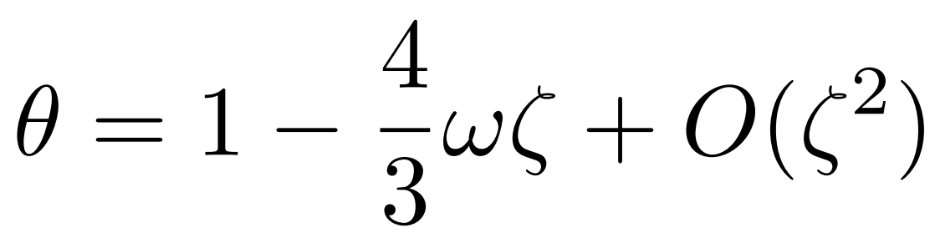
Corrected EPD
Ways to obtain correction factor ω:
Evaluate a nasty integral
Use an algebraic equation for sphere & cylinder
Run particle-in-cell simulation
Fit from experiment
*R. G. Forbes, Journal of Applied Physics 104, 084303 (2008)

Slide 8
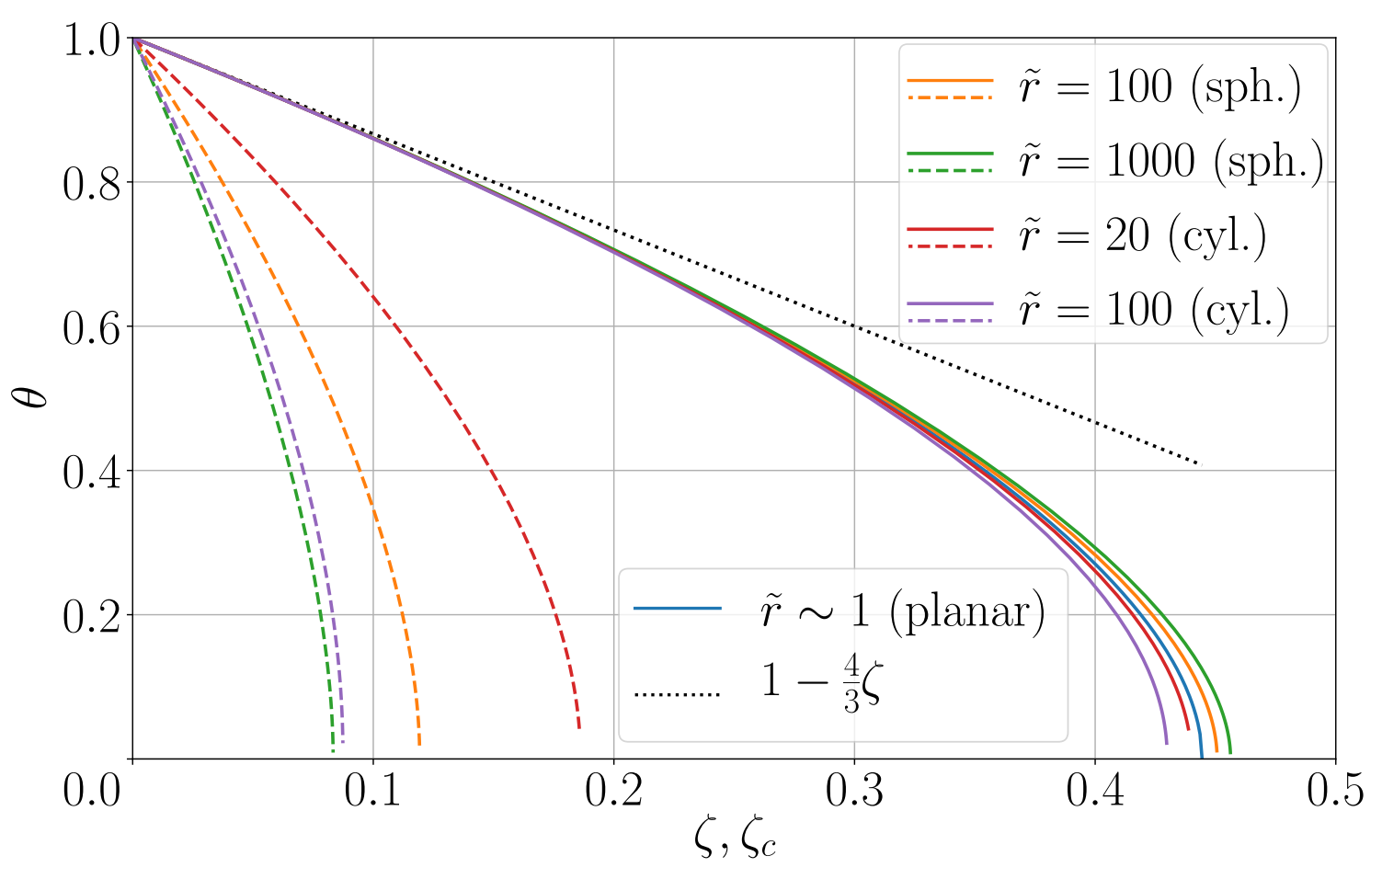
Behavior of the model

Slide 9
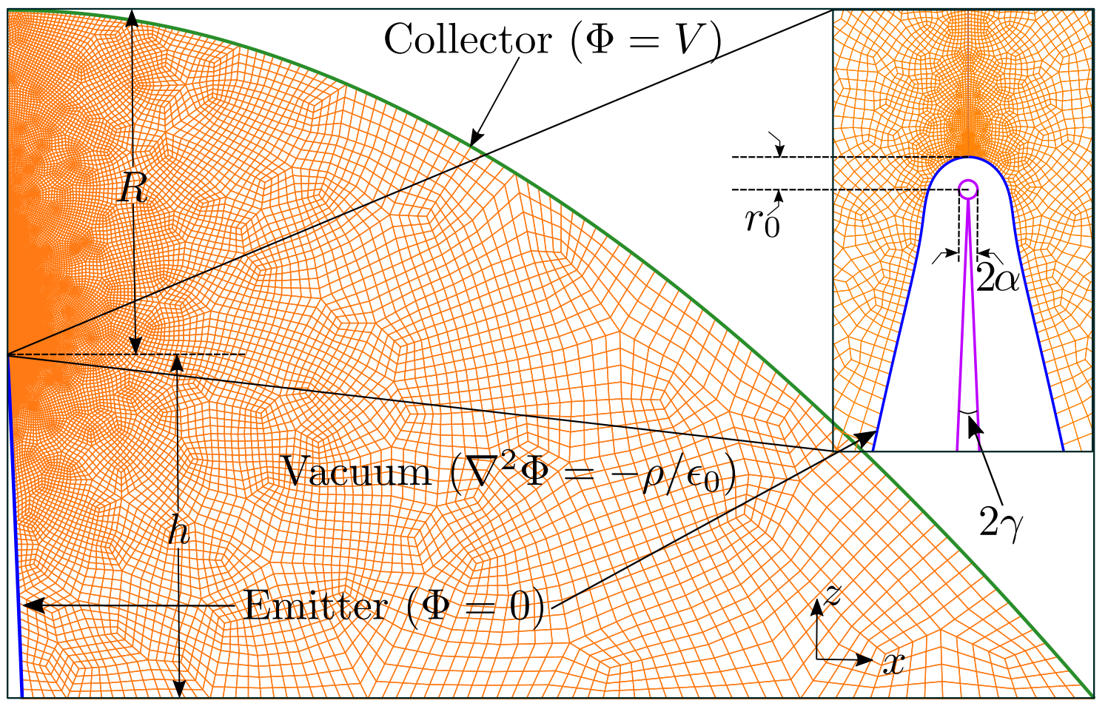

Comparison with PIC
$$γ=0.78° \\ r_{0}=315 nm,$$
$$R=6.5 cm,$$
$$h=R$$

Slide 10
Comparison with PIC
2D axisymmetric Femocs*
Steady-state field calculation
Adaptive timestep
Inject single superparticle with a weight that corresponds to the charge it carries
*Phys. Rev. E 101, 053307 (2020)

Slide 11

Comparison with PIC
fit
ramp
$$\frac{F}{F_{L}}=1−\frac{4}{3}ωk\frac{J_{s}\sqrt{V}}{F_{L}^{2}}$$
measure

Slide 12
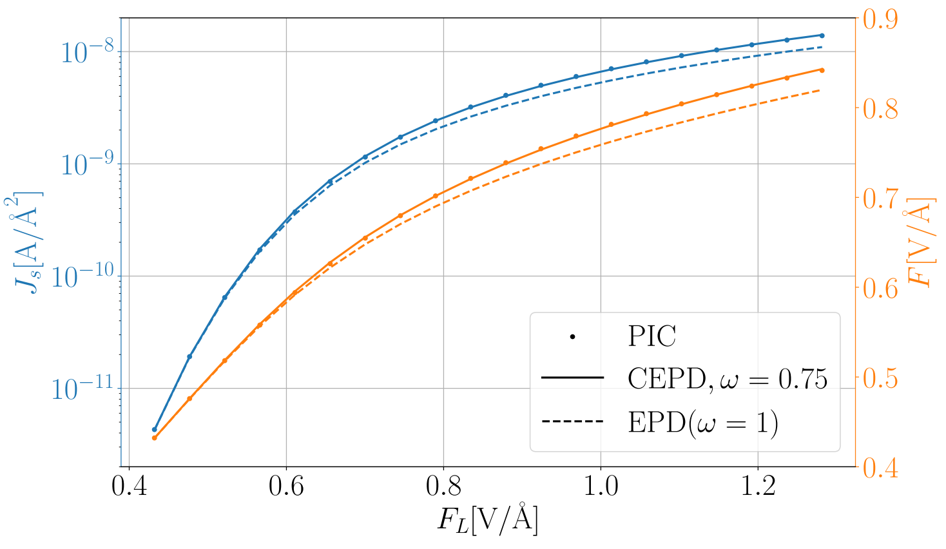
Comparison with PIC

Slide 13
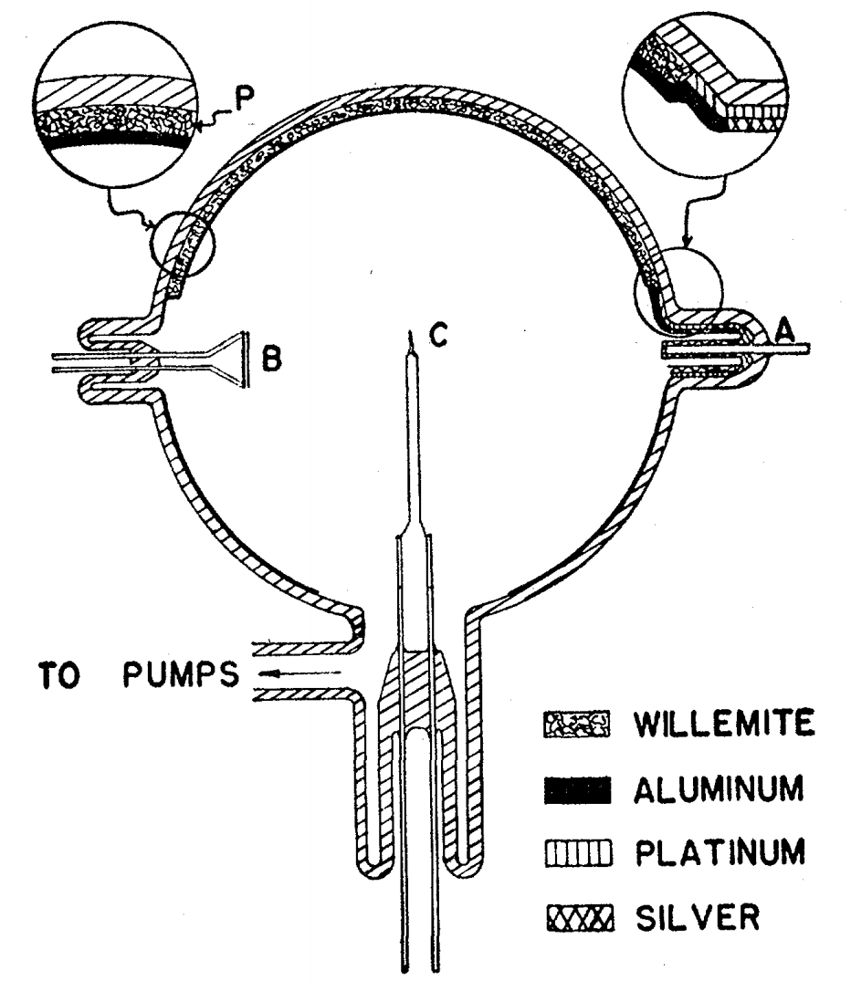
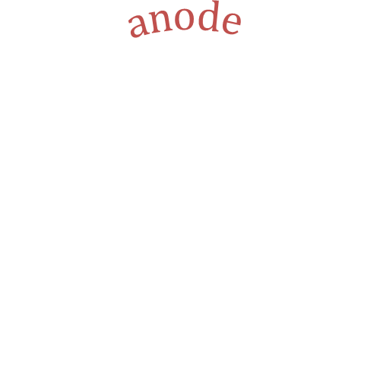

Comparison with exp.*
$$anode$$
$$cathode$$
*Barbour et al,
Physical Review 92, 45 (1953)

Slide 14
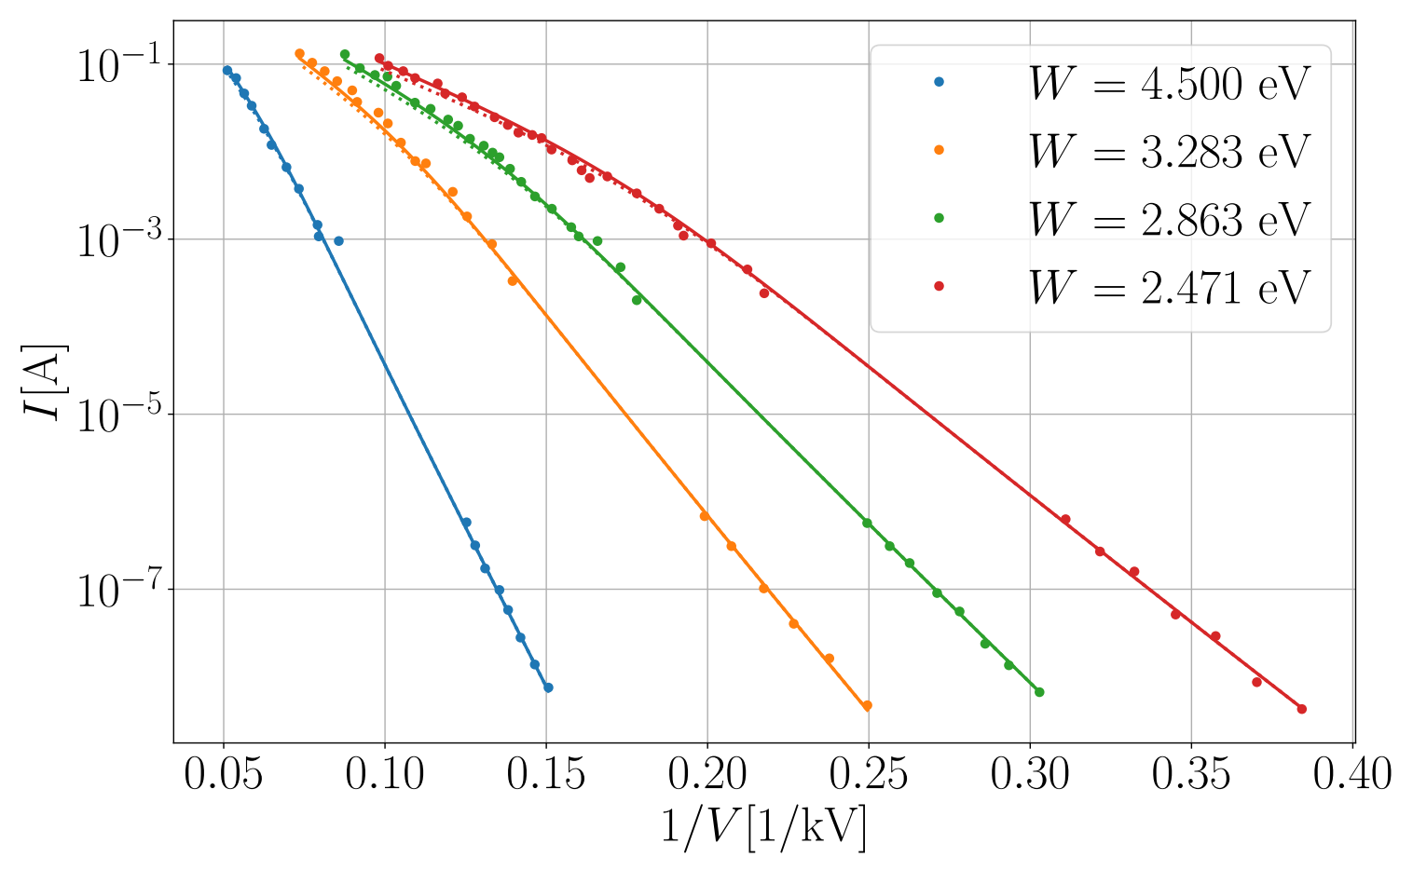
Comparison with exp.
β from
Fowler-Nordheim eq.

Slide 15
Comparison with exp.

Slide 16
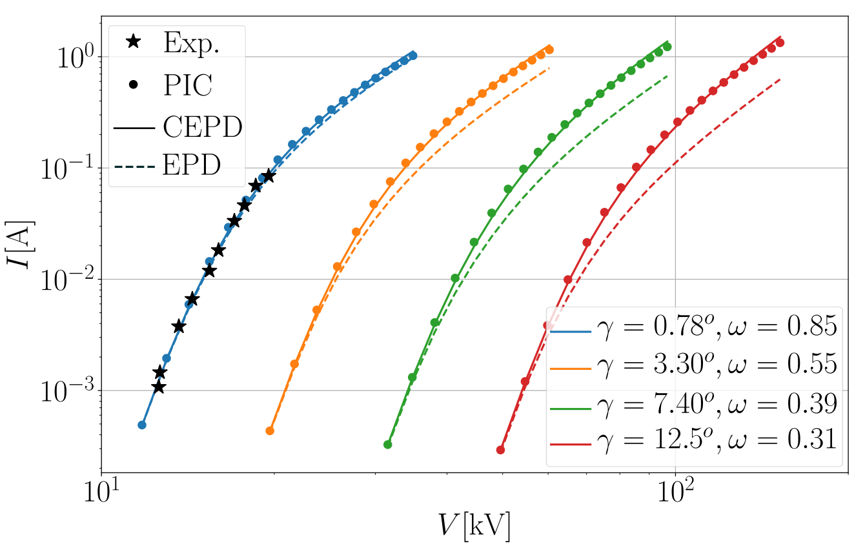
Inadequacy of EPD

Slide 17
Conclusions
By knowing ω and β, one can calculate SC suppressed emission current from a 3D emitter
ω can be calculated by running PIC (once)
ω is scale invariant, therefore it can be tabulated for various geometries
CEPD model can be used to calculate emission current for various work functions, temperatures etc. without the need to run PIC
For more details, see arXiv:2008.11984
(currently under review in PRE)

Slide 18
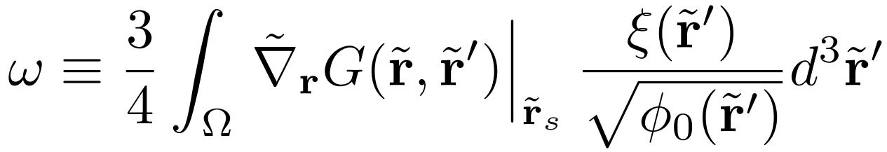
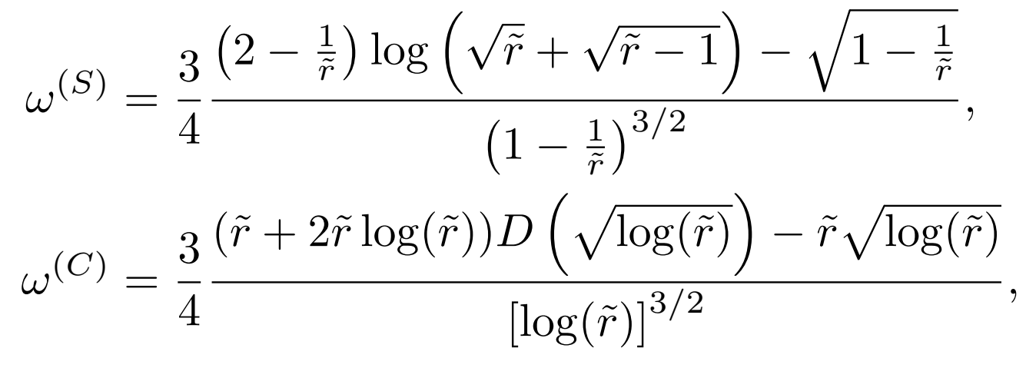
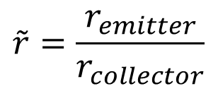
Corrected EPD
General
Sphere
Cylinder
$$\tilde{r}=\frac{r_{emitter}}{r_{collector}}$$

