Slide 1

Physics Meeting - Short News
26 October 2020

Slide 2
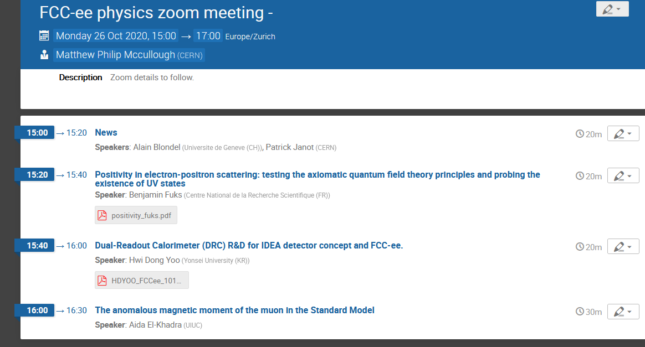
NB : precision calculations made in advance of data publication!
impact on FCC-ee EWPOs via α_{QED}(Q²) ?

Slide 3
Brief news of relevance
New CERN management has been announced
-- Director of Research is Joachim Mnich (from Desy)
-- NB new PH department head has not been announced
2. New ECFA chair has been elected: Karl Jakobs (Uni Freiburg)
Congratulation to Greg Bernardi who came second.
3. MTP (as discussed in June) has been approved.
→ Budget for High Field Magnet
→ budget for CLIC reduced to accelerator part only
→ FCC-ee Physics and Experiment studies will be supported
+ detector R&D in CERN-EP + ECFA panel on detector R&D
(not FCC exclusive, of course)

Slide 4
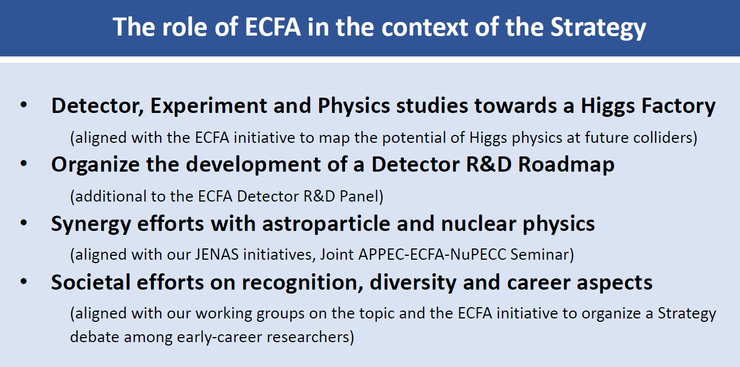

Slide 5
Next ECFA meeting 19-20 November 2020

Slide 6
NB TeraZ requirements on TDAQ, have been registered, not necessarily on systematics!
Progress on our requirements (E. Perez) + Roadmap Panel activities (S. Kuehn) will be presented at FCC 4th Phys. workshop

Slide 7
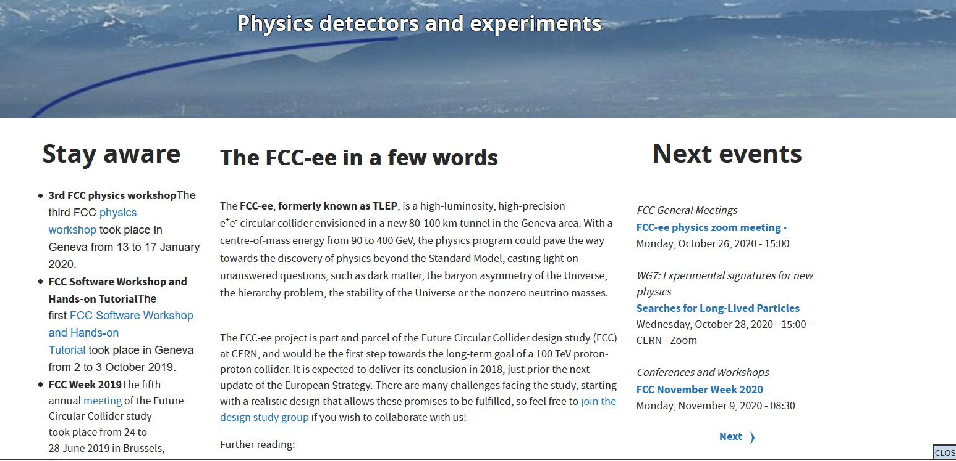
FCC-ee Web site → Marcin Chrząszcz agreed to take charge of enlivening the web site
For documentation e.g. on publications, he will appreciate your active participation!
Replace with links to
Indico categories, rather than to old meetings
+ Link to PPC work pages, etc.
Update text to 2020-2025 study
Adapt, as list will
become longer
Update documentation
marcin.chrzaszcz@cern.ch

Slide 8
Thanks for your proposals, more are welcome, esp. for theorists!
We will also request proposals from national contacts.

Slide 9
Important tasks of Physics Groups conveners
Mandate in preparation
For each Physics Group, one or two experimentalists, and one or two phenomenologists
Gather community
-- with help from FCC national contacts
-- using their own relations
-- as needed organize well advertised kick-off mini-workshops or meetings
-- collect a first set of Benchmark measurements
existing list can be found here https://www.overleaf.com/read/dyjpdszrqxhz
list of submissions to Snowmass https://indico.cern.ch/event/951830/
With high priority should focus on participating to the Physics Performance effort
via the Physics Benchmark Committee
-- Benchmark measurements → case studies leading to detector requirements
➔ common Physics Tools, Analysis Code, Detector Requirements, Public Documentation
NB independently of physics groups, volunteers are welcome in PP effort!
2’. Scope thoroughly the physics capabilities,
develop new measurements, event generators, understand th. uncertainties etc.
investigate New Physics sensitivities towards physics CDR

Slide 10
The Physics Performance coordinators are good contact points for those desiring to start FCC-PE&D work by one of the case studies, at the interface between physics benchmarks and the detector requirements, and using/creating the physics software tools.
This should be advertised to the various countries.

Slide 11
FCC national groups for PE&D activities
France and Italy well established already (Contacts: G. Bernardi, R. Aleksan, F. Bedeschi)
UK had their first meeting on 11 September (Contact G. Wilkinson, C. Leonidopoulos)
Spain had “next future collider” gathering on 7 October (Contact Juan Alcaraz)
➔ join FCC with future colliders (so far mostly ILC)
Poland: FCC information day @ Epiphany conf. January (Contact T. Lesiak, M. Chrząszcz)
Switzerland: FCC-INT well on the roadmap (contact R. Wallny) FCC PE&D workshops in 2021
CERN: creation of EP/FCC group is commissioned to EP dep. head (Contact: P. Janot)
Discussions started with Germany, USA, Austria, Belgium, Netherlands, Estonia, Sweden,
Denmark etc. Many countries represented in Program Advisory Committee for the workshop
G. Bernardi & T. Lesiak have been assembling an informal group of national contacts

Slide 12
World-wide contacts are also very intense and successful on the accelerator side!
Examples:
FCC – EIC (Electron Ion Collider at Brookhaven Nat. Lab → 2032)
strong synergies between electron ring and FCC-ee Z:
High intensity, RF system, polarization, etc… compatible RF frequency
collaboration under discussion.
FCC-ee injector and Booster (collaboration PSI/CERN/IJClab/BINP )
etc. etc.
“build bridges, not walls”

Slide 13
Other important roles
We are seeking volunteers for
-- FCC PE&D conference committee
a few more members from exp. and th.
-- General Physics Meetings Organizer
one Exp. Physicist to replace P. Azzi
Nominate or Volunteer by 31 October

Slide 14
FCC PE&D Conference committee
New member(s) are sought for FCC PE&D conference committee
Existing members: P. Azzi (to be replaced), A.Blondel, P. Giacomelli, C. Grojean, M. Klute (chair)
(did I forget somebody?) An online interface exists (Markus)
Dissemination is an important task for the collaboration!
-- beneficial to communicate on the project (physics capacities, plans, performance etc…) to wider audiences
-- beneficial to entrust FCC presentations to active members as well as new/young interested members
-- even if it goes somewhat beyond their own area of expertise
-- write-ups are also very useful
Tasks
-- collect and disseminate information, deadlines for abstracts etc… on upcoming conferences
-- collect suggestions for topics and seek suggestions/nominations for speakers
-- sometimes discuss directly with conference organizers/conveners etc.
-- ensure abstracts are reasonably consistent and coherent and that important topics are not absent.
Meetings: so far as needed but will seek a regular monthly meeting.
Seeking: at least one more member to replace Patrizia
Mandate: two years

Slide 15
Organizer of FCC PE&D monthly general meetings
Context: These meetings have been taking place since TLEP times.
Patrizia Azzi and Matthew McCullough are jointly organizing them at present.
Patrizia having accepted the task of Physics Performance Coordinator, she has asked to be relieved
-- thanks Patrizia for excellent and lively organization!
The object of the general meeting is as follows
-- inform the design study members – and whoever has registered on the mailing list – of the progress of the study
-- discuss new results of the study
-- as appropriate proceed to make them official results.
Content *typically* comprises:
-- General news, news pertaining to common working environment
-- Important new results from any of the working groups
++ Experiment
-- accelerator performance
-- MDI
-- physics performance results , i.e. detector requirements from case studies
-- detector simulation or test beam results
-- new detector ideas
++ Theory:
-- new results from theoretical calculations
-- new ideas for measurements that can be done at FCC-ee
-- before big conference cycles, special general meetings can be organized for review of the presentations

Slide 16
FCC-IS Kick-off and 4th FCC-Physics workshop
the FCC November workshop (9-13 November 2020) (357 registered at 13:30)
https://indico.cern.ch/event/923801/
will be remote
It comprises the 4th FCC Physics and Experiments Workshop (298 registered at 13:30)
https://indico.cern.ch/event/932973/ 10-13 November.
The two agendas are intimately linked
Introductory presentations on the 9 November
Physics workshop presentations on the following days.
➔ we recommend that you *register to, and attend, both events*.
Some of the many highlights: (invited speakers):
-- first day presentation by F. Gianotti Monday 9 10:00
-- ECFA R&D roadmap presentation Tuesday 10 15:30
-- Physics Performance, MDI/Epol/ee→H presentations
-- round table discussion on Tuesday 10 17:15 organized by B. Heinemann and D. Milstead
-- many pheno and detector parallel presentations, summaries on the last afternoon.
-- joint sessions Exp+pheno sessions

Slide 17
CONCLUSIONS
Quite a lot is happening and we are growing!
-- Physics Performance
-- Detector R&D road map
-- 4th Physics workshop
-- don’t forget to send us nominations (or volunteer) for the tasks at hand
-- ‘see’ you at the workshop in 2 weeks, at the latest!

