Slide 1

Physics Meeting - Short News
30 November 2020

Slide 2


Slide 3
General Physics meeting
30 November 2020 -- NEWS

Slide 4
Very briefly
DG: “CERN will put in place dedicated effort in experimental and theoretical physics”
Mandate and organization (aim) to be made public in March 2021
Until then we operate with 2013 mandate.
ECFA is putting together
-- Higgs (and Electroweak) Factory “physics experiments and detectors” workshops ^{*)}
-- a detector R&D road map panel
Great opportunities not to be missed!
*)see news of March and April 2020 for genesis.

Slide 5
Very briefly
FCC physics groups : thank you for your suggestions:
    -- precision EW at the Z
    -- High energy EW: Diboson, difermion and W mass
    -- Heavy Flavour Physics
    -- tau physics
    -- FCP (Feebly coupled particles/LLPs)
    -- other BSM direct
    -- QCD
    -- Higgs
    -- top
    -- FCC-hh
Dedicated Theory groups
    -- General BSM and model-specific global fits
    -- Precision theory calculations
    -- Monte-Carlo generators and fitting formulae
Accelerator- experiment joint groups
    -- MDI
    -- Energy calibration and Polarization (also for E_{CM}=m_{H} run)
Still subject to some changes and discussion.
A very rich program!

Slide 6
ECFA and FCC
excerpts from the PECFA meeting 19-20 November 2020
https://indico.cern.ch/event/966397/
Physics Experiment and Detector Workshops (From Jorgen D’Hondt’s presentation)
ECFA detector R&D roadmap (from Susanne Kuehn’s presentation)
LDG Accelerator R&D roadmap (from Lenny Rivkin’s presentation)
From January 2021, ECFA chair will be Karl Jakobs

Slide 7
AB: The initial ideas were developed with Jorgen in discussions in March 2020
will make it possible to organize general meeting with all the ‘Higgs Factory’ community (CLIC, FCC-ee, ILC, CEPC) We have been invited to be part of the IAC (11:49 today)

Slide 8
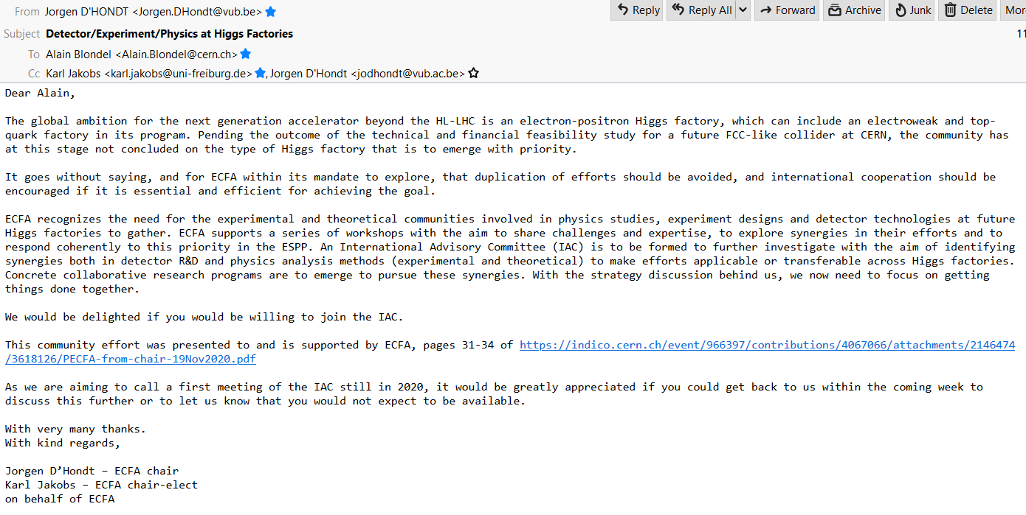
As we speak!

Slide 9
See presentation by Susanne Kuehn at FCC workshop
FCC IS CONCERNED BY ALL WP’S!

Slide 10
AB -- This is a very short time scale. It is an important process since people will refer to it in e.g. grant proposals.
-- The Z factory (5.10¹² Z) challenge will be written explicitly in the scope description
-- We had discussions with Allport and Kuehn;
→ our problems are often new and require tapping all task forces. We would like to actively address all of them.

Slide 12
Note that LDG reports directly to CERN council (not CERN DG):

Slide 13
AB: ERL has been proposed for FCC-ee at energies above the WW
AB: Luminosity Frontier facilities (like the FCC-ee) are not mentioned -- we need to insist!
-- Energy efficiency
-- beam-beam dynamics and extreme luminosity
(both are also useful for everyone)

Slide 14
AB: This may be where we can probably fit in
FCC-ee is full of science, and high(er) luminosity
can be both extremely challenging and science enabler.

Slide 15
AB: Again this is an extremely fast time line!

Slide 16
Conclusions
Following the ESPP 2020, a number of initiatives are being put in place to put its recommendations into effect.
We need to be actively participating and make sure it all converge nicely towards the very challenging goal of having an exciting project for the future of CERN after the LHC!

