Slide 1
Why people were on
Facebook during your talk
(And other lessons in effective communication for scientists)
Notes:
How to engage an audience, promote understanding, foster trust and respect, and deliver words that have an impact on someone else’s life.

Slide 2
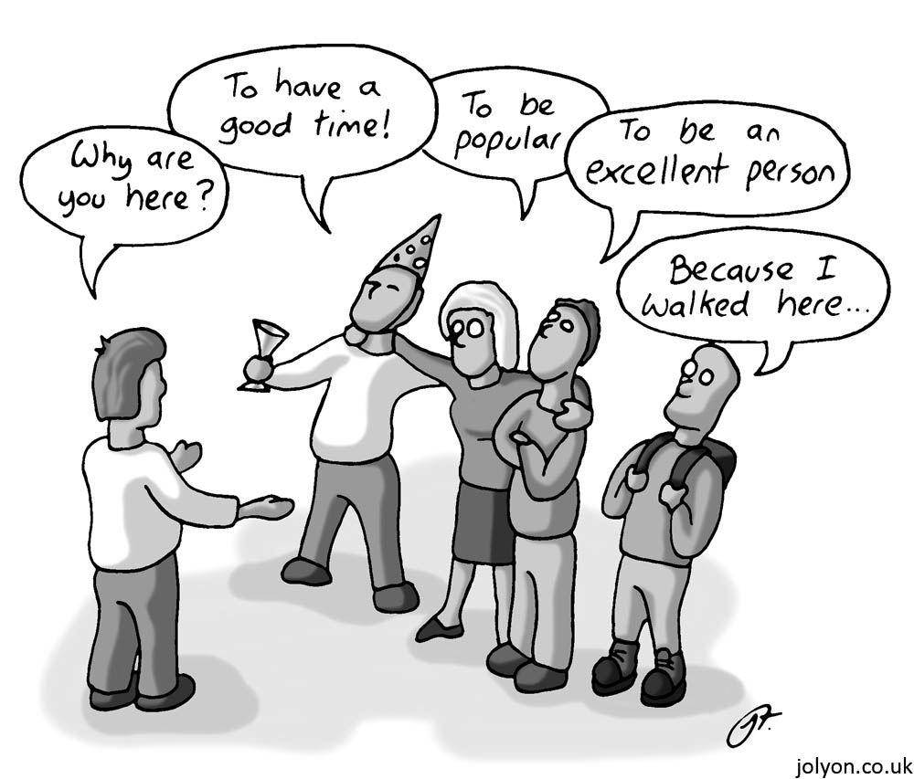
Why are you here?
Notes:
Have you ever tried to give driving directions to someone, and they still get lost?
Have you tried to work through a problem with your boss/collaboration, and find that the more you talk about it, the worse it gets?
Have you attempted to teach a subject to undergrads, and no matter how many times you explain it they just don’t get it?
Have you found yourself or your research mis-represented by your press office? By journalists?
Have you tried to explain something to your significant other, and they just don’t get it?
It’s not them. It’s you.
You cannot change other people. You can only change the way you interact with other people. And this changes everything.

Slide 3
First, a story

Slide 4
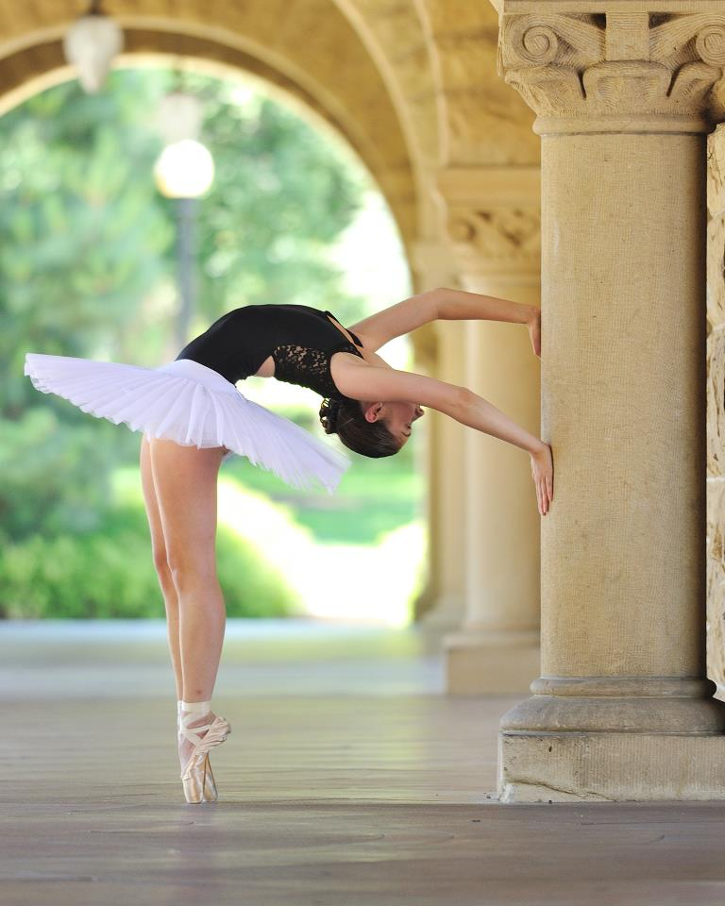
My friend Mio
Stanford University
Medical Doctor
Fluent in 4 languages
Ballerina

Slide 5
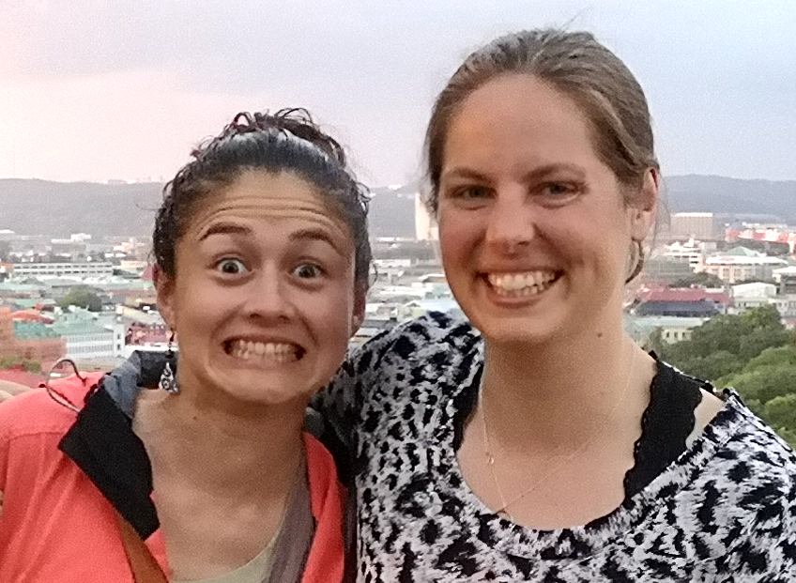
I mention antimatter…
“That’s really hard.”

Slide 6
Huh?

Slide 7
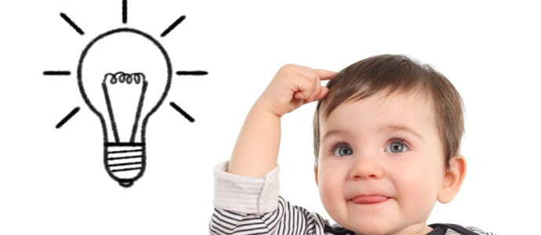
What is success?
Overview
People understand the ideas you are trying to convey
People do something with that information
  Remember
  Share
  Discuss
  Apply
Notes:
Did I succeed with Mio?
No.

Slide 8
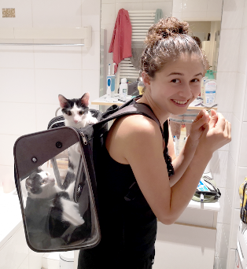
Today you will learn…
  I. Your audience
  Where do I start?
  Connect
II. How to Shine
  Self care
  Engage
III. Storytelling
  Good v. Bad
  Structure
Notes:
Mostly focused on talking with non-physicists
Also applicable in other settings.

Slide 9
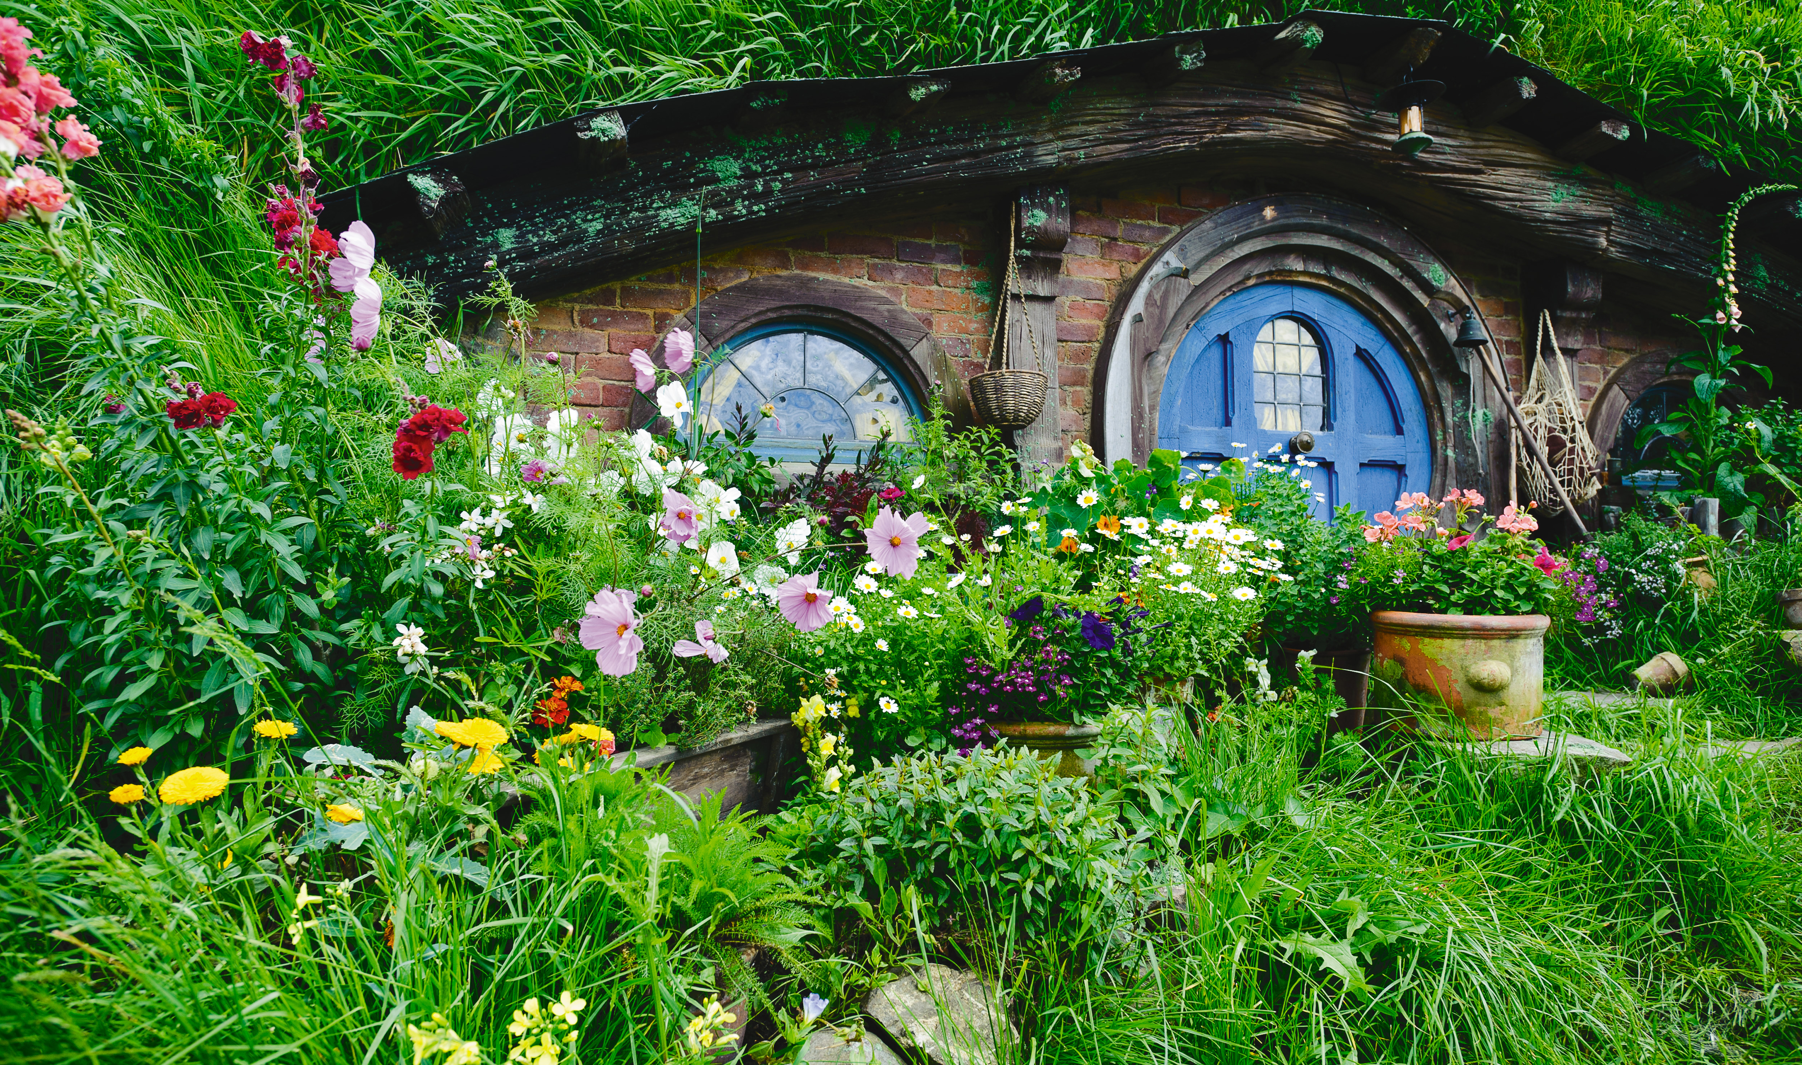
Part I: Where do I start?
Notes:
You’re normally in the world of particle physics…but just for a metaphor, we’re going to take a quick vacation into a new world…Middle Earth

Slide 10
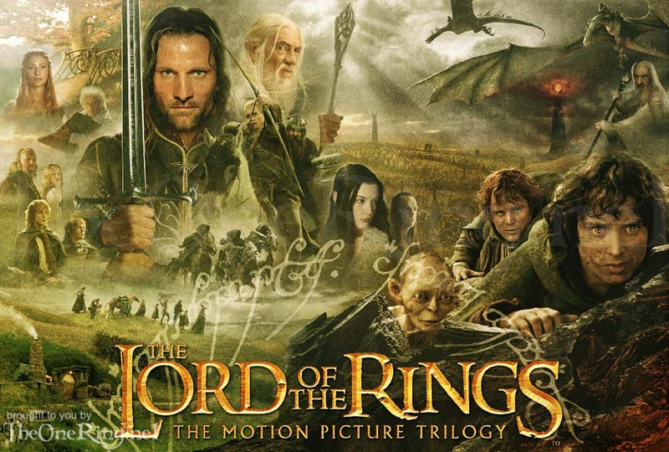
Notes:
MIDDLE EARTH

Slide 11
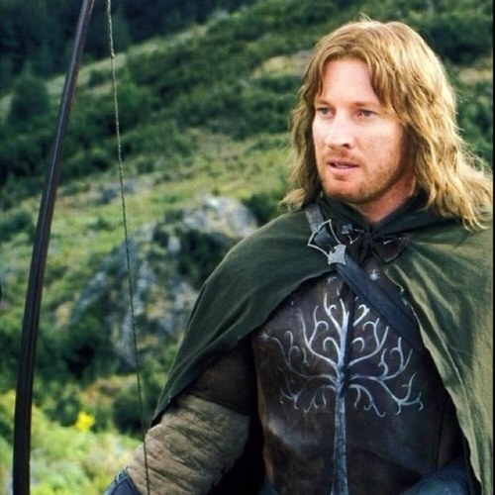
Audience: Where do I start?
So Faramir, what would you like to see happen in Middle Earth over the next few years?
Notes:
Our special guest Faramir is going to tell you a little bit about what he’s hoping to accomplish in Gondor over the next few months.
Somewhere in the middle of the twin towers….
You guys all know why Faramir said that and why it’s so significant, right?

Slide 12
Audience: Where do I start?
“For myself, I would see the White Tree in flower again in the courts of the kings, and the Silver Crown return, and Minas Tirith in peace: Minas Anor again as of old, full of light, high and fair, beautiful as a queen among other queens.”
Notes:
Our special guest Faramir is going to tell you a little bit about what he’s hoping to accomplish in Gondor over the next few months.
Somewhere in the middle of the twin towers….
You guys all know why Faramir said that and why it’s so significant, right?

Slide 13
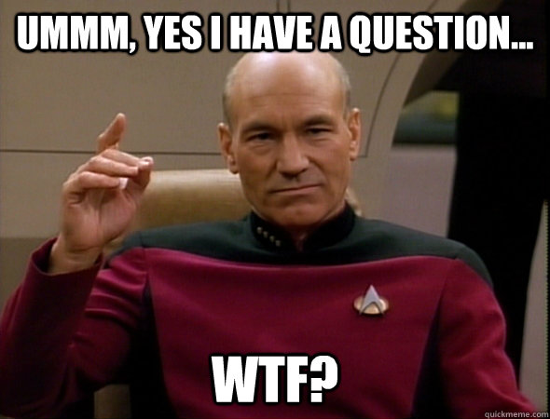
Audience: Where do I start?
Notes:
Captain Picard is a really smart guy, but he’s never heard of Lord of the Rings. He only knows about Star Trek.
Faramir is talking to Aragon, one of his coworkers and the designated spokesperson of Gondor. So what he said makes sense to Aragon. But anyone who has not been closely following the story since the Fellow Ship will likely feel a little lost at this point.

Slide 14
Audience: Where do I start?
What should Faramir have done instead?
Notes:
Ask Captain Picard if he knows what Lord of the rings is
Find out how much he knows
Start from there
***bonus point: Find out a little about captain Picard beforehand (if he knows that he’s be talking with him)

Slide 15
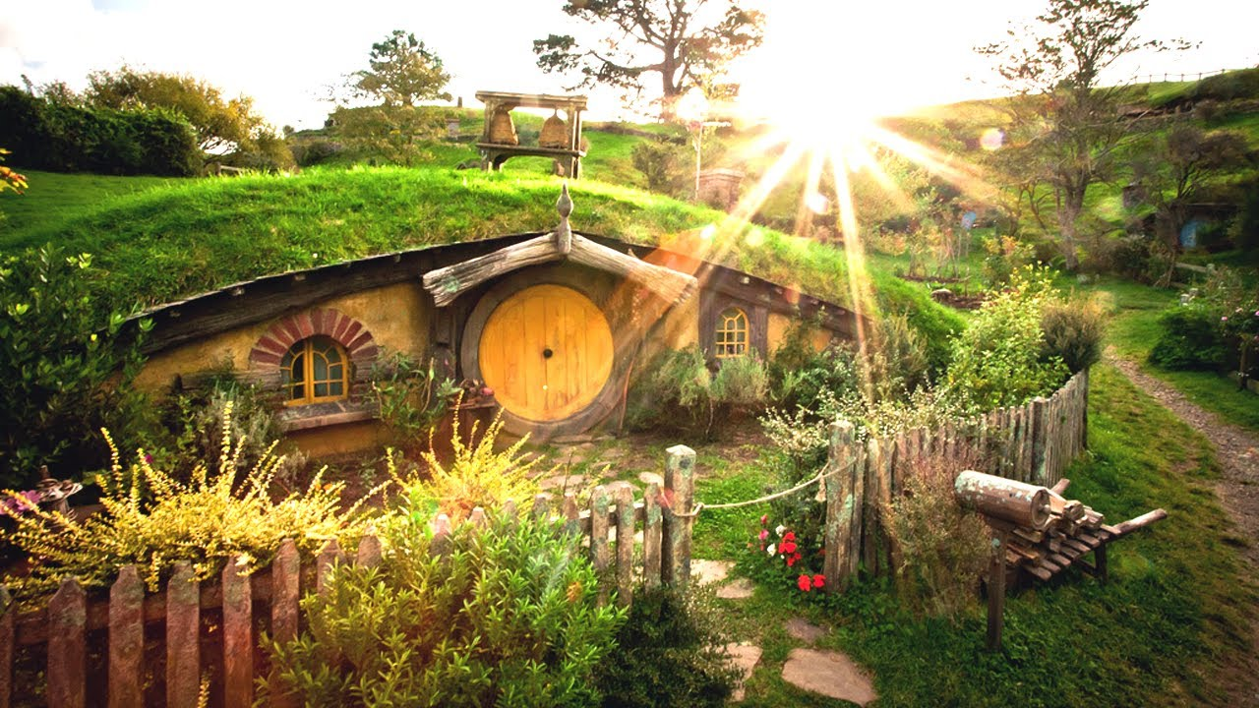
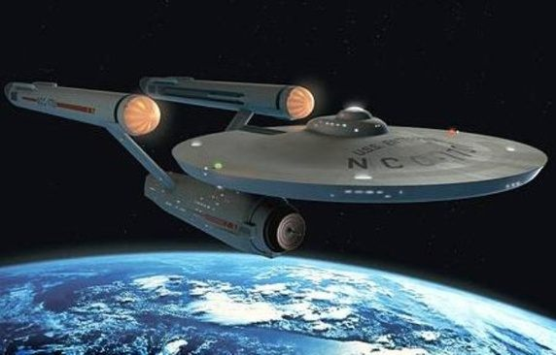
Where do I start?
Audience: Where do I start?
My universe
Their universe
Notes:
Make them feel like you’re in their universe, and slowly work them over towards yours.

Slide 16
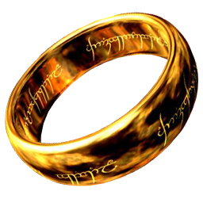
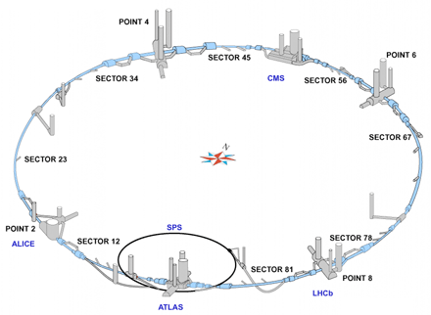
Audience: Where do I start?
The Lord of the Rings is a metaphor…
…For High Energy Physics research

Slide 17
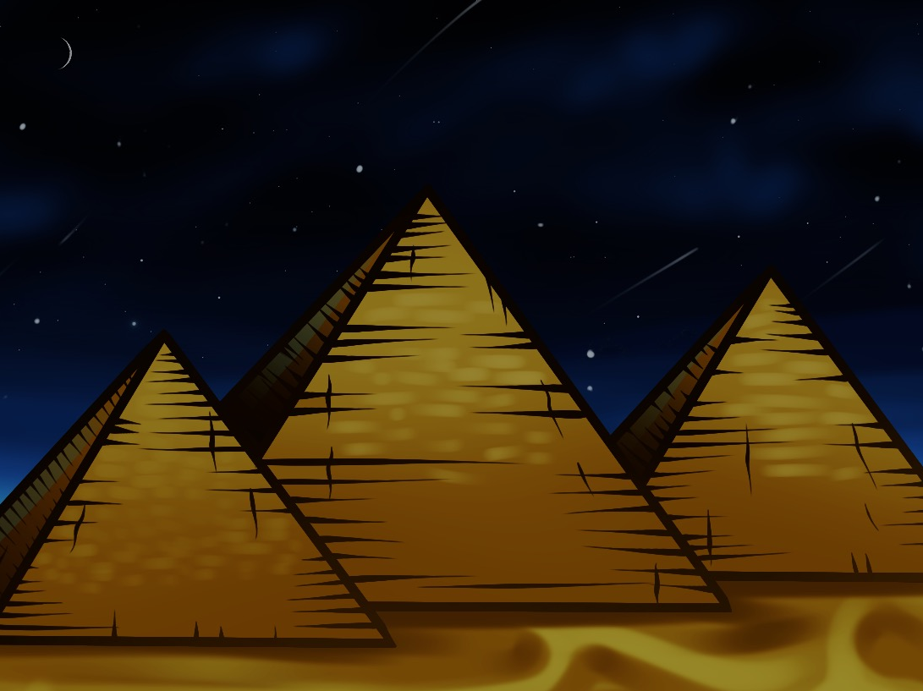
Behold! The great pyramid of audiences!
Your
analysis
Your experiment
The LHC community
The HEP community
The physics community
“I majored in physics” general public
Science journalists; professional staffers
Reporters, politicians, congress persons, ambassadors
“Cats are funny and Taylor Swift is my hero” general public
Notes:
TALK HERE ABOUT DIFFERENT AUDIENCES

Slide 18
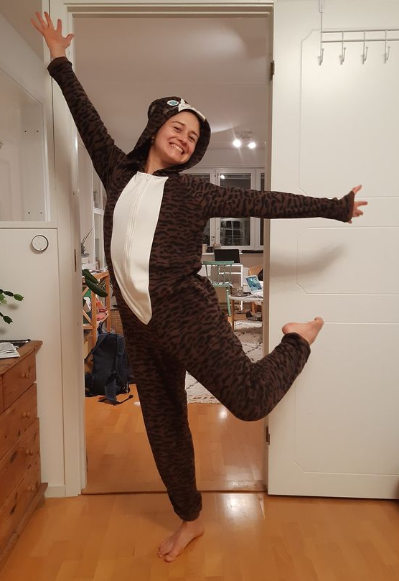
It’s about THEM
Audience: Connect
Who is your audience?
+
What do they want to know?
+
Why do they want to know?
=
How you explain it.
Notes:
Never assume what they know/don’t know. When in doubt, just ask!
People have knowledge in different areas

Slide 19
“Antimatter? What’s that?”

Slide 20

How much does Mio need to know about CP Violation?

Slide 21

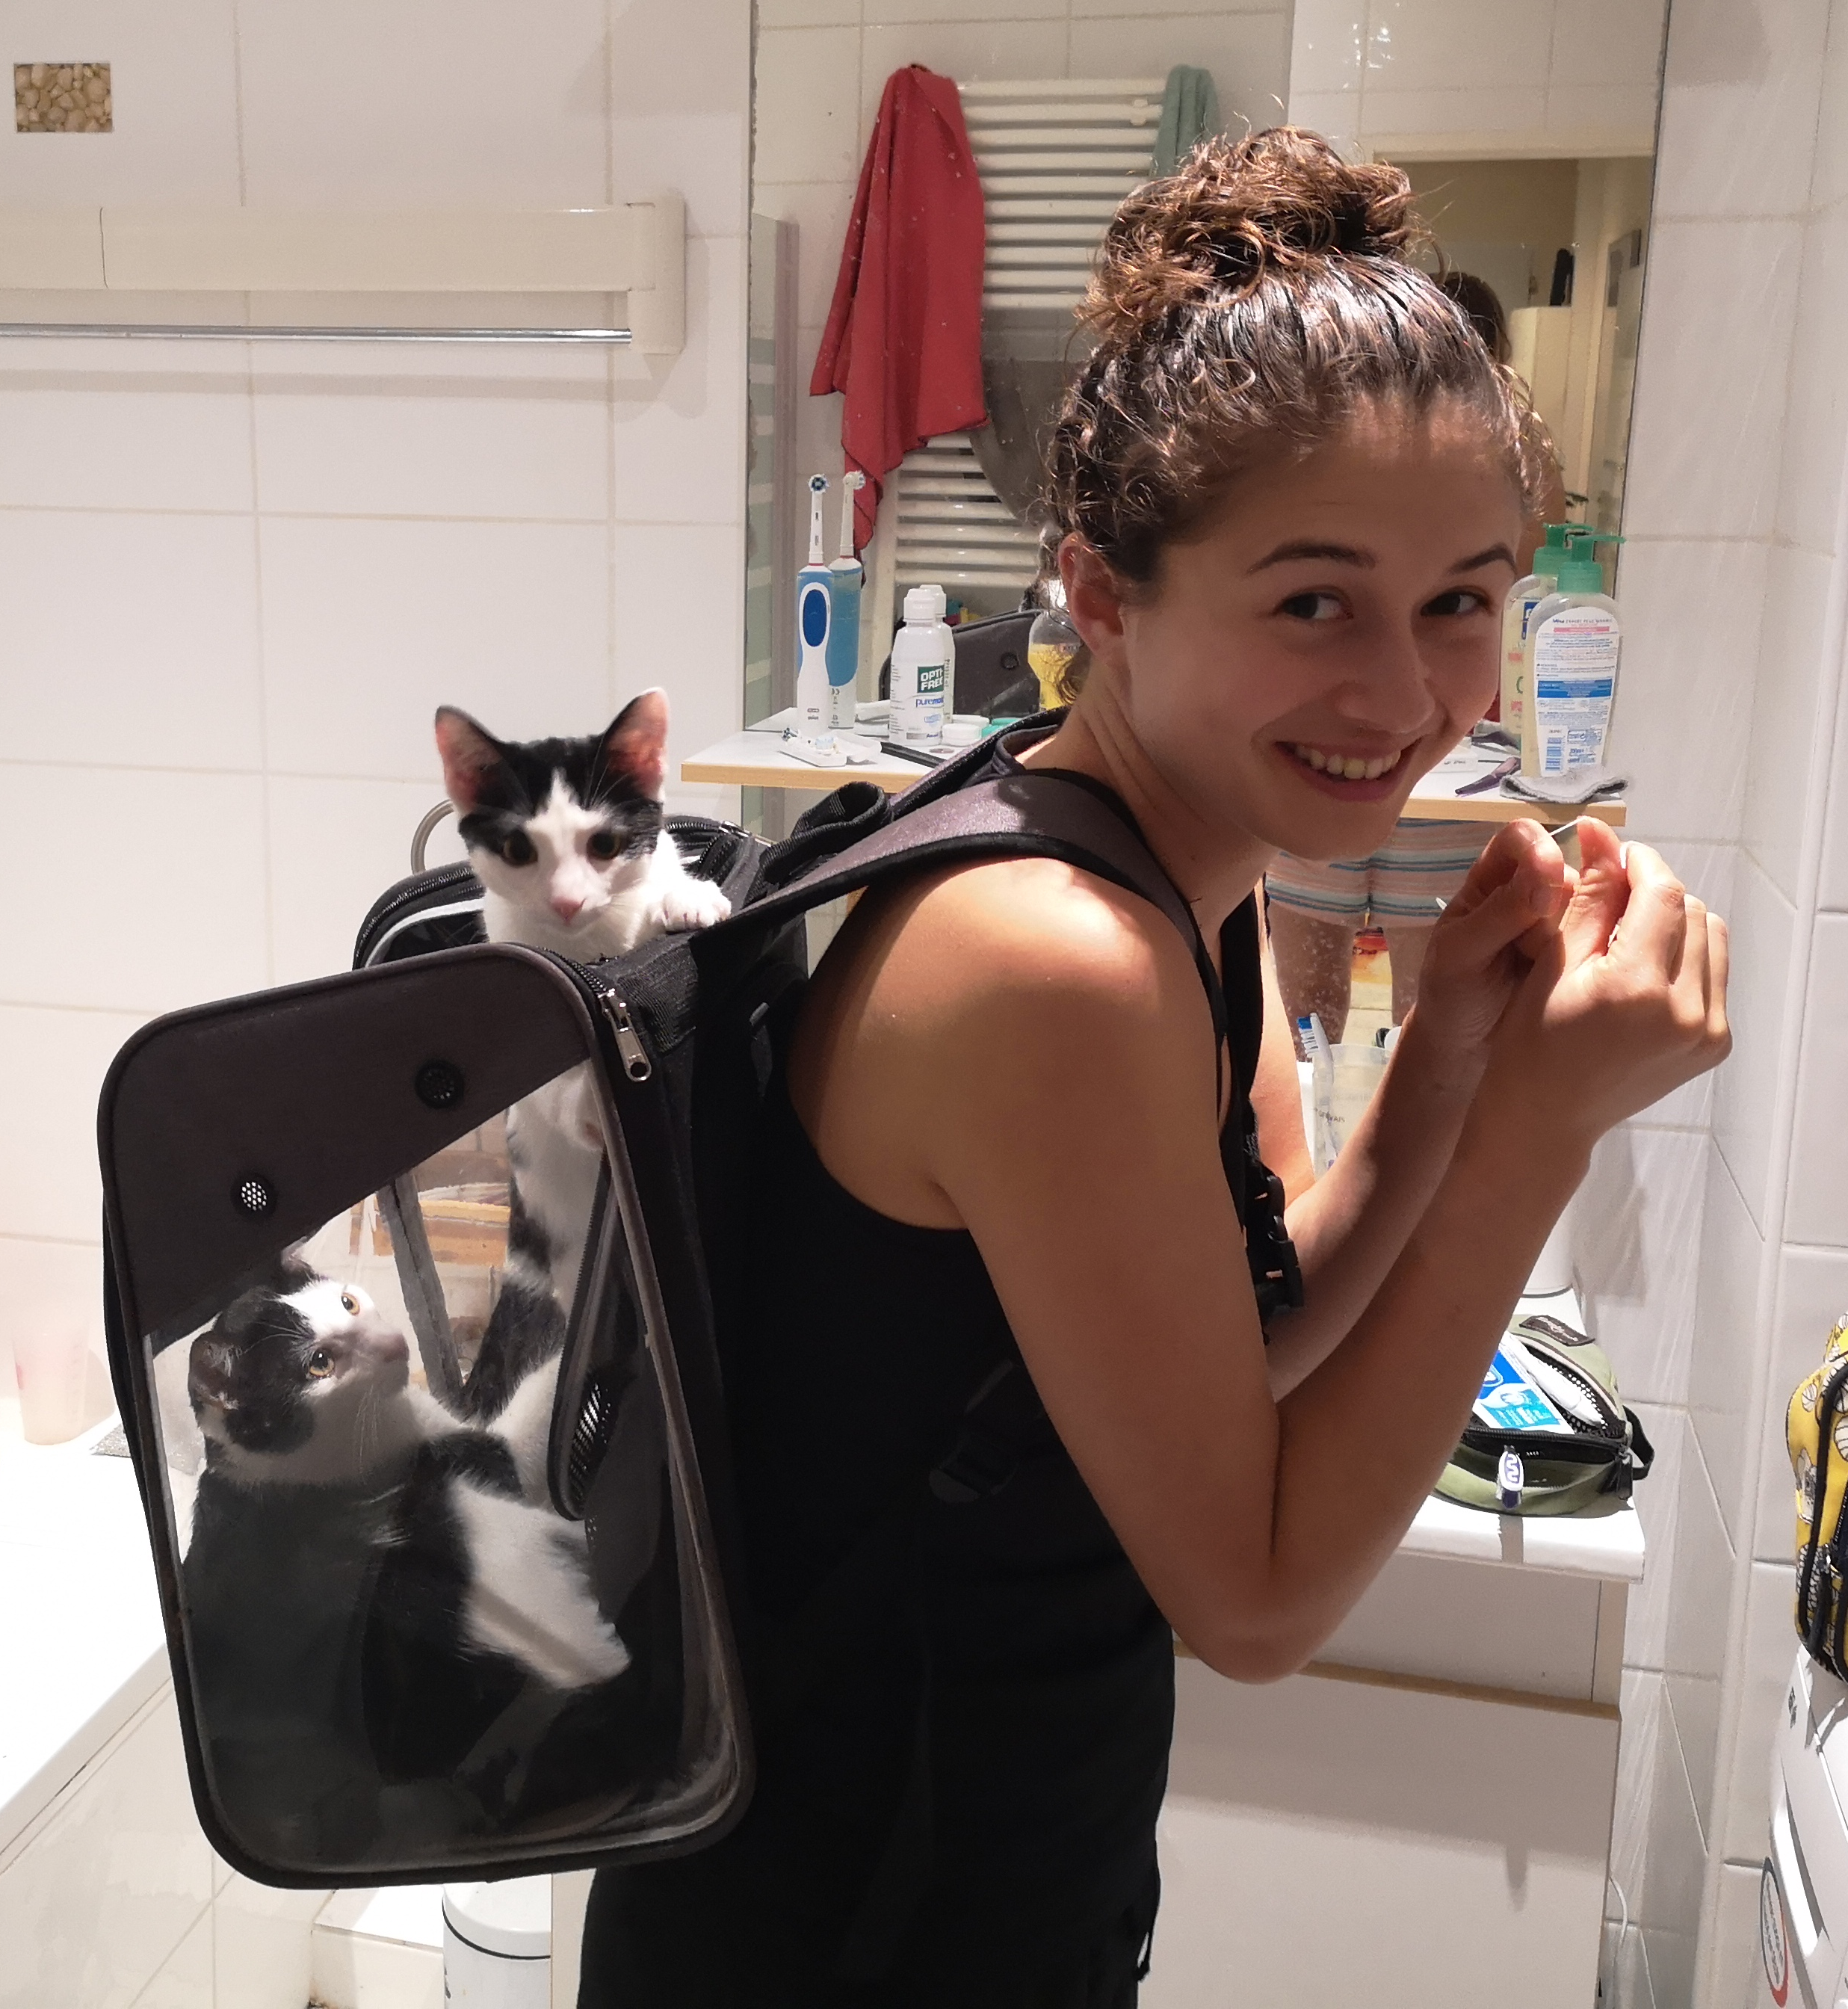

Mio who knows nothing about antimatter
Mio after learning something about antimatter

Slide 22
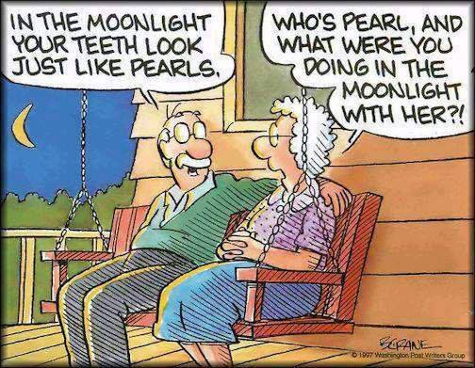
Listening…or understanding?
Audience: Connect
What you say…is not always what someone hears.
Notes:
Selective listening. In a discussion, and the other person just doesn’t understand…does saying the same thing over and over work?
Share personal experience when this has happened
No!

Slide 23
They don’t get it…Whyyyyyy?
Is there an underlying misconception that is confusing them?
Am I using words they don’t understand?
Did I not provide enough background information?
Am I moving too quickly?
Am I assuming they know something which they don’t?
Do they have pre-existing beliefs which are coloring how they interpret what I’m saying?
Notes:
A prominent and well-respected news organization planning a visit.
VICE: Conversations about CERN, the experiments and the research. End of the 30 minute conversation they ask me one last question about how the research at CERN compares to research at the Large Hadron Collider…

Slide 24
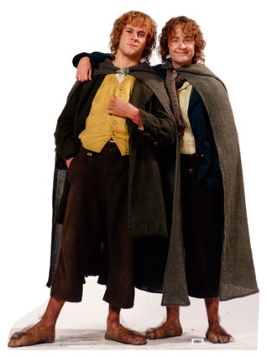
Summary: Audience
Find out what they know and then you’ll know where to start.
Connect and open the channel of communication (so that it flows both ways)

Slide 25
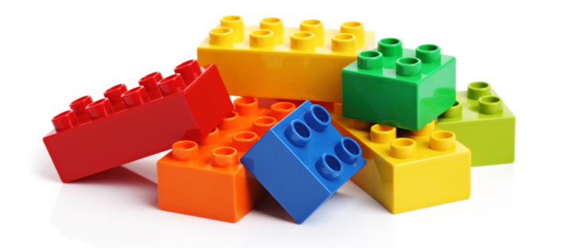
Activity!
It takes two to communicate. How skilled are you on both ends?
Notes:
Everyone is divided into pairs. Each person is given a set of blocks identical to their partners. One person constructs a structure with the blocks, and without showing their partner, they have to explain how to assemble it. The partner attempts to build an identical structure based on the instructions alone.
Activity fosters – Clear communication, listening, understanding your partner and how they need to be communicated to.
You are trying to build something together!!!!

Slide 26
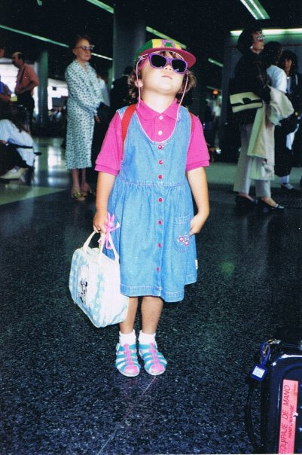
Part II:
How to shine
Notes:
Part 1: Theory. Now you know what you need to do. You need to
Capture (get their attention! Get them to be present!)
Connect (make that link between you and them. You are trying to share something about your life with them,
Convey – tell them what you want them to know in a way that they will remember and, ideally, be inspired.

Slide 27
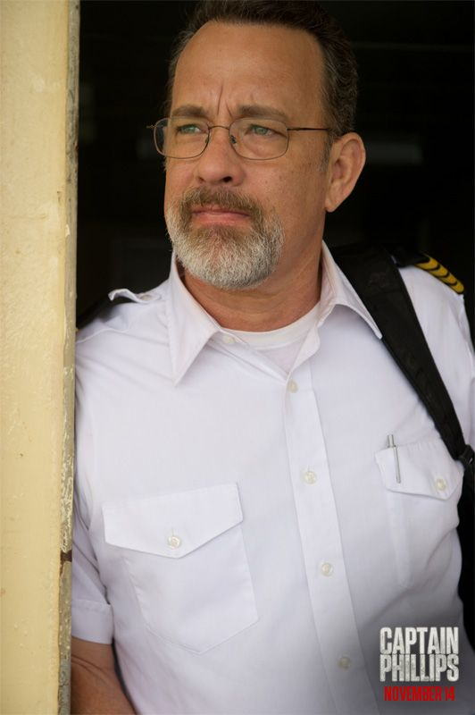
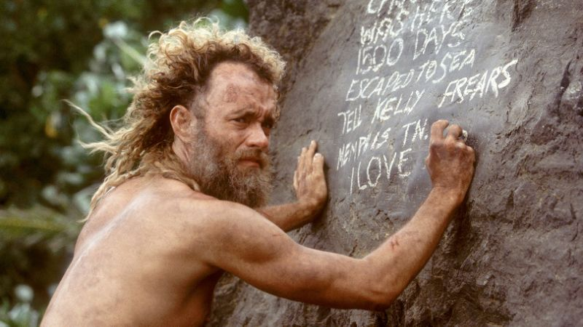
Be someone you would trust
How to Shine: Self Care
Tom Hanks, captain of MV Maersk Alabama,
Tom Hanks, when his best friend is a volleyball

Slide 28

Prepare
How to Shine: Self Care

Slide 29
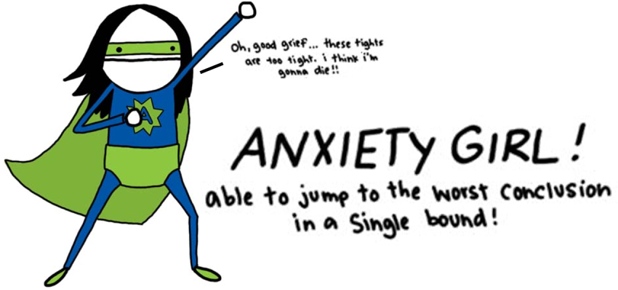
Taming anxiety
How to Shine: Self Care
Notes:
What happens when you get nervous?
Me, I talk in circles until everyone is confused and frustrated.
You…
You…

Slide 30
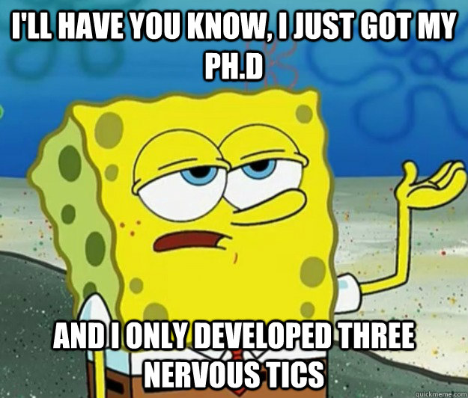
EVERYONE gets nervous
How to Shine: Self Care
Acknowledge and channel
Let go of “perfect”
Lecture…or Conversation?
Challenge…or Opportunity?
Notes:
Rethink as an amazing opportunity to have a conversation with someone cool. If you don’t know what to say, start by asking them questions, or nudge them to ask you questions. If you treat it like a conversation, everything else will come along naturally. The body language, vocal tone, etc.
Some things to try?
Less nervous over time become more comfortable
Practice in front of other people
Not every technique works for everyone - setting are different!
Comms talk! (toast masters?)
OK!

Slide 31
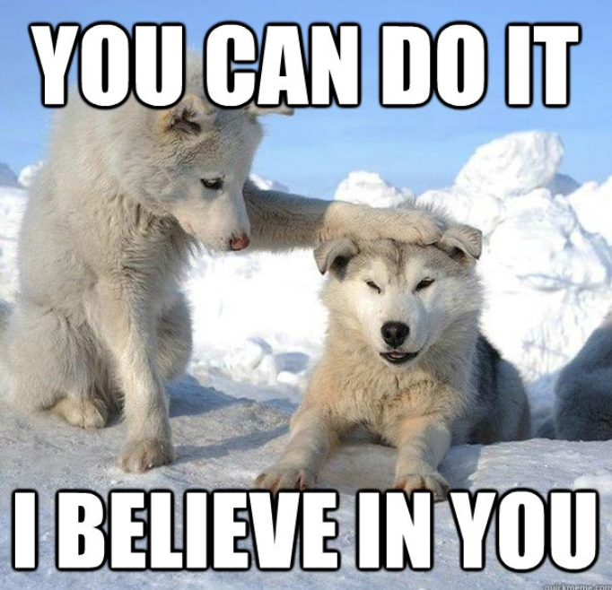
Be nice to yourself ☺
How to Shine: Self Care
Stay active
Slow down
Listen and respond…don’t react!
Notes:
Anyone have this experience, where you’re talking with someone and then suddenly it feels like you have no air, but you cannot breath because you
are talking and you want to finish your though before you run out of air so you speed up? And you’re worried that if you don’t finish it all on this one breath you will forget where you were.
Pauses are fine. We like pauses because it gives everyone a chance to catch up, reflect and think. It is also the natural flow of a conversation to have pauses.

Slide 32

Ready…Set…Engage!
How to Shine: Engage
What does it mean to engage someone?
How is engaging different than lecturing?
Notes:
Engaging is when someone wants to listen and talk to you. How do you achieve that?
First, make it clear that you want to listen and talk to them!
Second, engage them in the conversation. How can you do this?
Rhetorical questions?
Activities – Close your eyes and imagine the smallest thing you can think of. What is it and what does it look like?
Tailor the message?
Likeability, real people, real stories
Lessons learned, wrong turns. Nobody’s perfect!
An agreement to connect - We feel engaged with people when we feel like they’re along for the ride with us
Meaning. People want to be a part of something useful, valuable, and bigger than themselves.
Things to avoid:
Lecture
Info dumping
Bragging

Slide 33
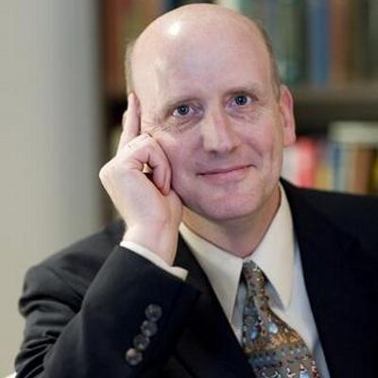
Start with a question
How to Shine: Engage
“As teachers, we are so eager to get to the answers that we do not devote sufficient time to developing the question.
“But it’s the question that piques people’s interest. Being told an answer doesn’t do anything for you.”
~Dan Willingham, cognitive scientist at the University of Virginia
Notes:
Most TV shows have a question or mystery to solve.
Watch documentaries on the discovery channel…what do they do?

Slide 34
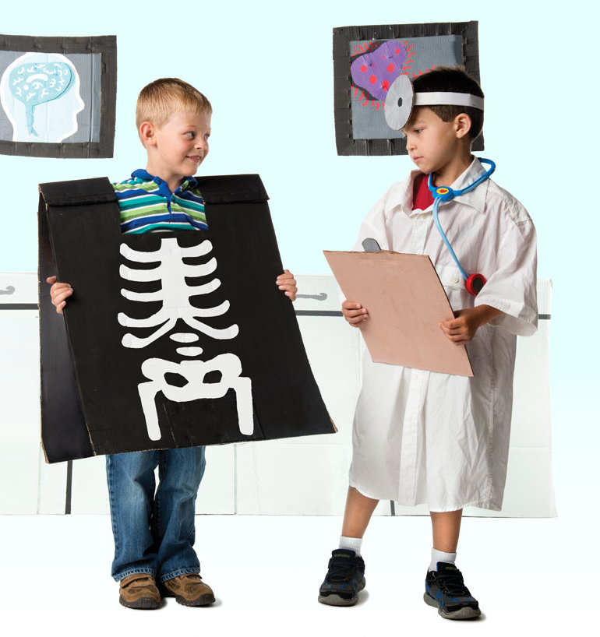
Relevant. Concrete.
How to Shine: Engage
“The human mind can’t handle too much abstraction.
“Bring your ideas down to earth by explaining how they connect to your listeners’ lives…”
Notes:
How can you do this?
Spin-off approach
We answer these big questions, and we cannot see where they will lead us right now.
Technology?
Education?
Past examples of fundamental breakthroughs?

Slide 35
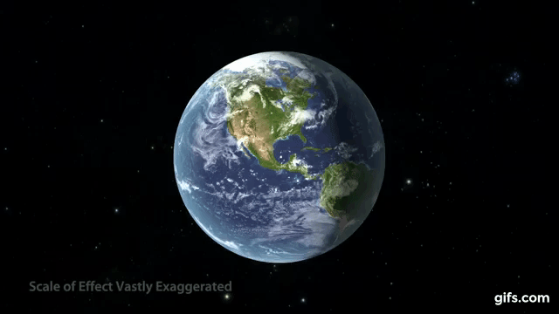
Down to Earth?
How to Shine: Engage

Slide 36
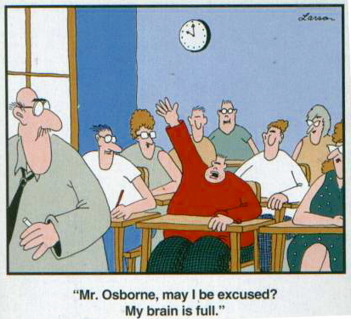
Know when to change topic
How to Shine: Engage
Notes:
Engaged slide, what it looks like

Slide 37
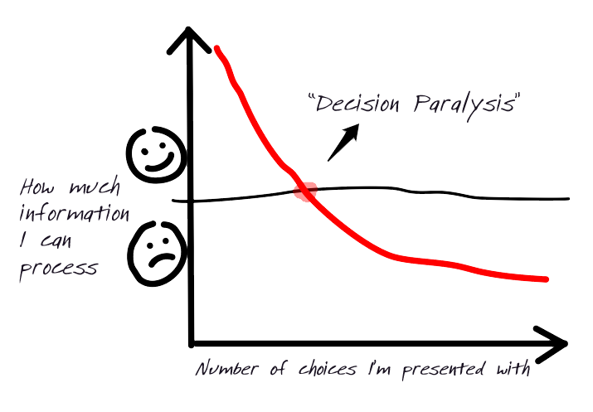
How to Shine: Engage
Information overload
Number of things I’m told
Notes:
Magic number 7 + or – 2

Slide 38
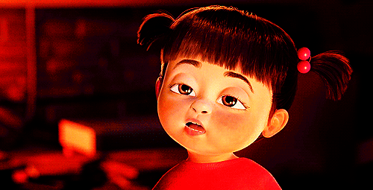
Signals to look for…
How to Shine: Engage

Slide 39
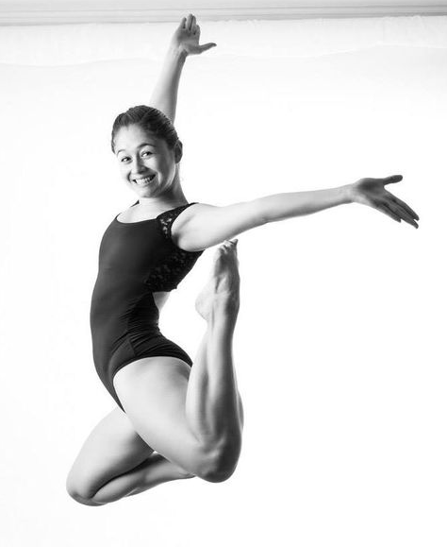
Summary: How to Shine
Take care of yourself; if you don’t care about you…how is your audience supposed to?
Engage with your audience and pay attention to them!

Slide 40
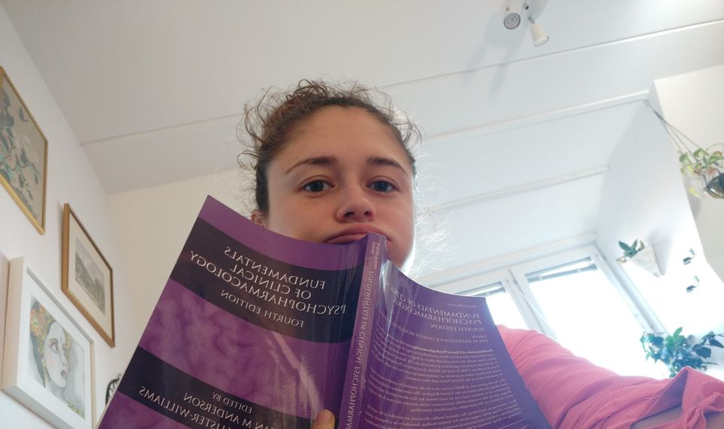
Part III: Storytelling
Notes:
Part 1: Theory. Now you know what you need to do. You need to
Capture (get their attention! Get them to be present!)
Connect (make that link between you and them. You are trying to share something about your life with them,
Convey – tell them what you want them to know in a way that they will remember and, ideally, be inspired.

Slide 41
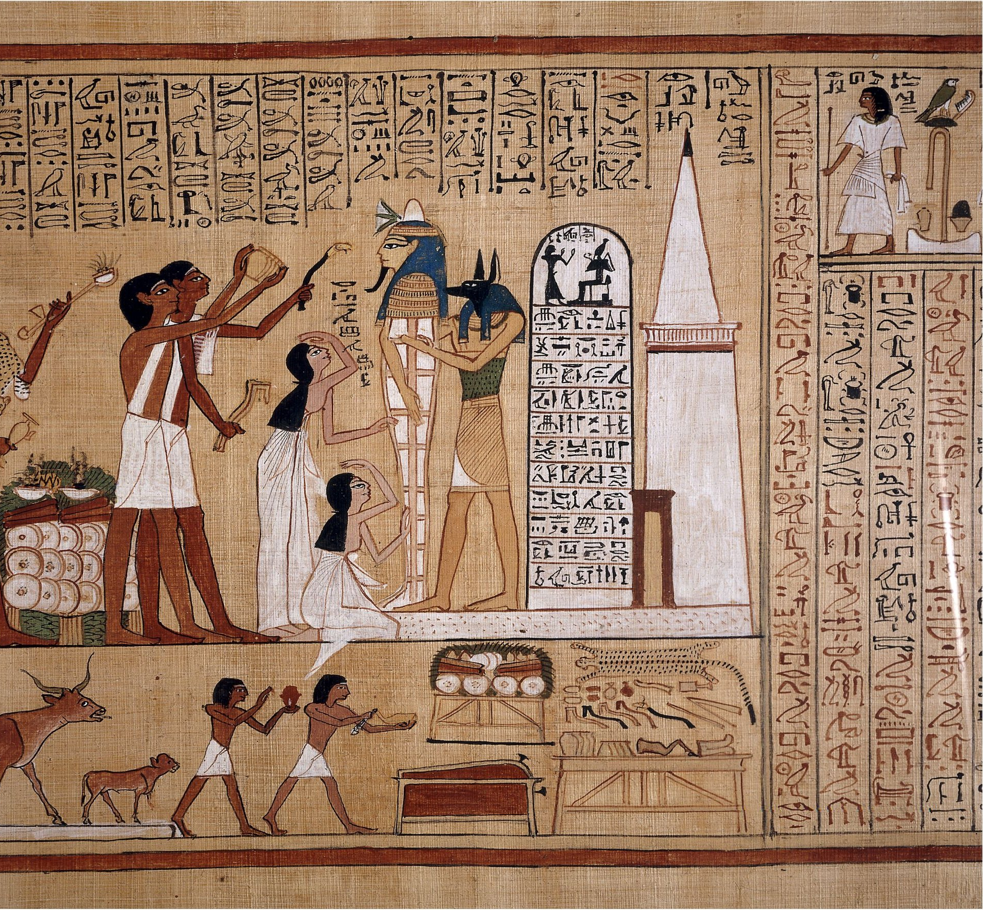
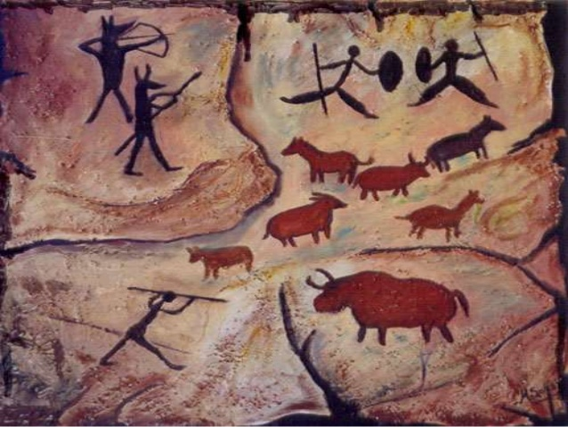
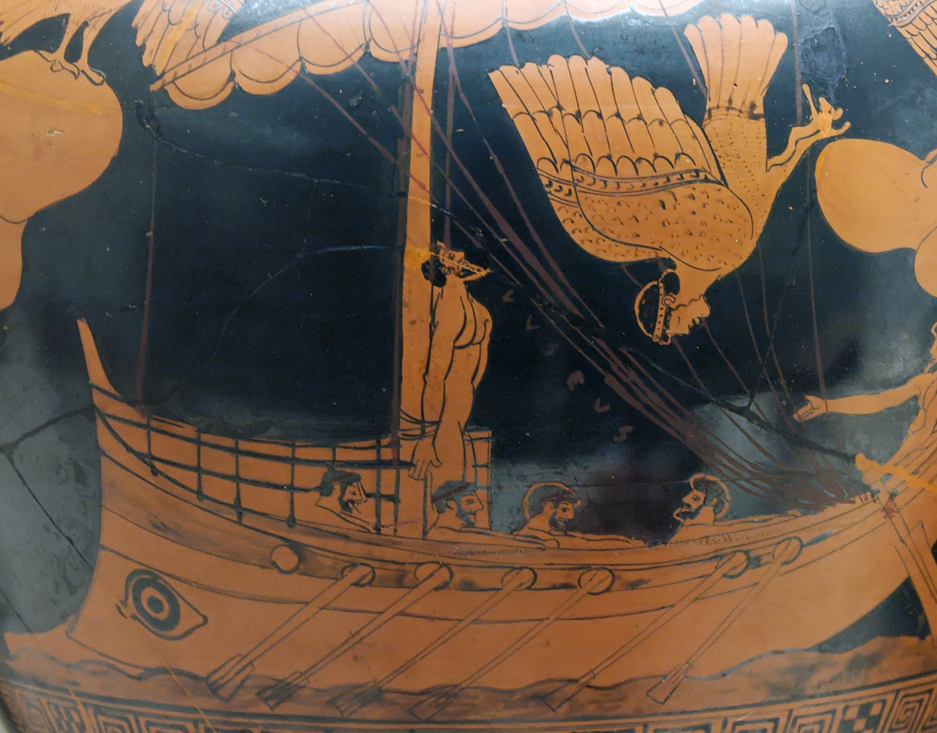
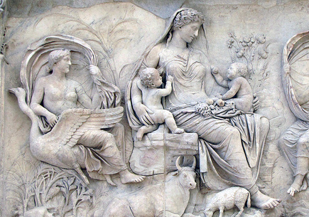
HUMANS ARE HARDWIRED FOR STORIES

Slide 42

Bad story
Storytelling: Good story, Bad story
Lame & flat characters
Random and irrelevant
No direction or point
Confusing plot
Notes:
The most frustrating thing is the elvin poems and the long histories that don’t add much

Slide 43
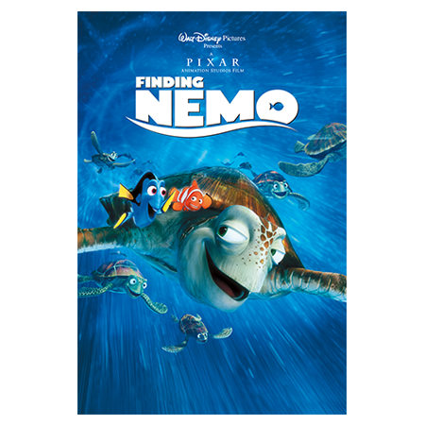
Good story
Storytelling: Good story, Bad story
We identify with the characters and care that they succeed
Everything that happens plays a role in the bigger story
There’s a hook that keeps us engaged
Plot lines are intriguing but not confusing

Slide 44
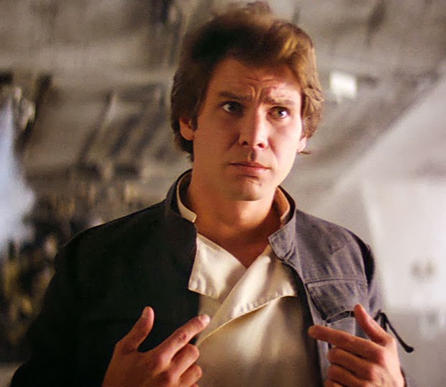
You are a story
Storytelling: Good story, Bad story
Notes:
Yes, our lives might seem random and irrelevant. But when you tell a story about your past weekend or something funny that happened, how do you do it? What parts do you include? What parts do you exclude? Every time we talk we never include all the information. We include enough to convey an idea, an event, or a feeling. It’s your job to figure out what’s important based on what you want to say.

Slide 45
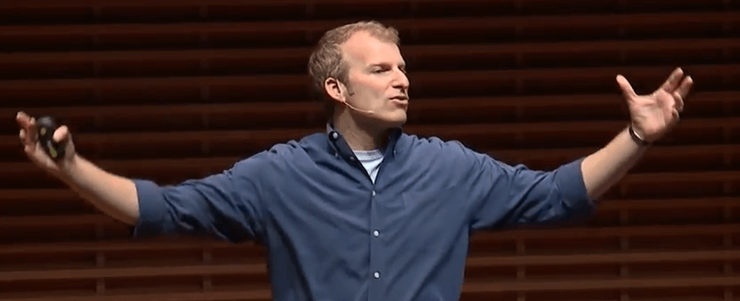
The importance of structure
Storytelling: Structure
“We actually process structured information, roughly 40% more effectively and efficiently than information that’s not structured.”
Matt Abrahams, Stanford Graduate School of Business
Notes:
https://www.youtube.com/watch?v=HAnw168huqA
http://www.singjupost.com/think-fast-talk-smart-communication-techniques-by-matt-abrahams-full-transcript/

Slide 46
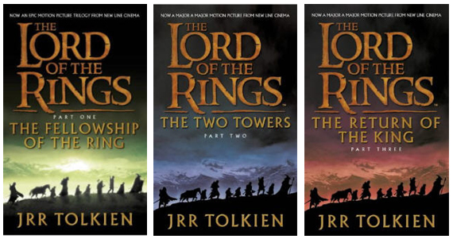
Random info → Coherent story
Storytelling: Structure

Slide 47
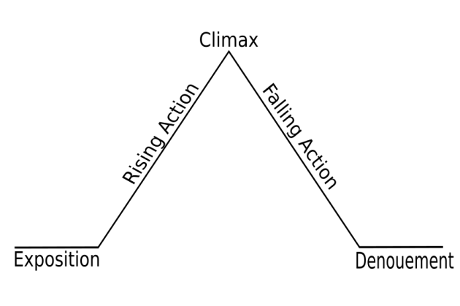
How to build a story…
Storytelling: Structure

Slide 48
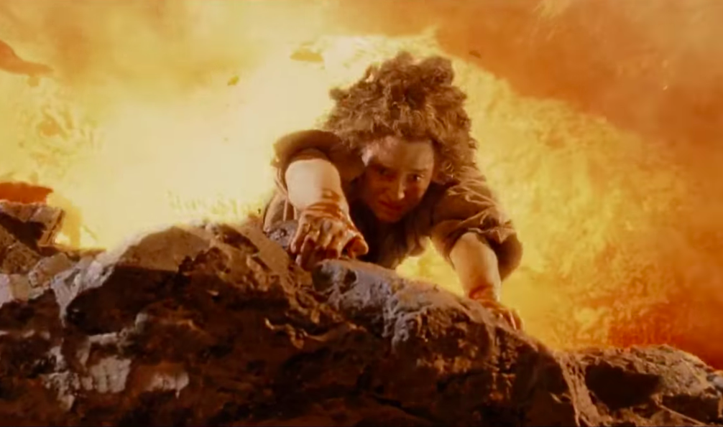

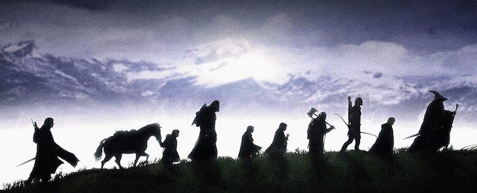
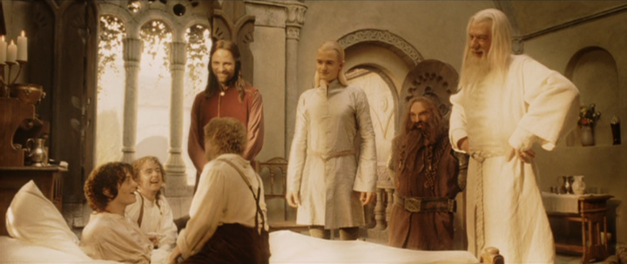
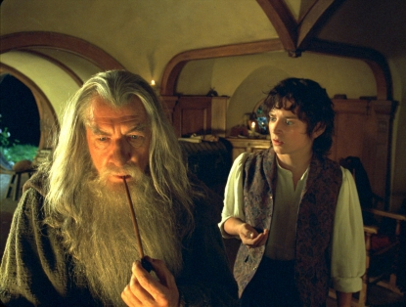
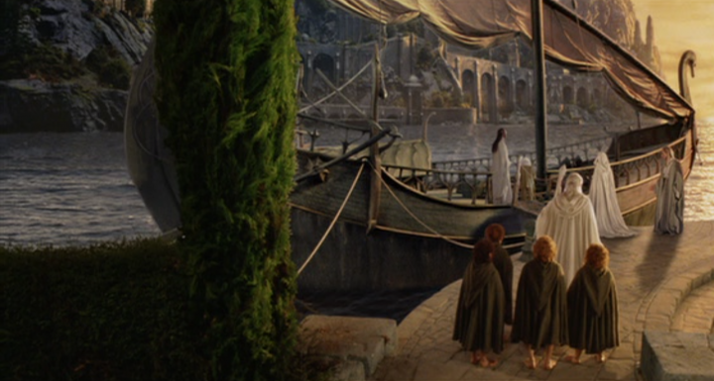
How to build a story…
Storytelling: Structure

Slide 49
How to build a story…
Storytelling: Structure
Results!
Analysis of results
Problem & plan to solve it
Introduction
Conclusion and next steps

Slide 50
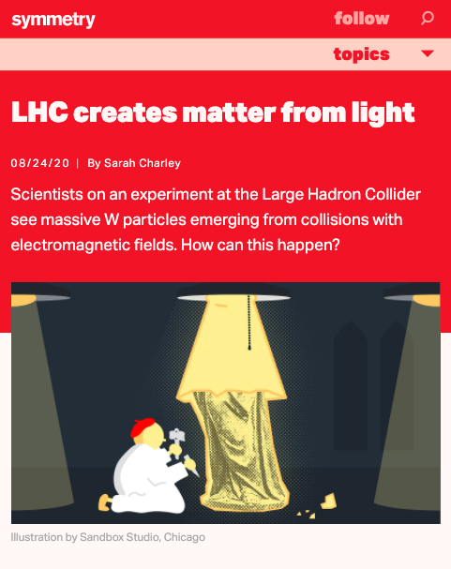
Wait…
Hypocrite Alert!

Slide 51
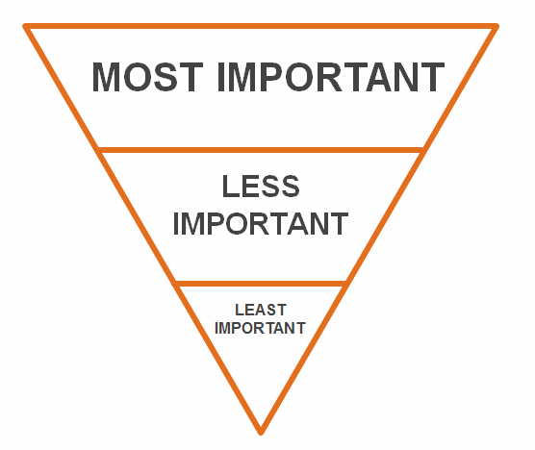
Ok…When it’s BIG news

Slide 52
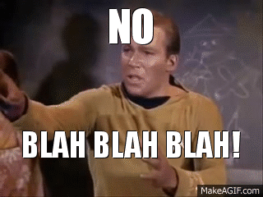
Storytelling: Structure

Slide 53
Today you learned…
  I. Your audience
  Where do I start?
  Connect
II. How to Shine
  Self care
  Engage
III. Storytelling
  Good v. Bad
  Structure
Notes:
Mostly focused on talking with non-physicists
Also applicable in other settings.

