Slide 1
Gyroklystron Update:
Review of K-band (20GHz to 40GHz), Gyrotron Klystron Experiments
5th November 2020
A. W .Cross, L. J. R. Nix, L. Zhang

Slide 2
Gyroklystron Simulation
Recap: 36GHz Gyroklystron can meet specification
Beam voltage / Beam current | 150 kV / 50 A
Output power / 2nd harmonic power | 3.2 MW / 2.3%
Output power stability | 0.4% @0.5% variation of the modulator voltage
Output frequency / 3dB bandwidth | 36 GHz / 108 MHz (0.3%)
Magnetic field and frequency drift | 1.46 T and < 1 MHz frequency drift due to the drift of magnetic field
Frequency drift due to beam voltage | 24 MHz @0.5% / 4.8MHz @0.1% variation of the modulator voltage
Pulse repetition rate / Duration | 1000 Hz / 1.5 us
Drive power / Gain | 410 W / 39 dB
Input / output waveguide mode | Input TE10 (Rectangular) mode, output TE02 (Circular) mode
Efficiency | 43% (without energy recovery), 58.0% (with single stage depressed collector)
Average spent beam power | 6.5 kW (mm-waves on),11.3kW (mm-waves off)
Dimensions | 60 cm (W) * 60 cm (L) * 1200 cm (H)
Phase stability | 17.0 degree @ 0.5% variation in modulator voltage 3.4 degree @ 0.1% variation in modulator voltage 0.34 degree @ 0.01% variation in modulator voltage

Slide 3
K-band Gyrotron Experiments
Harm- onic | Cavities (Outputmode) | Interaction | Freq (GHz) | Power (MW) | Effic (%) | Gain (dB) | Institute | PRF (Hz) (duty) | τ [μs]
2 | 2 (TE_{0,2}) | Gyro-klystron (Cylindrical) | 19.8 | 32 | 29 | 27 | Univ of Maryland | >0.1 | 1.5
3 | 2 (TE_{0,3}) | Gyro-klystron (Cylindrical) | 29.6 | 1 | 1 | 12 | Univ of Maryland | >0.1 | 1.5
1 | 4 (TE_{0,1}) | Gyro-klystron (Cylindrical) | 34.9 | 0.2 | 25% | 56 | NRL, USA | 5 | 2
1 | 2 (TE_{0,1}) | Gyro-klystron (Cylindrical) | 28.0 | 0.08 | 9 | 30 | CPI, USA | >0.1 | 1.5
2 | 4 (TE_{0,2}) | Gyro-klystron (Cylindrical) | 34.9 | 0.25 (5 av) | 24 | 36 | UESTC, China | 250 (2%) | 80
1 | 2 (TE_{7,3}) | Gyro-klystron (Cylindrical) | 37.5 | 1.5 | 7 | - | Saratov Univ, Rus | >0.1 | 1
1 | 2 (TE_{0,2}) | Gyro-klystron (Cylindrical) | 35 | 0.75 | 24 | 25 | IAP, Gycom | >0.1 | 1
1 | 3 (TE_{5,3}) | Gyro-klystron (Cylindrical) | 30.0 | 15 | 40 | 35 | IAP, Gycom | >0.1 | 0.5
1 | 1 (TE_{0,3}) | Gyrotron Oscillator | 36.0 | 4 | 10 | - | Strath-clyde, UK | 330 .003% | 0.1

Slide 4
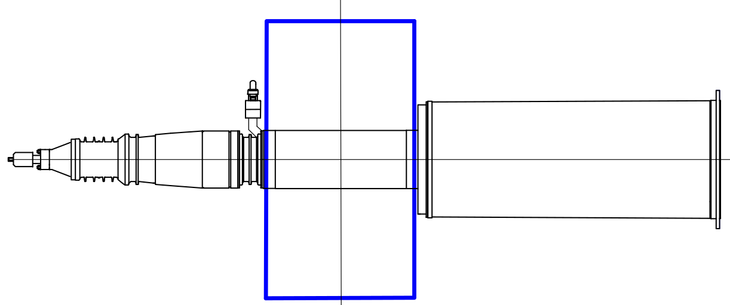
Dimensions of Ka-band Gyroklystron
Input window & coupler
Superconducting
magnet
Electron gun
60 cm
Interaction
circuit
Output
window
Collector
120 cm
Power, 3.2MW
Frequency, 36GHz
Efficiency, 43%
Gain, 39dB
Output mode, TE_{0,2}
Phase stability, 0.34 degrees @ 0.01% variation in voltage
Pulse Repetition Frequency, 100Hz to 1kHz
  to be experimentally confirmed
Modulator, Scandinova, K200
Cryo-cooled superconducting magnet, 1.46T

Slide 5
Power System for Ka-band Lineariser
Specification | Gyro-klystron
Power, (3.2MW) | √
Frequency, (36GHz) | √
Efficiency, (43%) | √
Phase stability, (0.34 degrees) | √
PRF (100Hz), Hard X-rays | √
PRF (1kHz), Soft X-rays | ?
Hardware |  | Suppliers
Modulator, (150kV, 50A, 1kHz) | √ | ScandiNova Diversified Technologies Inc
Magnetic field (1.46T) | √ | Cryogenics Ltd Oxford Instruments Ltd
Driver, (<500W) | √ | Mission Microwave Technologies Inc, (GaN)
Gyro-klystron | √ | CPI Inc, UESTC, Gycom

Slide 6
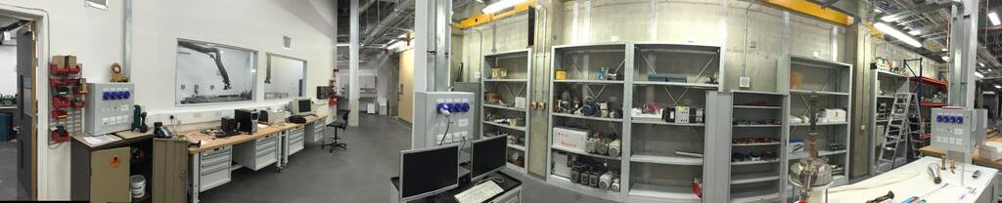
Technical Demonstrator: Strathclyde
Group of ~20 staff + postgrad students
36GHz, 3MW, gyro-klystrons to drive harmonic lineariser
Theory, modelling and simulation
Dedicated workshop with skilled technician operates CNC Lathe, CNC Mill, welding bay and electrochemical copper deposition
Magnetron Injection Gun, design, simulation, construction with industry and testing
  Electron beam diagnostics, current, voltage, beam position, etc
Suite of high power microwave measurement techniques, frequency, power, phase, mode
  Vector Network Analysers, spectrum analysers, power meters etc
Modulator experience and design / commissioning of superconducting magnets with cryogenic coolers
750m² laboratory with five 50cm concrete shielded experimental bays with 7mm lead doors and roof equipped with power, cooling, gas, vacuum and safety systems
INTEGRATED CAPABILITY from IDEA to DEMONSTRATOR
Theory
&
New concepts
Modelling
&
Simulations
Design
Construction
&
Experiments
Testing
&
Applications
Technology
Transfer to Industry
&
Manufacturability

Slide 7
References
Manfred Thumm,“State-of-the-Art of High-Power Gyro-Devices and Free Electron Masers”, Journal of Infrared, Millimeter, and Terahertz Waves, (2020)
W. Lawson, J. P. Calame, G. S. Nusinovich, and B. Hogan, “Reflections on the University of Maryland’s program investigating gyro-amplifiers as potential sources for linear colliders”, Terahertz Science and Technology, ISSN 1941- 7411, Vol.10, No.1, (2017)
M. Garven, J. P. Calame, Khanh T. Nguyen, Bruce G. Danly, Baruch Levush, and F. N. Wood, “Experimental Studies of a Four-Cavity, 35 GHz Gyroklystron Amplifier”, IEEE Trans on Plasma Science, 28, Nos. 3, (2000)
Yu.M. Guznov, Yu.Yu. Danilov, S.V. Kuzikov, Yu.V. Novozhilova, A.S. Shevchenko, N.I. Zaitsev, A.G. Rozhnev, and N.M. Ryskin,“High-Power Ka-band Gyroklystron Oscillator with Time-Delayed Feedback, International Vacuum Electronics Conference, (2013),
J. Wang, Y. Luo, “The study of a Ka-band high power TE01-TE02 gyroklystron”, Proc. 15th IEEE Int. Vacuum Electronics Conference (IVEC 2014), Monterey, CA, USA, P3.3, (2014)
L. Wang, K. Dong, W. He, J. Wang, Y. Luo, A. W. Cross, K. Ronald, A. D. R. Phelps et al, “Design of a Ka-band MW-level high efficiency gyroklystron for accelerators”, IET Microwave, Antennas Propagation, Vol. 12 , 11, pp. 1752-1757, (2018)
S. N. Spark, A. W. Cross, A. D. R. Phelps, “Megawatt, 330 Hz PRF tunable gyrotron experiments,” International Journal of Infrared and Millimeter Waves, vol. 15, no. 12, pp. 2003 2019, (1994)
Victor L. Granatstein and Igor Alexeff, “High Power Microwave Sources”, Artech House, (1987)
M. Blank, B. G. Danly, B. Levush, J. P. Calame, K. Nguyen, D. Pershing,; J. Petillo, T. A. Hargreaves, R. B. True, A. J. Theiss, G. R. Good, K.. Felch, B. G. James, P. Borchard, P. Cahalan, T. S. Chu, H. Jory, W. G. Lawson, and T. M. Antonsen, Jr., “Demonstration of a 10 kW average power 94 GHz gyroklystron amplifier,” Phys. Plasmas, (1999) [93.8GHz, 33.5%, 32dB, 92kW, 11% Duty, 100μs, 1.1kHz]
G.G.Denisov, N.I.Zaitsev, T.P.Ahmedzhanov, Yu.M.Guznov, G.I.Kalynova, A.N.Kuftin, M.A.Moiseev, A.S.Shevchenko, “Frequency Multiplication in Relativistic Gyro-Klystron Operating with Combination of TE- TM Modes”, 2013 IEEE 14th International Vacuum Electronics Conference (2013)

