Slide 1




Welcome to Generative Models School!
V2.0
2020, Nov 24-27
Andrey Ustyuzhanin on behalf of the school team
National Research University Higher School of Economics
Nov 24-27, 2020

Slide 2
Main agenda topics
Day | Topics | Language | Speakers
Tuesday | Introduction to machine learning | Russian | Dmitry Vetrov, Ekaterina Lobacheva, Nadezhda Chirkova
Wednesday | Introduction to generative models | Russian | Denis Derkach, Artem Maevskiy, Artem Ryzhikov
Thursday | Introduction to bandit problems | English/ Russian | Quentin Paris, Sergey Samsonov, Nikita Zhivotovskiy
Friday | Advances in generative models, panel discussion Closing dinner* | Russian | https://indico.cern.ch/event/967970/timetable/

Slide 3
Learning objectives
Understand principles of probabilistic machine learning models;
Understand principles of generative models’ design;
Understand the differences of modern generative model architectures and choose appropriate model class for generative models;
Define custom generative model architecture for a task at hand;
Understand the principles of bandit problem formulation for a task at hand and possible application strategies;
Understand the recent advances and challenges in generative models' research.

Slide 4
Organizational links
Timetable and materials: https://indico.cern.ch/event/967970/timetable/
Seminars: https://github.com/HSE-LAMBDA/GenModels-2020
Chat: https://t.me/joinchat/DMMgwhqUArz_ic-sn75EYA
More questions (including offline-related):
  Natalia Talaikova (ntalaikova@hse.ru)

Slide 5


Global Search Engines

Slide 6

HSE Faculty of Computer Science
  Established in March 2014,
  Active support from Yandex (more than 50 lecturers/seminarists are Yandex employee)
    Also cooperates with Kaspersky, WorldQuant, Huawei, SAS, JetBrains, and other
  Goal: enter the world’s top 30 Computer Science faculties by 2022
    big data storing and processing,
    software development and system programming,
    machine learning
  370 students enter bachelor program per year
  ~100 graduate master’s program per year
  Member of LHCb collaboration since June 2018
  Collaborates with many European and US universities

Slide 7

Bayesian Methods Research Group
  Group focuses on development and applications of Bayesian methods for Deep Learning
  Close partnership with Samsung, Nvidia, JetBrains,
  Research Project examples:
    Sparsification and acceleration of deep neural networks;
    Uncertainty estimation and defences against adversarial attacks;
    Loss-based learning for Deep Structured Prediction;
    Stochastic optimization methods;
    Learning and inference methods for probabilistic models;
  Papers accepted by ICML2020, NeurIPS2020, ICLR2020 and AISTATS2020, bronze medal for Samsung Best Paper award 2020
https://bayesgroup.ru/
bayesgroup

Slide 8

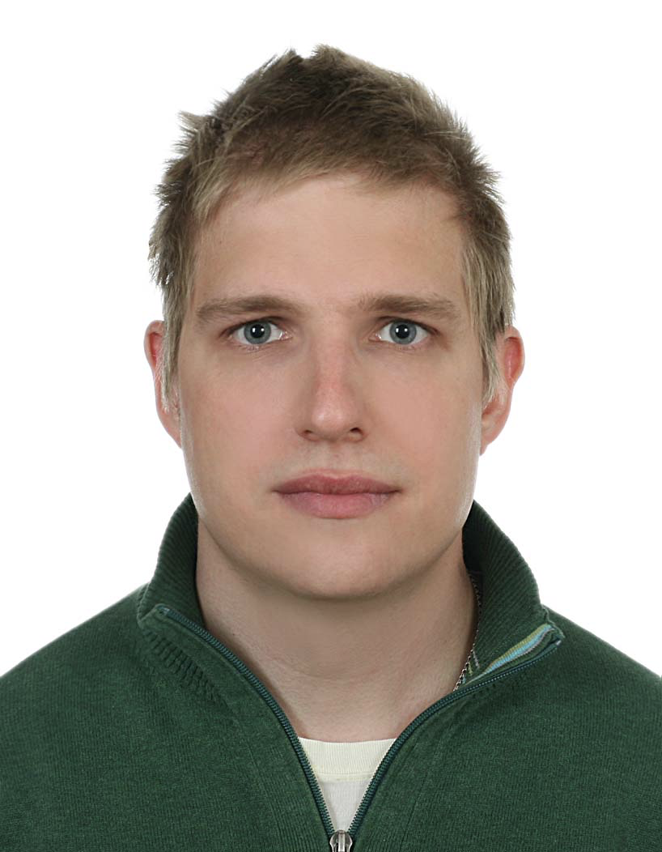
High-Dimensional Inference Laboratory
  Aims at developing new probability and statistical approaches to current problems in the field of data analysis.
  Partners: Ecole Polytechnique, Huawei, WIAS, MSU, Universitat Bielfeld, University of Haifa.
    Uncertainty quantification in machine learning algorithms (MCMC, RL, Gen. models, DL);
    Mathematical foundations of Reinforcement learning;
    Convex and non-convex optimization;
    Manifold learning and Optimal transport;
    Non-asymptotic analysis of high-dimensional random matrices and random;
  Leading Researchers: Eric Moulines, Alexey Naumov, Vladimir Spokoiny, Sergey Bobkov, Denis Belomestny, Alexander Tikhomirov, Alexander Goldenshluger
https://cs.hse.ru/en/hdilab/

Slide 9

Laboratory of Methods for Big Data Analysis
  Group focuses on data analyses in Natural sciences
  Close partnership with Yandex School of Data Analysis
  Collaborates with LHCb, SHiP, OPERA, CRAYFIS experiments
  Research Project examples:
    Fast Particle Identification algorithms;
    Fast and meaningful MC Generation;
    Optimization of particle detector;
    Surrogate-based optimization methods;
    Simulation-based inference.
  Co-organization of ML events: Flavours of Physics, TrackML, IDAO
  Open for interns, graduate students and post doc candidates!
hse_lambda

Slide 10
Modern Generative Modeling

Slide 11
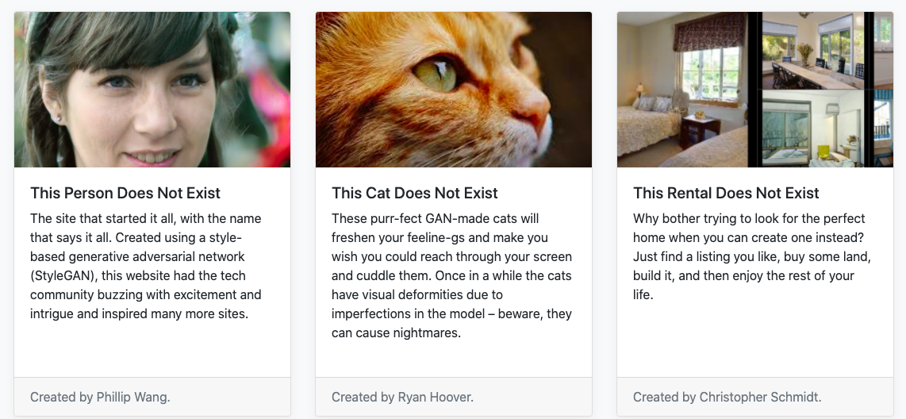
This X Does Not Exist!
https://thisxdoesnotexist.com/

Slide 12
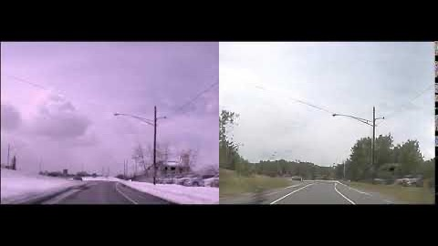
Video Modifications
We can automatically remove snow in video
https://incrussia.ru/news/ii-nauchilsya-poddelyvat-video/

Slide 13
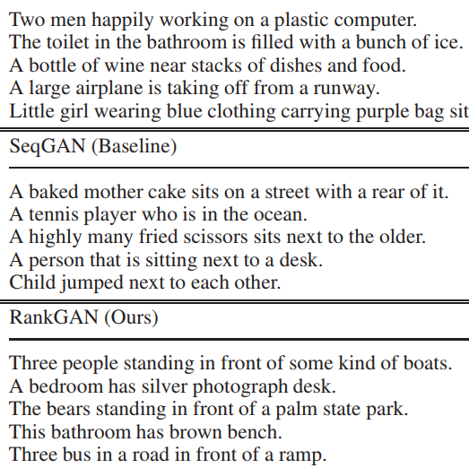
More Tricks for Your Brain
Text generation.
https://arxiv.org/abs/1812.08196

Slide 14

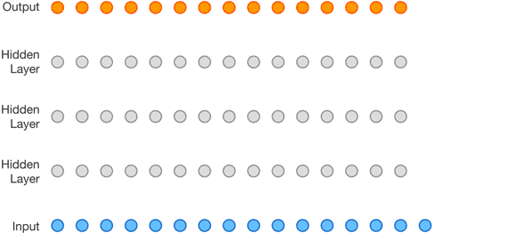
More Tricks for Your Brain
Text generation.
Voice from text generation.

Slide 15
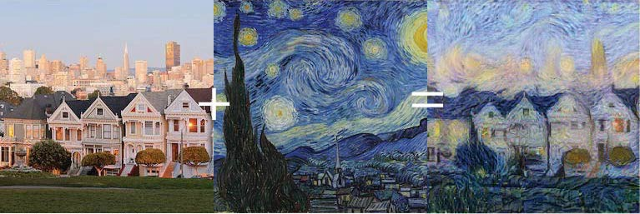
More Tricks for Your Brain
Text generation.
Voice from text generation.
Style transfer.

Slide 16
More Tricks for Your Brain: Links
Text generation.
          https://www.tensorflow.org/tutorials/text/text_generation
Voice from text generation.
          https://deepmind.com/blog/article/wavenet-generative-model-raw-audio
Style transfer.
          https://towardsdatascience.com/style-transfer-with-gans-on-hd-images-88e8efcf3716

Slide 17
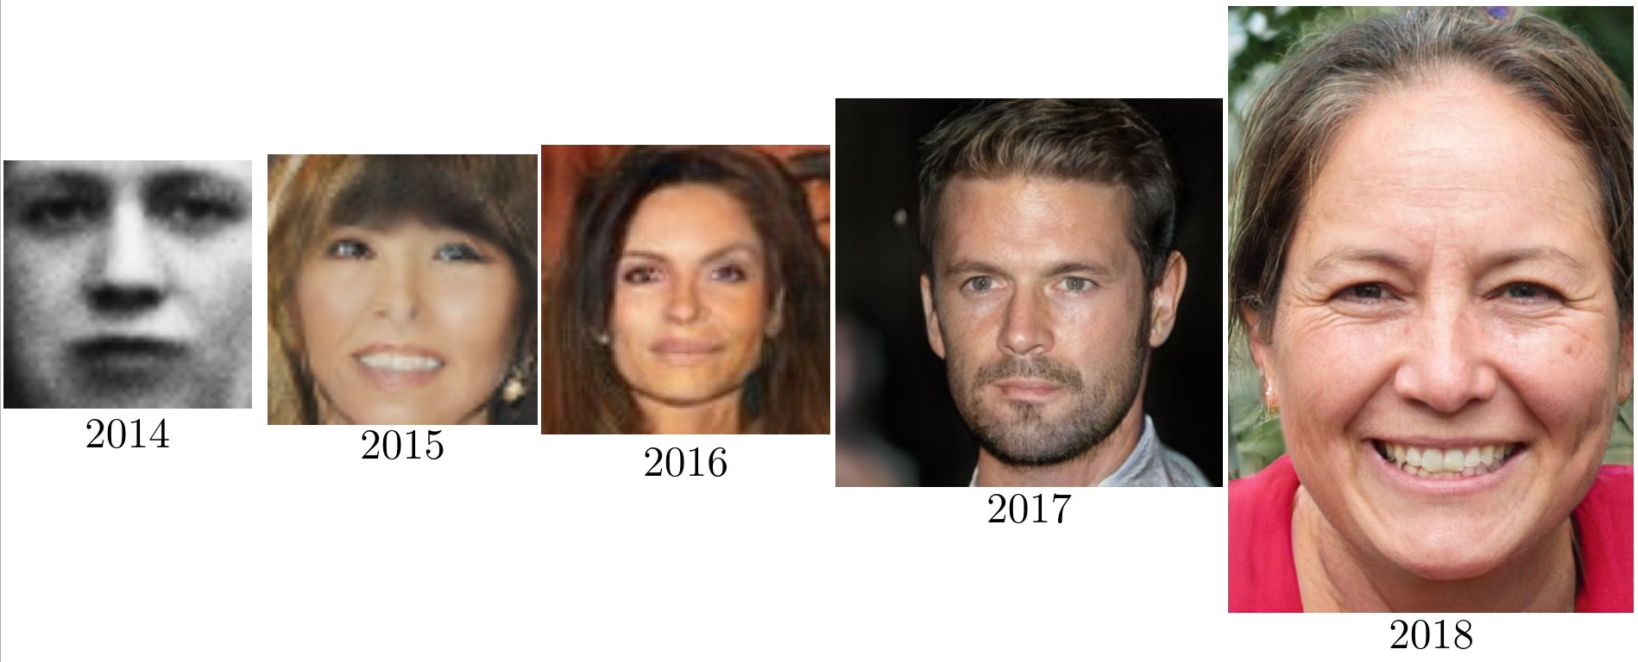
Generative Models Progress
The news are well motivated.
Enormous progress in recent years.
Technology is ready for new tasks.
https://twitter.com/goodfellow_ian/status/1084973596236144640

Slide 18
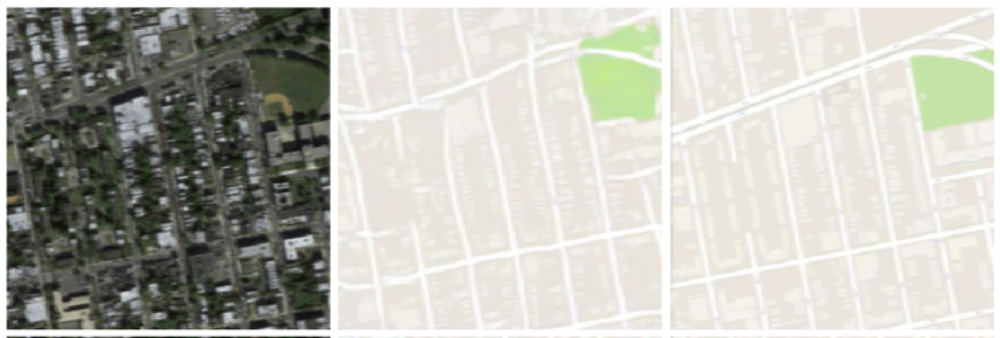
Dealing with Maps: generating map
Image-to-image style transfer.
Creates map on-the-fly from satellite image.
Input
Generated
True
https://github.com/ChengBinJin/pix2pix-tensorflow

Slide 19
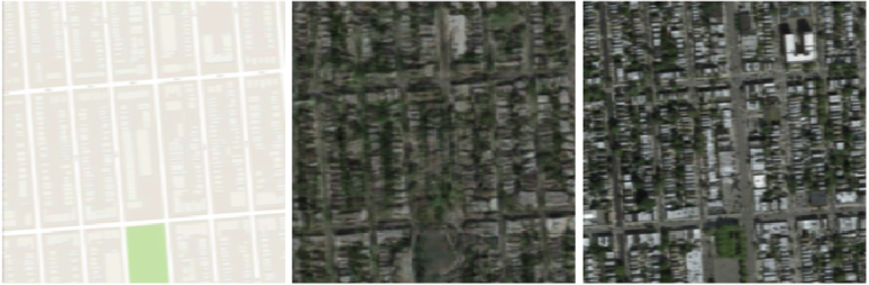
Dealing with Maps: generating satellite image
Image-to-image style transfer
Creates map on-the-fly from satellite image and vice versa.
Input
Generated
True
https://github.com/ChengBinJin/pix2pix-tensorflow

Slide 20
Dealing with Maps: generating satellite image
Image-to-image style transfer
Creates map on-the-fly from satellite image and vice versa.
The technology is the same as for “Monet” painting. Just need good representation.
=

Slide 21
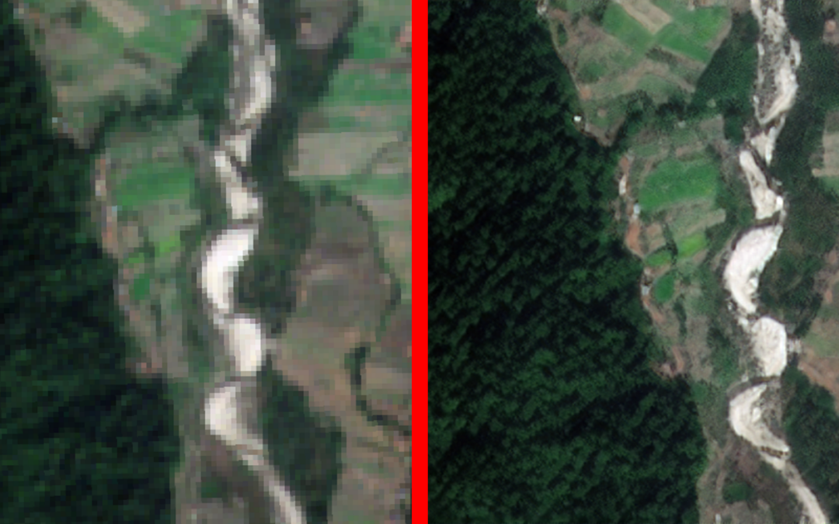
Dealing with Satellite Images: Super-resolution
We can “create” a more appropriate map quality
https://omdena.com/blog/super-resolution/

Slide 22
Dealing with Satellite Images: Super-resolution
We can “create” a more appropriate map quality.
This later can be used in segmentation task.
https://omdena.com/blog/super-resolution/

Slide 23
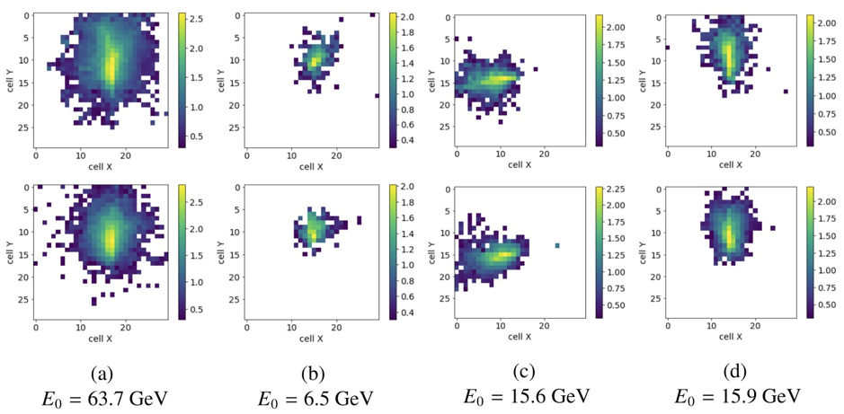
Creating Additional Images
Elementary particle passing through matter.
Generative model mimics computationally expensive calculations.
Hundreds of times faster.
https://arxiv.org/abs/1812.01319

Slide 24
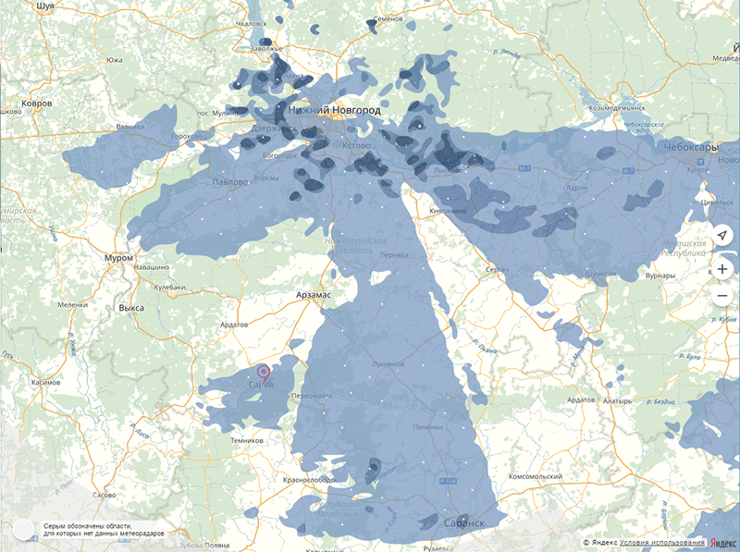
Weather prediction: nowcast
Video prediction for precipitation.
Generation of future state, based on the previous one.
https://www.kdd.org/kdd2019/accepted-papers/view/precipitation-nowcasting-with-satellite-imagery

Slide 25
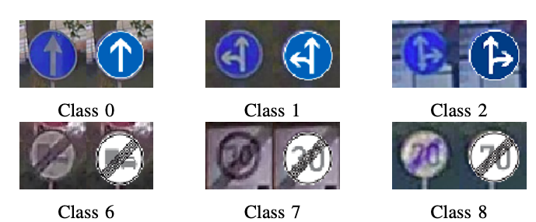
Dirty Road Signs Generation
Road signs from the book are too clean.
Need to put mud and shadows on the signs.
https://arxiv.org/abs/1907.12902

Slide 26
What Generative Models Produce
Cheat human’s eyes.
Cheat complicated algorithms (adversarial attack).
Simulate sophisticated algorithm’s results.
Create additional input for the future tasks*.

Slide 27
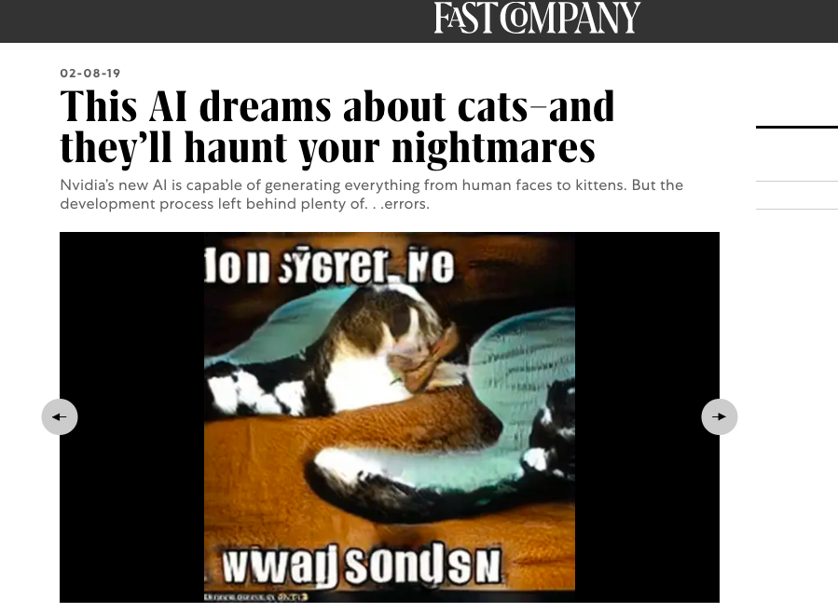
Generative Models Failures
https://www.fastcompany.com/90303908/this-ai-dreams-about-cats-and-theyll-haunt-your-nightmares

Slide 28
Generative Models Failures
Image is created as interpolation between existing ones.
https://www.fastcompany.com/90303908/this-ai-dreams-about-cats-and-theyll-haunt-your-nightmares

Slide 29
What Generative Models Do not Produce
No new information is created.
All interpolations are done in the representation space.

Slide 30



School Sponsors

Slide 31





Thank you!
austyuzhanin@hse.ru
anaderiRu
hse_lambda
Andrey Ustyuzhanin

